Slide 1
The Transfiguration
of Christ
Study 1 – “The power and presence of our Lord Jesus Christ” – 2 Peter 1

Slide 2
Transfiguration
“transfiguration” - metamorphoo (Eng. metamorphosis) = to change the form, to transform.
There are only four occurrences of the word in the N.T. - Matt. 17:2; Mark 9:2; Rom. 12:2; 2 Cor. 3:18 (first two of the transfiguration of Christ).
Rom. 12:2 – “transformed” = The transformation of the mind by renewal of thinking processes.
2 Cor. 3:18 – “changed” = The transform-ation of character by mirroring the character of Christ.

Slide 3
The Transfiguration encapsulate our privileges and responsibilities

Slide 4
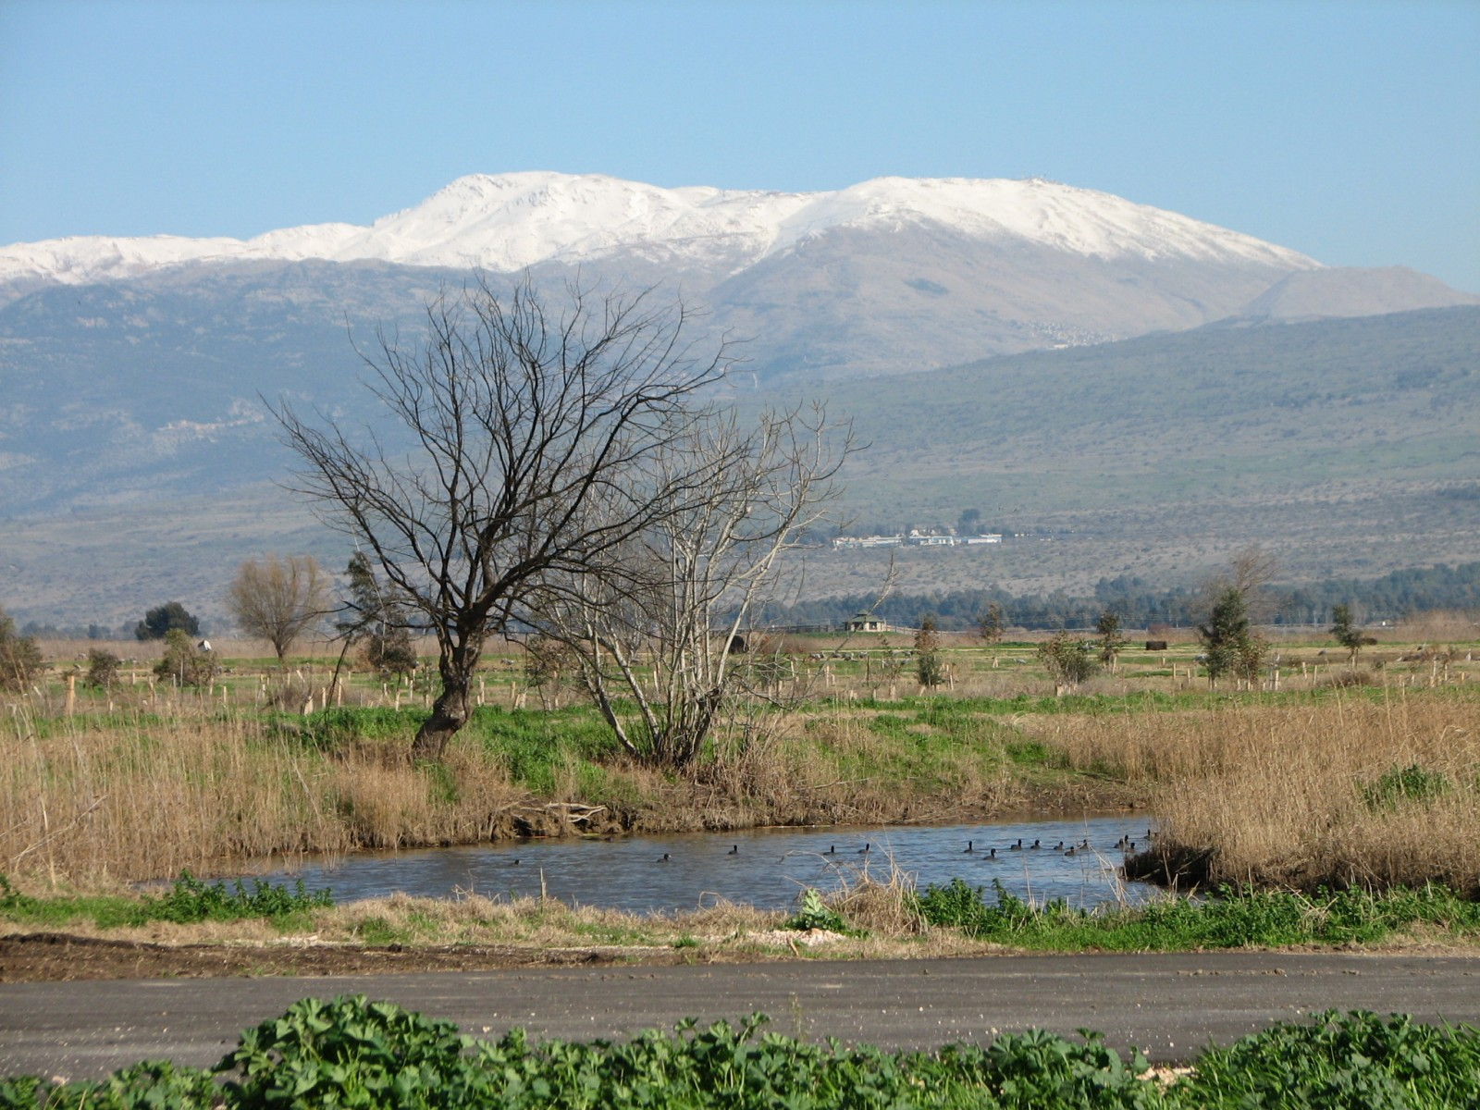
Mt Hermon – ‘Sanctuary’ for Christ
Probable site of the Transfiguration of our Lord

Slide 5
Pan’s challenge to the Son of man
Matt. 16:13 - When Jesus came into the coasts of Caesarea Philippi, he asked his disciples, saying, Whom do men say that I the Son of man am?
In 3 BC Philip the Tetrarch founded a city at Paneas, which became the administrative capital of his large tetrarchy.
Paneas (called in Arabic Banias) due to a difficulty in articulating ‘P’ by Arabs. Cp. Nablus = Neapolis (Greek).
Pan was the Greek god of the wild, shepherds and flocks, nature, of mountain wilds, hunting and rustic music. A carnal god.

Slide 6
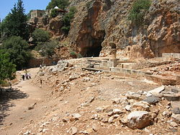
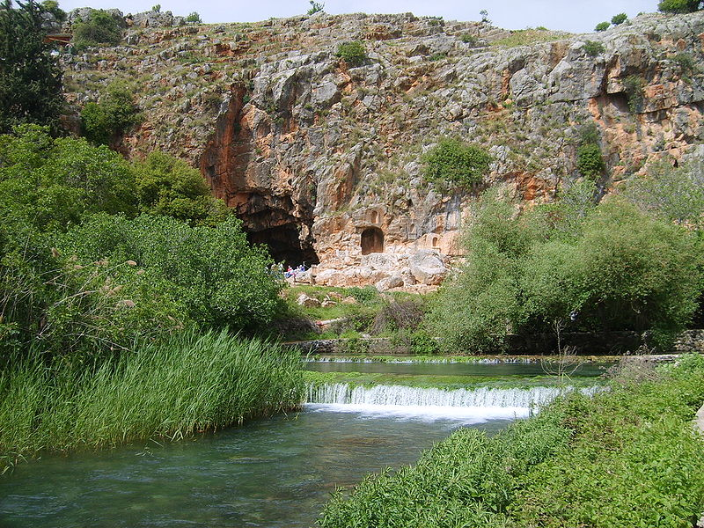
Banias (near Caesarea Philippi)
Centre of the worship of Pan from the Hellenistic period before Christ.
Ruins of the temple of Pan
For centuries men worshipped false gods here

Slide 7
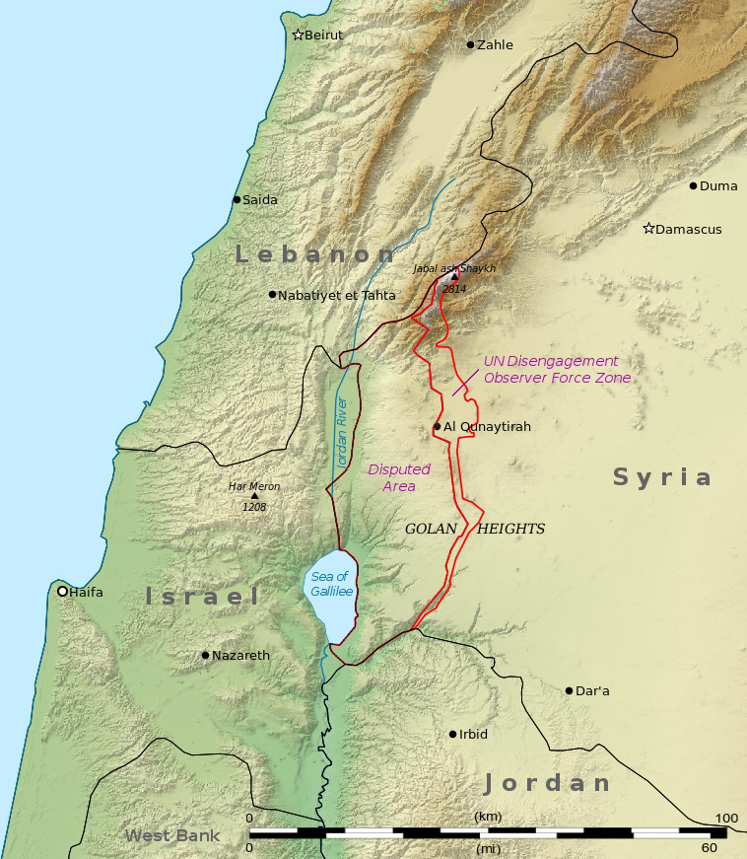
Caesarea Philippi
Matt. 15:21 - Christ leaves Galilee for Tyre and Sidon. Heals daughter of Syro-Phoenician.
V.29 - Returns to Galilee with many Gentiles. Feeds 4,000.
V.39 – Takes ship to Magdala.
Matt. 16:13 – To Caesarea Philippi.

Slide 8
So, why the question?
“Whom do men say that I the Son of man am?”
We need to understand the title “the Son of man” if we are to fully understand the lessons of the Transfiguration.
The title harks back to the dominion given to Adam and Eve over the carnal creation (the things Pan was alleged to rule over) – dominion lost by sin.
Christ came to restore that dominion.

Slide 9
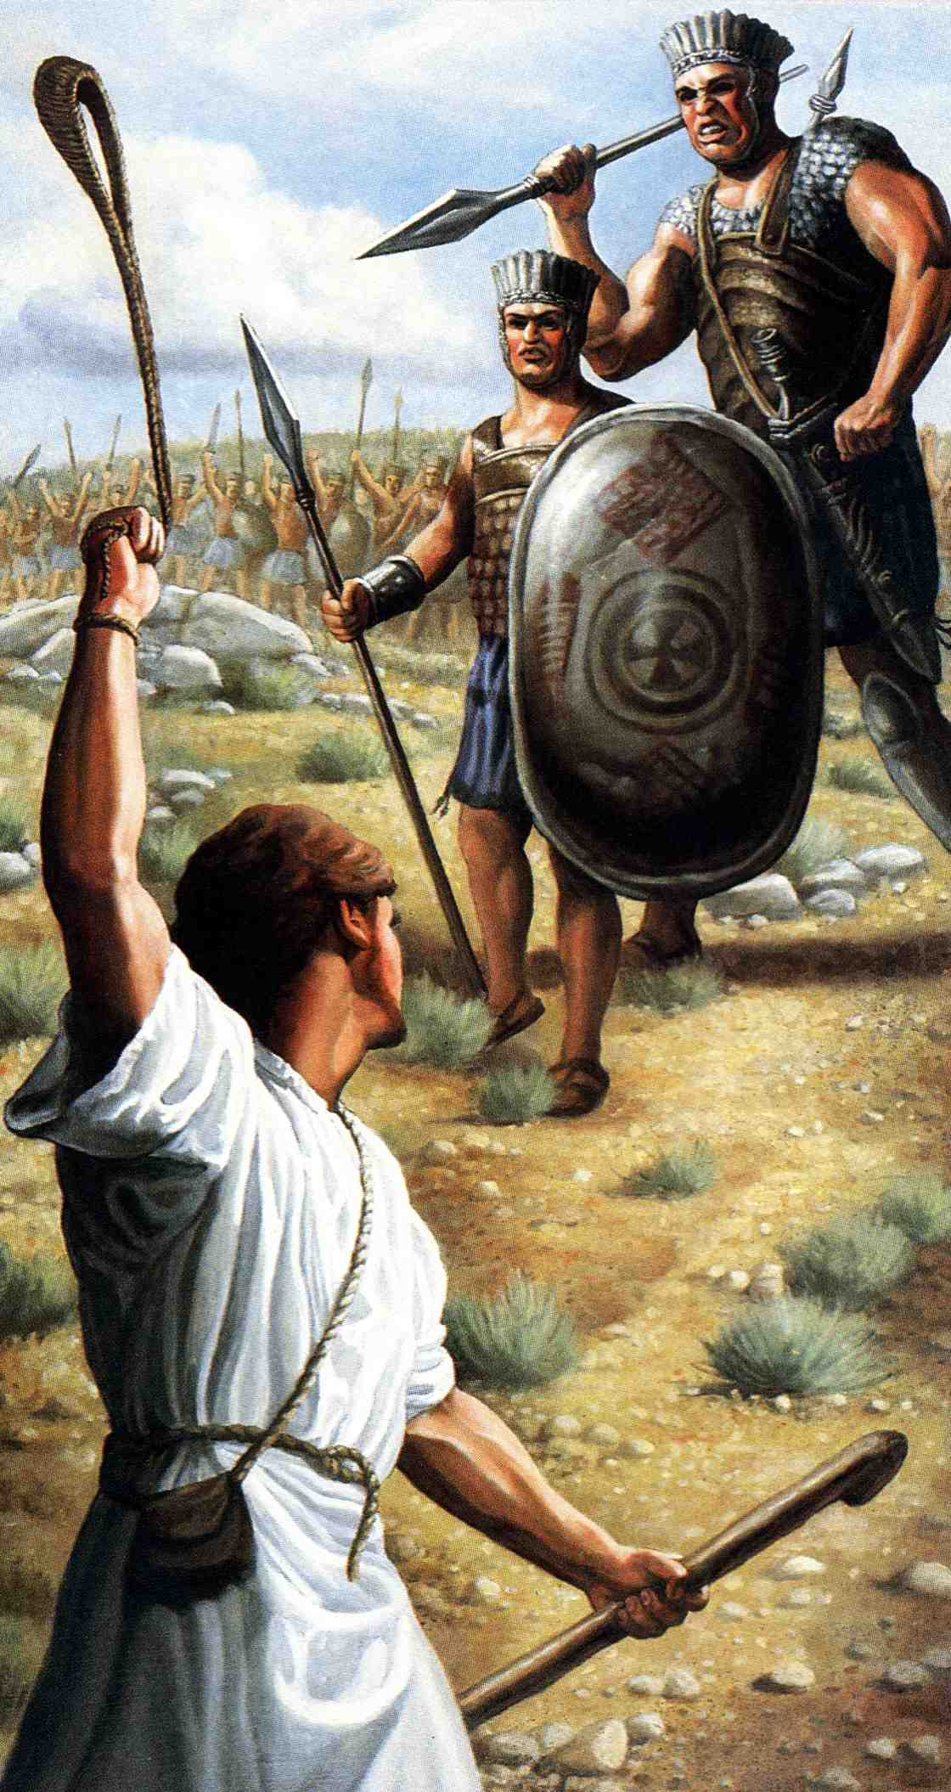
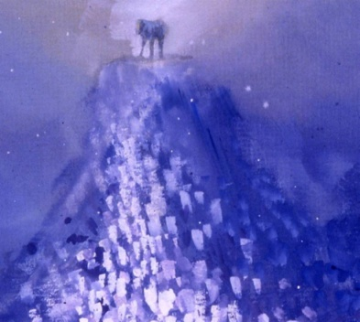
David’s exposition of Gen. 1 & 2 Psalm 8
Ps. 8:2 – “still” - shabath
Dominion exercised
David saw the death of Goliath as a type of the restoration of dominion over all carnal things by Christ through the work of Atonement
“Let them have dominion”
Sabbath
Sin
“The Son
of man”
Millennium
Dominion lost
Dominion restored

Slide 10
The background to Ps. 8
The subscription (appended to superscription of Psalm 9) – “To the chief Musician upon Muthlabben” indicates “On the death of the champion”.
David wrote the psalm after he had slain Goliath and brought his head to Jerusalem.
Hence, there are several allusions to 1 Sam. 17.

Slide 11
“Son of man” Hebrew - ben-a-adam
A title referring to divinely delegated authority to exercise dominion over carnal things.
Drawn from Ps.8:4 and Ps.80:17 - Roots of the phrase are in Gen.1:26,28.
“Son of man” is used 92 times of Ezekiel the prophet as a type of Christ (never “the Son of man”). The theme of Ezekiel is exercising dominion.

Slide 12
The Son of man
The title “the Son of man” occurs 89 times in the N.T. - 85 of those in the Gospel records.
It is used of Christ exercising dominion as the faithful and obedient “last Adam” in overpowering sin and death.
No. Notable occurrences
Matthew (32) Matt.9:5-8; 16:13-16; 26:63-64
Mark (15) Mark 2:28
Luke (26) Luke 5:24
John (12) John 5:17-27

Slide 13
The Sabbath and the Son of Man
Sabbath - Prefigures the Millennium during which Divine dominion will be exercised in the earth.
The Son of man - A title of Christ (“last Adam”) - delegated to exercise dominion over all carnal things on earth.
He deliberately taught and healed on the Sabbath day exercising dominion over sin, disease and death.
There are seven Sabbath days on which Christ healed in the Gospels.

Slide 14
Miracles on the Sabbath
Christ performed notable miracles on the Sabbath. It was a moral imperative.
Matt.12:1-13; Mk.2:23-3:6; Luke 6:1-12 - The man with a withered hand (in the synagogue). Lord of the Sabbath!
Luke 13:10-17 - The woman bowed with an infirmity for 18 years.
Luke 14:1-6 - The man with dropsy.
John 5:1-16 - The man with an infirmity for 38 years.
John 9:1-14 - The man born blind.

Slide 15
The value of miracles
To create “remembrance” - 2 Peter 1
Three cognate words are used here:
V.12 - hupomimnesko - to remind quietly; i.e. suggest to the memory.
V.13 - hupomnesis - a reminding or recollection
V.15 - mneme - memory
Hence, the “power” (dunamis) and “coming” (parousia - being near; presence) of Christ was made known by eyewitnesses.
“We have not followed cunningly devised fables”

Slide 16
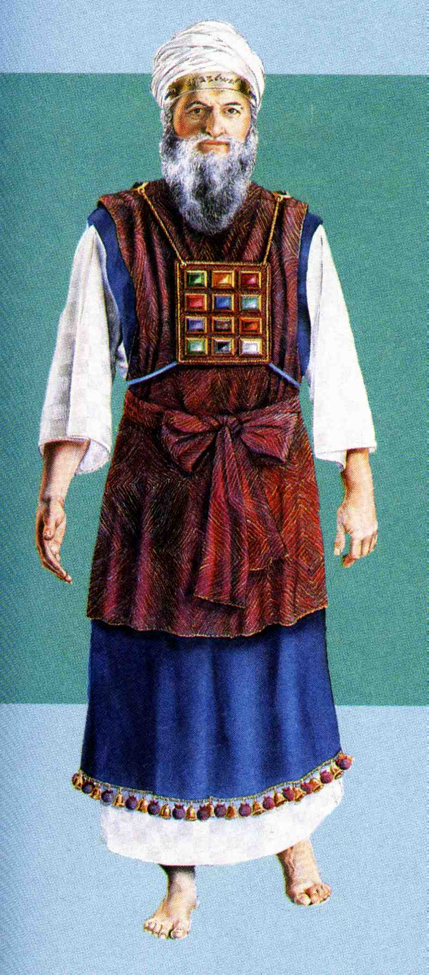
“Honour and Glory”
2 Pet. 1:17 – “For he received from God the Father honour and glory (time kai doxa)…”
Heb. 2:9 – “But we see Jesus ....crowned with glory and honour (doxa kai time)…”
Ex. 28:2 – “And thou shalt make holy garments for Aaron thy brother for glory and for beauty (Lxx. - time kai doxa).”
The “garments” of the High Priest

Slide 17
Unity in the Body of Christ Growing up into the head – Ps. 133:1
<A Song of degrees of David.> Behold, how good and how pleasant it is for brethren to dwell together in unity!
“degrees” – ma’alah – what comes up, ascent, elevation.
“pleasant” – na’iym – delightful (Roth.), pleasant, lovely, agreeable.
“dwell” – yashab – to sit down.
“unity” – gam yachad – Lit. “even as one” (Roth.) or “even together” (Ygs.).

Slide 18
Ps. 133:2
V.2 – “ointment” – shemen – oil – Ex. 30:25-30; Lev. 8:12. Symbol for the Word.
“skirts” – peh – mouth; i.e. the collar of the ephod. See Ex. 28:31-32 where “hole” is peh (3 occs.).
Eph. 4:13,15 - Till we all come in the unity of the faith, and of the know-ledge of the Son of God, unto a perfect man, unto the measure of the stature of the fulness of Christ: …But speaking the truth in love, may grow up into him in all things, which is the head, even Christ.

Slide 19
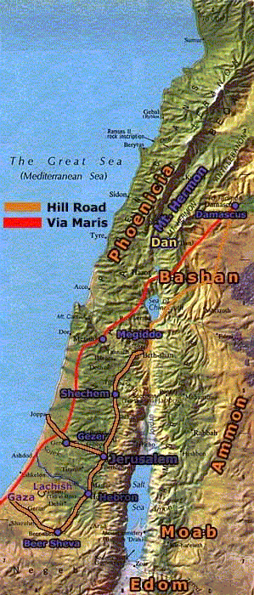
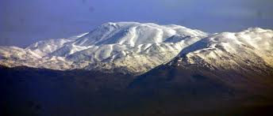
Ps. 133:3
V.3 – “dew” – Represents God’s word – Deut. 32:2.
“Hermon” – “a sanctuary” (BDB).
“descended” – yarad – Translated “ran down” and “went down” in V.2.
“Zion” – “Conspicuous”.
“forevermore” – ad olam – i.e. for the hidden period = the Millennium and beyond.

Slide 20
The limitations of miracles 2 Peter 1
Miracles provide assurance, they do not:
Create faith (“Faith comes by hearing, and hearing by the Word of God” - Rom.10:17) – The final objective - "knowledge" (epignosis - exact knowledge; full discernment) - 2 Peter 1:2-3,8.
Miracles create awe and respect, they do not:
Change character for the better. Character is developed by stages springing out of faith (v.5-7) - the operative power is “a more sure word of teaching” (v.19).

Slide 21
Our times! 1967 - Luke 21:24
And they (the Jews) shall fall by the edge of the sword, and shall be led away captive into all nations: and Jerusalem shall be trodden down of the Gentiles, until the times of the Gentiles be fulfilled.
The 6 Day War in June 1967 saw the recapture of the Old City of Jerusalem by Israel. This was a milestone in the fulfilment of Bible prophecy.

Slide 22
A more sure word of teaching!
2 Pet. 1:19 - We have also a more sure word of prophecy; whereunto ye do well that ye take heed, (as unto a light that shineth in a dark place, until the day dawn, and the day star arise) in your hearts.
“more sure” – bebaios - stable, steadfast, firm. More sure than what?
The miracle of the Transfiguration!
“prophecy” – prophetikos – proceeding from a prophet. See 2 Pet. 2:1.
“hearts” – Where character is formed.

Slide 23
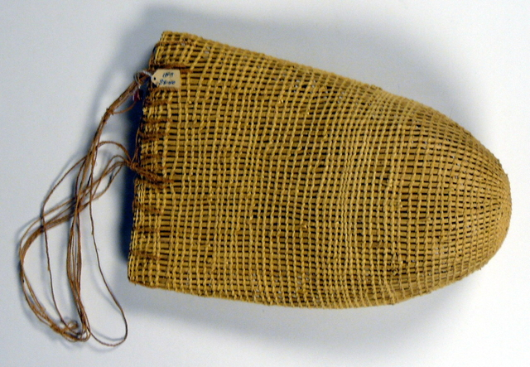
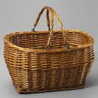
How many loaves?
Matt. 16:6-12 – The disciples mystified by the Lord’s reference to two miracles.
Feeding the 5,000 (mostly Jews) with 5 (grace) loaves – Took up 12 (= Israel) “baskets” – kophinos – a wicker hand basket. Cp. Mark 8:19-20.
Feeding the 4,000 (mostly Gentiles) with 7 (covenant) loaves – Took up 7 (Abrahamic Covenant) “baskets” – spuris – a reed lunch basket, hamper. Could be large – see Acts 9:25 (Paul).
The Gentiles were hungrier than the Jews for his teaching – the Jews preferred the doctrine of the Sadducees and Pharisees – Matt. 15:1-20

Slide 24
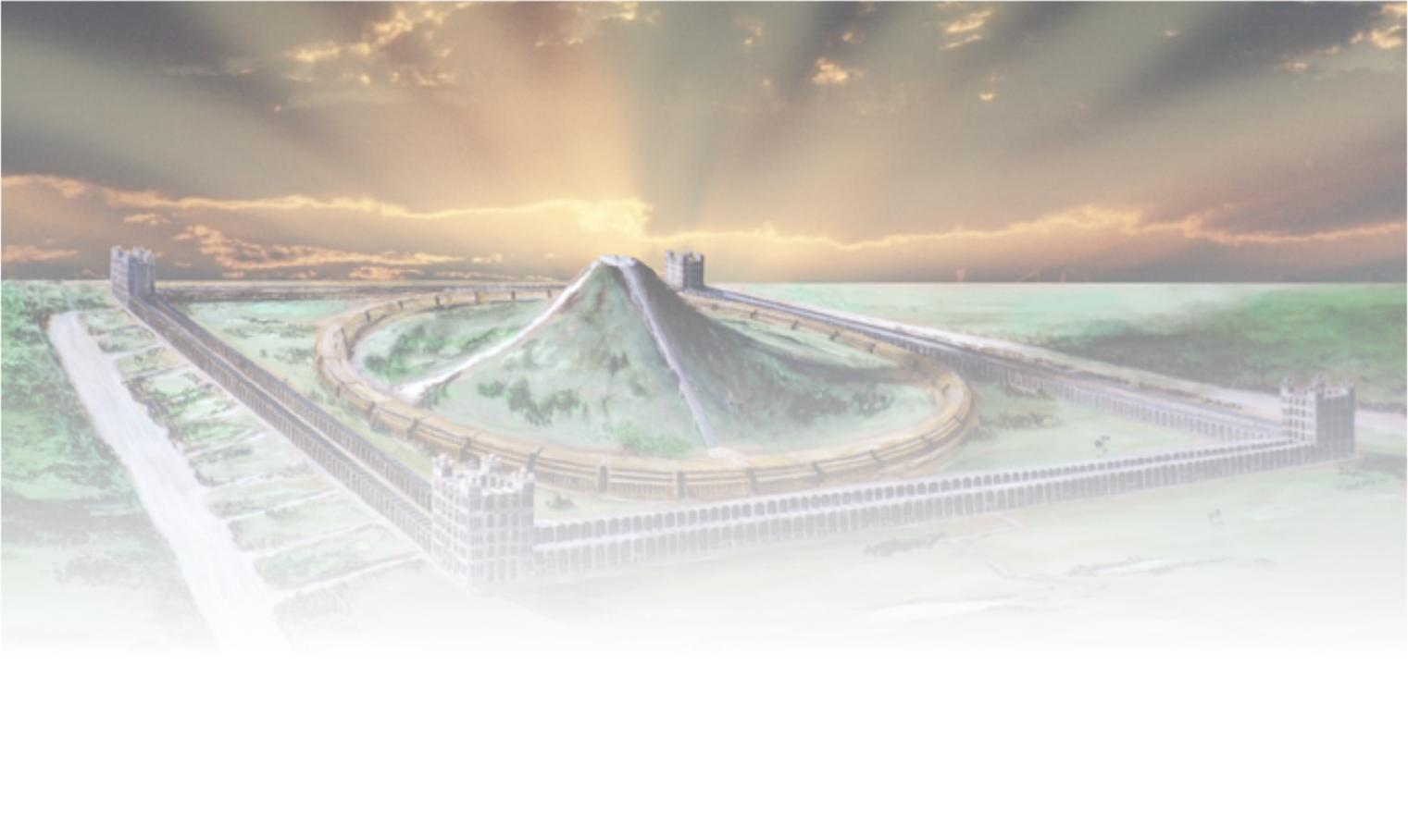
The Transfiguration of Christ
Next study (God willing) –
“Upon this rock I will build my ecclesia”

