Slide 1
The Transfiguration
of Christ
Study 2 – “Upon this rock I will build my Ecclesia” – Matt. 16:1-20

Slide 2
The sign of the prophet Jonah
Matt.16:4
Context Matt. 15 - Conversion of the Gentiles
V.1-20 - Judaism and its leaders repudiated.
V.21 - In the coasts of Tyre and Sidon.
V.22 - Heals daughter of woman of Canaan (dogs).
V.29 - Nigh sea of Galilee (Isa.9:1 – “nations”).
V.31 - Allusion to Isa. 61:1 (context Gentiles).
V.31 - They glorified “the God of Israel” (Jonah 1:16 - sailors; 2:8-9 - Jonah; 3:5,8 - king).
V.32 - “Three days” journey - Cp. Jonah 3:3.
V.38 - 4,000 (mostly Gentiles) brought into the covenant.

Slide 3
The sign of the prophet Jonah
Matt.16:4; 12:39-40
John 7:52 - “Search and look: for out of Galilee ariseth no prophet” said ignorant Pharisees.
2 Kings 14:25 - Jonah was the only O.T. prophet from Galilee - he came from Gath-Hepher (“The winepress of the well”) - a town about 5 kms from Nazareth! The root of Hepher means to pry into, search, dig, explore.
Jonah = “the dove” - symbol of the Spirit (Matt. 3:16 – “…he saw the Spirit of God descending like a dove”).
“son of Amittai” = “veracious” from emeth = truth, stability - a characteristic of Yahweh - Ex. 34:6.

Slide 4
Other hints of Jonah
Matt. 15:39 – “And he sent away the multitude, and took ship” (cp. Jonah 1:3 – “But Jonah rose up to flee…. and he found a ship going to Tarshish”).
Matt. 16:3 – “And in the morning, It will be foul weather to day” (cp. Jonah 1:4 – “But the LORD sent out a great wind into the sea, and there was a mighty tempest in the sea”).
“...and behold, a greater than Jonah is here” – Matt. 12:41

Slide 5
Simon Bar-jona - Matt. 16:17
“The hearing son of Jonah (the Dove = the Spirit)”.
Jonah evaded his duty to preach to Gentiles - escaping from Joppa (Jonah 1:3).
Peter tested at Joppa - was he willing to use the keys of the Kingdom (sufferings of Christ and the glory to follow – 1 Pet. 1:11) to open the door of faith to the Gentiles (Acts 10)?
Cp. Peter’s declaration in Matt. 16:22 (“Be it far from thee Lord”), with Acts 10:14 (“Not so Lord”).

Slide 6
Peter the “Rock”
Called “Cephas” (John 1:42) = a rock or stone.
Matt. 16:18
“thou art Peter” - petros = a piece of rock, or stone.
“and upon this rock I will build my ecclesia” - petra = a mass of rock, cliff, a ledge or platform.
Peter was to prove himself still a moveable rock – but his declaration was the immovable foundation of Christ's Ecclesia, consisting of Jew and Gentile

Slide 7
Transfiguration contrasts
Men
God
Matt.16:13 – “the men”
John the Baptist, Elijah, Jeremiah, a prophet
“flesh and blood”
Peter (petros) – rock
“gates of hell”
“suffer”, “be killed”
“Get behind me Satan”
17:5 – God’s voice
“my beloved Son, in whom I am well pleased”
“my Father...in heaven”
“upon this rock” (petra)
“keys of the kingdom”
“glory of his Father”
“Blessed art thou, Simon”

Slide 8
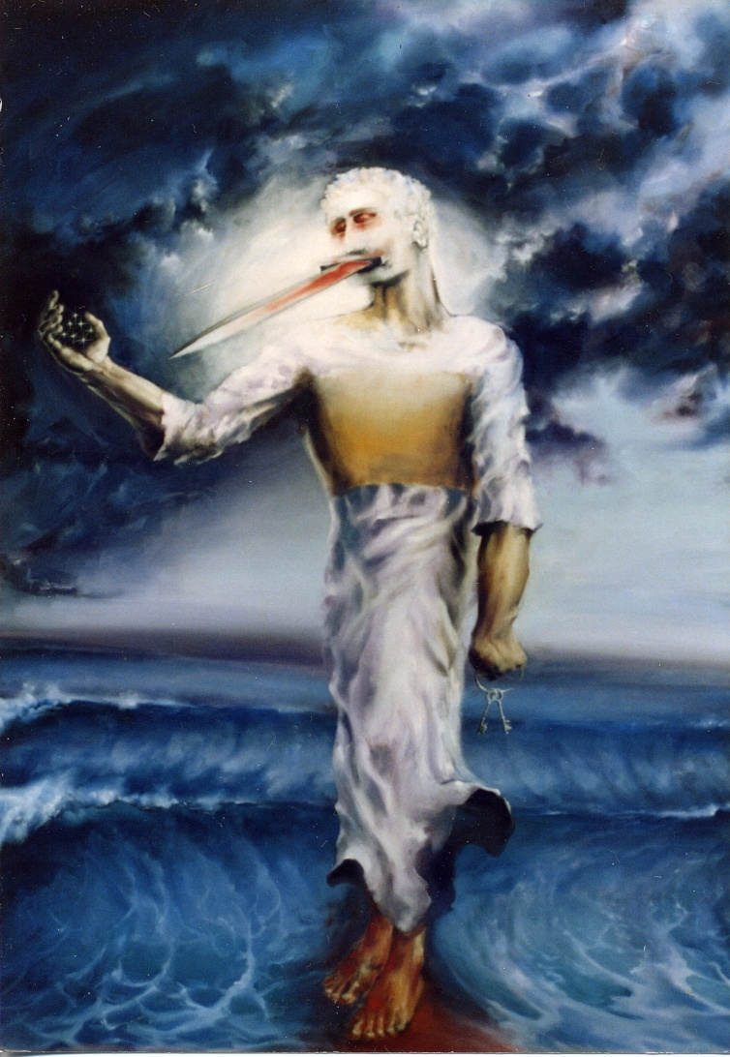
The keys of the Kingdom
Matt. 16:19 (Drawn from Isa. 22:22*).
The two keys given to Peter were:
  “The sufferings of Christ”, and
  “The glory that should follow” (1 Pet.1:11).
These “keys” are mentioned together at least 7 times in 1 Peter (note them later).
Peter used the Keys twice - to the Jews in Acts 2 and to the Gentiles in Acts 10.
(*Note: Matt. 16:18 “the gates of hell” is drawn from Isa. 38:10 - the words of Hezekiah – the suffering servant of Yahweh)

Slide 9
The keys of the Kingdom
Keys provide access, but only if used in the correct manner - Matt.16:19 – “…what-ever thou mayest bind upon the earth shall be having been bound in the heavens.” (Ygs. Lit.)
Principle: The cross must come before the crown.
Sufferings | Glory
V.21 – suffer many things V.25 - “lose life” V.24 - take up cross V.23 - rebuke – “get thee behind me” | be raised again “find life” V.27 - reward every man V.28 - see the Son of man coming in Kingdom

Slide 10
The Keys of the Kingdom
Matt. 16:13-20 – Peter’s declaration the foundation of Christ’s ecclesia.
Matt. 16:21-28 – The sufferings must precede the glory.
Ps. 22 reveals this structure.
1 Peter 1:11
Searching what, or what manner of time the Spirit of Christ which was in them did signify, when it testified beforehand the sufferings of Christ, and the glory that should follow.

Slide 11
Ps. 22 – David speaks for Messiah
Not David’s words, but the spirit of Christ speaking through him.
Two parts of Ps. 22 reveal the two keys to the Kingdom.
Vv.1-21a – Deal with the sufferings of Christ – in great detail.
Vv.21b-31 – Treat of the glory that would follow. See citation of V.22 in Heb. 2:12.
Ps. 22 is based on Gen. 22 – note V.4, 23, 27-28, 30-31.

Slide 12
The keys in 1 Peter
These “keys” are mentioned together at least 7 times in Peter’s 1st Epistle - 1 Peter 1:2-4,11,19-21; 3:18-22; 4:1,11,13; 5:2).
Peter used the keys twice:
  To the Jews in Acts 2 – see V.23-24 – “the pains of death”; V.33 – “being by the right hand of God exalted.”
  To the Gentiles in Acts 10. – see V.39 – “whom they slew and hanged on a tree”; V.40 – “him God raised up.”

Slide 13
Context of the Transfiguration
The Kingdom comes - Matt. 16:28
Time of the apocalypse of Christ - Matt. 17:2
Resurrection of the dead - Matt. 17:6-7
Saints appear in glory - Matt. 17:3
Elijah comes and restores Israel - Matt. 17:11
A great mountain (Babylon the Great) removed (Zech. 4:7) - Matt. 17:20
Mankind cured of “falling sickness” - Matt. 17:15-18
Mustard seed = Universal Kingdom - Matt. 17:20

Slide 14
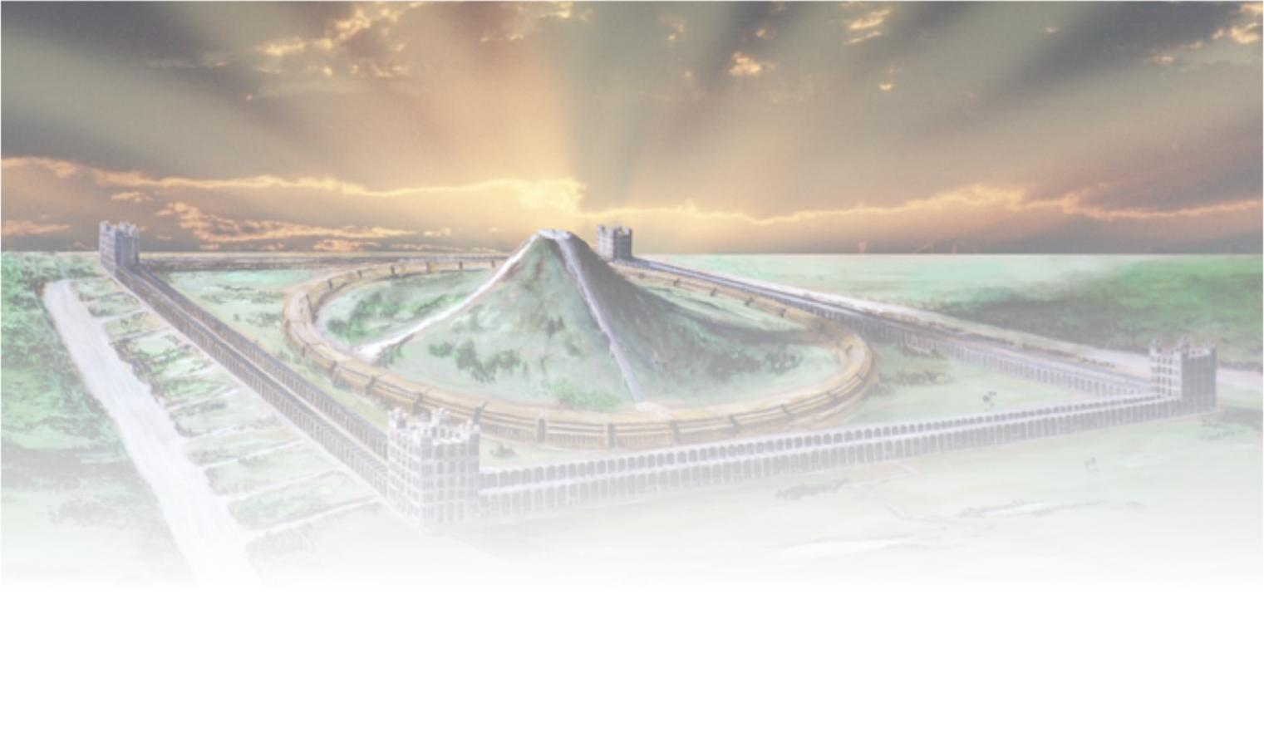
The Transfiguration of Christ
Next study (God willing) –
“The Son of man coming in his Kingdom”

