Slide 1
The Transfiguration
of Christ
Study 3 – “The Son of man coming in his Kingdom” – Matt. 16:21-17:9

Slide 2
Context of the Transfiguration
The Kingdom comes - Matt. 16:28
Time of the apocalypse of Christ - Matt. 17:2
Resurrection of the dead - Matt. 17:6-7
Saints appear in glory - Matt. 17:3
Elijah comes and restores Israel - Matt. 17:11
A great mountain (Babylon the Great) removed (Zech. 4:7) - Matt. 17:20
Mankind cured of “falling sickness” - Matt. 17:15-18
Mustard seed = Universal Kingdom - Matt. 17:20

Slide 3
Transfiguration characters
“The Son of man coming in his glory”
Christ - King-Priest in glory and honour.
Moses - The glorified saints who enter the Kingdom through resurrection from the dead.
Elijah - The glorified saints who enter the Kingdom by translation (alive and remain at return).
3 disciples - Mortal Jews who see the glory first.

Slide 4
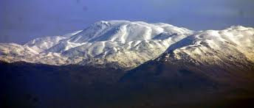
Transfiguration characters
“The Son of man coming in his glory”
Other disciples - Israel outside the Land waiting.
Multitude - The mortal nations who seek Christ.
Mt Hermon –
the mount of Transfiguration

Slide 5
Why the discrepancy in dating?
Matt. 17:1 – “And after six days....”
Mark 9:2 – “And after six days....”
Luke 9:28 – “And it came to pass about an eight days after these sayings.....”
Matthew and Mark use the exclusive dating method while Luke uses the inclusive method.
Six days prefigures the 6,000 year history of man before the apocalypse of Christ in glory, and 8 days points forward to the culmination of this in the time beyond the Millennium - the ‘eighth’ day – 2 Pet. 3:8.

Slide 6
Why Moses and Elijah?
Was it because they represented the Law and the Prophets?
Was it because they are both leaders of an Exodus, and Christ was speaking of his "Exodus“ (cp. Luke 9:31 and 2 Pet. 1:15)?
...or were there more important reasons?
Both Moses and Elijah were taught a very vital lesson......
Men are not changed for the Kingdom by miracles, but by hearing and believing the Word of God.

Slide 7
Moses and Elijah in Malachi 4 - Why?
Context V.1-2 – “the Sun of righteousness” apocalypsed - cp. “his face did shine as the sun” (Matt. 17:2).
Messenger of the covenant “like fuller’s soap” (Mal. 3:2) - cp. language of Mark 9:3.
Moses - Mal. 4:4 | Elijah - Mal. 4:5-6
“Remember” – The Law of Moses Statutes and judgements (No miracles mentioned) | Before judgements begin: To turn hearts Aims to avoid curse (Miracles follow later)

Slide 8
The work of Elijah
Mal. 4:5-6 – “Behold, I will send you Elijah the prophet before the coming of the great and dreadful day of the LORD: And he shall turn the heart of the fathers to the children, and the heart of the children to their fathers, lest I come and smite the earth with a curse.”
Heb. paneh – the face (before) – see use Mal. 3:1; Amos 1:1
Cited Luke 1:17 which Bro. Thomas translates – “…to restore to the posterity the father’s dispositions and disobedient ones to just person’s mode of thinking.”

Slide 9
Two phases to ‘Elijah’s’ work
The citation in Luke 1 is important – Malachi’s message was to “all Israel” (v.4) – John the Baptist was “Elijah” to Judah (Matt. 11:14; 17:10-13) – all that remains is for Elijah to appear to scattered Israel.
Matt. 11:13-15 - For, all the prophets and the law, until John, did prophesy; And, if ye are willing to accept it, he, is Elijah—the one destined to come. He that hath ears, let him hear! (Roth.)
The Second Exodus of Israel

Slide 10
John the Baptist – Elijah to Judah – Matt. 17:10-13
And his disciples asked him, saying, Why then say the scribes that Elijah must first come? And Jesus answered and said unto them, Elijah truly shall first come, and restore all things. But I say unto you, That Elijah is come already, and they knew him not, but have done unto him whatsoever they listed. Then the disciples understood that he spake unto them of John the Baptist.

Slide 11
“Passed by”
This phrase connects the record of Moses on Mount Horeb (Ex. 33:21-23; 34:6) with that of Elijah on the same mount (1 Kings 19:9-14).
It also links the above events with the call of Elisha to service in Elijah's stead (1 Kings 19:19-21).
All of the above laid the foundation for the events of the Transfiguration in which Moses and Elijah “pass by”, and finally even the bright cloud and the voice “passed by” so that Jesus was found alone - the Word (the voice) made flesh – John 1:14.

Slide 12
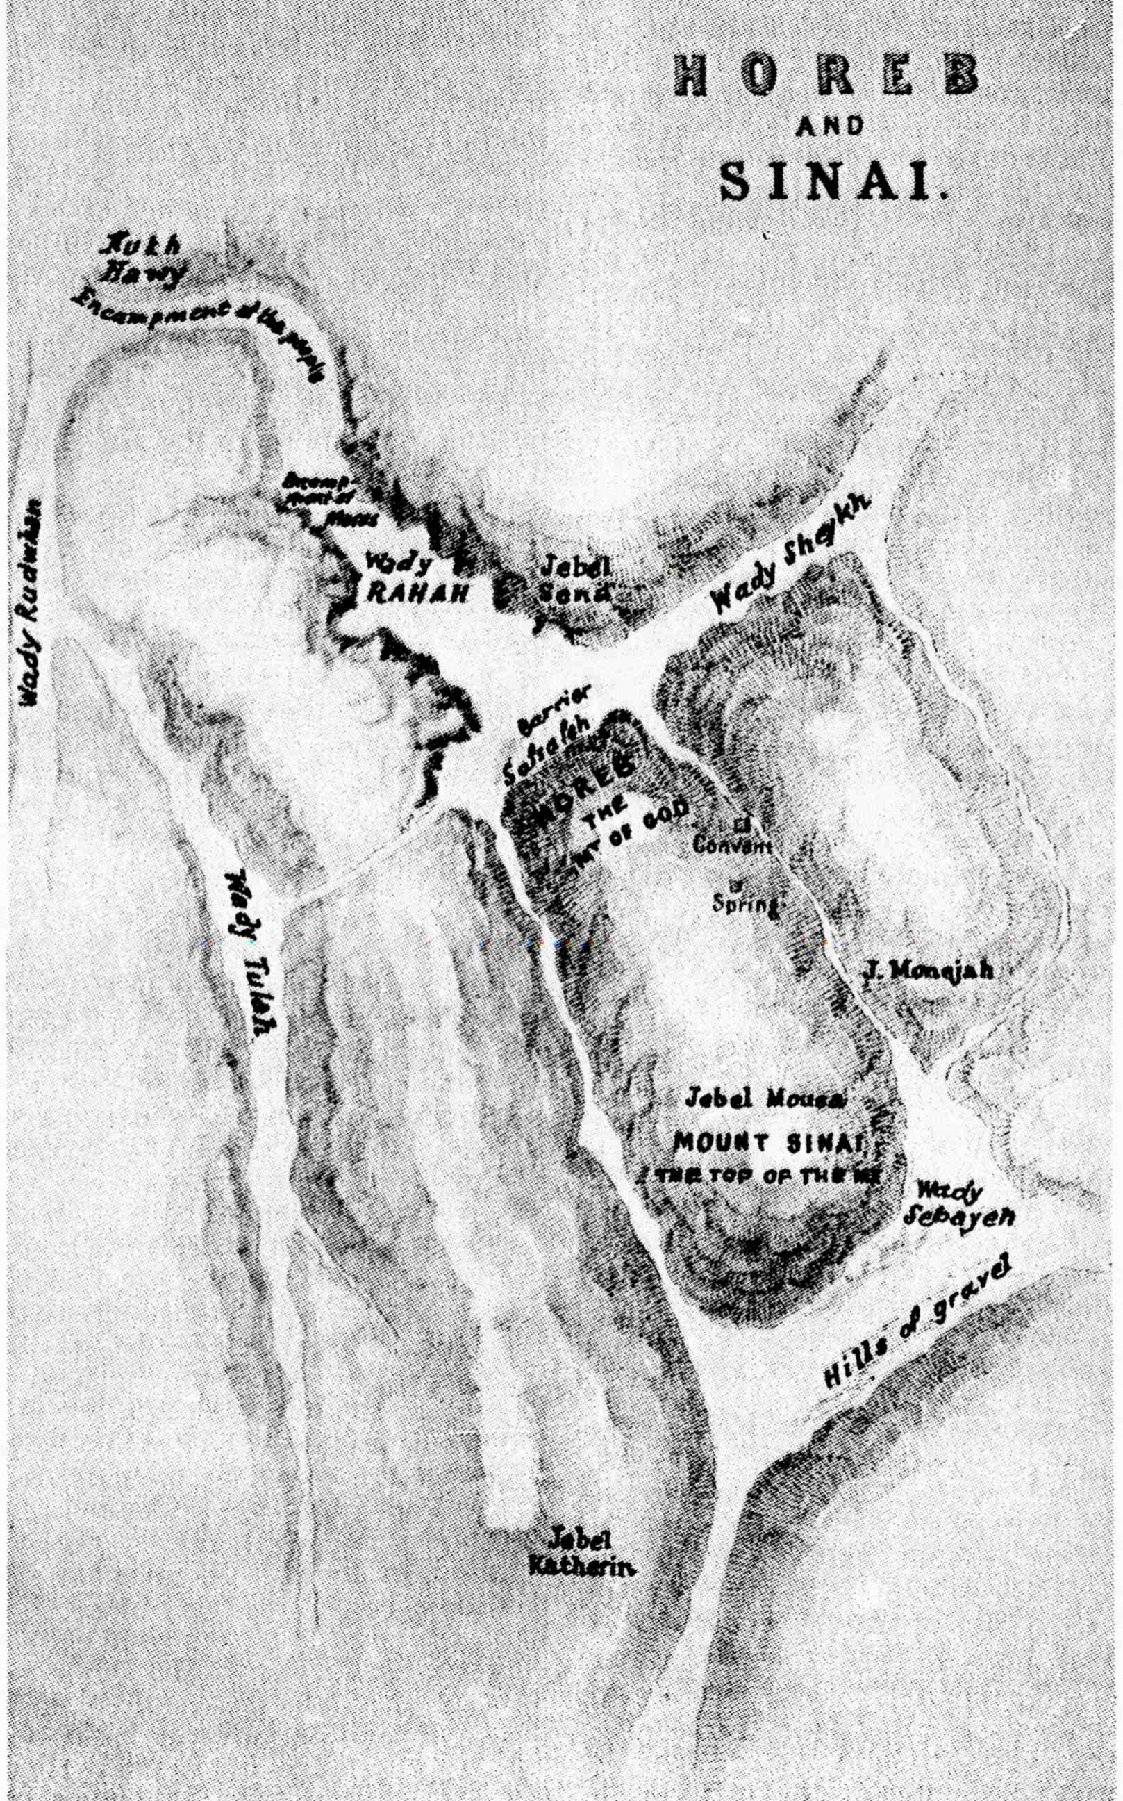
Israel disfellowshipped by God
Ex. 32:32 – Moses’ offer of substitution rejected.
V.34 – A lesser angel to lead (33:2).
Ex. 33:3 – Angel of presence (Ex. 23:20-23; Isa. 63:9) withdrawn.
V.7 – Tent of meeting removed outside the camp.
Ex. 32:31-33:7
6th ascent!

Slide 13
Israel shown gravity of their sin
Ex. 33:7 – Everyone seeking Yahweh went out to the tent.
V.8 – The people watch Moses anxiously.
V.9 - The pillar of cloud stands above tent.
V.10 – Israel acknow-ledge their sin.
V.11 – Moses and Joshua in fellowship.
Moses returns to camp.
Ex. 33:7-11
We have sinned

Slide 14
Moses intercedes in the midst of Israel
Ex. 33:12 – Moses pleads for restoration of the Angel of God’s presence from camp.
V.13-16 – Moses acts as a representative.
V.14 – Positive answer.
V.17 – Representative stature accepted.
V.18 – Seeks evidence of return of Angel.
V.19-23 – In the cave.
Ex. 33:12-23
Moses is encouraged to make an astonishing request (V.18):
“I beseech thee, shew me thy glory.”

Slide 15
“…while I pass by” – Ex. 33:19-22
V.19 – “I will make all my goodness pass before thee” – i.e. both physical and moral glory.
V.20 – “Thou canst not see my face: for there shall no man (adam) see me, and live.” – 1 Tim. 6:16.
V. 21 – “a clift” - neqârah - hole, crevice. Cp. Elijah’s cave – 1 Kings 19:9.
V. 22 – “and will cover thee with my hand” -kaph - palm, hollow or flat of the hand. Translated “clouds” - Job 36:32.

Slide 16
Moses 7th ascent – Yahweh passes by
Ex. 34:1-3 – Moses instructed to ascend alone with two tables of stone.
V.5 – Yahweh passes by and a voice is heard.
V.6-7 – The character of God proclaimed.
V.8-9 – Request for Israel to be forgiven.
V.11 – Moses accepted – Israel reproved.
Ex. 34:1-11
7th ascent!
Ex. 34:34 shows the ‘tent’ had been returned to the midst of the camp.

Slide 17
Ex. 34:6-7
Shew me now thy way!
This was “the angel of his presence” (Isa. 63:9; Acts 7:38) manifesting the full glory of God.
Rotherham - “Yahweh, Yahweh, A God (El = power) of compassion and favour,—Slow to anger and abundant in lovingkindness (chesed) and faithfulness (emeth).”
V.10 – “before all thy people I will do marvels” – Israel would not respond to the voice!
Ps. 103:7 – “He made known his ways unto Moses, his acts unto the children of Israel.”

Slide 18
Elijah pleads against Israel
1 Kings 18:38-39 – Fire from heaven on Mt Carmel humbles/prepares Israel.
1 Kings 18:44-46 – Spirit power in rain and running impress Ahab and people.
1 Kings 19:1-3 – The fury of Jezebel too much for Elijah – flees in fear for his life.
V.4-8 – Proves himself slow to respond to miracles in ‘probation’ (40 days).
V.9-10 – Arrives at Moses’ cave on Horeb to plead not for Israel but against them – Rom. 11:2.

Slide 19

Elijah on Mt. Horeb 1 Kings 19
Some in Israel ready to listen
Wind
Hazael
“the voice of a
gentle whisper”
“passed by”
“passed by”
“What doest thou here, Elijah?”
Earthquake
Jehu
“passed by”
“passed by”
“What doest thou here, Elijah?”
Fire
Elisha
“passed by”
“son of judgement” and “prophet” – God’s voice in Israel
“the voice of a
gentle whisper”

Slide 20
Elijah passes by - 2 Kings 2
Wind – “went up by a whirlwind into heaven” (v.11).
Earthquake – Jordan “divided hither and thither” - like an earthquake (v.8).
Fire – “a chariot of fire and horses of fire” (v.11).
Elisha - the persistent “still small voice” (v.2,4,6).
The mantle (v.8,13,14) - addereth - Symbol of prophetic office - Zech. 13:4 (cp. 1 Kings 19:19).
Note 2 Kings 2:15-18 - Sons of the prophets were so awe-struck by the dramatic events, they did not ‘hear’ Elisha's voice.

Slide 21
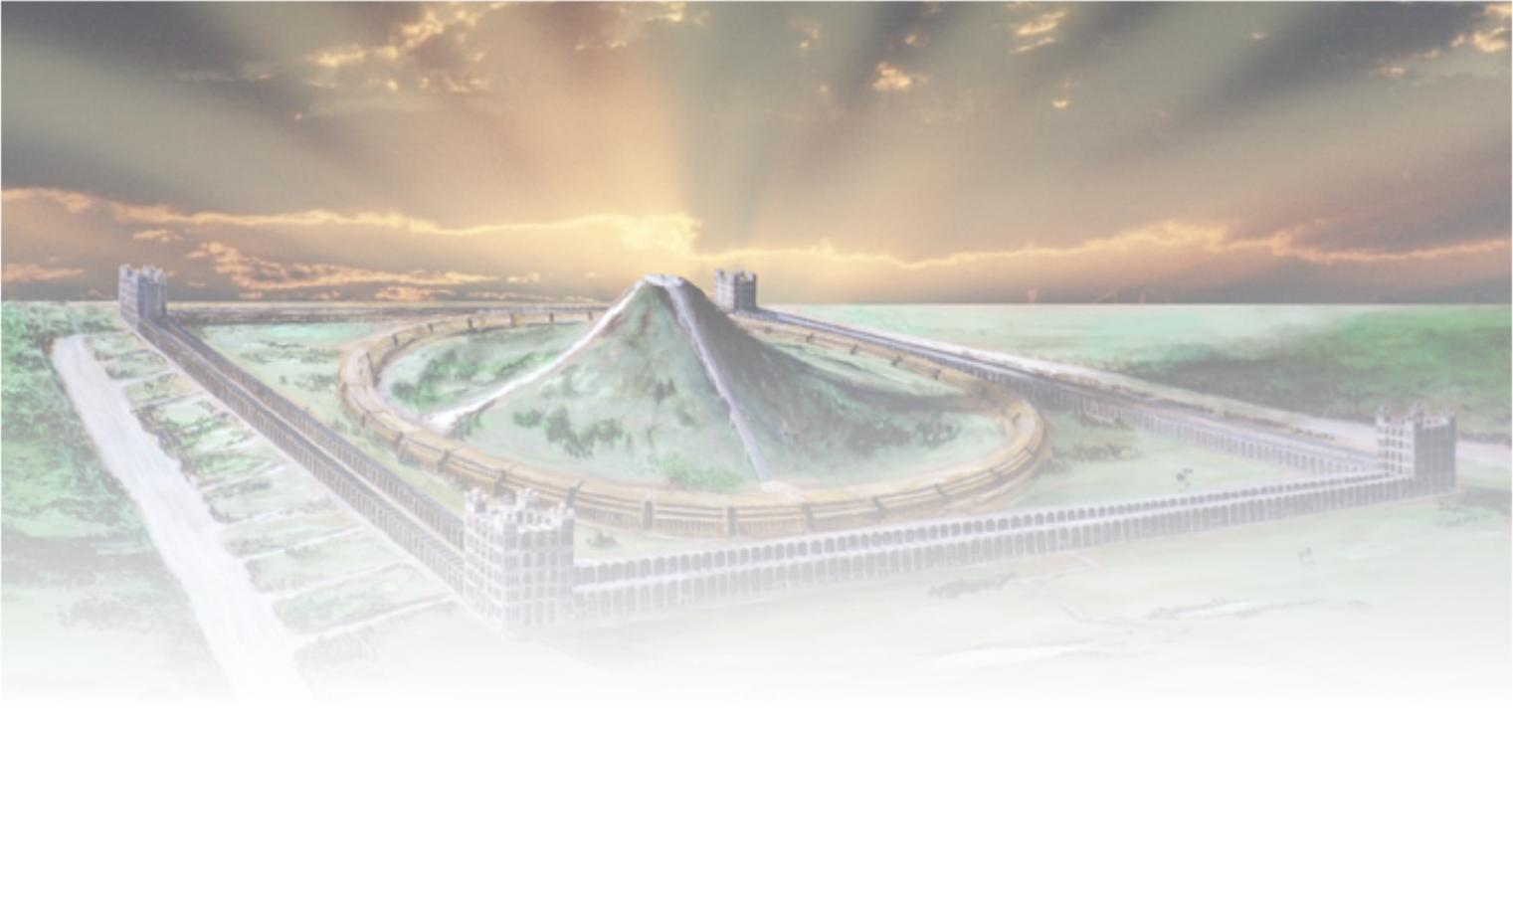
The Transfiguration of Christ
Next study (God willing) –
“This is my beloved son, hear him”

