Slide 1
The Transfiguration
of Christ
Study 4 – “This is my beloved son, hear him” – Luke 9:28-36

Slide 2
Present - crucible of the future
Luke 9:29 - And as he prayed, the fashion of his countenance was altered, and his raiment was white and glistering.
Genuine prayer is the hallmark of a close relationship with God – the source of morality. “Prayer and evil cannot live together.”
“fashion” – eidos – form, kind. Roth., RSV, Ygs. Lit. – “appearance”.
“countenance” – prosopon – the front or face.
“glistering” – exastrapto – to send forth (or flash out like) lightning (only occ. N.T.). Ygs. – “sparkling”; Weymouth – “radiant”.

Slide 3
Vision of the Kingdom
Luke 9:31 - Who appeared in glory, and spake of his decease which he should accomplish at Jerusalem.
“appeared” – optomai – to allow oneself to be seen.
“decease” – exodus – exit, departure from life. 3 occs. N.T. – one of Israel’s Exodus (Heb. 11:22), the other of Peter’s impending death.
“accomplish” – pleroo – to fill to the full; finish. Both Moses and Elijah have yet to complete their ‘Exodus’.

Slide 4
Death before glory
Luke 9:32 - But Peter and they that were with him were heavy with sleep: and when they were awake, they saw his glory, and the two men that stood with him.
“heavy” – bareo – to burden, weigh down, depress. The problem of human nature!
“sleep” – Type of death.
“awake” – Points to the resurrection.
“they saw his glory” – As faithful disciples will – 1 John 3:2 – “...we know that, when he shall appear, we shall be like him; for we shall see him as he is.”

Slide 5
The superiority of Christ
Luke 9:33 – “as they departed from him” – Moses and Elijah could not remain until Jesus accomplished his Exodus.
“good” – kalos – beautiful, excellent.
“tabernacles” – skene – tent. 3 tents would make them all equal! Not so.
“not knowing what he said” – Mark 9:6 – “For he wist not what to say”. Peter as a representative of all the disciples shows his limitations confronted by the glory of the Kingdom.

Slide 6
The voice passes
Luke 9:34 – “cloud” – Matt. 17:5 – “bright cloud”.
“overshadowed” – episkiazo - to throw a shadow upon, to envelop in a shadow, to overshadow. Cp. Moses Ex. 33:23.
V.35 – “a voice” – Cp. Ex. 34:5-6; 1 Kings 19:12-13.
“hear him” – The key lesson of the Transfiguration.
V.36 - “Jesus was found alone” – The full manifestation of his Father – John 1:14,18.

Slide 7
A voice from the excellent glory Luke 9:28-35, 43-44
“And there came a voice out of the cloud, saying, This is my beloved Son: hear him. And when the voice was past, Jesus was found alone.”
John 1:14
“And the Word was made flesh, and dwelt among us, (and we beheld his glory, the glory as of the only begotten of the Father,) full of grace and truth.”

Slide 8
Miracles impress – teaching fails
Luke 9:43 – “amazed” – ekplesso – to strike with astonishment.
“mighty power” - megaleiotēs – great-ness, magnificence.
“said” – The contrast – note emphasis V.44 – “sayings”, “ears”; V.45 – “saying”.
“But they understood not” – Impressed by miracles, but misunderstood message.
V.46 – The disciples distracted by dispute over who would be greatest in Kingdom.

Slide 9
Transfiguration
“transfiguration” - metamorphoo (Eng. metamorphosis) = to change the form, to transform.
There are only four occurrences of the word in the N.T. - Matt. 17:2; Mark 9:2; Rom. 12:2; 2 Cor. 3:18 (first two of the transfiguration of Christ).
Rom. 12:2 – “transformed” = The transformation of the mind by renewal of thinking processes.
2 Cor. 3:18 – “changed” = The transform-ation of character by mirroring the character of Christ.

Slide 10
Romans 12:1-2
V.1 - “bodies a living sacrifice” - Crucified with Christ, but live in newness of life (Gal. 2:20; Rom. 6:1-6).
“acceptable” - euarestos - fully agreeable.
“reasonable” - logikos - rational, intelligent.
V.2 - “conformed” - suschematizo (Middle Voice) - to fashion alike; conform to a pattern; be assimilated.
“transformed” - metamorphoo (Passive Voice).
“renewing” - anakainosis - renovation, change.
“prove” - dokimazo (Active Voice) - to test.

Slide 11
The important words of 2 Cor. 3:18
“beholding as in a glass” - The phrase is all one word in the Greek - katoptrizomai - to mirror oneself, i.e. to see reflected. The verb is in the Middle Voice indicating that this is an action done to or for ourselves.
“are changed” - metamorphoo (plural, present tense, passive voice) = to transform. Lit. “are being transformed”.
“glory” - doxa = in this case, the glory of God’s character - see 2 Cor. 4:6-7.

Slide 12
Character Metamorphosis 2 Cor. 3:18
Diaglott – “But we all beholding the glory of the Lord in *a face unveiled, are transformed into the same likeness, from glory to glory, as from the Lord, the Spirit.” (*Note - it is Christ’s face that is unveiled!)
RSV – “..are being changed into his likeness from one degree of glory to another...”
Weymouth – “...even as derived from the Lord the Spirit.”

Slide 13
Our transfiguration (metamorphosis) 2 Cor. 3:18
“…and we all, with unvailed face, the glory of the Lord beholding in a mirror, to the same image are being transformed, from glory to glory, even as by the Spirit of the Lord.” (Young’s Literal)

Slide 14
Spiritual Metamorphosis – Col. 3:1-5
V.1 – “risen” - sunegeiro - to rouse from death in company with.
V.2 – “affection” - phroneo (phron - the membrane around the heart) - to exercise the mind, to direct the mind towards. An operation of the mind which includes both the understanding and the will.
V.4 – “appear” (twice) - phaneroo - be manifested.
V.5 – “mortify” - nekroo - to deaden, i.e. to subdue.
(Note the contrast – “above” with “on the earth”)

Slide 15

Are you undergoing a Metamorphosis?
Glory!
Is your life hid with Christ in God?
Sufferings!
Keys of the Kingdom

Slide 16
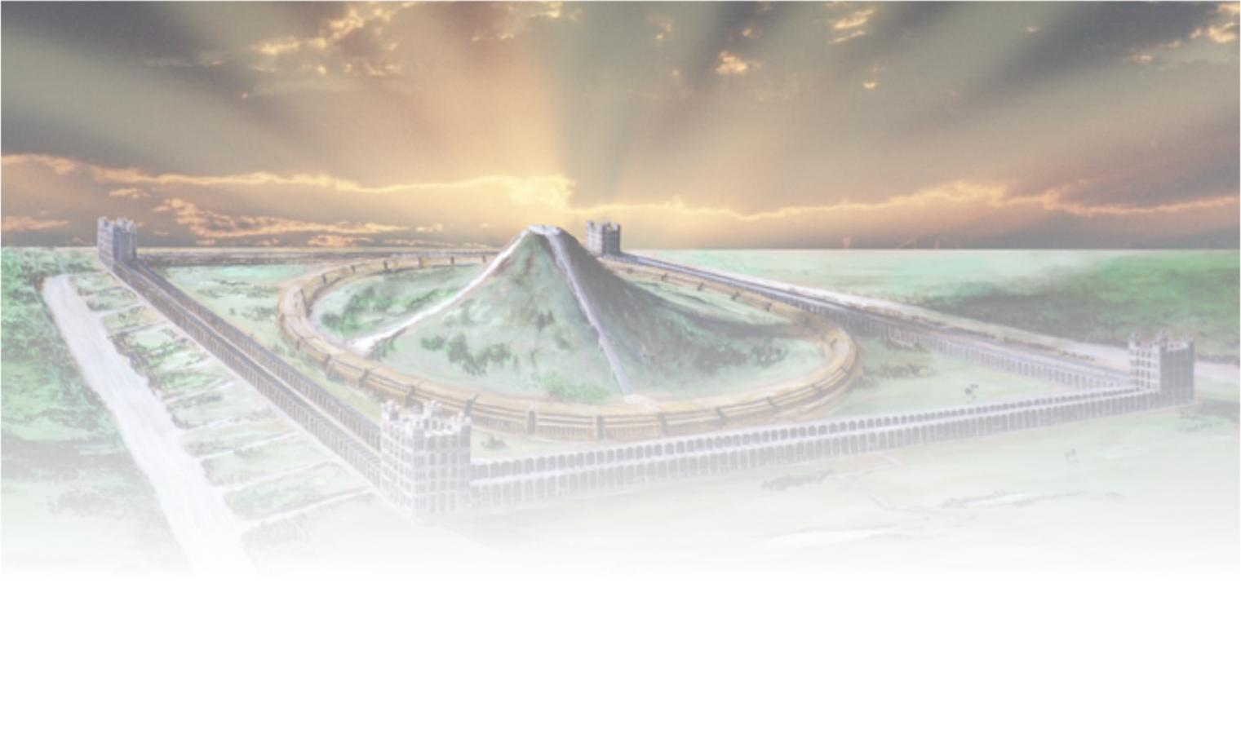
The Transfiguration of Christ
Next study (God willing) –
“What manner of persons ought we to be”

