Slide 1
The Transfiguration
of Christ
Study 6 – “All things are possible to him that believeth”

Slide 2
Context of the Transfiguration
The Kingdom comes - Matt. 16:28
Time of the apocalypse of Christ - Matt. 17:2
Resurrection of the dead - Matt. 17:6-7
Saints appear in glory - Matt. 17:3
Elijah comes and restores Israel - Matt. 17:11
A great mountain (Babylon the Great) removed (Zech. 4:7) - Matt. 17:20
Mankind ultimately cured of the “falling sickness” - Matt. 17:15-18
Mustard seed = Universal Kingdom - Matt. 17:20

Slide 3
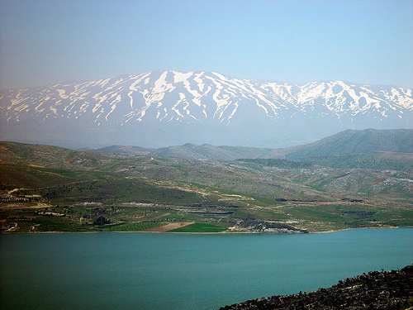
The holy mount of glory
Ps. 133:3 - As the dew of Hermon, and as the dew that descended upon the mountains of Zion: for there Yahweh commanded the blessing, even life for evermore.

Slide 4
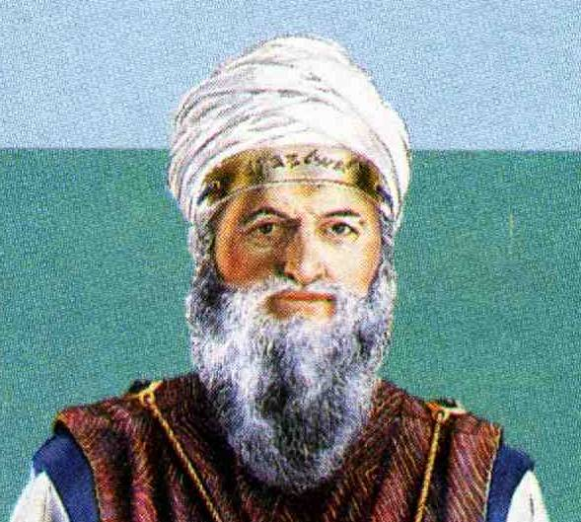
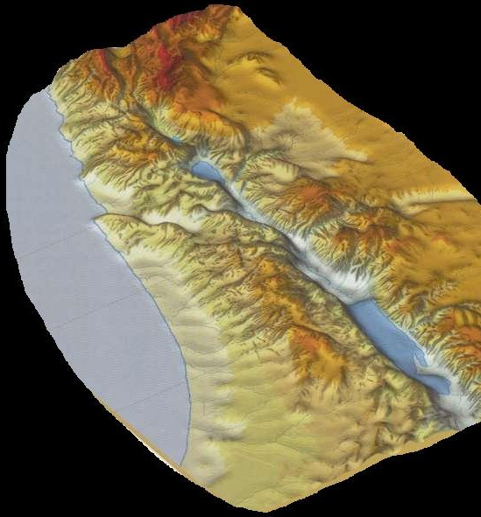
Mt Hermon and eternal life
Ps. 133:2 – “skirts” – peh – mouth; i.e. the collar. The point is that the anointing oil only reached the collar. Hence, the head represented the body.
V.3 – “dew of Hermon” – Does not descend on the mountains of Zion. Hermon is the ‘head’ of the Land and hence represents the body, as does Christ.
Mt Hermon

Slide 5
Emphasis on death and resurrection
Mark 9:9-13
V.9 - Commands silence about the glory until his resurrection.
V.12 - Redirects focus from Elijah to his own humiliation and suffering.
“be set at nought” – exoudenoo – to make utterly nothing of; despise. This is the antithesis of vv.2-3.
Without Christ’s death and resurrection there could be no future glory

Slide 6
Epilepsy – “The falling sickness”
In chronic manifestation is an abnormality of brain function causing prolonged loss of consciousness associated with convulsions.
Symptoms – Initial aura or sensation; falls unconscious; muscle spasms; breathing stops (¹/₂ minute); limbs rhythmically contract and relax; tongue bitten; lies still breathing heavily; remains unconscious varying times.
Spiritual counterpart – The spirit of lawless-ness – 1 John 3:4; 5:16-19; manifestation 1 Pet. 4:1-4; foaming shame – Jude 13.

Slide 7
The problem of human nature
The child is a microcosm of the human race.
The problem is called “a dumb spirit” (v.17), but “a dumb and deaf spirit” (v.25).
Also termed “the foul spirit” (v.25). “Foul” – akathartos – unclean, impure, lewd (used Eph. 5:5).
Parable – Men believe with the heart and confess with the mouth – Rom. 10:8-10 (“faith comes by hearing” – Rom. 10:17). This child represents all men at birth.
A problem from birth – v.21.

Slide 8
The power of faith
V.20 – Child convulsed with epilepsy in the presence of Christ (the sinless one).
V.21 – Source of the problem “from infancy”.
V.22 – Fallen human nature relates us to judgement and the destiny of all men – it destroys fully – John 3:15-16.
Appeal – if any power (dunamai), let bowels yearn (splagchnizomai) and offer relief.
V.23 - “If you have power (dunamai) to believe”.
“All things are subject to power (dunatos) to him that believeth.”

Slide 9
Death and Resurrection
V.24 – A desperate cry from the father of the epileptic encapsulates our problem.
V.25 – The people had dispersed – Jesus talked too much! He tried to engender faith.
Baptism rebukes the “unclean spirit” – the “old man” left behind (“enter no more”).
“As one dead” in baptism – Rom. 6:6.
V.27 – Jesus “took him” (krateo – to use strength), and “lifted him up” (egeiro – to rouse from sleep or death), and “he arose” (anistemi – to stand up).

Slide 10
Why the disciples were powerless
“This kind can come forth by nothing, but by prayer and fasting” - Mark 9:29
V.28 – Disciples mystified – They had been given power to cure diseases – Luke 9:1; 10:17.
Disciples failed because of unbelief - Matt.17:20.
This was a special case - It seems the power to cure this disease had been withdrawn.

Slide 11
Prayer and Fasting
Cure for the “falling sickness” required the sacrifice of Christ – vv.9-12, 31.
Christ’s mission depended on two things:
Prayer = Personal relationship with God - Christ the only one to maintain this perfectly (Ps.16:8).
Fasting = Self denial (Gr. nesteia - abstinence) – Christ “afflicted his soul” to make atonement for all men (Lev.16:29-34).

Slide 12
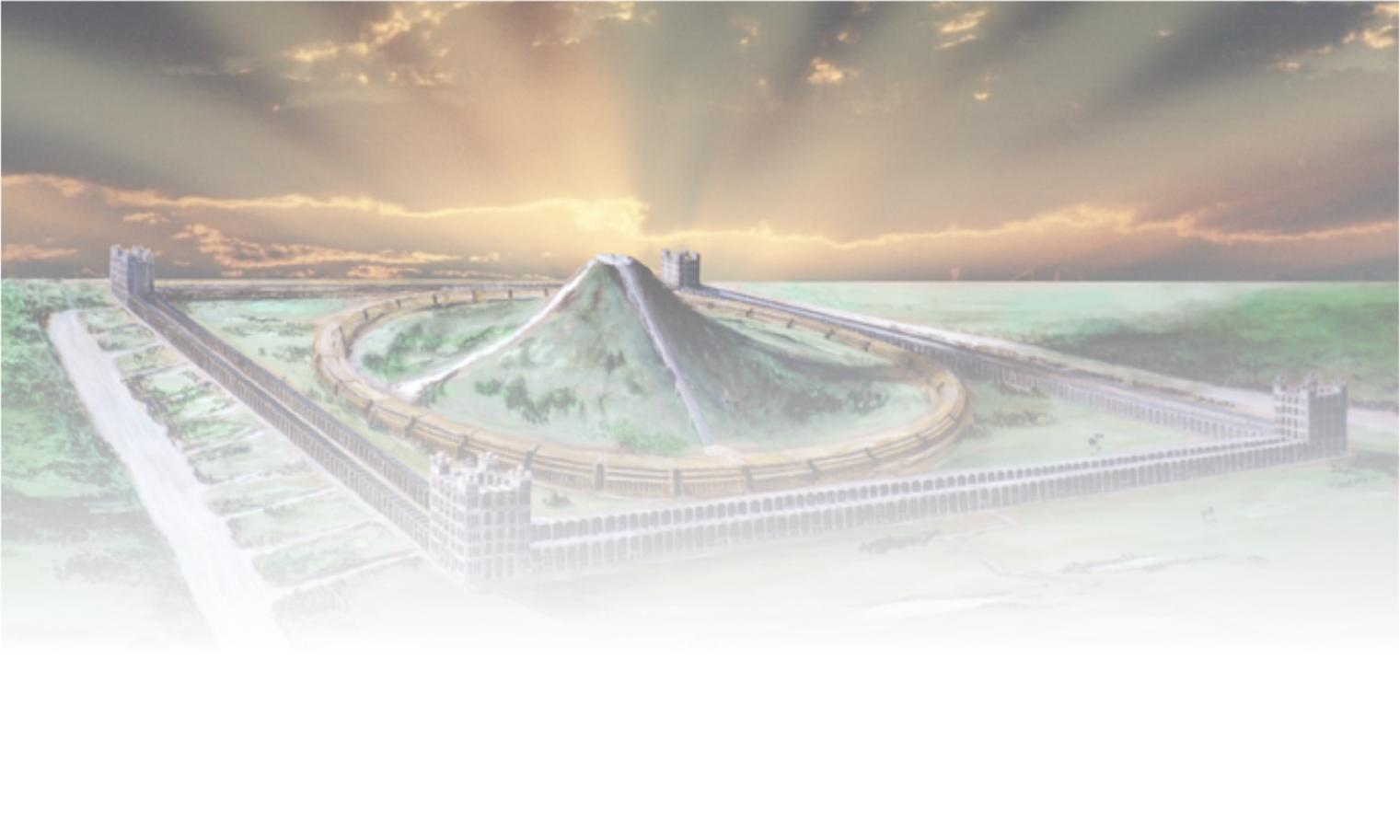
The Transfiguration of Christ
The End

Slide 13
...
V. –

