Slide 1
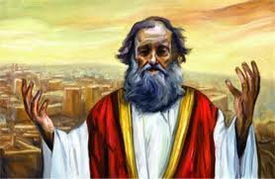
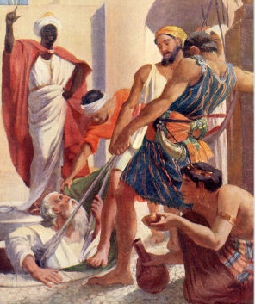
Jeremiah
Change before the end begins
Class 1: Redirecting your Life for God

Slide 2
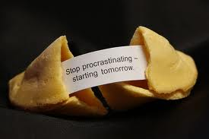

Easy to put off a Study of Jeremiah
Long book to study – 52 chapters
Not covered in Sunday School – very little previous knowledge
Many chapters are out of chronological order
Tends to be like Revelation: “some day I’ll get to it!”
The time has come!

Slide 3
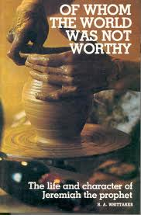
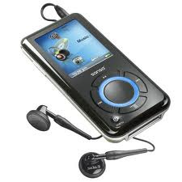
Christadelphian Resources on Jeremiah
Jeremiah – by C. C. Walker
Of Whom the World was not Worthy – by HAW
“Friends of Jeremiah” in Testimony Magazine
Speaker’s commentary [edited by F. C. Cook]
For the audio learners:
Check out www.LivoniaTapes.com
3 Classes by Ron Cowie
7 Classes by John Martin
6 classes I did at Hanover

Slide 4
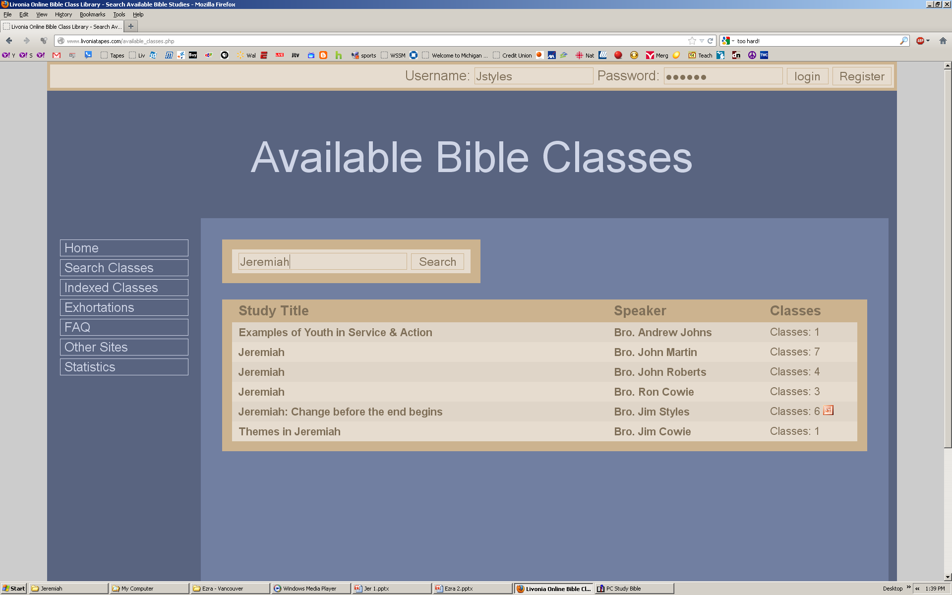
www.livoniatapes.com

Slide 5
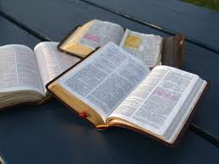
Game Plan for 6 Classes
Jeremiah re-directed by God
The failure of the People
Jeremiah’s Struggle with God’s plan
Jehoiakim: The King without a conscience
Rechabites: Faithful service to our Father
Zedekiah: The King without a Backbone
Jeremiah’s message: Change Before the End Begins!

Slide 6
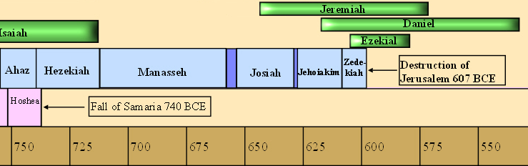
Kings before Jeremiah
Hezekiah (29 years) responded to Micah’s warning (3:12; Jer 26:18)
Dumped idols into rivers and valleys
Northern kingdom taken captive by Assyria
Manasseh (55 years) – Got idols out again!
One of the worst kings of Judah
Repented at the end!
Too late for Amon, but not for Josiah – good lesson for us!!!
Amon (2 years) – followed bad ways of Manasseh
Amon

Slide 7
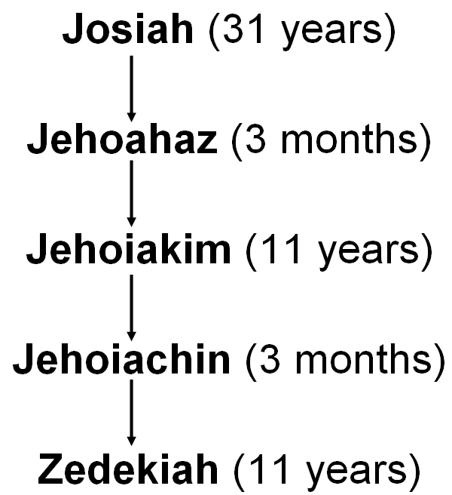
Kings of Judah from Josiah to the Captivity when Jeremiah prophecied
G

Slide 8
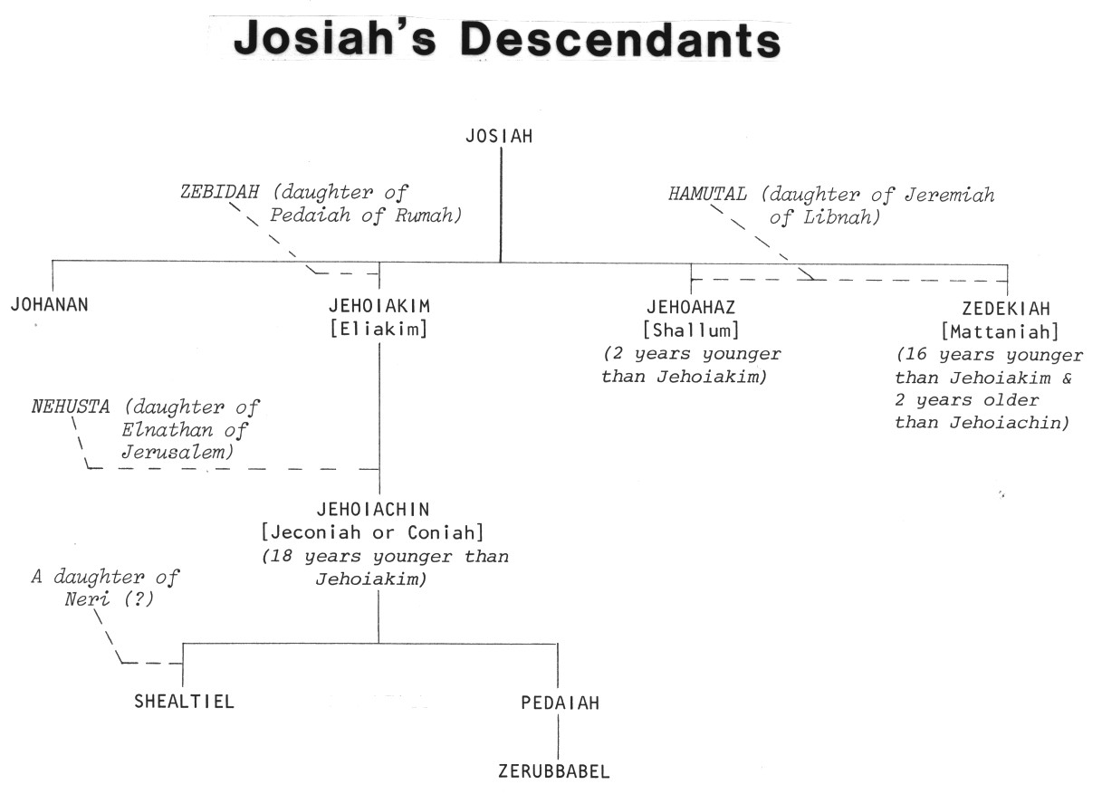
King Josiah’s Descendants
Josiah
1
Good King Josiah had no children who were like him!
Who’s next?

Slide 9
King Josiah’s Descendants
Josiah
2
1
Weep not for the dead, nor bemoan him; weep bitterly for him who goes away, for he shall return no more, nor see his native country. For thus says the LORD concerning Shallum the son of Josiah, king of Judah, who reigned instead of Josiah his father, who went from this place: "He shall not return here anymore (Jer 22:10-11)
Jews chose Jehoahaz, but Pharaoh took him to Egypt
Who’s next?

Slide 10
King Josiah’s Descendants
Josiah
2
1
Therefore thus says the LORD concerning Jehoiakim the son of Josiah, king of Judah: "They shall not lament for him, saying, 'Alas, my brother!' or 'Alas, my sister!' They shall not lament for him, saying, 'Alas, master!' or 'Alas, his glory!’ He shall be buried with the burial of a donkey, dragged and cast out beyond the gates of Jerusalem. (Jer. 22:18-19)
Neco put Jehoiakim in power – he was one of the worst kings of Judah!
3
Who’s next?

Slide 11
King Josiah’s Descendants
Now it came to pass in the thirty-seventh year of the captivity of Jehoiachin king of Judah, in the twelfth month, on the twenty-fifth day of the month, that Evil-Merodach king of Babylon, in the first year of his reign, lifted up the head of Jehoiachin king of Judah and brought him out of prison. And he spoke kindly to him and gave him a more prominent seat than those of the kings who were with him in Babylon. So Jehoiachin changed from his prison garments, and he ate bread regularly before the king all the days of his life. And as for his provisions, there was a regular ration given him by the king of Babylon, a portion for each day until the day of his death, all the days of his life. (Jer 52:31-34)
Then Jehoiachin king of Judah, his mother, his servants, his princes, and his officers went out to the king of Babylon; and the king of Babylon, in the eighth year of his reign, took him prisoner. (2Kgs 24:12)
Josiah
2
1
4
Jehoiachin surrendered to Babylon (2Kgs 24:12) & was later rewarded! (52:31-34)
3
Who’s next?

Slide 12
King Josiah’s Descendants
Josiah
2
1
4
Zedekiah was interested, but had no backbone!
3
Who’s next?

Slide 13
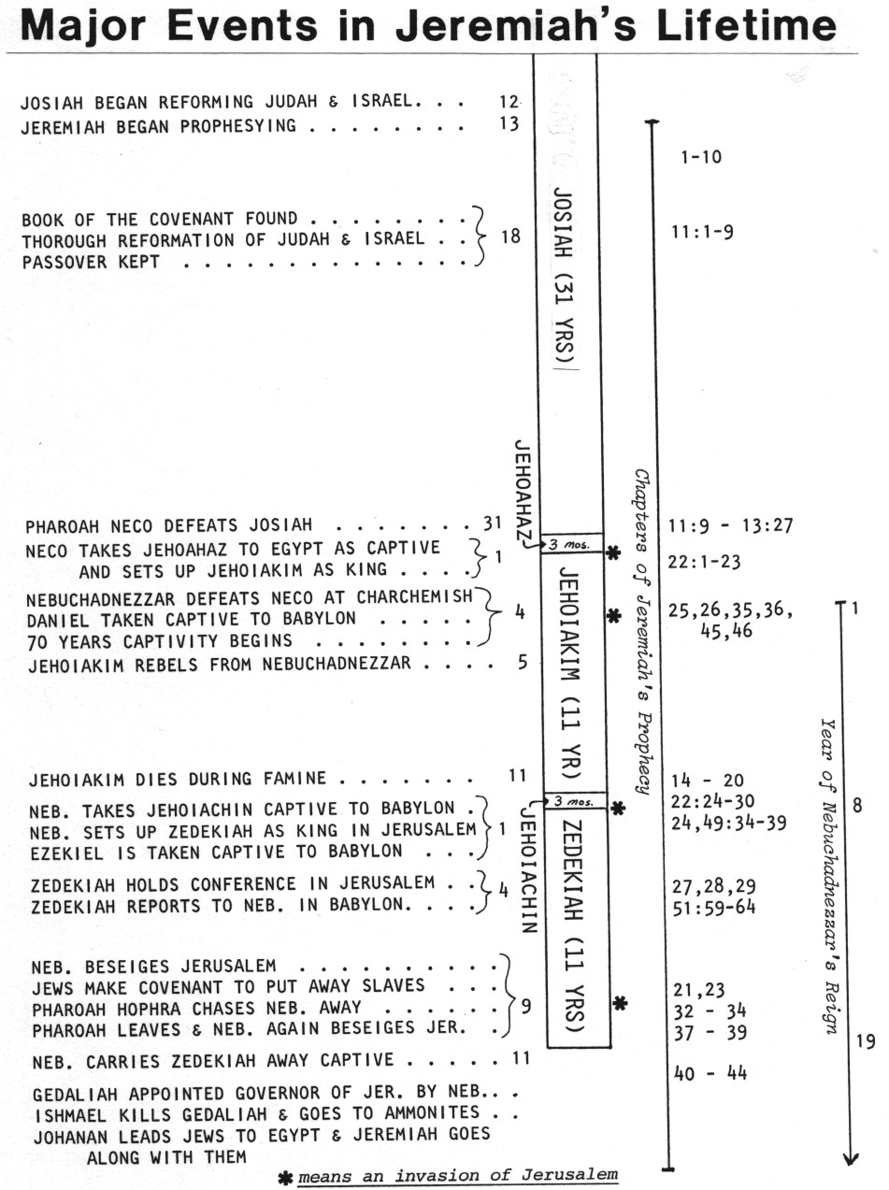
Many chapters of Jeremiah are out of chronological order!
Many chapters are clumped around invasions
Possibly arranged to put pressure on Zedekiah to respond!

Slide 14
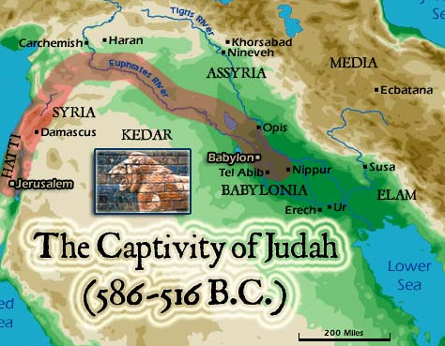

Ezekiel encourages the captives to settle in and lets them know why Jerusalem must be taken
Daniel works with Nebuchadnezzar so he learns the Most High rules in the kingdoms of men
Jeremiah tells Jews to change their ways, and surrender to Babylon. He tells the Nations that Yahweh is removing His people.

Slide 15
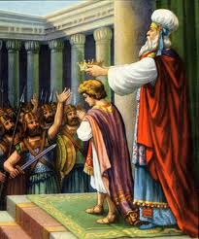
Josiah’s Reformation
2 Kgs 22-23 & 2 Chron 34-35
8 yrs old: became king & reigned 31 years
8th year: began to seek God
12th year: began to purge Judah of idols
then went north & reformed Israel!
Confusing time for people after 60 years of idolatry.
Now they must get rid of idols and serve only Yahweh!
18th year: repair temple and found book of Law.
Renewed covenant, removed idolatrous priests, held Passover, restored temple worship
Things were looking good!

Slide 16

Josiah’s Reformation…
Only Skin Deep!
Jeremiah 3:10-11
10 "And yet for all this her treacherous sister Judah has not turned to Me with her whole heart, but in pretense," says the LORD.
11 Then the LORD said to me, "Backsliding Israel has shown herself more righteous than treacherous Judah.
Repentance in Pretense only!

Slide 17
Josiah’s Reformation…
Only Skin Deep!
Jeremiah 4:3-4
3 For thus says the LORD to the men of Judah and Jerusalem: "Break up your fallow ground, and do not sow among thorns.
4 Circumcise yourselves to the LORD, and take away the foreskins of your hearts, you men of Judah and inhabitants of Jerusalem, lest My fury come forth like fire, and burn so that no one can quench it, because of the evil of your doings.“
They had a formal religion of outward show

Slide 18
Josiah’s Reformation…
Only Skin Deep!
Ezekiel 14:3
Son of man, these men have set up their idols in their hearts, and put before them that which causes them to stumble into iniquity. Should I let Myself be inquired of at all by them?
The idols were in their hearts!

Slide 19
Jews’ Religion: Formal & Legal
3:16 No more say "ark of covenant"
6:20 God says offerings were not sincere
7:23 God didn’t want sacrifices…but obedience!
Jews trusted in circumcision:
4:4 Circumcise foreskins of hearts
6:10 Ear uncircumcised – can’t hear word of Lord
9:26 Uncircumcised in heart
“
Therefore I will give their wives to others, and their fields to those who will inherit them; because from the least even to the greatest everyone is given to covetousness; from the prophet even to the priest everyone deals falsely [‘in pretense”]. (Jer 8:10)

Slide 20
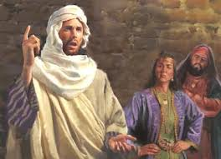
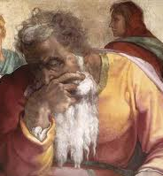
Jeremiah himself: the man
Probably born about the same time as Josiah [excited at Josiah’s reforms!]
Trained to be a priest (1:1)
  Usually started about 25 years old
  Now God asks him to be a prophet
Prophesied at least 40 years
Continued his mission till over 65 years old! [old man in the mire!]
Great example to us of faithful service in God’s family

Slide 21
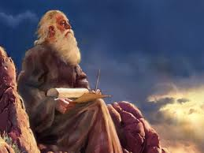
Number of Years Jeremiah continued to Prophecy
Josiah’s reign (from 13th) 18 years
Jehoahaz’ reign 3 months
Jehoiakim’s reign 11 years
Jehoiachin’s reign 3 months
Zedekiah’s reign 11 years
Gedaliah is governor ???
Time in Egypt ???
Total time: at least 40 years!

Slide 22
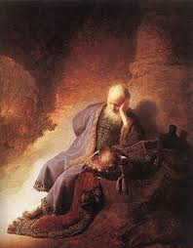
Jeremiah: Priest turned Prophet
Life of priest was pretty good – people took care of you!
Called from birth (1:5) like Christ (Isa 49:1) & Paul (Gal 1:15)
Did not want to be a prophet (1:6)
  Sometimes necessary to take on jobs we don’t want because no one else is filling it!
God promised to protect him (1:18-19)
  Later on, when people hated him, wanted to kill him, & torture him – Jeremiah felt deceived (19:7-8)
  Jeremiah did not want to deliver his message (19:9)
  Became so discouraged he wished he was not born (19:14-18)
Jeremiah became willing to serve God the way God wanted, not what Jeremiah wanted!

Slide 23
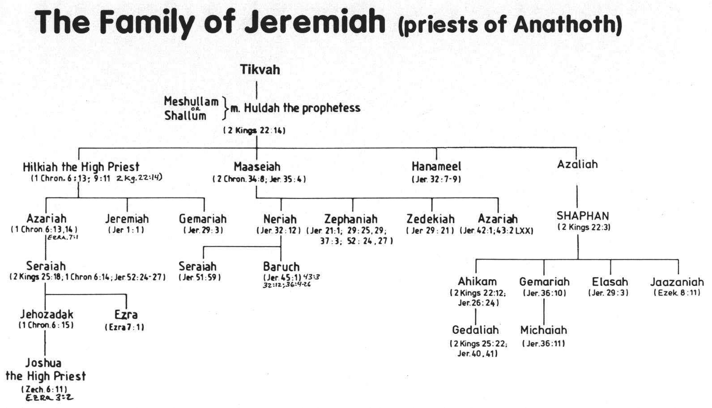
The Family of Jeremiah (priests of Anathoth)
Jeremiah came from a big family!
Most of Jeremiah’s contemporary family members rejected his prophecies
Mainly taken from Bro HAW’s book with modifications recommended by R.Cowie

Slide 24
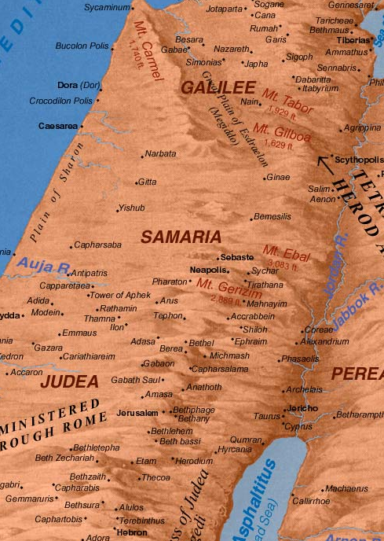
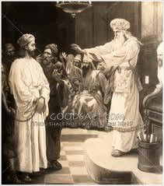
Jeremiah’s Family: Leaders in Judah
Hilkiah (high priest) probably Jeremiah’s Dad
  Jeremiah was raised in Anathoth (1:1), one of 13 cities given to Aaron’s descendants (Josh 21:18)
  Abiathar’s descendants lived there too (1Kgs 2:26)
Jeremiah had easy access to the king (22:1; 34:2, 6)
Jeremiah was given special treatment by rulers
Jehoiakim put Urijah to death, but spared Jeremiah (26:24)
Zedekiah (38:8-10) allowed Ebed-Melech to get Jeremiah out of the pit
Princes & priests (36:11-19, 25) allowed scroll to be read in priest chamber & before the king
Nebuchadnezzar (39:11-12) told Nebuzaradan to look after Jeremiah
But many of his family rejected him

Slide 25
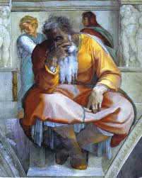
Many Family Members Rejected Jeremiah & His Message
Azariah (high priest, brother) & Gemariah (his brother) dealt treacherously with him (12:6)
Zedekiah (29:21) his cousin, prophesied lies
Azariah (42:1; 43:2 LXX) his cousin, claimed Jeremiah lied when he prophesied that God did not want them to flee to Egypt
Seraiah (Jeremiah’s Nephew [high priest]) and Zephaniah (cousin) and probably many other family members were killed by Nebuzaradan at Riblah (2 Kings 25:18-21; Jer 39:6)

Slide 26
The Family of Jeremiah (priests of Anathoth)
Jeremiah came from a big family!
Many of Jeremiah’s contemporary family members rejected his prophecies

Slide 27
The Family of Jeremiah (priests of Anathoth)
Some family members supported Jeremiah
Baruch wrote many of Jeremiah’s prophecies.
Shaphan’s family were faithful to God and supported Jeremiah to the end.

Slide 28
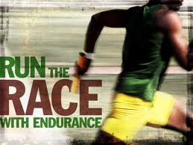
Jeremiah’s Social Life (Jer 16) He lived God’s message!
V.2 No wife or kids: not worth having a family now
V.5 No grieving at funerals: God won’t grieve when the nation goes captive
V.8 No parties: too many terrible events coming on the nation
And we sometimes think we have it bad today!

Slide 29

Jeremiah’s message to the Jews
Northern army is coming! Change before the judgment begins! Then it will be too late!
Jeremiah began this message during Josiah’s reformation years!
Once the Babylonians arrived in 4th of Jehoiakim, Jeremiah was vindicated & his message changed to: “surrender & go to Babylon”
His message still applies to us today! Now is the time! When Jesus returns it will be too late!

Slide 30

“Prophet to the Nations” (1:5)
Jeremiah’s Mission:
Jeremiah’s message to the nations:
1) Yahweh is the one responsible for Judah’s destruction, not the idols of the other nations or their kings (4:16; 6:18; 27:1-8; 40:2-3)
2) The nations will in turn be destroyed because of their proud boastings against Yahweh (25:17-38)
Daniel delivered a similar message: “Most High rules in the kingdoms of men”

Slide 31

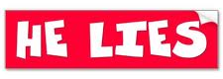
Jeremiah had no credibility (1:13-17)
13 And the word of the LORD came to me the second time, saying, "What do you see?" And I said, "I see a boiling pot, and it is facing away from the north.“ [KJV error: “toward the north”]
14 Then the LORD said to me: "Out of the north calamity shall break forth on all the inhabitants of the land.
15 For behold, I am calling all the families of the kingdoms of the north," says the LORD; "They shall come and each one set his throne at the entrance of the gates of Jerusalem, against all its walls all around, and against all the cities of Judah.
16 I will utter My judgments against them concerning all their wickedness, because they have forsaken Me, burned incense to other gods, and worshiped the works of their own hands.
17 "Therefore prepare yourself and arise, and speak to them all that I command you. Do not be dismayed before their faces, lest I dismay you before them.
Egypt was the power of the day! The people couldn’t see how a northern power would capture them.

Slide 32
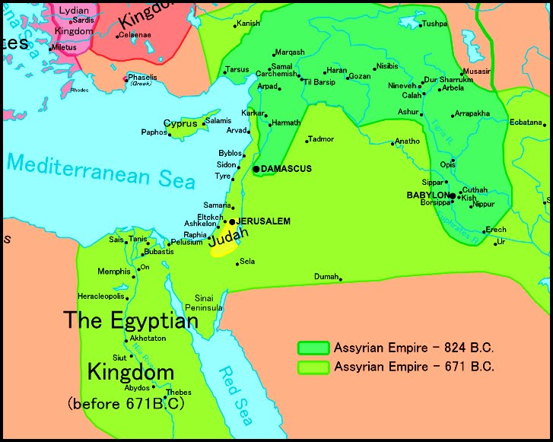
2
S
G

Slide 33
Jeremiah’s writings
Some were written by Baruch (36:4: 45:1)
Contain the most words of any prophet’s book of the Bible
Cover a longer period of time than any other prophets
It’s time to get to know him & understand his prophecy

Slide 34
Next Class
Class 2: The Failure of the People

Slide 35
2
S
G

Slide 36
2
17
G

