Slide 1
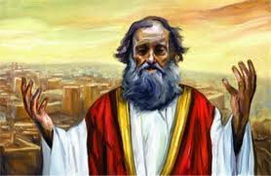
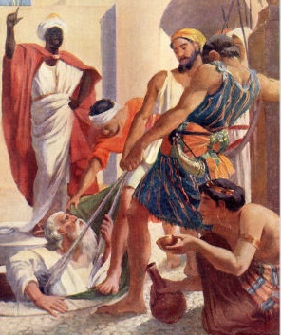
Jeremiah
Change before the end begins
Class 2: The Failure of the People

Slide 2
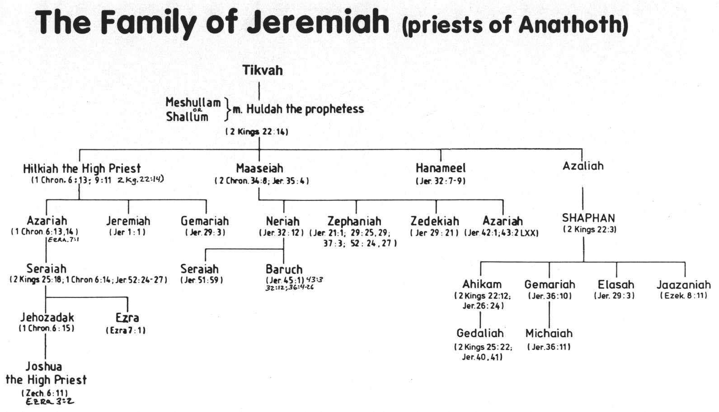
The Family of Jeremiah (priests of Anathoth)
Some family members supported Jeremiah
Baruch wrote many of Jeremiah’s prophecies.
Shaphan’s family were faithful to God and supported Jeremiah to the end.

Slide 3
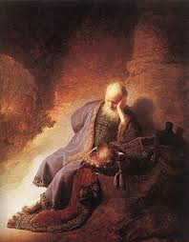
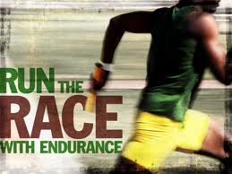
Jeremiah’s Social Life (Jer 16) He lived God’s message!
V.2 No wife or kids: not worth having a family now
V.5 No grieving at funerals: God won’t grieve when the nation goes captive
V.8 No parties: too many terrible events coming on the nation
And we sometimes think we have it bad today!

Slide 4

Jeremiah’s message to the Jews
Northern army is coming! Change before the judgment begins! Then it will be too late!
Jeremiah began this message during Josiah’s reformation years!
Once the Babylonians arrived in 4th of Jehoiakim, Jeremiah was vindicated & his message changed to: “surrender & go to Babylon”
His message still applies to us today! Now is the time! When Jesus returns it will be too late!

Slide 5

“Prophet to the Nations” (1:5)
Jeremiah’s Mission:
Jeremiah’s message to the nations:
1) Yahweh is the one responsible for Judah’s destruction, not the idols of the other nations or their kings (4:16; 6:18; 27:1-8; 40:2-3)
2) The nations will in turn be destroyed because of their proud boastings against Yahweh (25:17-38)
Daniel delivered a similar message: “Most High rules in the kingdoms of men”

Slide 6
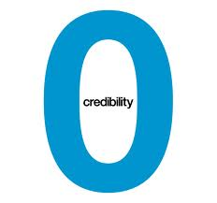
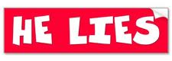
Jeremiah had no credibility (1:13-17)
13 And the word of the LORD came to me the second time, saying, "What do you see?" And I said, "I see a boiling pot, and it is facing away from the north.“ [KJV error: “toward the north”]
14 Then the LORD said to me: "Out of the north calamity shall break forth on all the inhabitants of the land.
15 For behold, I am calling all the families of the kingdoms of the north," says the LORD; "They shall come and each one set his throne at the entrance of the gates of Jerusalem, against all its walls all around, and against all the cities of Judah.
16 I will utter My judgments against them concerning all their wickedness, because they have forsaken Me, burned incense to other gods, and worshiped the works of their own hands.
17 "Therefore prepare yourself and arise, and speak to them all that I command you. Do not be dismayed before their faces, lest I dismay you before them.
Egypt was the power of the day! The people couldn’t see how a northern power would capture them.

Slide 7
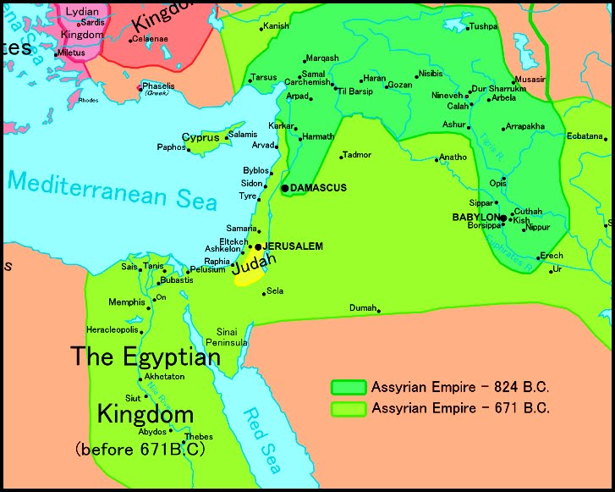
2
S
G

Slide 8

Jeremiah’s writings
Some were written by Baruch (36:4: 45:1)
Contain the most words of any prophet’s book of the Bible
Cover a longer period of time than any other prophets
It’s time to get to know him & understand his prophecy

Slide 9
Exodus 34:6-7
God’s Amazing Mercy
6 And the LORD passed before him and proclaimed, "The LORD, the LORD God, merciful and gracious, longsuffering, and abounding in goodness and truth,
7 "keeping mercy for thousands, forgiving iniquity and transgression and sin, by no means clearing the guilty, visiting the iniquity of the fathers upon the children and the children's children to the third and the fourth generation.”
But the mercy of the LORD is from everlasting to everlasting on those who fear Him (Ps 103:17)

Slide 10
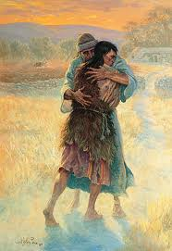
God’s Undeserved Mercy
3:1 Return to Me (context!)
3:7 Return to Me
3:12 Return…for I am merciful
3:22 Return…I will heal
4:1 Return to Me
7:1-7 If you will amend your ways then I will cause you to dwell
Prodigal Son Returns
Who is like you, O Lord, among the gods? (Ex 15:11)
God is willing to forgive past mistakes & so should we! Don’t be like the older brother!

Slide 11
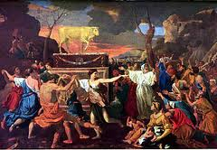
God Cannot work with Unrepentant Sinners
Jeremiah 25:4-7
4 "And the LORD has sent to you all His servants the prophets, rising early and sending them, but you have not listened nor inclined your ear to hear.
5 "They said, 'Repent now everyone of his evil way and his evil doings, and dwell in the land that the LORD has given to you and your fathers forever and ever.
6 'Do not go after other gods to serve them and worship them, and do not provoke Me to anger with the works of your hands; and I will not harm you.'
7 "Yet you have not listened to Me," says the LORD, "that you might provoke Me to anger with the works of your hands to your own hurt. Therefore…….
“but unless you repent you will all likewise perish” (Lk 13:3)

Slide 12
Jeremiah 2:32-37
32 Can a virgin forget her ornaments, or a bride her attire? Yet My people have forgotten Me days without number.
33 "Why do you beautify your way to seek love? Therefore you have also taught the wicked women your ways.
34 Also on your skirts is found the blood of the lives of the poor innocents. I have not found it by secret search, but plainly on all these things.
35 Yet you say, 'Because I am innocent, surely His anger shall turn from me.' Behold, I will plead My case against you, because you say, 'I have not sinned.'
36 Why do you gad about so much to change your way? Also you shall be ashamed of Egypt as you were ashamed of Assyria.
37 Indeed you will go forth from him with your hands on your head; for the LORD has rejected your trusted allies, and you will not prosper by them.
These sinners professed innocence!

Slide 13
Jeremiah 3:1-3
1 "They say, 'If a man divorces his wife, and she goes from him and becomes another man's, may he return to her again?' Would not that land be greatly polluted? But you have played the harlot with many lovers; yet return to Me," says the LORD.
2 "Lift up your eyes to the desolate heights and see: where have you not lain with men? By the road you have sat for them like an Arabian in the wilderness; and you have polluted the land with your harlotries and your wickedness.
3 Therefore the showers have been withheld, and there has been no latter rain. You have had a harlot's forehead; you refuse to be ashamed.

Slide 14
Jeremiah 3:8-14
8 "Then I saw that for all the causes for which backsliding Israel had committed adultery, I had put her away and given her a certificate of divorce; yet her treacherous sister Judah did not fear, but went and played the harlot also.
9 "So it came to pass, through her casual harlotry, that she defiled the land and committed adultery with stones and trees.
10 "And yet for all this her treacherous sister Judah has not turned to Me with her whole heart, but in pretense," says the LORD.
11 Then the LORD said to me, "Backsliding Israel has shown herself more righteous than treacherous Judah.
12 "Go and proclaim these words toward the north, and say: 'Return, backsliding Israel,' says the LORD, 'I will not cause My anger to fall on you. For I am merciful,' says the LORD; 'I will not remain angry forever.
13 that you have transgressed against the LORD your God, and have scattered your charms to alien deities under every green tree, and you have not obeyed My voice,' says the LORD.
14 "Return, O backsliding children," says the LORD; "for I am married to you. I will take you, one from a city and two from a family, and I will bring you to Zion.
God was just waiting for them to return!

Slide 15
Jeremiah 6:12-15
12 And their houses shall be turned over to others, fields and wives together; for I will stretch out My hand against the inhabitants of the land," says the LORD.
13 "Because from the least of them even to the greatest of them, everyone is given to covetousness; and from the prophet even to the priest, everyone deals falsely.
14 They have also healed the hurt of My people slightly, saying, 'Peace, peace!' When there is no peace.
15 Were they ashamed when they had committed abomination? No! They were not at all ashamed; nor did they know how to blush. Therefore they shall fall among those who fall; at the time I punish them, they shall be cast down," says the LORD.
They were used to living in Sin

Slide 16
Jeremiah 8:6-12
6 I listened and heard, but they do not speak aright. No man repented of his wickedness, saying, 'What have I done?' Everyone turned to his own course, as the horse rushes into the battle.
7 "Even the stork in the heavens knows her appointed times; and the turtledove, the swift, and the swallow observe the time of their coming. But My people do not know the judgment of the LORD.
8 "How can you say, 'We are wise, and the law of the LORD is with us'? Look, the false pen of the scribe certainly works falsehood.
9 The wise men are ashamed, they are dismayed and taken. Behold, they have rejected the word of the LORD; so what wisdom do they have?
10 Therefore I will give their wives to others, and their fields to those who will inherit them; because from the least even to the greatest everyone is given to covetousness; from the prophet even to the priest everyone deals falsely.
11 For they have healed the hurt of the daughter of My people slightly, saying, 'Peace, peace!' When there is no peace.
12 Were they ashamed when they had committed abomination? No! They were not at all ashamed, nor did they know how to blush. Therefore they shall fall among those who fall; in the time of their punishment they shall be cast down," says the LORD.

Slide 17
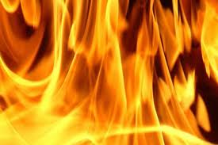
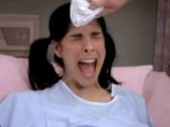
Jeremiah’s message to the Jews
Change before the judgment begins! Then it will be too late!
Jeremiah began this message during Josiah’s reign
He used 2 metaphors to illustrate the severity:
  Fire that can’t be put out (4:4; 5:14; 15:14; 17:4,27; 21:10,12,14; Lam 2:3,4; 4:11
  Woman in labor with child (4:31; 6:24; 13:21; 22:23)
We need to be ready! For the Son of Man is coming at an hour you do not expect! (Lk 12:40)

Slide 18
Jeremiah 17:1-4
1 The sin of Judah is written with a pen of iron ….
4 And you, even yourself, shall let go of your heritage which I gave you; and I will cause you to serve your enemies in the land which you do not know; for you have kindled a fire in My anger which shall burn forever.
This fire would not be put out!

Slide 19
Jeremiah 4:4
Circumcise yourselves to the LORD, and take away the foreskins of your hearts, you men of Judah and inhabi- tants of Jerusalem, lest My fury come forth like fire, and burn so that no one can quench it, because of the evil of your doings."
Once the fire started… it was too late!

Slide 20
Jeremiah 6:22-24
22 Thus says the LORD: "Behold, a people comes from the north country…
24 We have heard the report of it; our hands grow feeble. Anguish has taken hold of us, pain as of a woman in labor.
Terrible pain & once it starts, there’s no going back!

Slide 21
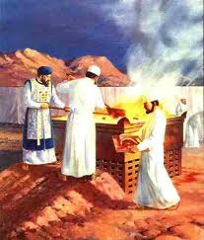
Jews’ Religion had become Formal and Legal
They had cooperated with Josiah’s reforms
3:16 No more say "ark of covenant“
People thought they had the ark, so they had God
1Sam 4:3 people said “it (ark) will save us”
6:20 God says offerings were not sincere
7:23 Not sacrifices… Obedience!
For I desire mercy and not sacrifice, and the knowledge of God more than burnt offerings. (Hosea 6:6)

Slide 22
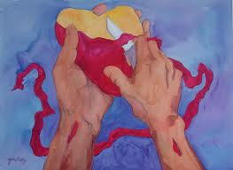
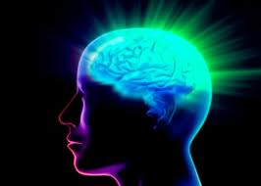
The Jews trusted in their Circumcision to save them
4:4 Circumcise foreskins of hearts
6:10 Ear uncircumcised - cannot hear word of the Lord
9:26 Uncircumcised in heart
Their formal, legal religion did not develop the mind of the spirit
Therefore I will give their wives to others, and their fields to those who will inherit them; because from the least even to the greatest everyone is given to covetousness; from the prophet even to the priest everyone deals falsely [“in pretense”]. (Jer 8:10)

Slide 23
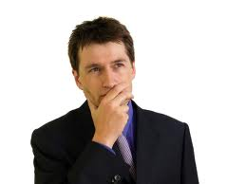


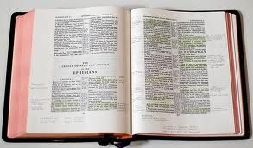
We have the true understanding of the Bible
We have our marked, wide-margin Bibles
We have been baptized into Christ
We are God’s special people
We do our daily Bible readings
We have the bread & wine
Yet for all this, we could hear “depart from me, I never knew you”

Slide 24
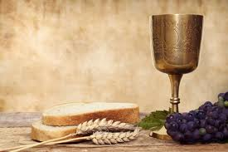
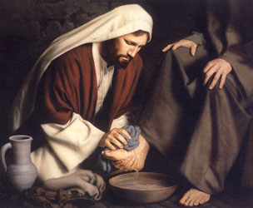
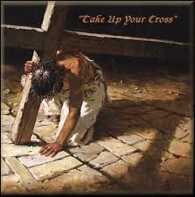
Don’t let our memorial service become a formal, legal service that has no impact on our lives!
Do this in remembrance of me
Christ expects it to humble us & motivate us to take up our cross and follow him

Slide 25
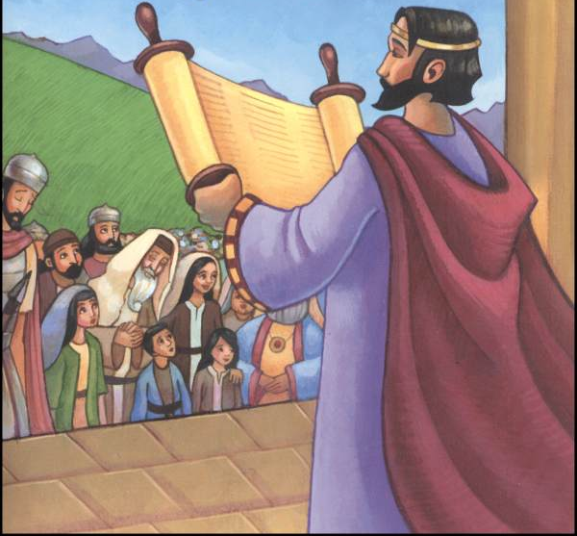
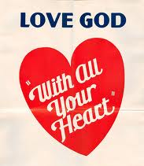
Why didn’t Josiah’s reformation work?
They did not Know God! No personal relationship with Him
Very sad ☹ Even though the people had to opportunity to hear God’s word, attending services in God’s house, and offer sacrifices to God…..they did not get to know their God
We must come to love the Lord with all our heart and soul and strength and mind

Slide 26
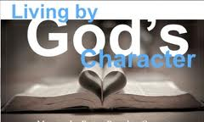
Exodus 34:6-7
God’s Character is the Goal for every Believer
6 And the LORD passed before him and proclaimed, "The LORD, the LORD God, merciful and gracious, longsuffering, and abounding in goodness and truth,
7 "keeping mercy for thousands, forgiving iniquity and transgression and sin, by no means clearing the guilty, visiting the iniquity of the fathers upon the children and the children's children to the third and the fourth generation.”
God has called us to live like Him

Slide 27
Jeremiah 2:7-11
7 I brought you into a bountiful country, to eat its fruit and its goodness. But when you entered, you defiled My land and made My heritage an abomination.
8 The priests did not say, 'Where is the LORD?' And those who handle the law did not know Me; the rulers also transgressed against Me; the prophets prophesied by Baal, and walked after things that do not profit.
9 "Therefore I will yet bring charges against you," says the LORD, "And against your children's children I will bring charges.
10 For pass beyond the coasts of Cyprus and see, send to Kedar and consider diligently, and see if there has been such a thing.
11 Has a nation changed its gods, which are not gods? But My people have changed their Glory for what does not profit.
The priests were involved everyday with God’s Law, but they did not know God!

Slide 28
Jeremiah 4:22
22 "For My people are foolish, they have not known Me. They are silly children, and they have no understanding. They are wise to do evil, but to do good they have no knowledge.”
Remember: This was happening during Josiah’s reformation!

Slide 29
Jeremiah 9:2-6
2 Oh, that I had in the wilderness a lodging place for travelers; that I might leave my people, and go from them! For they are all adulterers, an assembly of treacherous men.
3 "And like their bow they have bent their tongues for lies. They are not valiant for the truth on the earth. For they proceed from evil to evil, and they do not know Me," says the LORD.
4 "Everyone take heed to his neighbor, and do not trust any brother; for every brother will utterly supplant, and every neighbor will walk with slanderers.
5 Everyone will deceive his neighbor, and will not speak the truth; they have taught their tongue to speak lies; they weary themselves to commit iniquity.
6 Your dwelling place is in the midst of deceit; through deceit they refuse to know Me," says the LORD.
Josiah gave everyone a chance to develop a relationship with God – but they refused!

Slide 30
Jeremiah 22:15-16
15 "Shall you (Jehoiakim) reign because you enclose yourself in cedar? Did not your father (Josiah) eat and drink, and do justice and righteousness? Then it was well with him.
16 He judged the cause of the poor and needy; then it was well. Was not this knowing Me?" says the LORD.
Josiah knew God & learned to live like Him

Slide 31
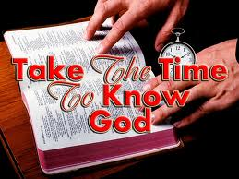
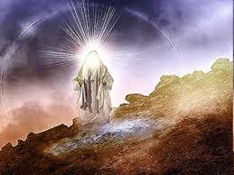
We must get to know God so we can live like him!
"And this is eternal life, that they may know You, the only true God, and Jesus Christ whom You have sent. (John 17:3)
Knowing God & His love for us motivates us to live like him!

Slide 32
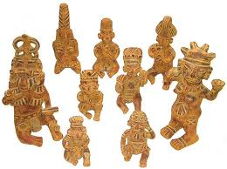
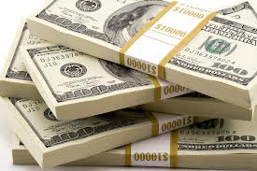


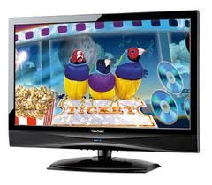
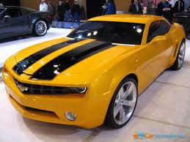
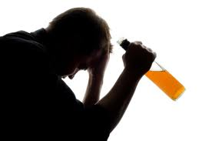
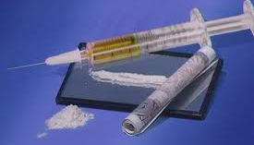
Why Turn to Idols?
1) They cannot see our sins
2) We get no guilt feelings
3) We don’t need to change
4) They provide instant happiness
5) They are fun and exciting
Serving our God can sometimes seem the opposite

Slide 33
Jeremiah 24:5-7
5 "Thus says the LORD, the God of Israel: 'Like these good figs, so will I acknowledge those who are carried away captive from Judah, whom I have sent out of this place for their own good, into the land of the Chaldeans.
6 'For I will set My eyes on them for good, and I will bring them back to this land; I will build them and not pull them down, and I will plant them and not pluck them up.
7 'Then I will give them a heart to know Me, that I am the LORD; and they shall be My people, and I will be their God, for they shall return to Me with their whole heart.
God will change them one day

Slide 34
Jeremiah 31:33-34
33 "But this is the covenant that I will make with the house of Israel after those days, says the LORD: I will put My law in their minds, and write it on their hearts; and I will be their God, and they shall be My people.
34 "No more shall every man teach his neighbor, and every man his brother, saying, 'Know the LORD,' for they all shall know Me, from the least of them to the greatest of them, says the LORD. For I will forgive their iniquity, and their sin I will remember no more."
This covenant will be in their hearts, not on stone tablets

Slide 35
Jeremiah 9:23-24
23 Thus says the LORD: "Let not the wise man glory in his wisdom, let not the mighty man glory in his might, nor let the rich man glory in his riches;
24 But let him who glories glory in this, that he understands and knows Me, that I am the LORD, exercising lovingkindness, judgment, and righteousness in the earth. For in these I delight," says the LORD.
Our joy & glory is that we know God & he is changing us to live like him

Slide 36
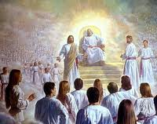
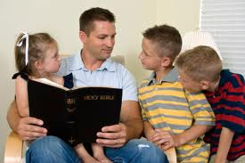
God has chosen us to be members of His family forever!
Thank God daily for His merciful kindness
Appreciate the awesome opportunity we have to live in God’s family
Strive to know Him & Jesus Christ:
  Through reading the Bible
  By prayer
  By meditating on the events of our lives
Never take it for granted… it’s a wonderful privilege that very few people have been granted
God’s undeserved kindness toward us

Slide 37
Ephesians 3:14-21
14 For this reason [because God’s grace was poured out on Gentiles – v.1] I bow my knees to the Father of our Lord Jesus Christ,
15 from whom the whole family in heaven and earth is named,
16 that He would grant you, according to the riches of His glory, to be strengthened with might through His Spirit in the inner man,
17 that Christ may dwell in your hearts through faith; that you, being rooted and grounded in love,
18 may be able to comprehend with all the saints what is the width and length and depth and height--
19 to know the love of Christ which passes knowledge; that you may be filled with all the fullness of God.
20 Now to Him who is able to do exceedingly abundantly above all that we ask or think, according to the power that works in us,
21 to Him be glory in the church by Christ Jesus to all generations, forever and ever. Amen.
Thanks be to God for his indescribable gift!

Slide 38
Next Class
Class 3: Jeremiah’s struggle with God

Slide 40
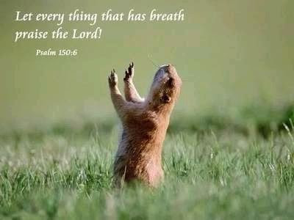
2
S
G

Slide 41
2
17
G

