Slide 1
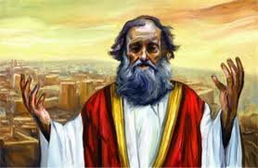
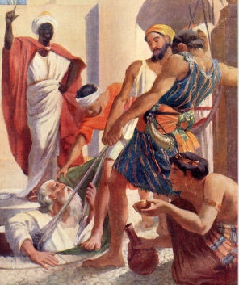
Jeremiah
Change before the end begins
Class 3: Jeremiah’s struggle with God

Slide 2
Jeremiah’s Struggle with God revealed in chapters 2-20
Goal:
1) Look at how God led Jeremiah to clearly see the depth of the spiritual sickness of his people.
2) Watch the patience God has with Jeremiah as He slowly let Jeremiah realize the strength of the medicine it would take to cure their sickness.
Key: Learn HOW to read Jeremiah 2-20
It’s like reading Habakkuk)
Helpful to read through entirely – all at once.
Then do it again!

Slide 3
Who’s Speaking ???
Key Words to Look for:
Jeremiah speaking:
We, us, weeping, wailing, lament
God speaking:
says the LORD, the LORD said
Problem - Both use:
me, I, daughter of my people

Slide 4
Who’s Speaking???
Key Themes to Look for:
Jeremiah speaking:
He cries & laments destruction of Judah
He begs God not to destroy
God speaking:
He points out evils of the people
Declares why Jerusalem & Judah must be destroyed

Slide 5

Start out easy!
Don’t worry – it gets harder!

Slide 6
Jeremiah 4
1 "If you will return, O Israel," says the LORD, "Return to Me; and if you will put away your abominations out of My sight, then you shall not be moved.
2 And you shall swear, 'The LORD lives,' in truth, in judgment, and in righteousness; the nations shall bless themselves in Him, and in Him they shall glory."
3 For thus says the LORD to the men of Judah and Jerusalem: "Break up your fallow ground, and do not sow among thorns.
4 Circumcise yourselves to the LORD, and take away the foreskins of your hearts, you men of Judah and inhabitants of Jerusalem, lest My fury come forth like fire, and burn so that no one can quench it, because of the evil of your doings."
5 Declare in Judah and proclaim in Jerusalem, and say: "Blow the trumpet in the land; cry, 'Gather together,' and say, 'Assemble yourselves, and let us go into the fortified cities.'
6 Set up the standard toward Zion. Take refuge! Do not delay! For I will bring disaster from the north, and great destruction.”

Slide 7
Jeremiah 4
7 The lion has come up from his thicket, and the destroyer of nations is on his way. He has gone forth from his place to make your land desolate. Your cities will be laid waste, without inhabitant.
8 For this, clothe yourself with sackcloth, lament and wail. For the fierce anger of the LORD has not turned back from us.
9 "And it shall come to pass in that day," says the LORD, "That the heart of the king shall perish, and the heart of the princes; the priests shall be astonished, and the prophets shall wonder."
10 Then I said, "Ah, Lord GOD! Surely You have greatly deceived this people and Jerusalem, saying, 'You shall have peace,' whereas the sword reaches to the heart."
11 At that time it will be said to this people and to Jerusalem, "A dry wind of the desolate heights blows in the wilderness toward the daughter of My people-- not to fan or to cleanse—
12 A wind too strong for these will come for Me; now I will also speak judgment against them.”

Slide 8

Jeremiah 6:12-14
The False Prophets predicted Peace
12 And their houses shall be turned over to others, fields and wives together; for I will stretch out My hand against the inhabitants of the land," says the LORD.
13 "Because from the least of them even to the greatest of them, everyone is given to covetousness; and from the prophet even to the priest, everyone deals falsely.
14 They have also healed the hurt of My people slightly, saying, 'Peace, peace!' When there is no peace.
Many people were gladly fooled!

Slide 9
Jeremiah 8:10-11
The False Prophets predicted Peace
10 Therefore I will give their wives to others, and their fields to those who will inherit them; because from the least even to the greatest everyone is given to covetousness; from the prophet even to the priest everyone deals falsely.
11 For they have healed the hurt of the daughter of My people slightly, saying, 'Peace, peace!' When there is no peace.

Slide 10
Jeremiah 23:16-17
The False Prophets predicted Peace
16 Thus says the LORD of hosts: "Do not listen to the words of the prophets who prophesy to you. They make you worthless; they speak a vision of their own heart, not from the mouth of the LORD.
17 They continually say to those who despise Me, 'The LORD has said, "You shall have peace"'; and to everyone who walks according to the dictates of his own heart, they say, 'No evil shall come upon you.‘”
These false prophets fooled the people & even had Jeremiah wondering

Slide 11
Ezekiel 13:4-10 (6th of Zedekiah)
The False Prophets predicted Peace
4 "O Israel, your prophets are like foxes in the deserts.
5 "You have not gone up into the gaps to build a wall for the house of Israel to stand in battle on the day of the LORD.
6 "They have envisioned futility and false divination, saying, 'Thus says the LORD!' But the LORD has not sent them; yet they hope that the word may be confirmed.
7 "Have you not seen a futile vision, and have you not spoken false divination? You say, 'The LORD says,' but I have not spoken."
8 Therefore thus says the Lord GOD: "Because you have spoken nonsense and envisioned lies, therefore I am indeed against you," says the Lord GOD.
9 "My hand will be against the prophets who envision futility and who divine lies; they shall not be in the assembly of My people, nor be written in the record of the house of Israel, nor shall they enter into the land of Israel. Then you shall know that I am the Lord GOD.
10 "Because, indeed, because they have seduced My people, saying, 'Peace!' when there is no peace
This was a consistent problem for years!

Slide 12
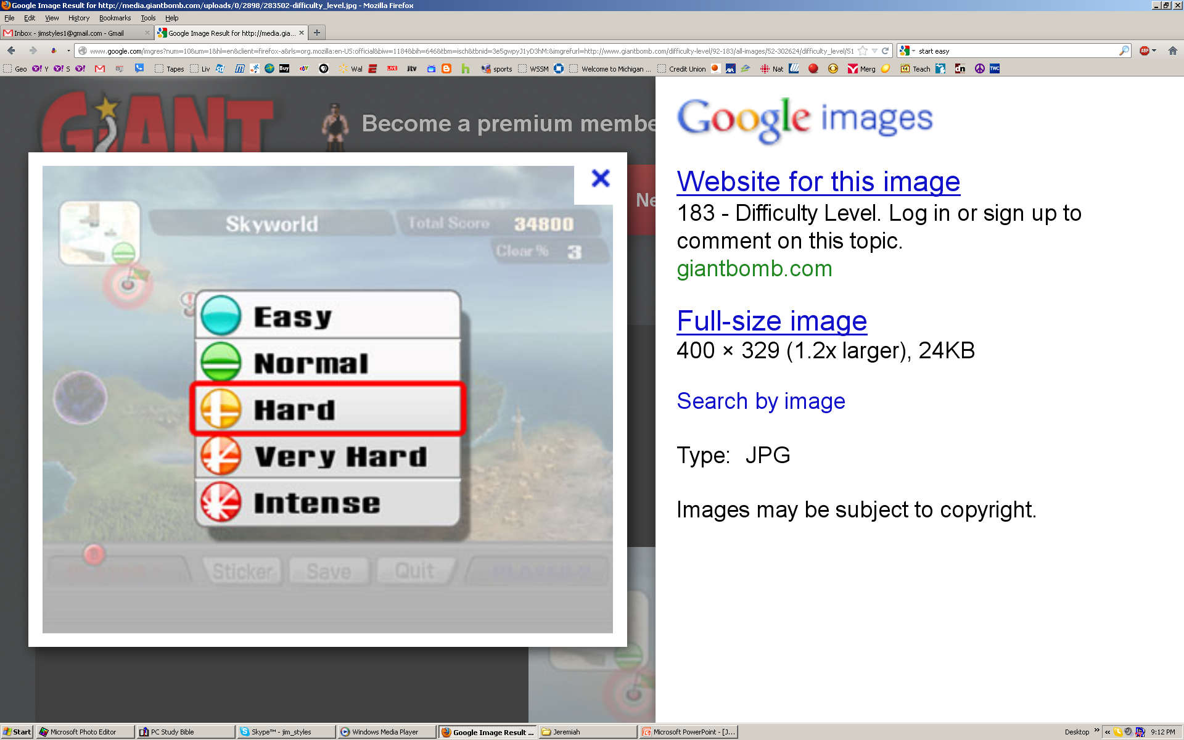

Slide 13
Jeremiah 6:6-13
6 For thus has the LORD of hosts said: "Cut down trees, and build a mound against Jerusalem. This is the city to be punished. She is full of oppression in her midst.
7 As a fountain wells up with water, so she wells up with her wickedness. Violence and plundering are heard in her. Before Me continually are grief and wounds.
8 Be instructed, O Jerusalem, lest My soul depart from you; lest I make you desolate, a land not inhabited."
9 Thus says the LORD of hosts: "They shall thoroughly glean as a vine the remnant of Israel; as a grape-gatherer, put your hand back into the branches."
10 To whom shall I speak and give warning, that they may hear? Indeed their ear is uncircumcised, and they cannot give heed. Behold, the word of the LORD is a reproach to them; they have no delight in it.

Slide 14
Jeremiah 6:6-13
6 For thus has the LORD of hosts said: "Cut down trees, and build a mound against Jerusalem. This is the city to be punished. She is full of oppression in her midst.
7 As a fountain wells up with water, so she wells up with her wickedness. Violence and plundering are heard in her. Before Me continually are grief and wounds.
8 Be instructed, O Jerusalem, lest My soul depart from you; lest I make you desolate, a land not inhabited."
9 Thus says the LORD of hosts: "They shall thoroughly glean as a vine the remnant of Israel; as a grape-gatherer, put your hand back into the branches."
10 To whom shall I speak and give warning, that they may hear? Indeed their ear is uncircumcised, and they cannot give heed. Behold, the word of the LORD is a reproach to them; they have no delight in it.

Slide 15
Jeremiah 6:6-13
11 Therefore I am full of the fury of the LORD. I am weary of holding it in. "I will pour it out on the children outside, and on the assembly of young men together; for even the husband shall be taken with the wife, the aged with him who is full of days.
12 And their houses shall be turned over to others, fields and wives together; for I will stretch out My hand against the inhabitants of the land," says the LORD.
13 "Because from the least of them even to the greatest of them, everyone is given to covetousness; and from the prophet even to the priest, everyone deals falsely.

Slide 16
Jeremiah 6:6-13
11 Therefore I am full of the fury of the LORD. I am weary of holding it in. "I will pour it out on the children outside, and on the assembly of young men together; for even the husband shall be taken with the wife, the aged with him who is full of days.
12 And their houses shall be turned over to others, fields and wives together; for I will stretch out My hand against the inhabitants of the land," says the LORD.
13 "Because from the least of them even to the greatest of them, everyone is given to covetousness; and from the prophet even to the priest, everyone deals falsely.

Slide 17
Jeremiah 8:18 – 9:3
18 I would comfort myself in sorrow; My heart is faint in me.
19 Listen! The voice, The cry of the daughter of my people from a far country: "Is not the Lord in Zion? Is not her King in her?“
"Why have they provoked Me to anger with their carved images — with foreign idols?"
20 "The harvest is past, The summer is ended, And we are not saved!"
21 For the hurt of the daughter of my people I am hurt. I am mourning; astonishment has taken hold of me. 22 Is there no balm in Gilead, Is there no physician there? Why then is there no recovery for the health of the daughter of my people?

Slide 18
Jeremiah 8:18 – 9:3
18 I would comfort myself in sorrow; My heart is faint in me.
19 Listen! The voice, The cry of the daughter of my people from a far country: "Is not the Lord in Zion? Is not her King in her?“
"Why have they provoked Me to anger with their carved images — with foreign idols?"
20 "The harvest is past, The summer is ended, And we are not saved!"
21 For the hurt of the daughter of my people I am hurt. I am mourning; astonishment has taken hold of me. 22 Is there no balm in Gilead, Is there no physician there? Why then is there no recovery for the health of the daughter of my people?

Slide 19
Jeremiah 8:18 – 9:3
9:1 Oh, that my head were waters, and my eyes a fountain of tears, that I might weep day and night for the slain of the daughter of my people!
2 Oh, that I had in the wilderness a lodging place for travelers; that I might leave my people, and go from them! For they are all adulterers, an assembly of treacherous men.
3 "And like their bow they have bent their tongues for lies. They are not valiant for the truth on the earth. For they proceed from evil to evil, and they do not know Me," says the Lord.

Slide 20
Jeremiah 8:18 – 9:3
9:1 Oh, that my head were waters, and my eyes a fountain of tears, that I might weep day and night for the slain of the daughter of my people!
2 Oh, that I had in the wilderness a lodging place for travelers; that I might leave my people, and go from them! For they are all adulterers, an assembly of treacherous men.
3 "And like their bow they have bent their tongues for lies. They are not valiant for the truth on the earth. For they proceed from evil to evil, and they do not know Me," says the Lord.

Slide 21
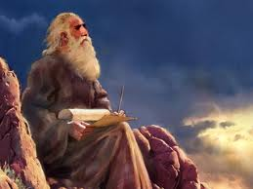
Jeremiah’s shock!
Chapters 2-3 are mainly about Israel’s destruction by the Assyrians
  2:7-11 mentions Judah’s sin – but no clear punishment
  2:18 Jeremiah missed “come together out of the north”
Chapter 4 reveals Judah’s coming destruction!
  Sees visions of the coming destruction (4:5-7, 13, 23-26)
  Feels shocked and deceived by God (4:10; 8:21)
This is Jeremiah’s initial reaction: blames God
  False prophets has been predicting peace (6:14; 23:17)
  Jeremiah cries out in agony, weeps & wails (4:19-21)
  He doesn’t understand yet, but continues to try
God is extremely patient!

Slide 22
Jeremiah was OK with Israel’s condemnation (3:6-12)
6 The LORD said also to me in the days of Josiah the king: "Have you seen what backsliding Israel has done? She has gone up on every high mountain and under every green tree, and there played the harlot.
7 "And I said, after she had done all these things, 'Return to Me.' But she did not return. And her treacherous sister Judah saw it.
8 "Then I saw that for all the causes for which backsliding Israel had committed adultery, I had put her away and given her a certificate of divorce; yet her treacherous sister Judah did not fear, but went and played the harlot also.
9 "So it came to pass, through her casual harlotry, that she defiled the land and committed adultery with stones and trees.
Israel was corrupt & deserved to be taken captive

Slide 23
Jeremiah was OK with Israel’s condemnation (3:6-12)
10 "And yet for all this her treacherous sister Judah has not turned to Me with her whole heart, but in pretense," says the LORD.
11 Then the LORD said to me, "Backsliding Israel has shown herself more righteous than treacherous Judah.
12 "Go and proclaim these words toward the north, and say: 'Return, backsliding Israel,' says the LORD, 'I will not cause My anger to fall on you. For I am merciful,' says the LORD; 'I will not remain angry forever.
Israel was corrupt & deserved to be taken captive

Slide 24
No way Judah could be destroyed!
Jeremiah 4:5-10
5 Declare in Judah and proclaim in Jerusalem, and say: "Blow the trumpet in the land; cry, 'Gather together,' and say, 'Assemble yourselves, and let us go into the fortified cities.'
6 Set up the standard toward Zion. Take refuge! Do not delay! For I will bring disaster from the north, and great destruction."
7 The lion has come up from his thicket, and the destroyer of nations is on his way. He has gone forth from his place to make your land desolate. Your cities will be laid waste, without inhabitant.
8 For this, clothe yourself with sackcloth, lament and wail. For the fierce anger of the LORD has not turned back from us.
9 "And it shall come to pass in that day," says the LORD, "That the heart of the king shall perish, and the heart of the princes; the priests shall be astonished, and the prophets shall wonder."
10 Then I said, "Ah, Lord GOD! Surely You have greatly deceived this people and Jerusalem, saying, 'You shall have peace,' whereas the sword reaches to the heart.“ (false prophets had been predicting peace: 23:16-17)
This blew Jeremiah away! He never anticipated telling Judah that it’s destruction was inevitable!

Slide 25
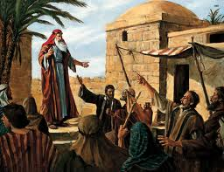
Jeremiah tries to address the problem
Realizes that the people refuse to respond (5:3-5; 6:10)
Holds in the anger of the Lord (6:11)
Put on sackcloth, lament & wail (6:24-26)
Calls for national assembly & repentance (8:14)
Jeremiah doesn’t give up! He tries to get the people to respond. Some did.

Slide 26
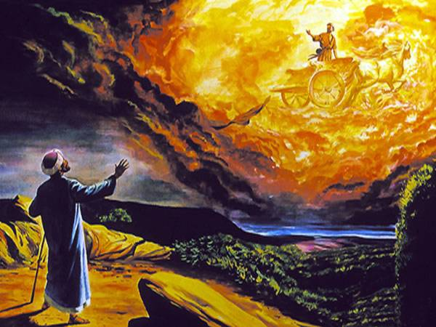
God hasn’t done enough!
Mourns & laments that no one can cure the sins of his people (8:18 – 9:1)
Takes up weeping & wailing (9:10)
Claims God hasn’t spoken through wise men and prophets to correct the people (9:12)
See how patient God was with Jeremiah. He listens to Jeremiah’s complaints & then answers them

Slide 27
Jeremiah 9:9-13
9 Shall I not punish them for these things?" says the LORD. "Shall I not avenge Myself on such a nation as this?"
10 I will take up a weeping and wailing for the mountains, and for the dwelling places of the wilderness a lamentation, because they are burned up, so that no one can pass through; nor can men hear the voice of the cattle. Both the birds of the heavens and the beasts have fled; they are gone.
11 "I will make Jerusalem a heap of ruins, a den of jackals. I will make the cities of Judah desolate, without an inhabitant."
12 Who is the wise man who may understand this? And who is he to whom the mouth of the LORD has spoken, that he may declare it? Why does the land perish and burn up like a wilderness, so that no one can pass through?
13 And the LORD said, "Because they have forsaken My law which I set before them, and have not obeyed My voice, nor walked according to it

Slide 28
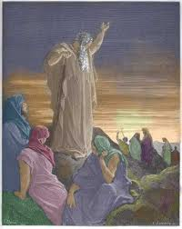
Still pleads with the People & accepts God’s correction
Begs the women to respond (9:18-21)
Appeals to people: idols are dead, Yahweh is alive (10:6-10)
Decides must endure punishment caused by bad shepherds (10:19-20)
Reminds God that man cannot direct his own steps, so correct Jews in just measure and pour fury out on Gentiles (10:23-25)
Jeremiah compared Jews to Gentiles, not to God’s standard

Slide 29
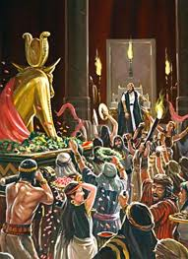
God uses experiences of life to help Jeremiah understand God’s situation
11:1-8 God established a covenant with Jews out of Egypt: Obey My Voice!
11:9-10 Conspiracy! Jews of Jeremiah’s time broke covenant, turned back to idols
11:14 God tells Jeremiah: don’t pray for them
11:15 God’s beloved has no right in His house!
11:18 God reveals to Jeremiah that Jeremiah’s house wants to kill him!
So how did God finally get Jeremiah to see what God was going through?
Some times we cannot see an issue until we experience it ourselves. God brings the right events into our lives to help us grow

Slide 30
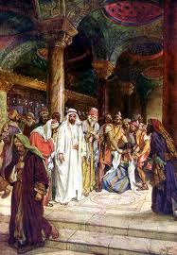
God lets him see that men from his home town want to kill him!
Finally realizes men of Anathoth want to kill him, asks for God’s vengeance (11:18-20)
Asks God to pull only the wicked out (12:1-4)
Begs people to put away pride, says he will weep in secret (13:15-17)
Jeremiah is still blind to the extent of the decline of the nation. God patiently works with him

Slide 31
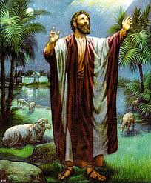
These are Your people…You have to do more to save them… don’t let my mission fail!
Reminds God these are His people, called by His Name, who He must save! (14:7-9)
Reminds God the prophets are misleading the people (14:13) God says He didn’t send them!
Tries to mediate for the nation (14:19-22) – Like Moses & Samuel
Laments that people don’t respond to him, but only curse him (15:10) “Jeremiah causes strife & contention…he’s a big trouble maker!”
Laments that God has let his mission fail (15:15-18) God demands Jeremiah return!
☹ Jeremiah gets depressed ☹

Slide 32
Jeremiah 15:15-21
15 O LORD, You know; remember me and visit me, and take vengeance for me on my persecutors. In Your enduring patience, do not take me away. Know that for Your sake I have suffered rebuke.
16 Your words were found, and I ate them, and Your word was to me the joy and rejoicing of my heart; for I am called by Your name, O LORD God of hosts.
17 I did not sit in the assembly of the mockers, nor did I rejoice; I sat alone because of Your hand, for You have filled me with indignation.
18 Why is my pain perpetual and my wound incurable, which refuses to be healed? Will You surely be to me like an unreliable stream, as waters that fail?
19 Therefore thus says the LORD: "If you return, then I will bring you back; you shall stand before Me; if you take out the precious from the vile, you shall be as My mouth. Let them return to you, but you must not return to them.
20 And I will make you to this people a fortified bronze wall; and they will fight against you, but they shall not prevail against you; for I am with you to save you and deliver you," says the LORD.
21 "I will deliver you from the hand of the wicked, and I will redeem you from the grip of the terrible.”
God’s assurance to Jeremiah

Slide 33
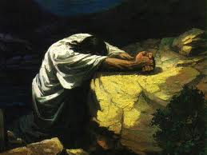
Sometimes feel like God has let us down
Jeremiah thought God would make him “a fortified city, iron pillar, bronze walls” (1:18)
God had promised him that “they will fight against you, but they will not prevail against you. For I am with you to deliver you” (1:19)
Jeremiah never expected to deliver such a devastating message to Judah & his friends
He didn’t anticipate that the people would grow to hate & despise him, and want to kill him
His life in the Truth, serving his God, hadn’t gone the way he expected at all!
God will never leave us or forsake us, but we & others do fail, so God has to deal with our mistakes!

Slide 34
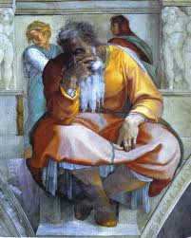
Jeremiah reflects on his attempt to work with God’s people
Realizes Gentiles will shame Jews when they turn to Yahweh & put away idols (16:19-20)
Reflects on his attempt to be faithful & asks God to heal and save him (17:14-18)
Remember I tried to save them…but now destroy those who want to kill me! (18:19-23)
He’s beginning to understand God’s perspective & his own need to be saved!

Slide 35
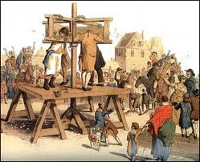
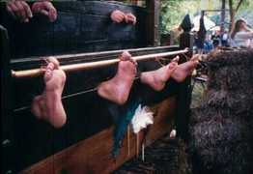
Jeremiah’s final thoughts
Feels God deceived him about his own sufferings (stocks), but takes courage from David’s words in Psalms 31, 41 (20:7-13)
Final thoughts: he does not enjoy the destruction that must come (20:14-18), but he will faithfully deliver God’s message.
We may have times when delivering God’s word to others brings reproach on us – remember Jeremiah!

Slide 36
Jeremiah 20:11
11 But the LORD is with me as a mighty, awesome One. Therefore my persecutors will stumble, and will not prevail. They will be greatly ashamed, for they will not prosper. Their everlasting confusion will never be forgotten.
12 But, O LORD of hosts, you who test the righteous, and see the mind and heart, let me see Your vengeance on them; for I have pleaded my cause before You.
13 Sing to the LORD! Praise the LORD! For He has delivered the life of the poor from the hand of evildoers.
14 Cursed be the day in which I was born! Let the day not be blessed in which my mother bore me!
15 Let the man be cursed who brought news to my father, saying, "A male child has been born to you!" Making him very glad.
16 And let that man be like the cities which the LORD overthrew, and did not relent; let him hear the cry in the morning and the shouting at noon,
17 Because he did not kill me from the womb, that my mother might have been my grave, and her womb always enlarged with me.
18 Why did I come forth from the womb to see labor and sorrow, that my days should be consumed with shame?
Jeremiah didn’t like his job!

Slide 37
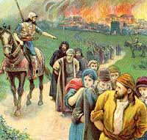
Jeremiah’s frustration: most of the Good figs were gone! (24:5-7)
5 "Thus says the LORD, the God of Israel: 'Like these good figs, so will I acknowledge those who are carried away captive from Judah, whom I have sent out of this place for their own good, into the land of the Chaldeans.
6 'For I will set My eyes on them for good, and I will bring them back to this land; I will build them and not pull them down, and I will plant them and not pluck them up.
7 'Then I will give them a heart to know Me, that I am the LORD; and they shall be My people, and I will be their God, for they shall return to Me with their whole heart.
Daniel and his friends – 4th year of Jehoiakim
Ezekiel and others – 1st year of Zedekiah

Slide 38
What can we learn from Jeremiah’s interaction with God?
It’s normal to question some of the things God brings into our lives. Do it quietly in prayer. Ask for wisdom to understand.
God is extremely patient with Jeremiah & we should be patient too with those who question God.
God is patient with those who try to walk with Him, but His righteousness demands that He act against Sin.
God brings events into our lives to help enlighten us in areas that we may be partially blind or biased.
Even when we do not understand what God is doing, faith allows us to continue doing His will.
Turn to the Bible to find help understanding our troubles, like Jeremiah used Psalms.
God is very patient & wants us to understand & grow

Slide 39
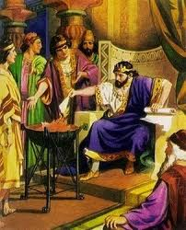
Next Class
Class 4: Jehoiakim - the King without a conscience

Slide 40

Enjoy reading Jeremiah!

Slide 42
2
S
G

Slide 43
2
S
G

Slide 44
Jeremiah 2
11
!

Slide 45
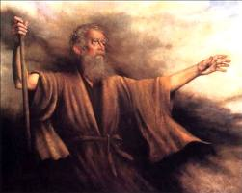
2
S
G

Slide 46
2
S
G

Slide 47
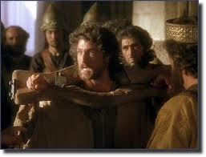
2
S
G

Slide 48
2
17
G

