Slide 1
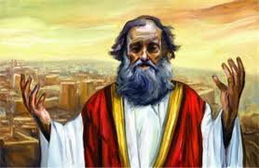
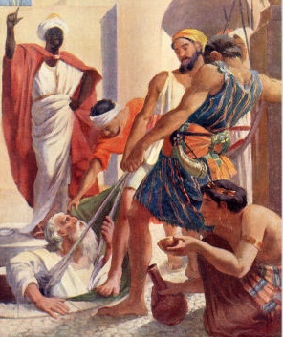
Jeremiah
Change before the end begins
Class 4: Jehoiakim - the King without a conscience

Slide 2
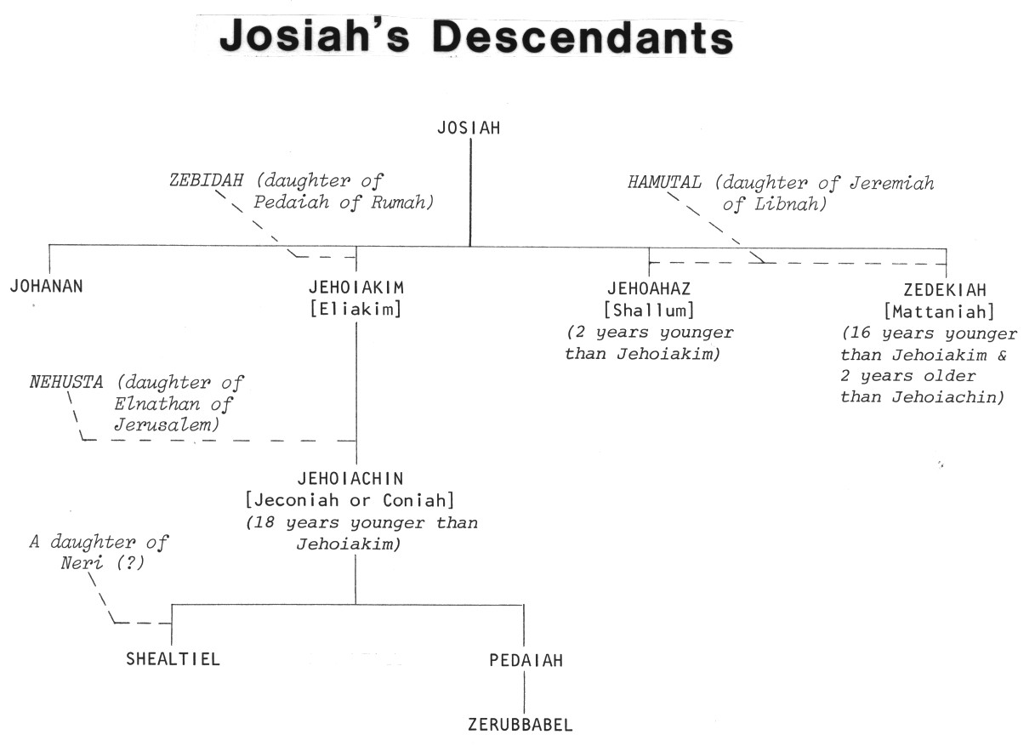
King Josiah’s Descendants
Josiah
2
1
4
3
Good King Josiah had no children who were like him!

Slide 3
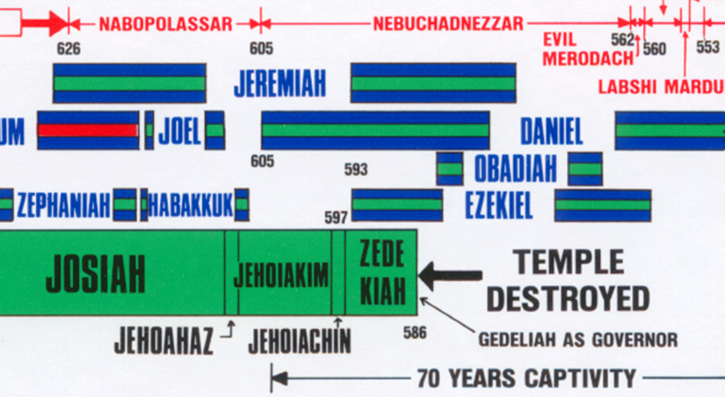
Jehoiakim in the Timeline
S
He only reigns 11 years

Slide 4
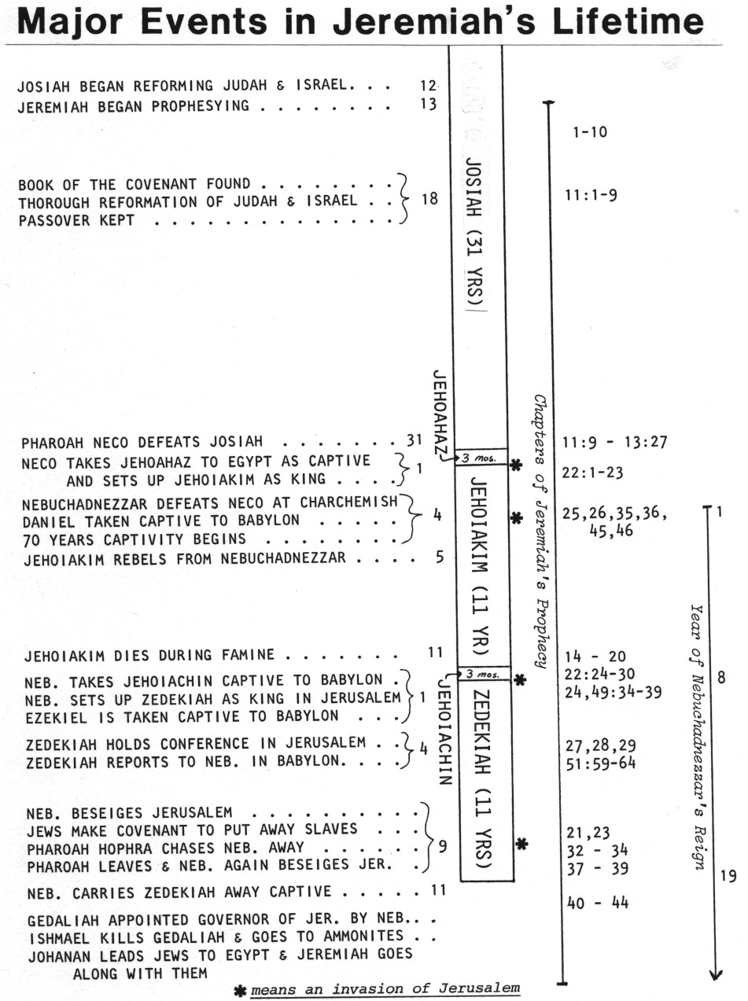
Focus on the reign of Jehoiakim
Many chapters are clumped around invasions

Slide 5
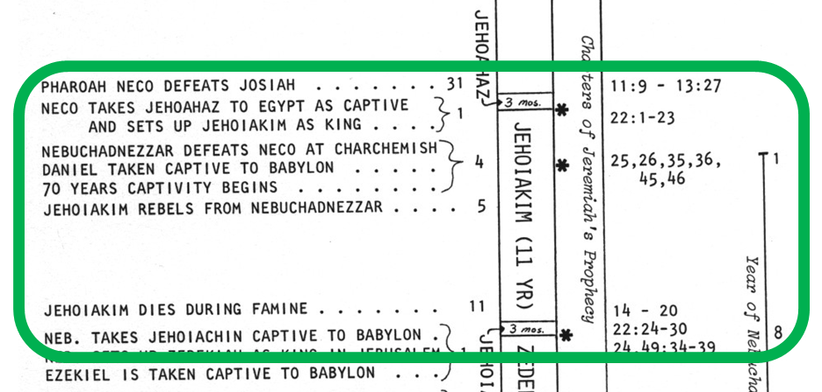
King Jehoiakim
Lots of changes during his reign

Slide 6

Jeremiah 26:1-5
1 In the beginning of the reign of Jehoiakim (probably 4th year) the son of Josiah, king of Judah, this word came from the LORD, saying,
2 "Thus says the LORD: 'Stand in the court of the LORD'S house, and speak to all the cities of Judah, which come to worship in the LORD'S house, all the words that I command you to speak to them. Do not diminish a word.
3 'Perhaps everyone will listen and turn from his evil way, that I may relent concerning the calamity which I purpose to bring on them because of the evil of their doings.'
4 "And you shall say to them, 'Thus says the LORD: "If you will not listen to Me, to walk in My law which I have set before you,
5 "to heed the words of My servants the prophets whom I sent to you, both rising up early and sending them (but you have not heeded),
6 "then I will make this house like Shiloh, and will make this city a curse to all the nations of the earth."'"
7 So the priests and the prophets and all the people heard Jeremiah speaking these words in the house of the LORD.
God was still willing to show mercy!

Slide 7
Jeremiah 26:8-11
8 Now it happened, when Jeremiah had made an end of speaking all that the LORD had commanded him to speak to all the people, that the priests and the prophets and all the people seized him, saying, "You will surely die!
9 "Why have you prophesied in the name of the LORD, saying, 'This house shall be like Shiloh, and this city shall be desolate, without an inhabitant'?" And all the people were gathered against Jeremiah in the house of the LORD.
10 When the princes of Judah heard these things, they came up from the king's house to the house of the LORD and sat down in the entry of the New Gate of the LORD'S house.
11 And the priests and the prophets spoke to the princes and all the people, saying, "This man deserves to die! For he has prophesied against this city, as you have heard with your ears.”
Court is in session!

Slide 8
Jeremiah 26:12-16
12 Then Jeremiah spoke (his defense!) to all the princes and all the people, saying: "The LORD sent me to prophesy against this house and against this city with all the words that you have heard.
13 "Now therefore, amend your ways and your doings, and obey the voice of the LORD your God; then the LORD will relent concerning the doom that He has pronounced against you.
14 "As for me, here I am, in your hand; do with me as seems good and proper to you.
15 "But know for certain that if you put me to death, you will surely bring innocent blood on yourselves, on this city, and on its inhabitants; for truly the LORD has sent me to you to speak all these words in your hearing.”
Jeremiah declared God’s message!

Slide 9
Jeremiah 26:16-19
16 So the princes and all the people said to the priests and the prophets, "This man does not deserve to die. For he has spoken to us in the name of the LORD our God."
17 Then certain of the elders of the land rose up and spoke to all the assembly of the people, saying:
18 "Micah of Moresheth prophesied in the days of Hezekiah king of Judah, and spoke to all the people of Judah, saying, 'Thus says the LORD of hosts: "Zion shall be plowed like a field, Jerusalem shall become heaps of ruins, and the mountain of the temple like the bare hills of the forest." '
19 "Did Hezekiah king of Judah and all Judah ever put him to death? Did he not fear the LORD and seek the LORD'S favor? And the Lord relented concerning the doom which He had pronounced against them. But we are doing great evil against ourselves.”
These people came to Jeremiah’s defense!

Slide 10
Micah 3 (in days of Hezekiah)
1 And I said: "Hear now, O heads of Jacob, and you rulers of the house of Israel: is it not for you to know justice?
2 You who hate good and love evil; who strip the skin from My people, and the flesh from their bones;
3 Who also eat the flesh of My people, Flay their skin from them, break their bones, and chop them in pieces like meat for the pot, like flesh in the caldron."
4 Then they will cry to the LORD, but He will not hear them; he will even hide His face from them at that time, because they have been evil in their deeds.
5 Thus says the LORD concerning the prophets who make my people stray; who chant "Peace" while they chew with their teeth, but who prepare war against him who puts nothing into their mouths:
This was about 110 years ago!

Slide 11
Micah 3:9-12
9 Now hear this, you heads of the house of Jacob and rulers of the house of Israel, who abhor justice and pervert all equity,
10 Who build up Zion with bloodshed and Jerusalem with iniquity:
11 Her heads judge for a bribe, her priests teach for pay, and her prophets divine for money. Yet they lean on the LORD, and say, "Is not the LORD among us? No harm can come upon us."
12 Therefore because of you Zion shall be plowed like a field, Jerusalem shall become heaps of ruins, and the mountain of the temple like the bare hills of the forest.
Micah influenced Hezekiah’s reformation!

Slide 12
Jeremiah 26:20-24
The Princes Case against Jeremiah:
20 Now there was also a man who prophesied in the name of the LORD, Urijah the son of Shemaiah of Kirjath Jearim, who prophesied against this city and against this land according to all the words of Jeremiah.
21 And when Jehoiakim the king, with all his mighty men and all the princes, heard his words, the king sought to put him to death; but when Urijah heard it, he was afraid and fled, and went to Egypt.
22 Then Jehoiakim (recent history) the king sent men to Egypt: Elnathan the son of Achbor, and other men who went with him to Egypt.
23 And they brought Urijah from Egypt and brought him to Jehoiakim the king, who killed him with the sword and cast his dead body into the graves of the common people.
24 Nevertheless the hand of Ahikam the son of Shaphan was with Jeremiah, so that they should not give him into the hand of the people to put him to death.
God rescued Jeremiah thru Ahikam

Slide 13
Jeremiah 36
1 Now it came to pass in the fourth year of Jehoiakim the son of Josiah, king of Judah, that this word came to Jeremiah from the LORD, saying:
2 "Take a scroll of a book and write on it all the words that I have spoken to you against Israel, against Judah, and against all the nations, from the day I spoke to you, from the days of Josiah even to this day.
3 "It may be that the house of Judah will hear all the adversities which I purpose to bring upon them, that everyone may turn from his evil way, that I may forgive their iniquity and their sin."
4 Then Jeremiah called Baruch the son of Neriah; and Baruch wrote on a scroll of a book, at the instruction of Jeremiah, all the words of the LORD which He had spoken to him.
5 And Jeremiah commanded Baruch, saying, "I am confined, I cannot go into the house of the LORD.
6 "You go, therefore, and read from the scroll which you have written at my instruction, the words of the LORD, in the hearing of the people in the LORD'S house on the day of fasting. And you shall also read them in the hearing of all Judah who come from their cities.
7 "It may be that they will present their supplication before the LORD, and everyone will turn from his evil way. For great is the anger and the fury that the LORD has pronounced against this people.”
8 And Baruch the son of Neriah did according to all that Jeremiah the prophet commanded him, reading from the book the words of the LORD in the LORD'S house.
Jeremiah was barred from the temple

Slide 14
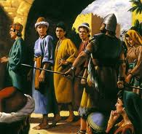
4th Year of Jehoiakim (Jer 36)
Nebuchadnezzar defeated Pharaoh at Carchemish
Nebuchadnezzar invaded Judah and Jerusalem “from the north”
He carried away captives (Dan 1:1)
Jeremiah’s prophecies were vindicated!
Jeremiah banned from the temple (36:5)
Good time to write and compile Jeremiah’s prophecies so far (36:2) – not as much risk they will be destroyed
13th of Josiah till 4th of Jehoiakim would be about 23 years. Jer 25:3 is also about the same year.
God hopes Jeremiah’s written prophecies might still influence the people. His mercy is still available!

Slide 15
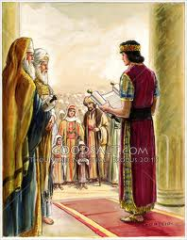
Reading God’s word might change the people
Jeremiah chose a fast day: hoping people would be in the mood for God’s word & hoping to reach a lot of people (v.6)
His credibility had increased because the Babylonians had come down from the north, as Jeremiah had predicted for years
Jeremiah hoped God’s word might change some people (like in Hezekiah’s & Josiah’s day), so Baruch copied the words (v.7-8)
Jeremiah’s hopes were up!

Slide 16
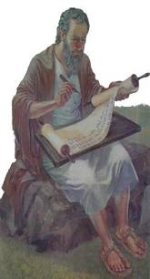
Baruch: Son of Neriah
Neriah is son of Mahseiah (Jer 32:12)
  Mahseiah is “keeper of the door” to temple
  might be same as Maaseiah governor of city 2 Chr 34:8
  Jer 52:24 – Nebuzaradan took door keepers, so they must have been a pretty high position
Baruch’s brother is Seraiah
  Jer 51:59 – Seraiah was quartermaster.
  He was responsible to ride with king each day and decide where to stop and spend the night

Slide 17
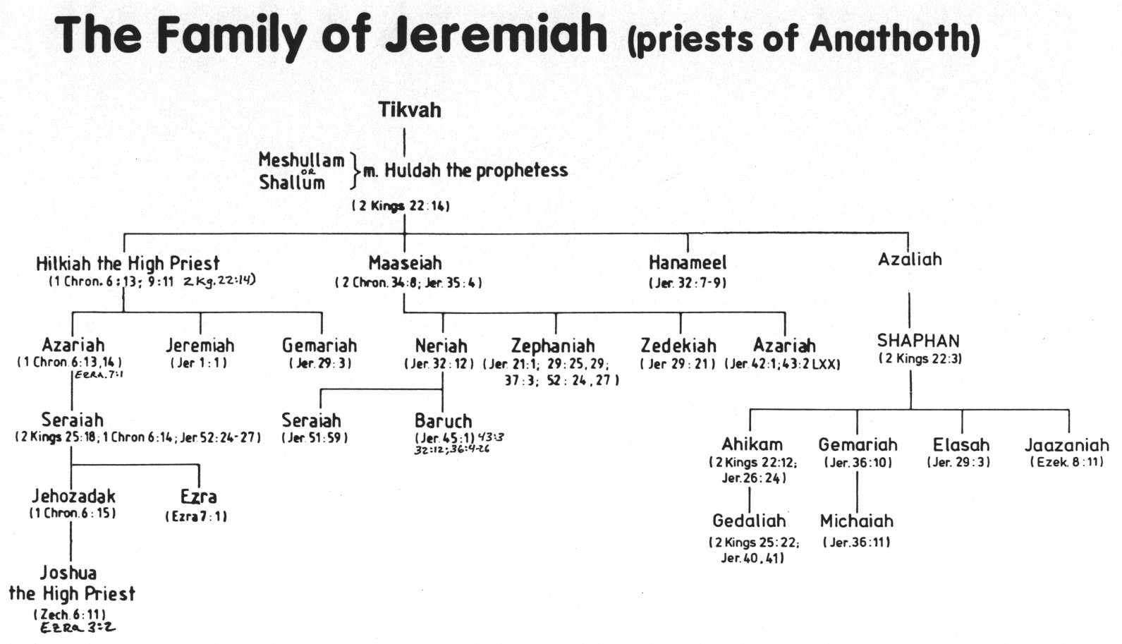
The Family of Jeremiah (priests of Anathoth)
Some family members supported Jeremiah
Baruch wrote many of Jeremiah’s prophecies.
Seraiah was quartermaster of Jerusalem & Baruch was his brother

Slide 18
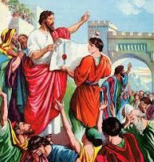
Baruch: Son of Neriah
Neriah is son of Mahseiah (Jer 32:12)
  Mahseiah is “keeper of the door” to temple
  [might be same as Maaseiah governor of city 2 Chr 34:8]
  Jer 52:24 – Nebuzaradan took door keepers, so they must have been a pretty high position
Baruch’s brother is Seraiah
  Jer 51:59 – Seraiah was quartermaster.
  He was responsible to ride with king each day and decide where to stop and spend the night
Baruch wrote out some of Jeremiah’s prophecies
Jeremiah asked Baruch to read the scroll in the temple because Jeremiah was barred from the temple, but not yet in prison
Baruch faithfully helped Jeremiah get God’s word out!

Slide 19
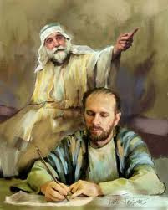
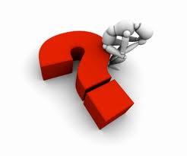
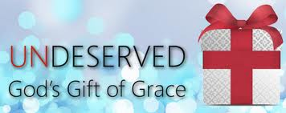
Baruch’s Depression (Jer 45)
Jeremiah’s dictation is all about the complete destruction of Jerusalem
Baruch realizes he will loose his lands, possessions, government position
God has to remind Baruch that God owns it all: He built & He planted (45:4)
It’s all God’s gifts to us!

Slide 20
Jeremiah 45:1-5
1 The word that Jeremiah the prophet spoke to Baruch the son of Neriah, when he had written these words in a book at the instruction of Jeremiah, in the fourth year of Jehoiakim the son of Josiah, king of Judah, saying,
2 "Thus says the LORD, the God of Israel, to you, O Baruch:
3 'You said, "Woe is me now! For the LORD has added grief to my sorrow. I fainted in my sighing, and I find no rest."'
4 "Thus you shall say to him, 'Thus says the LORD: "Behold, what I have built I will break down, and what I have planted I will pluck up, that is, this whole land.
5 "And do you seek great things for yourself? Do not seek them; for behold, I will bring adversity on all flesh," says the LORD. "But I will give your life to you as a prize in all places, wherever you go."‘”
Baruch became depressed because he was hoping for more!

Slide 21
Baruch’s Depression (Jer 45)
Jeremiah’s dictation is all about the complete destruction of Jerusalem
Baruch realizes he will loose his lands, possessions, government position
God has to remind Baruch that God owns it all: He built & He planted (45:4)
God spells it out for Baruch: It’s over! Don’t seek great things. Bad times are coming but you will be spared if your faith remains strong
I will give you your life as a prize

Slide 22
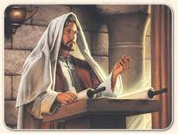
Baruch reads the scroll (Jer 36)
V. 9 Fast in 9th month (possibly same month Nebuchadnezzar invaded in 4th year) [v.9]
V.10 Baruch read the scroll in the temple (v.10)
V.11 Micaiah (grandson of Shaphan) hears the words & knows concerned princes will want to know the message
V. 14 Princes send Jehudi to get Baruch to read to them
V.16 Note: these princes respond with fear!
V.19 They care about Jeremiah’s & Baruch’s lives
V.20 They stored Jeremiah’s words with the Biblical scrolls in Elishama’s chamber. They were concerned about protecting God’s word.
Jeremiah probably got a little excited that maybe some people were ready to respond!

Slide 23
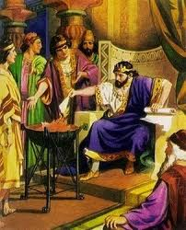
King Jehoiakim’s response to God’s prophecies
V.22 Jehudi reads the scroll to Jehoiakim & his princes (these were different princes)
V.23 Jehoiakim cuts up the Bible – no respect at all for God’s word
V.24 His princes didn’t care either – no repentance – no conscience!
The Bible can change our lives if we read it sincerely – not just to check off our readings! If we throw it in the fire, God cannot work with us anymore.

Slide 24
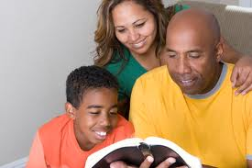
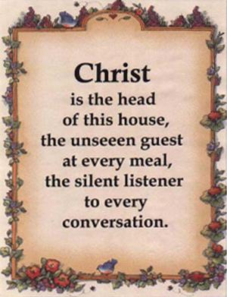
Make your Bible readings worthwhile and fun!

Slide 25
The Power of the Word
1 Thessalonians 2:13 (RSV)
And we also thank God constantly for this, that when you received the word of God which you heard from us, you accepted it not as the word of men but as what it really is, the word of God, which is at work in you believers.
The Word can change our lives

Slide 26
The Power of the Word
Psalm 119:9-11 (NASB)
9 How can a young man keep his way pure? By keeping it according to your word.
10 With all my heart I have sought you; do not let me wander from your commandments.
11 Your word I have treasured in my heart, that I may not sin against you.
The Word can protect us from Sin

Slide 27
The Power of the Word
I John 2:14
I have written to you, fathers, because you have known Him who is from the beginning. I have written to you, young men, because you are strong, and the word of God abides in you, and you have overcome the wicked one.
God’s word can dwell in our minds to help us live like our Father

Slide 28
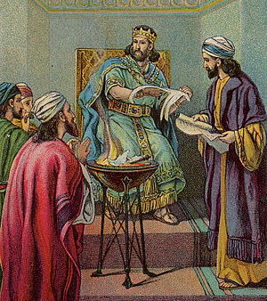
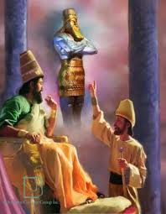
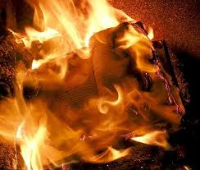
The unbelievable irony!
A gentile king was responding to God’s word in Babylon!
While the king of Judah was burning the Bible in Jerusalem
This would have been devastating to Jeremiah

Slide 29
Jeremiah 36:26-32
Jehoiakim wanted to get Jeremiah & Baruch
26 And the king commanded Jerahmeel the king's son, Seraiah the son of Azriel, and Shelemiah the son of Abdeel, to seize Baruch the scribe and Jeremiah the prophet, but the LORD hid them.
27 Now after the king had burned the scroll with the words which Baruch had written at the instruction of Jeremiah, the word of the LORD came to Jeremiah, saying:
28 "Take yet another scroll, and write on it all the former words that were in the first scroll which Jehoiakim the king of Judah has burned.
29 "And you shall say to Jehoiakim king of Judah, 'Thus says the LORD: "You have burned this scroll, saying, 'Why have you written in it that the king of Babylon will certainly come and destroy this land, and cause man and beast to cease from here?'"
30 'Therefore thus says the LORD concerning Jehoiakim king of Judah: "He shall have no one to sit on the throne of David (contrast Rechabites in 35:19) , and his dead body shall be cast out to the heat of the day and the frost of the night (why???)
31 "I will punish him, his family, and his servants for their iniquity; and I will bring on them, on the inhabitants of Jerusalem, and on the men of Judah all the doom that I have pronounced against them; but they did not heed."'"
32 Then Jeremiah took another scroll and gave it to Baruch the scribe, the son of Neriah, who wrote on it at the instruction of Jeremiah all the words of the book which Jehoiakim king of Judah had burned in the fire. And besides, there were added to them many similar words.
Why was Jehoiakim’s dead body cast out?

Slide 30
2 Chronicles 36:5-7
5 Jehoiakim was twenty-five years old when he became king, and he reigned eleven years in Jerusalem. And he did evil in the sight of the LORD his God.
6 Nebuchadnezzar king of Babylon came up against him (during his 4th year), and bound him in bronze fetters to carry him off to Babylon.
7 Nebuchadnezzar also carried off some of the articles from the house of the LORD to Babylon, and put them in his temple at Babylon.
Either Jehoiakim never went to Babylon, or he didn’t stay there very long

Slide 31
Nebuchadnezzar invaded during Jehoiakim’s 4th year
But Jehoiakim stayed on as king till his 11th year

Slide 32
Jeremiah 22:13-19
More about Jehoiakim
13 "Woe to him who builds his house by unrighteousness and his chambers by injustice, who uses his neighbor's service without wages and gives him nothing for his work,
14 Who says, 'I will build myself a wide house with spacious chambers, and cut out windows for it, Paneling it with cedar and painting it with vermilion.'
15 "Shall you reign because you enclose yourself in cedar? Did not your father eat and drink, and do justice and righteousness? Then it was well with him.
16 He judged the cause of the poor and needy; then it was well. Was not this knowing Me?" says the LORD.
17 "Yet your eyes and your heart are for nothing but your covetousness, for shedding innocent blood, and practicing oppression and violence."
18 Therefore thus says the LORD concerning Jehoiakim the son of Josiah, king of Judah: "They shall not lament for him, saying, 'Alas, my brother!' or 'Alas, my sister!' They shall not lament for him, saying, 'Alas, master!' or 'Alas, his glory!‘ (no one cared)
19 He shall be buried with the burial of a donkey, dragged and cast out beyond the gates of Jerusalem.
A fitting end for a rotten king!

Slide 33
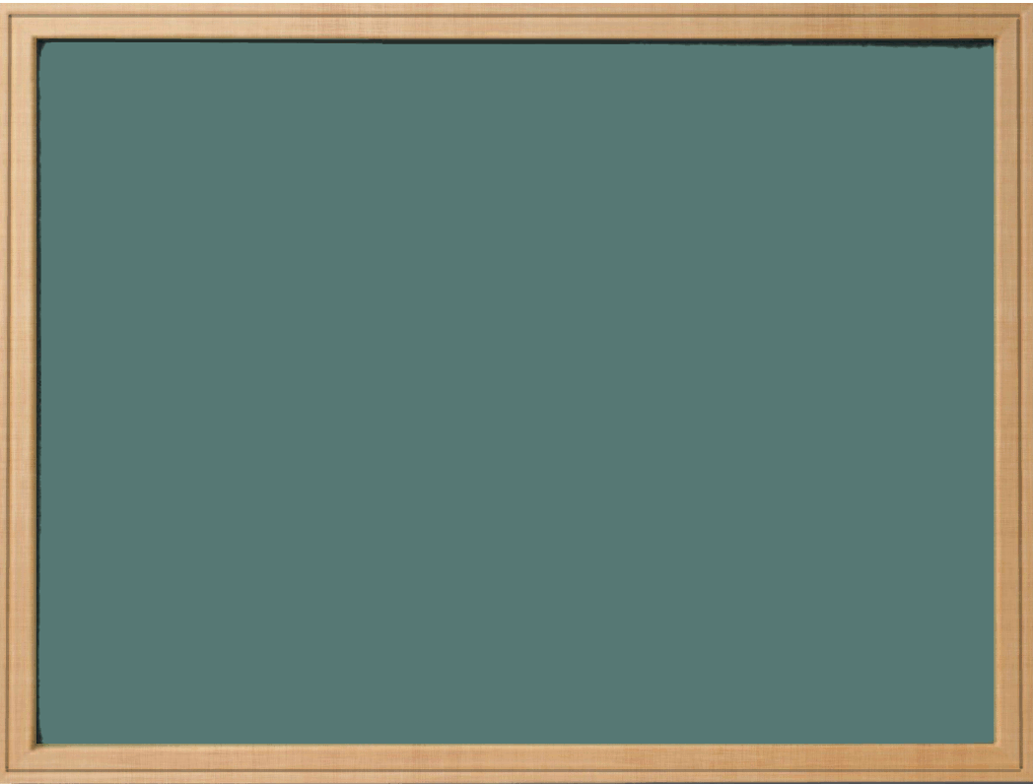
Lessons from Jehoiakim
Even if we have good parents, their characters may not rub off on us.
Don’t put our personal desires over the good of our family/ecclesia – we serve them, not they serve us!
Respect God’s word & respond to it when we read it every day
Pick good friends and spend time with others who respect God’s word
Poor choices we make may not only affect ourselves, but our family and ecclesia

Slide 34
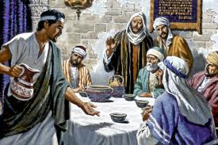
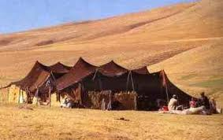

Next: Exhort!
Exhort The Rechabites: Obeying your Father

Slide 36
2
S
G

Slide 37
2
17
G

