Slide 1
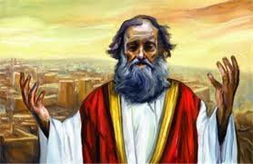
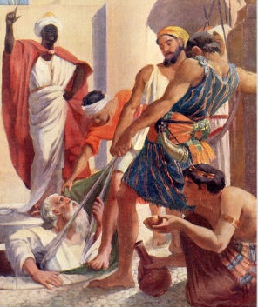
Jeremiah
Change before the end begins
Class 5: The Rechabites: a lesson in faithfulness

Slide 2

Setting of Jer 35: Contrasts!
Jer 31 – God will make a new covenant (v.31-33)
Jer 32 – Jeremiah redeems field in Anathoth, God promises to keep his covenant to redeem Israel (v. 40)
Jer 33 – God will keep his covenant with His people
Jews will return from captivity (vs.20,21,25)
Jer 34 – Zedekiah broke his covenant to free Hebrew slaves.
During 9th yr of Zedekiah. Egyptians came up, Babylonians temporarily left.
God will punish people who transgressed His covenant (note v.18)
Jer 35 – Faithful Rechabites obeyed their Father’s command.
Jer 36 – Jehoiakim burned scroll during 5th year
No respect for God’s word – cut it up!
He & wife (Nehusta) built own house with slave labor
Jer 22:13-18 Contrasts Jehoiakim with Josiah.
Lesson: Neither Jehoiakim nor Zedekiah were faithful to their Father (Josiah). They did not keep Father’s covenant. Josiah repented & responded when Book of the Law was found. Jehoiakim & Zedekiah did not.
Israel has changed their God (Jer 2:9-11)

Slide 3

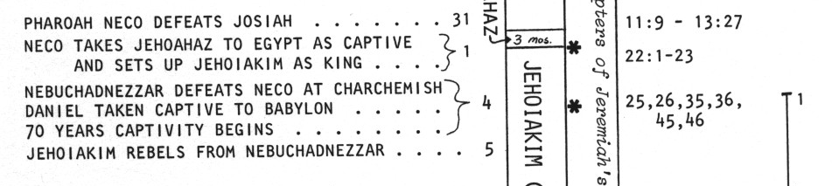
Time Period of Jeremiah 35
Jer 35:11 Syrians & Chaldeans (7th of Jehoiakim)
  2 Kg 24:1-2 Bands of Syrians
  4th year of Jehoiakim: Nebuchadnezzar came against Jerusalem (Dan 1:1; Jer 25:1; 46:2)
  7th year of Jehoiakim – Jehoiakim rebelled
Rechabites = Kenites = faithful Gentiles
  Spanned all the years of Israel
  From 1st year of Exodus to the captivity
  Even after captivity!
1 In his days Nebuchadnezzar king of Babylon came up, and Jehoiakim became his vassal for three years. Then he turned and rebelled against him.
2 And the LORD sent against him raiding bands of Chaldeans, bands of Syrians, bands of Moabites, and bands of the people of Ammon; He sent them against Judah to destroy it, according to the word of the LORD which He had spoken by His servants the prophets.
G

Slide 4
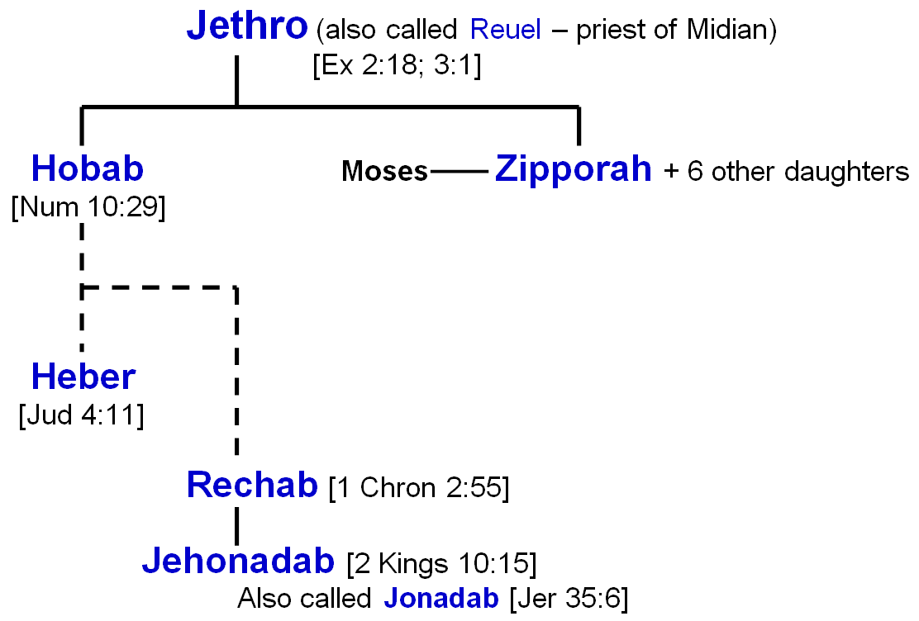
The Family of the Rechabites
S
G

Slide 5
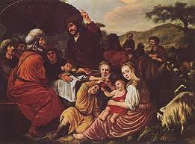
Tracing the Rechabites
Also called Kenites. They are Gentiles!
Ex 2:18 Moses meets Reuel (a title), priest of Midian
Ex 3:1 Reuel’s name is Jethro
Ex 18 Jethro brings Zipporah & 2 sons to meet Moses, & he rejoices in Yahweh’s victory over Egypt. Jethro offers sacrifices & has fellowship meal with Moses, Aaron & elders of Israel. Jethro gives Moses advice about dividing up the work of judging the people
Num 10:29 Moses asks Hobab (Moses’ brother-in-law) to travel with Jews. He doesn’t want to go, so Moses pleads…you can help navigate! You will be our eyes. God’s goodness to Israel is extended to Hobab’s family (like Rahab) – In Num 10 we aren’t sure if Hobab actually went!
Jud 1:16 Indicates Hobab did go! Children of Kenites went up with Judah.
Jud 4:11 Heber lost his family values & went out on his own. Jael maintained her family values & kept the faith. Here’s a believer forced into isolation who maintains her faith!
1 Sam 15:6 Saul lets Kenites move from Amalakites before he attacks, because Kenites helped Israel when they came out of Egypt
Gentiles who taught Israel about faithfulness to their Father

Slide 6
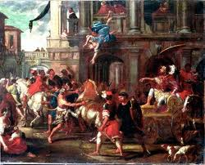
Tracing the Rechabites
1 Chr 2:55 Rechab’s family included with Judah
2 Kgs 9:16 Jehu chosen to eliminate Ahab’s house. He kills Joram (king of Israel), Ahaziah (King of Judah) & Jezebel.
2 Kgs 10 Jehu intimidates rulers of Samaria to kill 70 of Ahab’s male descendants (not really all Ahab’s sons). Then he kills the rest of Ahab’s house in Jezreel (v.11), then kills 42 kinsmen of Ahaziah (king of Judah) on the way to Samaria. Then he picks up Jehonadab to help him finish off Ahab’s house.
2 Kgs 10:15 1st mention of Jehonadab (same as Jonadab). Over 200 years before Jeremiah 35. Once in Samaria, kills all Ahab’s family, then gathers & kills all worshippers of Baal. Note v. 28-29 Jehu Destroyed Baal, but did not turn from golden calves at Bethel & Dan.
Contrasting Jehu & Jonadab
Jehu liked to fight for God, but didn’t want to live for Him. He never internalized the war to fight against his own evil desires
Jonadab saw evils of Ahab & Jezebel, & downfall of Jehu. He designed his principles to prevent him & his family from being lost!
Jonadab planned for the future for his family!

Slide 7
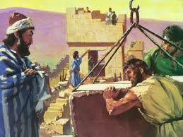
Tracing the Rechabites
Jer 35 The Example of the Rechabites!
Still around after the captivity & involved in the work
Neh 3:14 Malchijah the son of Rechab, leader of the district of Beth Haccerem, repaired the Refuse Gate (willing to take on the worst of jobs) – he built it & hung its doors with its bolts & bars
This family obeyed their Father & kept his commands over hundred of years!

Slide 8
Jeremiah 35:1-5
1 The word which came to Jeremiah from the LORD in the days of Jehoiakim the son of Josiah, king of Judah, saying,
2 "Go to the house of the Rechabites, speak to them, and bring them into the house of the LORD, into one of the chambers, and give them wine to drink."
3 Then I took Jaazaniah the son of Jeremiah, the son of Habazziniah, his brothers and all his sons, and the whole house of the Rechabites,
4 and I brought them into the house of the LORD, into the chamber of the sons of Hanan the son of Igdaliah, a man of God, which was by the chamber of the princes, above the chamber of Maaseiah the son of Shallum, the keeper of the door.
5 Then I set before the sons of the house of the Rechabites bowls full of wine, and cups; and I said to them, "Drink wine.”
The test of Rechab’s family

Slide 9
Jeremiah 35:6-11
6 But they said, "We will drink no wine, for Jonadab the son of Rechab, our father, commanded us, saying, 'You shall drink no wine, you nor your sons, forever.
7 'You shall not build a house, sow seed, plant a vineyard, nor have any of these; but all your days you shall dwell in tents, that you may live many days in the land where you are sojourners.'
8 "Thus we have obeyed the voice of Jonadab the son of Rechab, our father, in all that he charged us, to drink no wine all our days, we, our wives, our sons, or our daughters,
9 "nor to build ourselves houses to dwell in; nor do we have vineyard, field, or seed.
10 "But we have dwelt in tents, and have obeyed and done according to all that Jonadab our father commanded us.
11 "But it came to pass, when Nebuchadnezzar king of Babylon came up into the land, that we said, 'Come, let us go to Jerusalem for fear of the army of the Chaldeans and for fear of the army of the Syrians.' So we dwell at Jerusalem.”
Faithful obedience to their Father’s commands!

Slide 10

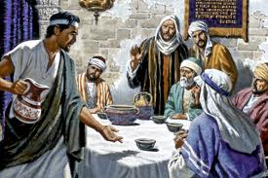
Tracing the Rechabites
Jer 35 The Example of the Rechabites!
Brings Rechabites into temple chamber
Many important people gathered
Rechabites were out of their normal environment
Lots of pressure to conform!
Jonadab’s family Values: designed to counter Ahab/Jezebel policies! Still in use in Jeremiah’s day.
1) No alcohol: keep sober, make thoughtful decisions, be responsible!
2) Live in tents: stay away from evils of city life (big groups of people)
3) No farming of crops: be always aware of our dependence on God to provide
Reason: “that you may live many days in the land” [echo of 5th commandment “honor your Father & Mother, that your days may be long upon the land” – a commandment with promise!
Result: Rechabites refuse to change their family values. They still obey their ancestor's command from over 200 years ago!
Good Family Values can help us in living for God

Slide 11
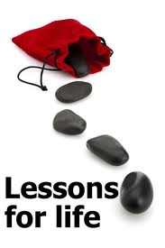
Lessons from the Rechabites
Keep God’s family values even when at school, work, business trips – when there’s pressure to change our family values & conform
Rechabites were not ashamed to admit loyalty to their family values & commitment to their Father’s principles!
They still kept their dead Father’s commandments – even when he couldn’t see them anymore!
Israel would not keep their living God’s commandments, even when He sees everything & His angels are all around to help us every day!
God highly values faithfulness to our covenant with Him!

Slide 12

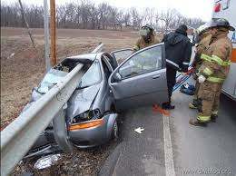
Why did Jonadab forbid the drinking of Alcoholic beverages?
Alcohol is deceitful: it affects our judgment & self-control. It can free the devil inside us to momentarily take over!
Noah – after faithfulness in building ark and enduring flood, alcohol influenced him to be involved with the shameful incident with Ham and led to the curse of Canaan
Lot – after surviving the evils of Sodom and being rescued, alcohol removed his inhibitions and he made his own 2 daughters pregnant & had 2 sons, Moab and Ammon, by his own daughters

Slide 13
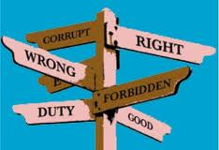
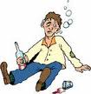
Why did Jonadab forbid the drinking of Alcoholic beverages?
Alcohol is deceitful: it affects our judgment & self-control. It can free the devil inside us to momentarily take over!
Nadab & Abihu – After going thru 7 days of separation to God so they could become priests for the Jewish nation, alcohol ruined their decision-making process and they offered profane fire in their censers, so God struck them dead on the first day they should have served as priests!
Lev 10:8-11 God gave rule to priests – Don’t drink alcohol when you serve in tabernacle! Must distinguish between clean and unclean!
1 Cor 6:9-11 Note the warning of being deceived. Drunkards will not be in God’s kingdom!

Slide 14
1 Corinthians 6:9-11
9 Do you not know that the unrighteous will not inherit the kingdom of God? Do not be deceived. Neither fornicators, nor idolaters, nor adulterers, nor homosexuals, nor sodomites,
10 nor thieves, nor covetous, nor drunkards, nor revilers, nor extortioners will inherit the kingdom of God.
11 And such were some of you. But you were washed, but you were sanctified, but you were justified in the name of the Lord Jesus and by the Spirit of our God.
Watch your alcohol intake… drunkards will not be in God’s kingdom

Slide 15
1 Timothy 5:23
23 No longer drink only water, but use a little wine for your stomach's sake and your frequent infirmities.
A little wine for our health’s sake is good, but excess leads to sin. We have so many choices for beverages today! Don’t deceive yourself or lead others astray with excessive use of alcohol.

Slide 16
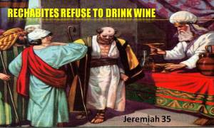
The Rechabite lesson is not just about alcohol & houses
Rechabites remind us to set up family standards which encourage a Godly life & help us all “keep unspotted by the world” (James 1:27)
Rechabites faithfully keep the family values even when under pressure to conform
Godly standards don’t make you righteous, but they do provide a great environment for God’s character to develop in us
Lets make sure we establish sound Godly standards in our families when we go home!

Slide 17
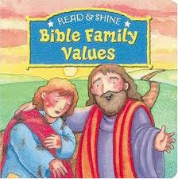

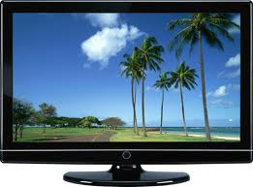
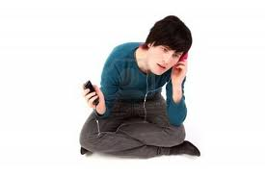
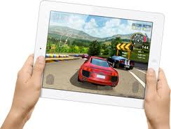
Major Family Values (Good Habits) Impact our spiritual lives
Do daily Bible reading and/or study
Pray daily – maybe at set times
Choose to live close to other Godly families
Seek a marriage partner in God’s family
Attend Sunday meetings, Bible classes, CYCs
May also involved setting standards about:
Alcoholic beverages
TV programs
Music
Friends
Movies
Internet

Slide 18

Lessons to think about and take home:
Try to develop some Family Values for yourself and your family that are appropriate for the challenges of our day
Appreciate our Family Values & Godly Standards we may have inherited
Don’t be afraid to stand up for Godly Standards when under pressure
Talk to each other and our children about why we have these standards and how they can help us live Godly lives
Remember our Father is a living God. He and His heavenly family are watching each day to see if we keep His commands
God highly values faithfulness & we have the opportunity to practice this in our daily lives every day
Godly Family Values will really improve your life!

Slide 19
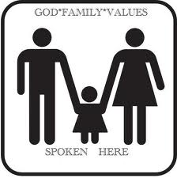
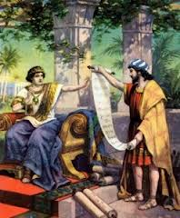
Jeremiah
Change before the end begins
Shaphan’s Family Values

Slide 20
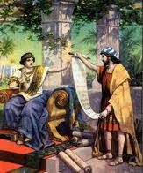
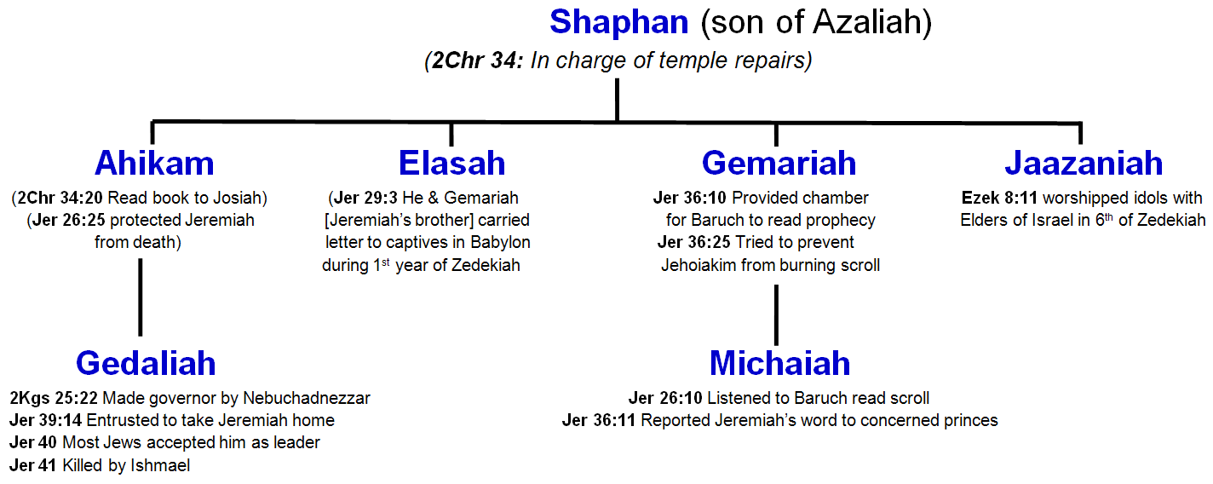
Shaphan’s Family
We will tackle them in chronological order
1
2
4
3
5
6
3
Sequence
Shaphan – Josiah’s day Ahikam – Josiah & Jehoiakim
Gemariah & Michaiah – 5th of Jehoiakim
Elasah – 1st of Zedekiah Jaazaniah – 6th of Zedekiah
Gedaliah – 11th of Zedekiah

Slide 21
Shaphan’s Family
1
2
4
3
5
6
3
Shaphan raised Godly children & grandchildren during a tough spiritual time

Slide 22
2 Chronicles 34:8-13
8 Now in the eighteenth year of his (Josiah’s) reign, when he had purged the land and the temple, he sent Shaphan the son of Azaliah, Maaseiah the governor of the city, and Joah the son of Joahaz the recorder, to repair the house of the LORD his God.
9 When they came to Hilkiah the high priest, they delivered the money that was brought into the house of God, which the Levites who kept the doors had gathered from the hand of Manasseh and Ephraim, from all the remnant of Israel, from all Judah and Benjamin, and which they had brought back to Jerusalem.
10 Then they put it in the hand of the foremen who had the oversight of the house of the LORD; and they gave it to the workmen who worked in the house of the LORD, to repair and restore the house.
11 They gave it to the craftsmen and builders to buy hewn stone and timber for beams, and to floor the houses which the kings of Judah had destroyed.
12 And the men did the work faithfully. Their overseers were Jahath and Obadiah the Levites, of the sons of Merari, and Zechariah and Meshullam, of the sons of the Kohathites, to supervise. Others of the Levites, all of whom were skillful with instruments of music,
13 were over the burden bearers and were overseers of all who did work in any kind of service. And some of the Levites were scribes, officers, and gatekeepers.
Worked with responsible people

Slide 23
2 Chronicles 34:15-21
15 Then Hilkiah answered and said to Shaphan the scribe, "I have found the Book of the Law in the house of the LORD." And Hilkiah gave the book to Shaphan.
16 So Shaphan carried the book to the king, bringing the king word, saying, "All that was committed to your servants they are doing.
17 "And they have gathered the money that was found in the house of the LORD, and have delivered it into the hand of the overseers and the workmen."
18 Then Shaphan the scribe told the king, saying, "Hilkiah the priest has given me a book." And Shaphan read it before the king.
19 Thus it happened, when the king heard the words of the Law, that he tore his clothes.
20 Then the king commanded Hilkiah, Ahikam the son of Shaphan, Abdon the son of Micah, Shaphan the scribe, and Asaiah a servant of the king, saying,
21 "Go, inquire of the LORD for me, and for those who are left in Israel and Judah, concerning the words of the book that is found; for great is the wrath of the LORD that is poured out on us, because our fathers have not kept the word of the LORD, to do according to all that is written in this book.”
Josiah trusted Shaphan

Slide 24
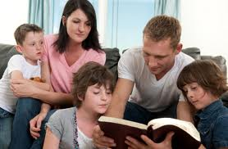
Shaphan’s Spiritual Values
Shaphan was a Godly man who was trusted by the King
He developed trust with the temple workers
He highly respected the word of God
He had Godly children
Now look at the impact he had on his sons!

Slide 25
Shaphan’s Family
1
2
4
3
5
6
3
Shaphan – Josiah’s day Ahikam – Josiah & Jehoiakim
Gemariah & Michaiah – 5th of Jehoiakim
Elasah – 1st of Zedekiah Jaazaniah – 6th of Zedekiah
Gedaliah – 11th of Zedekiah

Slide 26
2 Chronicles 34:18-27
18 Then Shaphan the scribe told the king, saying, "Hilkiah the priest has given me a book." And Shaphan read it before the king.
19 Thus it happened, when the king heard the words of the Law, that he tore his clothes.
20 Then the king commanded Hilkiah, Ahikam the son of Shaphan, Abdon the son of Micah, Shaphan the scribe, and Asaiah a servant of the king, saying,
21 "Go, inquire of the LORD for me, and for those who are left in Israel and Judah, concerning the words of the book that is found; for great is the wrath of the LORD that is poured out on us, because our fathers have not kept the word of the LORD, to do according to all that is written in this book."
22 So Hilkiah and those the king had appointed went to Huldah the prophetess, the wife of Shallum the son of Tokhath, the son of Hasrah, keeper of the wardrobe. (She dwelt in Jerusalem in the Second Quarter.) And they spoke to her to that effect.
Josiah entrusted Ahikam to inquire of God for him!

Slide 27
2 Chronicles 34:18-27
23 Then she answered them, "Thus says the LORD God of Israel, 'Tell the man who sent you to Me,
24 "Thus says the LORD: 'Behold, I will bring calamity on this place and on its inhabitants, all the curses that are written in the book which they have read before the king of Judah,
25 'because they have forsaken Me and burned incense to other gods, that they might provoke Me to anger with all the works of their hands. Therefore My wrath will be poured out on this place, and not be quenched.'"'
26 "But as for the king of Judah, who sent you to inquire of the LORD, in this manner you shall speak to him, 'Thus says the LORD God of Israel: "Concerning the words which you have heard--
27 "because your heart was tender, and you humbled yourself before God when you heard His words against this place and against its inhabitants, and you humbled yourself before Me, and you tore your clothes and wept before Me, I also have heard you," says the LORD.
Who do You think “the man” was?

Slide 28
Jeremiah 26
20 Now there was also a man who prophesied in the name of the LORD, Urijah the son of Shemaiah of Kirjath Jearim, who prophesied against this city and against this land according to all the words of Jeremiah.
21 And when Jehoiakim the king, with all his mighty men and all the princes, heard his words, the king sought to put him to death; but when Urijah heard it, he was afraid and fled, and went to Egypt.
22 Then Jehoiakim the king sent men to Egypt: Elnathan the son of Achbor, and other men who went with him to Egypt.
23 And they brought Urijah from Egypt and brought him to Jehoiakim the king, who killed him with the sword and cast his dead body into the graves of the common people.
24 Nevertheless the hand of Ahikam the son of Shaphan was with Jeremiah, so that they should not give him into the hand of the people to put him to death.
Ahikam saved Jeremiah’s life!
He must have had a lot of influence!

Slide 29
Shaphan’s Family
1
2
4
3
5
6
3
Shaphan – Josiah’s day Ahikam – Josiah & Jehoiakim
Gemariah & Michaiah – 5th of Jehoiakim
Elasah – 1st of Zedekiah Jaazaniah – 6th of Zedekiah
Gedaliah – 11th of Zedekiah

Slide 30
Jeremiah 36:10-13, 25
10 Then Baruch read from the book the words of Jeremiah in the house of the LORD, in the chamber of Gemariah the son of Shaphan the scribe, in the upper court at the entry of the New Gate of the LORD'S house, in the hearing of all the people.
11 When Michaiah the son of Gemariah, the son of Shaphan, heard all the words of the LORD from the book,
12 he then went down to the king's house, into the scribe's chamber; and there all the princes were sitting-- Elishama the scribe, Delaiah the son of Shemaiah, Elnathan the son of Achbor, Gemariah the son of Shaphan, Zedekiah the son of Hananiah, and all the princes.
13 Then Michaiah declared to them all the words that he had heard when Baruch read the book in the hearing of the people.
25 Nevertheless Elnathan, Delaiah, and Gemariah implored the king not to burn the scroll; but he would not listen to them.
3 Generations of faithful service!

Slide 31
Shaphan’s Family
1
2
4
3
5
6
3
Shaphan – Josiah’s day Ahikam – Josiah & Jehoiakim
Gemariah & Michaiah – 5th of Jehoiakim
Elasah – 1st of Zedekiah Jaazaniah – 6th of Zedekiah
Gedaliah – 11th of Zedekiah

Slide 32
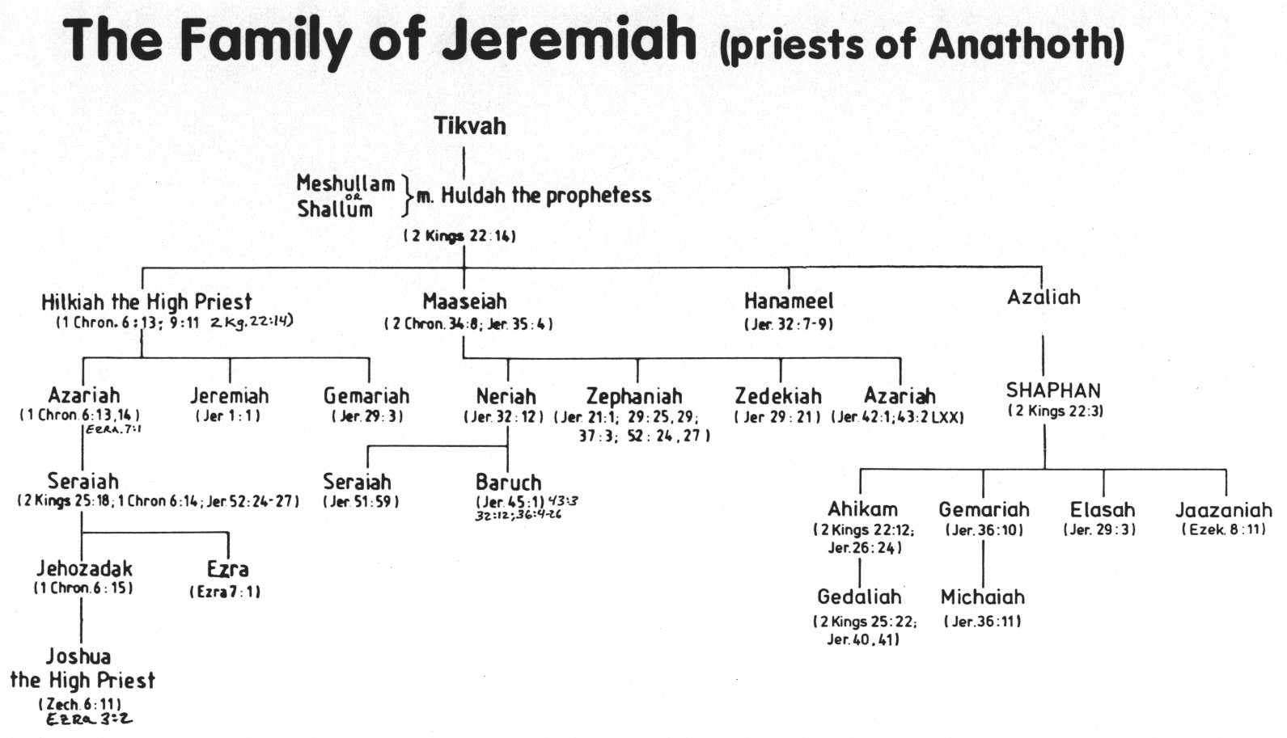
The Family of Jeremiah (priests of Anathoth)
Some family members supported Jeremiah
Gemariah may also have supported Jeremiah

Slide 33
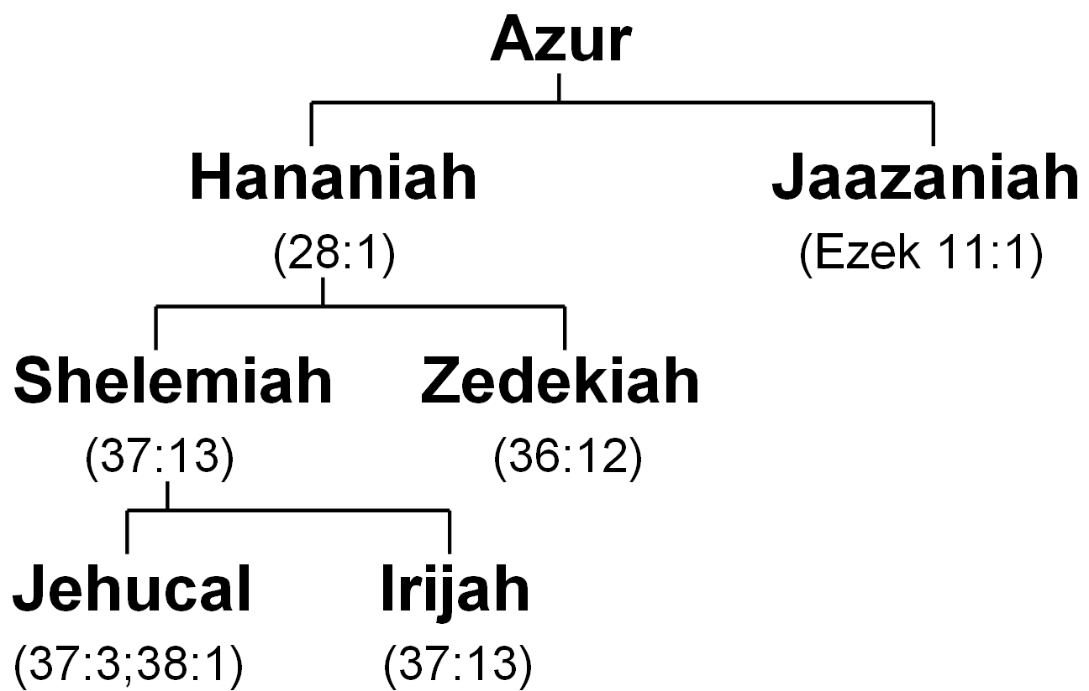
Some False Prophets Jeremiah dealt with
S
False prophets in Jerusalem and Babylon were teaching that the captivity would be over soon & everyone would return!
G

Slide 34
Jeremiah 28
False prophets were fooling many!
1 And it happened in the same year, at the beginning of the reign of Zedekiah king of Judah, in the fourth year and in the fifth month [Zedekiah held a conference in Jerusalem earlier this year to gather support to rebel against Babylon! (27:3)], that Hananiah the son of Azur the prophet, who was from Gibeon, spoke to me in the house of the LORD in the presence of the priests and of all the people, saying,
2 "Thus speaks the LORD of hosts, the God of Israel, saying: 'I have broken the yoke of the king of Babylon.
3 'Within two full years I will bring back to this place all the vessels of the LORD'S house, that Nebuchadnezzar king of Babylon took away from this place and carried to Babylon.
4 'And I will bring back to this place Jeconiah (Jehoiachin) the son of Jehoiakim, king of Judah, with all the captives of Judah who went to Babylon,' says the LORD, 'for I will break the yoke of the king of Babylon.‘“
False prophets were predicting a quick return!

Slide 35
Jeremiah 28
False prophets were fooling many!
5 Then the prophet Jeremiah spoke to the prophet Hananiah in the presence of the priests and in the presence of all the people who stood in the house of the LORD,
6 and the prophet Jeremiah said, "Amen! The LORD do so; the LORD perform your words which you have prophesied, to bring back the vessels of the LORD'S house and all who were carried away captive, from Babylon to this place.
7 "Nevertheless hear now this word that I speak in your hearing and in the hearing of all the people:
8 "The prophets who have been before me and before you of old prophesied against many countries and great kingdoms-- of war and disaster and pestilence.
9 "As for the prophet who prophesies of peace, when the word of the prophet comes to pass, the prophet will be known as one whom the LORD has truly sent.”
Jeremiah had to stand up to the false prophets!

Slide 36
Jeremiah 28
False prophets were fooling many!
10 Then Hananiah the prophet took the yoke off the prophet Jeremiah's neck and broke it. (Jeremiah wore to yoke to display Israel’s bondage to Babylon!)
11 And Hananiah spoke in the presence of all the people, saying, "Thus says the LORD: 'Even so I will break the yoke of Nebuchadnezzar king of Babylon from the neck of all nations within the space of two full years.'" And the prophet Jeremiah went his way. [didn’t argue, yell, push – just let God handle it!]
12 Then the word of the LORD came to Jeremiah, after Hananiah the prophet had broken the yoke from the neck of the prophet Jeremiah, saying,
13 "Go and tell Hananiah, saying, 'Thus says the LORD: "You have broken the yokes of wood, but you have made in their place yokes of iron."
14 'For thus says the LORD of hosts, the God of Israel: "I have put a yoke of iron on the neck of all these nations, that they may serve Nebuchadnezzar king of Babylon; and they shall serve him. I have given him the beasts of the field also."'"
15 Then the prophet Jeremiah said to Hananiah the prophet, "Hear now, Hananiah, the LORD has not sent you, but you make this people trust in a lie.
16 "Therefore thus says the LORD: 'Behold, I will cast you from the face of the earth. This year you shall die, because you have taught rebellion against the LORD.'"
17 So Hananiah the prophet died the same year in the seventh month.
This should have warned false prophets not to disagree with Jeremiah!

Slide 37
The Family of Jeremiah (priests of Anathoth)
Some family members supported Jeremiah
Back to Elasah & Gemariah

Slide 38
Jeremiah 29
1 Now these are the words of the letter that Jeremiah the prophet sent from Jerusalem to the remainder of the elders who were carried away captive-- to the priests, the prophets, and all the people whom Nebuchadnezzar had carried away captive from Jerusalem to Babylon.
2 (This happened after Jeconiah the king, the queen mother, the eunuchs, the princes of Judah and Jerusalem, the craftsmen, and the smiths had departed from Jerusalem.) [so, early in Jehoiakim’s reign]
3 The letter was sent by the hand of Elasah the son of Shaphan, and Gemariah (Jeremiah’s brother!) the son of Hilkiah, whom Zedekiah king of Judah sent to Babylon, to Nebuchadnezzar king of Babylon, saying,
4 Thus says the LORD of hosts, the God of Israel, to all who were carried away captive, whom I have caused to be carried away from Jerusalem to Babylon:
5 Build houses and dwell in them; plant gardens and eat their fruit.
6 Take wives and beget sons and daughters; and take wives for your sons and give your daughters to husbands, so that they may bear sons and daughters-- that you may be increased there, and not diminished.
This was a controversial letter!

Slide 39
Jeremiah 29
7 And seek the peace of the city where I have caused you to be carried away captive, and pray to the LORD for it; for in its peace you will have peace.
8 For thus says the LORD of hosts, the God of Israel: Do not let your prophets and your diviners who are in your midst deceive you, nor listen to your dreams which you cause to be dreamed.
9 For they prophesy falsely to you in My name; I have not sent them, says the LORD.
10 For thus says the LORD: After seventy years are completed at Babylon, I will visit you and perform My good word toward you, and cause you to return to this place.
11 For I know the thoughts that I think toward you, says the LORD, thoughts of peace and not of evil, to give you a future and a hope.
Jeremiah entrusted Elasah & Gemariah (Jeremiah’s bother) to deliver this message!

Slide 40
Jeremiah 29
15 Because you have said, "The LORD has raised up prophets for us in Babylon"--
16 therefore thus says the LORD concerning the king who sits on the throne of David, concerning all the people who dwell in this city, and concerning your brethren who have not gone out with you into captivity--
17 thus says the LORD of hosts: Behold, I will send on them the sword, the famine, and the pestilence, and will make them like rotten figs that cannot be eaten, they are so bad.
18 And I will pursue them with the sword, with famine, and with pestilence; and I will deliver them to trouble among all the kingdoms of the earth-- to be a curse, an astonishment, a hissing, and a reproach among all the nations where I have driven them,
19 because they have not heeded My words, says the LORD, which I sent to them by My servants the prophets, rising up early and sending them; neither would you heed, says the LORD.
20 Therefore hear the word of the LORD, all you of the captivity, whom I have sent from Jerusalem to Babylon.
21 Thus says the LORD of hosts, the God of Israel, concerning Ahab the son of Kolaiah, and Zedekiah the son of Maaseiah, who prophesy a lie to you in My name: Behold, I will deliver them into the hand of Nebuchadnezzar king of Babylon, and he shall slay them before your eyes.
22 And because of them a curse shall be taken up by all the captivity of Judah who are in Babylon, saying, "The LORD make you like Zedekiah and Ahab, whom the king of Babylon roasted in the fire";
23 because they have done disgraceful things in Israel, have committed adultery with their neighbors' wives, and have spoken lying words in My name, which I have not commanded them. Indeed I know, and am a witness, says the LORD.
The people were given proof that Jeremiah’s message was of God

Slide 41
Jeremiah 29
24 You shall also speak to Shemaiah the Nehelamite, saying,
25 Thus speaks the LORD of hosts, the God of Israel, saying: You have sent letters in your name to all the people who are at Jerusalem, to Zephaniah the son of Maaseiah the priest, and to all the priests, saying,
26 "The LORD has made you priest instead of Jehoiada the priest, so that there should be officers in the house of the LORD over every man who is demented and considers himself a prophet, that you should put him in prison and in the stocks.
27 Now therefore, why have you not reproved Jeremiah of Anathoth who makes himself a prophet to you?
28 For he has sent to us in Babylon, saying, 'This captivity is long; build houses and dwell in them, and plant gardens and eat their fruit.'"
29 Now Zephaniah the priest read this letter in the hearing of Jeremiah the prophet.
30 Then the word of the LORD came to Jeremiah, saying:
31 Send to all those in captivity, saying, Thus says the LORD concerning Shemaiah the Nehelamite: Because Shemaiah has prophesied to you, and I have not sent him, and he has caused you to trust in a lie,
32 therefore thus says the LORD: Behold, I will punish Shemaiah the Nehelamite and his family: he shall not have anyone to dwell among this people, nor shall he see the good that I will do for My people, says the LORD, because he has taught rebellion against the LORD.
God tried to show these prophets were false!

Slide 42
Shaphan’s Family
1
2
4
3
5
6
3
Shaphan – Josiah’s day Ahikam – Josiah & Jehoiakim
Gemariah & Michaiah – 5th of Jehoiakim
Elasah – 1st of Zedekiah Jaazaniah – 6th of Zedekiah
Gedaliah – 11th of Zedekiah

Slide 43
Ezekiel 8:1-12
Even Shaphan had an idolatrous son!
1 And it came to pass in the sixth year, in the sixth month, on the fifth day of the month, as I sat in my house with the elders of Judah sitting before me, that the hand of the Lord GOD fell upon me there.
2 Then I looked, and there was a likeness, like the appearance of fire-- from the appearance of His waist and downward, fire; and from His waist and upward, like the appearance of brightness, like the color of amber.
3 He stretched out the form of a hand, and took me by a lock of my hair; and the Spirit lifted me up between earth and heaven, and brought me in visions of God to Jerusalem, to the door of the north gate of the inner court, where the seat of the image of jealousy was, which provokes to jealousy.
4 And behold, the glory of the God of Israel was there, like the vision that I saw in the plain.
5 Then He said to me, "Son of man, lift your eyes now toward the north." So I lifted my eyes toward the north, and there, north of the altar gate, was this image of jealousy in the entrance.
6 Furthermore He said to me, "Son of man, do you see what they are doing, the great abominations that the house of Israel commits here, to make Me go far away from My sanctuary? Now turn again, you will see greater abominations."
7 So He brought me to the door of the court; and when I looked, there was a hole in the wall.
8 Then He said to me, "Son of man, dig into the wall"; and when I dug into the wall, there was a door.
9 And He said to me, "Go in, and see the wicked abominations which they are doing there."
10 So I went in and saw, and there-- every sort of creeping thing, abominable beasts, and all the idols of the house of Israel, portrayed all around on the walls.
11 And there stood before them seventy men of the elders of the house of Israel, and in their midst stood Jaazaniah the son of Shaphan. Each man had a censer in his hand, and a thick cloud of incense went up.
12 Then He said to me, "Son of man, have you seen what the elders of the house of Israel do in the dark, every man in the room of his idols? For they say, 'The LORD does not see us, the LORD has forsaken the land.‘”
Jaazaniah got in with the wrong crowd!

Slide 44
Shaphan’s Family
1
2
4
3
5
6
3
Shaphan – Josiah’s day Ahikam – Josiah & Jehoiakim
Gemariah & Michaiah – 5th of Jehoiakim
Elasah – 1st of Zedekiah Jaazaniah – 6th of Zedekiah
Gedaliah – 11th of Zedekiah

Slide 45
2Kings 25:21-23
21 Then the king of Babylon struck them and put them to death at Riblah in the land of Hamath. Thus Judah was carried away captive from its own land.
22 Then he made Gedaliah the son of Ahikam, the son of Shaphan, governor over the people who remained in the land of Judah, whom Nebuchadnezzar king of Babylon had left.
23 Now when all the captains of the armies, they and their men, heard that the king of Babylon had made Gedaliah governor, they came to Gedaliah at Mizpah-- Ishmael the son of Nethaniah, Johanan the son of Careah, Seraiah the son of Tanhumeth the Netophathite, and Jaazaniah the son of a Maachathite, they and their men.
Nebuchadnezzar made him governor

Slide 46
Jeremiah 39:13-14
13 So Nebuzaradan the captain of the guard sent Nebushasban, Rabsaris, Nergal-Sharezer, Rabmag, and all the king of Babylon's chief officers;
14 then they sent someone to take Jeremiah from the court of the prison, and committed him to Gedaliah the son of Ahikam, the son of Shaphan, that he should take him home. So he dwelt among the people.
Nebuzaradan trusted Gedaliah to take good care of Jeremiah

Slide 47
Jeremiah 40
5 Now while Jeremiah had not yet gone back, Nebuzaradan said, "Go back to Gedaliah the son of Ahikam, the son of Shaphan, whom the king of Babylon has made governor over the cities of Judah, and dwell with him among the people. Or go wherever it seems convenient for you to go." So the captain of the guard gave him rations and a gift and let him go.
6 Then Jeremiah went to Gedaliah the son of Ahikam, to Mizpah, and dwelt with him among the people who were left in the land.
7 And when all the captains of the armies who were in the fields, they and their men, heard that the king of Babylon had made Gedaliah the son of Ahikam governor in the land, and had committed to him men, women, children, and the poorest of the land who had not been carried away captive to Babylon,
8 then they came to Gedaliah at Mizpah-- Ishmael the son of Nethaniah, Johanan and Jonathan the sons of Kareah, Seraiah the son of Tanhumeth, the sons of Ephai the Netophathite, and Jezaniah the son of a Maachathite, they and their men.
9 And Gedaliah the son of Ahikam, the son of Shaphan, took an oath before them and their men, saying, "Do not be afraid to serve the Chaldeans. Dwell in the land and serve the king of Babylon, and it shall be well with you.
10 "As for me, I will indeed dwell at Mizpah and serve the Chaldeans who come to us. But you, gather wine and summer fruit and oil, put them in your vessels, and dwell in your cities that you have taken.”
People trusted Gedaliah to be a faithful leader

Slide 48
Jeremiah 40
11 Likewise, when all the Jews who were in Moab, among the Ammonites, in Edom, and who were in all the countries, heard that the king of Babylon had left a remnant of Judah, and that he had set over them Gedaliah the son of Ahikam, the son of Shaphan,
12 then all the Jews returned out of all places where they had been driven, and came to the land of Judah, to Gedaliah at Mizpah, and gathered wine and summer fruit in abundance.
13 Moreover Johanan the son of Kareah and all the captains of the forces that were in the fields came to Gedaliah at Mizpah,
14 and said to him, "Do you certainly know that Baalis the king of the Ammonites has sent Ishmael the son of Nethaniah to murder you?" But Gedaliah the son of Ahikam did not believe them.
15 Then Johanan the son of Kareah spoke secretly to Gedaliah in Mizpah, saying, "Let me go, please, and I will kill Ishmael the son of Nethaniah, and no one will know it. Why should he murder you, so that all the Jews who are gathered to you would be scattered, and the remnant in Judah perish?"
16 But Gedaliah the son of Ahikam said to Johanan the son of Kareah, "You shall not do this thing, for you speak falsely concerning Ishmael.”
Gedaliah willing to give people the benefit of doubt & let them reveal their true motives

Slide 49
Jeremiah 41
1 Now it came to pass in the seventh month that Ishmael the son of Nethaniah, the son of Elishama, of the royal family and of the officers of the king, came with ten men to Gedaliah the son of Ahikam, at Mizpah. And there they ate bread together in Mizpah.
2 Then Ishmael the son of Nethaniah, and the ten men who were with him, arose and struck Gedaliah the son of Ahikam, the son of Shaphan, with the sword, and killed him whom the king of Babylon had made governor over the land.
3 Ishmael also struck down all the Jews who were with him, that is, with Gedaliah at Mizpah, and the Chaldeans who were found there, the men of war.
Gedaliah accepted what God allowed to come his way – He had a living faith!

Slide 50
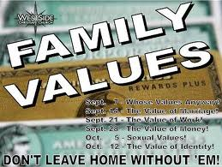
Shaphan’s Family Values
Respect God’s word: treasure it, listen to it, protect it
Trust what God brings into your life
Pick Godly people for your friends & spend time with them
Be willing to help your friends when they need you
Spend your time working in the ecclesia
Teach God’s principles to your children
Godly family values work even in the toughest times!

Slide 51
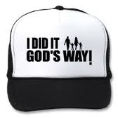

Make God’s Family Values, Your Family Values – Like Shaphan!
X

Slide 52
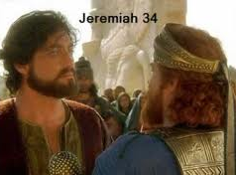
Next Class
Class 6 Zedekiah: the king without a backbone

Slide 54
Class Sequence: Chronological
Shaphan – Josiah’s day
Ahikam – Josiah & Jehoiakim
Gemariah & Michaiah – 5th of Jehoiakim
Elasah – 1st of Zedekiah
Jaazaniah – 6th of Zedekiah
Gedaliah – 11th of Zedekiah
Shaphan raised Godly children & grandchildren during a tough spiritual time

Slide 55
2
17
G

