Slide 1
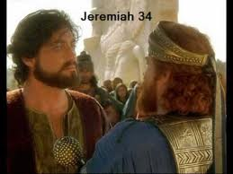
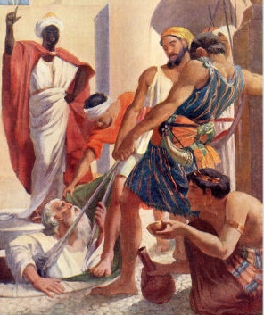
Jeremiah
Change before the end begins
Class 6 Zedekiah: the king without a backbone

Slide 2
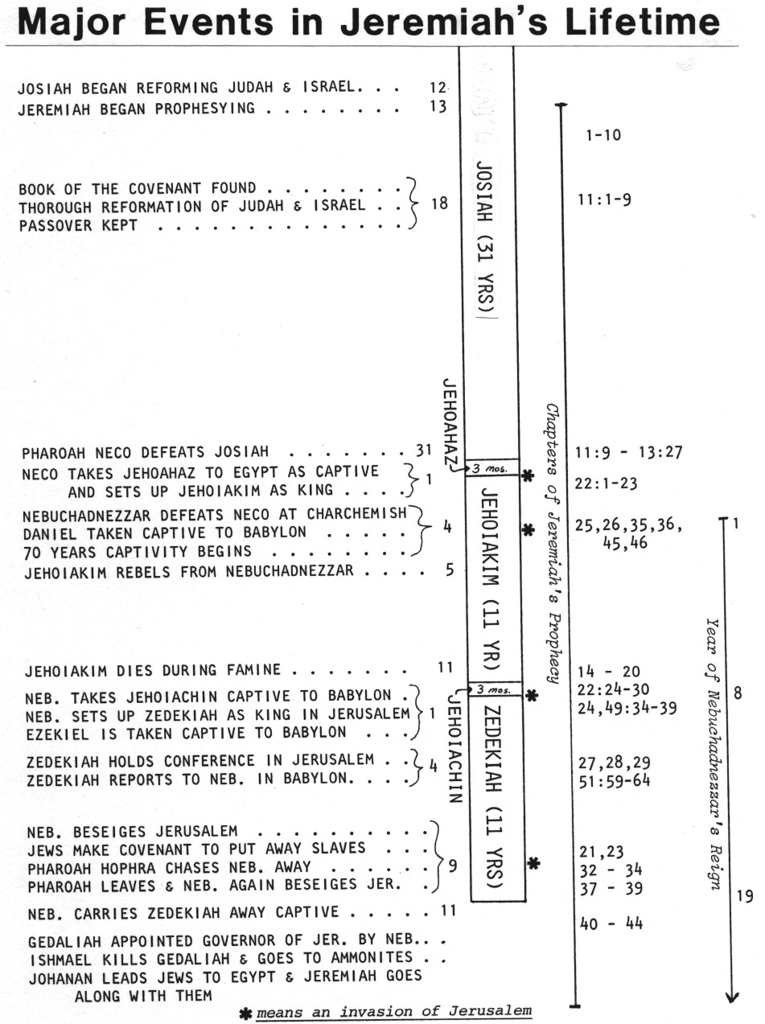
Focus on the reign of Zedekiah
Many chapters are clumped around invasions

Slide 3
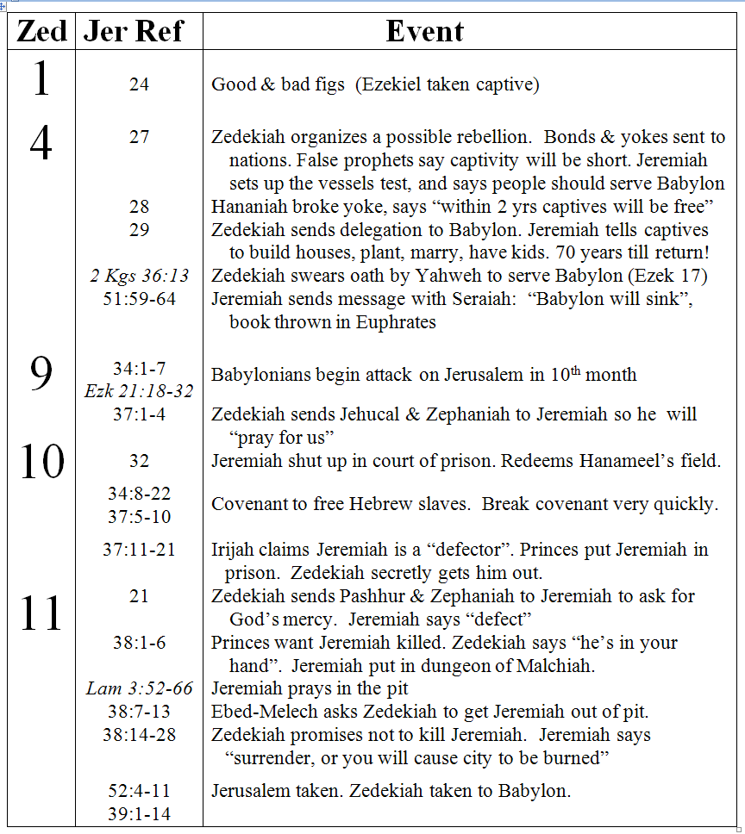
2
Jeremiah’s prophecies during Zedekiah’s reign
2 Chr 36:13
51:59-64
G

Slide 4
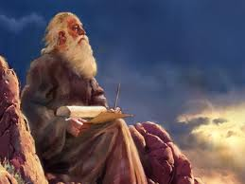
Jeremiah recompiled his writings to influence Zedekiah
2 Chron 36:11-21
Only a few things revealed about Zedekiah
V.12 Did evil in God’s sight
    Did not humble himself before Jeremiah (spoke word of the Lord)
V.13 Rebelled against Nebuchadnezzar, broke oath
  Stiffened neck, hardened heart against turning to God
V.14 Leaders transgressed. Defiled house of Lord
2 Kgs 25 Describes siege & Zedekiah’s capture
Jeremiah’s prophecies give more insight into Zedekiah & the people. Challenging time for Jeremiah. He endured much suffering!

Slide 5
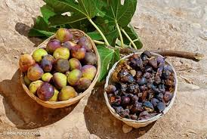
Jer 24: Good & Bad Figs
Given in Zedekiah’s 1st year
V.1 Neb took Jeconiah (Jehoiachin) to Babylon
  Also took Ezekiel, Mordecai, etc.
V.5 “for their own good”: better environment than Jerusalem!
V.6-7 God intends to bring them back later: after changes are made!
V.8 Zedekiah = bad fig. He must go!
God does move us around at times because He knows another location might be better for ourselves or children

Slide 6
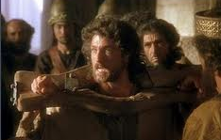
Jer 27: the Bonds & Yokes
V.1 “Jehoiakim” should be “Zedekiah” (v.3)
  Beginning = 4th year (see 28:1)
V.3 Five nations sent messengers to Jerusalem
  Zedekiah possibly planning a rebellion!
  Jeremiah’s mission is to explain to nations that Yahweh owns the land & has given it to Neb. “my servant” (v.6)
V.11 “nations” that serve Babylon willingly get to stay!
V.12-15 Personal appeal to Zedekiah: “serve Babylon & live!”
V.16-18 Personal appeal to priests & people: “serve Babylon & live!”
V.18 Note Jeremiah’s challenge to prophets: Ask God to keep vessels here – see if He will!
Even at this point Jeremiah is still trying to appeal to everyone, hoping some will change!

Slide 7
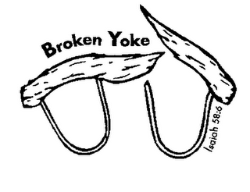
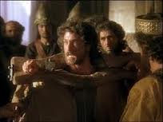
Jer 28: False Prophet Hananiah
4th year of Zedekiah
Hananiah’s false message: Everyone will return within 2 years
  Probably counting on Zedekiah’s rebellion to work
  Jeremiah is still walking around with a yoke on his neck – He lived his message!

Slide 8
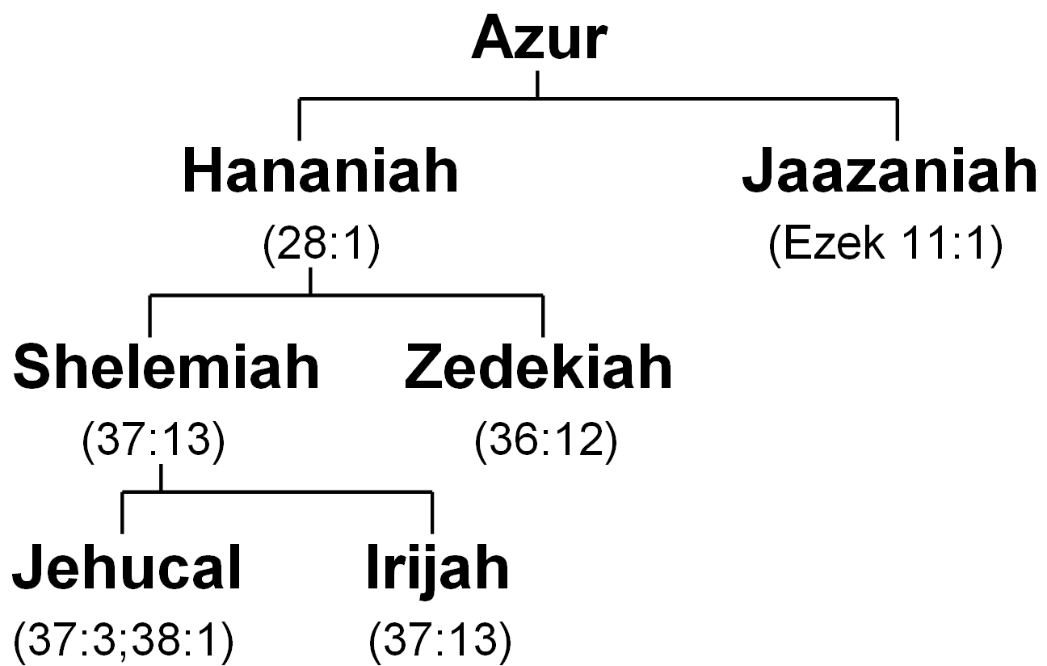
Some False Prophets Jeremiah dealt with
S
False prophets in Jerusalem and Babylon were teaching that the captivity would be over soon & everyone would return!
G

Slide 9
Jer 28: False Prophet Hananiah
4th year of Zedekiah
Hananiah’s false message: Everyone will return within 2 years
  Probably counting on Zedekiah’s rebellion to work
  Jeremiah is still walking around with a yoke on his neck – He lived his message!
V.10-11 Hananiah breaks yoke… predicts 2 years
V.13 God tells Jeremiah to go back & blame Hananiah personally – for misleading people
  God trying to get to Hananiah’s conscience
  Also showing the people Hananiah is a false prohet
  James 3:1 Teachers judges with stricter judgment!
V.17 Hananiah died within 2 months!
  Urijah (his grandson) later tries to get back at Jeremiah (37:13)
Jeremiah gives the good confession: No fight, no verbal war, no sustained argument. He’s willing to let God handle it over time!

Slide 10
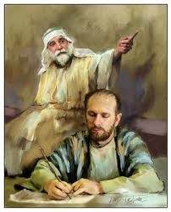
Jer 29: Letter to the Captives
Zedekiah probably sent a delegation to assure Nebuchadnezzar he would not rebel
Jeremiah uses this occasion to send encouraging letter to the Good Figs
  V.5 build houses & live in them, plant gardens & then eat the fruit
  V.6 take wives & have kids
  All involve many years → long captivity
V.8 False prophets in Babylon: claimed the captivity would be short (like Hananiah)
V.10 70 years…then I will cause you to return
  “thoughts of peace” & “future & a hope”
God wants us to have “hope, future, peace”, but it only comes when we search for him with all our hearts

Slide 11
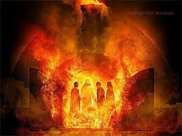
Jeremiah 29: Letter to the Captives
V.15 False prophets: like Ahab & Zedekiah (v.21) & Shemaiah (v.24)
V.16-32 Jeremiah tries to counter the work of the false prophets
V.21 Zedekiah = Jeremiah’s cousin
  Neb will punish them, maybe by influence of Daniel
V.22 “roasted in fire” – like Daniel’s 3 friends!
V.24 Shemaiah: sent letters to priests in Jerusalem to motivate them to silence Jeremiah because of his message
V.31-32 Shemaiah “caused you to trust in a lie”
  Punishment: Shemaiah himself & his family – they won’t see the good God will do for Israel
Mistakes we make can have a bad impact on our families! We must present the Truth of God’s word.

Slide 12

Jeremiah 51:59-64
Message sent with Seraiah
59 The word which Jeremiah the prophet commanded Seraiah the son of Neriah, the son of Mahseiah, when he went with Zedekiah the king of Judah to Babylon in the fourth year of his reign. And Seraiah was the quartermaster. 60 So Jeremiah wrote in a book all the evil that would come upon Babylon, all these words that are written against Babylon.
61 And Jeremiah said to Seraiah, "When you arrive in Babylon and see it, and read all these words, 62 then you shall say, 'O Lord, You have spoken against this place to cut it off, so that none shall remain in it, neither man nor beast, but it shall be desolate forever.' 63 Now it shall be, when you have finished reading this book, that you shall tie a stone to it and throw it out into the Euphrates. 64 Then you shall say, 'Thus Babylon shall sink and not rise from the catastrophe that I will bring upon her. And they shall be weary.'"

Slide 13
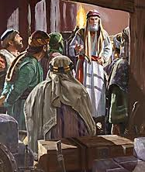
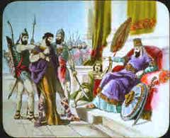
Jeremiah 51:59-64 Message sent with Seraiah
V.59 Seraiah is Baruch’s brother (45:1)
Nebuchadnezzar probably wanted to question Zedekiah himself about the meeting he held back in 27:3
2 Chr 36:13 says Zedekiah had to swear an oath to God that he would not rebel. In Ezek 17 he is held responsible for breaking that oath to God and his covenant with Nebuchadnezzar

Slide 14
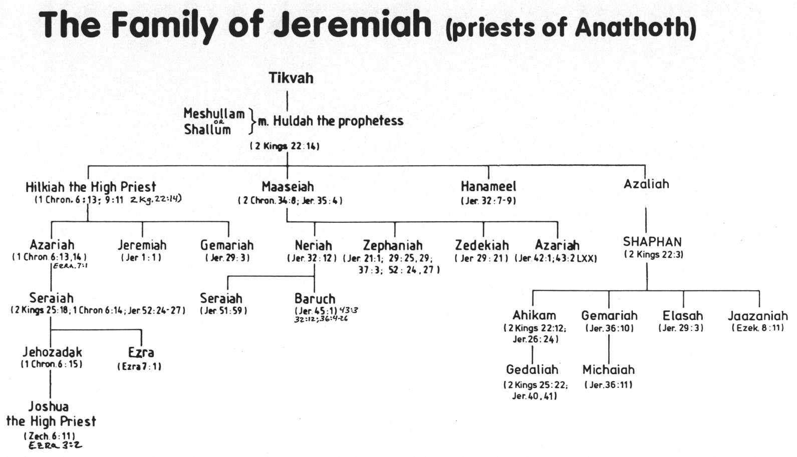
The Family of Jeremiah (priests of Anathoth)
Some family members supported Jeremiah
Baruch wrote many of Jeremiah’s prophecies.
Seraiah was quartermaster of Jerusalem & Baruch was his brother

Slide 15
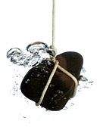
Jeremiah 51:59-64 Message sent with Seraiah
V.59 Seraiah is Baruch’s brother (45:1)
Nebuchadnezzar probably wanted to question Zedekiah himself about the meeting he held back in 27:3
Captives would have been encouraged to hear of Babylon’s eventual destruction (like Rev 18:20-21)
Seraiah tied a stone to the book and threw it into the Euphrates – so shall Babylon sink!

Slide 16
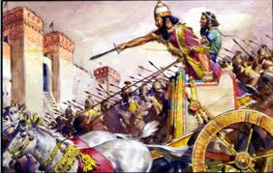
Jer 34:1-7 Babylonians begin the final siege!
Zedekiah is clearly told:
  v.2 Jerusalem is doomed to be burned!
  v.3 You will be captured, your eyes will see the king of Babylon, & then go to Babylon
  v.5 You will die in peace & they will burn incense for you
Zedekiah may have felt this didn’t sound too bad for him!
This wasn’t the whole story! Zedekiah didn’t realize he would see his sons die & then be blinded!

Slide 17
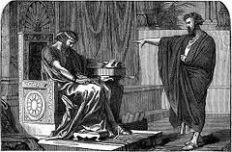
Jeremiah 37:1-4 Zedekiah asks Jeremiah to Pray for them
V.3 Jehucal = Hananiah’s grandson
  Zephaniah = Jeremiah’s cousin

Slide 18
Some False Prophets Jeremiah dealt with
S
False prophets in Jerusalem and Babylon were teaching that the captivity would be over soon & everyone would return!
G

Slide 19
The Family of Jeremiah (priests of Anathoth)
Some family members supported Jeremiah

Slide 20
Jeremiah 37:1-4 Zedekiah asks Jeremiah to Pray for them
V.3 Jehucal = Hananiah’s grandson
  Zephaniah = Jeremiah’s cousin
“Pray for us” – Zedekiah waited until Nebuchadnezzar surrounded Jerusalem
  He turned to God during trouble, but never intended to change
God uses trouble to bring us back to Him. We need to acknowledge our mistakes & change our lives!

Slide 21
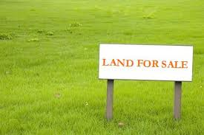
Jeremiah 32: Buys a field in Anathoth
V.1 10th year of Zedekiah
V.2 Zedekiah shut Jeremiah up in court of prison
  Tried to silence Jeremiah from influencing the people to give up & defect
  Shows Zedekiah wanted Jeremiah to pray for him, but did not want to do God’s will
V.7 Hanameel = Jeremiah’s uncle – may have been one of the men of Anathoth who earlier tried to kill Jeremiah!
  Note: God told Jeremiah to buy the field (v.25)
  Warning to Us: When God’s will conflicts with ours, we may have a tendency to mistreat or silence those who speak God’s will

Slide 22
The Family of Jeremiah (priests of Anathoth)

Slide 23
Jeremiah 32: Buys a field in Anathoth
Picture what’s happening:
  Babylonians have Jerusalem under siege
  Jerusalem is about to be destroyed & burned
  Land is currently worthless! Save money for food!
  Jeremiah is jailed in court of prison
V.16-25 Jeremiah prays for help to understand
  James 1 “if anyone lacks wisdom, let him ask God”
God’s goal: His proof that land will be worth something again & He will bring them back! (see v. 36-44)
Jeremiah obeyed God’s will even though he didn’t understand it! God asks us to do the same. This is where faith motivates us to live for God.

Slide 24
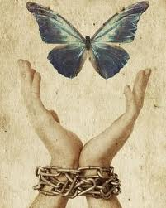
Jeremiah 34:8-22 Covenant to free Hebrew Slaves
Why release the slaves? They knew God instituted the slavery laws right after the 10 commandments – whey they had been slaves in Egypt
Ex 21:1-11 Hebrew slaves go free every 7th year
Lev 25:39-55 Laws about Hebrew slaves: should treat them as servants – must be released at Jubilee
Now that Babylonians threatened to enslave the Jewish nation, they decided to release their Jewish slaves as the Law required
V.8 Zedekiah makes everyone make a covenant in the temple (v.15)
This was a sad event. Indicates the oppression, mistreatment of people, unkindness, lack of respect for God’s Law going on in Judah.

Slide 25

Jeremiah 34:8-22 Covenant to free Hebrew Slaves
V.10 People obeyed Zedekiah, just like they obeyed Josiah – in pretense!
V.11 later changed their minds – Why???
  Pharaoh Hophra finally came at Zedekiah’s request (see Lam 4:17)
  Nebuchadnezzar pulled back his siege (v21-22)
  Jews couldn’t obey their covenant with their living Father for a few months. Rechabites (Jer 35) kept theirs for years!
V.17-22 Note God’s sarcasm – “liberty”
  Since you don’t protect the covenant, God won’t either!
This whole event is further explained in Jer 37:5-10
It doesn’t work to force a covenant, just leads to legalism. Faith has power – it will change our lives & attitudes!

Slide 26
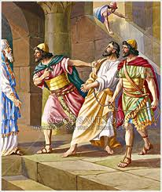
Jeremiah 37:11-21 Jeremiah charged as a Defector
When Chaldeans pulled back, he was freed from court of prison
  Zedekiah probably thought no one would believe Jeremiah’s prophecies now!
V.12 Jeremiah wanted to see & claim his property he bought (Jer 32)
  Irijah = Hananiah’s grandson (Jer 28) wants revenge!

Slide 27
Some False Prophets Jeremiah dealt with
S
Dead now!
False prophets in Jerusalem and Babylon were teaching that the captivity would be over soon & everyone would return!
G

Slide 28
Jeremiah 37:11-21 Jeremiah charged as a Defector
When Chaldeans pulled back, he was freed from court of prison
  Zedekiah probably thought no one would believe Jeremiah’s prophecies now!
V.12 Jeremiah wanted to see & claim his property he bought (Jer 32)
  Irijah = Hananiah’s grandson (Jer 28) wants revenge!
  Defecting: some Jews did
    38:19 Zedekiah was afraid of being delivered to defectors
    39:9 Nebuzaradan carried away captives & defectors
False charges still happen today. We need to talk, ask, listen (like Phinehas in Josh 22) – so we don’t misjudge motives of others.

Slide 29
Jeremiah 37:11-21 Jeremiah charged as a Defector
V.15 Jeremiah struck, put in prison: he’s 50-60 years old now!
V.16 Probably stayed there a few months, thought he would die there (v.20)
V.17 Zedekiah secretly gets Jeremiah out: why???
  Babylonians are back
  Zedekiah wants to know God’s plan, but still doesn’t want to change.
V.18-21 Jeremiah appeals to Zedekiah that he hasn’t done anything wrong – don’t send back to dungeon!
  Zedekiah keeps Jeremiah in palace court of prison (32:2)
Look at what Jeremiah went through!

Slide 30
Zedekiah’s weakness
He wants to know what will happen
  intrigued about the future
  He doesn’t want to change his life
Warning to us: Studying Bible prophecy can be the same for us
  We love to match current events to the Bible
  We may not want to change our lives
Note Jeremiah’s response: a faithful witness
  Zedekiah will be given to the Babylonians
  Jeremiah didn’t change the message so his life could be improved!
We must truthfully declare God’s message, no matter if it costs us too!

Slide 31
Jeremiah 21: Zedekiah seeks God’s mercy
v.1 Pashhur: head of priestly family of Malchiah
  Zephaniah = Jeremiah’s cousin
Zedekiah tries to pattern his inquiry after Hezekiah sending a group to Isaiah (2Kgs 19:1-7) after Rabshakeh’s speech.
  Hezekiah was sincere & repented in sackcloth, Zedekiah is not
  Rom 2:4 “the goodness of God leads you to repentance”
V.4-7 God sees through Zedekiah’s false sincerity
  God is direct: “I myself will fight against you”
  “I will deliver Zedekiah & people to Babylonians”
God has had it with Zedekiah’s lack of faith!

Slide 32
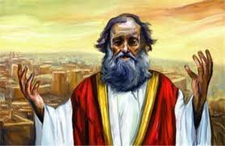
Jeremiah 21: Zedekiah seeks God’s mercy
V.8-10 Jeremiah’s Gospel: “defect to Chaldeans!”
  Note connection to Deut 30:19 “life & death”
  Jeremiah exhorts people to obey before curses of Deut 28 happen!
  Very different message from Hezekiah’s day – this would require lots of faith
  Some defectors were put in prison (37:13)
V.11-14 Addressed to Zedekiah’s house: king & princes
  Exhort: execute judgment & deliver oppressed
  Live the Truth! No bribes, no political favors!
V.12 “lest”: implies God was still willing to stop the fire at this point! He is so merciful!
God is extremely merciful, but His patience will eventually run out. We must respond before the end begins!

Slide 33
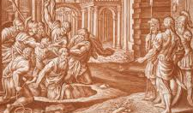
Jer 38:1-6 Princes put Jeremiah in Dungeon
V.1-4 Princes hear Jeremiah’s message, but misrepresent his motive
  V.4 he does not seek the peoples’ welfare, but their harm
Warning: it’s easy to misread or misrepresent motives if we don’t understand God’s big picture – don’t get lost in the daily details!
V.5 Note Zedekiah’s weakness & lack of commitment to Truth: “he’s in your hand” – just like Pilate with Jesus
  Zedekiah couldn’t handle peer pressure – gave in
  No commitment to God & Godly principles
Establish your commitment to God & His principles early on, so when pressure comes, you will respond in faith

Slide 34
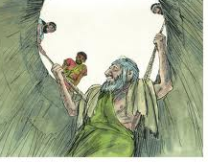
Jer 38:1-6 Princes put Jeremiah in Dungeon
V.6 Dungeon of Malchiah = old cistern!
  Same Malchiah later killed by Neb (2Kgs 25:7)
  Princes would not kill Jeremiah directly, but did leave him to die
  No food, no water, probably no sleep!
Jeremiah is 50-60 yrs old now (13th of Josiah was 38 yrs ago)
  Where was the “fortified city, iron pillar, bronze walls” God had promised?
When events of life take a turn we don’t expect, God gives our faith & trust an opportunity to grow

Slide 35
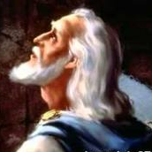
Lam 3:52-66 Jeremiah prays in the Pit
Like Jonah, David, Paul & Jesus – Jeremiah prayed when in trouble

Slide 36
Lamentations 3:52-57
52 My enemies without cause hunted me down like a bird. 53 They silenced my life in the pit and threw stones at me. 54 The waters flowed over my head; I said, "I am cut off!“ 55 I called on Your name, O Lord, from the lowest pit. 56 You have heard my voice: "Do not hide Your ear from my sighing, from my cry for help.“ 57 You drew near on the day I called on You, and said, "Do not fear!”
Jeremiah’s solution: Call on God!

Slide 37
Lam 3:52-66 Jeremiah prays in the Pit
Like Jonah, David, Paul & Jesus – Jeremiah prayed when in trouble
  Prayed to God for help when he didn’t understand the events of life
  Gave God the credit for his salvation
Heb 12:10 God brings these troubles on us “for our profit, that we may share His holiness”
In the midst of all that was going on in Jerusalem, God was preparing Jeremiah personally for life forever in God’s family!

Slide 38
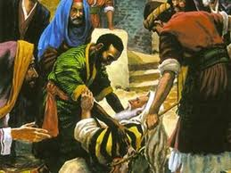
Jeremiah 38:7-13 Deliverance through Ebed-Melech
Ebed-Melech: a eunuch, foreigner, Gentile, probably a black man
Man of Faith – “put your trust in Yahweh” (39:18)
His faith now, saved his own life later (39:17-18)
May have been connected to Zedekiah’s daughters (41:10), stayed in the land with Gedaliah, then was taken by Ishmael, and finally rescued by Johanan (41:16)
Help & deliverance sometimes arises from an unexpected source. Prayers are answered in ways we don’t expect!

Slide 39
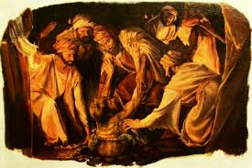
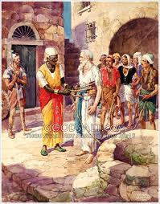
Jeremiah 38:7-13 Deliverance through Ebed-Melech
Ebed-Melech touched Zedekiah’s conscience
Zedekiah now swings to the other side – get Jeremiah out of the pit!
Zedekiah expected resistance from the princes – he suggests taking 30 men!
God took care of Jeremiah by an unexpected source!

Slide 40
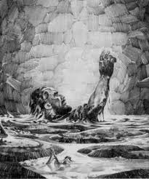
Jeremiah is almost 60 years old now
Picture Jeremiah:
  Thin to the bones
  No food or water or sleep.
  Cried his eyes dry.
  Too weak to hold ropes.
  He slowly rises out of the slime pit!
Greatest man of faith on earth at the time
True Bible hero…. Ready for immortality
My brethren, take the prophets, who spoke in the name of the Lord, as an example of suffering and patience. Indeed we count them blessed who endure. (James 5:10-11)

Slide 41
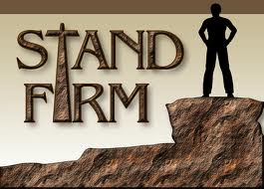
Jer 38:14-28 Zedekiah calls for Jeremiah
V.14 Zedekiah calls for Jeremiah this time – it’s serious!
Zedekiah wants a secret deal with Jeremiah:
  Won’t kill him, won’t deliver him to the princes
  Zedekiah wants to know God’s message, but is not willing to do anything about it
V.17 Jeremiah tries to exhort Zedekiah personally [“you”]
  like Micah’s appeal to Hezekiah (26:18)
  It’s up to YOU Zedekiah! You will be responsible for the fire!
V.19 Zedekiah has no faith in God
Zedekiah has no faith to stand firm for God

Slide 42
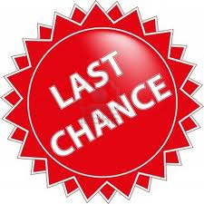
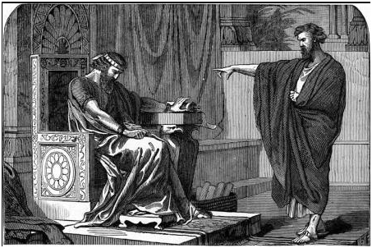
Jeremiah’s final appeal to Zedekiah: Jer 38:20-23
V.20 Jeremiah pleads:
  Please! Obey! [still time to change!]
  V.21-22 If you don’t surrender, YOU will sink in the mire!
  V.23 YOU will cause your family to be destroyed!
  YOU will cause Jerusalem to be burned!
V.24-28 Zedekiah is afraid to let anyone even know he cared at all!
"For whoever is ashamed of Me and My words in this adulterous and sinful generation, of him the Son of Man also will be ashamed when He comes in the glory of His Father with the holy angels.“ (Mark 8:38)

Slide 43
Zedekiah’s Failure
No personal relationship with God
Only sought God when he was in trouble
Trusted in other nations, not God
Did not keep his covenants
Surrounded & influenced by ungodly people
Easily swayed: gave in to peer pressure
Afraid to confess Bible truths to others
Did not care about the welfare of his family
Knew the end was coming, but he was not willing to change his way of life!
Learn from Zedekiah’s mistakes! Aim to be like Jeremiah

Slide 44
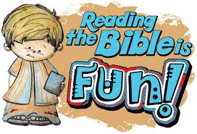
Hope you enjoyed Jeremiah!

Slide 45
2
S
G

Slide 46
2
17
G

