Slide 1
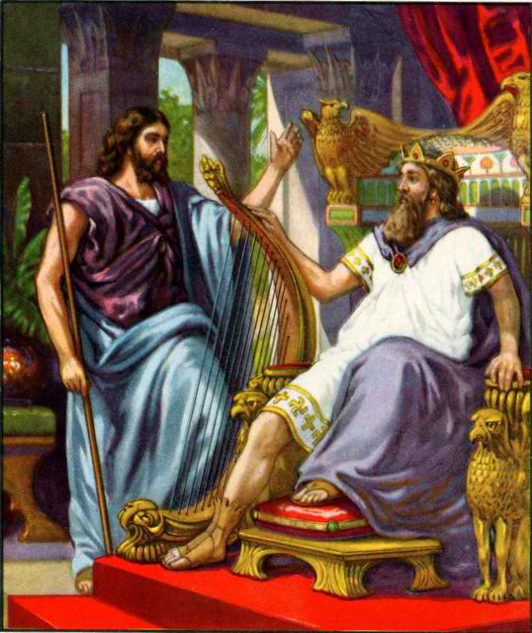
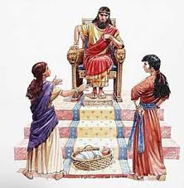
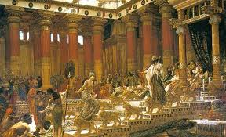
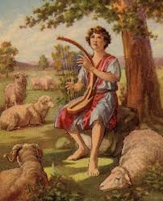
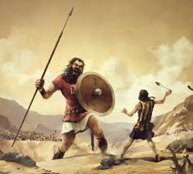
Class 1: God Prepares David to be King
David & Solomon: Kings in Practice

Slide 2
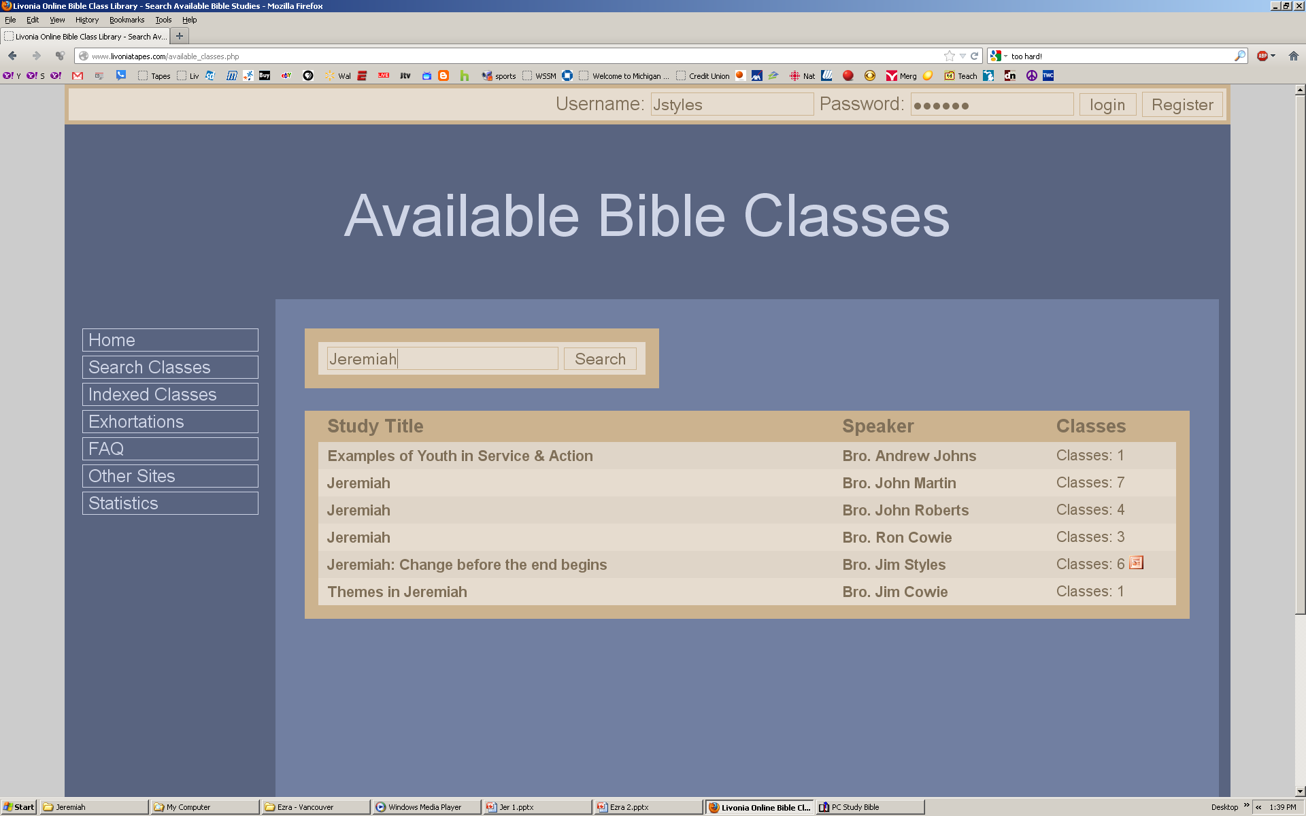
www.livoniatapes.com

Slide 3
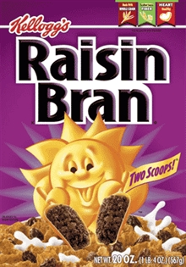
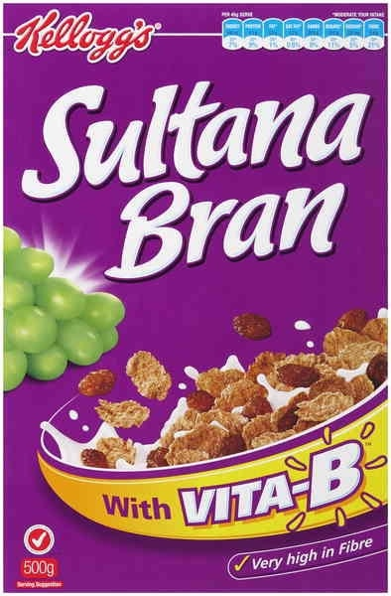
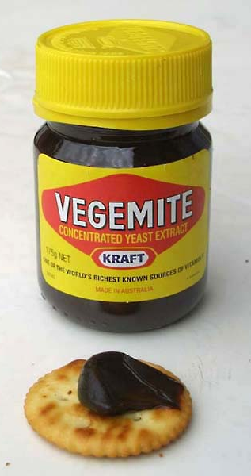
We’re still getting use to Australian food!

Slide 4
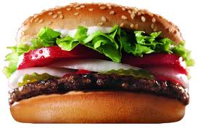


We’re still getting use to Australian food

Slide 5
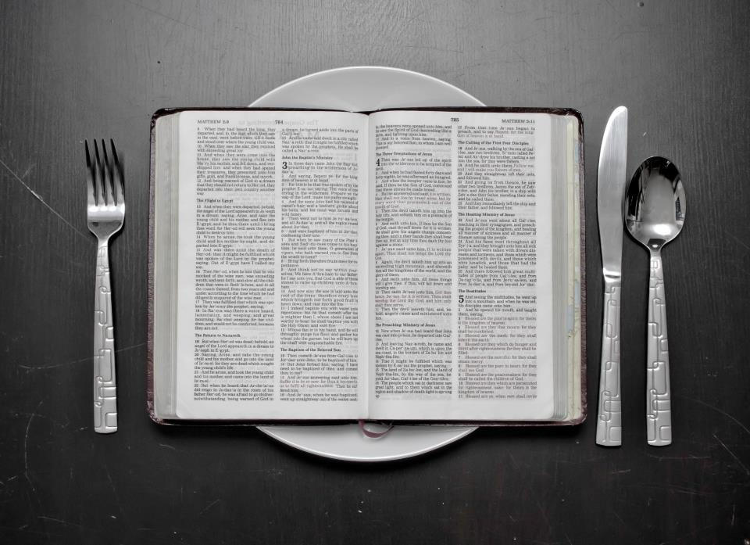

Hopefully you won’t mind eating our spiritual meals….
from my NKJV

Slide 6
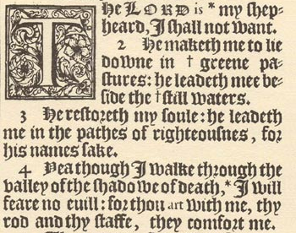
At least I’m not using a 1611 KJV !

Slide 7

Our Goal this week…
Focus on the Lessons from David & Solomon
You already know the stories

Slide 8
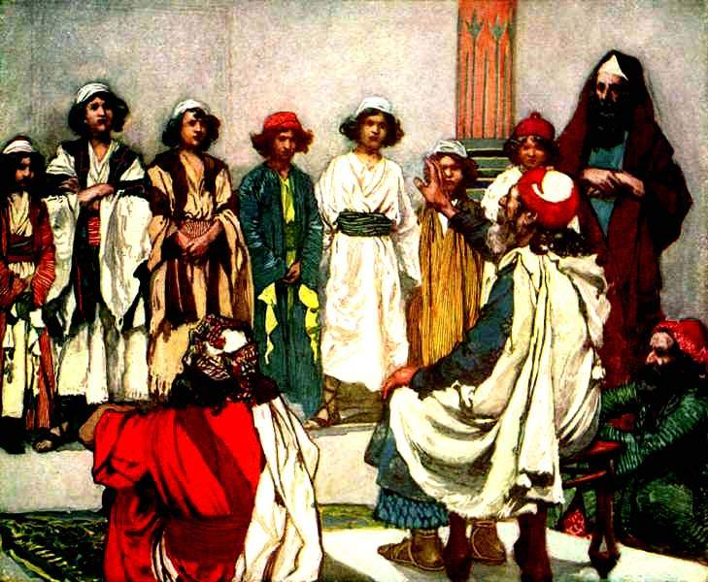
God made sure David grew up in the right family!
He has us in the right families too!

Slide 9
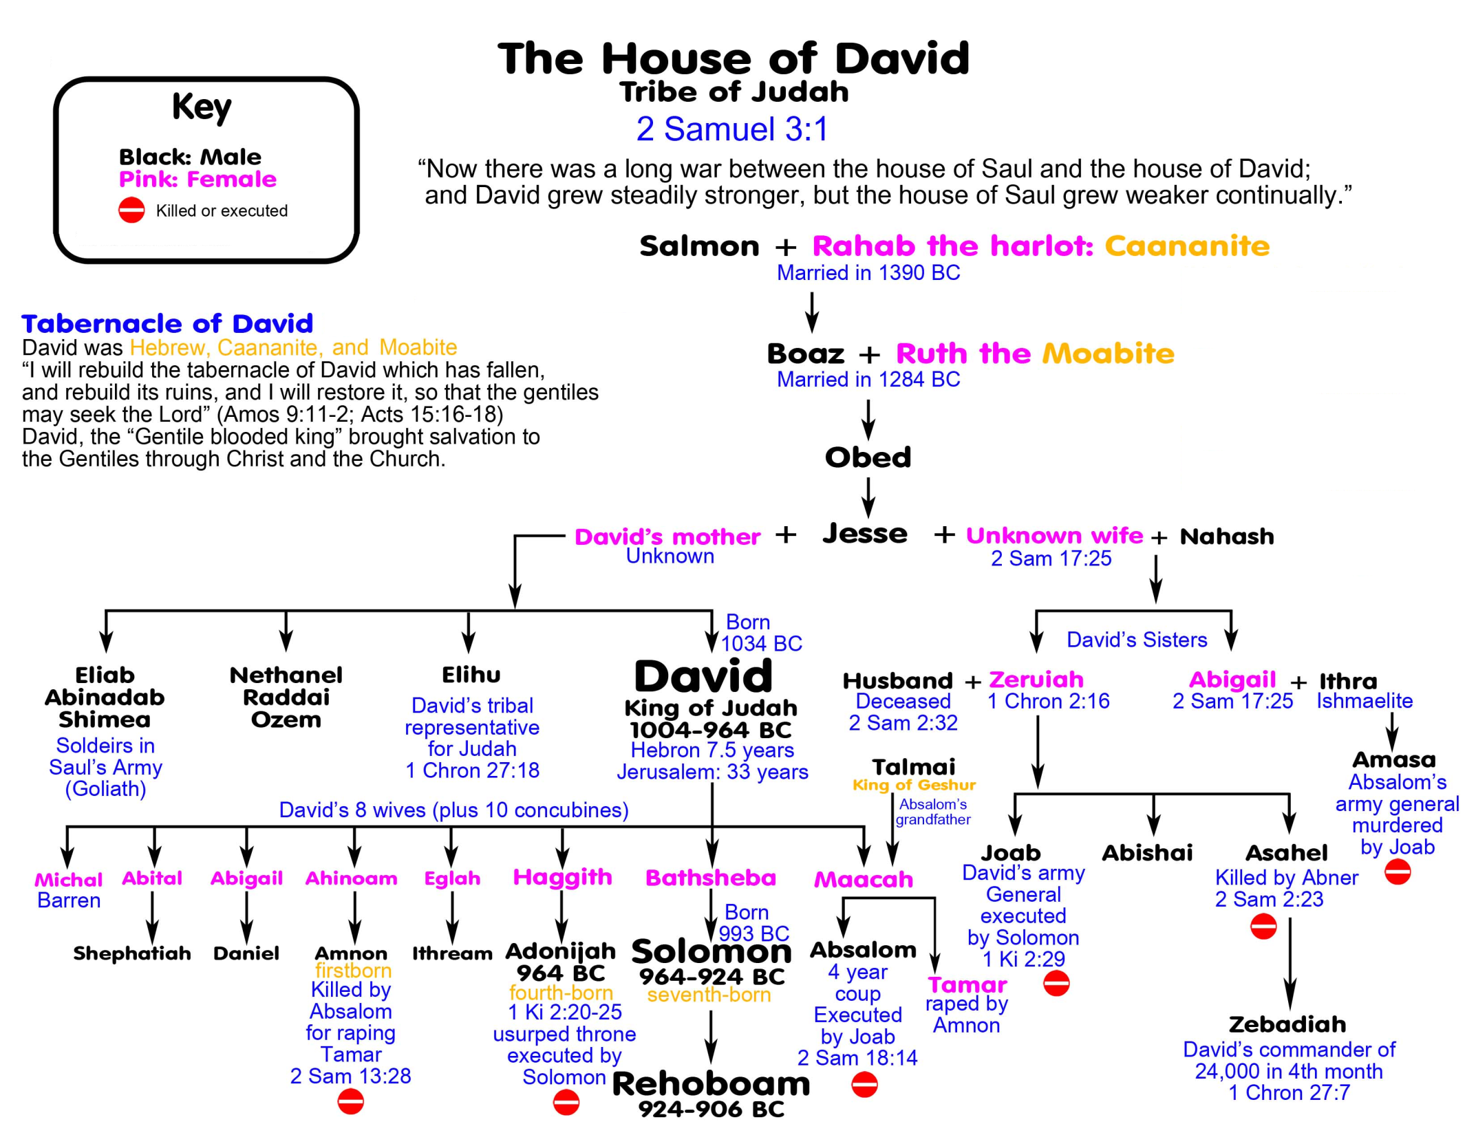
David understood God’s diversity
Maybe same woman as David’s Mom
7 older brothers taught David humility & patience
(or Jether)

Slide 10

1 Samuel 16:7-13
God chose David to be king
7 But the Lord said to Samuel, "Do not look at his appearance or at his physical stature, because I have refused him. For the Lord does not see as man sees; for man looks at the outward appearance, but the Lord looks at the heart."
8 So Jesse called Abinadab, and made him pass before Samuel. And he said, "Neither has the Lord chosen this one." 9 Then Jesse made Shammah pass by. And he said, "Neither has the Lord chosen this one." 10 Thus Jesse made seven of his sons pass before Samuel. And Samuel said to Jesse, "The Lord has not chosen these." 11 And Samuel said to Jesse, "Are all the young men here?" Then he said, "There remains yet the youngest, and there he is, keeping the sheep.”
And Samuel said to Jesse, "Send and bring him. For we will not sit down till he comes here." 12 So he sent and brought him in. Now he was ruddy, with bright eyes, and good-looking. And the Lord said, "Arise, anoint him; for this is the one!" 13 Then Samuel took the horn of oil and anointed him in the midst of his brothers; and the Spirit of the Lord came upon David from that day forward. So Samuel arose and went to Ramah.
David was willing to do what needed to be done!

Slide 11
1 Samuel 17:26-30
Brother falsely accused him!
Then David spoke to the men who stood by him, saying, "What shall be done for the man who kills this Philistine and takes away the reproach from Israel? For who is this uncircumcised Philistine, that he should defy the armies of the living God?"
27 And the people answered him in this manner, saying, "So shall it be done for the man who kills him."
28 Now Eliab his oldest brother heard when he spoke to the men; and Eliab's anger was aroused against David, and he said, "Why did you come down here? And with whom have you left those few sheep in the wilderness? I know your pride and the insolence of your heart, for you have come down to see the battle."
29 And David said, "What have I done now? Is there not a cause?" 30 Then he turned from him toward another and said the same thing; and these people answered him as the first ones did.
David continued to be kind & focused on the mission for God

Slide 12
1 Samuel 25:42-44
Saul gave away David’s wife!
42 So Abigail rose in haste and rode on a donkey, attended by five of her maidens; and she followed the messengers of David, and became his wife. 43 David also took Ahinoam of Jezreel, and so both of them were his wives.
44 But Saul had given Michal his daughter, David's wife, to Palti the son of Laish, who was from Gallim.
David had to deal with many disappointments in his family life

Slide 13
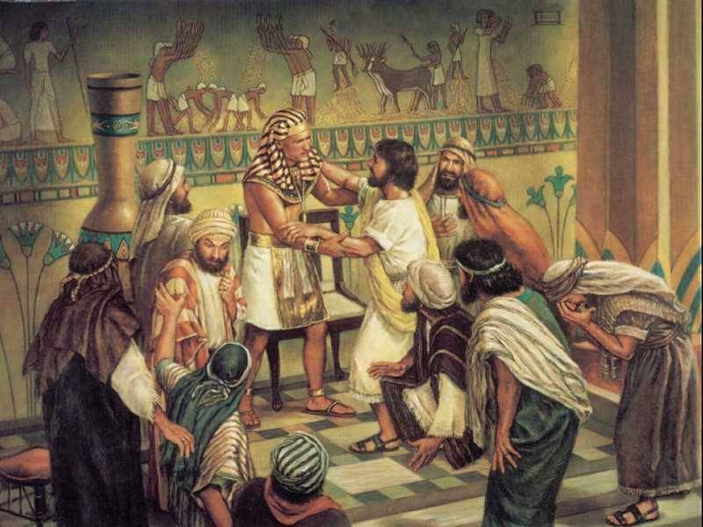
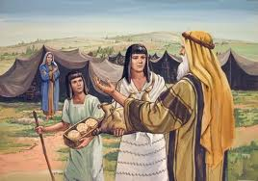
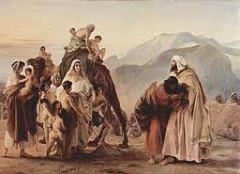
God uses families to teach us major lessons about living in His family
Joseph & brothers
God’s Election
Patience & mercy
Sarah & Hagar
Jacob’s Family
Families give us opportunities to practice righteousness so we can live in God’s family!
Trust & obedience

Slide 14
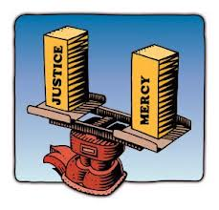
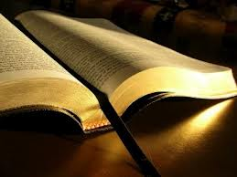
Kings in Practice
Walking in the light of God’s word
God taught David to accept people from different races and cultures
David was willing to do whatever God needed
He was the youngest of 8 brothers
  Not the focus of the family – accepted his role!
  Learned to do as told – lots of bosses!
  Understood God designed his family
David dealt with false accusations from his brothers and moved on
David dealt with disappointments & moved on
David made some mistakes, but he practiced righteousness

Slide 15
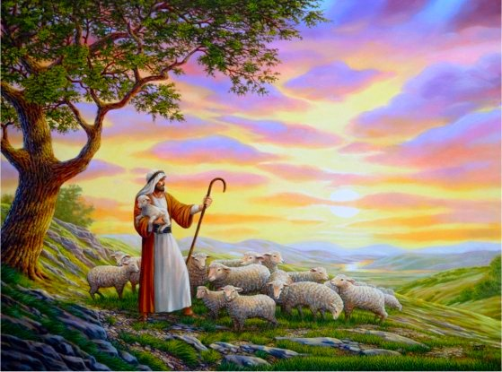
Shepherding God’s Flock

Slide 16
1 Samuel 16:11
David the Shepherd
11 And Samuel said to Jesse, "Are all the young men here?" Then he said, "There remains yet the youngest, and there he is, keeping the sheep.”
28 Now Eliab his oldest brother heard when he spoke to the men; and Eliab's anger was aroused against David, and he said, "Why did you come down here? And with whom have you left those few sheep in the wilderness? I know your pride and the insolence of your heart, for you have come down to see the battle."
1 Samuel 17:28
Shepherding was not a waste of time!

Slide 17
Psalm 78:70-72
God’s shepherd
70 He (God) also chose David His servant, and took him from the sheepfolds;
71 From following the ewes that had young He brought him, to shepherd Jacob His people, and Israel His inheritance.
72 So he shepherded them according to the integrity of his heart, and guided them by the skillfulness of his hands.
David defended the weak

Slide 18
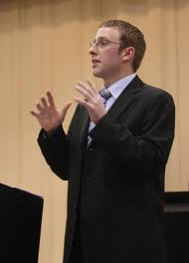
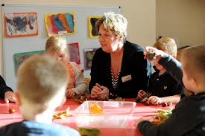
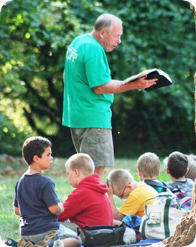
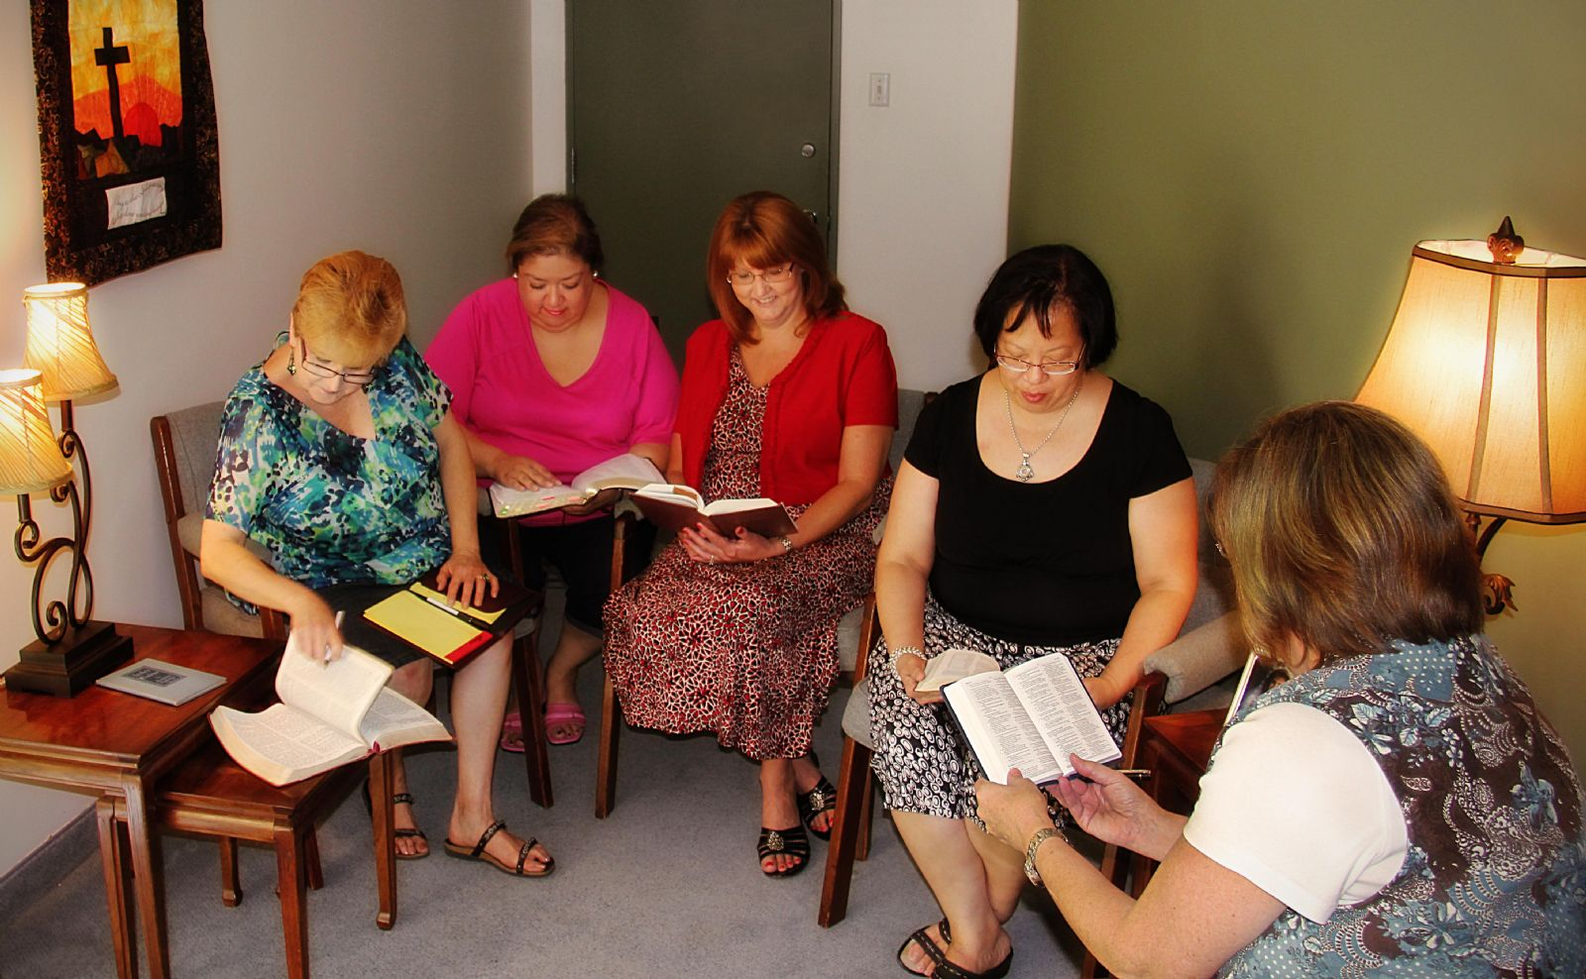
We need ecclesial shepherds today!

Slide 19
Acts 13:22
After God’s heart
22 And when He (God) had removed him (Saul), He raised up for them David as king, to whom also He gave testimony and said, 'I have found David the son of Jesse, a man after My own heart, who will do all My will.’
Luke 22:42 "Father, if it is Your will, take this cup away from Me; nevertheless not My will, but Yours, be done." 43 Then an angel appeared to Him from heaven, strengthening Him.
God’s kings practice doing His will

Slide 20
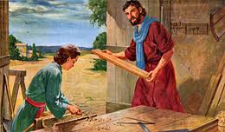
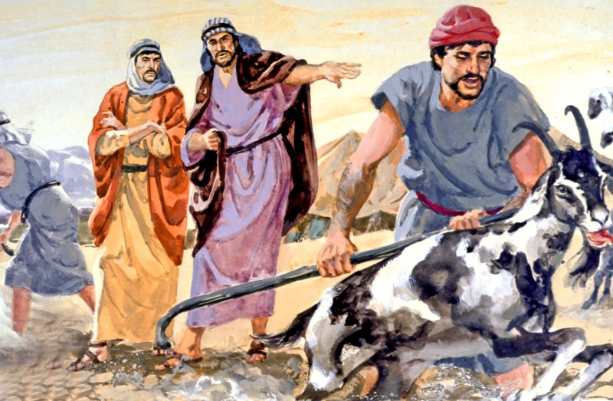
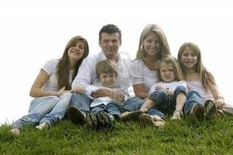
Life lessons learned on the job
Jacob
Build your house on a rock
Trust in God’s ways
God tries to use our everyday life to teach us about life in His family
Appreciate the work of God’s Angels

Slide 21
1 Samuel 15:20-23
God rejected Saul for disobedience
20 And Saul said to Samuel, "But I have obeyed the voice of the Lord, and gone on the mission on which the Lord sent me, and brought back Agag king of Amalek; I have utterly destroyed the Amalekites. 21 But the people took of the plunder, sheep and oxen, the best of the things which should have been utterly destroyed, to sacrifice to the Lord your God in Gilgal.“
22 So Samuel said:"Has the Lord as great delight in burnt offerings and sacrifices, As in obeying the voice of the Lord? Behold, to obey is better than sacrifice, and to heed than the fat of rams. 23 For rebellion is as the sin of witchcraft, and stubbornness is as iniquity and idolatry. Because you have rejected the word of the Lord, He also has rejected you from being king.“
Samuel probably shared some of this with David when he anointed David King!

Slide 22
1 Samuel 17:17-25
David obeyed his father’s commands
17 Then Jesse said to his son David, "Take now for your brothers an ephah of this dried grain and these ten loaves, and run to your brothers at the camp. 18 And carry these ten cheeses to the captain of their thousand, and see how your brothers fare, and bring back news of them." 19 Now Saul and they and all the men of Israel were in the Valley of Elah, fighting with the Philistines.
20 So David rose early in the morning, left the sheep with a keeper, and took the things and went as Jesse had commanded him. And he came to the camp as the army was going out to the fight and shouting for the battle.
Teach your children & grandchildren obedience!

Slide 23
2 Samuel 5:23-25
David followed God’s commands
23 Therefore David inquired of the Lord, and He said, "You shall not go up; circle around behind them, and come upon them in front of the mulberry trees. 24 And it shall be, when you hear the sound of marching in the tops of the mulberry trees, then you shall advance quickly. For then the Lord will go out before you to strike the camp of the Philistines." 25 And David did so, as the Lord commanded him; and he drove back the Philistines from Geba as far as Gezer.
David usually obeyed whatever God commanded

Slide 24
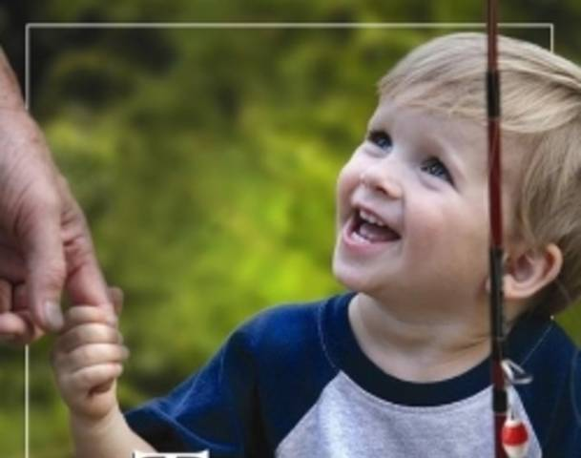
Obedience to parents can be the basis for later obedience to God
“Train up a child in the way he should go” (Prov 22:6)

Slide 25

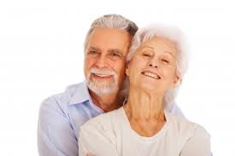
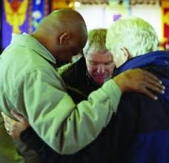
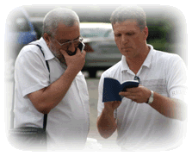
True shepherds lead by example!

Slide 26
Kings in Practice
Walking in the light of God’s word
David was aware that God uses the smaller trials of life to help prepare us for the greater challenges ahead
He allowed God to use the experiences of his life to teach him how to live in God’s family
  Learned how to shepherd God’s people by taking good care of his sheep
Knew of God’s rejection of Saul for disobedience
He practiced obedience to his father, Jesse, so he could learn to obey his heavenly Father.
David made some mistakes, but he practiced righteousness

Slide 27
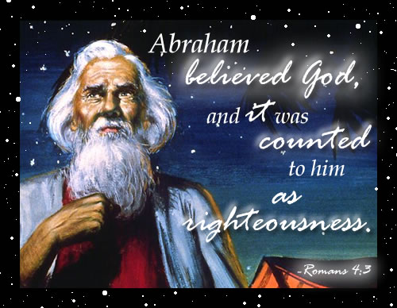
David had the faith of Abraham
Believed God would do the impossible

Slide 28
1 Samuel 17:31-37
David’s faith in God’s ability to save
31 Now when the words which David spoke were heard, they reported them to Saul; and he sent for him. 32 Then David said to Saul, "Let no man's heart fail because of him; your servant will go and fight with this Philistine."
33 And Saul said to David, "You are not able to go against this Philistine to fight with him; for you are a youth, and he a man of war from his youth."
34 But David said to Saul, "Your servant used to keep his father's sheep, and when a lion or a bear came and took a lamb out of the flock, 35 I went out after it and struck it, and delivered the lamb from its mouth; and when it arose against me, I caught it by its beard, and struck and killed it. 36 Your servant has killed both lion and bear; and this uncircumcised Philistine will be like one of them, seeing he has defied the armies of the living God." 37 Moreover David said, "The Lord, who delivered me from the paw of the lion and from the paw of the bear, He will deliver me from the hand of this Philistine.“
And Saul said to David, "Go, and the Lord be with you!“
David learned by experience to trust God

Slide 29
Psalm 34:7
David felt God’s presence
7 The angel of the LORD encamps all around those who fear Him, and delivers them.
Note the context: David was scared and came up with a plan. Act like an insane person before Achish so he would let him live. On the surface it looked like David was just scheming his way through the problem. David did act, but in his own mind, he was fully aware of God’s angel helping him through the situation.

Slide 30
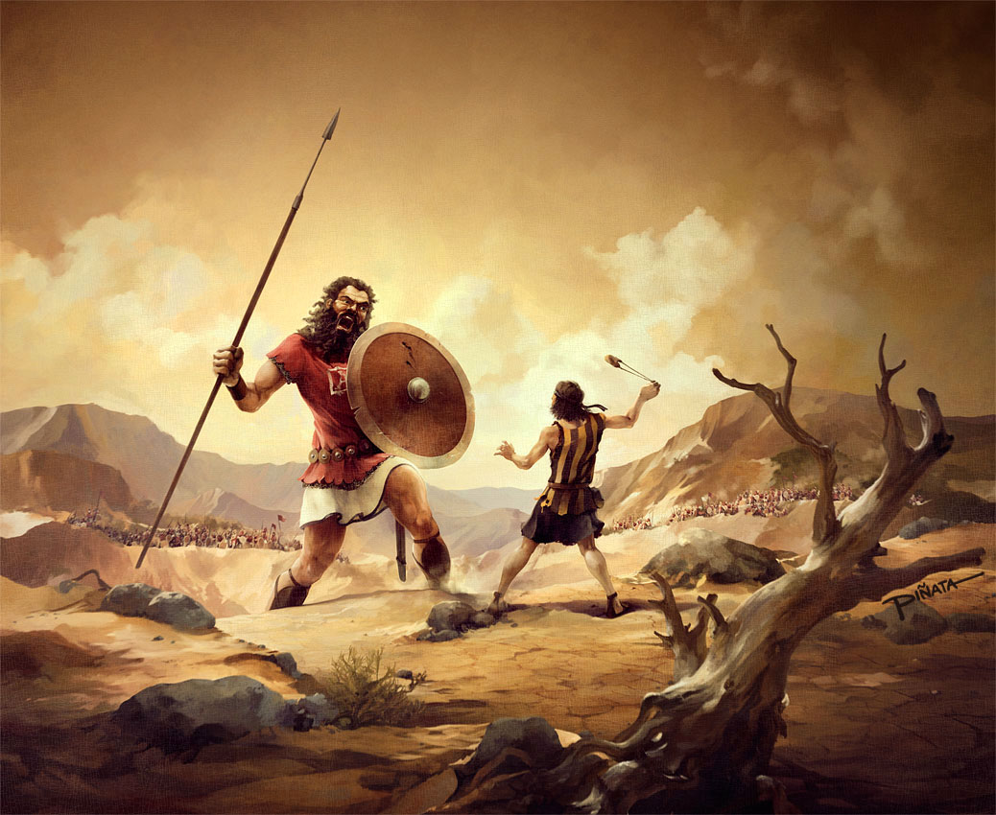
The Battle is the Lord’s

Slide 31
1 Samuel 17:45-50
The battle is the Lord’s
Then David said to the Philistine, "You come to me with a sword, with a spear, and with a javelin. But I come to you in the name of the Lord of hosts, the God of the armies of Israel, whom you have defied. 46 This day the Lord will deliver you into my hand, and I will strike you and take your head from you. And this day I will give the carcasses of the camp of the Philistines to the birds of the air and the wild beasts of the earth, that all the earth may know that there is a God in Israel. 47 Then all this assembly shall know that the Lord does not save with sword and spear; for the battle is the Lord's, and He will give you into our hands."
48 So it was, when the Philistine arose and came and drew near to meet David, that David hurried and ran toward the army to meet the Philistine. 49 Then David put his hand in his bag and took out a stone; and he slung it and struck the Philistine in his forehead, so that the stone sank into his forehead, and he fell on his face to the earth. 50 So David prevailed over the Philistine with a sling and a stone, and struck the Philistine and killed him. But there was no sword in the hand of David.
Keep David’s perspective!

Slide 32
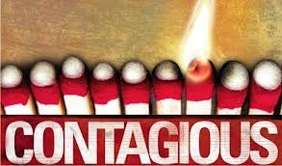
David’s Faith & Enthusiasm were contagious
Contagious Faith!
The army was fearful & deserting
David stepped forward believing God can do the impossible
David used the skill he already had & God made the impossible happen
The fearful Israelites were energized and motivated to attack the Philistines (v.53)
Kings are leaders: we can go home & motivate our ecclesias & families

Slide 33
1 Samuel 19:9-16
David resists taking vengeance
9 Now the distressing spirit from the Lord came upon Saul as he sat in his house with his spear in his hand. And David was playing music with his hand. 10 Then Saul sought to pin David to the wall with the spear, but he slipped away from Saul's presence; and he drove the spear into the wall. So David fled and escaped that night.
11 Saul also sent messengers to David's house to watch him and to kill him in the morning. And Michal, David's wife, told him, saying, "If you do not save your life tonight, tomorrow you will be killed." 12 So Michal let David down through a window. And he went and fled and escaped. 13 And Michal took an image and laid it in the bed, put a cover of goats' hair for his head, and covered it with clothes. 14 So when Saul sent messengers to take David, she said, "He is sick."
15 Then Saul sent the messengers back to see David, saying, "Bring him up to me in the bed, that I may kill him.“
David humbled himself and ran away

Slide 34
1 Samuel 24:4-7
David waited on God
4 Then the men of David said to him, "This is the day of which the Lord said to you, 'Behold, I will deliver your enemy into your hand, that you may do to him as it seems good to you.'" And David arose and secretly cut off a corner of Saul's robe. 5 Now it happened afterward that David's heart troubled him because he had cut Saul's robe. 6 And he said to his men, "The Lord forbid that I should do this thing to my master, the Lord's anointed, to stretch out my hand against him, seeing he is the anointed of the Lord." 7 So David restrained his servants with these words, and did not allow them to rise against Saul. And Saul got up from the cave and went on his way.
David trusted God’s ways

Slide 35
1 Samuel 26:7-12
David believed God would act for him
7 So David and Abishai came to the people by night; and there Saul lay sleeping within the camp, with his spear stuck in the ground by his head. And Abner and the people lay all around him. 8 Then Abishai said to David, "God has delivered your enemy into your hand this day. Now therefore, please, let me strike him at once with the spear, right to the earth; and I will not have to strike him a second time!"
9 But David said to Abishai, "Do not destroy him; for who can stretch out his hand against the Lord's anointed, and be guiltless?" 10 David said furthermore, "As the Lord lives, the Lord shall strike him, or his day shall come to die, or he shall go out to battle and perish. 11 The Lord forbid that I should stretch out my hand against the Lord's anointed. But please, take now the spear and the jug of water that are by his head, and let us go."
David waited for God to act!

Slide 36
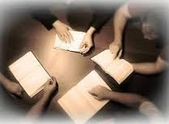
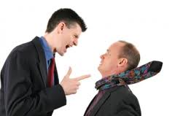
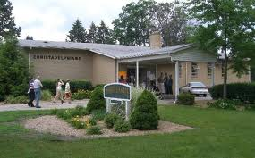
Everything is God’s. We only need to do our part!
Don’t need to hammer the gospel into people
Ecclesial discussions
God’s Ecclesia

Slide 37
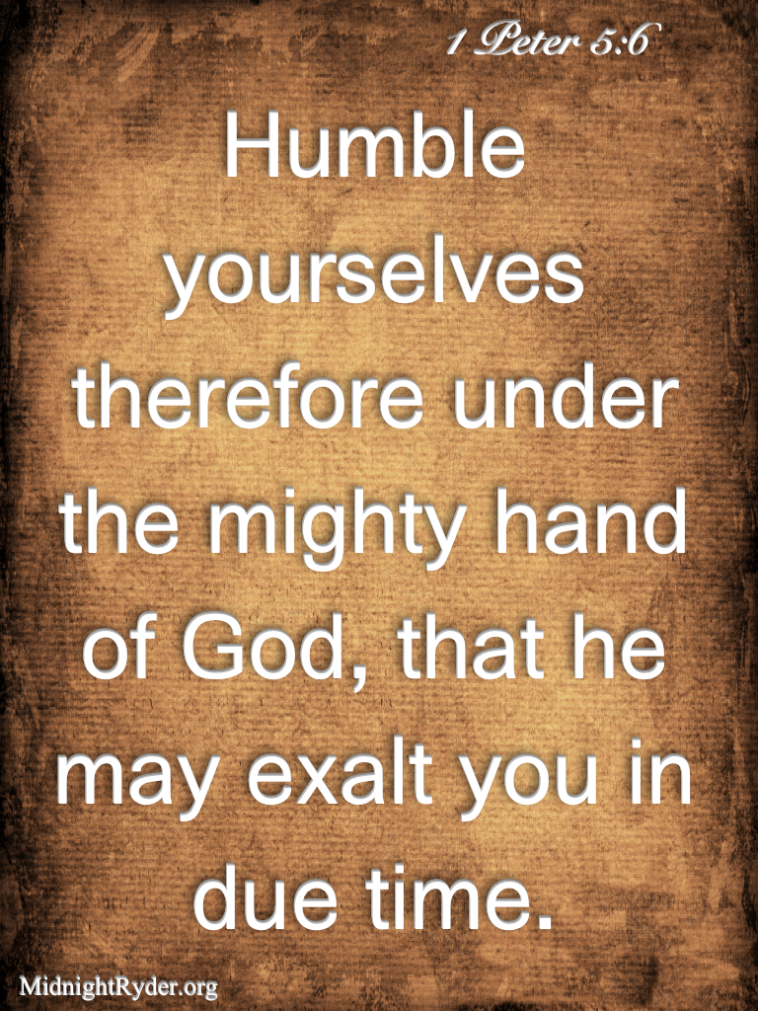
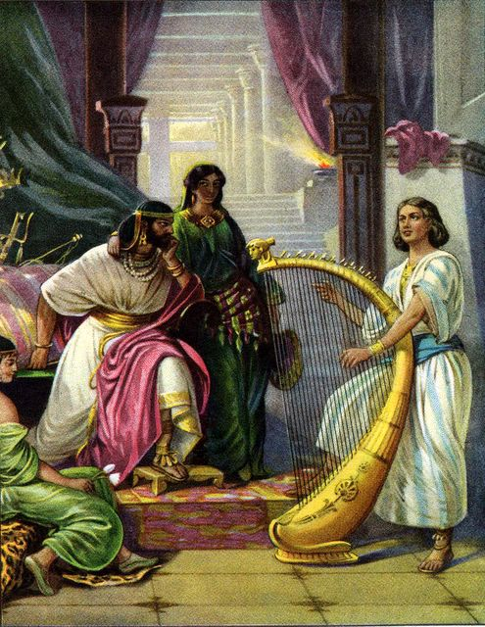
2
S
G

Slide 38
1 Samuel 18:20-24
David remained humble
20 Now Michal, Saul's daughter, loved David. And they told Saul, and the thing pleased him. 21 So Saul said, "I will give her to him, that she may be a snare to him, and that the hand of the Philistines may be against him." Therefore Saul said to David a second time, "You shall be my son-in-law today."
22 And Saul commanded his servants, "Communicate with David secretly, and say, 'Look, the king has delight in you, and all his servants love you. Now therefore, become the king's son-in-law.'"
23 So Saul's servants spoke those words in the hearing of David. And David said, "Does it seem to you a light thing to be a king's son-in-law, seeing I am a poor and lightly esteemed man?" 24 And the servants of Saul told him, saying, "In this manner David spoke.“
David came to realize Saul’s intentions!

Slide 39
1 Samuel 19:1-8
David’s continued faithfulness
19 Now Saul spoke to Jonathan his son and to all his servants, that they should kill David; but Jonathan, Saul's son, delighted greatly in David. 2 So Jonathan told David, saying, "My father Saul seeks to kill you. Therefore please be on your guard until morning, and stay in a secret place and hide. 3 And I will go out and stand beside my father in the field where you are, and I will speak with my father about you. Then what I observe, I will tell you."
4 Thus Jonathan spoke well of David to Saul his father, and said to him, "Let not the king sin against his servant, against David, because he has not sinned against you, and because his works have been very good toward you. 5 For he took his life in his hands and killed the Philistine, and the Lord brought about a great deliverance for all Israel. You saw it and rejoiced. Why then will you sin against innocent blood, to kill David without a cause?"
6 So Saul heeded the voice of Jonathan, and Saul swore, "As the Lord lives, he shall not be killed." 7 Then Jonathan called David, and Jonathan told him all these things. So Jonathan brought David to Saul, and he was in his presence as in times past.
8 And there was war again; and David went out and fought with the Philistines, and struck them with a mighty blow, and they fled from him.
We need faithfulness during tough times!

Slide 40
1 Samuel 18:1-4
David attracted Godly men
1 Now when he had finished speaking to Saul, the soul of Jonathan was knit to the soul of David, and Jonathan loved him as his own soul. 2 Saul took him that day, and would not let him go home to his father's house anymore. 3 Then Jonathan and David made a covenant, because he loved him as his own soul. 4 And Jonathan took off the robe that was on him and gave it to David, with his armor, even to his sword and his bow and his belt.
David’s faith was genuine & contagious

Slide 41
1 Samuel 18:5-9
Saul becomes jealous of David
5 So David went out wherever Saul sent him, and behaved wisely. And Saul set him over the men of war, and he was accepted in the sight of all the people and also in the sight of Saul's servants. 6 Now it had happened as they were coming home, when David was returning from the slaughter of the Philistine, that the women had come out of all the cities of Israel, singing and dancing, to meet King Saul, with tambourines, with joy, and with musical instruments. 7 So the women sang as they danced, and said:
"Saul has slain his thousands, and David his ten thousands."
8 Then Saul was very angry, and the saying displeased him; and he said, "They have ascribed to David ten thousands, and to me they have ascribed only thousands. Now what more can he have but the kingdom?" 9 So Saul eyed David from that day forward.
David remained humble & faithful

Slide 42
Kings in Practice
David had a close relationship with God
David was jealous for the Lord God of Israel, not jealous of other people like Saul
David was aware that the battles are the Lord’s & completely trusted God’s ability to save
David’s faith was living & active so it became contagious
David waited on God, and did not take vengeance
David remained humble and faithful to God
David attracted other Godly men to him
Walking in the light of God’s word
David made some mistakes, but he practiced righteousness

Slide 43
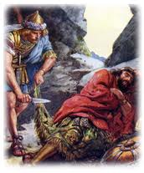
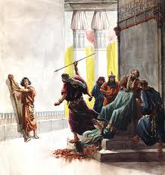
Dealing with Disappointments in Life
David had a lot of discouraging times

Slide 44
1 Samuel 20:28-34
Saul’s mistreatment of Jonathan
28 So Jonathan answered Saul, "David earnestly asked permission of me to go to Bethlehem. 29 And he said, 'Please let me go, for our family has a sacrifice in the city, and my brother has commanded me to be there. And now, if I have found favor in your eyes, please let me get away and see my brothers.' Therefore he has not come to the king's table."
30 Then Saul's anger was aroused against Jonathan, and he said to him, "You son of a perverse, rebellious woman! Do I not know that you have chosen the son of Jesse to your own shame and to the shame of your mother's nakedness? 31 For as long as the son of Jesse lives on the earth, you shall not be established, nor your kingdom. Now therefore, send and bring him to me, for he shall surely die."
32 And Jonathan answered Saul his father, and said to him, "Why should he be killed? What has he done?" 33 Then Saul cast a spear at him to kill him, by which Jonathan knew that it was determined by his father to kill David.
34 So Jonathan arose from the table in fierce anger, and ate no food the second day of the month, for he was grieved for David, because his father had treated him shamefully.
Now David knew Saul’s intentions for sure

Slide 45
1 Samuel 20:35-42
David had to deal with discouraging events
And so it was, in the morning, that Jonathan went out into the field at the time appointed with David, and a little lad was with him. 36 Then he said to his lad, "Now run, find the arrows which I shoot." As the lad ran, he shot an arrow beyond him.
41 As soon as the lad had gone, David arose from a place toward the south, fell on his face to the ground, and bowed down three times. And they kissed one another; and they wept together, but David more so. 42 Then Jonathan said to David, "Go in peace, since we have both sworn in the name of the Lord, saying, 'May the Lord be between you and me, and between your descendants and my descendants, forever.'" So he arose and departed, and Jonathan went into the city.
David knew God was in control & trusted Him

Slide 46
1 Samuel 21:1-3, 7
David felt responsibility
Now David came to Nob, to Ahimelech the priest. And Ahimelech was afraid when he met David, and said to him, "Why are you alone, and no one is with you?"
2 So David said to Ahimelech the priest, "The king has ordered me on some business, and said to me, 'Do not let anyone know anything about the business on which I send you, or what I have commanded you.' And I have directed my young men to such and such a place. 3 Now therefore, what have you on hand? Give me five loaves of bread in my hand, or whatever can be found."
7 Now a certain man of the servants of Saul was there that day, detained before the Lord. And his name was Doeg, an Edomite, the chief of the herdsmen who belonged to Saul.
David felt responsible for his actions

Slide 47
1 Samuel 22:9-19
Doeg told on David & Ahimelech
9 Then answered Doeg the Edomite, who was set over the servants of Saul, and said, "I saw the son of Jesse going to Nob, to Ahimelech the son of Ahitub. 10 And he inquired of the Lord for him, gave him provisions, and gave him the sword of Goliath the Philistine."
11 So the king sent to call Ahimelech the priest, the son of Ahitub, and all his father's house, the priests who were in Nob. And they all came to the king. 12 And Saul said, "Hear now, son of Ahitub!“ He answered, "Here I am, my lord."
13 Then Saul said to him, "Why have you conspired against me, you and the son of Jesse, in that you have given him bread and a sword, and have inquired of God for him, that he should rise against me, to lie in wait, as it is this day?"
14 So Ahimelech answered the king and said, "And who among all your servants is as faithful as David, who is the king's son-in-law, who goes at your bidding, and is honorable in your house? 15 Did I then begin to inquire of God for him? Far be it from me! Let not the king impute anything to his servant, or to any in the house of my father. For your servant knew nothing of all this, little or much."
We are responsible for our choices & actions

Slide 48
1 Samuel 22:9-19
David had to carry this the rest of his life
16 And the king said, "You shall surely die, Ahimelech, you and all your father's house!" 17 Then the king said to the guards who stood about him, "Turn and kill the priests of the Lord, because their hand also is with David, and because they knew when he fled and did not tell it to me." But the servants of the king would not lift their hands to strike the priests of the Lord. 18 And the king said to Doeg, "You turn and kill the priests!" So Doeg the Edomite turned and struck the priests, and killed on that day eighty-five men who wore a linen ephod. 19 Also Nob, the city of the priests, he struck with the edge of the sword, both men and women, children and nursing infants, oxen and donkeys and sheep — with the edge of the sword.
Now one of the sons of Ahimelech the son of Ahitub, named Abiathar, escaped and fled after David. 21 And Abiathar told David that Saul had killed the Lord's priests. 22 So David said to Abiathar, "I knew that day, when Doeg the Edomite was there, that he would surely tell Saul. I have caused the death of all the persons of your father's house. 23 Stay with me; do not fear. For he who seeks my life seeks your life, but with me you shall be safe."
Responsibility helps shape our characters

Slide 49
Matthew 12:1-8
Jesus comments on David’s actions
1 At that time Jesus went through the grainfields on the Sabbath. And His disciples were hungry, and began to pluck heads of grain and to eat. 2 And when the Pharisees saw it, they said to Him, "Look, Your disciples are doing what is not lawful to do on the Sabbath!"
3 But He said to them, "Have you not read what David did when he was hungry, he and those who were with him: 4 how he entered the house of God and ate the showbread which was not lawful for him to eat, nor for those who were with him, but only for the priests? 5 Or have you not read in the law that on the Sabbath the priests in the temple profane the Sabbath, and are blameless? 6 Yet I say to you that in this place there is One greater than the temple. 7 But if you had known what this means, 'I desire mercy and not sacrifice,' you would not have condemned the guiltless. 8 For the Son of Man is Lord even of the Sabbath.”
David understood that showing mercy to starving men ranked more important than the procedures of the law

Slide 50


How would you have ranked these laws?
Keep the Sabbath
Priests eat showbread
Circumcise on 8th day
Keep the Sabbath
Honor a covenant
Master/slave relationship
Priest offer sacrifice
Feed hungry people
Keep the Sabbath
Heal someone
Kill lying Gibeonites
Husband/wife relationship
This is the challenge for all parents and AB’s

Slide 51
1 Samuel 23:1-5
David’s willingness to help others
Then they told David, saying, "Look, the Philistines are fighting against Keilah, and they are robbing the threshing floors."
2 Therefore David inquired of the Lord, saying, "Shall I go and attack these Philistines?“
And the Lord said to David, "Go and attack the Philistines, and save Keilah."
3 But David's men said to him, "Look, we are afraid here in Judah. How much more then if we go to Keilah against the armies of the Philistines?" 4 Then David inquired of the Lord once again. And the Lord answered him and said, "Arise, go down to Keilah. For I will deliver the Philistines into your hand." 5 And David and his men went to Keilah and fought with the Philistines, struck them with a mighty blow, and took away their livestock. So David saved the inhabitants of Keilah.
These same people were willing to turn David over to Saul!

Slide 52
1 Chronicles 28:2-3
David was a willing servant of his people
2 Then King David rose to his feet and said, "Hear me, my brethren and my people: I had it in my heart to build a house of rest for the ark of the covenant of the Lord, and for the footstool of our God, and had made preparations to build it.
We must remember that God has blessed us with the privilege of working with and serving His people

Slide 53
1 Samuel 24:1-7
David refused to take vengeance
24 Now it happened, when Saul had returned from following the Philistines, that it was told him, saying, "Take note! David is in the Wilderness of En Gedi." 2 Then Saul took three thousand chosen men from all Israel, and went to seek David and his men on the Rocks of the Wild Goats. 3 So he came to the sheepfolds by the road, where there was a cave; and Saul went in to attend to his needs. (David and his men were staying in the recesses of the cave.)
4 Then the men of David said to him, "This is the day of which the Lord said to you, 'Behold, I will deliver your enemy into your hand, that you may do to him as it seems good to you.'" And David arose and secretly cut off a corner of Saul's robe. 5 Now it happened afterward that David's heart troubled him because he had cut Saul's robe. 6 And he said to his men, "The Lord forbid that I should do this thing to my master, the Lord's anointed, to stretch out my hand against him, seeing he is the anointed of the Lord." 7 So David restrained his servants with these words, and did not allow them to rise against Saul. And Saul got up from the cave and went on his way.
!

Slide 54
Kings in Practice
Accepted disappointments in life from God
Willing to help those who would do him wrong
Felt the responsibility of causing others trouble even death!
Lived with the burden of the mistakes he had made – but forged ahead through faith in God
Willing to help even those who would betray him or do him wrong
Refused to take vengeance, but left it in God’s hands.
Walking in the light of God’s word
David made some mistakes, but he practiced righteousness

Slide 55

Lessons from Today
Remember God designed our families to help train us to live in His family
Practice shepherding God’s family
Stay humble so you will serve where needed
Develop a contagious faith like David’s
Deal with disappointments – accept God’s will
Remember: the battles are the Lord’s
Don’t take vengeance – God is in control
God wants obedience, not rituals

Slide 56
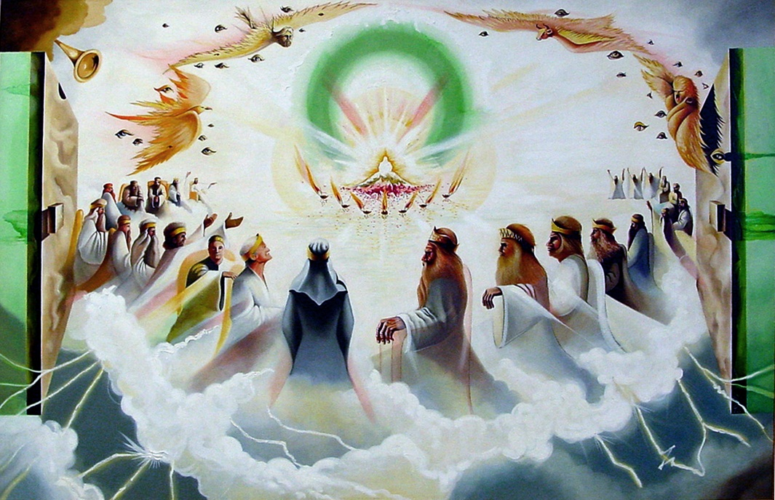
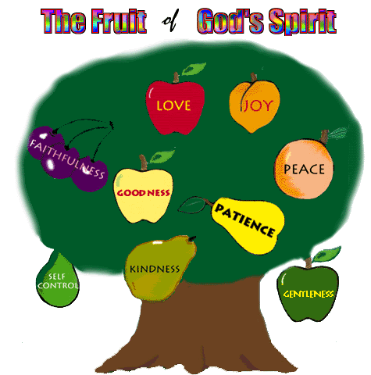
Let’s go home & practice living in God’s family now!
We hope to be kings for our God

Slide 57
2
S
G

