Slide 1
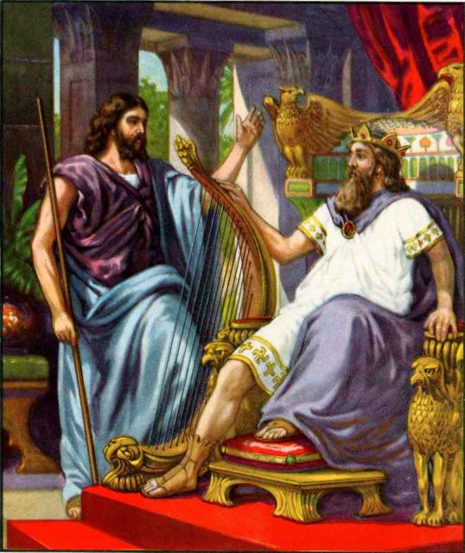
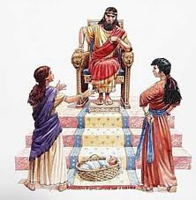
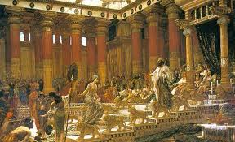
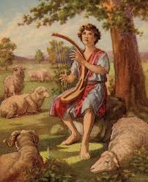
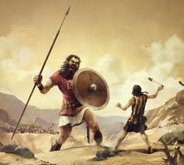
Class 2: Even Kings make Mistakes
David & Solomon: Kings in Practice

Slide 2
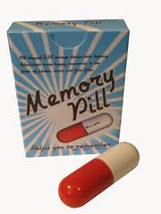
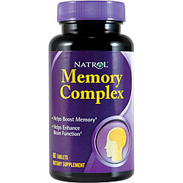
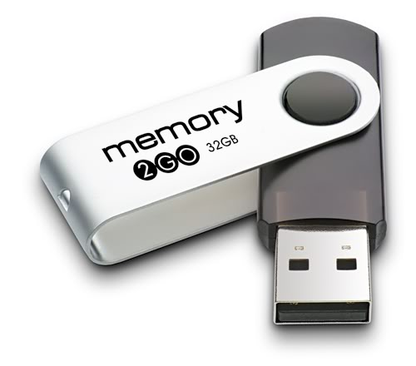
Memory pills?
Memory sticks might have to suffice!

Slide 3

1 Samuel 19:9-16
David resists taking vengeance
9 Now the distressing spirit from the Lord came upon Saul as he sat in his house with his spear in his hand. And David was playing music with his hand. 10 Then Saul sought to pin David to the wall with the spear, but he slipped away from Saul's presence; and he drove the spear into the wall. So David fled and escaped that night.
11 Saul also sent messengers to David's house to watch him and to kill him in the morning. And Michal, David's wife, told him, saying, "If you do not save your life tonight, tomorrow you will be killed." 12 So Michal let David down through a window. And he went and fled and escaped. 13 And Michal took an image and laid it in the bed, put a cover of goats' hair for his head, and covered it with clothes. 14 So when Saul sent messengers to take David, she said, "He is sick."
15 Then Saul sent the messengers back to see David, saying, "Bring him up to me in the bed, that I may kill him.“
David humbled himself and ran away

Slide 4
1 Samuel 24:4-7
David waited on God
4 Then the men of David said to him, "This is the day of which the Lord said to you, 'Behold, I will deliver your enemy into your hand, that you may do to him as it seems good to you.'" And David arose and secretly cut off a corner of Saul's robe. 5 Now it happened afterward that David's heart troubled him because he had cut Saul's robe. 6 And he said to his men, "The Lord forbid that I should do this thing to my master, the Lord's anointed, to stretch out my hand against him, seeing he is the anointed of the Lord." 7 So David restrained his servants with these words, and did not allow them to rise against Saul. And Saul got up from the cave and went on his way.
David trusted God’s ways

Slide 5
1 Samuel 26:7-12
David believed God would act for him
7 So David and Abishai came to the people by night; and there Saul lay sleeping within the camp, with his spear stuck in the ground by his head. And Abner and the people lay all around him. 8 Then Abishai said to David, "God has delivered your enemy into your hand this day. Now therefore, please, let me strike him at once with the spear, right to the earth; and I will not have to strike him a second time!"
9 But David said to Abishai, "Do not destroy him; for who can stretch out his hand against the Lord's anointed, and be guiltless?" 10 David said furthermore, "As the Lord lives, the Lord shall strike him, or his day shall come to die, or he shall go out to battle and perish. 11 The Lord forbid that I should stretch out my hand against the Lord's anointed. But please, take now the spear and the jug of water that are by his head, and let us go."
David waited for God to act!

Slide 6
Psalm 34:7
David felt God’s presence
7 The angel of the LORD encamps all around those who fear Him, and delivers them.
Note the context: David was scared and came up with a plan. Act like an insane person before Achish so he would let him live. On the surface it looked like David was just scheming his way through the problem. David did act, but in his own mind, he was fully aware of God’s angel helping him through the situation.

Slide 7
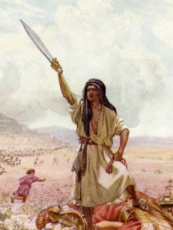
Taking Personal Vengeance!
Rather than waiting for God

Slide 8
1 Samuel 25
David’s request to Nabal
1 Then Samuel died; and the Israelites gathered together and lamented for him, and buried him at his home in Ramah. And David arose and went down to the Wilderness of Paran.
2 Now there was a man in Maon whose business was in Carmel, and the man was very rich. He had three thousand sheep and a thousand goats. And he was shearing his sheep in Carmel. 3 The name of the man was Nabal, and the name of his wife Abigail. And she was a woman of good understanding and beautiful appearance; but the man was harsh and evil in his doings. He was of the house of Caleb.
4 When David heard in the wilderness that Nabal was shearing his sheep, 5 David sent ten young men; and David said to the young men, "Go up to Carmel, go to Nabal, and greet him in my name. 6 And thus you shall say to him who lives in prosperity: 'Peace be to you, peace to your house, and peace to all that you have! 7 Now I have heard that you have shearers. Your shepherds were with us, and we did not hurt them, nor was there anything missing from them all the while they were in Carmel. 8 Ask your young men, and they will tell you. Therefore let my young men find favor in your eyes, for we come on a feast day. Please give whatever comes to your hand to your servants and to your son David.'"
9 So when David's young men came, they spoke to Nabal according to all these words in the name of David, and waited.
God expected us to share on feast days

Slide 9
1 Samuel 25
Nabal’s evil response
10 Then Nabal answered David's servants, and said, "Who is David, and who is the son of Jesse? There are many servants nowadays who break away each one from his master. 11 Shall I then take my bread and my water and my meat that I have killed for my shearers, and give it to men when I do not know where they are from?"
12 So David's young men turned on their heels and went back; and they came and told him all these words. 13 Then David said to his men, "Every man gird on his sword." So every man girded on his sword, and David also girded on his sword. And about four hundred men went with David, and two hundred stayed with the supplies.
☹ David responded like Saul ☹

Slide 10
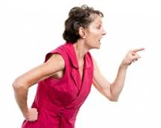
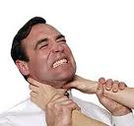
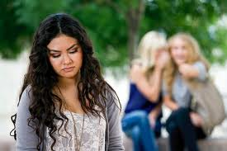
We all make mistakes….
God is looking at how we react to the mistakes of others!

Slide 11
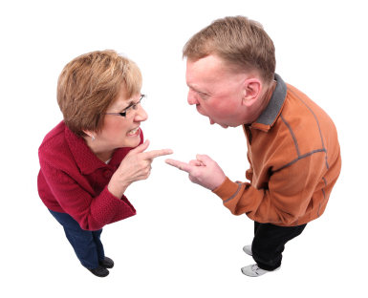
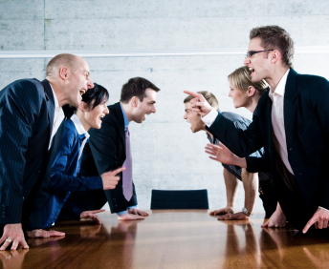
Our young people are watching how we respond to ecclesial & family conflicts!
Angels are watching too!

Slide 12
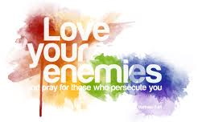
Luke 6:35-36
Living like God
35 But love your enemies, do good, and lend, hoping for nothing in return; and your reward will be great, and you will be sons of the Most High. For He is kind to the unthankful and evil. 36 Therefore be merciful, just as your Father also is merciful.
David needed some help showing God’s mercy to those who were unkind to him

Slide 13
1 Samuel 25
Abigail finds out
14 Now one of the young men told Abigail, Nabal's wife, saying, "Look, David sent messengers from the wilderness to greet our master; and he reviled them. 15 But the men were very good to us, and we were not hurt, nor did we miss anything as long as we accompanied them, when we were in the fields. 16 They were a wall to us both by night and day, all the time we were with them keeping the sheep. 17 Now therefore, know and consider what you will do, for harm is determined against our master and against all his household. For he is such a scoundrel that one cannot speak to him.”
They know David will respond!

Slide 14
1 Samuel 25
Abigail makes a plan!
18 Then Abigail made haste and took two hundred loaves of bread, two skins of wine, five sheep already dressed, five seahs of roasted grain, one hundred clusters of raisins, and two hundred cakes of figs, and loaded them on donkeys. 19 And she said to her servants, "Go on before me; see, I am coming after you." But she did not tell her husband Nabal.
20 So it was, as she rode on the donkey, that she went down under cover of the hill; and there were David and his men, coming down toward her, and she met them. 21 Now David had said, "Surely in vain I have protected all that this fellow has in the wilderness, so that nothing was missed of all that belongs to him. And he has repaid me evil for good. 22 May God do so, and more also, to the enemies of David, if I leave one male of all who belong to him by morning light.“
David justified his anger!

Slide 15
1 Samuel 25
Abigail takes the blame!
23 Now when Abigail saw David, she dismounted quickly from the donkey, fell on her face before David, and bowed down to the ground. 24 So she fell at his feet and said: "On me, my lord, on me let this iniquity be! And please let your maidservant speak in your ears, and hear the words of your maidservant. 25 Please, let not my lord regard this scoundrel Nabal. For as his name is, so is he: Nabal is his name, and folly is with him! But I, your maidservant, did not see the young men of my lord whom you sent. 26 Now therefore, my lord, as the Lord lives and as your soul lives, since the Lord has held you back from coming to bloodshed and from avenging yourself with your own hand, now then, let your enemies and those who seek harm for my lord be as Nabal.
She appeals to David’s awareness of God

Slide 16
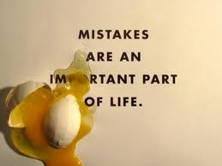
Abigail’s approach to correcting a mistake
Willing to deal with the situation even when it was not her fault
Freely admits the mistake
Willing to share the blame
Appeals to David’s Godly character and his Godly past
Appeals to David’s understanding that God works through the people who interact with us
Mistakes will happen. God waits to see how we will respond!

Slide 17
1 Samuel 25
Abigail remembered Goliath!
27 And now this present which your maidservant has brought to my lord, let it be given to the young men who follow my lord. 28 Please forgive the trespass of your maidservant. For the Lord will certainly make for my lord an enduring house, because my lord fights the battles of the Lord, and evil is not found in you throughout your days. 29 Yet a man has risen to pursue you and seek your life, but the life of my lord shall be bound in the bundle of the living with the Lord your God; and the lives of your enemies He shall sling out, as from the pocket of a sling. 30 And it shall come to pass, when the Lord has done for my lord according to all the good that He has spoken concerning you, and has appointed you ruler over Israel, 31 that this will be no grief to you, nor offense of heart to my lord, either that you have shed blood without cause, or that my lord has avenged himself. But when the Lord has dealt well with my lord, then remember your maidservant.”
She prevented David from making a terrible mistake!

Slide 18
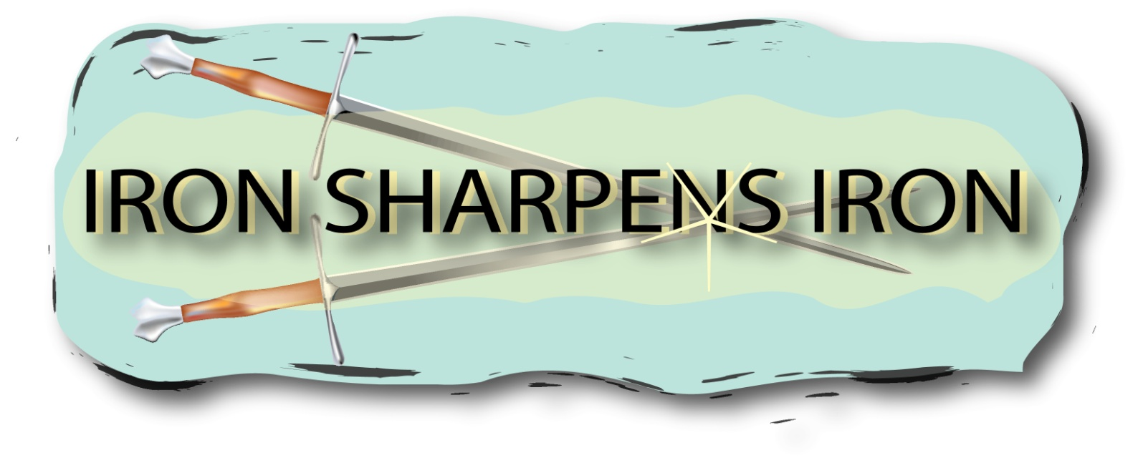
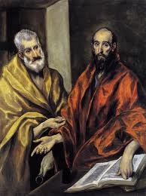
2
S
Galatians 2:11-13 Now when Peter had come to Antioch, I withstood him to his face, because he was to be blamed; 12 for before certain men came from James, he would eat with the Gentiles; but when they came, he withdrew and separated himself, fearing those who were of the circumcision. 13 And the rest of the Jews also played the hypocrite with him, so that even Barnabas was carried away with their hypocrisy.
So patiently listen, consider and respond to the counsel of others

Slide 19
1 Samuel 25
David thanks Abigail for her counsel
32 Then David said to Abigail: "Blessed is the Lord God of Israel, who sent you this day to meet me! 33 And blessed is your advice and blessed are you, because you have kept me this day from coming to bloodshed and from avenging myself with my own hand. 34 For indeed, as the Lord God of Israel lives, who has kept me back from hurting you, unless you had hurried and come to meet me, surely by morning light no males would have been left to Nabal!" 35 So David received from her hand what she had brought him, and said to her, "Go up in peace to your house. See, I have heeded your voice and respected your person.“
David saw God’s hand in Abigail’s actions

Slide 20
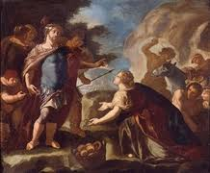
Responding to God’s Angels working in our Lives
God speaks to us through His word, but also through the counsel of others
If we aren’t looking for it, we may miss the Godly guidance others have offered for us to consider
  Prov 11:13 Where there is no counsel, the people fall; But in the multitude of counselors there is safety.
  Prov 15:22 Without counsel, plans go awry, but in the multitude of counselors they are established.
  Prov 19:20 Listen to counsel and receive instruction, that you may be wise in your latter days.
Be in tune with the work of angels

Slide 21
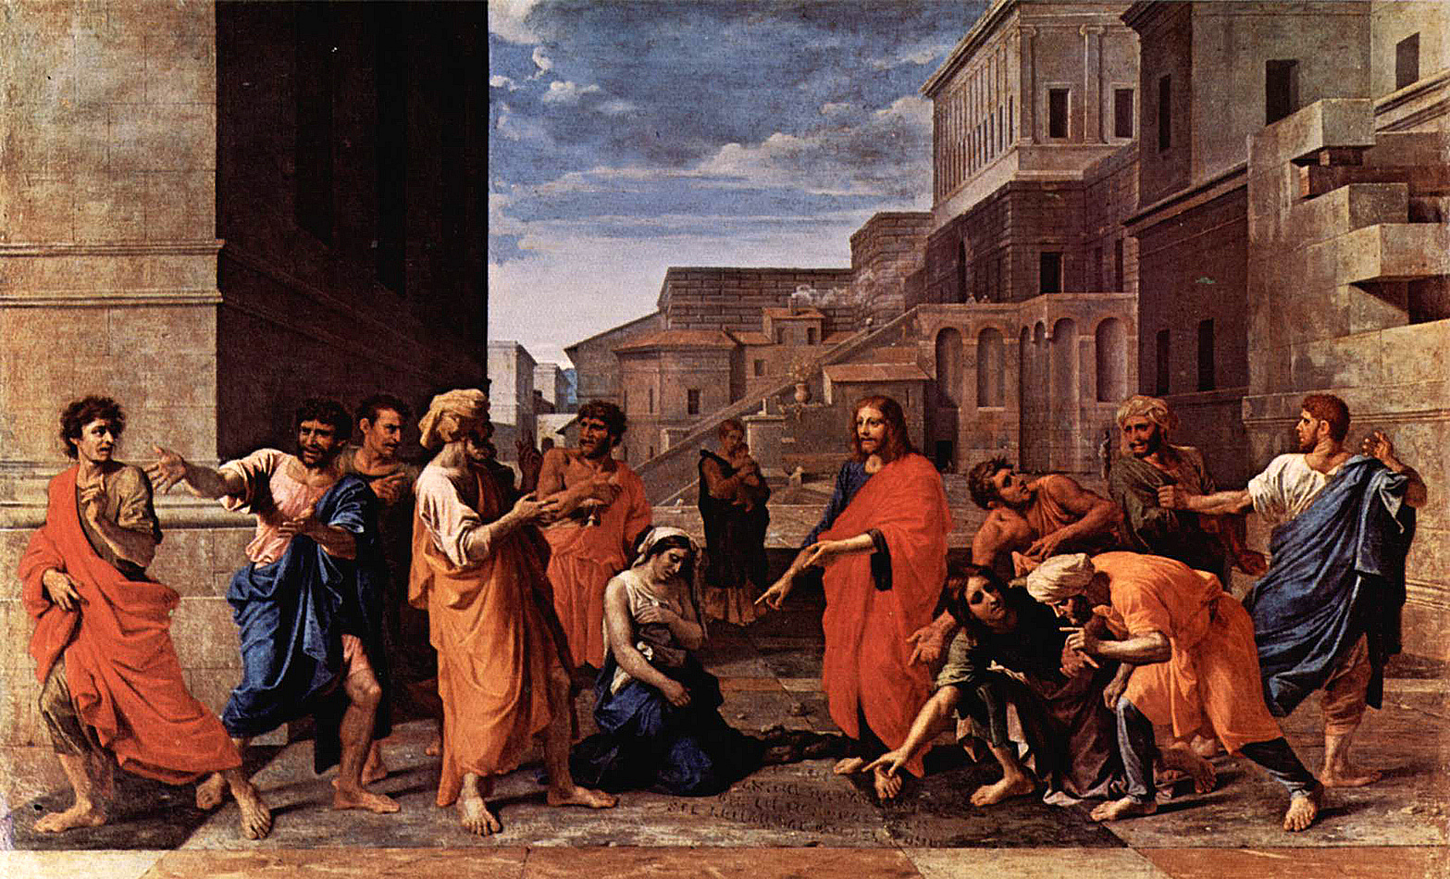
God brings situations into our lives to let us practice being merciful, like God is. As kings we must learn God’s perfect balance of justice and mercy.
The woman taken in adultery

Slide 22
1 Samuel 25
God took care of Nabal!
36 Now Abigail went to Nabal, and there he was, holding a feast in his house, like the feast of a king. And Nabal's heart was merry within him, for he was very drunk; therefore she told him nothing, little or much, until morning light. 37 So it was, in the morning, when the wine had gone from Nabal, and his wife had told him these things, that his heart died within him, and he became like a stone. 38 Then it happened, after about ten days, that the Lord struck Nabal, and he died.
39 So when David heard that Nabal was dead, he said, "Blessed be the Lord, who has pleaded the cause of my reproach from the hand of Nabal, and has kept His servant from evil! For the Lord has returned the wickedness of Nabal on his own head.“
Leave vengeance to God – He knows the best way to handle it!

Slide 23
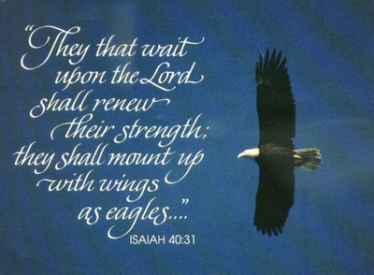

Slide 24
1 Samuel 25
David appreciated Abigail’s kindness
And David sent and proposed to Abigail, to take her as his wife. 40 When the servants of David had come to Abigail at Carmel, they spoke to her saying, "David sent us to you, to ask you to become his wife."
41 Then she arose, bowed her face to the earth, and said, "Here is your maidservant, a servant to wash the feet of the servants of my lord." 42 So Abigail rose in haste and rode on a donkey, attended by five of her maidens; and she followed the messengers of David, and became his wife. 43 David also took Ahinoam of Jezreel, and so both of them were his wives.
44 But Saul had given Michal his daughter, David's wife, to Palti the son of Laish, who was from Gallim.
David had to deal with many disappointments in his life

Slide 25
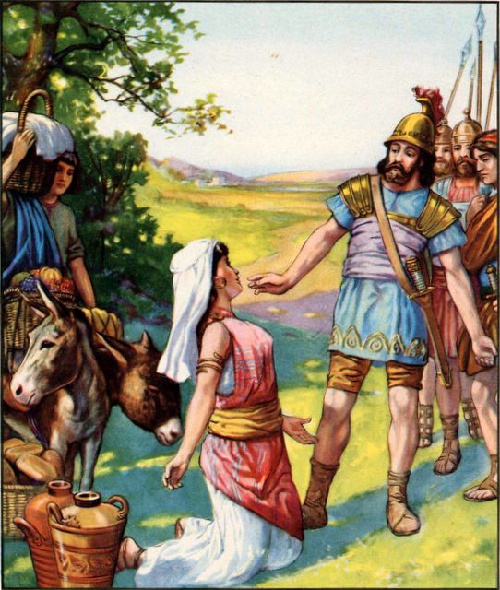
Lessons from David & Abigail
Avenge not yourselves (Rom 12:19)
  Deut 32:35 Vengeance is Mine, and recompense; Their foot shall slip in due time; For the day of their calamity is at hand, and the things to come hasten upon them.'
  God wants to see if we will wait patiently for Him to work things out
Wise people accept counsel & reproof from Godly people
  Prov 12:15 The way of a fool is right in his own eyes, but he who heeds counsel is wise.
  Prov 27:17 Iron sharpens iron, and one man sharpens another.
Patience & Mercy are essential to reign as kings

Slide 26
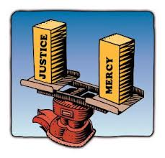
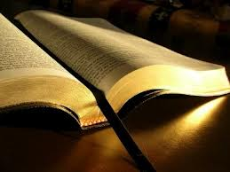
Kings in Practice
David was willing to be corrected, even by a woman
He thanked Abigail when she prevented him from taking vengeance
He was very much aware of God’s direction in his life, looking for it and responding to it
Thanked God for holding him back from Sin
Thanked God for handling his vengeance
Walking in the light of God’s word
David made some mistakes, but he practiced righteousness

Slide 27
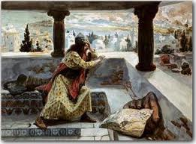
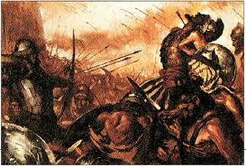
Adultery and Murder!
Rather than faithfulness to his God

Slide 28
2 Samuel 11
David takes Bathsheba
1 It happened in the spring of the year, at the time when kings go out to battle, that David sent Joab and his servants with him, and all Israel; and they destroyed the people of Ammon and besieged Rabbah. But David remained at Jerusalem.
2 Then it happened one evening that David arose from his bed and walked on the roof of the king's house. And from the roof he saw a woman bathing, and the woman was very beautiful to behold. 3 So David sent and inquired about the woman. And someone said, "Is this not Bathsheba, the daughter of Eliam, the wife of Uriah the Hittite?" 4 Then David sent messengers, and took her; and she came to him, and he lay with her, for she was cleansed from her impurity; and she returned to her house. 5 And the woman conceived; so she sent and told David, and said, "I am with child.“
God let her become pregnant!

Slide 29
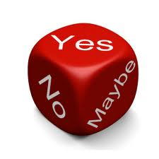
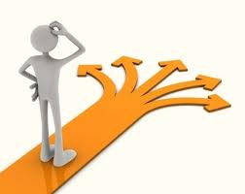
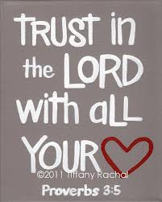
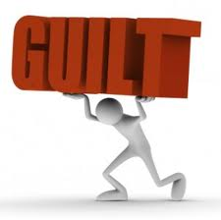
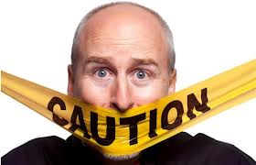

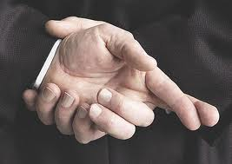
David’s Big Decision!
S
Come clean & trust God or dig deeper into lies

Slide 30
2 Samuel 11
David’s 1st attempt at cover up!
6 Then David sent to Joab, saying, "Send me Uriah the Hittite." And Joab sent Uriah to David. 7 When Uriah had come to him, David asked how Joab was doing, and how the people were doing, and how the war prospered. 8 And David said to Uriah, "Go down to your house and wash your feet." So Uriah departed from the king's house, and a gift of food from the king followed him. 9 But Uriah slept at the door of the king's house with all the servants of his lord, and did not go down to his house. 10 So when they told David, saying, "Uriah did not go down to his house," David said to Uriah, "Did you not come from a journey? Why did you not go down to your house?"
11 And Uriah said to David, "The ark and Israel and Judah are dwelling in tents, and my lord Joab and the servants of my lord are encamped in the open fields. Shall I then go to my house to eat and drink, and to lie with my wife? As you live, and as your soul lives, I will not do this thing."
12 Then David said to Uriah, "Wait here today also, and tomorrow I will let you depart." So Uriah remained in Jerusalem that day and the next. 13 Now when David called him, he ate and drank before him; and he made him drunk. And at evening he went out to lie on his bed with the servants of his lord, but he did not go down to his house.
God frustrated David’s 1st attempt!

Slide 31
2 Samuel 11
David schemes further into sin
14 In the morning it happened that David wrote a letter to Joab and sent it by the hand of Uriah. 15 And he wrote in the letter, saying, "Set Uriah in the forefront of the hottest battle, and retreat from him, that he may be struck down and die." 16 So it was, while Joab besieged the city, that he assigned Uriah to a place where he knew there were valiant men. 17 Then the men of the city came out and fought with Joab. And some of the people of the servants of David fell; and Uriah the Hittite died also.
18 Then Joab sent and told David all the things concerning the war, 19 and charged the messenger, saying, "When you have finished telling the matters of the war to the king, 20 if it happens that the king's wrath rises, and he says to you: 'Why did you approach so near to the city when you fought? Did you not know that they would shoot from the wall? 21 Who struck Abimelech the son of Jerubbesheth? Was it not a woman who cast a piece of a millstone on him from the wall, so that he died in Thebez? Why did you go near the wall?' — then you shall say, 'Your servant Uriah the Hittite is dead also.'“
Looks like David has thought it all out!

Slide 32
2 Samuel 11
The plan is implemented
22 So the messenger went, and came and told David all that Joab had sent by him. 23 And the messenger said to David, "Surely the men prevailed against us and came out to us in the field; then we drove them back as far as the entrance of the gate. 24 The archers shot from the wall at your servants; and some of the king's servants are dead, and your servant Uriah the Hittite is dead also."
25 Then David said to the messenger, "Thus you shall say to Joab: 'Do not let this thing displease you, for the sword devours one as well as another. Strengthen your attack against the city, and overthrow it.' So encourage him."
26 When the wife of Uriah heard that Uriah her husband was dead, she mourned for her husband. 27 And when her mourning was over, David sent and brought her to his house, and she became his wife and bore him a son. But the thing that David had done displeased the Lord.
David might have fooled most people, but we cannot fool God

Slide 33
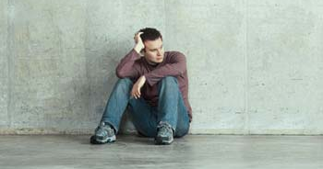
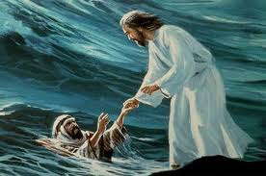
What happens when your heroes fail?
David would have been the hero of many in Israel
  Warrior: killed Goliath
  Spiritual man: respected for his Godly character
Many kids would have grown up looking up to David as their hero – wanting to be like him
Many adults would have looked to David as their spiritual example and leader
Look to Jesus as your hero. He will never fail you!

Slide 34
David’s mistakes
1st Adultery: gives in to passion
2nd Murder: premeditated decision to kill Uriah!
David will learn from it all!

Slide 35
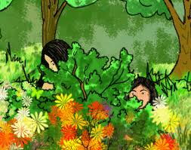
Hiding from God
Academically we know God is aware of our sin
But our mind of the flesh thinks we can get away with hiding it from God
God wants us to acknowledge our sin
  His angels work to make us face our mistakes
  He is looking for genuine repentance with a commitment to change
David finally faced his sin & committed to change – God forgave him!
God can deal with our sins if we are willing to learn from them

Slide 36
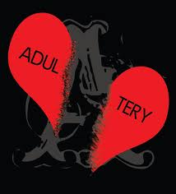
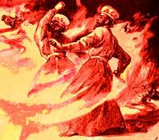
What did David deserve for his sin?
S
So why didn’t God strike him dead?
With the merciful You will show yourself merciful (Psa 18:25)

Slide 37
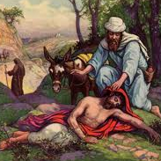
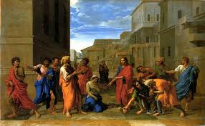
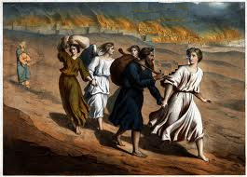
Learning to show mercy
be merciful, just as your Father also is merciful Luke 6:36

Slide 38
2 Samuel 12
Nathan’s simple parable
1 Then the Lord sent Nathan to David. And he came to him, and said to him: "There were two men in one city, one rich and the other poor. 2 The rich man had exceedingly many flocks and herds. 3 But the poor man had nothing, except one little ewe lamb which he had bought and nourished; and it grew up together with him and with his children. It ate of his own food and drank from his own cup and lay in his bosom; and it was like a daughter to him. 4 And a traveler came to the rich man, who refused to take from his own flock and from his own herd to prepare one for the wayfaring man who had come to him; but he took the poor man's lamb and prepared it for the man who had come to him."
5 So David's anger was greatly aroused against the man, and he said to Nathan, "As the Lord lives, the man who has done this shall surely die! 6 And he shall restore fourfold for the lamb, because he did this thing and because he had no pity.“
God gets David to acknowledge the severity of the sin

Slide 39
2 Samuel 12
God can forgive our mistakes!
7 Then Nathan said to David, "You are the man! Thus says the Lord God of Israel: 'I anointed you king over Israel, and I delivered you from the hand of Saul. 8 I gave you your master's house and your master's wives into your keeping, and gave you the house of Israel and Judah. And if that had been too little, I also would have given you much more! 9 Why have you despised the commandment of the Lord, to do evil in His sight? You have killed Uriah the Hittite with the sword; you have taken his wife to be your wife, and have killed him with the sword of the people of Ammon. 10 Now therefore, the sword shall never depart from your house, because you have despised Me, and have taken the wife of Uriah the Hittite to be your wife.' 11 Thus says the Lord: 'Behold, I will raise up adversity against you from your own house; and I will take your wives before your eyes and give them to your neighbor, and he shall lie with your wives in the sight of this sun. 12 For you did it secretly, but I will do this thing before all Israel, before the sun.'"
13 So David said to Nathan, "I have sinned against the Lord.“
And Nathan said to David, "The Lord also has put away your sin; you shall not die. 14 However, because by this deed you have given great occasion to the enemies of the Lord to blaspheme, the child also who is born to you shall surely die." 15 Then Nathan departed to his house.
Psalm 32: David’s joy for forgiveness!

Slide 40
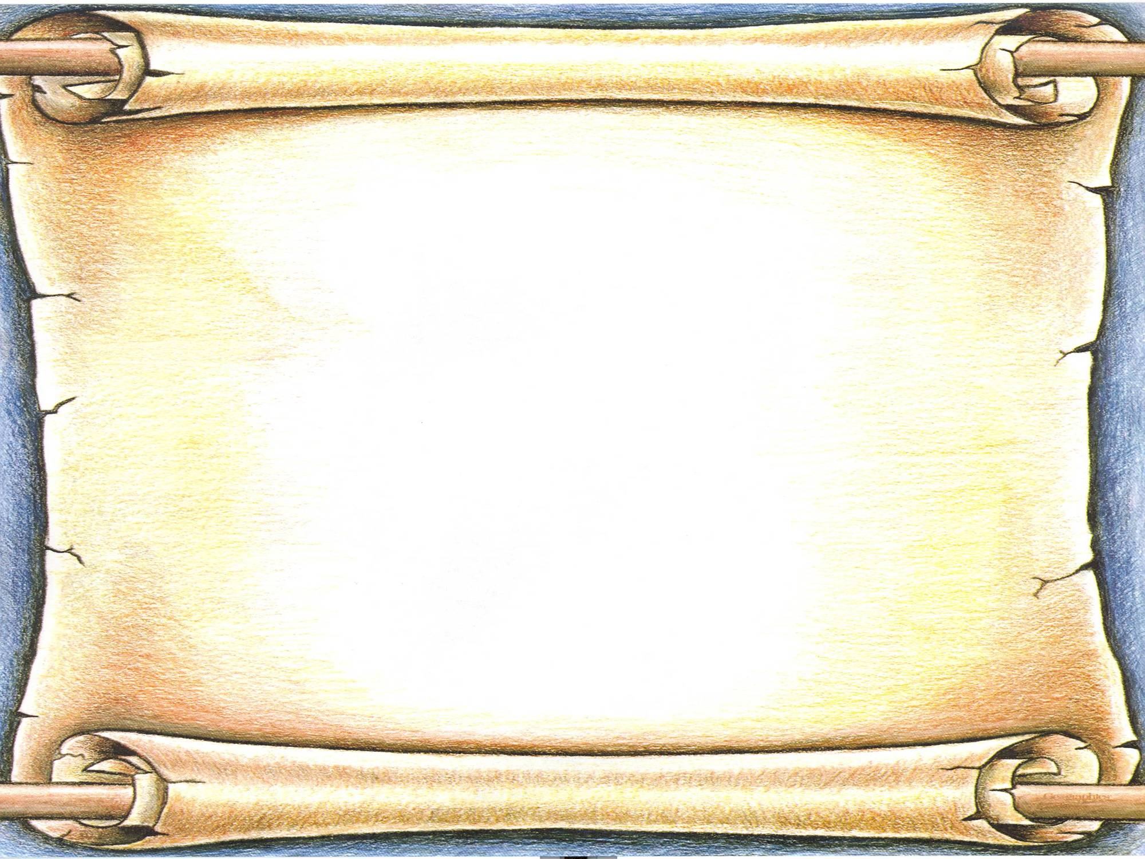
Forgiveness is not something we do for other people. We do it for ourselves - to get well and move on!
A different perspective…

Slide 41
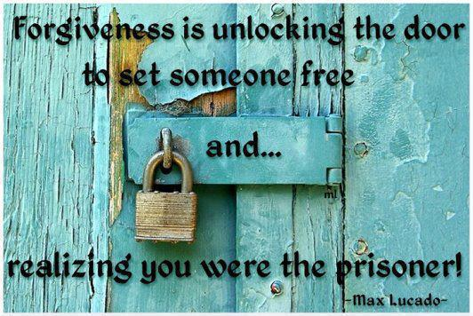

Slide 42
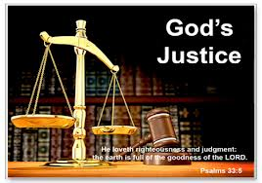
Let God deal out the consequences!
He knows exactly what will be best for everyone involved
He is far more merciful that we are!
  1 Chron 21:13 Please let me fall into the hand of the Lord, for His mercies are very great; but do not let me fall into the hand of man."
Who would you rather have deal out the consequences for your mistakes!
Whatever you want men to do to you, do also to them (Mat 7:12)

Slide 43
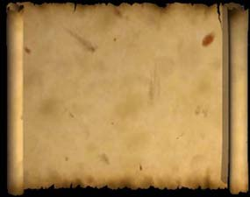
Jesus on Forgiveness….
Forgive and you shall be forgiven” (Lk 6:37)
"For if you forgive men their trespasses, your heavenly Father will also forgive you. But if you do not forgive men their trespasses, neither will your Father forgive your trespasses. (Matt 6:14-15)

Slide 44
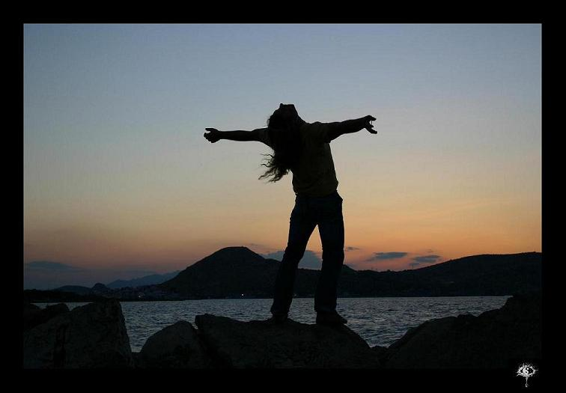
When you forgive, you in no way change the past….
but you sure do change the future!

Slide 45
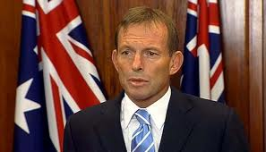
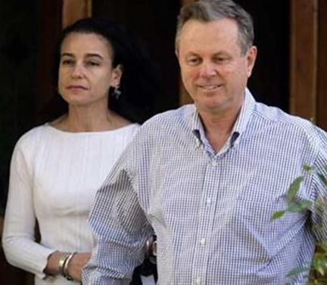
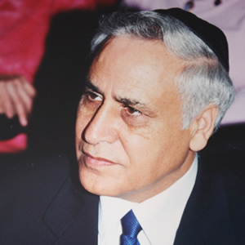
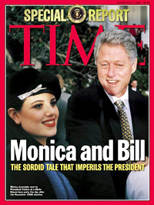
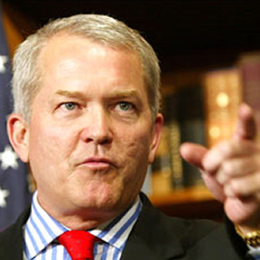
God kept David in Power & Faithful David stayed to work in God’s Family
Without God & David’s faith this would be impossible!

Slide 46


Numbering all Israel
Rather than following God’s ways & trusting Him to provide

Slide 47
1 Chronicles 21:1-6
David numbers all Israel
1 Now Satan stood up against Israel, and moved David to number Israel. 2 So David said to Joab and to the leaders of the people, "Go, number Israel from Beersheba to Dan, and bring the number of them to me that I may know it."
3 And Joab answered, "May the Lord make His people a hundred times more than they are. But, my lord the king, are they not all my lord's servants? Why then does my lord require this thing? Why should he be a cause of guilt in Israel?"
4 Nevertheless the king's word prevailed against Joab. Therefore Joab departed and went throughout all Israel and came to Jerusalem. 5 Then Joab gave the sum of the number of the people to David. All Israel had one million one hundred thousand men who drew the sword, and Judah had four hundred and seventy thousand men who drew the sword. 6 But he did not count Levi and Benjamin among them, for the king's word was abominable to Joab.
Even Joab knew this was wrong!

Slide 48
Numbers 1:1-4
Directions for census
1 Now the Lord spoke to Moses in the Wilderness of Sinai, in the tabernacle of meeting, on the first day of the second month, in the second year after they had come out of the land of Egypt, saying: 2 "Take a census of all the congregation of the children of Israel, by their families, by their fathers' houses, according to the number of names, every male individually, 3 from twenty years old and above — all who are able to go to war in Israel. You and Aaron shall number them by their armies.
Males, 20 years old and up

Slide 49
Numbers 1:47-51
Don’t number the Levites!
47 But the Levites were not numbered among them by their fathers' tribe; 48 for the Lord had spoken to Moses, saying: 49 "Only the tribe of Levi you shall not number, nor take a census of them among the children of Israel; 50 but you shall appoint the Levites over the tabernacle of the Testimony, over all its furnishings, and over all things that belong to it; they shall carry the tabernacle and all its furnishings; they shall attend to it and camp around the tabernacle.
The Levites belonged to God

Slide 50
Exodus 30:11-16
Half-shekel tax
11 Then the Lord spoke to Moses, saying: 12 "When you take the census of the children of Israel for their number, then every man shall give a ransom for himself to the Lord, when you number them, that there may be no plague among them when you number them. 13 This is what everyone among those who are numbered shall give: half a shekel according to the shekel of the sanctuary (a shekel is twenty gerahs). The half-shekel shall be an offering to the Lord. 14 Everyone included among those who are numbered, from twenty years old and above, shall give an offering to the Lord. 15 The rich shall not give more and the poor shall not give less than half a shekel, when you give an offering to the Lord, to make atonement for yourselves. 16 And you shall take the atonement money of the children of Israel, and shall appoint it for the service of the tabernacle of meeting, that it may be a memorial for the children of Israel before the Lord, to make atonement for yourselves.
David was thinking about the temple!

Slide 51
1 Chronicles 21:7-13
David repents & takes responsibility
7 And God was displeased with this thing; therefore He struck Israel. 8 So David said to God, "I have sinned greatly, because I have done this thing; but now, I pray, take away the iniquity of Your servant, for I have done very foolishly."
9 Then the Lord spoke to Gad, David's seer, saying, 10 "Go and tell David, saying, 'Thus says the Lord: "I offer you three things; choose one of them for yourself, that I may do it to you."'"
11 So Gad came to David and said to him, "Thus says the Lord: 'Choose for yourself, 12 either three years of famine, or three months to be defeated by your foes with the sword of your enemies overtaking you, or else for three days the sword of the Lord — the plague in the land, with the angel of the Lord destroying throughout all the territory of Israel.' Now consider what answer I should take back to Him who sent me."
13 And David said to Gad, "I am in great distress. Please let me fall into the hand of the Lord, for His mercies are very great; but do not let me fall into the hand of man.“
God brings the consequences

Slide 52
The fall out from David’s sin
David takes full responsibility for his sin
God forgave David, but there would still be consequences for his sin
God used this event to bring judgment on some in Israel
David clearly understood that God is more merciful than we are
David’s fixation on the temple led him down a bad pathway

Slide 53

Lessons from Today
Others may make mistakes, but be careful how you react to their mistakes!
Don’t seek vengeance – leave it to God
Mercy triumphs over judgment
Accept counsel & reproof from Godly people
Admit our mistakes & accept responsibility
God forgives, but there may be consequences
Let God handle the consequences for sins of others

Slide 54


Let’s go home & practice living in God’s family now!
We hope to be kings for our God

Slide 55
2
S
G

