Slide 1
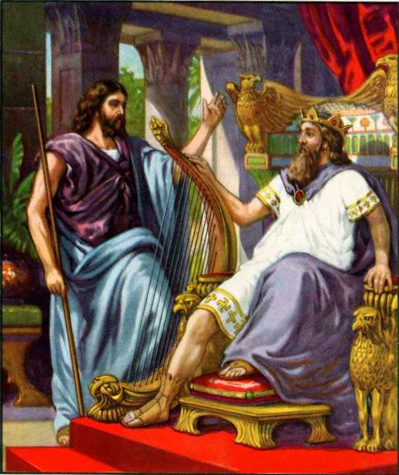
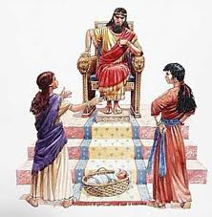
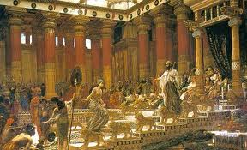
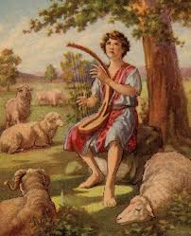
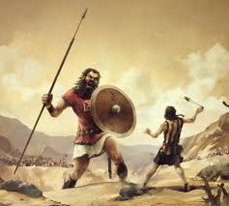
Class 3: Moving on after Disappointments
David & Solomon: Kings in Practice

Slide 2
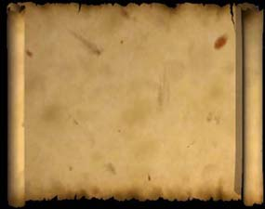
Jesus on Forgiveness….
Forgive and you shall be forgiven” (Lk 6:37)
"For if you forgive men their trespasses, your heavenly Father will also forgive you. But if you do not forgive men their trespasses, neither will your Father forgive your trespasses. (Matt 6:14-15)

Slide 3
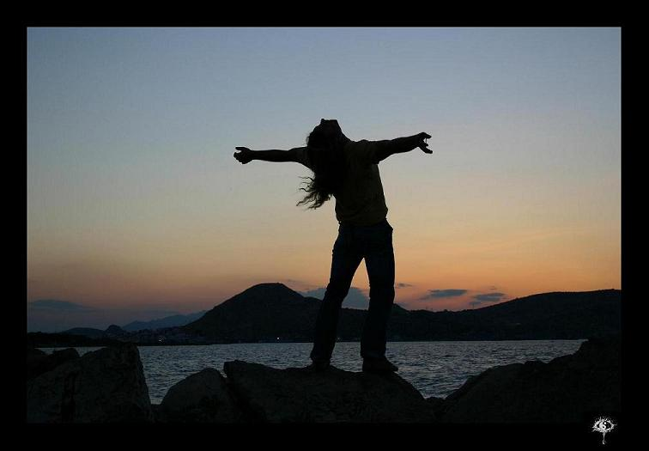
When you forgive, you in no way change the past….
but you sure do change the future!

Slide 4
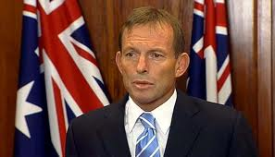
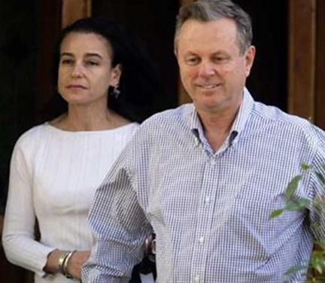
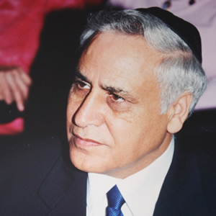
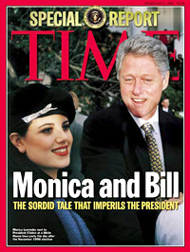
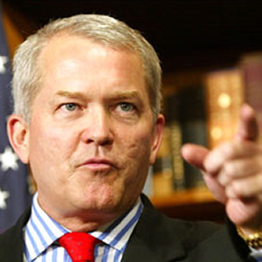
God kept David in Power & Faithful David stayed to work in God’s Family
Without God & David’s faith this would be impossible!

Slide 5

2 Samuel 12:15-23
David’s child dies
And the Lord struck the child that Uriah's wife bore to David, and it became ill. 16 David therefore pleaded with God for the child, and David fasted and went in and lay all night on the ground. 17 So the elders of his house arose and went to him, to raise him up from the ground. But he would not, nor did he eat food with them. 18 Then on the seventh day it came to pass that the child died. And the servants of David were afraid to tell him that the child was dead. For they said, "Indeed, while the child was alive, we spoke to him, and he would not heed our voice. How can we tell him that the child is dead? He may do some harm!"
19 When David saw that his servants were whispering, David perceived that the child was dead. Therefore David said to his servants, "Is the child dead?“
And they said, "He is dead."
David was prepared to accept God’s will & consequences for his sin

Slide 6
2 Samuel 12:15-23
David’s response to his child’s death
20 So David arose from the ground, washed and anointed himself, and changed his clothes; and he went into the house of the Lord and worshiped. Then he went to his own house; and when he requested, they set food before him, and he ate. 21 Then his servants said to him, "What is this that you have done? You fasted and wept for the child while he was alive, but when the child died, you arose and ate food."
22 And he said, "While the child was alive, I fasted and wept; for I said, 'Who can tell whether the Lord will be gracious to me, that the child may live?' 23 But now he is dead; why should I fast? Can I bring him back again? I shall go to him, but he shall not return to me."
David lived in hope, but accepted reality

Slide 7
2 Samuel 12:24-26
David & Bathsheba try again!
24 Then David comforted Bathsheba his wife, and went in to her and lay with her. So she bore a son, and he called his name Solomon [peaceful]. Now the Lord loved him, 25 and He sent word by the hand of Nathan the prophet: So he called his name Jedidiah [loved of Yah], because of the Lord.
David understood the mercy of God and realized that God lets us move forward!
God didn’t make David & Bathsheba split up!

Slide 8
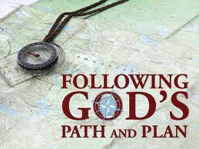
Accepting God’s will & decisions in everything
David was sorry for his sins of adultery with Bathsheba and murder of Uriah
God forgave David, but brought consequences – death of their child & more to come
David pleaded with God for the life of their child, but completely accepted God’s will when he died
David moved forward and tried again with Bathsheba – God blessed this child
These events changed David
Accepting God’s will brings peace!

Slide 9
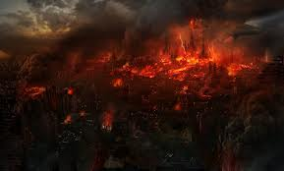
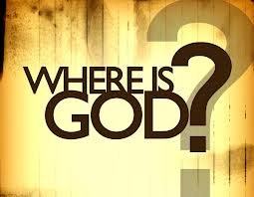
Dealing with disappointment
1 Sam 29: Philistine princes would not allow David & his men to join them in battle
1 Sam 30: The Amalakites raided Ziklag, burned it, & took all the families captive
  David was greatly distressed, & his men spoke of stoning him (v.6)
  David strengthened himself in the Lord his God (v.6)
  David inquired of God through Abiathar
Saul & Jonathan die in battle, the ark is taken, tabernacle is pulled from Shiloh
About a week later, David was king over Judah
David turned to God even more when disappointed

Slide 10
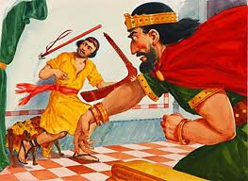
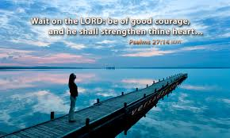
Disappointment with Saul
Saul was jealous & angry with David because God was with him (1Sam 18:12)
Saul’s many attempts to kill David
Saul’s attempt to separate Jonathan & David
David thought he could live at the palace
  Spend time with his close friend Jonathan
  Fight the battles of the Lord
  But instead, has to flee to the Philistines – rejected by Saul & his countrymen
David patiently waits for God to resolve the situation!

Slide 11
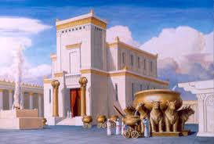
Disappointment about building the Temple
(1 Chron 17)
David brought the ark to Jerusalem & put it into a special tent – “the tabernacle of David” (1 Chron 15)
David set up regular worship before the ark in Jerusalem (1 Chron 16)
David hoped to build a permanent home for the ark
Nathan informs David that God wants Solomon to build God’s house (1 Chron 17:4)
David continued preparing for the building of the temple (1 Chron 22) and organized the Levites, priests, musicians & gatekeepers (1 Chron 23-26)
David accepted God’s will and continued to do what he could to help the project!

Slide 12
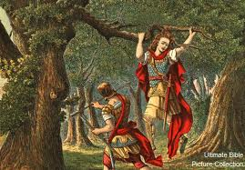
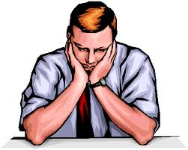
Disappointment over his Family troubles
His baby died (2 Sam 12)
Amnon forced Tamar (2 Sam 13)
Absalom killed Amnon (2 Sam 13)
Absalom fled to Geshur (2 Sam 13)
Absalom’s treason & David flees (2 Sam 15)
Absalom’s death (2 Sam 18)
David felt responsible: “I will raise up adversity against you from your own house” (2 Sam 12:10)

Slide 13


How do we do dealing with disappointments in life?
Others are watching to see if we trust God’s work!

Slide 14
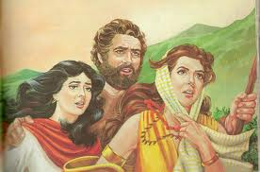
Lot let his family troubles depress him & turn to isolation
Genesis 19:30
30 Then Lot went up out of Zoar and dwelt in the mountains, and his two daughters were with him; for he was afraid to dwell in Zoar. And he and his two daughters dwelt in a cave.
Lot should have returned to Abraham
  Hard to admit bad choices to others – but it is very effective! (Naomi when she returned)
  Make it easy for people to return!!!
Lot chooses to hide in a cave – away from all influences – another bad choice
  Ends up fathering 2 children by his daughters

Slide 15

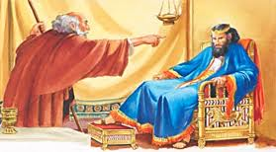
David becomes a changed man
Angels can help us change for the better!
Before: David’s reaction to Nabal
Then: David’s adultery with Bathsheba
  David’s declaration “the man that has done this shall surely die” (2 Sam 12:5)
  God’s mercy “The Lord also has put away your sin; You shall not die” (12:13)
Now: David angry at Amnon, but did nothing (2 Sam 13:21)
David’s mercy to Absalom after killing Amnon (2 Sam 14)
David flees Jerusalem during Absalom’s treason (2 Sam 15)
David’s reaction to Shimei: “the Lord has said to him, ‘curse David’” (2 Sam 16:10)
David’s reaction to Absalom’s death (2 Sam 18:33)
David’s mercy to Shimei (2Sam 19) and Joab (1 Kgs 2:5)
God will work on our weaknesses….if we let him! Many times He chooses to use our families!

Slide 16
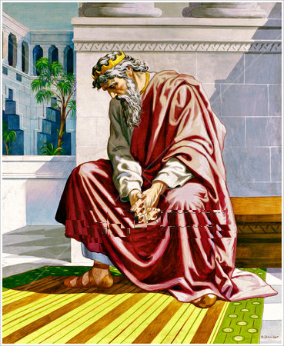
David felt Responsible
for death of priests at Nob
for destruction of Ziklag
for the death of Uzza
for the death of Uriah
for Bathsheba’s baby dying
for Absalom’s rebellion
for death of Absalom
for all his family troubles
For the census & plague
Leaders must accept responsibility for mistakes & deal with it

Slide 17
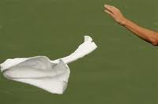
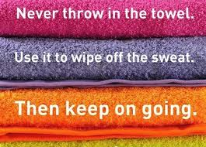
David could have easily given up!
Throw in the towel..
and quit!
His best friend & advisor Jonathan was dead
Samuel his counselor was dead
David made many mistakes & cost many people
He failed as a father raising his sons
He failed in his leadership role as king
He failed in his faithfulness to his God
David kept moving forward because he had confidence in his God, who allowed him to move on

Slide 18
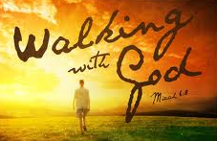
Godly leaders move on in Faith
David should have been publically embarrassed and could have given up
David could have become depressed & thought God had given up on him
David strengthen himself in his God
He moved forward trusting in God’s mercy
He didn’t get sidetracked by family failures
He had faith in God’s ability to bring good out of bad events
He stayed involved in God’s work & made it his life
He had a huge impact on the spiritual development of many in his day and for years to come
All things work together for good to those who love God, to those who are the called according to His purpose. Rom 8:28-29

Slide 19
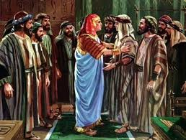
Genesis 50:19-21
God can bring good out of our mistakes!
19 Joseph said to them, "Do not be afraid, for am I in the place of God? 20 But as for you, you meant evil against me; but God meant it for good, in order to bring it about as it is this day, to save many people alive. 21 Now therefore, do not be afraid; I will provide for you and your little ones." And he comforted them and spoke kindly to them.
So learn from our mistakes and move on trusting in God to work it all out

Slide 20
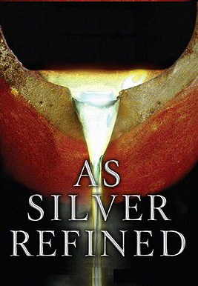
God is refining our characters, re-creating us after the image of His son
You have refined us…
That process can be rather painful & distressing
Afterward it yields the peaceable fruit of righteousness to those who have been trained by it (Heb 12:11)
Psalm 66:10

Slide 21
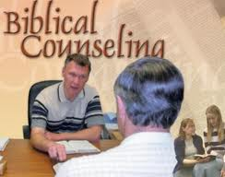
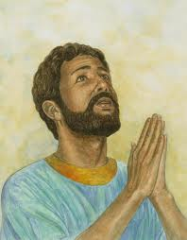
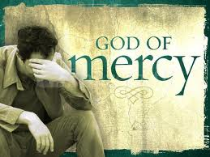
Encourage each other to move forward & get involved!
No matter what mistakes we made in the past
No matter how bad our family situation
No matter how our mistakes may have cost our ecclesias and families
God can forgive and move on – we all need to as well!
But I have trusted in Your mercy; My heart shall rejoice in Your salvation. (Ps 13:5)

Slide 22
Psalm 51
How David moved on… Prayer
1 Have mercy upon me, O God, According to Your loving kindness; According to the multitude of Your tender mercies, Blot out my transgressions. 2 Wash me thoroughly from my iniquity, And cleanse me from my sin.
3 For I acknowledge my transgressions, And my sin is always before me. 4 Against You, You only, have I sinned, And done this evil in Your sight — That You may be found just when You speak, And blameless when You judge.
5 Behold, I was brought forth in iniquity, And in sin my mother conceived me. 6 Behold, You desire truth in the inward parts, And in the hidden part You will make me to know wisdom.
7 Purge me with hyssop, and I shall be clean; Wash me, and I shall be whiter than snow. 8 Make me hear joy and gladness, That the bones You have broken may rejoice. 9 Hide Your face from my sins, And blot out all my iniquities.
10 Create in me a clean heart, O God, And renew a steadfast spirit within me. 11 Do not cast me away from Your presence, And do not take Your Holy Spirit from me.
Confessed his sin & appealed to God’s mercy

Slide 23
Psalm 51
How David Moved on
12 Restore to me the joy of Your salvation, And uphold me by Your generous Spirit. 13 Then I will teach transgressors Your ways, And sinners shall be converted to You.
14 Deliver me from the guilt of bloodshed, O God, The God of my salvation, And my tongue shall sing aloud of Your righteousness. 15 O Lord, open my lips, And my mouth shall show forth Your praise. 16 For You do not desire sacrifice, or else I would give it; You do not delight in burnt offering. 17 The sacrifices of God are a broken spirit, A broken and a contrite heart — These, O God, You will not despise.
18 Do good in Your good pleasure to Zion; Build the walls of Jerusalem. 19 Then You shall be pleased with the sacrifices of righteousness, With burnt offering and whole burnt offering; Then they shall offer bulls on Your altar.
Committed to tell others about God’s ways & His mercy

Slide 24
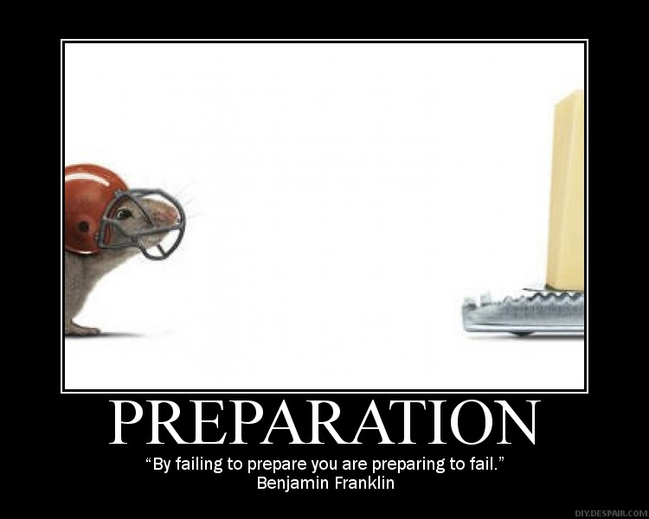
David prepared for the future of God’s ecclesia…
And then trusted God to make it happen

Slide 25
1 Chronicles 22:1-5
David prepared for the Temple
1 Then David said, "This is the house of the Lord God, and this is the altar of burnt offering for Israel." 2 So David commanded to gather the aliens who were in the land of Israel; and he appointed masons to cut hewn stones to build the house of God. 3 And David prepared iron in abundance for the nails of the doors of the gates and for the joints, and bronze in abundance beyond measure, 4 and cedar trees in abundance; for the Sidonians and those from Tyre brought much cedar wood to David.
5 Now David said, "Solomon my son is young and inexperienced, and the house to be built for the Lord must be exceedingly magnificent, famous and glorious throughout all countries. I will now make preparation for it." So David made abundant preparations before his death.
David passed on the supplies, organization and his enthusiasm!

Slide 26
1 Chronicles 22:11-14
David prayed for Solomon’s success
11 Now, my son, may the Lord be with you; and may you prosper, and build the house of the Lord your God, as He has said to you. 12 Only may the Lord give you wisdom and understanding, and give you charge concerning Israel, that you may keep the law of the Lord your God. 13 Then you will prosper, if you take care to fulfill the statutes and judgments with which the Lord charged Moses concerning Israel. Be strong and of good courage; do not fear nor be dismayed.
David was confident that God could help Solomon succeed as long as Solomon would remain faithful

Slide 27
1 Chron 22:17-19
David commanded leaders to help Solomon
17 David also commanded all the leaders of Israel to help Solomon his son, saying, 18 "Is not the Lord your God with you? And has He not given you rest on every side? For He has given the inhabitants of the land into my hand, and the land is subdued before the Lord and before His people. 19 Now set your heart and your soul to seek the Lord your God. Therefore arise and build the sanctuary of the Lord God, to bring the ark of the covenant of the Lord and the holy articles of God into the house that is to be built for the name of the Lord.“
He reminded them about all that God had already done for them

Slide 28
1 Chronicles 23:25-32
Lowered the starting age of Levites
25 For David said, "The Lord God of Israel has given rest to His people, that they may dwell in Jerusalem forever"; 26 and also to the Levites, "They shall no longer carry the tabernacle, or any of the articles for its service." 27 For by the last words of David the Levites were numbered from twenty years old and above; 28 because their duty was to help the sons of Aaron in the service of the house of the Lord, in the courts and in the chambers, in the purifying of all holy things and the work of the service of the house of God,
32 and that they should attend to the needs of the tabernacle of meeting, the needs of the holy place, and the needs of the sons of Aaron their brethren in the work of the house of the Lord.
Was 30-50 years old (Num 4:46-47) to carry and 25-50 years old for daily service (Num 8:24)
David wanted the young people involved!

Slide 29
1 Chronicles 28:8
David knew the connection between keeping God’s commandments & leaving an inheritance
Now therefore, in the sight of all Israel, the assembly of the Lord, and in the hearing of our God, be careful to seek out all the commandments of the Lord your God, that you may possess this good land, and leave it as an inheritance for your children after you forever.
The next generation is counting on us to leave them an inheritance from God

Slide 30
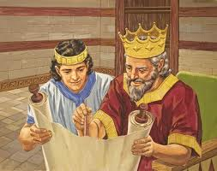
David did what he could to help the next generation
1 Chron 23-27: David organized Priests, Levites, Gatekeepers, Musicians, Military and State Officials
1 Chron 28: David assembled the leaders and then commanded Solomon to build God’s house
And David said to his son Solomon, "Be strong and of good courage, and do it; do not fear nor be dismayed, for the Lord God — my God — will be with you. He will not leave you nor forsake you, until you have finished all the work for the service of the house of the Lord. (1 Chron 28:20-21)

Slide 31
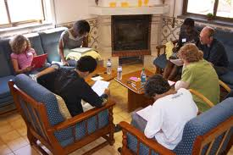
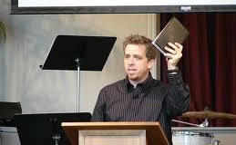
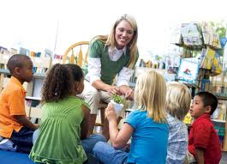
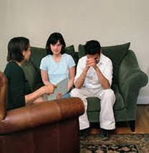
What are we doing to help out the next generation?
Help our young learn to read and study the Bible
Help our young men learn to give exciting, solid Bible classes
Help finance the activities of our CYC’s & Sunday Schools & outreach
Help save the failing marriages of our youth

Slide 32
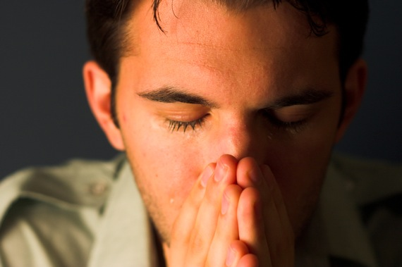
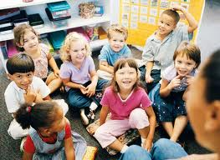
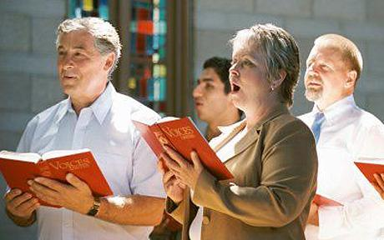
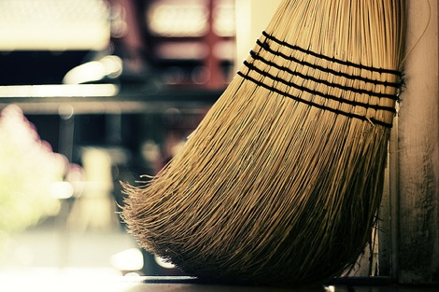
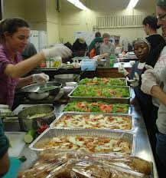
Whatever mistakes we have made….
It’s time to move on and be helpful in God’s family in the future!
Get involved!

Slide 33
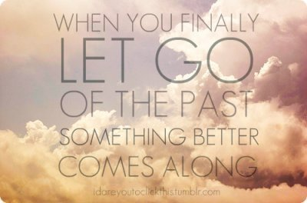

Slide 34
Philippians 3:13-15
Forgetting what is behind….
13 Brethren, I do not count myself to have apprehended; but one thing I do, forgetting those things which are behind and reaching forward to those things which are ahead, 14 I press toward the goal for the prize of the upward call of God in Christ Jesus.
15 Therefore let us, as many as are mature, have this mind;
and pressing forward toward the goal!

Slide 35


Help our young parents raise Godly children!
Teach our young children about our Father in heaven & His Son

Slide 36

Lessons from David Today
Accept God’s will in everything and move forward in faith
Realize there will be disappointments in life – God uses them to turn us into His children
Move forward knowing that God is in control and can use even bad events for our good
Be a willing shepherd of God’s flock today
Help prepare for the future – work with our young people and help them grow

Slide 37
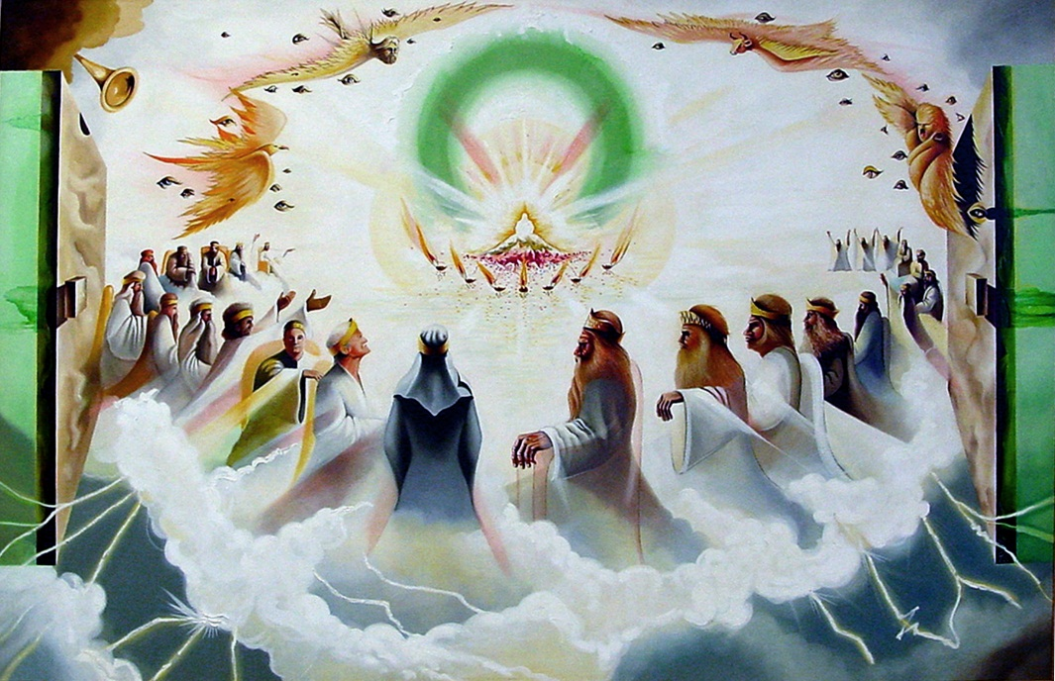
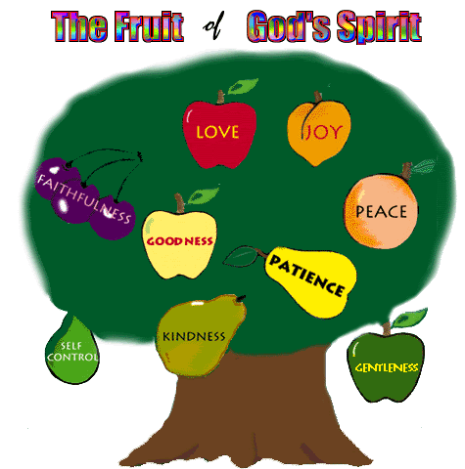
Let’s go home & practice living in God’s family now!
We hope to be kings for our God

