Slide 1
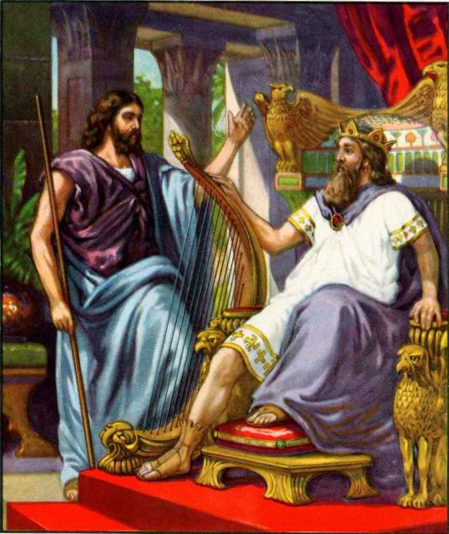
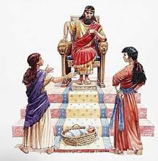
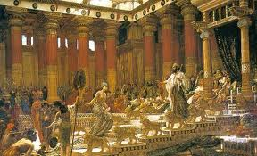
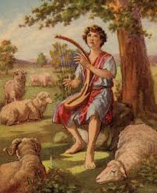
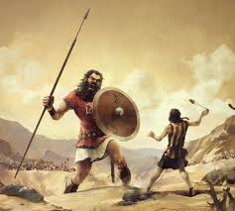
Class 4: Solomon builds God’s house
David & Solomon: Kings in Practice

Slide 2
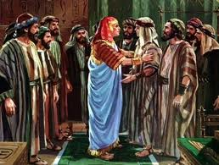

Genesis 50:19-21
God can bring good out of our mistakes!
19 Joseph said to them, "Do not be afraid, for am I in the place of God? 20 But as for you, you meant evil against me; but God meant it for good, in order to bring it about as it is this day, to save many people alive. 21 Now therefore, do not be afraid; I will provide for you and your little ones." And he comforted them and spoke kindly to them.
So learn from our mistakes and move on trusting in God to work it all out

Slide 3
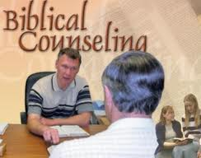
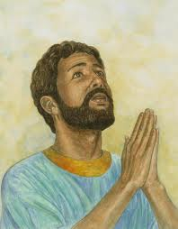
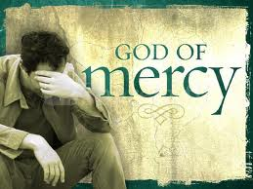
Encourage each other to move forward & get involved!
No matter what mistakes we made in the past
No matter how bad our family situation
No matter how our mistakes may have cost our ecclesias and families
God can forgive and move on – we all need to as well!
But I have trusted in Your mercy; My heart shall rejoice in Your salvation. (Ps 13:5)

Slide 4
Psalm 51
How David moved on… Prayer
1 Have mercy upon me, O God, According to Your loving kindness; According to the multitude of Your tender mercies, Blot out my transgressions. 2 Wash me thoroughly from my iniquity, And cleanse me from my sin.
3 For I acknowledge my transgressions, And my sin is always before me. 4 Against You, You only, have I sinned, And done this evil in Your sight — That You may be found just when You speak, And blameless when You judge.
5 Behold, I was brought forth in iniquity, And in sin my mother conceived me. 6 Behold, You desire truth in the inward parts, And in the hidden part You will make me to know wisdom.
7 Purge me with hyssop, and I shall be clean; Wash me, and I shall be whiter than snow. 8 Make me hear joy and gladness, That the bones You have broken may rejoice. 9 Hide Your face from my sins, And blot out all my iniquities.
10 Create in me a clean heart, O God, And renew a steadfast spirit within me. 11 Do not cast me away from Your presence, And do not take Your Holy Spirit from me.
Confessed his sin & appealed to God’s mercy

Slide 5
Psalm 51
How David Moved on
12 Restore to me the joy of Your salvation, And uphold me by Your generous Spirit. 13 Then I will teach transgressors Your ways, And sinners shall be converted to You.
14 Deliver me from the guilt of bloodshed, O God, The God of my salvation, And my tongue shall sing aloud of Your righteousness. 15 O Lord, open my lips, And my mouth shall show forth Your praise. 16 For You do not desire sacrifice, or else I would give it; You do not delight in burnt offering. 17 The sacrifices of God are a broken spirit, A broken and a contrite heart — These, O God, You will not despise.
18 Do good in Your good pleasure to Zion; Build the walls of Jerusalem. 19 Then You shall be pleased with the sacrifices of righteousness, With burnt offering and whole burnt offering; Then they shall offer bulls on Your altar.
Committed to tell others about God’s ways & His mercy

Slide 6
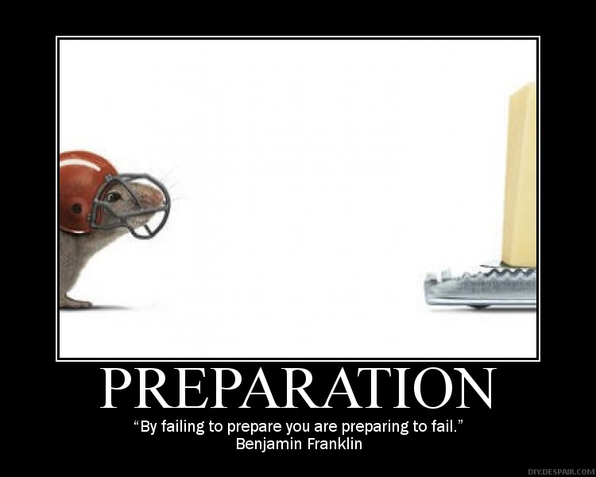
David prepared for the future of God’s ecclesia…
And then trusted God to make it happen

Slide 7
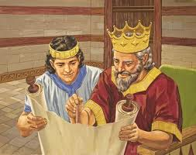
David did what he could to help the next generation
1 Chron 23-27: David organized Priests, Levites, Gatekeepers, Musicians, Military and State Officials
1 Chron 28: David assembled the leaders and then commanded Solomon to build God’s house
And David said to his son Solomon, "Be strong and of good courage, and do it; do not fear nor be dismayed, for the Lord God — my God — will be with you. He will not leave you nor forsake you, until you have finished all the work for the service of the house of the Lord. (1 Chron 28:20-21)

Slide 8
1 Chronicles 28:8
David knew the connection between keeping God’s commandments & leaving an inheritance
Now therefore, in the sight of all Israel, the assembly of the Lord, and in the hearing of our God, be careful to seek out all the commandments of the Lord your God, that you may possess this good land, and leave it as an inheritance for your children after you forever.
The next generation is counting on us to leave them an inheritance from God

Slide 9
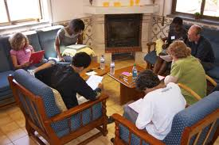
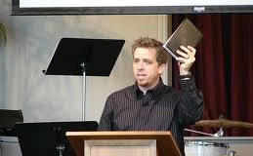

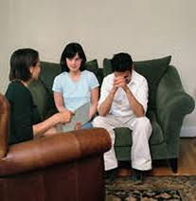
What are we doing to help out the next generation?
Help our young learn to read and study the Bible
Help our young men learn to give exciting, solid Bible classes
Help finance the activities of our CYC’s & Sunday Schools & outreach
Help save the failing marriages of our youth

Slide 10
Class 4: Solomon builds God’s house
David & Solomon: Kings in Practice

Slide 11
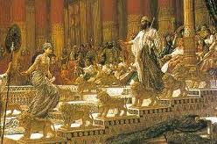
Marriage to Pharoah’s Daughter (1 Kings 3)
He had already married Naamah the Ammonitess and had Rehoboam one year before ascending the throne (1 Kg 14:21; 11:42-43)
Marriage to Pharoah’s daughter was political
Seems she was converted to worship Yahweh (Psa 45:10)
  Solomon was very faithful in the early years of his reign
  She is distinguished from the women who turned away his heart in 1 Kings 11:1
  No mention of Solomon building idols to gods of Egypt
This marriage may have stimulated the Song of Solomon, which describes the greater marriage of Christ & his bride
Solomon was off to a good start!

Slide 12
Psalm 45:6, 10, 16
Psa 45 may be about their wedding
6 Your throne, O God, is forever and ever; A scepter of righteousness is the scepter of your kingdom. 7 You love righteousness and hate wickedness; Therefore God, your God, has anointed you eith the oil of gladness more than your companions
10 Listen, O daughter, consider and incline your ear; Forget your own people also, and your father's house; 11 So the King will greatly desire your beauty; Because he is your Lord, worship him. 13 The royal daughter is all glorious within the palace; Her clothing is woven with gold.
16 Instead of your fathers shall be your sons, Whom you shall make princes in all the earth.
She may have learned to worship Yahweh

Slide 13
Marriage to Pharoah’s Daughter (1 Kings 3)
He had already married Naamah the Ammonitess and had Rehoboam one year before ascending the throne (1 Kg 14:21; 11:42-43)
Marriage to Pharoah’s daughter was political
Seems she was converted to worship Yahweh (Psa 45:10)
  Solomon was very faithful in the early years of his reign
  She is distinguished from the women who turned away his heart in 1 Kings 11:1
  No mention of Solomon building idols to gods of Egypt
This marriage may have stimulated the Song of Solomon, which describes the greater marriage of Christ & his bride
Solomon was off to a good start!

Slide 14
1 Kings 3:6-9
Solomon asks for God’s help
6 And Solomon said: "You have shown great mercy to Your servant David my father, because he walked before You in truth, in righteousness, and in uprightness of heart with You; You have continued this great kindness for him, and You have given him a son to sit on his throne, as it is this day. 7 Now, O Lord my God, You have made Your servant king instead of my father David, but I am a little child; I do not know how to go out or come in. 8 And Your servant is in the midst of Your people whom You have chosen, a great people, too numerous to be numbered or counted. 9 Therefore give to Your servant an understanding heart to judge Your people, that I may discern between good and evil. For who is able to judge this great people of Yours?“
God wants to help us….so ask Him (Jam 1)

Slide 15
1 Kings 3:10-14
God gave Solomon wisdom, riches & honor
10 The speech pleased the Lord, that Solomon had asked this thing. 11 Then God said to him: "Because you have asked this thing, and have not asked long life for yourself, nor have asked riches for yourself, nor have asked the life of your enemies, but have asked for yourself understanding to discern justice, 12 behold, I have done according to your words; see, I have given you a wise and understanding heart, so that there has not been anyone like you before you, nor shall any like you arise after you. 13 And I have also given you what you have not asked: both riches and honor, so that there shall not be anyone like you among the kings all your days. 14 So if you walk in My ways, to keep My statutes and My commandments, as your father David walked, then I will lengthen your days.“
God loves to help us work in His family!

Slide 16
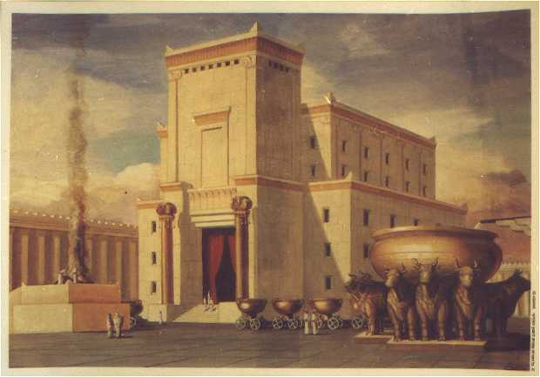
In Solomon’s 4th year as king He sets out to build God’s House
G

Slide 17
1 Kings 6
Solomon builds God’s house
1 And it came to pass in the four hundred and eightieth year after the children of Israel had come out of the land of Egypt, in the fourth year of Solomon's reign over Israel, in the month of Ziv, which is the second month, that he began to build the house of the Lord. 2 Now the house which King Solomon built for the Lord, its length was sixty cubits, its width twenty, and its height thirty cubits.
37 In the fourth year the foundation of the house of the Lord was laid, in the month of Ziv. 38 And in the eleventh year, in the month of Bul, which is the eighth month, the house was finished in all its details and according to all its plans. So he was seven years in building it.
Only took 7 years to finish!

Slide 18
Acts 7:48-50
God’s problem with a temple building
48 "However, the Most High does not dwell in temples made with hands, as the prophet (Isa 66:1-2) says:
49 'Heaven is My throne, and earth is My footstool. What house will you build for Me? says the Lord, or what is the place of My rest?
50 Has My hand not made all these things?'
He always intended to dwell in the minds & hearts of His people

Slide 19

God didn’t need a house, but it could help with His intentions to dwell in His children
I will put my law in their minds, and write it on their hearts (Jer 31:33)
And what agreement hath the temple of God with idols? for ye are the temple of the living God; as God hath said, I will dwell in them, and walk in them; and I will be their God, and they shall be my people (2 Cor 6:16)

Slide 20
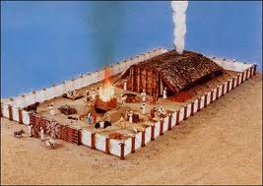
God moved His dwelling place
Tabernacle used to be in Shiloh of Ephraim (Josh 18:1)
Moved to Nob when Philistines captured ark (1 Sam 4)
Then moved to Gibeon after Doeg slew the priests at Nob (1 Chron 16:39) & remained there
David brought ark into Jerusalem & put up a tent for it (2 Sam 6:17) “the tabernacle of David” (Amos 9:11; Acts 15:16)
After numbering all the people & the plague that followed, David determined that God had chosen Jerusalem for His house (1Chr 22:1)
“He forsook the tabernacle of Shiloh” (Psa 78:60)
“He did not choose the tribe of Ephraim, but chose the tribe of Judah, Mount Zion which He loved (vs 67-68)

Slide 21
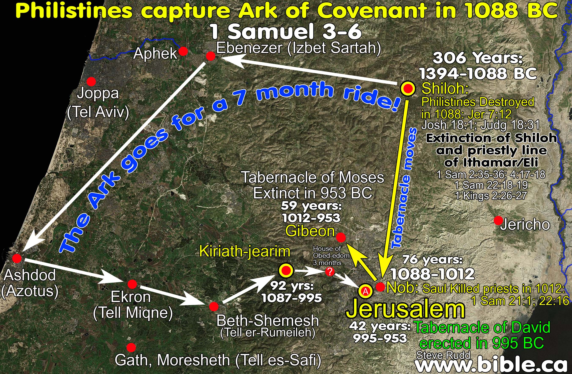
Journeys of the Ark & Tabernacle

Slide 22
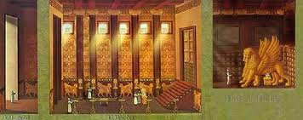
David wanted to build God a House
He knew God wanted to dwell in people
  Understood that God didn’t dwell in houses
  Realized that people needed a central focus to worship God in spirit and truth
  Goal was for God to live in lives of His people
Eliminate idol worship at high places
Testimony to other nations about the Living God of all the earth
In my father’s house are many abiding places. I go to prepare a place for you. (Jn 14:1)

Slide 23
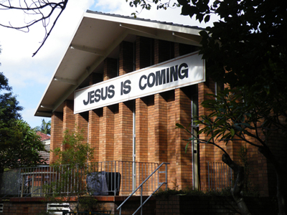
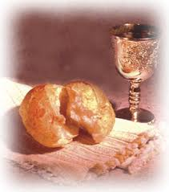
Be careful about trusting too much on rituals and buildings!
This caused the Jews to lose sight of the goal!

Slide 24
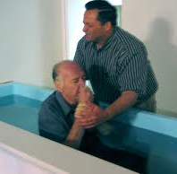
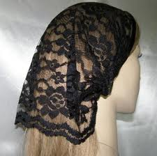
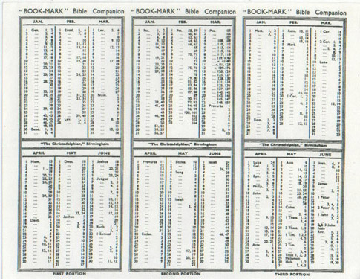
The longer a community exists….
the more it trusts in its rituals

Slide 25
Zechariah 7:1-7
Trusting in rituals
Now in the fourth year of King Darius it came to pass that the word of the Lord came to Zechariah, on the fourth day of the ninth month, Chislev, 2 when the people [of Bethel] sent Sherezer, with Regem-Melech and his men, to the house of God, to pray before the Lord, 3 and to ask the priests who were in the house of the Lord of hosts, and the prophets, saying, "Should I weep in the fifth month and fast as I have done for so many years?"
4 Then the word of the Lord of hosts came to me, saying, 5 "Say to all the people of the land, and to the priests: 'When you fasted and mourned in the fifth and seventh months during those seventy years, did you really fast for Me — for Me? 6 When you eat and when you drink, do you not eat and drink for yourselves? 7 Should you not have obeyed the words which the Lord proclaimed through the former prophets when Jerusalem and the cities around it were inhabited and prosperous, and the South and the Lowland were inhabited?'"
70 years of wasted rituals!

Slide 26
1 Kings 7
Solomon’s building projects
1 But Solomon took thirteen years to build his own house; so he finished all his house.
2 He also built the House of the Forest of Lebanon; its length was one hundred cubits, its width fifty cubits, and its height thirty cubits, with four rows of cedar pillars, and cedar beams on the pillars. 3 And it was paneled with cedar above the beams that were on forty-five pillars, fifteen to a row. 4 There were windows with beveled frames in three rows, and window was opposite window in three tiers. 5 And all the doorways and doorposts had rectangular frames; and window was opposite window in three tiers.
6 He also made the Hall of Pillars: its length was fifty cubits, and its width thirty cubits; and in front of them was a portico with pillars, and a canopy was in front of them.
7 Then he made a hall for the throne, the Hall of Judgment, where he might judge; and it was paneled with cedar from floor to ceiling.
8 And the house where he dwelt had another court inside the hall, of like workmanship. Solomon also made a house like this hall for Pharaoh's daughter, whom he had taken as wife.
Solomon loved to build, but at the peoples’ expense!

Slide 27
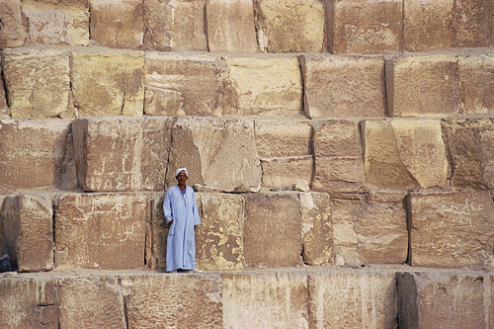
1 Kings 6:7
Stones were finished at the quarry
And the temple, when it was being built, was built with stone finished at the quarry, so that no hammer or chisel or any iron tool was heard in the temple while it was being built.
Shows the spiritual importance of the building. God wanted it clear that we must be shaped into the image of His son now!

Slide 28
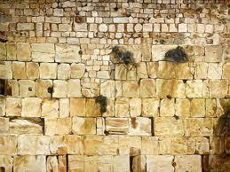
1 Peter 2:4-6
You are living stones of God’s house
4 Coming to Him (Jesus) as to a living stone, rejected indeed by men, but chosen by God and precious, 5 you also, as living stones, are being built up a spiritual house, a holy priesthood, to offer up spiritual sacrifices acceptable to God through Jesus Christ.
You are the living stones of God’s living temple – a spiritual house of priests

Slide 29
1 Kings 9:1-9
God’s promise (at least 24 years into his reign)
1 And it came to pass, when Solomon had finished building the house of the Lord and the king's house, and all Solomon's desire which he wanted to do, 2 that the Lord appeared to Solomon the second time, as He had appeared to him at Gibeon. 3 And the Lord said to him: "I have heard your prayer and your supplication that you have made before Me; I have consecrated this house which you have built to put My name there forever, and My eyes and My heart will be there perpetually. 4 Now if you walk before Me as your father David walked, in integrity of heart and in uprightness, to do according to all that I have commanded you, and if you keep My statutes and My judgments, 5 then I will establish the throne of your kingdom over Israel forever, as I promised David your father, saying, 'You shall not fail to have a man on the throne of Israel.’
God’s promise was conditional

Slide 30
1 Kings 9:1-9
God’s warning to Solomon
6 But if you or your sons at all turn from following Me, and do not keep My commandments and My statutes which I have set before you, but go and serve other gods and worship them, 7 then I will cut off Israel from the land which I have given them; and this house which I have consecrated for My name I will cast out of My sight. Israel will be a proverb and a byword among all peoples. 8 And as for this house, which is exalted, everyone who passes by it will be astonished and will hiss, and say, 'Why has the Lord done thus to this land and to this house?' 9 Then they will answer, 'Because they forsook the Lord their God, who brought their fathers out of the land of Egypt, and have embraced other gods, and worshiped them and served them; therefore the Lord has brought all this calamity on them.'“
God will not hesitate to destroy His house

Slide 31
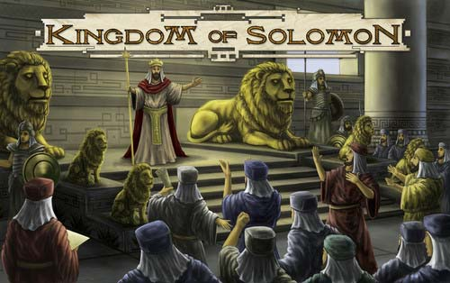
Solomon’s great Royal Kingdom
Solomon & Hiram exchanged gifts (9:10-14)
Solomon’s labor force built the temple, his own house, the Millo, wall of Jerusalem, Hazor, Megiddo and Gezer, lower Beth Horon, Baalath and Tadmor, storage cities, cities for chariots & cavalry, etc (9:15-23)
Solomon built a fleet of ships at Ezion Geber, near Elath (9:26-28)
Queen of Sheba came to see everything (10:1-13)
Solomon’s great wealth described (10:14-29)
Solomon had the greatest kingdom the earth has known!

Slide 32
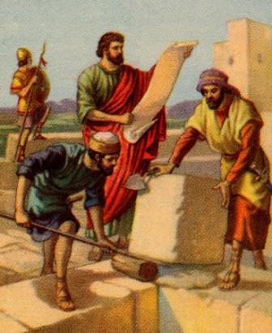
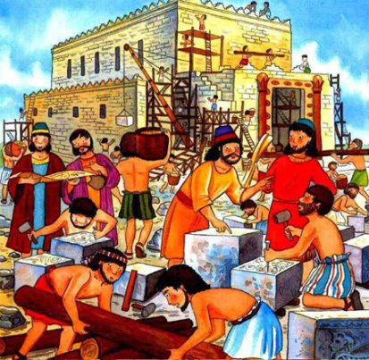
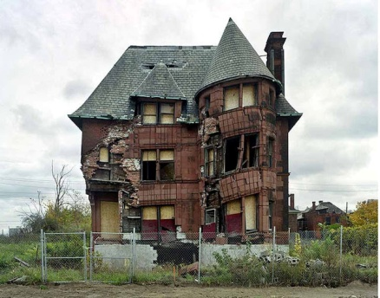
Solomon was a busy man!
1Kgs 5:13 180,000 man labor force for his building projects [30,000 Jews & 150,000 Gentiles]
1Kgs 9:15-19 Spent much of his time in building projects:
  7 years building the temple
  13 years building his house
  Built a house for Pharaoh’s daughter
  Repaired the Millo (tower), wall of Jerusalem, etc
Solomon had hoped these projects would last 100’s of years

Slide 33
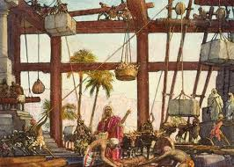
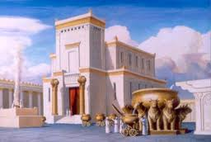
Solomon’s building projects cost him in the end
Needed to tax the people to get this work done – may have led to the rebellion in Rehoboam’s day
Got Solomon into a building mode that continued for years – included building places to worship idols in 1 Kings 11
Be careful not to lose sight of the goal when you are involved in Ecclesial projects that you enjoy!

Slide 34

Solomon thought the end product was more important than the people being developed!
Be careful about your work in family & ecclesial life!

Slide 35
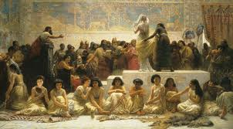
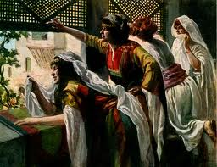
Many Political marriages cost him in the end (1Kg 11)
He had wives from so many different countries who worshipped so many different idols (11:1)
When he was old, his wives turned away his heart from faithful worship of Yahweh (11:3-8)
God was angry with Solomon
  God decided to tear the kingdom from him (11:9-13)
  God raised up adversaries: Hadad the Edomite, Rezon of Syria (9:14-25)
Jeroboam rebelled & fled to Egypt (11:26-40)
Solomon’s weakness got the better of him

Slide 36

Lessons from Today
Commit to working in God’s ecclesia & building His house – whatever needs to be done!
Ask God for wisdom & help to do the job
Our focus isn’t on the building, but the people who make up God’s house
The stones were finished at the quarry – Be ready now!
Even with everything Solomon had, he still was influenced to turn away when old - watch out!

Slide 37
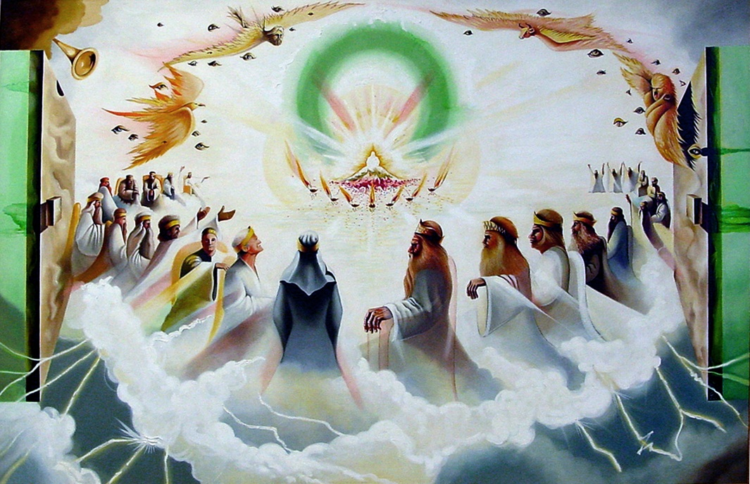

Let’s go home & practice living in God’s family now!
We hope to be kings for our God

Slide 38
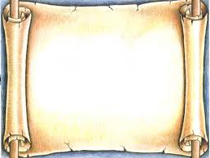
1 Cor 10:11-12
11 Now all these things happened to them (Israel) as examples, and they were written for our admonition, upon whom the ends of the ages have come.
12 Therefore let him who thinks he stands take heed lest he fall.

Slide 39
2
S
G

