Slide 1
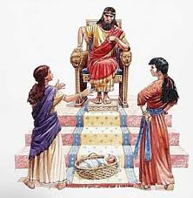
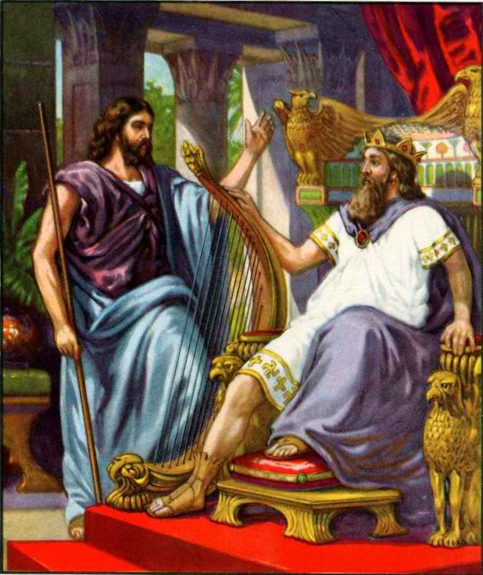
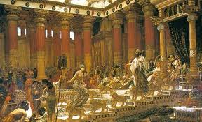
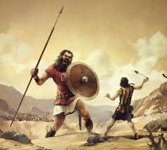
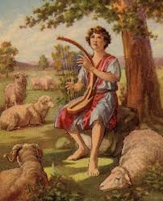
Class 5: Solomon’s Disillusionment with life & God
David & Solomon: Kings in Practice

Slide 2
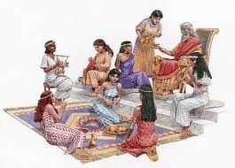

David & Solomon went through it so we don’t have to!
If you think having power & riches will bring you happiness….David shows it won’t work
If you think having wisdom & riches will bring you happiness…. Solomon shows it won’t last
Those of us who can learn from the lives of others, will not have to repeat their sad experiences & the consequences they brought

Slide 3
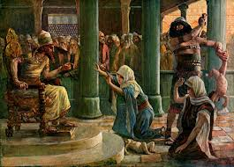
What went wrong with Solomon that his wives could turn away his heart?
Started out such a faithful king
Focused on building God’s house (David had left him this responsibility)
Liked to build and thought he could leave a legacy for himself
Solomon analyzed society & governments & people, and became disillusioned with life
Ecclesiastes gives us an incite to what went wrong
Solomon failed to understand that God uses this life to train us for our life to come – this life may not be “fair”

Slide 4
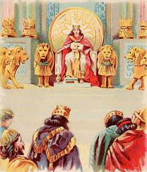
Solomon was the Author
Son of David, King over Israel in Jerusalem (1:1, 12) – before split
Building projects (2:1-11) [2 Chr 9:27]
Gained more wisdom than before him in Jerusalem (1:16) [1 Kings 4:29-34]
1000 wives (7:27) [1 Kgs 11:3]
Set in order many proverbs (12:9) [1Kgs 4:32]
Preacher quotes from Solomon’s prayer at the dedication of the Temple (7:20 and 1 Kings 8:46).
No other King of Israel qualifies

Slide 5
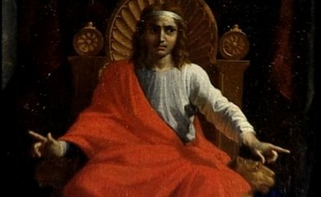
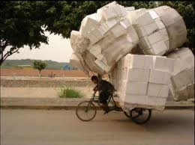
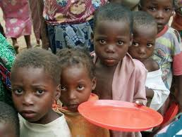


Life Issues that bothered Solomon?
What do you get from all your hard work?
Nothing new, nothing accomplished… just repeating cycles
Life seems unfair:
  some righteous suffer what wicked people should get
  Government & society are full of unfair situations
  Everyone dies: death eliminates the profit of wisdom
  There may not be justice now
Punishment isn’t executed right away so some think they can get away with evil
Some people are workaholics & don’t take the time to enjoy God’s gifts. Others are not allowed to enjoy them
So many people are not content with what God gives them
He tried to analyze life & figure it out

Slide 6
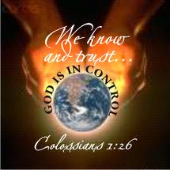
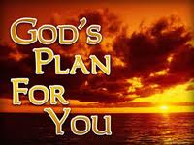


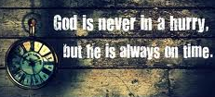

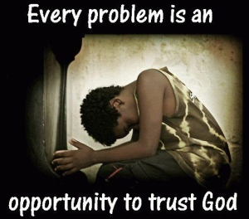



Ecclesiastes: Lasting Happiness can only be found with God
Ecc 1: What’s the profit of all our work?

Slide 7
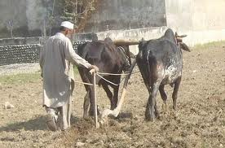
What profit has a man from all his labor? (1:3)
Solomon presents 4 cycles in nature that show life as a series of endless cycles resulting in nothing new – just weariness!
  Generation after generation (1:4)
  Sun rises & sets, then rises again (1:5)
  Wind whirls about continually (1:6)
  Rivers run into the sea, but sea doesn’t get full (1:7)
So much labor that you can’t find the words to express it, or see it all, nor hear it all (1:8)
  Not quite the way we usually use this verse!
Endless labor for nothing new (1:9-10) – most “new” things are only new because we forget the past!
  Politics, Educational methods, Bible study, etc.
Most things we accomplish are forgotten in a few years (1:11) – each generation needs to learn again by experience!
What does all our hard work accomplish?

Slide 8
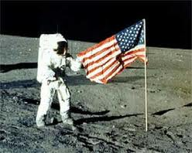

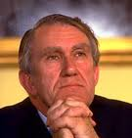
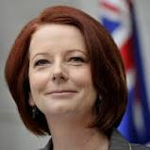
What profit has a man from all his labor? (1:3)
Solomon realizes that for all our efforts in this life, we really don’t accomplish much & it will be forgotten soon!(11)
Solomon laments because it seems to him a waste of time – vanity! (v.12)
Solomon had the enthusiasm & excitement of youth and set out to do a lot and accomplish things that would make him famous.
He found out the rich & famous are soon forgotten!

Slide 9
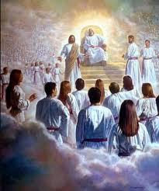
Solomon didn’t understand what God is doing
Solomon didn’t realize yet that the goal of this life is to learn to live as children of God
It’s not about what WE get done now, but what GOD is doing in us. God is changing us into His children by the events of our lives.
Paul (in Romans 8) sees the creation God subjected to vanity in hope, groaning in travail, as it will be delivered from the bondage of corruption, into the glorious liberty of the children of God
God is training His children!

Slide 10
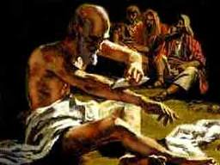
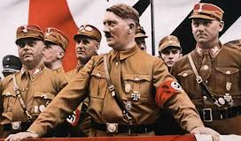
Job had pondered the profit of serving God
Job 9:21-22 (Job Speaking) "Although I am blameless, I have no concern for myself; I despise my own life. 22 It is all the same; that is why I say, 'He destroys both the blameless and the wicked.' (NIV)
Job 34:5-9 (Elihu speaking) "Job says, 'I am innocent, but God denies me justice. 6 Although I am right, I am considered a liar; although I am guiltless, his arrow inflicts an incurable wound.' 7 What man is like Job, who drinks scorn like water? 8 He keeps company with evildoers; he associates with wicked men. 9 For he says, 'It profits a man nothing when he tries to please God.'
Job saw no profit in serving God, if the righteous & wicked were treated the same in this life

Slide 11

Matthew 16:24-27
Jesus had it figured out!
24 Then Jesus said to His disciples, "If anyone desires to come after Me, let him deny himself, and take up his cross, and follow Me. 25 For whoever desires to save his life will lose it, but whoever loses his life for My sake will find it. 26 For what profit is it to a man if he gains the whole world, and loses his own soul? Or what will a man give in exchange for his soul? 27 For the Son of Man will come in the glory of His Father with His angels, and then He will reward each according to his works. [Solomon finally came to this conclusion! Ecc 12:13-14]
Jesus learned from the experiences of others

Slide 12
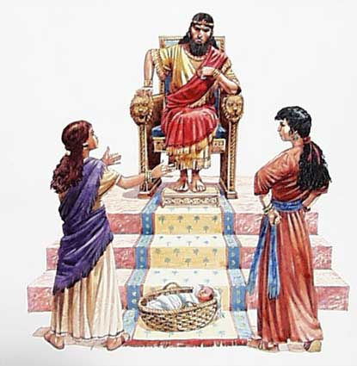
Test 1: Does Wisdom bring profit? (1:12-18)
Solomon’s first gift was wisdom
He tried to use the wisdom of this world to understand and analyze life
He becomes frustrated that he can’t make the crooked straight (1:15) - but then learns it is because God makes it that way! (7:13)
He attempted to analyze with wisdom as opposed to madness & folly (using contrasts), but only found that more knowledge brought more sorrow (1:17-18) The more you know, the more you don’t know, but you are more aware!
Solomon “perceived” (1:17) – he came to know by experience

Slide 13
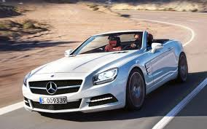
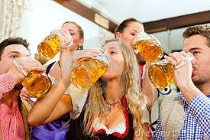
Test 2: Is pleasure profitable [parties & wine] (2:1-3)
Solomon’s 2nd gift – riches – used to buy whatever pleasures he wanted
Solomon analyzed with his wisdom: What do all the pleasures accomplish? Not much!
Just bring happiness for a moment, then you need more pleasure again!
Disappointment of pleasures: they don’t continue to bring the same satisfaction year after year
We get used to what we have, & expect it!

Slide 14
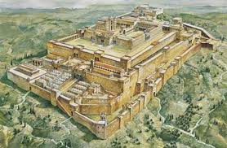
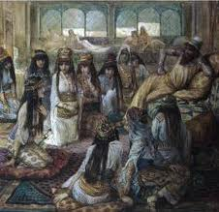
Test 2: Is Pleasure Profitable [hard work & great possessions] (v.4-11)
Solomon built houses, planted vineyards, gardens & orchards with irrigation
He got male & female servants
He bred huge herds & flocks
He gathered silver & gold and king’s treasures
He acquired male & female singers, and many concubines (NASB, NIV, RSV)
He became great and excelled beyond all kings in Jerusalem before him – He tried everything!
It was all vanity & grasping for wind, & didn’t bring the satisfaction he looked for

Slide 15
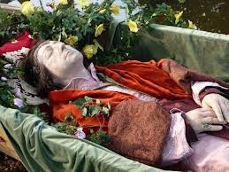
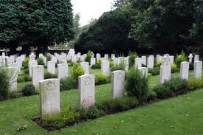
Death eliminates the profit of Wisdom
Next king can only do what previous king did too (v.12) [there’s really nothing new]
Wisdom is more profitable than folly now in this life as a guide (v.13)
Yet both wise and fool die! (v.14-15)
Wise man won’t be remembered any longer than the fool (v.16) [again in 9:15]
Solomon hated life… he found this very distressing (v.17) – life is not fair!
Death levels the playing field! All go to one place (3:20)

Slide 16
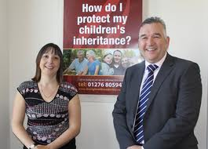
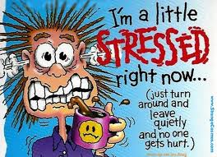
Profits of your hard work pass to others
All you accomplish is given away to others
  may be a fool (v.19)
  May not work at all (v.21)
Why work so hard now and stress out? (v.22-23)
  Days become sorrowful
  Work is burdensome
  Can’t sleep at night
Life doesn’t seem fair!

Slide 17

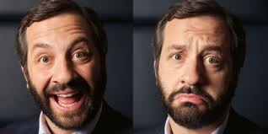
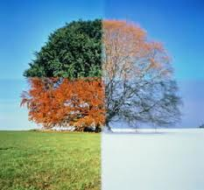
Ecc 3: There is a right time for everything
There is a season [set time – Neh 2:6] for every purpose under heaven (under the sun)
To be born & to die, to plant & to harvest
To kill & to heal, to demolish & to build
To weep & to laugh, to mourn & to dance
To scatter stones & to remove them, to hug & to not hug
To search & to give up, to keep & to throw away
To tear & to sow, to be silent & to speak
To love & to hate, to war & to make peace
We don’t have the wisdom to always do things at the right time, but God does!

Slide 18

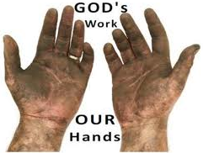
God does things at the right time (3:9-15)
What profit does a worker get from all his work? (3:9)
Men are occupied with work because God intended it that way – to “humble” [1:13 YLT] us (v.10)
  not “grievous” (1:13) now. Solomon is beginning to see God’s purpose!
God made everything beautiful in its time – in harmony with all God’s work (v.11)
He has put eternity: “but though He has permitted man to consider time in its fullness” [Jer Bible], no one can figure out the work God does from beginning to end!
Solomon says: Unless the Lord does it, they labor in vain who work (Ps 127:1-2)

Slide 19
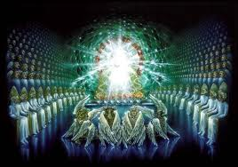
God does things at the right time (3:9-15)
Appreciate what God does for you and has given you – allow it to let you rejoice and do good (3:12)
  “I know” (v.12 & 14) - Solomon’s confidence
  Those who understand God’s working will rejoice in God’s gifts more than those who live only for this life
Eat, drink and enjoy the results of your labor – it is God’s gift to you (v.13)
Whatever God does is forever – He’s working for our eternal good, not temporary – this should cause us to fear Him (v.14) & learn to live by faith in God.
God knows the end from the beginning, but He requires an account of our past (v.15)
  There will be a judgment day
  There must be something beyond the time of reward
We must trust God’s pathway for us – He knows what He is doing!

Slide 20
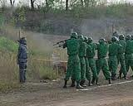
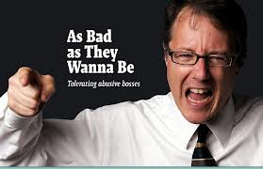
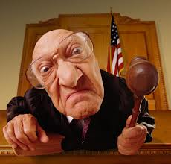
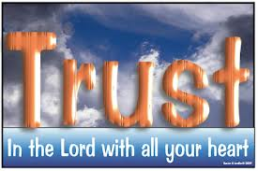
God uses “unfairness” now to test us (16-22)
For now, there are sometimes wicked judgments made (v.16)
  Acts 24:24-27: Felix left Paul in prison 2 years waiting for a bribe
God has set a time to eventually judge (17)
  8:6,11 The wicked think they can get away with evil now
  Faith in God’s future justice helps us choose now to live as God’s children
God uses the delay to test us:
  It appears now that we have lives like animals (18)
  We live for a while, then die (19)
  Both man & animals are of the dust, & return (20)
  No one knows for sure if man’s spirit goes up (21) – takes faith!
So rejoice & be thankful for God’s gifts now – it is our heritage from God (21)
You can’t know for sure what will happen after death (22) [again in 6:12; 7:14; 10:14; 2:19]
God is testing us now to see if we really want to live like Him & if we will trust Him forever

Slide 21
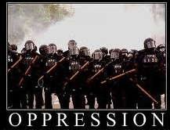
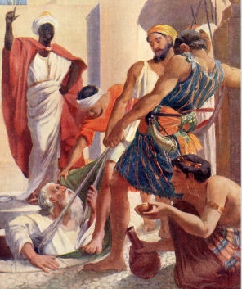
Ecc 4: There is “unfairness” in Government & Society (v.1-3)
Many people are oppressed by people who have power
These oppressed people have no comforters – no one to help them
Some oppressed people may be better off dead (2)
Better is he who never existed – didn’t have to see & experience this evil work (3) [Stillborn again in 6:3. This is similar to Job 3:10; 10:18; Jer 20:14; Mat 26:24)
God uses these situations to test His people: Trust Him!

Slide 22
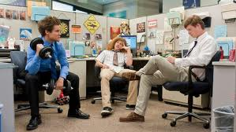
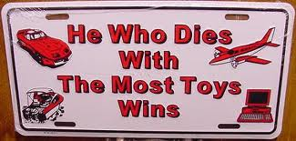
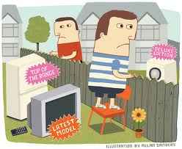
Some people oppress themselves (4-8)
Some people are so fixed on out-doing their neighbor that they oppress themselves to be the best (4)
Other extreme: the fool doesn’t work at all & ruins himself (5) [Prov 6:10; 24:33)
Much better to have a little with peace, than lots with too much stress (6) [Prov 23:4-5]
Some people work endlessly, but are never satisfied, & don’t take the time to enjoy what God gives us (7)
Godliness with contentment is great gain (1 Tim 6:6) [“you gain a lot when you lead a Godly life, but you must be happy with what you have”]

Slide 23
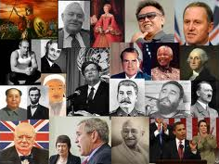
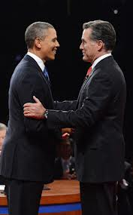
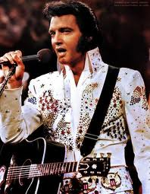
Individual Fame & Power have no lasting Profit (4:13-16)
Old & foolish king who doesn’t respond can easily be replaced by a poor boy from prison who responds to the people (13-15)
  2 Chr 16: Old foolish King Asa
But then the next generation will not appreciate this new young king (16)
Don’t waste your time striving for fame and power. They're fleeting and easily lost, and in the end will not profit

Slide 24

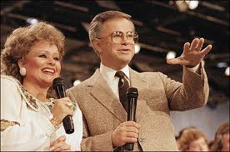
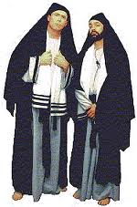
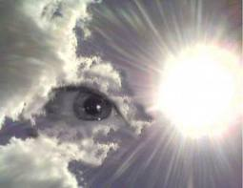

Don’t aim for Religious Fame (5:1-7)
Tammy Faye & Jimmy Baker
When you go to God’s house, go to hear (1) – s.w. as “obey” (1Sam 15:22)
Watch what you say & think: God is in heaven. Don’t put on a show for others to see! (v.2)
Dream comes through much activity: as too much stress can cause us to dream, so too many words can cause one to speak foolishly [3]
God expects vows to be paid… so don’t utter hasty vows in God’s house to gain fame (4)
  Prov 20:25 It is a snare for a man to devote rashly something as holy, and afterward to reconsider his vows. [based on Deut 23:21-23]
God & His angels will hold you accountable for what you say (6)
Rather than striving for fame through religion, fear God!

Slide 25




Don’t aim for Riches (5:8-17)
Poor people will be oppressed, their justice perverted, so higher officials (including the king) can profit from them (8-9)
People whose focus is riches, are not satisfied with any increase in riches….there is never enough (10)
  Prov 23:4-5 Don’t overwork for riches….they will fly away!
When you become richer… there are simply more people to share your riches with (11)
  Or more upgrades for your electronic toys!
When our focus is on riches, we worry and fret to the point we lose sleep over it (12)
Some people who hoard their riches end up losing them anyways through some misfortune (13-16)
So what was the profit of all the riches he worked for? (16-17)
For men will be lovers of themselves, lovers of money, boasters, proud, blasphemers, disobedient to parents, unthankful, unholy (2 Tim 3:2)

Slide 26






Ecc 6: Be content with God’s good gifts (6:1-9)
There are many people to whom God has given riches, but God allows a stranger to enjoy their riches (1-2)
Even if you have lots of kids & live 2,000 years, but don’t experience God’s goodness, a stillborn child is better (3-6)
Be thankful for God’s blessings

Slide 27






Be content with God’s good gifts (6:1-9)
People work hard just to have the food they want, but never seem to get all they desire (7)
Even the wise never have enough & poor people who are wise will still desire more (8)
Enjoy what you have rather than desiring what you don’t have – be content!(9)
God’s way brings real happiness!

Slide 28



Don’t Challenge God’s plan (6:10-12)
God planned everything long ago, don’t argue with God! [1:9; 3:15] (v.10)
  God determined events & purpose of man
  We can’t understand all God does (8:16-17)
The more we argue, the less we really say (11)
  “The more the words, the less the meaning” (NIV)
Only God knows what is good for us in this life & God knows the future too! (12)
  “after him” is in this life, not immortality (3:22; 7:14)
Oh, the depth of the riches both of the wisdom and knowledge of God! How unsearchable are His judgments and His ways past finding out! (Rom 11:33)

Slide 29







Arguing with God’s Plan
We tend to do it in difficult times
  Struck with a terrible disease
  Someone we love dies
  Lose our job or home
  Marriage troubles, children troubles
Our natural reaction is: “that’s not fair!”
Faith motivates us to reflect on the past and trust God in our future – He is in control!

Slide 30

And we know that God causes all things to work together for good to those who love God, to those who are called according to His purpose. (Rom 8:28)

Slide 31


Ecc 9: God causes both wicked & righteous to die
Considered all this in my heart – Solomon carefully thought this over (v.1) – so he could declare it! [important issues!]
  The righteous & wise & their works are in the hand of God – God knows how they live
  No one knows whether they will experience love or hate by what they see now – can’t tell our status before God by the events of this life
  God is finding out if we really want to live His way, His kind of life – eternal life (1 Jn 5:11,13)
  We must learn to live by faith, believing in a future reward
One event happens to everyone – we die (v.2)
Since all die, many people think they can lead evil lives and all that will happen is that they will die like everyone else (v.3)
  Since God makes no consistent distinction in this life, people lose restraint and turn to evil
  People are not motivated to do good because they have no hope!
Faith helps us live by God’s character no matter what happens!

Slide 32



Why doesn’t God deal with us in this life according to how we live?
He’s trying to find out who really wants to live like Him
  Not because we will be punished if we don’t
  But because we love God and really desire His way of life
This was one of the major issues in Job: no matter how bad things got for Job, he still held fast to his belief that God’s way of life was right (he did however think God has misjudged him)
God will grant the righteous eternal life! There can be no mistakes. He has to find out who really desires to live as a member of God’s family
If God punished us for each mistake every day, He could train us to be more like Him, but out of fear, not love!
What would happen when we get eternal life and the threat of punishment was over?

Slide 33



So, make the most of your life now! (Ecc 9)
Don’t brood about what is coming, enjoy your life now (v.7) – it’s God’s gift! (3:13; 5:19)
  Eat & drink with joy & a merry heart
  For God has already approved your works [For this is what God wants you to do]
Garments white & head with oil (v.8) – indicate living righteously with a positive attitude of joy & happiness
Live joyfully with the wife whom you love (v.9) – part of God’s gift (“which He has given you”)
  Solomon messed this up & took 700 wives & 300 concubines (1Kgs 11:3)
Do it with all your might (v.10) - Give your activities your best shot
  No work or reason or knowledge or wisdom in Sheol where you are going! (this is the only use of Sheol in Ecclesiastes)
  Giving it all your might doesn’t guarantee you will accomplish what you desire [wisdom can guarantee success!]
Therefore, my beloved brethren, be steadfast, immovable, always abounding in the work of the Lord, knowing that your labor is not in vain in the Lord (1Cor 15:58)

Slide 34

It’s not about human effort, God is in control! (11-12)
“I returned and saw” – a new issue, usually after a conclusion
It’s not about the best human effort: no matter how hard we strive for some goal, God may get involved and alter the events!
God controls the timing of events in our lives! (v.11)
“Time and chance happen to them all”
  For everything there is a set time (3:1)
  For man does not know his time (9:12), but God does!
  “chance”: Heb word means “an occurrence or a happening”. Only other time used is 1Kings 5:4 where God is clearly in control of the events!
  This is “time and chance” from man’s perspective – not God’s
God brings bad events upon us that we couldn’t foresee or avoid (12)
  Like fish and birds that are trapped, there are times when God suddenly stops us in our tracks – not to destroy us – but to help us develop. Faith helps us see beyond the devastating event (like Paul’s blindness in Acts 9)
Behold, God works all these things, twice, in fact, three times with a man, to bring back his soul from the Pit, that he may be enlightened with the light of life. (Job 33:29-30)

Slide 35

Solomon became disillusioned with life & his wives turned away his heart from God
He analyzed life & came to hate it (Ecc 2:17)
He decided God was not fair in how He treated people in this life
Over years he became disillusioned with life & God
He had wives from so many different countries who worshipped so many different idols (11:1)
When he was old, his wives turned away his heart from faithful worship of Yahweh (11:3-8)
In his disillusionment, Solomon let his weakness for women misdirect him

Slide 36

Lessons Solomon Learned
God has a plan, don’t challenge it, you can’t understand it all
God does things at the right time – we just don’t know yet
Wisdom & pleasures of this world will not bring you lasting happiness
Life isn’t “fair”: God gives us individually what we need
God uses “unfairness” to test us now – to see if we really trust Him
God can’t reward/punish us individually in this life: we would just serve him out of fear
God is training us for the life to come, and our reward will be given then
Enjoy the good gifts God blesses you with while you can
Make the most of this life, with an awareness of God

Slide 37

Ecclesiastes may be Solomon’s confession of his mistakes before God
Let’s appreciate his quest for understanding
Learn from his mistakes so we don’t have to repeat them
Appreciate our loving God who uses the vanities of this life to train us to become His children forever
Thank God for His patience in dealing with us

Slide 38



Warning to ourselves!
You are never too old!
Try to work out important issues about God we don’t understand before they lead to disillusionment in ourselves
Never think we have been in the Truth for so many years that we cannot lose our faith and turn away from God
If we do become discouraged over time, bad influences we have around us will wear us down and turn us away, so don’t bring bad influences into your lives & think they will not affect us.
So if you think you are standing firm, be careful that you don’t fall (1 Cor 10:12)

Slide 39

May God bless us now & continue to train us to be kings in the age to come
Kings who will honor & glorify God
Kings who will uphold His justice & mercy
Kings who will remember they are servants
Kings who appreciate their loving Father who redeemed us from the dominion of darkness and elevated us into the kingdom of His Son
Let’s go home more committed than ever to work in our ecclesias and families to help train the kings & priests of the age to come

Slide 40

And have made us kings and priests to our God; and we shall reign on the earth.“ (Rev 5:10)

Slide 41


Let’s go home & practice living in God’s family now!
We hope to be kings for our God

