Slide 1

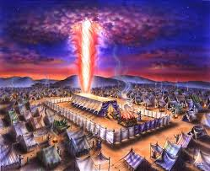
The Royal Family
Families, Ecclesias & Angels

Slide 2
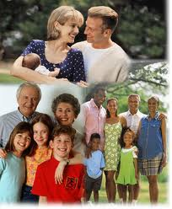
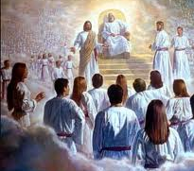
God chose to Use Families
He could have chosen another way - communes, polygamy, divorce….
Gen 2:18 not good for man to be alone
Gen 18:19 I have known Abraham…that he might command his children
Eph 3:14-21 the Father of the Lord Jesus Christ…from whom the whole family in heaven and in earth is named
God allows us to experience His divine family and character through our families & ecclesias

Slide 3
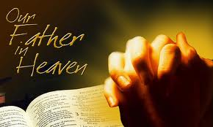
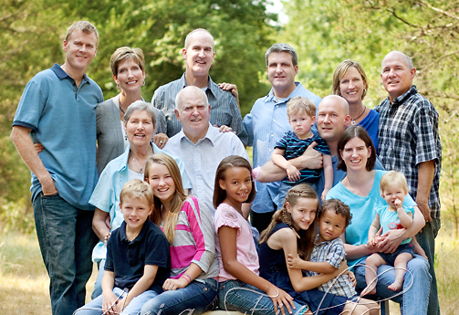
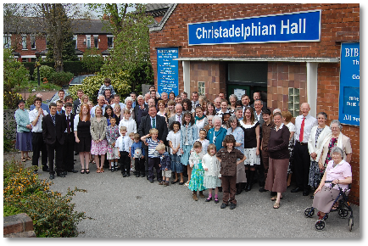
What better way to come to know & understand God than to live in families ourselves?
God allows us to experience His divine family and character through our families & ecclesias

Slide 4
God designed our Family relationships – they aren’t just by chance!
Children learn to be obedient to our heavenly Father and trust Him
Parents learn God is in control
Children learn to work with the rest of the family
Parents learn they can give more than they ever expected to the family
Spouses experience the desire Christ has for us
Everyone learns to love one another, as God has loved us

Slide 5
Raising Children & caring for our elderly helps us understand what God’s Family (angels) goes through to raise us!
Hebrews 12:7-11
7 If you endure chastening, God deals with you as with sons; for what son is there whom a father does not chasten? 8 But if you are without chastening, of which all have become partakers, then you are illegitimate and not sons. 9 Furthermore, we have had human fathers who corrected us, and we paid them respect. Shall we not much more readily be in subjection to the Father of spirits and live? 10 For they indeed for a few days chastened us as seemed best to them, but He for our profit, that we may be partakers of His holiness. 11 Now no chastening seems to be joyful for the present, but painful; nevertheless, afterward it yields the peaceable fruit of righteousness to those who have been trained by it.

Slide 6
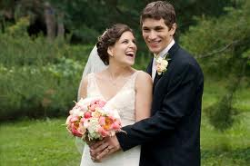
Marriage helps us practice Faithfulness and Mercy
Deuteronomy 7:9
"Therefore know that the Lord your God, He is God, the faithful God who keeps covenant and mercy for a thousand generations with those who love Him and keep His commandments;

Slide 7
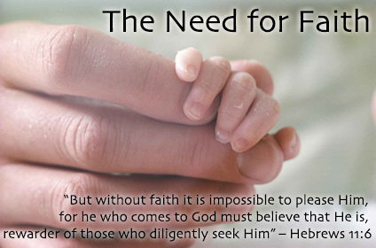

Slide 8
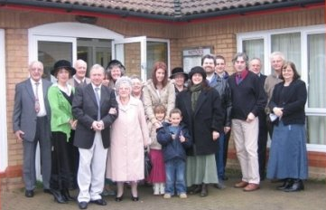
God chose to Use Ecclesias
1 Timothy 3:15 (NKJV)
15 but if I am delayed, I write so that you may know how you ought to conduct yourself in the house of God, which is the church of the living God, the pillar and ground of the truth.
1 Timothy 3:15 (NIV)
15 if I am delayed, you will know how people ought to conduct themselves in God's household, which is the church of the living God, the pillar and foundation of the truth.

Slide 9
God Chose to use Ecclesias:
It’s His Choice – like Families
Ecclesia in the wilderness
  Stephen refers to it this way (Acts 7:38)
Period of the Judges and Kings
First century ecclesias
Our ecclesias today too!
God could have worked in different ways: Individuals or small families

Slide 10
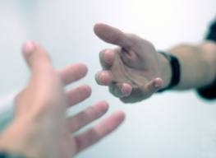
Why Does God Use Ecclesias?
Helps us to keep on track when we go through trials or get discouraged.
Helps us to learn to extend beyond our own family and work with God’s family!
Helps to balance us when God brings together people from different backgrounds.
Helps us appreciate others in God’s family when He supplies members who have differing talents.
Provides us with an opportunity to serve others in love, like Christ has done for us
Brings Glory to God because the ability to make it work – function as one unit – is all of God!

Slide 11
No one can perfectly apply God’s principles in daily life
Extended applications into daily life
First Principles
Extended applications into daily life
First Principles

Slide 12
We help to keep each other in balance!
We try to extend God’s principles into our lives…..but….
First Principles
Each of us is out of balance in some area

Slide 13

Ecclesias & Families let us practice working for unity
Galatians 3:27-29
27 For as many of you as were baptized into Christ have put on Christ.
28 There is neither Jew nor Greek, there is neither slave nor free, there is neither male nor female; for you are all one in Christ Jesus.
29 And if you are Christ's, then you are Abraham's seed, and heirs according to the promise.
Masters & Slaves
Rich & Poor
Educated & Uneducated
Jews & Gentiles
Males & Females
Elders & Children

Slide 14
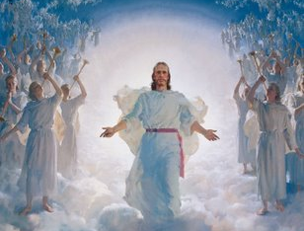
Ecclesia is our Extended Family in Christ
Ephesians 3:14-21
14 For this reason I bow my knees to the Father of our Lord Jesus Christ, 15 from whom the whole family in heaven and earth is named, 16 that He would grant you, according to the riches of His glory, to be strengthened with might through His Spirit in the inner man, 17 that Christ may dwell in your hearts through faith; that you, being rooted and grounded in love, 18 may be able to comprehend with all the saints what is the width and length and depth and height-- 19 to know the love of Christ which passes knowledge; that you may be filled with all the fullness of God.
We need to love and care about every member. Everyone is needed!

Slide 15

God builds our Ecclesias and families
God brings into our lives the ecclesial troubles we need to make us face issues we need help with.
God gives us the brothers and sisters and young people we need
  to get us through our trials
  for us to help through their trials
It’s all of God! Trust Him!

Slide 16
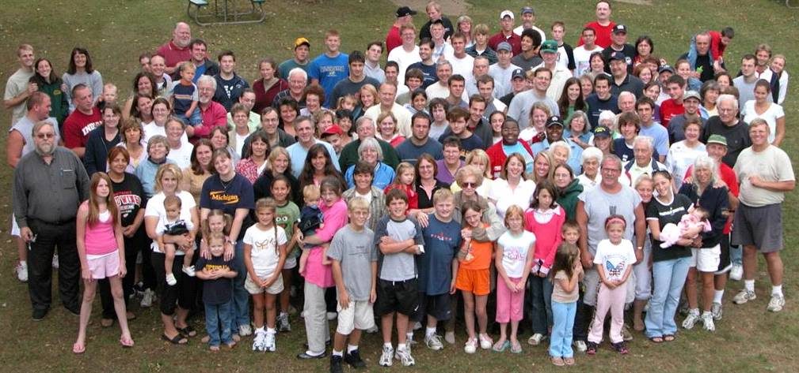
The ecclesia of the living God, the pillar and foundation of the Truth
Do your best to encourage & comfort one another

