Slide 1


God’s Flexibility
Bible examples of how God is sometimes willing to adapt His plans to accommodate us

Slide 2
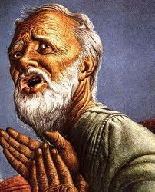
Abraham (Gen 18:23-32)
23 And Abraham came near and said, "Would You also destroy the righteous with the wicked? 24 Suppose there were fifty righteous within the city; would You also destroy the place and not spare it for the fifty righteous that were in it? 25 Far be it from You to do such a thing as this, to slay the righteous with the wicked, so that the righteous should be as the wicked; far be it from You! Shall not the Judge of all the earth do right?"
26 So the Lord said, "If I find in Sodom fifty righteous within the city, then I will spare all the place for their sakes."
Note how the angel was willing to accommodate Abraham’s request

Slide 3
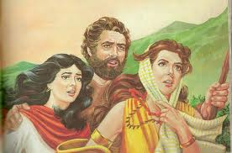
Lot asks for Zoar (Gen 19:19-20)
19 Indeed now, your servant has found favor in your sight, and you have increased your mercy which you have shown me by saving my life; but I cannot escape to the mountains, lest some evil overtake me and I die. 20 See now, this city is near enough to flee to, and it is a little one; please let me escape there (is it not a little one?) and my soul shall live.“
Even after saving Lot from the destruction of Sodom, God was willing to accommodate Lot’s request to settle in Zoar

Slide 4
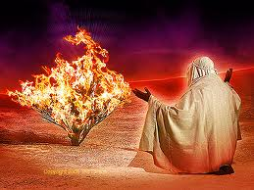
Moses can’t speak (Ex 4:10-15)
10 Then Moses said to the Lord, "O my Lord, I am not eloquent, neither before nor since You have spoken to Your servant; but I am slow of speech and slow of tongue."
11 So the Lord said to him, "Who has made man's mouth? Or who makes the mute, the deaf, the seeing, or the blind? Have not I, the Lord? 12 Now therefore, go, and I will be with your mouth and teach you what you shall say."
13 But he said, "O my Lord, please send by the hand of whomever else You may send."
14 So the anger of the Lord was kindled against Moses, and He said: "Is not Aaron the Levite your brother? I know that he can speak well. And look, he is also coming out to meet you. When he sees you, he will be glad in his heart. 15 Now you shall speak to him and put the words in his mouth. And I will be with your mouth and with his mouth, and I will teach you what you shall do.
God accommodated Moses even though He was angry at Moses

Slide 5
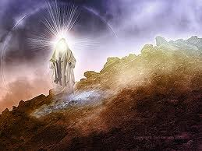
Moses requests Angel (Ex 33:12-17)
12 Then Moses said to the Lord, "See, You say to me, 'Bring up this people.' But You have not let me know whom You will send with me. Yet You have said, 'I know you by name, and you have also found grace in My sight.' 13 Now therefore, I pray, if I have found grace in Your sight, show me now Your way, that I may know You and that I may find grace in Your sight. And consider that this nation is Your people."
14 And He said, "My Presence will go with you, and I will give you rest."
15 Then he said to Him, "If Your Presence does not go with us, do not bring us up from here. 16 For how then will it be known that Your people and I have found grace in Your sight, except You go with us? So we shall be separate, Your people and I, from all the people who are upon the face of the earth."
17 So the Lord said to Moses, "I will also do this thing that you have spoken; for you have found grace in My sight, and I know you by name.“
God responded to Moses’ desire to send the angel Moses already knew

Slide 6
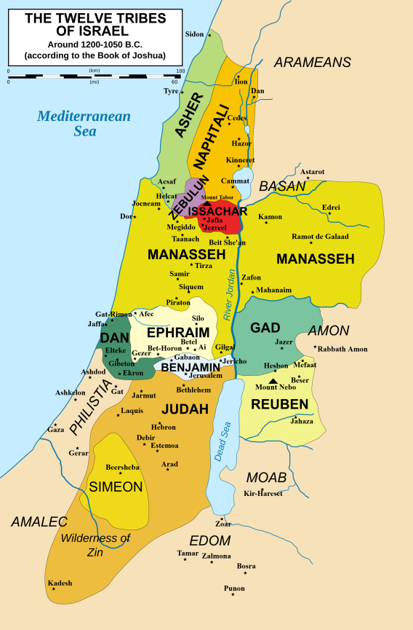
2.5 Tribes (Num 32:2-5)
2 the children of Gad and the children of Reuben came and spoke to Moses, to Eleazar the priest, and to the leaders of the congregation, saying, 3 "Ataroth, Dibon, Jazer, Nimrah, Heshbon, Elealeh, Shebam, Nebo, and Beon, 4 the country which the Lord defeated before the congregation of Israel, is a land for livestock, and your servants have livestock." 5 Therefore they said, "If we have found favor in your sight, let this land be given to your servants as a possession. Do not take us over the Jordan.“
God modified the inheritance of Israel because of the request of the 2.5 tribes

Slide 7
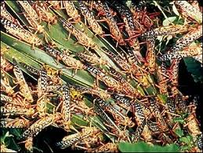
Amos: “please pardon!” (7:1-3) NASB
Thus the Lord God showed me: Behold, He formed locust swarms at the beginning of the late crop; indeed it was the late crop after the king's mowings. 2 And so it was, when they had finished eating the grass of the land, that I said:
"O Lord God, forgive, I pray! Oh, that Jacob may stand, for he is small!“ 3 So the Lord relented concerning this. "It shall not be," said the Lord.
Even though God was just to bring this on Israel, He modified His plan & did not bring the locust or fire according to Amos’ requests

Slide 8
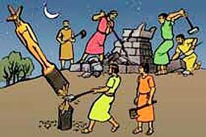
Gideon destroys altar at night (Jud 6:25-27)
25 Now it came to pass the same night that the Lord said to him, "Take your father's young bull, the second bull of seven years old, and tear down the altar of Baal that your father has, and cut down the wooden image that is beside it; 26 and build an altar to the Lord your God on top of this rock in the proper arrangement, and take the second bull and offer a burnt sacrifice with the wood of the image which you shall cut down." 27 So Gideon took ten men from among his servants and did as the Lord had said to him. But because he feared his father's household and the men of the city too much to do it by day, he did it by night.
God accommodated Gideon’s fears

Slide 9
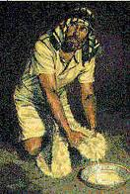
Gideon & Fleece (Jud 6:36-40)
36 So Gideon said to God, "If You will save Israel by my hand as You have said — 37 look, I shall put a fleece of wool on the threshing floor; if there is dew on the fleece only, and it is dry on all the ground, then I shall know that You will save Israel by my hand, as You have said." 38 And it was so. When he rose early the next morning and squeezed the fleece together, he wrung the dew out of the fleece, a bowlful of water. 39 Then Gideon said to God, "Do not be angry with me, but let me speak just once more: Let me test, I pray, just once more with the fleece; let it now be dry only on the fleece, but on all the ground let there be dew." 40 And God did so that night. It was dry on the fleece only, but there was dew on all the ground.
God again accommodated Gideon’s fears and reluctance

Slide 10
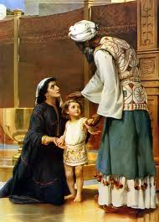
Hannah asks for a child 1 Samuel 1:9-11
9 So Hannah arose after they had finished eating and drinking in Shiloh. Now Eli the priest was sitting on the seat by the doorpost of the tabernacle of the Lord. 10 And she was in bitterness of soul, and prayed to the Lord and wept in anguish. 11 Then she made a vow and said, "O Lord of hosts, if You will indeed look on the affliction of Your maidservant and remember me, and not forget Your maidservant, but will give Your maidservant a male child, then I will give him to the Lord all the days of his life, and no razor shall come upon his head."
God chose to work through Hannah & Samuel because of Hannah’s prayers

Slide 11
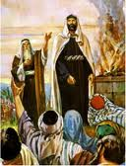
Israel asks for King (1Sam 8:6-9)
6 But the thing displeased Samuel when they said, "Give us a king to judge us." So Samuel prayed to the Lord. 7 And the Lord said to Samuel, "Heed the voice of the people in all that they say to you; for they have not rejected you, but they have rejected Me, that I should not reign over them. 8 According to all the works which they have done since the day that I brought them up out of Egypt, even to this day — with which they have forsaken Me and served other gods — so they are doing to you also. 9 Now therefore, heed their voice. However, you shall solemnly forewarn them, and show them the behavior of the king who will reign over them.“
Even though this request was a failure to see God as their King, God still gave them what they wanted

Slide 12
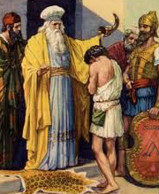
Samuel anoints David (1Sam 16:1-3)
Now the Lord said to Samuel, "How long will you mourn for Saul, seeing I have rejected him from reigning over Israel? Fill your horn with oil, and go; I am sending you to Jesse the Bethlehemite. For I have provided Myself a king among his sons."
2 And Samuel said, "How can I go? If Saul hears it, he will kill me.“
But the Lord said, "Take a heifer with you, and say, 'I have come to sacrifice to the Lord.' 3 Then invite Jesse to the sacrifice, and I will show you what you shall do; you shall anoint for Me the one I name to you.“
God accommodated Samuel’s fears rather then force him to risk his life

Slide 13
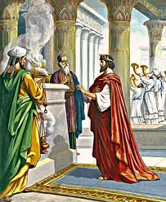
Hezekiah’s Passover (2Chr 30:18-20)
18 For a multitude of the people, many from Ephraim, Manasseh, Issachar, and Zebulun, had not cleansed themselves, yet they ate the Passover contrary to what was written. But Hezekiah prayed for them, saying, "May the good Lord provide atonement for everyone 19 who prepares his heart to seek God, the Lord God of his fathers, though he is not cleansed according to the purification of the sanctuary." 20 And the Lord listened to Hezekiah and healed the people.
God accommodate Hezekiah’s request even though this was technically against the Mosaic Law

Slide 14
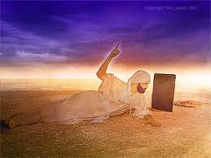
Ezekiel’s Dung (Ez 4:14-15)
14 So I said, "Ah, Lord God! Indeed I have never defiled myself from my youth till now; I have never eaten what died of itself or was torn by beasts, nor has abominable flesh ever come into my mouth."
15 Then He said to me, "See, I am giving you cow dung instead of human waste, and you shall prepare your bread over it.“
God accommodated Ezekiel’s request even though it was to satisfy his personal feelings

Slide 15
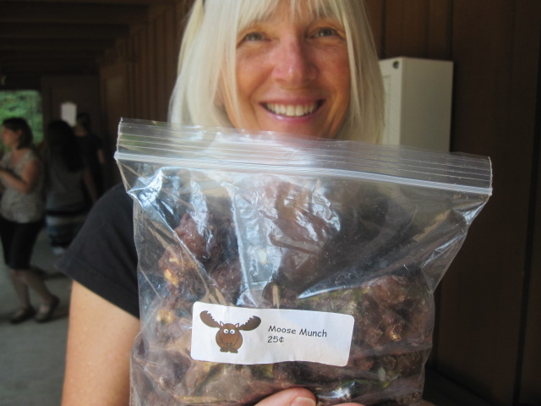
Moose Munch Sale 10 cents!
X

Slide 16
Moose Munch Sale 5 cents!
Special Sale only 5 cents
X

Slide 17
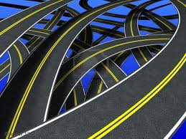
God’s Flexibility
Some outcomes are fixed, but the pathway is flexible

Slide 18
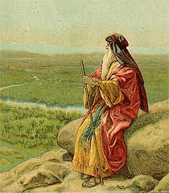
Moses sees Land (Dt 3:23-27)
23 "Then I pleaded with the Lord at that time, saying: 24 'O Lord God, You have begun to show Your servant Your greatness and Your mighty hand, for what god is there in heaven or on earth who can do anything like Your works and Your mighty deeds? 25 I pray, let me cross over and see the good land beyond the Jordan, those pleasant mountains, and Lebanon.'
26 "But the Lord was angry with me on your account, and would not listen to me. So the Lord said to me: 'Enough of that! Speak no more to Me of this matter. 27 Go up to the top of Pisgah, and lift your eyes toward the west, the north, the south, and the east; behold it with your eyes, for you shall not cross over this Jordan.
God allowed Moses to see the land, but would not modify His decision to keep him out

Slide 19
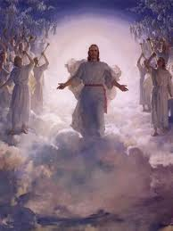
Micaiah’s vision (1 Kgs 22:20-23)
20 And the Lord said, 'Who will per- suade Ahab to go up, that he may fall at Ramoth Gilead?' So one spoke in this manner, and another spoke in that manner. 21 Then a spirit came forward and stood before the Lord, and said, 'I will persuade him.' 22 The Lord said to him, 'In what way?' So he said, 'I will go out and be a lying spirit in the mouth of all his prophets.' And the Lord said, 'You shall persuade him, and also prevail. Go out and do so.‘
Angels help God determine the pathway to choose

Slide 20
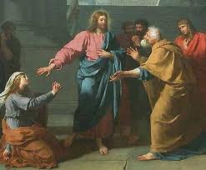
Syro-Phoenician Woman’s request to Jesus (Mark 7:24-30)
24 From there He arose and went to the region of Tyre and Sidon. And He entered a house and wanted no one to know it, but He could not be hidden. 25 For a woman whose young daughter had an unclean spirit heard about Him, and she came and fell at His feet. 26 The woman was a Greek, a Syro-Phoenician by birth, and she kept asking Him to cast the demon out of her daughter. 27 But Jesus said to her, "Let the children be filled first, for it is not good to take the children's bread and throw it to the little dogs."
28 And she answered and said to Him, "Yes, Lord, yet even the little dogs under the table eat from the children's crumbs."
29 Then He said to her, "For this saying go your way; the demon has gone out of your daughter."
30 And when she had come to her house, she found the demon gone out, and her daughter lying on the bed.
Jesus didn’t want to heal a Gentile woman’s daughter at this time, but responded to her faith!

Slide 21
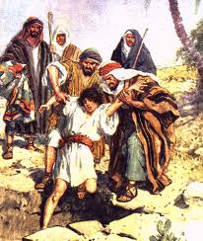
God’s Flexibility
God can even use our mistakes to bring about good!

Slide 22
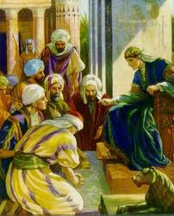
Joseph’s Brothers (Gen 50:15-21)
15 When Joseph's brothers saw that their father was dead, they said, "Perhaps Joseph will hate us, and may actually repay us for all the evil which we did to him." 16 So they sent messengers to Joseph, saying, "Before your father died he commanded, saying, 17 'Thus you shall say to Joseph: "I beg you, please forgive the trespass of your brothers and their sin; for they did evil to you."' Now, please, forgive the trespass of the servants of the God of your father." And Joseph wept when they spoke to him.
18 Then his brothers also went and fell down before his face, and they said, "Behold, we are your servants."
19 Joseph said to them, "Do not be afraid, for am I in the place of God? 20 But as for you, you meant evil against me; but God meant it for good, in order to bring it about as it is this day, to save many people alive. 21 Now therefore, do not be afraid; I will provide for you and your little ones." And he comforted them and spoke kindly to them.

Slide 23
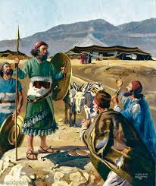
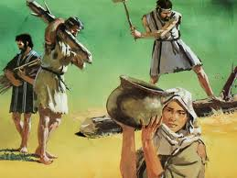
Covenant with Gibeonites (Josh 9:3-15)
3 But when the inhabitants of Gibeon heard what Joshua had done to Jericho and Ai, 4 they worked craftily, and went and pretended to be ambassadors. And they took old sacks on their donkeys, old wineskins torn and mended, 5 old and patched sandals on their feet, and old garments on themselves; and all the bread of their provision was dry and moldy. 6 And they went to Joshua, to the camp at Gilgal, and said to him and to the men of Israel, "We have come from a far country; now therefore, make a covenant with us.“
14 Then the men of Israel took some of their provisions; but they did not ask counsel of the Lord. 15 So Joshua made peace with them, and made a covenant with them to let them live; and the rulers of the congregation swore to them.

Slide 24
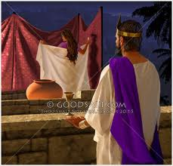
God used Bathsheba (1Chr 22:7-11)
7 And David said to Solomon: "My son, as for me, it was in my mind to build a house to the name of the Lord my God; 8 but the word of the Lord came to me, saying, 'You have shed much blood and have made great wars; you shall not build a house for My name, because you have shed much blood on the earth in My sight. 9 Behold, a son shall be born to you, who shall be a man of rest; and I will give him rest from all his enemies all around. His name shall be Solomon, for I will give peace and quietness to Israel in his days. 10 He shall build a house for My name, and he shall be My son, and I will be his Father; and I will establish the throne of his kingdom over Israel forever.‘
God is more interested in how we handle our sins, than the sin itself!

Slide 25
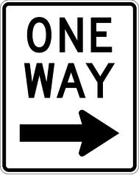
God’s Flexibility
Some outcomes are fixed with only one pathway

Slide 26
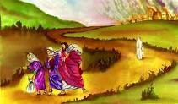
Lot’s wife (Gen 19:17, 26)
17 So it came to pass, when they had brought them outside, that he said, "Escape for your life! Do not look behind you nor stay anywhere in the plain. Escape to the mountains, lest you be destroyed."
26 But his wife looked back behind him, and she became a pillar of salt.
Many pathways dealing with consequences of our actions are fixed – we must be careful!

Slide 27
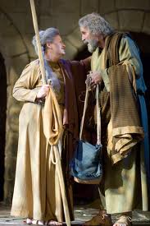
Abram pleads for Ishmael (Gen 20:1-3)
17 Then Abraham fell on his face and laughed, and said in his heart, "Shall a child be born to a man who is one hundred years old? And shall Sarah, who is ninety years old, bear a child?" 18 And Abraham said to God, "Oh, that Ishmael might live before You!"
19 Then God said: "No, Sarah your wife shall bear you a son, and you shall call his name Isaac; I will establish My covenant with him for an everlasting covenant, and with his descendants after him.
God’s covenant had to be established on His promises, according to His election (Rom 9)

Slide 28
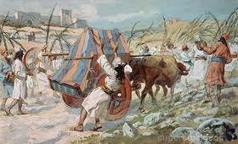
God struck Uzzah (2 Sam 6:6-8)
6 And when they came to Nachon's threshing floor, Uzzah put out his hand to the ark of God and took hold of it, for the oxen stumbled. 7 Then the anger of the Lord was aroused against Uzzah, and God struck him there for his error; and he died there by the ark of God. 8 And David became angry because of the Lord's outbreak against Uzzah; and he called the name of the place Perez Uzzah to this day.
Sometimes God’s holiness cannot accommodate other outcomes

Slide 29
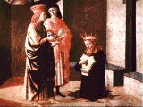
David prays for his child (2 Sam 12:15-20)
And the Lord struck the child that Uriah's wife bore to David, and it became ill. 16 David there- fore pleaded with God for the child, and David fasted and went in and lay all night on the ground. 17 So the elders of his house arose and went to him, to raise him up from the ground. But he would not, nor did he eat food with them. 18 Then on the seventh day it came to pass that the child died. And the servants of David were afraid to tell him that the child was dead. For they said, "Indeed, while the child was alive, we spoke to him, and he would not heed our voice. How can we tell him that the child is dead? He may do some harm!"
19 When David saw that his servants were whispering, David perceived that the child was dead. Therefore David said to his servants, "Is the child dead?“ And they said, "He is dead."
20 So David arose from the ground, washed and anointed himself, and changed his clothes; and he went into the house of the Lord and worshiped. Then he went to his own house; and when he requested, they set food before him, and he ate.
David understood God’s pathways!

Slide 30
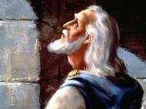
Do not pray for these people! (Jer 14:11; 15:1)
11 Then the Lord said to me, "Do not pray for this people, for their good. 12 When they fast, I will not hear their cry; and when they offer burnt offering and grain offering, I will not accept them. But I will consume them by the sword, by the famine, and by the pestilence.“
1 Then the Lord said to me, "Even if Moses and Samuel stood before Me, My mind would not be favorable toward this people. Cast them out of My sight, and let them go forth.
God had to remove them to Babylon to save a remnant

Slide 31
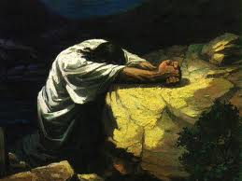
Let this cup pass (Mat 26:39)
39 He went a little farther and fell on His face, and prayed, saying, "O My Father, if it is possible, let this cup pass from Me; nevertheless, not as I will, but as You will."
40 Then He came to the disciples and found them sleeping, and said to Peter, "What! Could you not watch with Me one hour? 41 Watch and pray, lest you enter into temptation. The spirit indeed is willing, but the flesh is weak."
42 Again, a second time, He went away and prayed, saying, "O My Father, if this cup cannot pass away from Me unless I drink it, Your will be done."
Jesus realized there was only 1 way

Slide 32
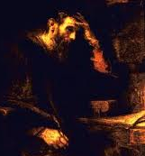
Paul asks for thorn’s removal (2 Cor 12:7-10)
7 And lest I should be exalted above measure by the abundance of the revela- tions, a thorn in the flesh was given to me, a messenger of Satan to buffet me, lest I be exalted above measure. 8 Concerning this thing I pleaded with the Lord three times that it might depart from me. 9 And He said to me, "My grace is sufficient for you, for My strength is made perfect in weakness." Therefore most gladly I will rather boast in my infirmities, that the power of Christ may rest upon me. 10 Therefore I take pleasure in infirmities, in reproaches, in needs, in persecutions, in distresses, for Christ's sake. For when I am weak, then I am strong.
God knew Paul needed this!

Slide 33
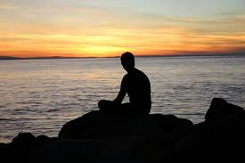
Lessons for us
Be aware that many times God has a variety of pathways He can work through – pray! He’s listening and can sometimes accommodate our desires.
Even when we have made terrible mistakes, God can bring good out of it
Accept that some times God will not alter His pathway because He knows what’s best for all involved – trust and believe He loves us and wants to save us!
Without faith it is impossible to please Him

Slide 34

Philippians 4:6-7
Don’t be afraid to ask God!
6 Be anxious for nothing, but in everything by prayer and supplication, with thanksgiving, let your requests be made known to God; 7 and the peace of God, which surpasses all understanding, will guard your hearts and minds through Christ Jesus.
The peace comes from trusting God is in control and knows what’s best for all of us!

Slide 35
God’s Flexibility
Bible examples of how God is sometimes willing to adapt His plans to accommodate us

Slide 36

Hebrews 12:5-11
And you have forgotten the exhortation which speaks to you as to sons: "My son, do not despise the chastening of the Lord, Nor be discouraged when you are rebuked by Him; For whom the Lord loves He chastens, And scourges every son whom He receives." If you endure chastening, God deals with you as with sons….. that we may be partakers of His holiness. Now no chastening seems to be joyful for the present, but painful; nevertheless, afterward it yields the peaceable fruit of righteousness to those who have been trained by it.

Slide 37
2
S
G

