Slide 1
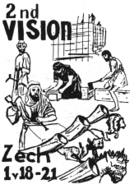
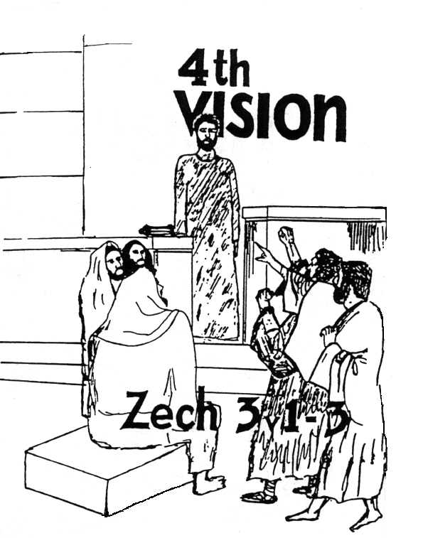
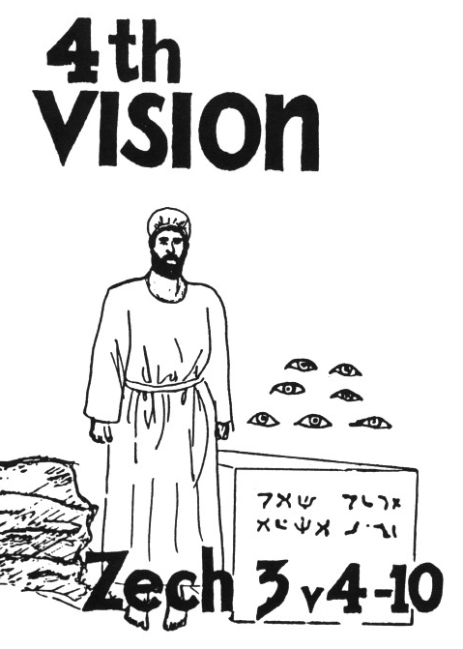
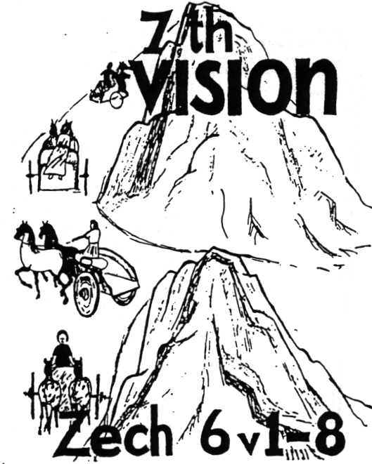
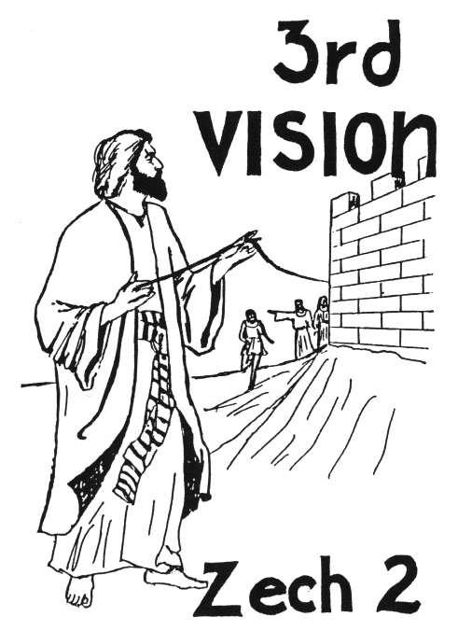
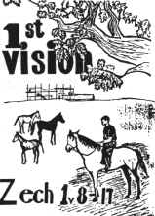
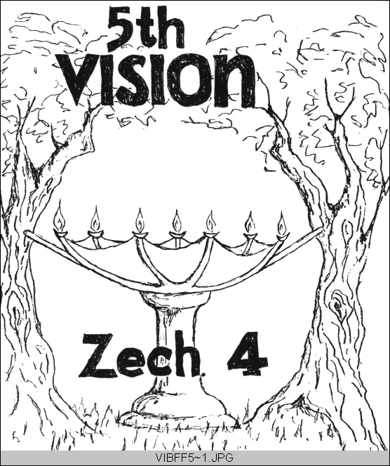

Zechariah’s
Night Visions
(Zech. 1-6)
Class 1:
Background to the Ecclesial Situation

Slide 2
Zechariah
Name means “Yah has remembered”
Son of Berechiah: “Blessing of Yah”
Grandson of Iddo: probably the same Iddo who returned with Zerubabbel (Neh 12:16)

Slide 3
Zechariah’s prophecy has two applications
1) Original application to the return of Jeshua & Zerubbabel and the building of God’s physical house (temple).
2) Future application to Christ’s coming & return, and the building of his spiritual house
Understanding the original application helps us to properly apply the future

Slide 4
The Returned Exiles
Jeshua & Zerubbabel return (Ezra 1-2)
Begin rebuilding the temple (Ezra 3-4)
Zechariah & Haggai motivate the people to finish the temple (Ezra 5-6)
Ezra returns with more exiles (Ezra 7-10)
God uses Haman to convince more Jews to return home (Esther)
Nehemiah builds the walls of Jerusalem

Slide 5
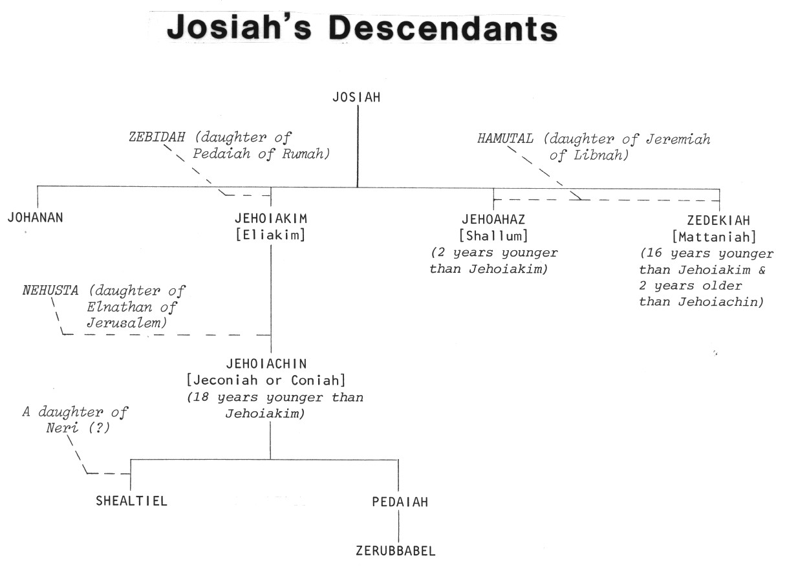
King Josiah’s Descendants
Josiah
2
1
4
3
Good King Josiah had no children who were like him!

Slide 6
Jeremiah’s Prophecies about the 70 years
Jer 25:11-14 (during early years of Jehoiakim’s reign) after 70 years God will punish Babylon
Jer 29:10-14 (during early years of Zedekiah) after 70 years God will bring the Jews back and give them a future with peace and hope

Slide 7

Timeline of the Persian Kings during the temple building

Slide 8
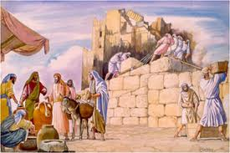
Building the Temple
Cyrus 6 years
Cambyses 8 years
Gomates 7 months
Darius 6 years
Time to finish = 20 years

Slide 9

Ezra 3:10-13
10 When the builders laid the foundation of the temple of the Lord, the priests stood in their apparel with trumpets, and the Levites, the sons of Asaph, with cymbals, to praise the Lord, according to the ordinance of David king of Israel. 11 And they sang responsively, praising and giving thanks to the Lord:
"For He is good,
For His mercy endures forever toward Israel."
Then all the people shouted with a great shout, when they praised the Lord, because the foundation of the house of the Lord was laid.
continued

Slide 10
Ezra 3:10-12
12 But many of the priests and Levites and heads of the fathers' houses, old men who had seen the first temple, wept with a loud voice when the foundation of this temple was laid before their eyes. Yet many shouted aloud for joy, 13 so that the people could not discern the noise of the shout of joy from the noise of the weeping of the people, for the people shouted with a loud shout, and the sound was heard afar off.

Slide 11
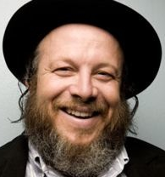
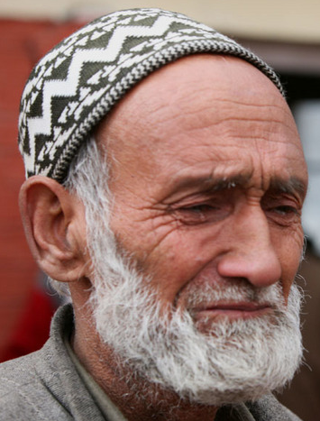
People’s Reaction to Laying the Foundation (Ezra 3:12 )
Younger: Shouted & praised (excited!)
Older: Wept (disappointed) ☹
Hag 2:3-4 Is it not in your sight as nothing?
Zech 4:8-10 Who has despised the day of small things?

Slide 12
The Kings of Ezra 4
Effect on Temple | Name in Ezra 4 | Actual Name | Length of Reign
Issued decree to build temple | Cyrus | Cyrus the Great | 9 years after decree
Did not hinder the work | Ahaseurus | Cambyses II | 8 years
Stopped work on temple | Artaxerxes | Gomates (Pseudo-Smerdis) | 7 months
Encouraged work to finish | Darius | Darius Hystaspes (Darius the Great) | 36 years

Slide 13
Timeline of the Persian Kings during the temple building

Slide 14

Why did God stop the work?
15 years of work had worn out and discouraged the people
Older people didn’t like the new temple
Adversaries hired counselors against them
Workers wanted to spend time on their own houses, farms and businesses
People were afraid of adversaries (8:4-5)
Be careful! Sometimes God gives us what we want so we will learn to quit dreaming for it!

Slide 15
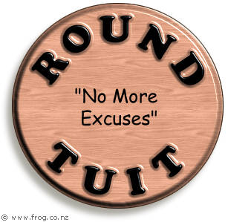
What were the people doing?
(see Haggai 1)
Claimed the time was not right (v.2)
[said the 70 years were not over yet]

Slide 16
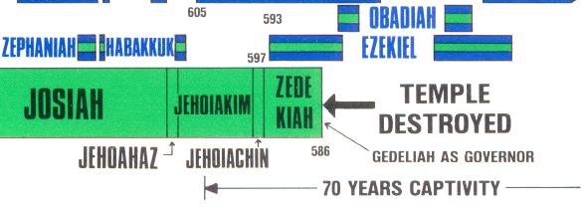
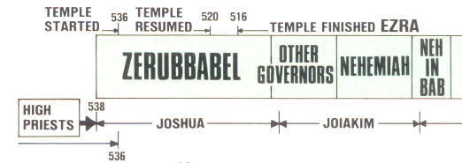
When did the 70 years start?
70 years
70 years

Slide 17

What were the people doing?
(see Haggai 1)
Claimed the time was not right (v.2)
[said the 70 years were not over yet]
Paneled their own homes (v.4)
Tried to improve their own economic situation (v.6)

Slide 18
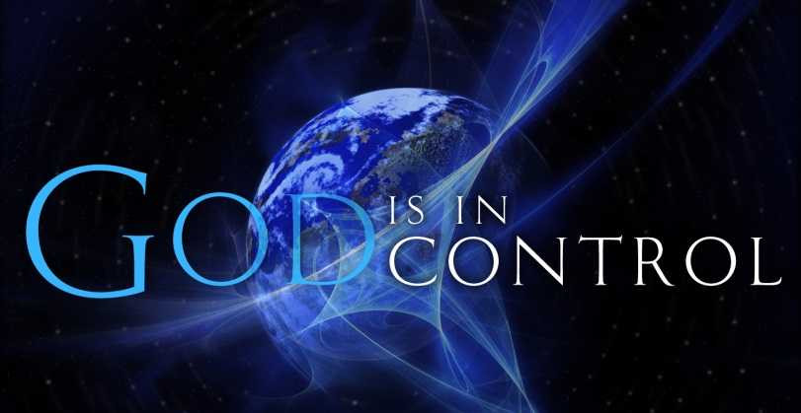
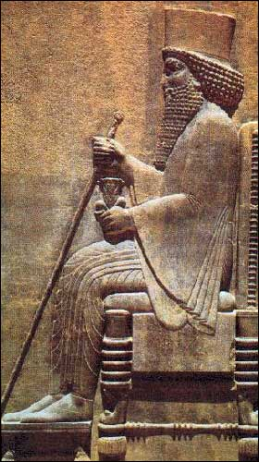
God raises up Darius to be King!
A few months after the temple work was forced to stop, God opened a door by bringing Darius to the throne
Some of the Jews realized this was their opportunity and began working on the temple again, but they needed more help

Slide 19
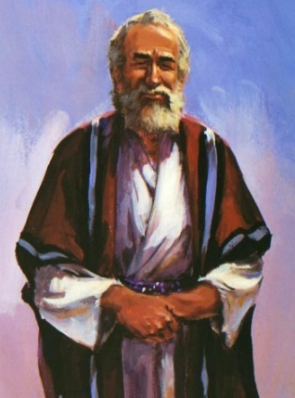

“The Prophets of God Helping them” (Ezra 5:1-2 )
Coordinated efforts of Haggai & Zechariah
Haggai: Probably older man - exhorts and reprimands the people for their poor choices and lack of faith.
Zechariah: Probably younger man - encourages the people that the angels are working behind the scenes and they will help finish the temple!

Slide 20
Haggai & Zechariah together
2nd Year of Darius
Hag 1:1-11 6th month, 1st day
consider how your have fared!
Hag 1:12-15 6th month, 24th day
Began working on the temple again
Hag 2:1-9 7th month, 21st day
End of Tabernacles – “I am with you”

Slide 21
Haggai & Zechariah together
2nd Year of Darius
Zech 1:1-6 8th month
Return to God or face captivity again!
Hag 2:10-23 9th month, 24th day
Nation unclean, but God will bless them!
Zech 1:7-6:15 11th month, 24th day
Night visions: God will finish the temple!

Slide 22
Haggai & Zechariah together
4th Year of Darius
Zech 7:1-8:23 9th month, 4th day
Obedience to God is more important than meaningless rituals
The Lord will return to Zion and dwell in Jerusalem. A remnant of Jews and many nations will seek Him in Jerusalem

Slide 23
Outline of Zechariah 1
1-6 Return to the Lord, or face captivity again!
7-11 Vision: 4 horsemen
12-17 God will extend mercy to Jerusalem & build His house again
18-21 Vision: 4 horns & 4 craftsmen

Slide 24

1st Step: “Return to Me”
Same message before in Jer 3:1,7; 4:1; 24:7; Isa 44:22
Quoted later in Mal 3:7-10
Our God is faithful and will not fail us!

Slide 25
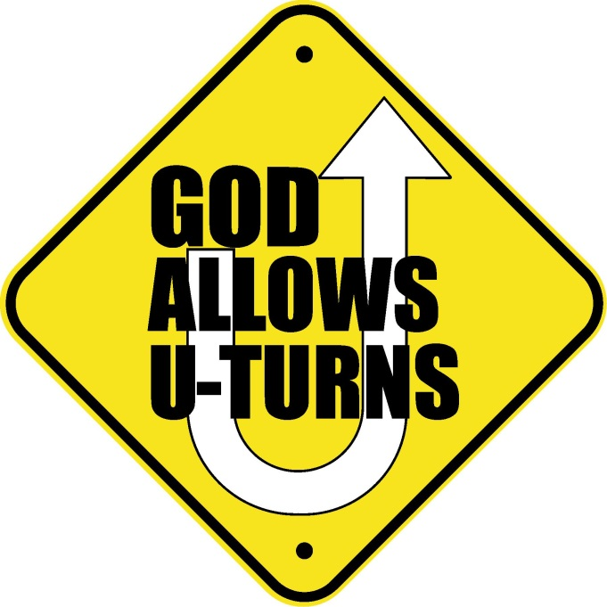
Turn from your evil ways (1:4)
Taken from 2 Kings 17:13 when God explained why He had to remove Israel from the land.
God’s warning is that if the people do not respond, He will have to send them away captive again!

Slide 26
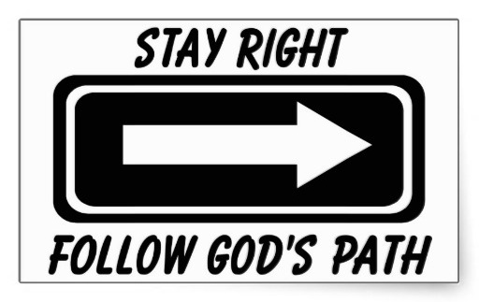
The people’s response (1:6):
God was right!
People admit they made mistakes
Acknowledge God dealt with them according to their deeds

Slide 27
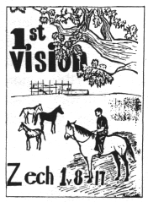
The 1st Vision
What Zechariah saw:
A man riding on a red horse
standing among myrtle trees
Red, sorrel & white horses
What had they done?
Patrol the earth
Bought rest

Slide 28
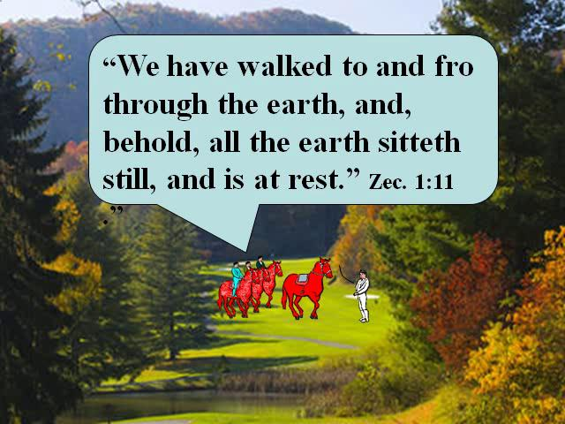
Vision of the Horses among the Myrtle Trees
Colored horses used to represent God’s power to enforce war, famine, pestilence and peace throughout the world (Zech 6:1-8; Rev 6:1-8; 19:11-16) – Zechariah gives us a basis to understand Revelation, but it doesn’t mean the exact same thing!
Myrtle trees (evergreens) used to represent endurance, stability and peace (Lev 23:40-43 & Neh 8:15; Isa 55:13; 41:19; 61:3) – May also be connected to Esther (Hadassah - myrtle) because these angels were designing events to replace Vashti with Esther as queen for Darius Hystaspes!

Slide 29
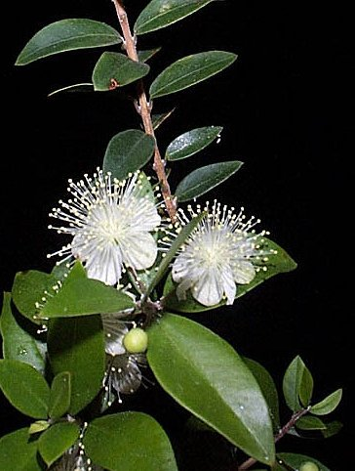
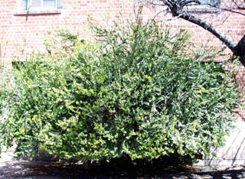
Myrtle shrub or small tree
(Myrtus communis)
5 to 15 feet tall, 4 to 20 feet spread
Key Characteristics:
  evergreen
  drought tolerant

Slide 30
Who are the horsemen?
1:10 These are the ones whom the LORD has sent to walk to and fro throughout the earth
4:10 These seven…they are the eyes of the Lord which scan to and fro throughout the whole earth
They are the Angels! God’s eyes that run to and fro throughout the whole earth (2 Chron 16:9) - Unseen!

Slide 31
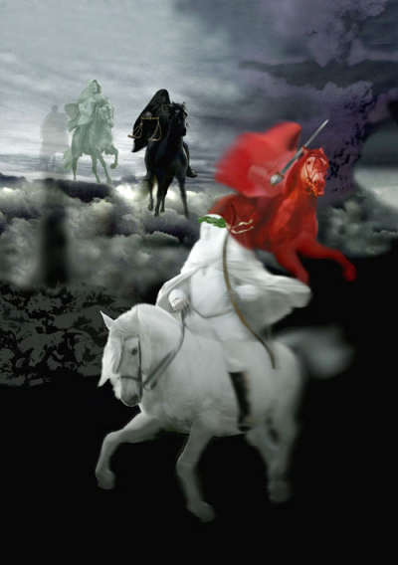
What had the Angels done?
Suppressed the adversaries of Ezra 4 so the work on the temple could begin again
Put down the rebellions throughout the Persian empire caused by Gomates’ 7 month take over and Darius’ overthrow of Gomates
Brought the earth back to “resting quietly” (Zech 1:11)

Slide 32
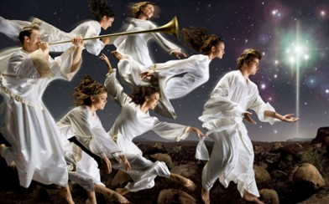
Look at what the Angels did behind the scene! (Ezra 5)
v.6 Keep yourselves far from there
v.7 Let the work of this house of God alone
v.8 Let the cost be paid from the King’s expense from taxes (so the adversaries of Ezra 4 ended up paying to finish the temple!)
v.9 And whatever else they need…let it be given them day by day without fail!

Slide 33
How long will God not have Mercy?
God still has great zeal for Jerusalem (14)
God is angry at the nations (15)
God will show mercy to Jerusalem (16)
God’s house will be built (16)
God will again choose Jerusalem (17)
God motivated them to continue building in His mercy

Slide 34
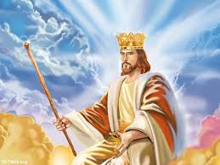
The Long-Term fulfillment
The Angels today are influencing the nations to bring about the events for Christ’s return
They are excited as ever for God to again have mercy on Jerusalem and send His Son, the king/priest, who will rebuild God’s house.
The Jews must return to God or be destroyed when 2/3 in the land will be cut off & only 1/3 refined (Zech 13:8-9)
Are you as excited as the Angels?

Slide 35

Lessons from 1st Vision
Get Involved in God’s work today
Stay involved even in tough times
When we get discouraged, remember:
  the angels are on our side and enthusiastically work for our spiritual success!
  God loves us and is zealous for us to grow and develop in His family

Slide 36
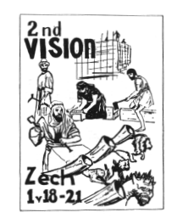
The 2nd Vision
What Zechariah saw:
4 horns
4 craftsmen or carpenters
What happened?
The horns scattered and
humiliated Israel
The carpenters will terrify
and cast out the horns

Slide 37
4 Horns of Zech 1:18-10
Horns = Kings (Dan 7:24; 8:21)
4 Kings responsible for scattering Israel:
Shalmaneser – 2 Kgs 18:9-12
Sennacherib – 2 Kgs 18:13-16
Pharaoh Necho – 2 Kgs 23:31-34
Nebuchadnezzar – 2 Kgs 24:10–25:11
Or the 4 horns may refer to the adversaries all around Israel that had bothered them until now

Slide 38
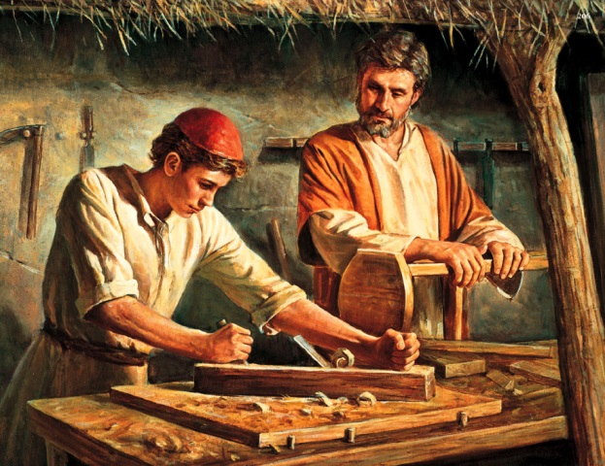
4 Carpenters (KJV)
“craftsmen” (NKJ, NIV, NASB)
1 Sam 13:19 Now there was no blacksmith to be found throughout all the land of Israel, for the Philistines said, “Lest the Hebrews make swords or spears.”
Ezra 3:7 They also gave money to the masons and the carpenters…
God will empower His temple builders to overcome their adversaries so they can finish the temple

Slide 39
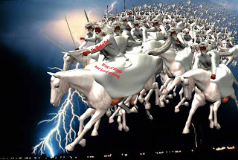
Use of “Lord of hosts”
Isaiah – about 60 times
Jeremiah – about 80 times
Zechariah – about 50 times
in only 14 chapters!
The people were scared and needed assurance that Yahweh of armies would be there to save and protect His people!

Slide 40
Nations learned to fear Jews
Deut 2:25 `This day I will begin to put the dread and fear of you upon the nations under the whole heaven, who shall hear the report of you, and shall tremble and be in anguish because of you.'
Deut 11:25 "No man shall be able to stand against you; the LORD your God will put the dread of you and the fear of you upon all the land where you tread, just as He has said to you.
Josh 2:9-11 Rahab: "I know that the LORD has given you the land, that the terror of you has fallen on us, and that all the inhabitants of the land are fainthearted because of you.
Esther 6:13 When Haman told his wife Zeresh and all his friends everything that had happened to him, his wise men and his wife Zeresh said to him, "If Mordecai, before whom you have begun to fall, is of Jewish descent, you will not prevail against him but will surely fall before him."

Slide 41
Next Class
We’ll continue looking at the next 2 visions & the impact they had on the people

Slide 43
L
S
H
d

Slide 44
Lessons from Today
E

