Slide 1
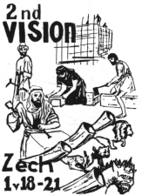
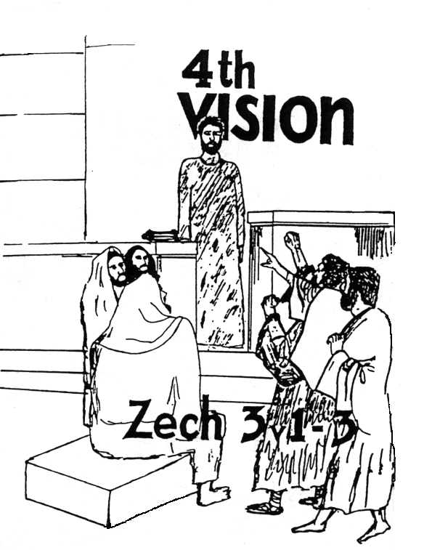
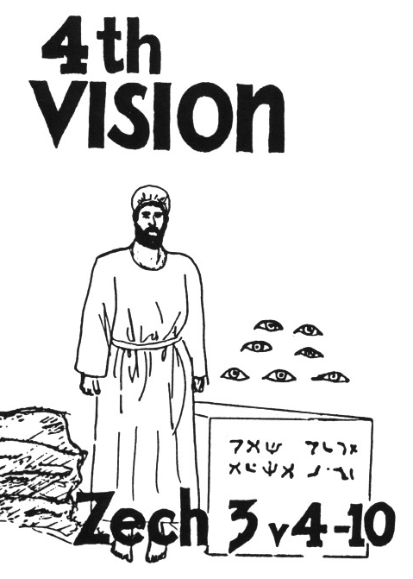

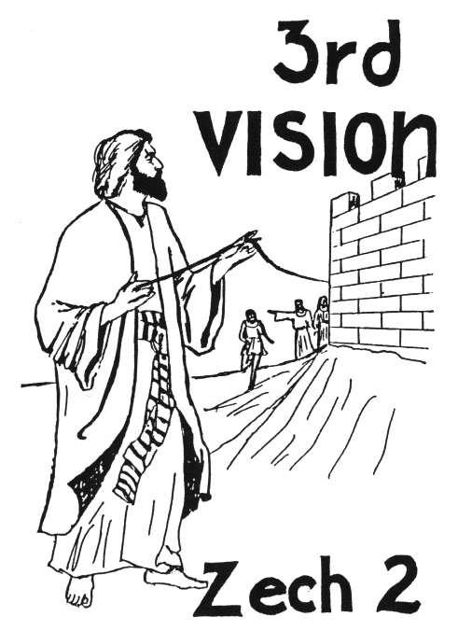



Zechariah’s
Night Visions
(Zech. 1-6)
Class 3:
Not by Might, nor by Power, but by God’s Spirit

Slide 2
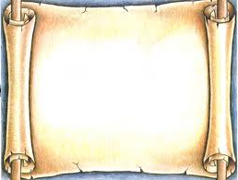
Christadelphian writers who cover the historical application
Edward Whittaker in Testimony Magazine (June 1985)
W. H. Boulton in the 1907 Christadelphian Magazine
C.C. Walker in Theophany
Geoff & Ray Walker in The Second Exodus

Slide 3
Time to Review!

Slide 4
Time to Review!

Slide 5
Time to Review!

Slide 6
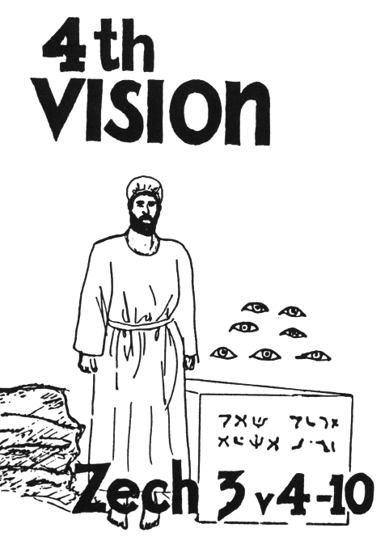
The 4th Vision:
What Zechariah saw:
Joshua & Satan standing before the
Angel of the Lord
Angel tells Satan “the Lord rebuke you”
Angel tells other angels to change
Joshua’s dirty clothes & put a clean
turban on him
Joshua and his companions are a
wondrous sign
God will bring forth His servant, the
Branch, the stone
7 eyes are looking at the stone
God will remove the iniquity of the land

Slide 7
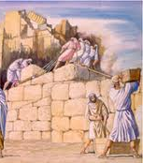
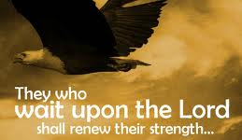
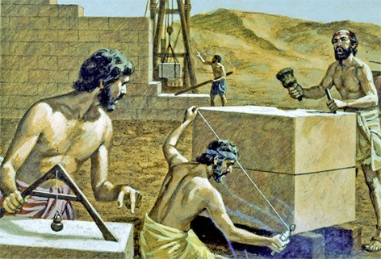
Joshua’s Sad State
Joshua was the High Priest of Israel (Hag 1:12; Ezra 5:2)
He had no temple to work in
He was filthy from working on the temple
He did not have the holy garments that were for glory and beauty (Ex 28:2)
The adversaries were committed to make him fail

Slide 8
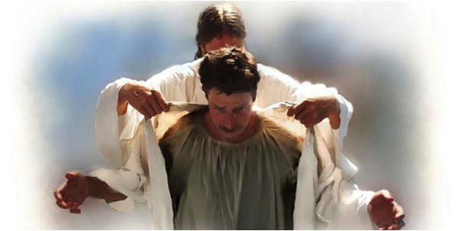
God Encourages Joshua (vs 2-5)
God has chosen Jerusalem & plucked it from the fire (v.2) [Note Jude 23]
The Angel of the Lord is on your side (v.2)
The Lord will rebuke the adversaries (v.2)
Joshua’s iniquity will be removed (v.4)
Joshua will be clothed in rich robes (v.4) and a clean turban (v.5) – Indicates he will operate as High Priest again!

Slide 9

Zechariah 3:6-7
Angel admonished Joshua
6 Then the Angel of the Lord admonished Joshua, saying, 7 "Thus says the Lord of hosts:
'If you will walk in My ways,
And if you will keep My command,
Then you shall also judge My house,
And likewise have charge of My courts;
I will give you places to walk
Among these who stand here.

Slide 10
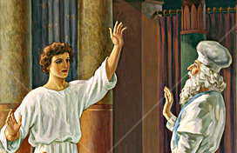
Angel’s charge to Joshua (6-7)
Walk in My ways
Keep My command
Then you will also judge My house
Then you will have charge of My courts
You will have “right of access” (RSV) among those (angels v.4) who stand by
God promised to bless Joshua as High Priest & grant him access to God’s house among the angels!

Slide 11
Zechariah 3:8-10
8 'Hear, O Joshua, the high priest, you and your companions who sit before you, for they are a wondrous sign; For behold, I am bringing forth My Servant the BRANCH.
9 For behold, the stone that I have laid before Joshua: Upon the stone are seven eyes. Behold, I will engrave its inscription,‘ Says the Lord of hosts, 'And I will remove the iniquity of that land in one day.
10 In that day,' says the Lord of hosts, 'Everyone will invite his neighbor under his vine and under his fig tree.'"

Slide 12

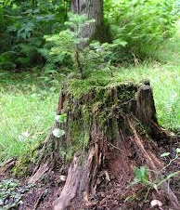
My Servant, the Branch (v.8)
Used in Jer 23:5 and 33:15 of someone who would be raised up in the line of David (a King)
Hag 2:23 – God says he will take “Zerubbabel My servant” make him as a signet ring, because He has chosen him.
Here applies to Zerubabbel, the governor, in the line of the King, whose hands will finish the temple! (4:9) – God’s promise!
Joshua & companions were men of sign

Slide 13
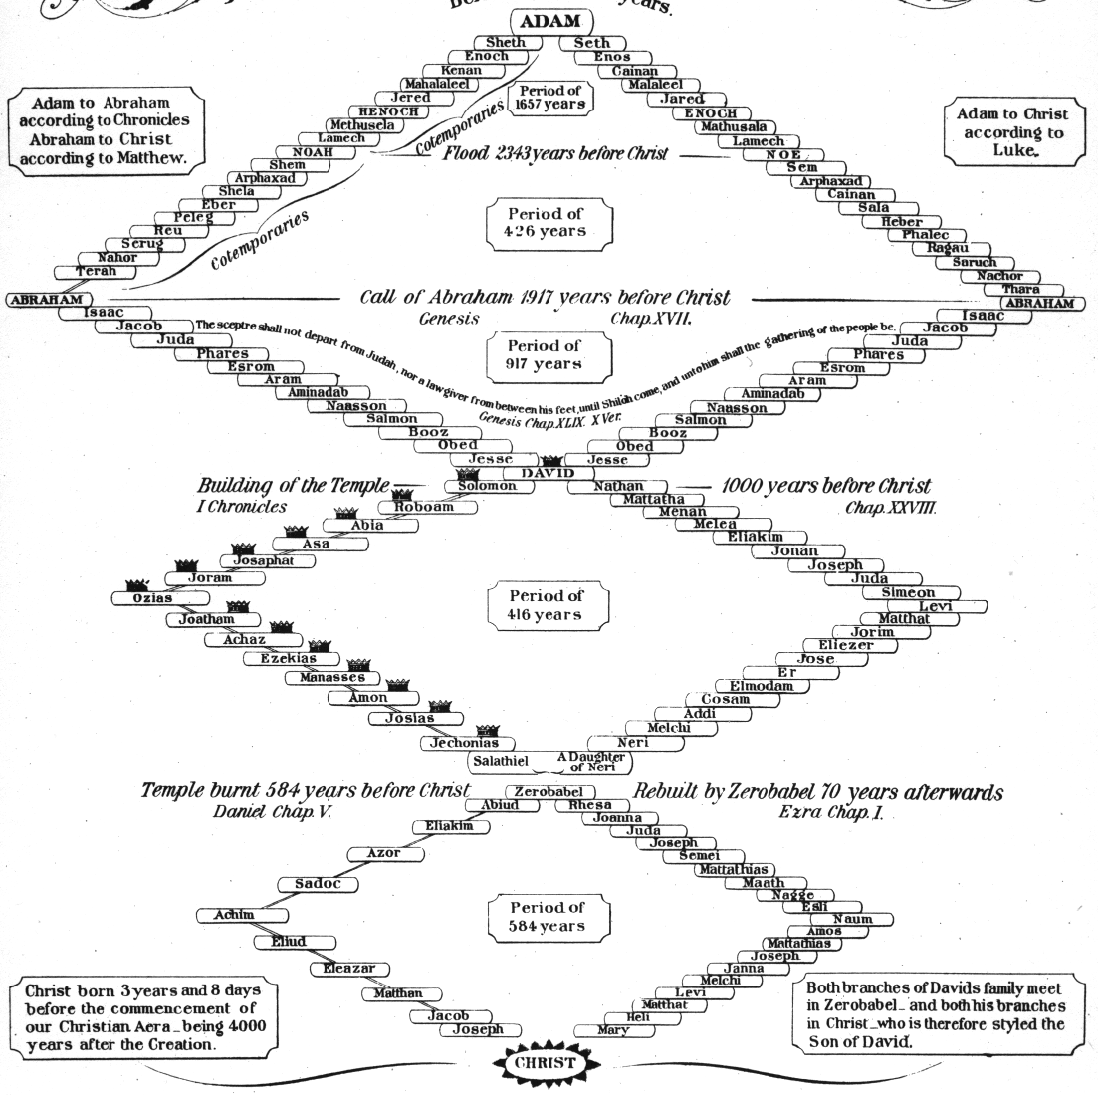

Slide 14
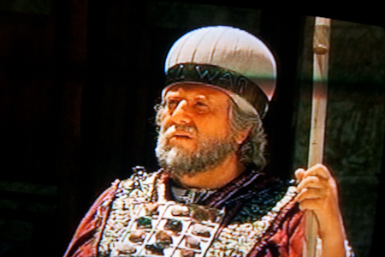
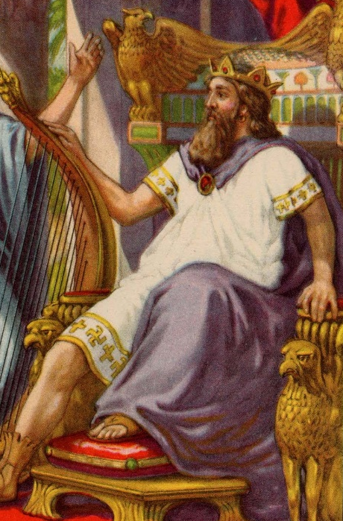
My Servant, the Branch
Used again in 6:11-13 and clearly applies to Joshua
The “Branch” prophecies ultimately predict a Messiah to come who will unite the offices of priest and king, as he will sit on his throne as priest and king (6:13)
Neither Joshua nor Zerubabbel could individually depict what Messiah would do, but together they predicted what God would do through His Son

Slide 15
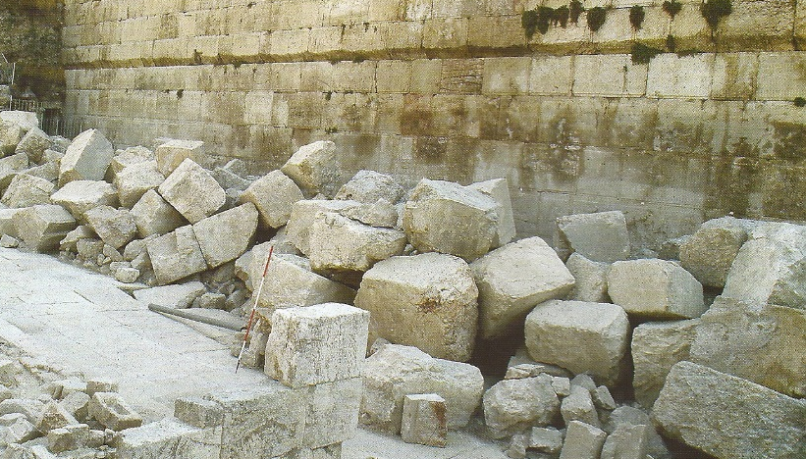
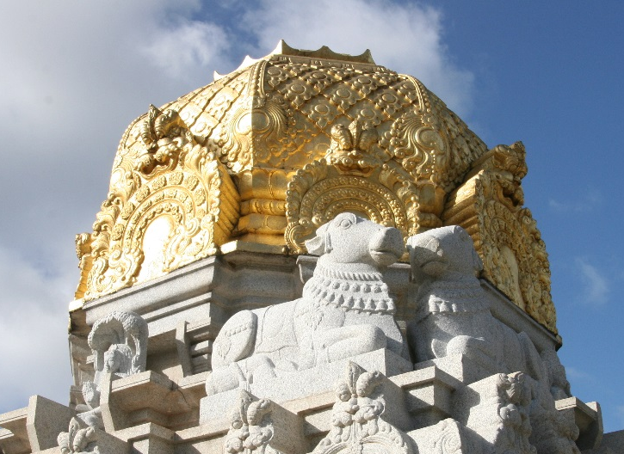
The Stone (3:9)
Not the cornerstone of the temple foundation because it was laid 16 years earlier in Ezra 3:8-13
This stone is the capstone (Zech 4:7), the final stone of the temple
Inscription was probably “Grace” as this was shouted in 4:7

Slide 16

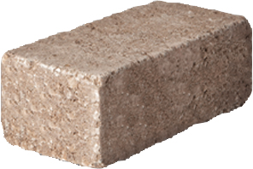
Upon the stone are 7 eyes (v.9)
Grace
Grace
Grace
Iniquity
removed!
“upon the stone” means the eyes are fixed, looking upon the stone. They are not in the stone, because the inscription is engraved in the stone
“7 eyes” are the angels (4:10) who will make sure the last stone (capstone) is placed into the temple

Slide 17
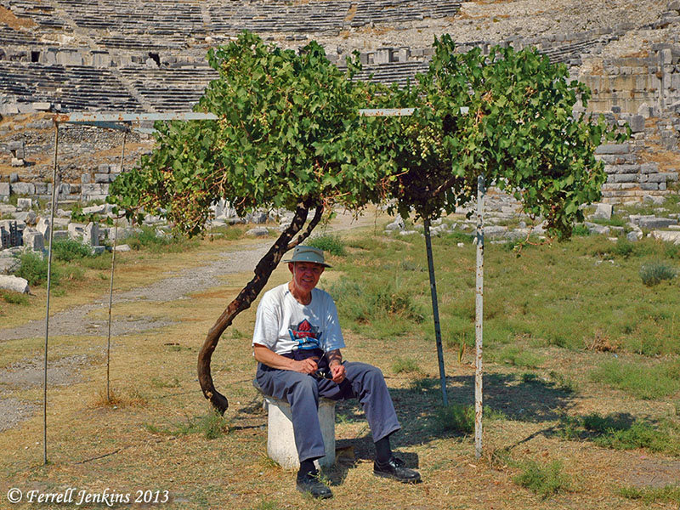
Under His Vine & His Fig Tree
Taken from Micah 4:4 indicating peace and prosperity
“invite his neighbor” implies a time of wonderful peace between people who get along and work together
If this is what the kingdom will be like, we should try to make it happen today!

Slide 18
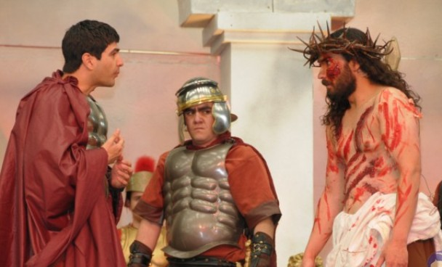
The Long-term Fulfillment
Jesus had to come in our nature & work in the filthy arena of sinful flesh to build God’s house (cross before the crown!)
Although Jesus’ adversaries accused him, God ultimately rebuked them and raised Jesus from the dead
God changed his clothes to immortality so as our immortal high priest he can save those who become part of God’s house

Slide 19
Zechariah 4
5th Vision
Now the angel who talked with me came back and wakened me, as a man who is wakened out of his sleep. 2 And he said to me, "What do you see?"
So I said, "I am looking, and there is a lampstand of solid gold with a bowl on top of it, and on the stand seven lamps with seven pipes to the seven lamps. 3 Two olive trees are by it, one at the right of the bowl and the other at its left." 4 So I answered and spoke to the angel who talked with me, saying, "What are these, my lord?"
5 Then the angel who talked with me answered and said to me, "Do you not know what these are?"
And I said, "No, my lord."
6 So he answered and said to me:
"This is the word of the Lord to Zerubbabel:'Not by might nor by power, but by My Spirit,'Says the Lord of hosts. 7 'Who are you, O great mountain? Before Zerubbabel you shall become a plain!And he shall bring forth the capstone with shouts of "Grace, grace to it!"'"

Slide 20
Zechariah 4
5th vision
8 Moreover the word of the Lord came to me, saying:
9 "The hands of Zerubbabel have laid the foundation of this temple; His hands shall also finish it. Then you will know that the Lord of hosts has sent Me to you. 10 For who has despised the day of small things? For these seven rejoice to see The plumb line in the hand of Zerubbabel. They are the eyes of the Lord, Which scan to and fro throughout the whole earth."
11 Then I answered and said to him, "What are these two olive trees — at the right of the lampstand and at its left?" 12 And I further answered and said to him, "What are these two olive branches that drip into the receptacles of the two gold pipes from which the golden oil drains?"
13 Then he answered me and said, "Do you not know what these are?“ And I said, "No, my lord."
14 So he said, "These are the two anointed ones, who stand beside the Lord of the whole earth."

Slide 21

The 5th Vision
What Zechariah saw:
Lampstand with a bowl on top
7 lamps and 7 pipes
2 olive trees dripping oil through 2 pipes into the bowl

Slide 22
What’s missing in this vision as compared to the tabernacle?
We have….
Lampstand
Lamps
Oil
What’s missing?
No human effort to supply the oil!

Slide 23
The Components of the vision
Lampstand = one community of believers
7 Lamps = individual ecclesias or pockets of believers (Rev 1:20)
Lights = revealing of God’s character and purpose to unbelievers & believers (Mat 5:14-15)
Oil = God’s spirit at work in our lives

Slide 24
The 2 Olive Trees?
Zerubabbel & Joshua (like the 2 witnesses of Rev 11:3-4)
The 2 Olive Branches (v.12)?
The “two anointed ones” (Sons of oil)
Haggai & Zechariah

Slide 25
What was the mountain (v.7) that Zerubabbel faced at that time?
Ezra 4:23-24
23 Now when the copy of King Artaxerxes' letter was read before Rehum, Shimshai the scribe, and their companions, they went up in haste to Jerusalem against the Jews, and by force of arms made them cease.
24 Thus the work of the house of God which is at Jerusalem ceased, and it was discontinued until the second year of the reign of Darius king of Persia.

Slide 26
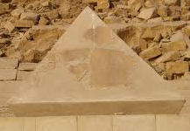

The capstone (v.7)
Grace
Last stone lifted into place
It’s force was felt by every stone in the building and held everything in place
Shouts of “grace, grace to it!”
God’s grace was all over this last stone because there was nothing the people could have done to deserve God’s kindness to them in letting them finish this house!

Slide 27
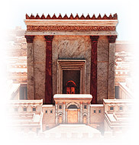
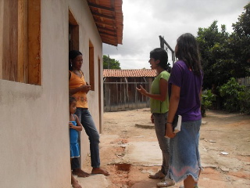
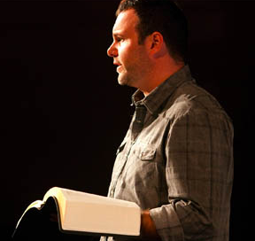
God’s House will be Finished!
Not by might, nor by power, but by God’s spirit (v.6)
Soon! Zerubabbel’s hands will finish it (v.9)
The angels (7 eyes) rejoice to see the work continuing (v.10)
Beware lest we despise the day of small things!

Slide 28
Haggai 2:2-4
The day of small things
2 "Speak now to Zerubbabel the son of Shealtiel, governor of Judah, and to Joshua the son of Jehozadak, the high priest, and to the remnant of the people, saying:
3 'Who is left among you who saw this temple in its former glory? And how do you see it now? In comparison with it, is this not in your eyes as nothing?
4 'Yet now be strong, Zerubbabel,' says the LORD; 'and be strong, Joshua, son of Jehozadak, the high priest; and be strong, all you people of the land,' says the LORD, 'and work; for I am with you,' says the LORD of hosts.
Never despise God’s work. The angels are always excited!

Slide 29
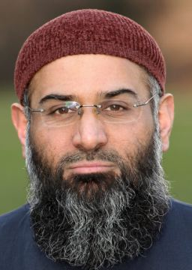
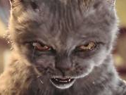
Who has despised the day of small things?
Most ecclesias today are small
Many have simple buildings, rent, or use homes
Witnessing projects may appear simple and small
Services: we try to use everyone
Warning: Don’t despise what God has given us and He is using to build His house! Get involved and appreciate what He has provided!

Slide 30

Look at the Angels in Zechariah
“Angel of the Lord” (Michael)
“Angel who talked with me” (possibly Gabriel)
“those who stood before him” (3:4)
Note the teamwork of the angels all throughout Zechariah!

Slide 31
Involvement of the Angels
Zech 1: Angels working with angels to provide political environment to finish building. An angel pleading with God for His mercy on the people.
Zech 2: Angels involved in the security of Jerusalem and assisting Jews who want to return to the land.
Zech 3: An angel stands up for the Jews and rebukes the adversaries. Assisting angels change Joshua’s clothes. Angels watching over the capstone.
Zech 4: Angels involved in removing the mountain and rejoicing in the temple work!

Slide 32
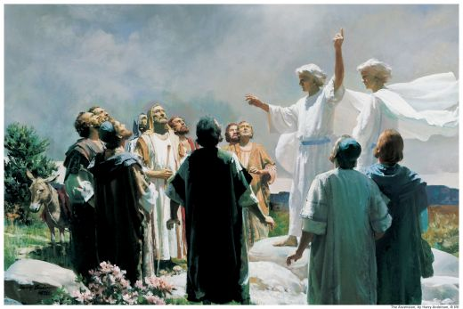
Angels throughout the Bible
2 Chron 16:9 The eyes of the Lord run to and fro throughout the whole earth
Dan 4:17 'This decision is by the decree of the watchers, and the sentence by the word of the holy ones…
Heb 1:14 Are they not all ministering spirits sent forth to minister for those who will inherit salvation.

Slide 33
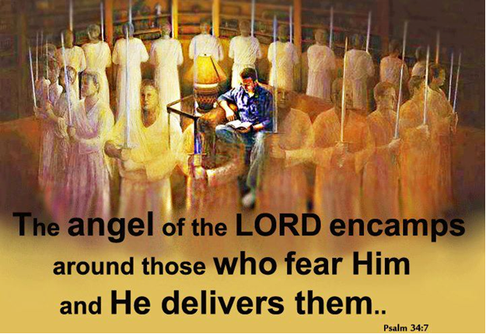
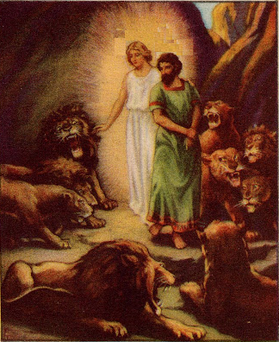
No different today!
Angels involved in the political events
Angels protecting God’s family: in our homes and when we travel
Angels pleading to God on our behalf
Angels guide us in our walk to the Kingdom

Slide 34
Luke 20:35-36
We hope to be equal to Angels
35 "But those who are counted worthy to attain that age, and the resurrection from the dead, neither marry nor are given in marriage;
36 "nor can they die anymore, for they are equal to the angels and are sons of God, being sons of the resurrection.
We will behave like angels. Now is our practice time!

Slide 35
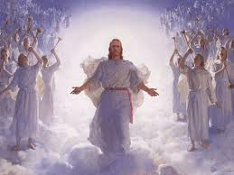
What Angels do now, we hope to do in the Kingdom!
Psa 103:20-22 God’s ministers who excel in strength and do God’s word and do His pleasure.
Heb 1:14 Ministering spirits sent forth to minister for those who will inherit salvation.
This is our practice time!

Slide 36
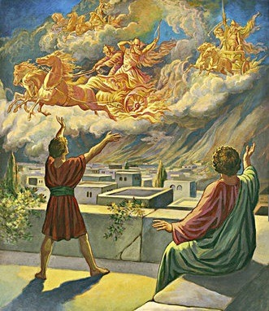
Angels are here right now!
They hear what we say and think (Gen 18:12-13; 1 Pet 3:6; Lk 24:6-7)
They rejoice when we make good choices (Luke 15:10), disappointed when we don’t
They watch the way we treat each other
They know what we do in our homes
Don’t disappoint them!

Slide 37
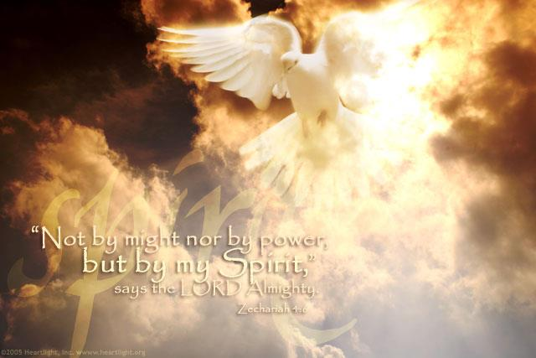
The Long-term Fulfillment
The Jews today will not succeed by their own might & power, but God’s spirit will deliver them again & build Ezekiel’s temple in the land
God’s spiritual house will be assembled when Jesus returns & the capstone is raised!
The mountain of Muslim opposition will be removed & Abraham’s descendants will inherit the land
The Angels will bring about these events today, just as they did years ago

Slide 38

Lessons from Today
Our God will rebuke our adversaries and bless our work today
The angels are watching over our ecclesial work and will make sure God’s house is assembled in the kingdom
Remember…it’s God’s spirit, not our might, that keeps our ecclesial lights shining
It is only by God’s grace that we will fit into His spiritual house
The Angels work for us 24 – 7 – 365. They want us to make it. Don’t let them down!

