Slide 1
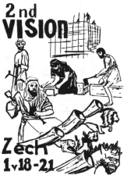
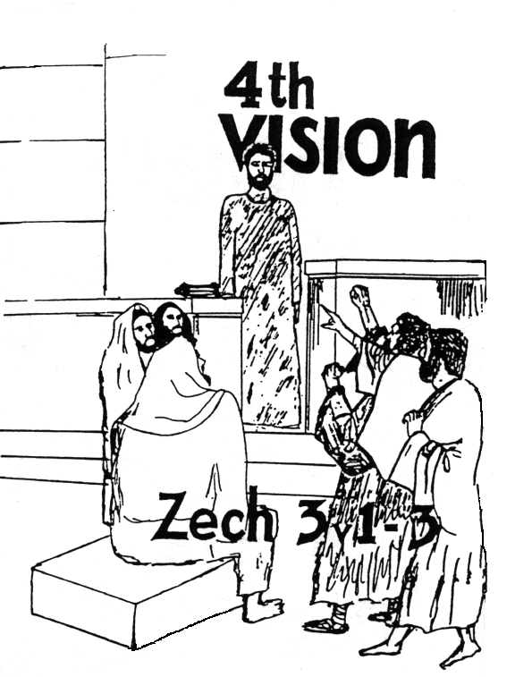
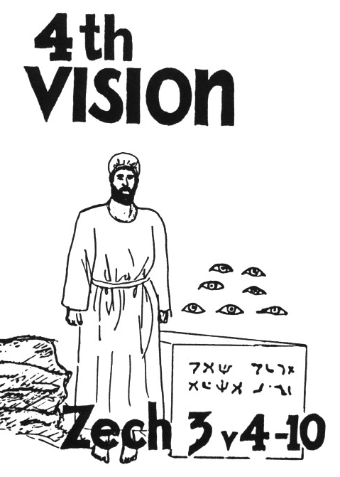

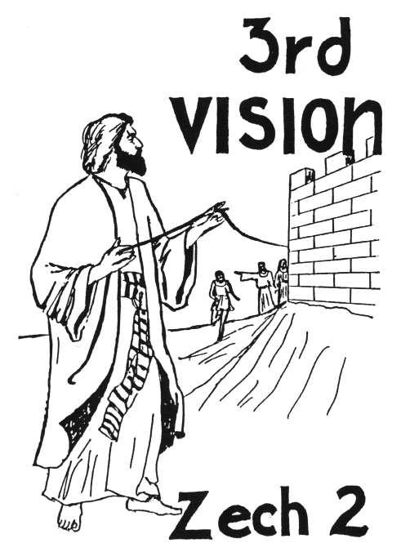



Zechariah’s
Night Visions
(Zech. 1-6)
Class 4: God’s House brings Responsibility to Live for Him

Slide 2
Time to Review!

Slide 3
Time to Review!

Slide 4
Time to Review!

Slide 5
Time to Review!

Slide 6
Time to Review!

Slide 7
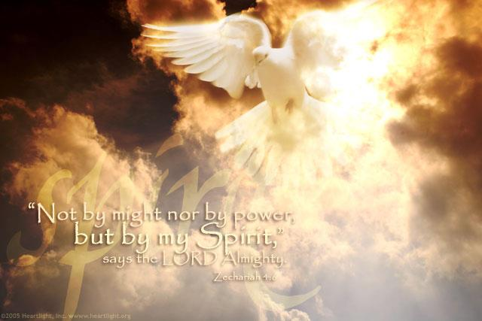
The Long-term Fulfillment
The Jews today will not succeed by their own might & power, but God’s spirit will deliver them again & build Ezekiel’s temple in the land
God’s spiritual house will be assembled when Jesus returns & the capstone is raised!
The mountain of Muslim opposition will be removed & Abraham’s descendants will inherit the land
The Angels will bring about these events today, just as they did years ago

Slide 8

Zechariah 5:1-4
6th Vision
Then I turned and raised my eyes, and saw there a flying scroll. 2 And he said to me, "What do you see? "So I answered, "I see a flying scroll. Its length is twenty cubits and its width ten cubits."
3 Then he said to me, "This is the curse that goes out over the face of the whole earth: 'Every thief shall be expelled,' according to this side of the scroll; and, 'Every perjurer shall be expelled,' according to that side of it."
4 "I will send out the curse," says the Lord of hosts; "It shall enter the house of the thief and the house of the one who swears falsely by My name. It shall remain in the midst of his house and consume it, with its timber and stones."

Slide 9
Zechariah 5:5-11
6th Vision (continued)
5 Then the angel who talked with me came out and said to me, "Lift your eyes now, and see what this is that goes forth." 6 So I asked, "What is it?" And he said, "It is a basket that is going forth.“ He also said, "This is their [thief & perjurer of v.3] resemblance throughout the earth: 7 Here is a lead disc lifted up, and this is a woman sitting inside the basket"; 8 then he said, "This is Wickedness!" And he thrust her down into the basket, and threw the lead cover over its mouth. 9 Then I raised my eyes and looked, and there were two women, coming with the wind in their wings; for they had wings like the wings of a stork, and they lifted up the basket between earth and heaven.
10 So I said to the angel who talked with me, "Where are they carrying the basket?" 11 And he said to me, "To build a house for it in the land of Shinar; when it is ready, the basket will be set there on its base."

Slide 10

The 6th Vision
What Zechariah Saw:
A flying scroll (20 X 10 cu)
It cursed thieves and
perjurers
An ephah basket with a
woman inside
A lead disc on the basket
2 women with wings flew
the basket to the land of
Shinar, where there is a
house for it

Slide 11
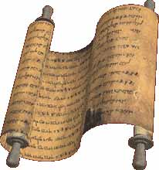
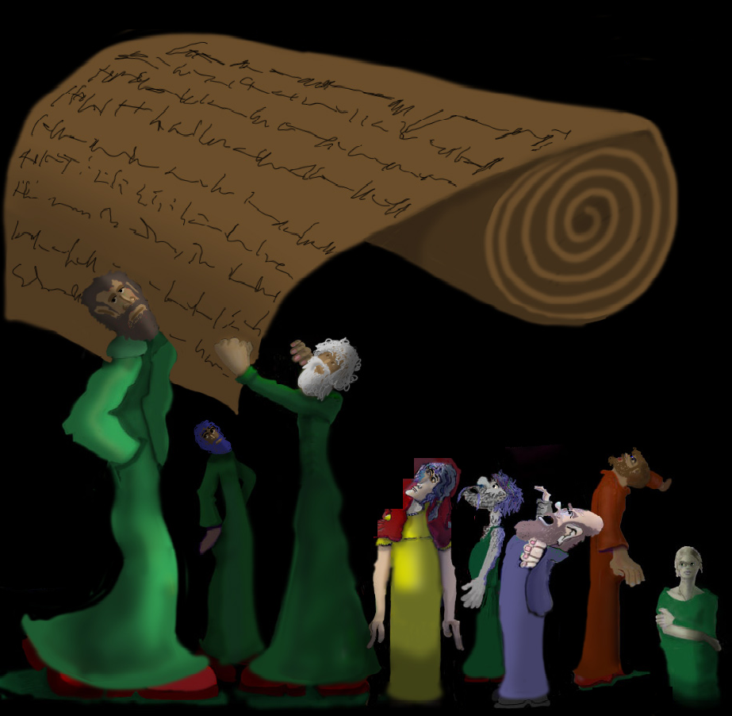
The Flying Scroll
Same measurements as the Holy Place of the tabernacle
Written on both sides like the 10 commandments (Ex 32:15)
Flying – widespread implementation of this curse throughout the land
Sent out by God (v.4)

Slide 12
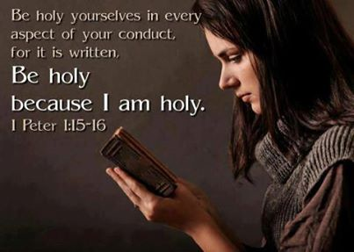
Purpose of the Curse
Expel the thieves and perjurers
Consume their homes (suffer same fate as houses infected with leprosy – Lev 14:45; Matt 10:6)
Purge the land so God’s house will not be surrounded by wickedness

Slide 13
“cut off” (KJV) or “expelled” (NKJV) (5:3)
God will clean the land – not the sinners!
Strongs #5352 naqah (naw-kaw’); a primitive root; to be (or make) clean
Theological Wordbook of the O.T.
By Harris, Archer & Waltke
In the case of the Piel nqh it is always (with the exception of 1 Kgs 2:9) the LORD who is the subject. Thus he is the one addressed in petitions for acquittal (e.g. “acquit me of hidden faults” Ps 19:12 [H 13]), or the One who does not leave the sinner unpunished (Ex 20:7; 37:7; Jer 30:11; 46:28; Job 9:28).
Likewise, in the case of the adjective when it means “innocent” it is God who assumes responsibility for the guiltless. Thus he holds himself responsible for innocent blood (Deut 19:10, 13; 2 Kgs 24:4; Jer 2:34f; 19:3f; 22:3ff; passim). Job, however, in a trough of pessimism, observes that God destroys the innocent with the guilty (Job 9:23).
Not only may the sinner himself be cleansed, freed of guilt, acquitted or held innocent, but a place may be purged of the evil found in it. The “cutting off” of liars and perjurers from the land spoken of in the vision of the flying roll (Zech 5:3) would amount to a purging of the land from evil.

Slide 14
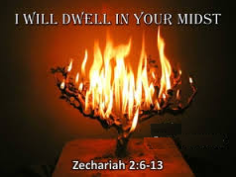
God’s House being built brings responsibility to live for God
God wants to live and dwell among His people (Ex 25:8; 1 Kg 6:13)
God cannot dwell among unrighteousness
Num 35:34
34 'Therefore do not defile the land which you inhabit, in the midst of which I dwell; for I the LORD dwell among the children of Israel.'"
“You shall be Holy, for I am Holy”

Slide 15
2 Cor 6:16-18
Membership in God’s family brings responsibilities
16 What agreement has the temple of God with idols? For you are the temple of the living God. As God has said: "I will dwell in them and walk among them. I will be their God, and they shall be My people."
17 Therefore "Come out from among them and be separate, says the Lord. Do not touch what is unclean, and I will receive you."
18 "I will be a Father to you, and you shall be My sons and daughters, says the Lord Almighty."
God expects us to live as His children

Slide 16
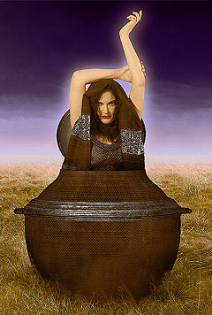
The woman in the ephah
What’s an ephah?
International Standard Bible Encyclopedia
A dry measure of about one bushel capacity. It corresponds to the bath in liquid measure and was the standard for measuring grain and similar articles since it is classed with. balances and weights (Lev 19:36; Amos 8:5) in the injunctions regarding just dealing in trade.
In (Zech 5:6-10) it is used for the utensil itself.

Slide 17
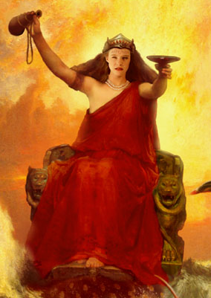
Woman in the Ephah
Who’s the Woman?
She represents a religious group (Rev 12, 17) which in this case is based on economics. Note “their resemblance” (v.6) is the thief and perjurer (v.3).
Refers to apostate people who either fled back to Babylon or stayed in Babylon for greater economic prosperity.

Slide 18
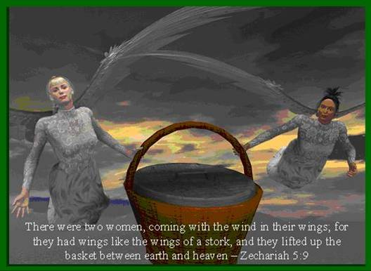
This is Wickedness (Lawlessness)
Woman tries to escape and spread her influence throughout the land of Israel
The angel thrusts her back and puts a lead cover over the basket
2 women: apostate Judah & Israel (Jer 3:6-10; Ezek 23:4-5) fly the basket to Shinar (Babylonia in its fullest extent). See Gen 11:2
Lawlessness: same word in Septuagint is used in 2 Thess 2:7 for “mystery of lawlessness”

Slide 19
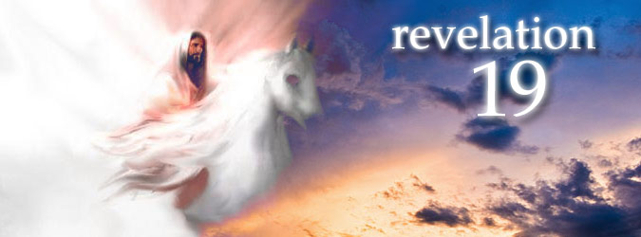
The Long-term Fulfillment
Christ will purge the land and world when he establishes himself as King/Priest in Ezekiel’s temple.
Many Gentiles have now joined the apostate church “mystery Babylon”
Those that have joined the apostate Babylonian church will be finally destroyed when Christ’s kingdom is set up

Slide 20
Zechariah 6:1-8
7th Vision
Then I turned and raised my eyes and looked, and behold, four chariots were coming from between two mountains, and the mountains were mountains of bronze. 2 With the first chariot were red horses, with the second chariot black horses, 3 with the third chariot white horses, and with the fourth chariot dappled horses — strong steeds. 4 Then I answered and said to the angel who talked with me, "What are these, my lord?"
5 And the angel answered and said to me, "These are four spirits of heaven, who go out from their station before the Lord of all the earth. 6 The one with the black horses is going to the north country, the white are going after them, and the dappled are going toward the south country." 7 Then the strong steeds went out, eager to go, that they might walk to and fro throughout the earth. And He said, "Go, walk to and fro throughout the earth." So they walked to and fro throughout the earth. 8 And He called to me, and spoke to me, saying, "See, those who go toward the north country have given rest to My Spirit in the north country."

Slide 21
7th Vision
What Zechariah saw:
4 chariots coming between 2 mountains
Red, black, white and speckled horses
They are the 4 spirits of heaven (angels on patrol)
Black & white go north, speckled go south, red stick around (like man on red horse under myrtle tree in 1:8)
Chariots bring rest to the north

Slide 22
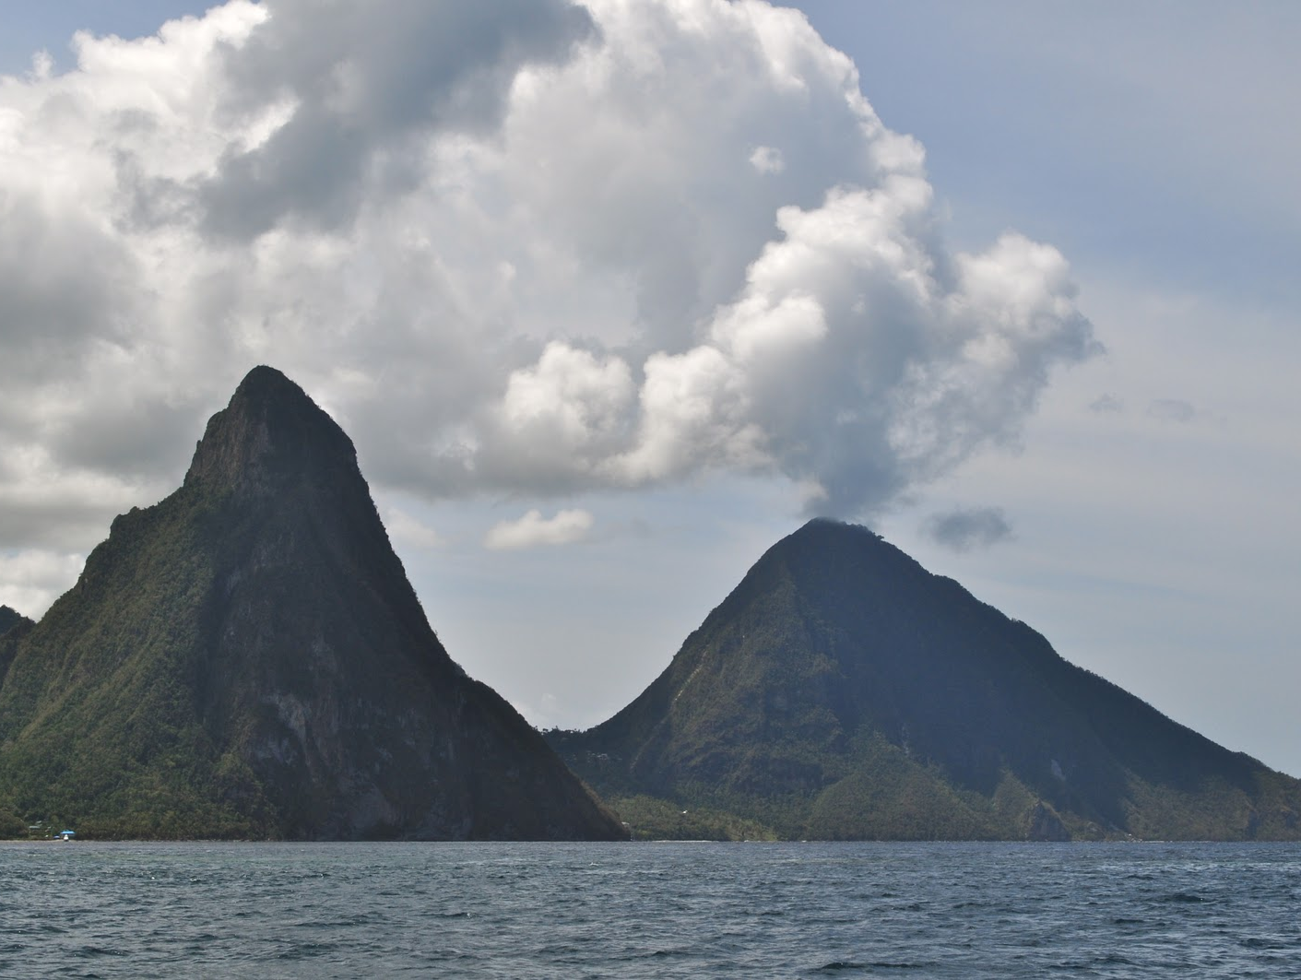
The 2 Mountains: seemingly impassible barriers
Persian army
Samaritans

Slide 23
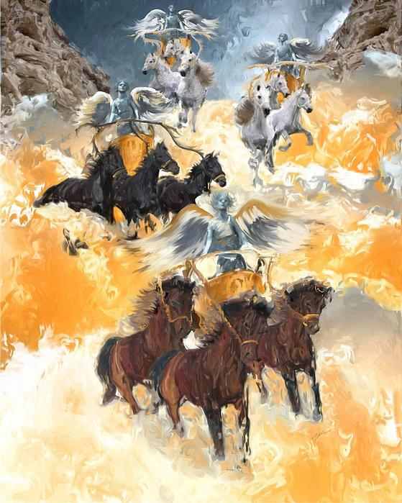
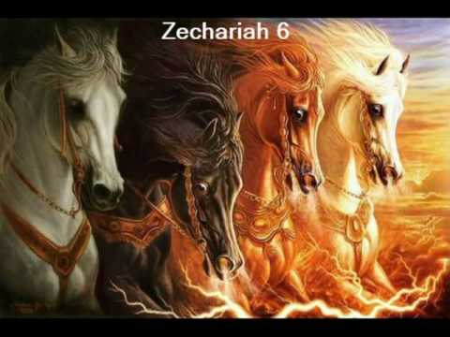
The Chariots
Symbols of power in war. In this case God’s angels enforcing His will on earth (Psa 68:17).
  Red = violence & bloodshed
  Black = mourning & woe
  White = victory & peace
  Speckled = mix of mourning & victory
Darius’ wars against Babylon, Scythians, Macedonia and India

Slide 24
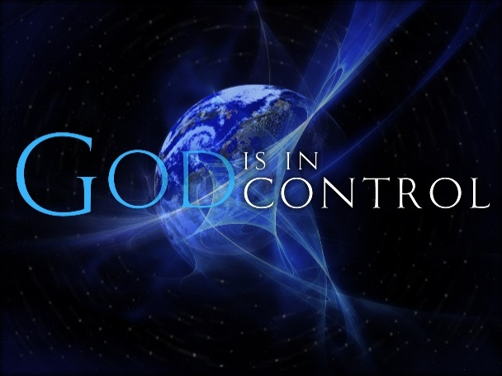
Chariots were a comforting reminder that….

Slide 25

The Long-term Fulfillment
Your Kingdom Come…
The Angels are excited and can’t wait for the time when they can patrol the earth and bring the peace of God’s kingdom
The mountains of religious and political opposition will be demolished
Even so Come Lord Jesus!

Slide 26
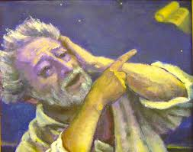
End of the Night Visions
6:9 Is the normal opening of prophecy: “Then the word of the Lord came unto me, saying”
Night visions end on the encouraging note that God will continue to provide peace for the returned captives building God’s house.
6:9-15 is connected to the night visions, but not necessarily part of them.

Slide 27
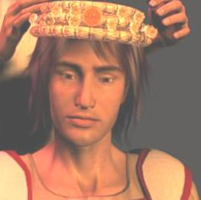
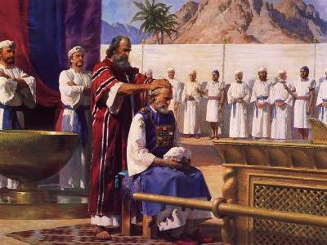
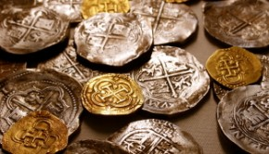
The Coronation of Joshua
Heldai, Tobijah, and Jedaiah return from Babylon and bring a gift of silver & gold.
Zechariah is told to make a crown and set it on Joshua
Joshua is crowned as “the man whose name is the Branch”

Slide 28
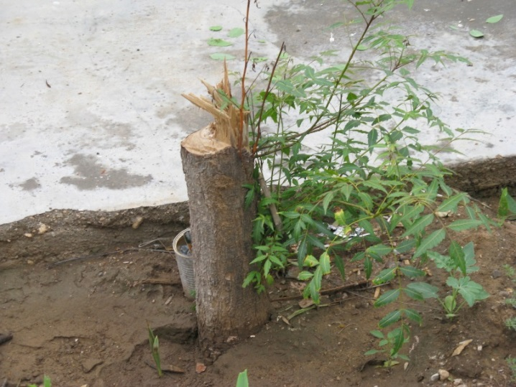
Joshua’s Role
He shall “branch out” (same word in Jer 33:15 'I will cause to grow up to David a Branch of righteousness; he shall execute judgment and righteousness in the earth.
He shall build the temple of the Lord
He shall bear the glory (honor)
He shall sit and rule on his throne
He shall be a priest on his throne
Counsel of peace will be between both offices (priest and king)

Slide 29
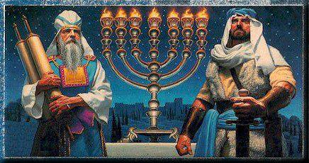
Why Joshua is King/Priest
Israel had no king at this time.
Role of the High Priest was going to become extremely powerful and valuable.
Great way to predict that the true Messiah would perfectly blend the offices of king & priest.

Slide 30
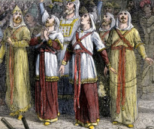
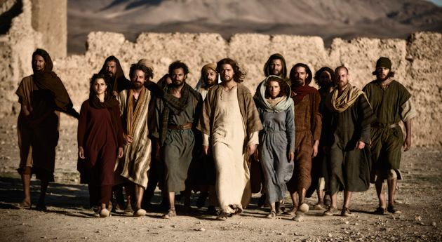
Helem, Tobijah, Jedaiah & Hen
Captives who returned at this time to finish the temple
Obeyed the call of 2:7 “up, Zion! Escape, you who dwell with the daughter of Babylon”
They were important examples of God’s promise to bring back more captives to finish the work on His house

Slide 31
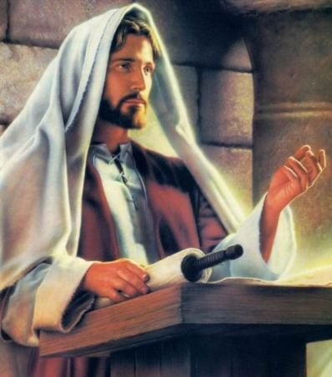
“Then you will know that the Lord of hosts has sent Me to you”
Moses to Pharaoh (Ex 3:13, 14,15; 7:16)
Angel’s words to Zechariah (2:9,11; 4:9; 6:15)
Probably Zechariah’s words to his people
God’s support for His messengers and prophets. He is faithful and will do it!

Slide 32



Final exhortation & warning
This will come to pass IF you diligently obey the voice of the Lord your God
The discouraged, disappointed, fearful returned captives did obey God’s voice and they got to work and finished His house.
God is looking to see if we WANT to obey!

Slide 33

Lessons from Today
Adoption into God’s family brings responsibility to serve God & follow His commands
Membership in God’s ecclesias brings responsibility to work in God’s house & serve one another
Worshipping in God’s house brings responsibility to want to live like God
Thank God for His angels who are working constantly in the political heavens to bring about God’s kingdom & they are excited to help us prepare for that day
Our King/Priest – Jesus Christ – will soon reign on earth to execute true justice & mercy
God expects obedience because of all He has done for us

