Slide 1

God’s Wonderful Plan of Redemption
Class 1:
Redemption is All of God
Thanks be to God for His gift that is too wonderful for words (2 Cor 9:15 NCV)

Slide 2
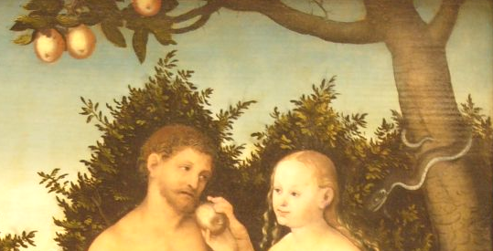

When Adam & Eve chose Sin…
God could have killed them and started over ---- but He didn’t!
He loves those that love Him and His righteousness ---- so He set out to save them.
His redemptive plan must uphold His righteousness ---- He is a holy and just God ---- those He saves must uphold His righteousness too.
God is Love!

Slide 3

1 John 4:7-11
God loved us so much…..
7 Beloved, let us love one another, for love is of God; and everyone who loves is born of God and knows God. 8 He who does not love does not know God, for God is love. 9 In this the love of God was manifested toward us, that God has sent His only begotten Son into the world, that we might live through Him. 10 In this is love, not that we loved God, but that He loved us and sent His Son to be the propitiation for our sins. 11 Beloved, if God so loved us, we also ought to love one another.
God’s love should change how we live!

Slide 4
Romans 5:6-8
God loved us when we weren’t worth loving
6 For when we were still without strength, in due time Christ died for the ungodly. 7 For scarcely for a righteous man will one die; yet perhaps for a good man someone would even dare to die. 8 But God demonstrates His own love toward us, in that while we were still sinners, Christ died for us.
This is the model for us. We show God’s love to others who may not deserve it!

Slide 5
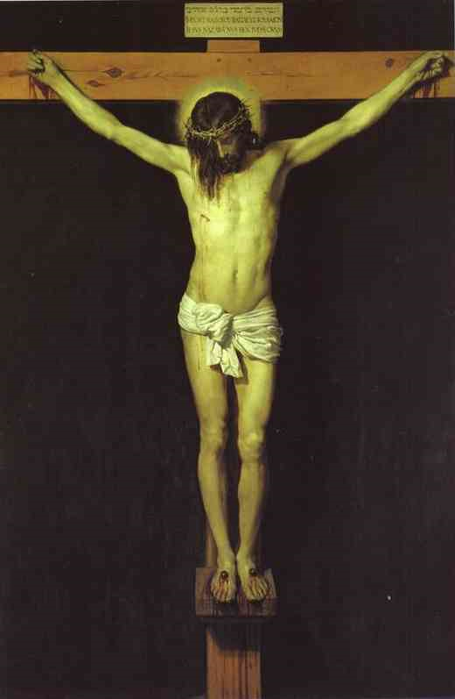
Moral Impact of the Atonement
1 Corinthians 2:1-2
1 And I, brethren, when I came to you (from Athens), did not come with excellence of speech or of wisdom declaring to you the testimony of God.
2 For I determined not to know anything among you except Jesus Christ and Him crucified.
map

Slide 6
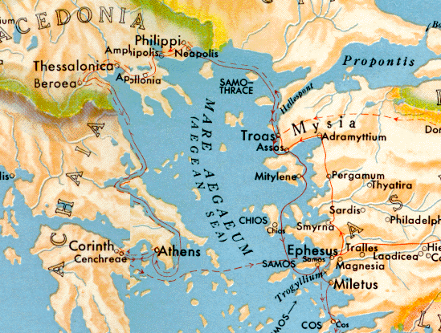
Athens: Stoic & Epicurean philosophers

Slide 7
Moral Impact of the Atonement
1 Corinthians 2:1-2
1 And I, brethren, when I came to you (from Athens), did not come with excellence of speech or of wisdom declaring to you the testimony of God.
2 For I determined not to know anything among you except Jesus Christ and Him crucified.
The Atonement is the First Principle & affects all others. We need an academic knowledge & emotional appreciation to understand it.

Slide 8
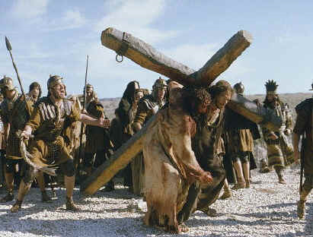
1 Peter 2:21-24
21 For to this you were called, because Christ also suffered for us, leaving us an example, that you should follow His steps:
22 "Who committed no sin, nor was deceit found in His mouth";
23 who, when He was reviled, did not revile in return; when He suffered, He did not threaten, but committed Himself to Him who judges righteously;
24 who Himself bore our sins in His own body on the tree, that we, having died to sins, might live for righteousness-- by whose stripes you were healed.
We have been asked to follow in Christ’s steps. He went first, and we must follow him to the Father.

Slide 9
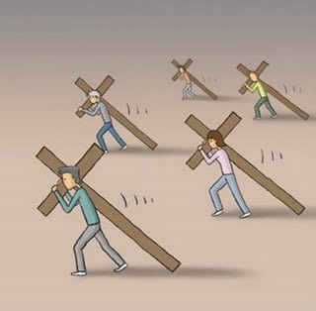
2 Corinthians 5:14-15
14 For the love of Christ compels us, because we judge thus: that if one died for all, then all died;
15 and he died for all, that those who live should live no longer for themselves, but for him who died for them and rose again.
A study and appreciation of our redemption should change our lives. Husbands/wives & brothers/sisters & parents/children cannot live for themselves.

Slide 10

Redemption is all of God
Isaiah 43:10-12
10 "You are My witnesses," says the LORD, "And My servant whom I have chosen, that you may know and believe Me, and understand that I am He. Before Me there was no God formed, nor shall there be after Me.
11 I, even I, am the LORD, and besides Me there is no savior.
12 I have declared and saved, I have proclaimed, and there was no foreign god among you; therefore you are My witnesses," says the LORD, "that I am God. [Note: Jews failed (v.22-24), but God still set out to save!(v.25)]
Must start with the understanding and appreciation that God initiated our redemption!

Slide 11
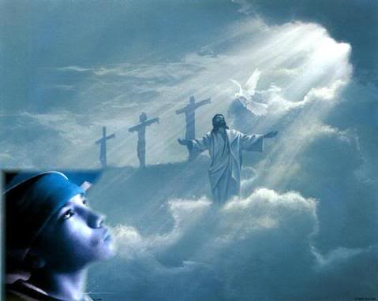
1 Corinthians 1:27-29
27 But God has chosen the foolish things of the world to put to shame the wise, and God has chosen the weak things of the world to put to shame the things which are mighty;
28 and the base things of the world and the things which are despised God has chosen, and the things which are not, to bring to nothing the things that are,
29 that no flesh should glory in His presence.
In God’s redemptive plan there is no place for human boasting. Every person redeemed will know and feel that without God’s kindness and grace they never would have made it.

Slide 12
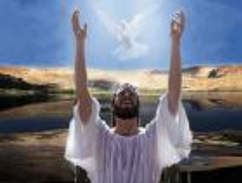
2 Corinthians 5:5, 18-19
5 Now He who has prepared us for this very thing (eternity – v.1) is God, who also has given us the Spirit as a guarantee.
18 Now all things are of God, who has reconciled us to Himself through Jesus Christ, and has given us the ministry of reconciliation,
19 that is, that God was in Christ reconciling the world to Himself, not imputing their trespasses to them, and has committed to us the word of reconciliation.
All the credit goes to God. He was the primary force in redemption. He was in Christ, so He could save us all!

Slide 13
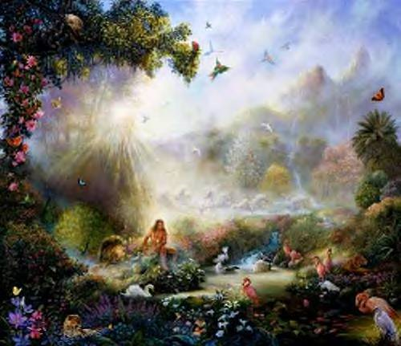

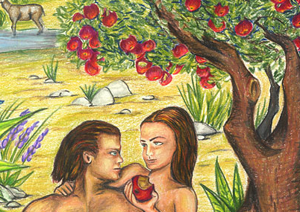
The Origin of Sin – it’s not of God!
Genesis 1:31
Then God saw everything that He had made, and indeed it was very good. So the evening and the morning were the sixth day.
Genesis 6:5
Then the LORD saw that the wickedness of man was great in the earth, and that every intent of the thoughts of his heart was only evil continually.
Ecclesiastes 7:29
29 Truly, this only I have found: that God made man upright, but they have sought out many schemes.”

Slide 14
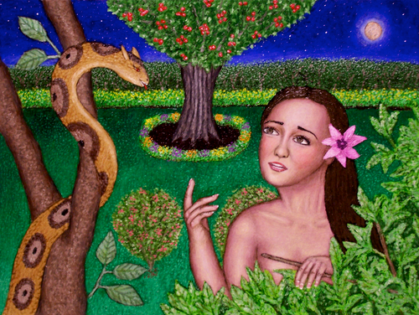
Genesis 3:4-5
4 Then the serpent said to the woman, "You will not surely die.
5 "For God knows that in the day you eat of it your eyes will be opened, and you will be like God, knowing good and evil."
6 So when the woman saw that the tree was good for food, that it was pleasant to the eyes, and a tree desirable to make one wise, she took of its fruit and ate. She also gave to her husband with her, and he ate.
7 Then the eyes of both of them were opened, and they knew that they were naked; and they sewed fig leaves together and made themselves coverings.
It took an outside tempter. The serpent made a reasonable suggestion!

Slide 15

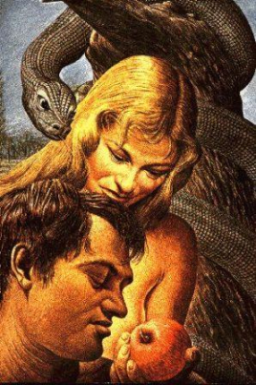
Eve’s sin was different from Adam’s
2 Corinthians 11:3
But I fear, lest somehow, as the serpent deceived Eve by his craftiness, so your minds may be corrupted from the simplicity that is in Christ.
1 Timothy 2:11-15
11 Let a woman learn in silence with all submission.
12 And I do not permit a woman to teach or to have authority over a man, but to be in silence.
13 For Adam was formed first, then Eve.
14 And Adam was not deceived, but the woman being deceived, fell into transgression.
15 Nevertheless she will be saved in childbearing if
they continue in faith, love, and holiness, with
self-control.
Adam made a conscious choice, Eve was deceived

Slide 16
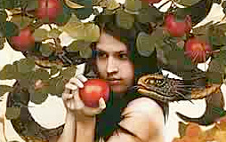

Adam’s & Eve’s desires were different before they sinned
Genesis 3:6
6 So when the woman saw that the tree was good for food, that it was pleasant to the eyes, and a tree desirable to make one wise, she took of its fruit and ate. She also gave to her husband with her, and he ate.
1 John 2:15
15 Do not love the world or the things in the world. If anyone loves the world, the love of the Father is not in him.
16 For all that is in the world-- the lust of the flesh, the lust of the eyes, and the pride of life -- is not of the Father but is of the world.
Now things have changed!

Slide 17


Adam & Eve before sin:
Temptation came from without
“very good”

Slide 18

Ephesians 4:22-24
22 that you put off, concerning your former conduct, the old man which grows corrupt according to the deceitful lusts,
23 and be renewed in the spirit of your mind,
24 and that you put on the new man which was created according to God, in true righteousness and holiness.
Our lusts are now “deceitful”! That’s not the way Adam was at his creation. God needed to change Adam & Eve so every day they would see their need for redemption!

Slide 19

Law of Sin is in our Bodies
Gen 8:21 the imagination of man's heart is evil from his youth
Jer 17:9 The heart is deceitful above all things, and desperately wicked;
James 1:14 But each one is tempted when he is drawn away by his own desires and enticed.
Rom 7:23 But I see another law in my members, warring against the law of my mind, and bringing me into captivity to the law of sin which is in my members.
I Jn 2:16 For all that is in the world-- the lust of the flesh, the lust of the eyes, and the pride of life-- is not of the Father but is of the world.
Gal 5:17 For the flesh lusts against the Spirit, and the Spirit against the flesh; and these are contrary to one another, so that you do not do the things that you wish.

Slide 20
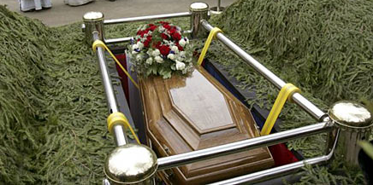
Results of Sin - Mortality
Adam & Eve became mortal:
  for dust you are, and to dust you shall return (Gen 3:19)
All their descendents inherit mortality:
  just as through one man sin entered the world, and death through sin, and thus death spread to all men, because all sinned– (Rom 5:12)

Slide 21

Results of Sin: Adam & Eve & their descendents inherit a bias to sin
Gen 6:5 Then the LORD saw that the wickedness of man was great in the earth, and that every intent of the thoughts of his heart was only evil continually. [when God said it again in 8:21 only Noah’s family was left]
Mk 7:21 from within…out of the heart of man
Rom 7:9 when the commandment came, sin revived, and I died.
“sinful body” (6:6), “body of death” (7:24)
Outside tempter not necessary anymore!

Slide 22



Now temptation comes from without and from within!
Physical defilement
Tempted from within

Slide 23


2 Aspects of Sin in the Bible:
Personal transgressions – we sin against God
2. Human nature – the cause of sin today – because of it’s bias to sin – the devil
One is the root (nature) and the other is the branches (our transgressions)

Slide 24
2 Extreme errors in dealing with Human Nature:
Human nature is good – God made it. Sin is evil, not human nature.
Human nature is very bad – so bad that man is guilty for it, or God requires an offering for it – to atone for our nature.
The Truth is somewhere in the middle. Human nature is bad – it is prone to sin. However, God does not hold us guilty for it, and it doesn’t need an offering, because it will not be redeemed. God won’t redeem the devil in us.

Slide 25

Elpis Israel by John Thomas
The word sin is used in two principal acceptations in the scripture. It signifies in the first place, “the transgression of the law”; and in the next, it represents that physical principle of the animal nature, which is the cause of all its diseases, death, and resolution into
dust. It is that in the flesh “which has the power of death”; and it is called sin, because the development, or fixation, of this evil in the flesh, was the result of transgression. Inasmuch as this evil principle pervades every part of the flesh, the animal nature is styled “sinful flesh,” that is, “flesh full of sin”; so that sin, in the sacred style, came to stand for the substance called man.

Slide 26
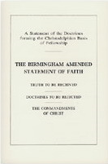
Statement of Faith (clause 5)
That Adam broke this law, and was adjudged unworthy of immortality, and sentenced to return to the ground from whence he was taken – a sentence which defiled and became a physical law of his being, and was transmitted to all his posterity (Gen. 3:15-19, 22-23; 2 Cor 1:9; Rom 7:24; 2 Cor 5:2-4; Rom 7:18-23; Gal 5:16-17; Rom 6:12; 7:21; John 3:6; Rom. 5:12; 1 Cor 15:22; Psa. 51:5; Job 14:4)

Slide 27
God condemned Sin ( all of it) in the body of Jesus Christ
Romans 8:3-8
3 For what the law could not do in that it was weak through the flesh, God did by sending His own Son in the likeness of sinful flesh, on account of sin: He condemned sin in the flesh,
4 that the righteous requirement of the law might be fulfilled in us who do not walk according to the flesh but according to the Spirit.
5 For those who live according to the flesh set their minds on the things of the flesh, but those who live according to the Spirit, the things of the Spirit.
Continued…..

Slide 28

Romans 8:6-8
6 For to be carnally minded is death, but to be spiritually minded is life and peace.
7 Because the carnal mind is enmity against God; for it is not subject to the law of God, nor indeed can be.
8 So then, those who are in the flesh cannot please God.
God condemned Sin so we would learn to love God & love our neighbor

Slide 29
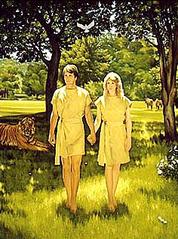
Adam and Eve left the garden with 2 major problems
1) Mortality
2) Nature prone to sin!
God’s Plan of Redemption will deal with both!

Slide 30
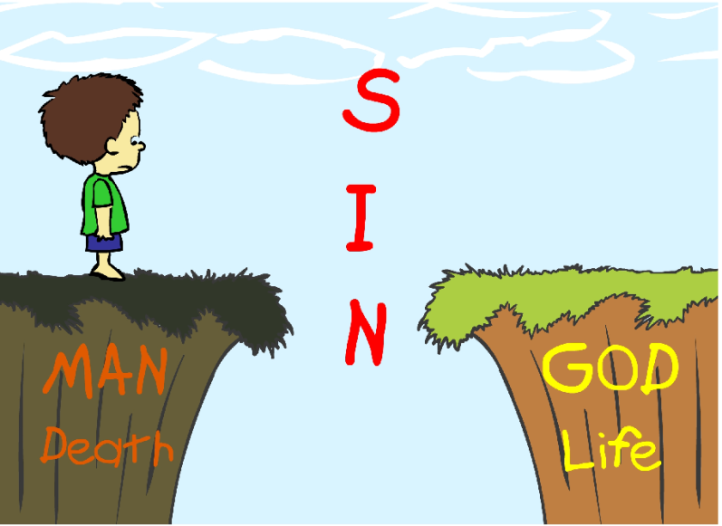
No man could save…
Romans 3:9-12
9 What then? Are we better than they? Not at all. For we have previously charged both Jews and Greeks that they are all under sin.
10 As it is written: "There is none righteous, no, not one;
11 There is none who understands; there is none who seeks after God.
12 They have all turned aside; they have together become unprofitable; there is none who does good, no, not one."
so God intervened

Slide 31
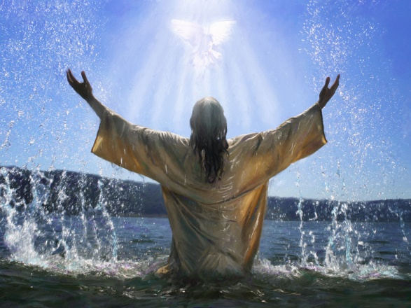
Isaiah 59:12-16
12 For our transgressions are multiplied before You, and our sins testify against us; for our transgressions are with us, and as for our iniquities, we know them:
13 In transgressing and lying against the LORD, and departing from our God, speaking oppression and revolt, conceiving and uttering from the heart words of falsehood.
14 Justice is turned back, and righteousness stands afar off; for truth is fallen in the street, and equity cannot enter.
15 So truth fails, and he who departs from evil makes himself a prey. Then the LORD saw it, and it displeased Him that there was no justice.
16 He saw that there was no man, and wondered that there was no intercessor; therefore His own arm brought salvation for Him; and His own righteousness, it sustained Him.

Slide 32
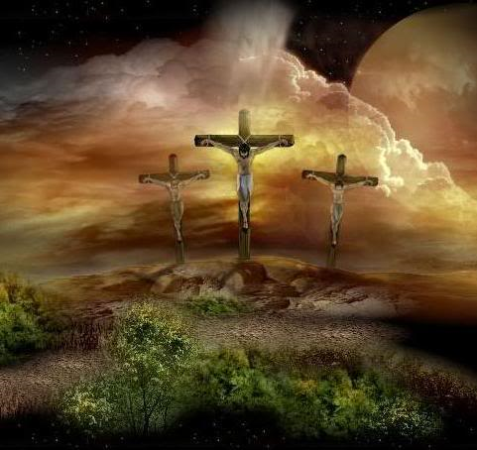
God’s plan to redeem us deals with both our personal sins and our nature that tempts us to sin
In our next class we will look at how God intervened, by providing His only begotten Son – and finally saved one of our race!

