Slide 1

God’s wonderful Plan of Redemption
Class 4:
The Power of Faith working through Love (Gal. 5:6)

Slide 2
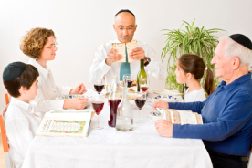
What went wrong with the Law?
It became rituals without meaning
Amos 5:21-27
21 "I hate, I despise your feast days, and I do not savor your sacred assemblies.
22 Though you offer Me burnt offerings and your grain offerings, I will not accept them, nor will I regard your fattened peace offerings.
23 Take away from Me the noise of your songs, for I will not hear the melody of your stringed instruments.
24 But let justice run down like water, and righteousness like a mighty stream.
25 "Did you offer Me sacrifices and offerings in the wilderness forty years, O house of Israel?
26 You also carried Sikkuth your king and Chiun, your idols, the star of your gods, which you made for yourselves.
27 Therefore I will send you into captivity beyond Damascus," says the LORD, whose name is the God of hosts

Slide 3
What went wrong with the Law?
It became rituals without meaning
Isaiah 43:22-24
22 "But you have not called upon Me, O Jacob; and you have been weary of Me, O Israel.
23 You have not brought Me the sheep for your burnt offerings, nor have you honored Me with your sacrifices. I have not caused you to serve with grain offerings, nor wearied you with incense.
24 You have bought Me no sweet cane with money, nor have you satisfied Me with the fat of your sacrifices; but you have burdened Me with your sins, you have wearied Me with your iniquities.

Slide 4
What went wrong with the Law?
It became rituals without meaning
Zechariah 7:1-7
Now in the fourth year of King Darius it came to pass that the word of the Lord came to Zechariah, on the fourth day of the ninth month, Chislev, 2 when the people sent Sherezer, with Regem-Melech and his men, to the house of God [from Bethel – NASB], to pray before the Lord, 3 and to ask the priests who were in the house of the Lord of hosts, and the prophets, saying, "Should I weep in the fifth month and fast as I have done for so many years?"

Slide 5
What went wrong with the Law?
It became rituals without meaning
Zechariah 7:1-7
4 Then the word of the Lord of hosts came to me, saying, 5 "Say to all the people of the land, and to the priests: 'When you fasted and mourned in the fifth and seventh months during those seventy years, did you really fast for Me — for Me? 6 When you eat and when you drink, do you not eat and drink for yourselves?

Slide 6
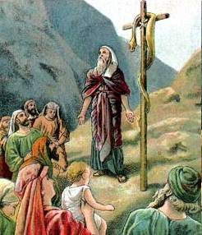
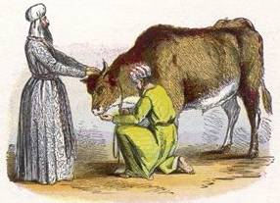
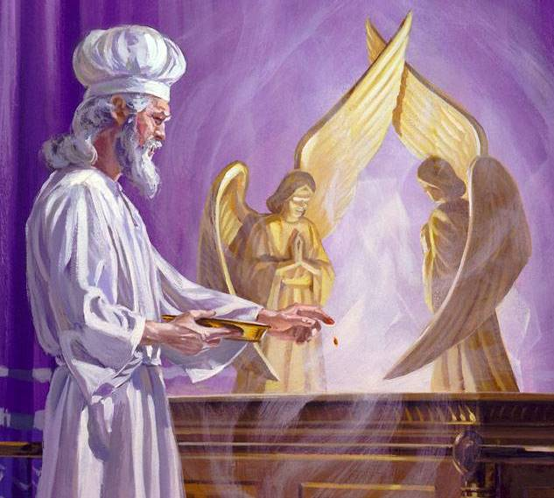
The Law led people to trust in a ritual system
But rituals don’t always affect our conscience!

Slide 7
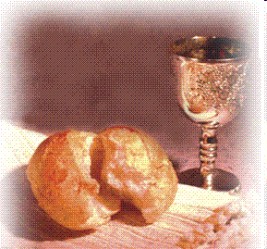
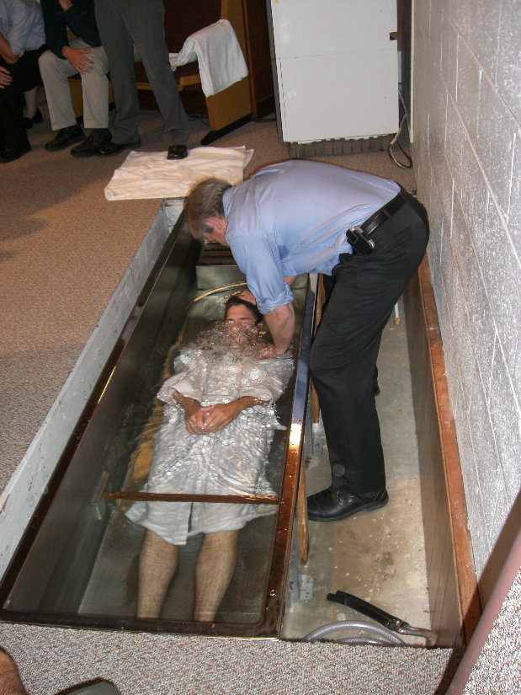
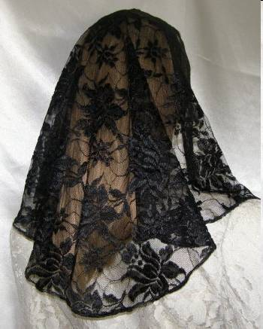
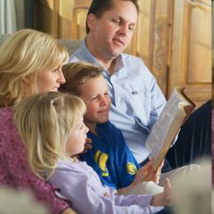
We need to be careful that this doesn’t happen to us today

Slide 8
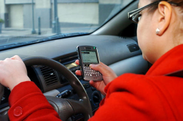
Problems with man’s use of God’s law
We can develop an attitude of thinking that we can earn our salvation
Laws can become unintended limits – we only do what the laws demand
Many times when we hear laws, our minds try to find ways around them
It’s very clear in young children!

Slide 9

Matthew 12:3-8
The aim of the Law
3 But He said to them, "Have you not read what David did when he was hungry, he and those who were with him: 4 how he entered the house of God and ate the showbread which was not lawful for him to eat, nor for those who were with him, but only for the priests? 5 Or have you not read in the law that on the Sabbath the priests in the temple profane the Sabbath, and are blameless? 6 Yet I say to you that in this place there is One greater than the temple. 7 But if you had known what this means, 'I desire mercy and not sacrifice,' you would not have condemned the guiltless.”
God hoped His people would see beyond the rituals to seek justice & mercy by faith

Slide 10
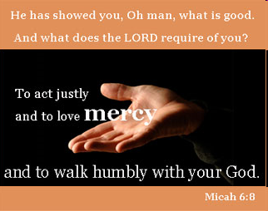
Matthew 23:23
23 "Woe to you, scribes and Pharisees, hypocrites! For you pay tithe of mint and anise and cummin, and have neglected the weightier matters of the law: justice and mercy and faith. These you ought to have done, without leaving the others undone.
People tend to rank laws. We put the laws at the top which are easiest for us to do!

Slide 11
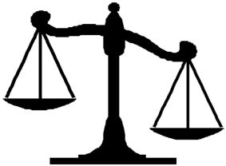
What went wrong with the Law?
The Jews used it to earn eternal life
Romans 10:1-4
1 Brethren, my heart's desire and prayer to God for Israel is that they may be saved.
2 For I bear them witness that they have a zeal for God, but not according to knowledge.
3 For they being ignorant of God's righteousness, and seeking to establish their own righteousness, have not submitted to the righteousness of God.
4 For Christ is the end of the law for righteousness to everyone who believes.
Good works
Bad

Slide 12
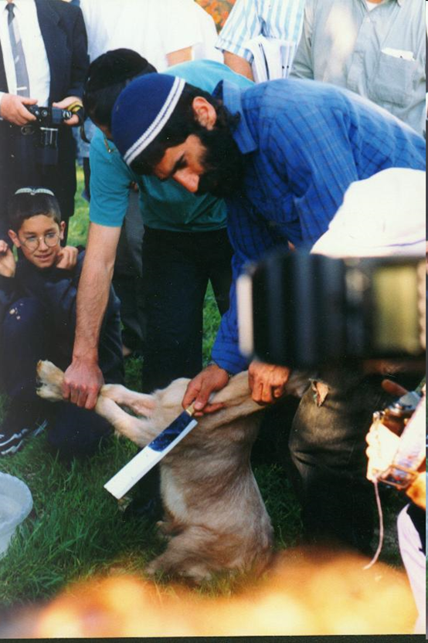
Hebrews 10:1-4
1 For the law, having a shadow of the good things to come, and not the very image of the things, can never with these same sacrifices, which they offer continually year by year, make those who approach perfect.
2 For then would they not have ceased to be offered? For the worshipers, once purified, would have had no more consciousness of sins.
3 But in those sacrifices there is a reminder of sins every year.
4 For it is not possible that the blood of bulls and goats could take away sins.

Slide 13
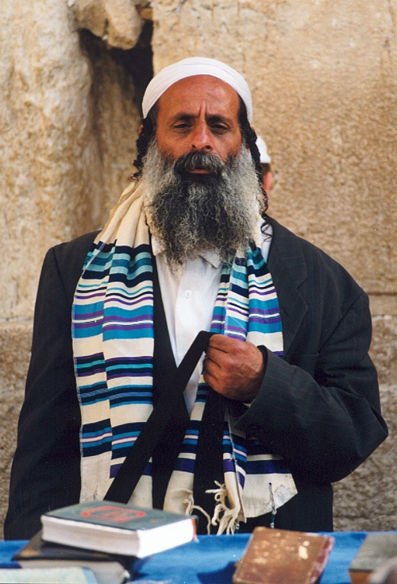
The Thinking of Judaism
Keeping the law is the way for me to earn my salvation
I can’t keep the whole law
So I’ll rank the laws and keep some of them (those that are easier for me!)
Then I’ll stress the laws that I keep
Be Careful! We don’t want this!

Slide 14
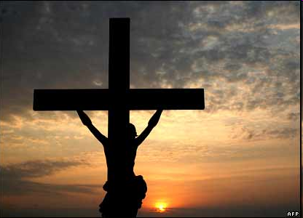
Galatians 2:15-21
15 "We who are Jews by nature, and not sinners of the Gentiles,
16 "knowing that a man is not justified by the works of the law but by faith in Jesus Christ, even we have believed in Christ Jesus, that we might be justified by faith in Christ and not by the works of the law; for by the works of the law no flesh shall be justified.
19 "For I through the law died to the law that I might live to God.
20 "I have been crucified with Christ; it is no longer I who live, but Christ lives in me; and the life which I now live in the flesh I live by faith in the Son of God, who loved me and gave Himself for me.
21 "I do not set aside the grace of God; for if righteousness comes through the law, then Christ died in vain."

Slide 15

Galatians 3:10-12
10 For as many as are of the works of the law are under the curse; for it is written, "Cursed is everyone who does not continue in all things which are written in the book of the law, to do them."
11 But that no one is justified by the law in the sight of God is evident, for "the just shall live by faith."
12 Yet the law is not of faith, but "the man who does them shall live by them."
The Law cursed everyone
The Law could not grant eternal life

Slide 16
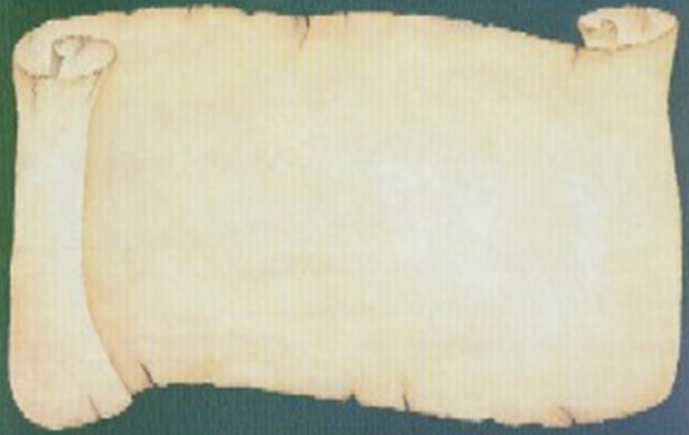
Weaknesses of the Law
Humans could not keep it
It was never designed to give eternal life
Only a shadow of Christ’s work
Cursed Jesus
Put limits on the good we should do
Couldn’t give forgiveness of sins
Priesthood failed the first day
Made nothing perfect
Not motivated by love
The Law was designed as a National Code

Slide 17
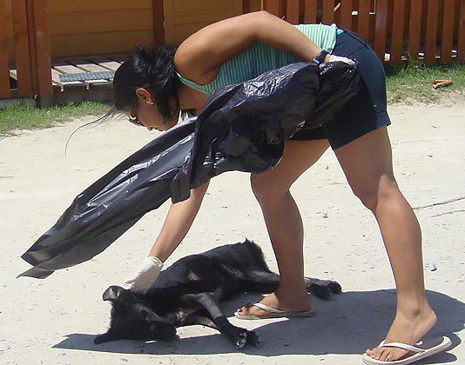
Leviticus 4:1-3
Very limited “forgiveness”
1 Now the LORD spoke to Moses, saying,
2 "Speak to the children of Israel, saying: 'If a person sins unintentionally against any of the commandments of the LORD in anything which ought not to be done, and does any of them,
3 'if the anointed priest sins, bringing guilt on the people, then let him offer to the LORD for his sin which he has sinned a young bull without blemish as a sin offering.
No offerings for intentional sins!

Slide 18

Acts 13:38-39
38 "Therefore let it be known to you, brethren, that through this Man is preached to you the forgiveness of sins;
39 "and by Him everyone who believes is justified from all things from which you could not be justified by the law of Moses.

Slide 19
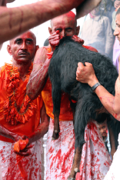
The Power of Faith in Jesus
Romans 3:19-28
19 Now we know that whatever the law says, it says to those who are under the law, that every mouth may be stopped, and all the world may become guilty before God.
20 Therefore by the deeds of the law no flesh will be justified in His sight, for by the law is the knowledge of sin.
21 But now the righteousness of God apart from the law is revealed, being witnessed by the Law and the Prophets,
22 even the righteousness of God, through faith in Jesus Christ, to all and on all who believe. For there is no difference;
23 for all have sinned and fall short of the glory of God,
Continued

Slide 20

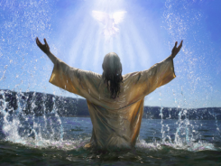
The Power of Faith in Jesus
Romans 3:19-28
24 being justified freely by His grace through the redemption that is in Christ Jesus,
25 whom God set forth as a propitiation [a gift that generates peace] by His blood, through faith, to demonstrate His righteousness, because in His forbearance God had passed over the sins that were previously committed,
26 to demonstrate at the present time His righteousness, that He might be just and the justifier of the one who has faith in Jesus. [the faith of Jesus]
27 Where is boasting then? It is excluded. By what law? Of works? No, but by the law of faith.
28 Therefore we conclude that a man is justified by faith apart from the deeds of the law.

Slide 21
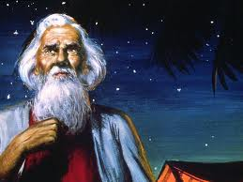
Abraham believed the Lord (Gen 15:6)
The Power of Faith
The one who will come from your own body will be your heir (15:4)
Count the stars… so will your descendants be (v.5)
Abraham believed the Lord & He counted it to him for righteousness (v.6)
“Against all hope, in hope Abraham believed” (Rom 4:18)

Slide 22
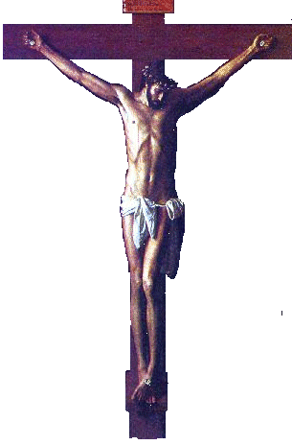
Different Viewpoints of the Cross
The People:
They judged Christ as a criminal who deserved to die a judicial, violent death. They punished Jesus with crucifixion and thought they were treating him as God would have punished a terrible sinner.
Christianity has built its substitution doctrine from this point of view, thinking God put Jesus through the punishment sinners deserve, so that sinners won’t have to be punished. The churches present Jesus as an innocent victim who died only for us in obedience to God.
God & Christ:
They look on the cross as the complete destruction of Sin. They finished the moral battle against Sin that Jesus was fighting everyday, by killing the cause of sin (the devil) in the body of Jesus. They judged the devil in human nature, condemned it to death, and then killed it. This was God’s declaration of righteousness – it showed us how to live!

Slide 23
Jesus Christ is our Representative
Substitution
1. Jesus died in my place as my substitute
2. Jesus took my place and suffered the punishment I deserve
3. Therefore, I can escape punishment since all my sins (past, present and future) have been borne away by Christ
Representation:
1. Jesus died to redeem himself first, as my representative (as one of us)
2. Jesus was not suffering anyone’s punishment. He willingly died to show me that Sin must be conquered and put to death
3. Therefore, I must follow Christ’s example, put to death my evil desires, and live for God. God will forgive my sins because I agree with Christ’s life and I will try to follow him.
Faith sees Jesus as our Representative

Slide 24
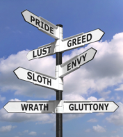
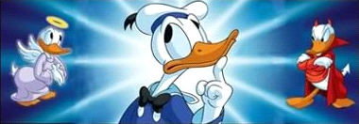
God’s Redemptive Plan deals with:
1) Our personal mistakes
God forgives our sins
2) Our sin-prone nature (evil desires)
God motivates us to fight it
This is the basis to forgive our sins

Slide 25

Romans 8:1-4
1 There is therefore now no condemnation to those who are in Christ Jesus, who do not walk according to the flesh, but according to the Spirit.
2 For the law of the Spirit of life in Christ Jesus has made me free from the law of sin and death.
3 For what the law could not do in that it was weak through the flesh, God did by sending His own Son in the likeness of sinful flesh, on account of sin: He condemned sin in the flesh,
4 that the righteous requirement of the law might be fulfilled in us who do not walk according to the flesh but according to the Spirit.

Slide 26
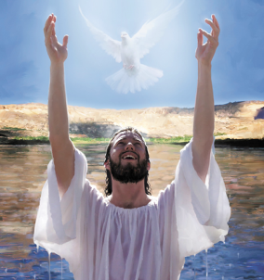
2 Corinthians 5:17-21
17 Therefore, if anyone is in Christ, he is a new creation; old things have passed away; behold, all things have become new.
18 Now all things are of God, who has reconciled us to Himself through Jesus Christ, and has given us the ministry of reconciliation,
19 that is, that God was in Christ reconciling the world to Himself, not imputing their trespasses to them, and has committed to us the word of reconciliation.
20 Now then, we are ambassadors for Christ, as though God were pleading through us: we implore you on Christ's behalf, be reconciled to God.
21 For He made Him who knew no sin to be sin for us, that we might become the righteousness of God in Him.

Slide 27
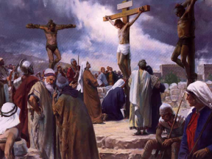
Isaiah 53:3-7
3 He is despised and rejected by men, a Man of sorrows and acquainted with grief. And we hid, as it were, our faces from Him; he was despised, and we did not esteem Him.
4 Surely He has borne our griefs and carried our sorrows; yet we esteemed Him stricken, smitten by God, and afflicted.
5 But He was wounded for our transgressions, he was bruised for our iniquities; the chastisement for our peace was upon Him, and by His stripes we are healed.
6 All we like sheep have gone astray; we have turned, every one, to his own way; and the LORD has laid on Him the iniquity of us all.
7 He was oppressed and He was afflicted, yet He opened not His mouth; he was led as a lamb to the slaughter, and as a sheep before its shearers is silent, so He opened not His mouth.

Slide 28
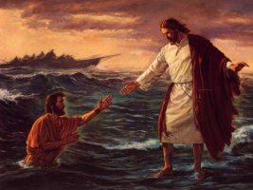
Hebrews 2:14-18 (RSV)
14 Since therefore the children share in flesh and blood, he himself likewise partook of the same nature, that through death he might destroy him who has the power of death, that is, the devil,
15 and deliver all those who through fear of death were subject to lifelong bondage.
16 For surely it is not with angels that he is concerned but with the descendants of Abraham.
17 Therefore he had to be made like his brethren in every respect, so that he might become a merciful and faithful high priest in the service of God, to make expiation for the sins of the people.
18 For because he himself has suffered and been tempted, he is able to help those who are tempted.

Slide 29
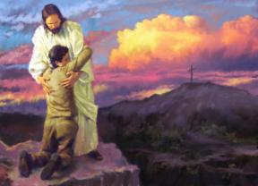
Hebrews 7:22-28
22 by so much more Jesus has become a surety of a better covenant.
23 Also there were many priests, because they were prevented by death from continuing.
24 But He, because He continues forever, has an unchangeable priesthood.
25 Therefore He is also able to save to the uttermost those who come to God through Him, since He always lives to make intercession for them.
26 For such a High Priest was fitting for us, who is holy, harmless, undefiled, separate from sinners, and has become higher than the heavens;
27 who does not need daily, as those high priests, to offer up sacrifices, first for His own sins and then for the people's, for this He did once for all when He offered up Himself.
28 For the law appoints as high priests men who have weakness, but the word of the oath, which came after the law, appoints the Son who has been perfected forever.

Slide 30
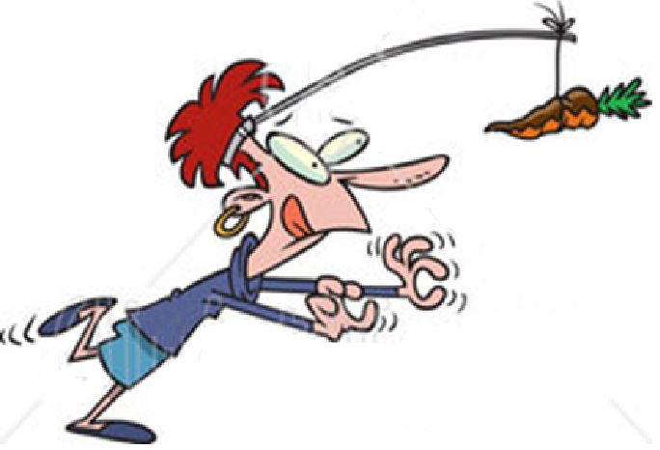
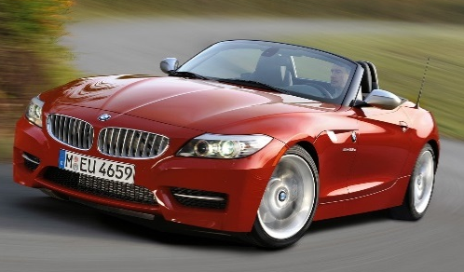
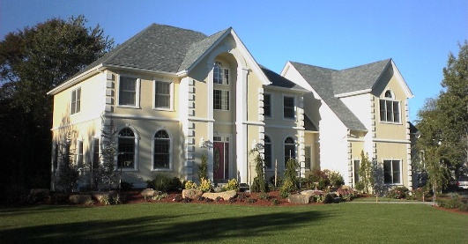

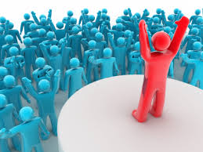
This world runs on “carrot & stick” motivation
Our educational and economic systems use this approach to motivate people. It is based on works and we are all very comfortable and familiar with it!

Slide 31
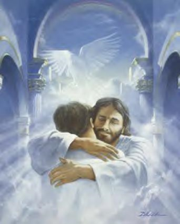
God uses a different strategy: He gives us grace as a gift of love & then asks us to respond to His kindness!
Ephesians 2:4-10
4 But God, who is rich in mercy, because of His great love with which He loved us,
5 even when we were dead in trespasses, made us alive together with Christ (by grace you have been saved),
6 and raised us up together, and made us sit together in the heavenly places in Christ Jesus,
7 that in the ages to come He might show the exceeding riches of His grace in His kindness toward us in Christ Jesus.

Slide 32

God gives us grace as a gift and then asks us to respond to His kindness!
Ephesians 2:4-10
8 For by grace you have been saved through faith, and that not of yourselves; it is the gift of God,
9 not of works, lest anyone should boast.
10 For we are His workmanship, created in Christ Jesus for good works, which God prepared beforehand that we should walk in them.

Slide 33
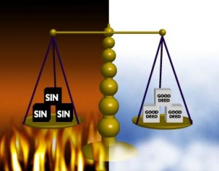
Don’t try to be justified by Law
Galatians 5:1-4
1 Stand fast therefore in the liberty by which Christ has made us free, and do not be entangled again with a yoke of bondage.
2 Indeed I, Paul, say to you that if you become circumcised, Christ will profit you nothing.
3 And I testify again to every man who becomes circumcised that he is a debtor to keep the whole law.
4 You have become estranged from Christ, you who attempt to be justified by law; you have fallen from grace.
For by works of law will no flesh be justified

Slide 34
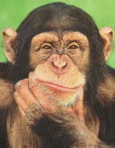
How do we know if we are living by law or by faith?
Do we depend on rituals to save us?
Do we serve one another through love?
Do we judge ourselves, or each other?
Do we stress a ritual more than the principles it is supposed to teach us?
Do we do our Bible readings to check them off, or so we can change our lives?
Do we go to meeting because “we have to” or because we want to?

Slide 35
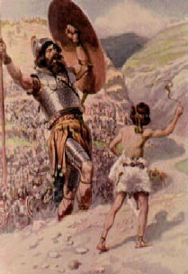
Faith has more power than Law
Hebrews 11:1-6
1 Now faith is the substance of things hoped for, the evidence of things not seen.
2 For by it the elders obtained a good testimony.
6 But without faith it is impossible to please Him, for he who comes to God must believe that He is, and that He is a rewarder of those who diligently seek Him.
Hebrews 11 is a testimony of what God did in people by faith, that works of law could never have accomplished, and they kept their faith until the end!

Slide 36
Philippians 3:7-11
Righteousness from God by Faith
7 But what things were gain to me, these I have counted loss for Christ. 8 Yet indeed I also count all things loss for the excellence of the knowledge of Christ Jesus my Lord, for whom I have suffered the loss of all things, and count them as rubbish, that I may gain Christ 9 and be found in Him, not having my own righteousness, which is from the law, but that which is through faith in Christ, the righteousness which is from God by faith; 10 that I may know Him and the power of His resurrection, and the fellowship of His sufferings, being conformed to His death, 11 if, by any means, I may attain to the resurrection from the dead.
Paul experienced the power of faith to motivate him to fellowship Christ’s sufferings & be conformed to his death to Sin!

Slide 37
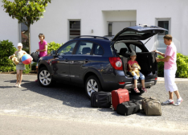
So, as we leave this weekend….
Give thanks to God for his gift of kindness in redeeming us from Sin
Respond to God’s gift by walking with Him
Serve His family in love
Read our Bibles daily so we can join Christ in victory over sin
Attend meeting so we can help each other
Witness to our friends about God’s power to change our lives

Slide 38

God wants us to make a choice
Satisfy our flesh
Live as one of God’s children
therefore choose life, that both you and your descendants may live (Deut 30:19)

Slide 39
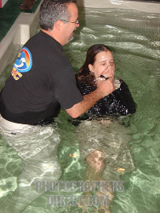
Titus 2:11-14
11 For the grace of God that brings salvation has appeared to all men,
12 teaching us that, denying ungodliness and worldly lusts, we should live soberly, righteously, and godly in the present age,
13 looking for the blessed hope and glorious appearing of our great God and Savior Jesus Christ,
14 who gave Himself for us, that He might redeem us from every lawless deed and purify for Himself His own special people, zealous for good works.

Slide 40
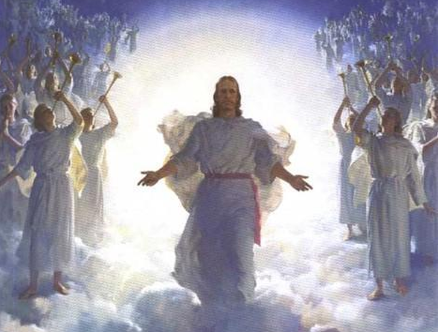
Christ has invited YOU to join God’s family forever...
don’t miss out!

Slide 41
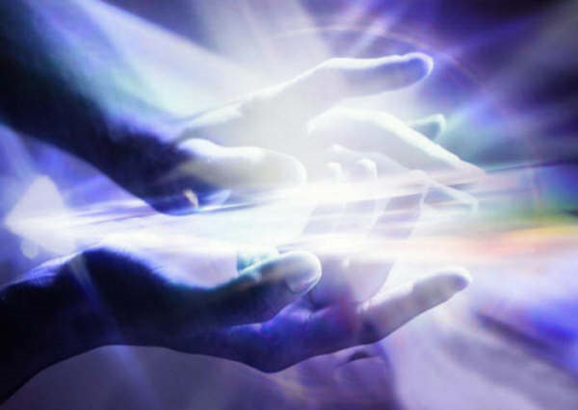
Thanks be to God for His indescribable gift!
(2 Corinthians 9:15)

