Slide 1
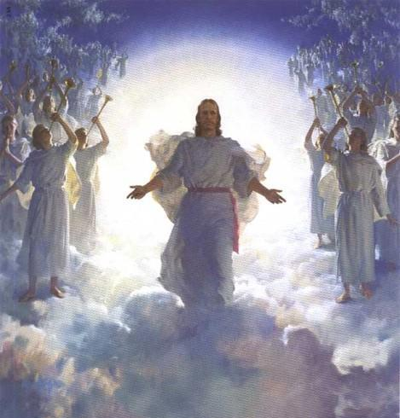

The Future Antichrist Deception:
The Future Antichrist Belief will cause many to reject Jesus Christ when he comes
He is the Antichrist!

Slide 2

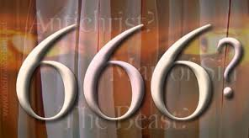



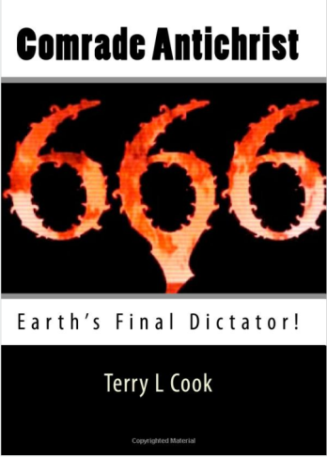
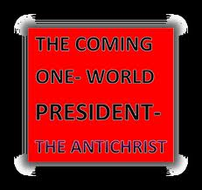
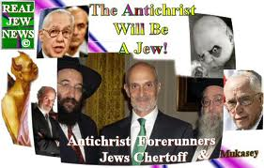
Most current Antichrist ideas will cause people to reject Jesus

Slide 3
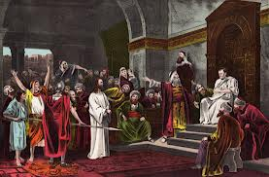
It happened once before!
We have no king but Caesar!

Slide 4
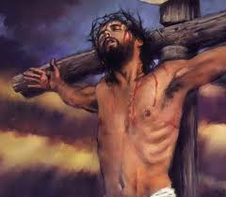
The Jews rejected & crucified their King!
They wanted a king to save them from the Romans
Some had been watching Bible prophecy and realized that this man might be “the prophet”
A “very great multitude” welcomed Jesus into Jerusalem, laid down their clothes, and shouted "Hosanna to the Son of David! Blessed is he who comes in the name of the Lord” (Matt 21:9)
This same multitude then rejected Jesus and crucified him only a few hours later!
It happened before because people misunderstood Bible prophecy & it will happen again!

Slide 5
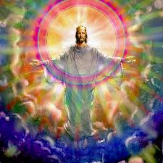
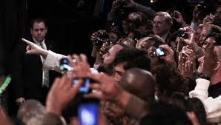
Many people around the world today are being prepared to reject Jesus when he returns!
S
They will claim Jesus is “Antichrist”

Slide 6
Lie # 1
Antichrist will be a Jew, who will arise to lead the Jews

Slide 7
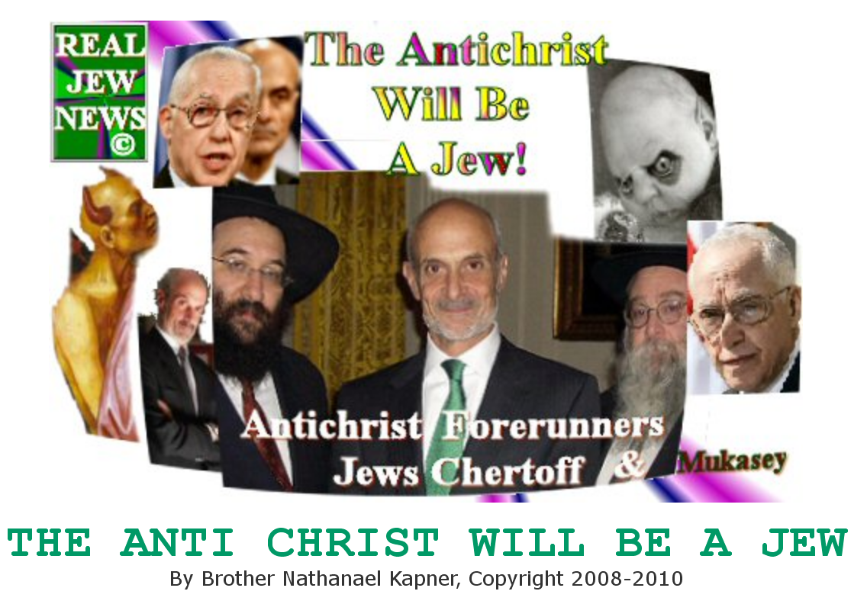
Look at the false ideas around today!

Slide 8
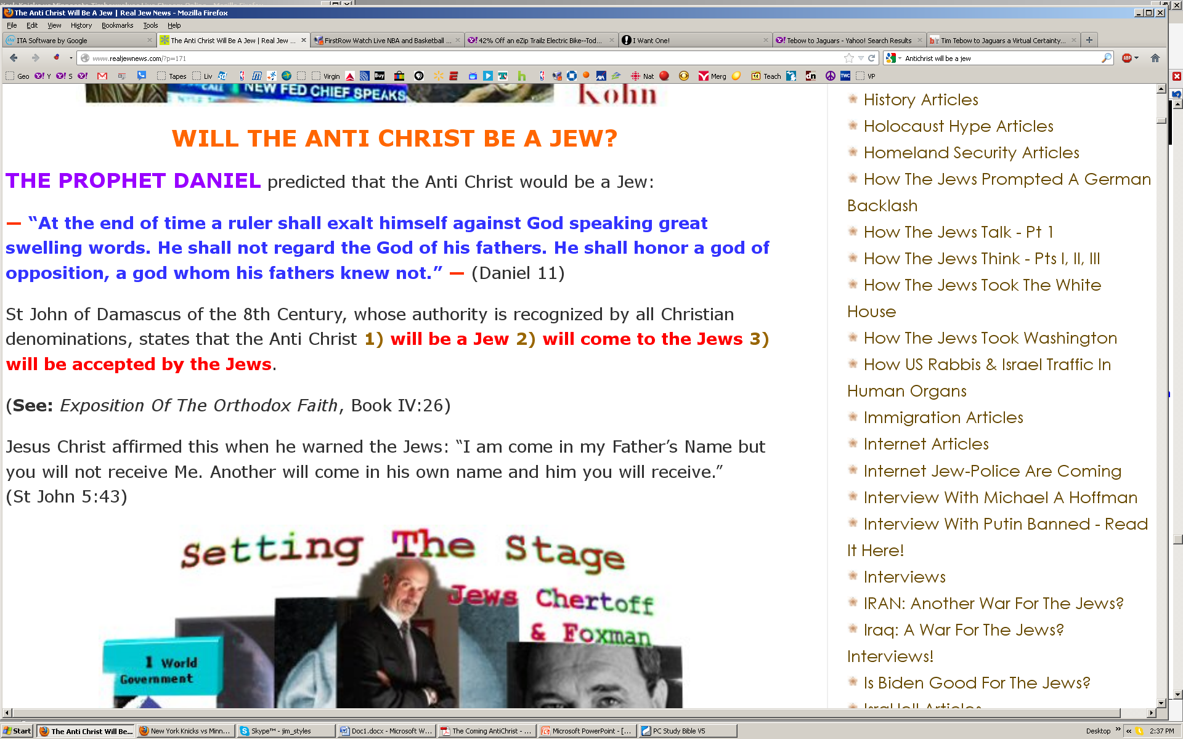
Examples of false teachings in Christianity today
Many people will be fooled!

Slide 9

Matthew 2:1-2
Truth: Jesus Christ is a Jew
1 Now after Jesus was born in Bethlehem of Judea in the days of Herod the king, behold, wise men from the East came to Jerusalem, 2 saying, "Where is He who has been born King of the Jews? For we have seen His star in the East and have come to worship Him."
People will mistake Jesus for the Antichrist!

Slide 10
Zechariah 12:10-12
Truth: Jesus will convert Jews first!
10 "And I will pour on the house of David and on the inhabitants of Jerusalem the Spirit of grace and supplication; then they will look on Me whom they pierced. Yes, they will mourn for Him as one mourns for his only son, and grieve for Him as one grieves for a firstborn. 11 In that day there shall be a great mourning in Jerusalem, like the mourning at Hadad Rimmon in the plain of Megiddo. 12 And the land shall mourn, every family by itself
Jews will accept Jesus!

Slide 11
Lie # 2
Antichrist will be a world ruler

Slide 12
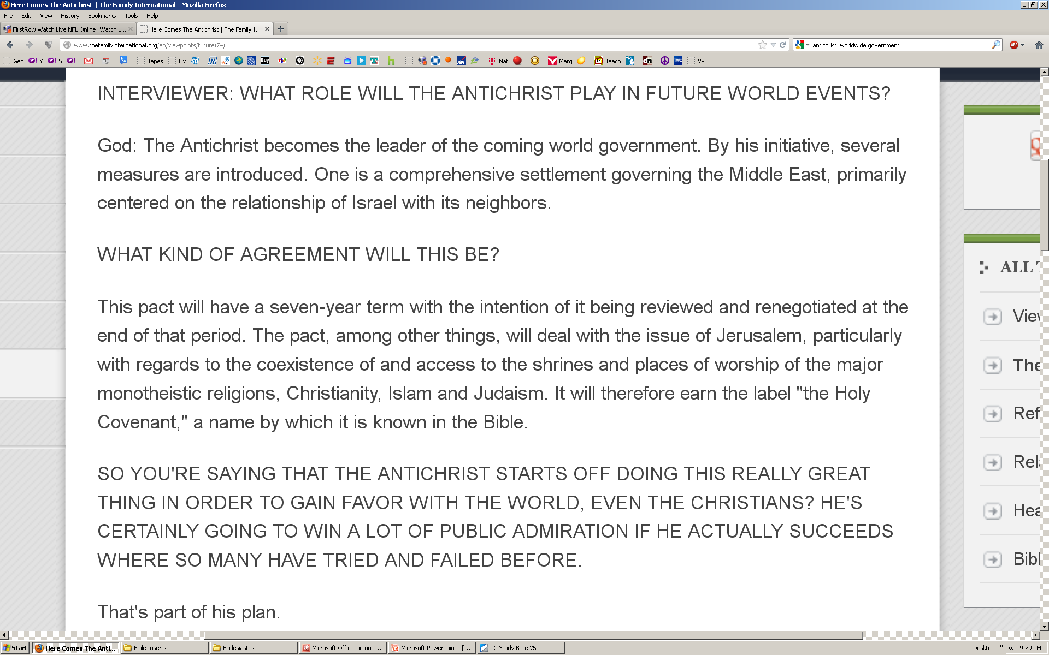
Antichrist will be a world ruler
S
TheFamilyInternational.org “Here Comes the Antichrist”

Slide 13
Zechariah 14:8-9
Truth: Jesus will be the world ruler
8 And in that day it shall be that living waters shall flow from Jerusalem, half of them toward the eastern sea and half of them toward the western sea; In both summer and winter it shall occur.
9 And the Lord shall be King over all the earth. In that day it shall be — "The Lord is one,“ and His name one.

Slide 14
Luke 1:30-33
Truth: Jesus will be the world ruler
30 Then the angel said to her, "Do not be afraid, Mary, for you have found favor with God.
31 And behold, you will conceive in your womb and bring forth a Son, and shall call His name Jesus.
32 He will be great, and will be called the Son of the Highest; and the Lord God will give Him the throne of His father David.
33 And He will reign over the house of Jacob forever, and of His kingdom there will be no end.“

Slide 15
Lie # 3
Antichrist will bring peace to the earth

Slide 16
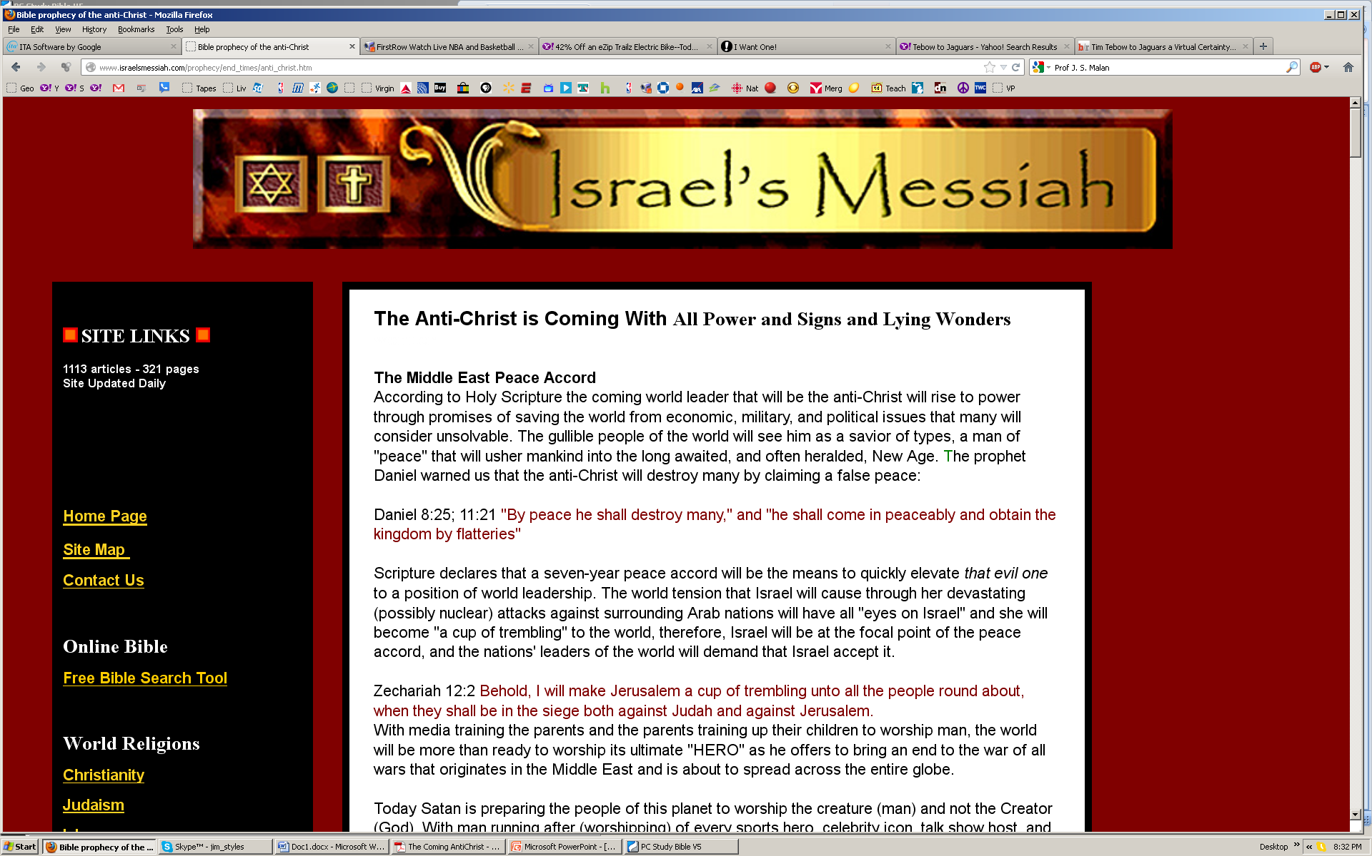

Slide 17
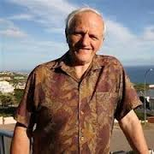

The Antichrist by Prof J. S. Malan, University of the North, South Africa
“During the first 3�years of the tribulation period the Antichrist will reign as prince of peace and pursue world unity. Then he will make his big move to gain absolute power.”
But Jesus is the only one who can bring world peace!

Slide 18
Isaiah 9:6-8
Truth: Jesus will bring Peace!
6 For unto us a Child is born, unto us a Son is given; And the government will be upon His shoulder. And His name will be called Wonderful, Counselor, Mighty God, Everlasting Father, Prince of Peace.
7 Of the increase of His government and peace there will be no end, upon the throne of David and over His kingdom, to order it and establish it with judgment and justice from that time forward, even forever. The zeal of the Lord of hosts will perform this.

Slide 19
Zechariah 9:9-10
Truth: Jesus will bring Peace!
9 "Rejoice greatly, O daughter of Zion! Shout, O daughter of Jerusalem! Behold, your King is coming to you; He is just and having salvation, Lowly and riding on a donkey, A colt, the foal of a donkey.
10 I will cut off the chariot from Ephraim And the horse from Jerusalem; The battle bow shall be cut off. He shall speak peace to the nations; His dominion shall be 'from sea to sea, And from the River to the ends of the earth.‘

Slide 20
Lie # 4
Antichrist will make a covenant with the Jews

Slide 21
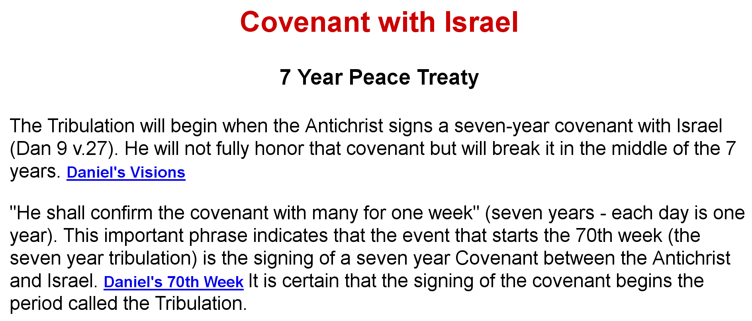
Antichrist will make a covenant with the Jews
DiscoverRevelation.com

Slide 22
Daniel 9:24-27 (NASB)
Who makes the covenant in Dan 9?
24 "Seventy weeks have been decreed for your people and your holy city, to finish the transgression, to make an end of sin, to make atonement for iniquity, to bring in everlasting righteousness, to seal up vision and prophecy and to anoint the most holy place. 25 "So you are to know and discern that from the issuing of a decree to restore and rebuild Jerusalem until Messiah the Prince there will be seven weeks and sixty-two weeks; it will be built again, with plaza and moat, even in times of distress.

Slide 23
Daniel 9:24-27 (NASB)
Messiah (Jesus) makes the covenant in Dan 9
26 "Then after the sixty-two weeks the Messiah will be cut off and have nothing, and the people of the prince who is to come will destroy the city and the sanctuary. And its end will come with a flood; even to the end there will be war; desolations are determined. 27 "And he will make a firm covenant with the many for one week, but in the middle of the week he will put a stop to sacrifice and grain offering; and on the wing of abominations will come one who makes desolate, even until a complete destruction, one that is decreed, is poured out on the one who makes desolate."
All this was fulfilled by AD 70

Slide 24
Ezekiel 37:24-28
God makes the covenant with the Jews
24 "David My servant shall be king over them, and they shall all have one shepherd; they shall also walk in My judgments and observe My statutes, and do them.
25 Then they shall dwell in the land that I have given to Jacob My servant, where your fathers dwelt; and they shall dwell there, they, their children, and their children's children, forever; and My servant David shall be their prince forever.
26 Moreover I will make a covenant of peace with them, and it shall be an everlasting covenant with them; I will establish them and multiply them, and I will set My sanctuary in their midst forevermore.
27 My tabernacle also shall be with them; indeed I will be their God, and they shall be My people.
28 The nations also will know that I, the Lord, sanctify Israel, when My sanctuary is in their midst forevermore."'“

Slide 25
Jeremiah 31:31-34
God makes the covenant with the Jews
31 "Behold, the days are coming, says the Lord, when I will make a new covenant with the house of Israel and with the house of Judah —
32 not according to the covenant that I made with their fathers in the day that I took them by the hand to lead them out of the land of Egypt, My covenant which they broke, though I was a husband to them, says the Lord.
33 But this is the covenant that I will make with the house of Israel after those days, says the Lord: I will put My law in their minds, and write it on their hearts; and I will be their God, and they shall be My people.
34 No more shall every man teach his neighbor, and every man his brother, saying, 'Know the Lord,' for they all shall know Me, from the least of them to the greatest of them, says the Lord. For I will forgive their iniquity, and their sin I will remember no more.“

Slide 26
Lie # 5
Antichrist will organize the Jews to rebuild the temple

Slide 27
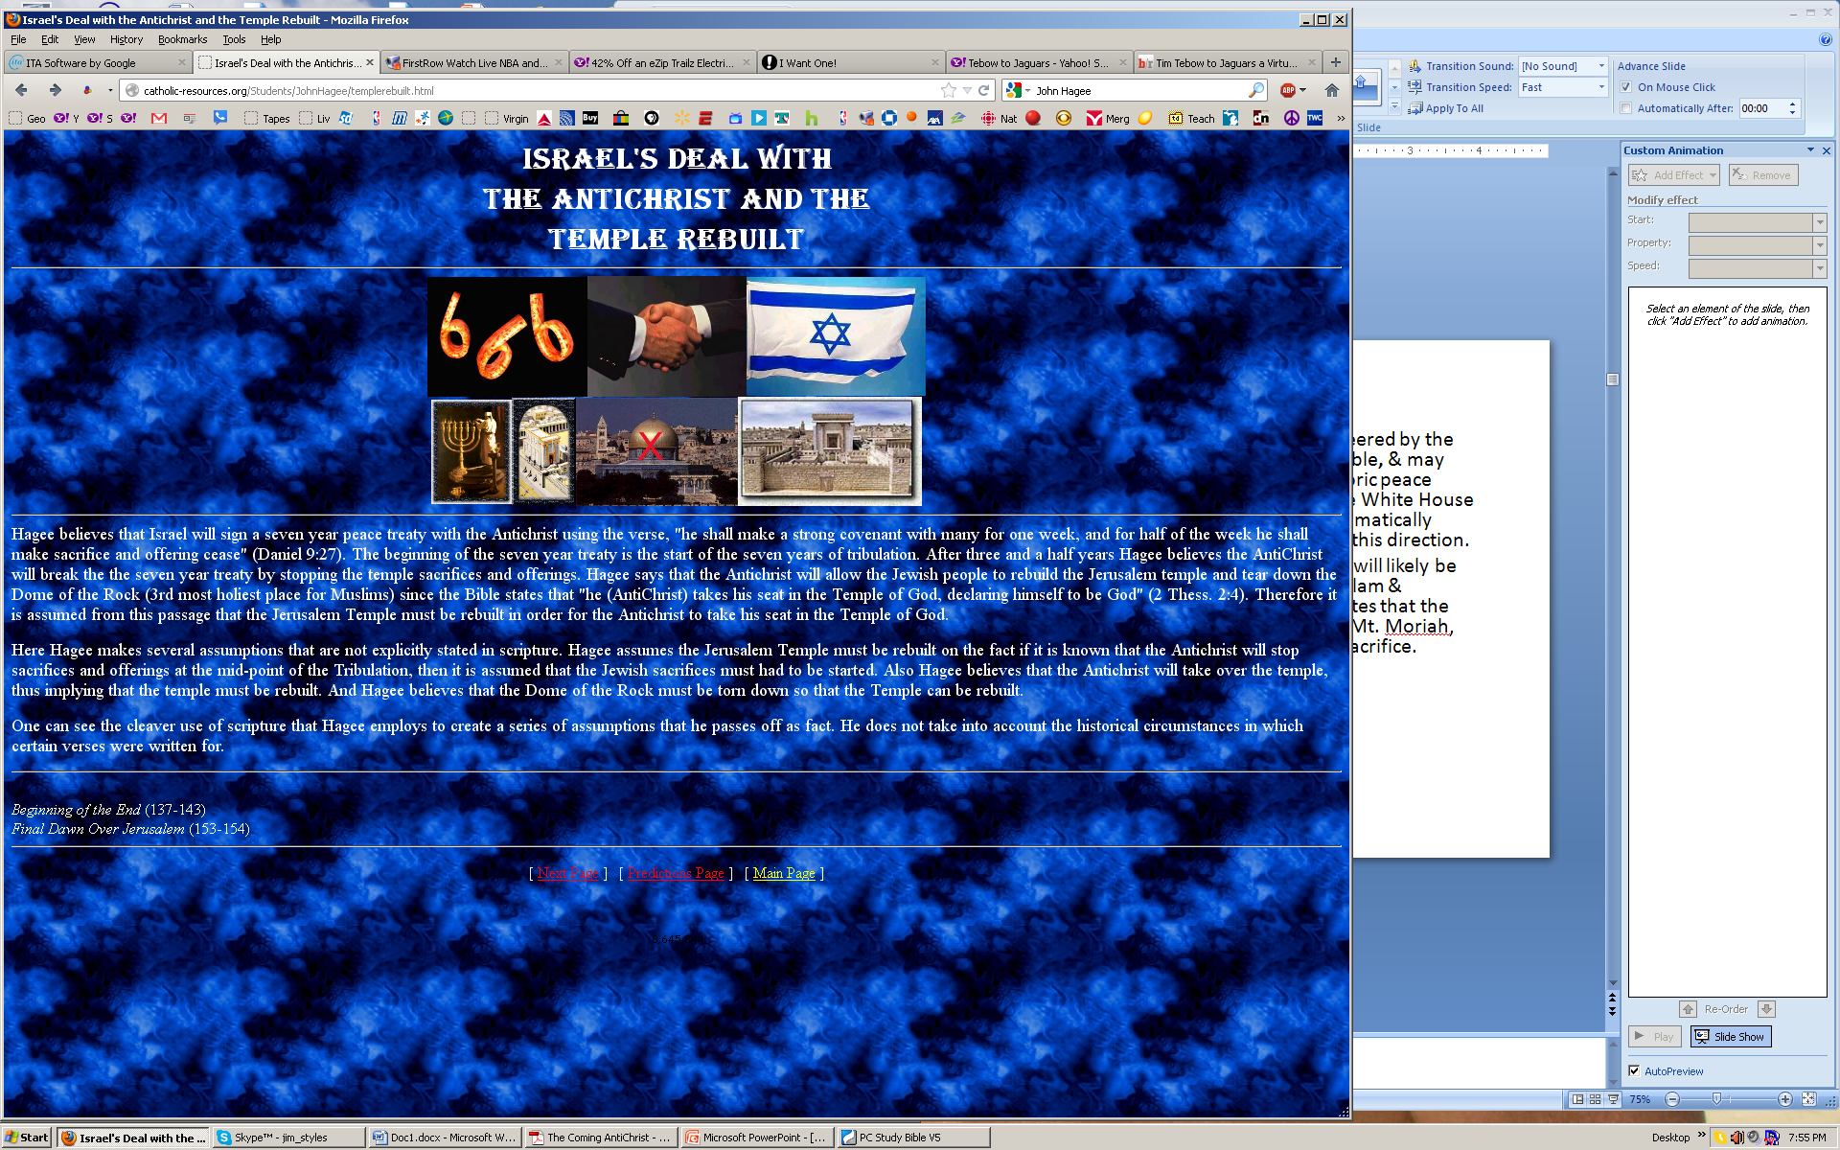
John Hagee believes that Israel will sign a seven year peace treaty with the Antichrist using the verse, "he shall make a strong covenant with many for one week, and for half of the week he shall make sacrifice and offering cease" (Daniel 9:27). The beginning of the seven year treaty is the start of the seven years of tribulation. After three and a half years Hagee believes the AntiChrist will break the the seven year treaty by stopping the temple sacrifices and offerings. Hagee says that the Antichrist will allow the Jewish people to rebuild the Jerusalem temple and tear down the Dome of the Rock (3rd most holiest place for Muslims) since the Bible states that "he (AntiChrist) takes his seat in the Temple of God, declaring himself to be God" (2 Thess. 2:4). Therefore it is assumed from this passage that the Jerusalem Temple must be rebuilt in order for the Antichrist to take his seat in the Temple of God.

Slide 28
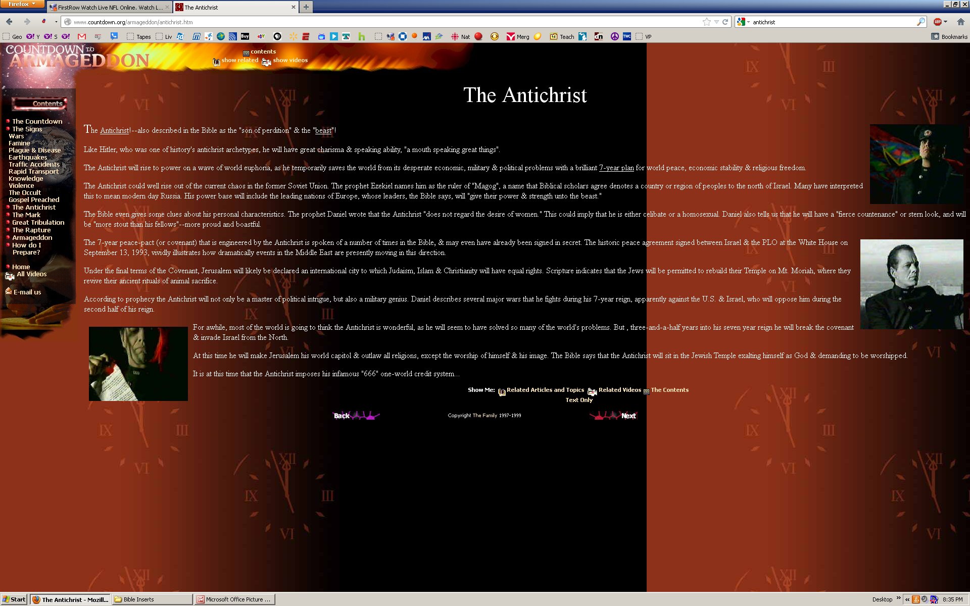
The 7-year peace-pact (or covenant) that is engineered by the Antichrist is spoken of a number of times in the Bible, & may even have already been signed in secret. The historic peace agreement signed between Israel & the PLO at the White House on September 13, 1993, vividly illustrates how dramatically events in the Middle East are presently moving in this direction.
Under the final terms of the Covenant, Jerusalem will likely be declared an international city to which Judaism, Islam & Christianity will have equal rights. Scripture indicates that the Jews will be permitted to rebuild their Temple on Mt. Moriah, where they revive their ancient rituals of animal sacrifice.

Slide 29
Acts 15:15-17
Jesus will rebuild the temple!
James’ Summary: And with this the words of the prophets agree, just as it is written:
16 'After this I will return and will rebuild the tabernacle of David, which has fallen down; I will rebuild its ruins, and I will set it up;
17 So that the rest of mankind may seek the Lord, even all the Gentiles who are called by My name, says the Lord who does all these things.‘
God will have Jesus organize the Jews to rebuilt the temple at Jerusalem

Slide 30
Zechariah 6:12-13
Zechariah’s prediction about Messiah
Then speak to him (Joshua the High Priest), saying, 'Thus says the Lord of hosts, saying: "Behold, the Man whose name is the BRANCH! From His place He shall branch out, and He shall build the temple of the Lord; 13 Yes, He shall build the temple of the Lord. He shall bear the glory, and shall sit and rule on His throne; so He shall be a priest on His throne, and the counsel of peace shall be between them both (he will operate as both king and priest)."‘
He will build the temple and reign as king

Slide 31
Ezekiel 44:10-12
Jesus will organize the Levites
10 "And the Levites who went far from Me, when Israel went astray, who strayed away from Me after their idols, they shall bear their iniquity.
11 Yet they shall be ministers in My sanctuary, as gatekeepers of the house and ministers of the house; they shall slay the burnt offering and the sacrifice for the people, and they shall stand before them to minister to them.
Jesus will be high priest of the new temple

Slide 32
Isaiah 56:6-8
Sacrifices will be brought to Jesus
6 "Also the sons of the foreigner who join themselves to the Lord, to serve Him, and to love the name of the Lord, to be His servants — Everyone who keeps from defiling the Sabbath, and holds fast My covenant —
7 Even them I will bring to My holy mountain, and make them joyful in My house of prayer. Their burnt offerings and their sacrifices will be accepted on My altar; For My house shall be called a house of prayer for all nations."
8 The Lord God, who gathers the outcasts of Israel, says, "Yet I will gather to him others besides those who are gathered to him."
Jesus will rule in this house!

Slide 33
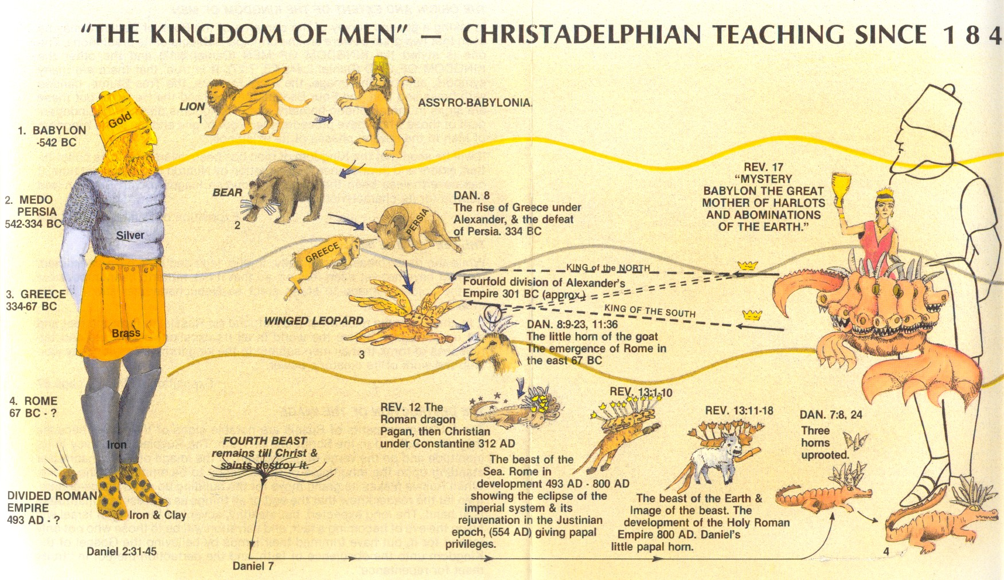
Many Christians misunderstand Bible Prophecy
What has gone wrong?
Prophecy in Revelation relates to the last 2,000 years!

Slide 34
1 John 2:18-19
Antichrist in the Bible
18 Little children, it is the last hour; and as you have heard that the Antichrist is coming, even now many antichrists have come, by which we know that it is the last hour.
John wrote this around 70AD
The Bible does not predict that there will be one specific Antichrist today

Slide 35
1 John 4:1-3
John is the only Bible writer to mention Antichrist
1 Beloved, do not believe every spirit, but test the spirits, whether they are of God; because many false prophets have gone out into the world. 2 By this you know the Spirit of God: Every spirit that confesses that Jesus Christ has come in the flesh is of God, 3 and every spirit that does not confess that Jesus Christ has come in the flesh is not of God. And this is the spirit of the Antichrist, which you have heard was coming, and is now already in the world.
The spirit of Antichrist has already begun almost 2,000 years ago!

Slide 36
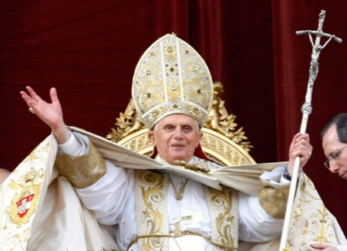
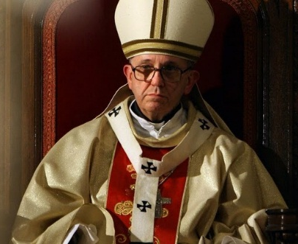
2 Thessalonians 2:1-12
Paul warned an apostasy would come
Now, brethren, concerning the coming of our Lord Jesus Christ and our gathering together to Him, we ask you, 2 not to be soon shaken in mind or troubled, either by spirit or by word or by letter, as if from us, as though the day of Christ had come. 3 Let no one deceive you by any means; for that Day will not come unless the falling away comes first, and the man of sin is revealed, the son of perdition, 4 who opposes and exalts himself above all that is called God or that is worshiped, so that he sits as God in the temple of God, showing himself that he is God.
Paul predicted an apostasy that came from Rome

Slide 37
2 Thessalonians 2:1-12
Paul warned an apostasy would come
5 Do you not remember that when I was still with you I told you these things? 6 And now you know what is restraining, that he may be revealed in his own time. 7 For the mystery of lawlessness is already at work; only He who now restrains will do so until He is taken out of the way. 8 And then the lawless one will be revealed, whom the Lord will consume with the breath of His mouth and destroy with the brightness of His coming. 9 The coming of the lawless one is according to the working of Satan, with all power, signs, and lying wonders, 10 and with all unrighteous deception among those who perish, because they did not receive the love of the truth, that they might be saved. 11 And for this reason God will send them strong delusion, that they should believe the lie, 12 that they all may be condemned who did not believe the truth but had pleasure in unrighteousness.
This strong delusion has fooled many!

Slide 38
Remember: It happened once before!
We have no king but Caesar!

Slide 39
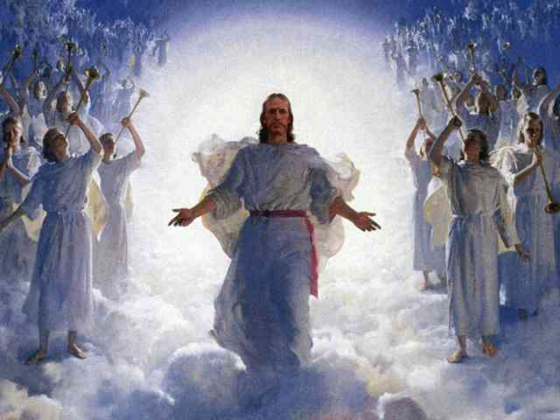
Many people will reject Jesus when he returns!
What can you do about it?

Slide 40
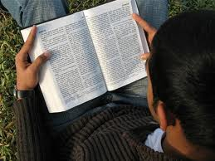
What can you do now, so you will not reject Jesus when he comes?
Read your Bible everyday and notice what it says Jesus Christ will do when he returns
Pray to God for understanding of His word
Study the Bible with us so you won’t be fooled
Blessed is he who reads and those who hear the words of this prophecy, and keep those things which are written in it; for the time is near. (Rev 1:3)

Slide 41

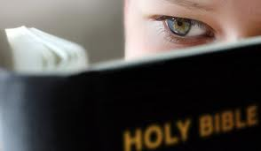
Now is the opportunity of your lifetime!
S
Find out what Jesus will do for you and this earth
It’s time to read the Bible and be prepared!
Get out your Bible and read!

Slide 42


Reading the Bible is fun!
G

Slide 43
The Future Antichrist Belief will cause many to reject Jesus Christ when he comes
He is the Antichrist!

Slide 44


