Slide 1
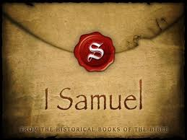
Chapter Five

Slide 2
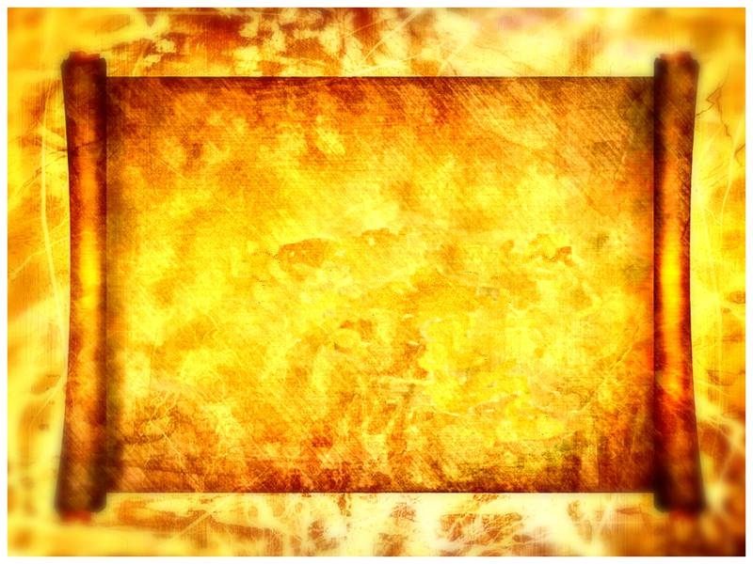
The Hand Of
The LORD
Notes:
*****

Slide 3
Objective
1: Mind set of the Jews and Philistines
2: Dagon and its Influence
3: Attitude to God
4: Consequence
5: Lessons
Notes:
Psa 78 vs54 -64 for reason…
Interst…
NO mention of Samuel
all about Gods dealings with Israelites /Phils
Objective….
1: Mind set of the Jews and Philistines
2: Dagon and its Influence
3: Attitude to God
4: Consequence
5: Lessons

Slide 4
The Hand Of
The LORD
Notes:
Mentioned twice in this chp.. 3 x in rest of chpt’s
Strong's 3027 Yad / 3068 YHWH lit: Hand of I will be that I will be
denotes personal involvement in the matter… using physical part of his being.
a terrifying position to be in if this hand is against you
yet David declared……..
*****

Slide 5
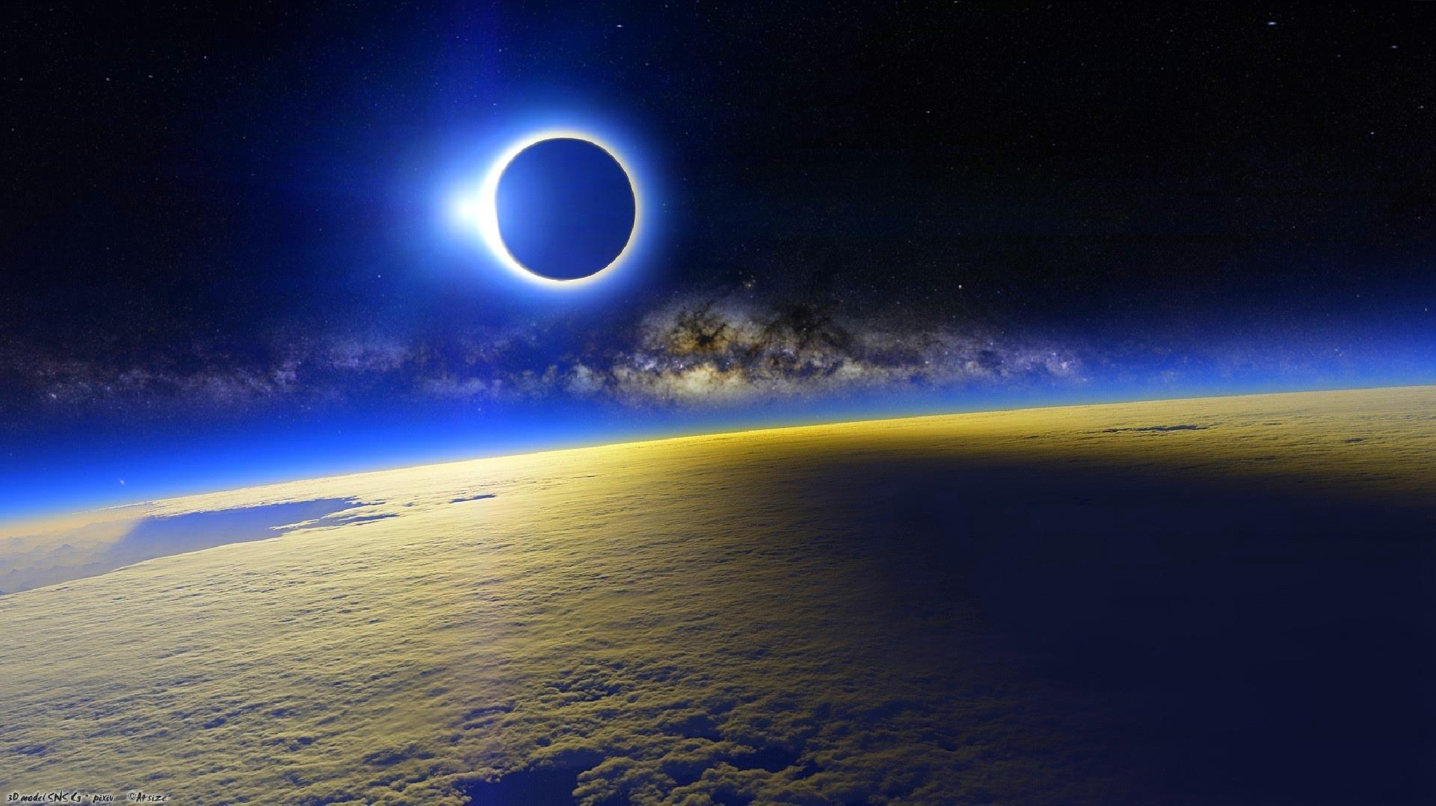
2 Samuel 24:14
And David said…., I am in a great strait: let us fall now into the hand of the LORD; for his mercies are great: and let me not fall into the hand of man.
Notes:
Conformation that H.O.T.L should not b feared…
As David knew, source of very present help in a time of need……
why in great straight?
Again Elijah…
*****

Slide 6
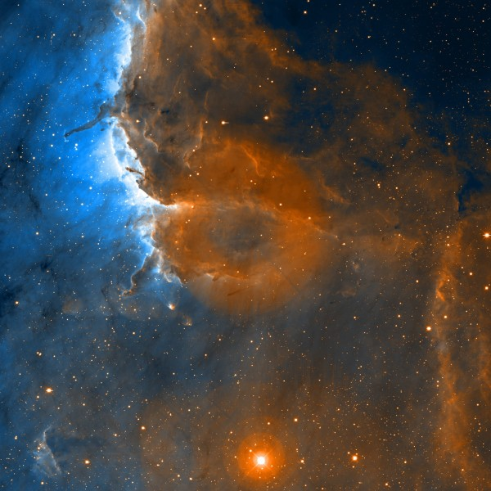
1 Kings 18:46 (KJV)
And the
hand of the LORD was on Elijah; and he girded up his loins, and ran before Ahab to the entrance of Jezreel.
Notes:
Very present help in need to Elijah…
So how do b on wrong side of Hand?…
Clue in 1 Sam12:15
But if ye will not obey ⁸⁰⁸⁵ the voice ⁶⁹⁶³ of the LORD ³⁰⁶⁸, but rebel ⁴⁷⁸⁴ against the commandment ⁶³¹⁰ of the LORD ³⁰⁶⁸, then shall the hand ³⁰²⁷ of the LORD ³⁰⁶⁸ be against you, as [it was] against your fathers ¹.
Hear and do!!!, react to that which you know to be true,
many eg’s of H.O.T.L for and against…
Pharaoh….
*****

Slide 7
Exodus 9:3 (KJV)
Behold, the hand of the LORD is upon thy cattle which is in the field, upon the horses, upon the asses, upon the camels, upon the oxen, and upon the sheep: there shall be a very grievous murrain.
Notes:
Against Nature to perform his will…Pharaoh (Ex 9:3)….
Yet same hand… comfort to David & help to Elijah
distinction being made..
*****

Slide 8
Deut 2:15 (KJV
For indeed the hand of the LORD was against them, to destroy them from among the host, until they were consumed.
Notes:
Men of war in wilderness – not permitted to enter promised land (interesting : long time period)
READ
but again for the ultimate benefit of Israel – that they had no experience of war when enter land – Meant had to learn to trust God
as we would expect, Beginning to see Purpose /pattern, use of hand of LORD revealed
*****

Slide 9
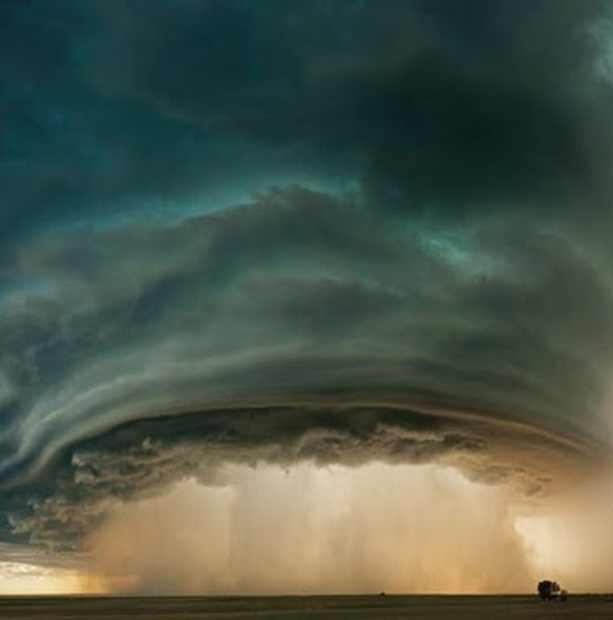
Joshua 4: (KJV)
22 Then ye shall let your children know, saying, Israel came over this Jordan on dry land.
23 For the LORD your God dried up the waters of Jordan from before you, until ye were passed over, as the LORD your God did to the Red sea, which he dried up from before us, until we were gone over:
24 That all the people of the earth might know the hand of the Lord, that it is mighty: that ye might fear the LORD your God for ever.
Notes:
But ultimately……– ‘that it is mighty: that ye might fear the Lord your God for ever.’
Feature : Mighty to Protect,
READ vs:24
What other features?…
*****

Slide 10
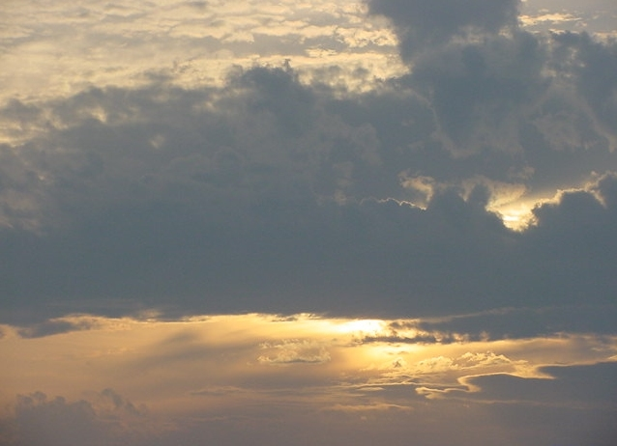
Joshua 22:31 (KJV)
31 And Phinehas the son of Eleazar the priest said unto the children of Reuben, and to the children of Gad, and to the children of Manasseh,
This day we perceive that the Lord is among us, because ye have not committed this trespass against the Lord: now ye have delivered the children of Israel out of the hand of the LORD.
Notes:
READ:
Deliverances :e.g. Children of Israel ( Jos 22:31 out of hand!)
Another feature…
*****

Slide 11
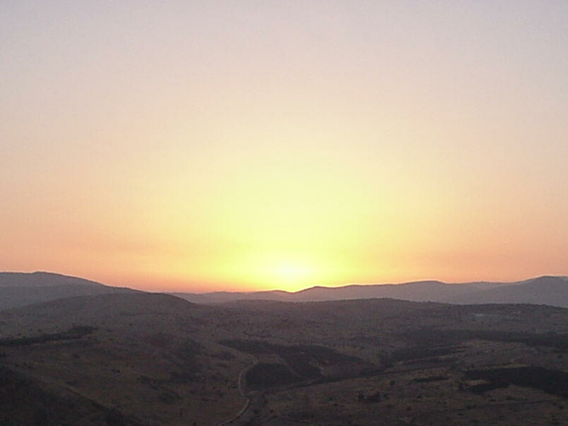
Judges 2:15 (KJV)
And the ANGER of the LORD was hot against Israel, and he delivered them into the hands of spoilers that spoiled them, and he sold them into the hands of their enemies round about, so that they could not any longer stand before their enemies.
15 Whithersoever they went out, the hand of the LORD was against them for evil, as the LORD had said, and as the LORD had sworn unto them: and they were greatly distressed.
Notes:
Punishes or discipline ( Jdg 2:15…read)
summarize….
*****

Slide 12
Protection

Slide 13
Protection
Discipline

Slide 14
Protection
Discipline
Punishment

Slide 15
Protection
Discipline
Punishment
Deliverance

Slide 16
Protection
Discipline
Punishment
Deliverance
Comfort

Slide 17
Protection
Discipline
Punishment
Deliverance
Comfort
Notes:
In this cpt we deal with Punishment – severest attribute allocated to THOTL, and allocated to taking of ark…
whole cpt about the ‘Ark’
so what about the ark of God?

Slide 18
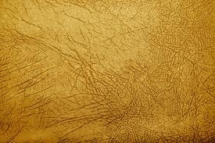
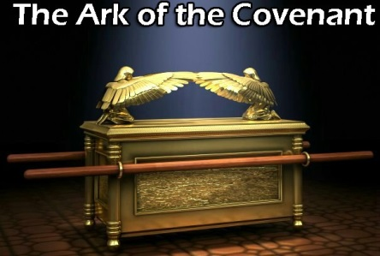
Carried by the priests some 2,000 cubits in advance of the people and their army
Seven days around Jericho’s wall by seven priests
Ark was always wrapped in a veil
52(l)×31(d)×31(h) inch
Plated entirely with gold
Notes:
5 x clicks….
Develop idea of mind set!!
In this record of 1 Sam 5 teach us of particular mind set in relation to ark and God
explore for a few min.
*****

Slide 19
Notes:
Both Parties believed the box to possess some supernatural power and for opposing reasons. Israelites' felt its presence would ensure them victory,
treating as lucky charm,
Israelites trying to force Gods hand by bringing it to battle – Almost … your will help us despite our failings…
Do we do this?
One camp, phils fearful of what box could do to destroy them (philistines)
The other overjoyed at arrival …
One fears the box - one glorifies the box
But God not in the box..
Jews new the ark was important re: salvation like bible on shelf!!
2.5 Bill! Printed
New Priests important re: religion …..Our high priest?
But their faith was in a box… Israel WORSHIPPED THE BOX not in their God whom they has forgotten
No confession of sin or repentance – no thought of it..
we be Abraham's seed!
Proof…
****

Slide 20
The Ark was taken by the Philistines
(1 Sam. 5:1)
This is where we are now….
Notes:
What we have now is a situation where the Philistines believe they have the upper hand
As most early civilisations, they believed the capture of an enemy deity ensures complete victory…..
Probably based on good reasoning. And previous success,
Most nations had Wood, stone idols - so the theory had some grounding.
Most battles were down to luck
They should been completely wrong in this instance ….
Should not have been an idol to capture……how wrong.
Israelite's had succumbed in their outlook to adopting the religion of the nations around them, jealous of them, wanted be like them..
‘Soon cry go up give us a king!!!
What a demonstration Lack of faith etc…..
God not in the box…..
1 Kings 8:27But will God indeed dwell on the earth? behold, the heaven and heaven of heavens cannot contain thee; how much less this house that I have builded?
The box had no power of itself and God was never going to allow the Israelites to defeat the philistines just because they had the ark..

Slide 21
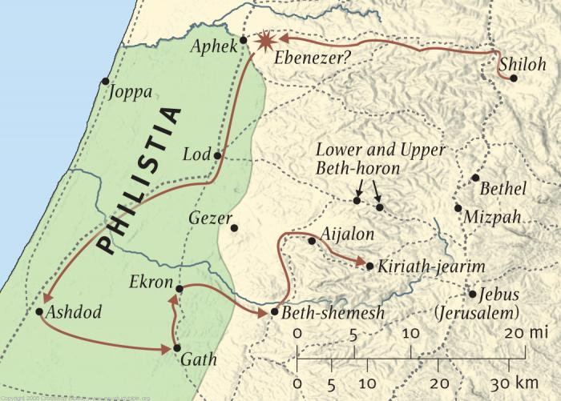
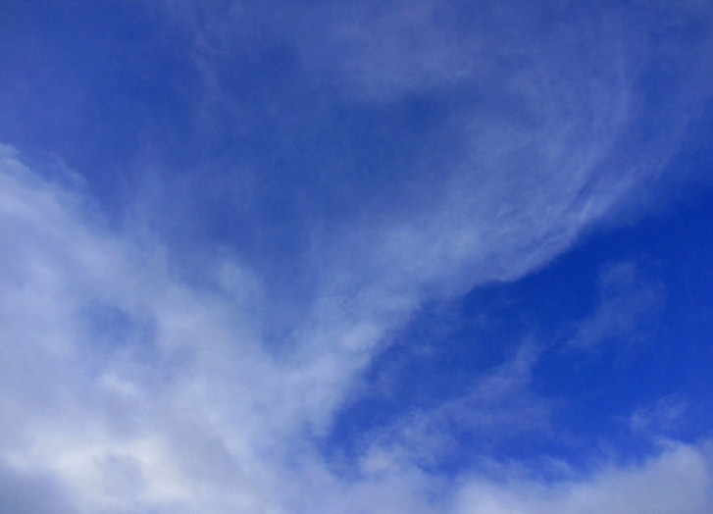
Notes:
The Ark in Philistia. The Philistines think their victory indicates that their god, Dagon, is superior to the God of Israel, and they bring the ark into Dagon’s temple to honour their god.
Remind who phils?
They seem to have adopted the Canaanite language and proper names and gods soon after they arrived (see notes on 1 Sam. 5:2; 31:10). They were skilled in pottery and also in
metal work (lur gy) (13:20).
*****

Slide 22
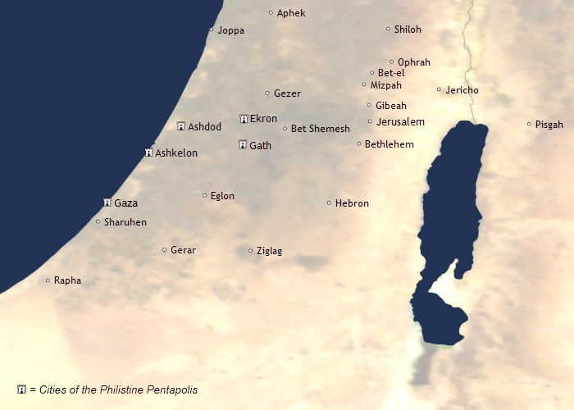
Notes:
Ashdod and Ekron were the two northernmost cities of the Philistine pentapolis (five ruling cities: Ashdod, Gaza, Ashkelon, Gath, Ekron; see 6:17). Ashdod was near the coast,
on the important Via Maris (Sea Road)
The Philistines, who appear in both Judges and Samuel, were one of the “Sea Peoples” who migrated from across the Aegean and settled on the coastal plain of southern Palestine about 1200 b.c., establishing a league of city-states.
all evidence points to the philistines being a sea people reason for mentioning this … come back to this point in a few mins…
(The Philistines of Genesis were probably from an earlier wave of immigrants from across the Aegean.)
*****

Slide 23
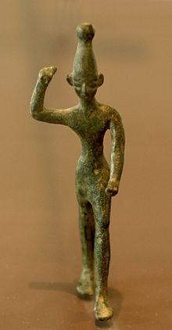
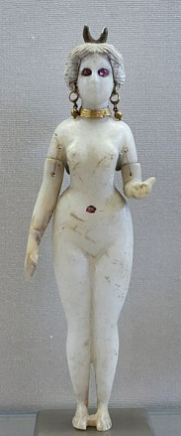
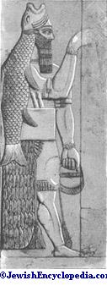
Notes:
The deities they worshipped were Baal, Astarte or Ashtoreth and Dagon,

Slide 24
a god of the rain,
thunder,
Fertility
and agriculture
Notes:
Baal : a god of the rain, thunder, fertility and agriculture

Slide 25

Astarte was
connected with
fertility,
sexuality,
And war.
Notes:
Astarte was connected with fertility, sexuality, and war.

Slide 26
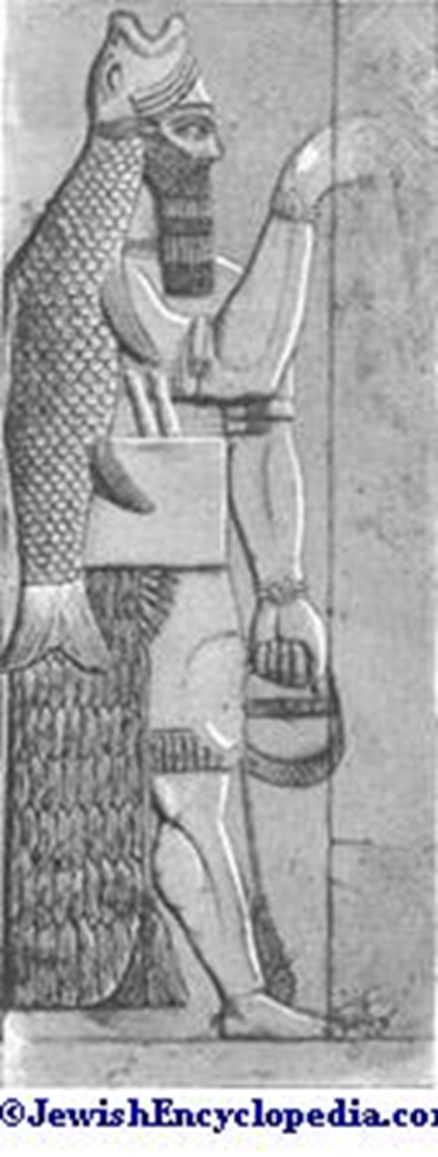
Dagon was
God of grain
(fertility),
And fish
(multiplying).
Notes:
Dagon was originally an Assyro-Babylonian fertility god who evolved into their major god, reportedly of grain
Dagon is a deity known from Early Bronze Age Mesopotamian and northern Syrian cities The Philistines apparently adopted him as their principal god (Judg. 16:23: soon after their arrival in Canaan. ;
EVIDENCE FOR THIS ASSUMTION: *****READ

Slide 27
Judges 16:23 (KJV
²³ Then the lords of the Philistines gathered them together for to offer a great sacrifice unto Dagon their god, and to rejoice: for they said, Our god hath delivered Samson our enemy into our hand.
Notes:
*****

Slide 28
Notes:
Why Ashdod? Ekron nearer?
not 100% sure why taken to Ashdod,, more populated so as to show off the ark…..Easy defence
*****

Slide 29
1 Sam 5:2 KJV
When the Philistines took the ark of God, they brought it into the house of Dagon, and set it by Dagon.
Notes:
‘Brought’ heb: bow= Gen 2:19 when God brought creation ( and Eve) to Adam to be named….usually denotes for a purpose…
Interesting ‘set it up by’…………….. lit : set it, present it, Exhibit it, Establish it, near to …
implies a permanent residing – intended to keep it as perm reminder of victory over People and God of Israel.
BUT: This not tolerated by almighty..
*****

Slide 30
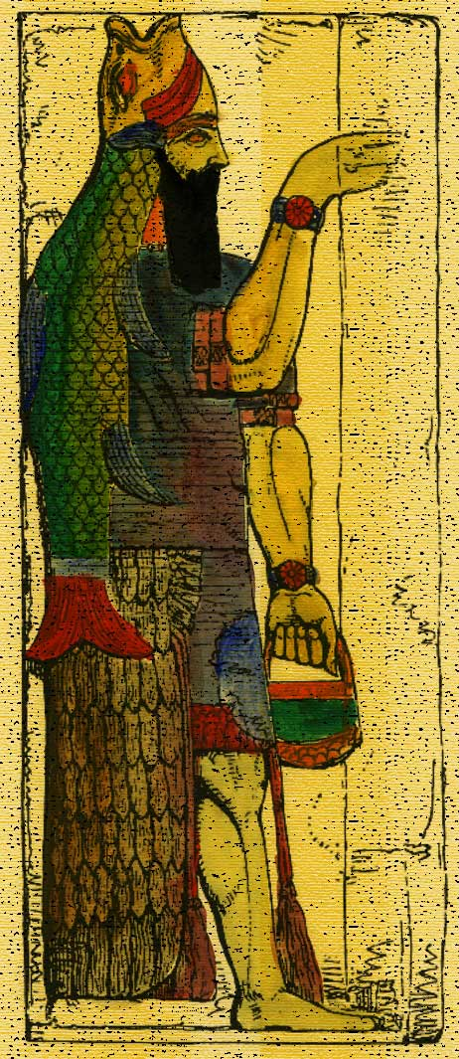
Just Got Personal!
Notes:
The superstition of the power of box caused them to see the box ‘as’ A God such was the mind of the phils - God was now going to teach lesson!
Yes, I let u defeat my people
Yes, I let you carry away this box.
For these things according to my will so my people will return to me….
But to see me as being subject to your stone idol – no way!
I will demonstrate to you using your false worship just who is the true God
just as I did to the Egyptians.
*****

Slide 31
Dagon’s Characteristics
Notes:
What know re Dagon..

Slide 32
Dagon Characteristics
^{Originally an}
Assyro-Babylonian fertility god
Notes:
*****

Slide 33
Dagon Characteristics
^{Adopted by Phillistines}
^{Not invented by them!}
Notes:
*****

Slide 34
Dagon Characteristics
1 Chron 10:8-10
King Saul’s Head was Displayed in
^{A temple of Dagon}
Notes:
⁹ And when they had stripped him, they took his head, and his armour, and sent into the land of the Philistines round about, to carry tidings unto their idols, and to the people.
¹⁰ And they put his armour in the house of their gods, and fastened his head in the temple of Dagon.
Which may have been payback for this event relating to the ark….
Conjecture….
*****

Slide 35
Dagon Characteristics
^{Fish and/or fishing}
^{(as symbol of}
^{Multiplying / Fertility).}
Notes:
Know as Fish God ( Has its significance)….
*****

Slide 36
Dagon Characteristics
^{Reportedly of grain}
^{(as symbol of fertility)}
Notes:
Grain :
*
The philistine very heavy drinkers this why grain so important to them, think week long drinking feasts @ Samson wedding….(jdg 14:10) Drinking feast, binge drinking
Wikipedia…
The Philistines were also renowned for both their production and consumption of alcoholic beverages. Numerous finds have exposed a well-managed spirits industry, from breweries and wineries to retail outlets that advertised beer, wine, and strong drink. Among the most numerous artefacts' unearthed from Philistine ruins are beer mugs and wine craters (large drinking bowls). The story of Samson's wedding feast alludes to the Philistine practice of engaging in week-long drinking parties, as the Hebrew word mishkeh, translated as "strong drink" in Judges 14:10, indicates a "drinking feast."^{[21]}
****

Slide 37
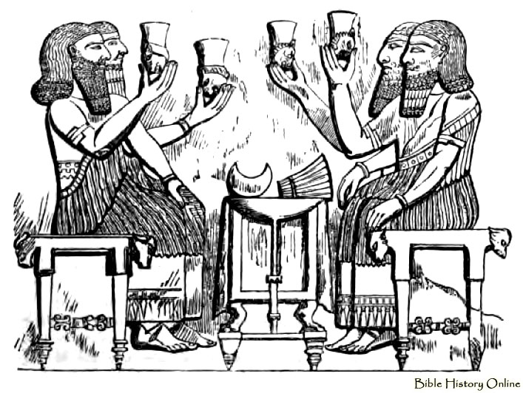
Dagon Characteristics
^{They Rose early?}
Notes:
VS:3
So surprising then they rose early….
I suspect the night before would have been major celebration and lots of alcohol….
You may have own thoughts….
‘Early’ suggests before they normally would!
some event perhaps.
Excited!
*****

Slide 38
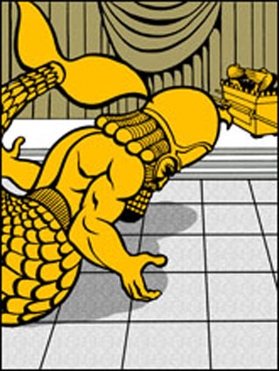
Dagon Characteristics
^{‘FALLEN’}
^{upon} ^{his face……}
Notes:
Vs :3 CSI- Fallen not pushed!
God uses nature, not a supernatural force from within the ark that caused the fall as depicted in Raiders.O.L.A
We seen how God uses stormy winds to fulfil his will in previous talks,
but perhaps a movement of the earth, earthquake!
This may provide some explanation as to why the drunken phils awoke.
Fallen e.g. same word when Jericho fell
When Ehud fallen
Both cases, 3rd party involved….or external force.
Word also have the idea of abasement (To lower in rank, prestige, do to esteem, giving reverence)
Scriptural principle that When one comes into contact with God : - one falls to the ground act of reverence, submission, acknowledgement of his greatness.
see it with Abram (Gen17:3)
Joshua (josh 5:14)
also see with kings….
and Jesus
.
*****

Slide 39
Dagon Characteristics
…fallen upon his ‘FACE’ to the earth
Notes:
Face down – obedience humbleness, subjection,
notice ark was described as ‘ark of God’ in vs:2..ark of LORD (Yahweh) Not Elohim! As in Vs: 2
Further proof, perhaps, that God had seen this event as a personal attack.
*****

Slide 40
Dagon Characteristics
^{…fallen upon his face to the}
^{‘EARTH’}
Notes:
Vs:3 & 4 different words but same HEB - KJV has Earth / other versions - ground. - Same word usually land,
same word in Gen13:17 when God tells Abram he will give him the land!
significant: God gave this portion of land to Israel (in fulfilment of promise to Abraham,) portion, Judah, read in ….Joshua 15:20-47 (vs41 Beth Dagon) so lit and symbolically
No false God to stand in way of Gods Righteous judgement and promises he has made… .
So phils had 2b humbled
So the idol they had put faith and trust in was 2b reckoned with.
their superstations had caused them to Confront the Living God
not about Israel -
*****

Slide 41
Dagon Characteristics
^{…fallen upon his face to the}
^{‘EARTH’}
Notes:
Dagon fell faced towards the ark ins subjection to it.
How remarkable that they could not see that the fact they had to lift Dagon back in position made it a structure of stone and not a living god.
It could not defend itself or pick its self up…
How powerless was the Hand of Dagon in relation to HAND OF THE LORD!
Yet: Still they did not want to discard this god …
but God had decreed…
1st commandment……³ Thou shalt have no other gods before me.
Top of the list….
Israelites just learnt this lesson big time – now Phils going to learn this lesson.
*****

Slide 42
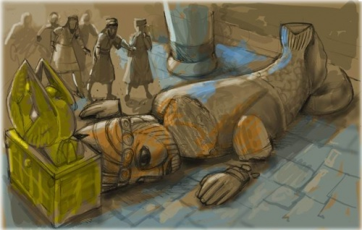
Dagon Characteristics
…head of Dagon and both the palms of his hands were cut off upon the threshold;
Notes:
READ Vs 4….
Only to find the next morning……
Head and hands removed!!!
What message being sent here….? Should they have learnt?
*****

Slide 43
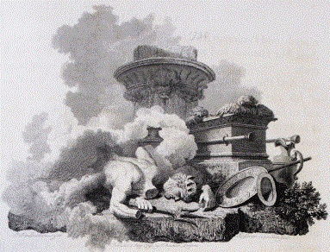
Dagon Characteristics
…head of Dagon and both the palms of his hands were cut off upon the threshold;
Notes:
Here we have certain symbology we need to take note of…
The invisible immortal God only wise - vs. Dagon part man part fish.
The fish part remained.
BUT: God HAS problem with man Who opposeth and exalteth himself above all that is called God, or that is worshipped; so that he as God sitteth in the temple of God, shewing himself that he is God. 2 Thessalonians 2:4
*****

Slide 44
Dagon Characteristics
^{…notice the Hat;}
^{Look familiar?}
Notes:
just as an aside
Did you notice the head of Dagon – specifically the hat.
*****

Slide 45
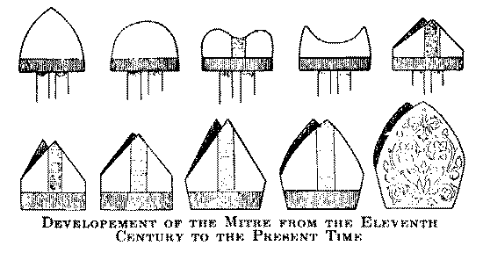
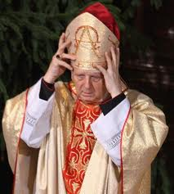
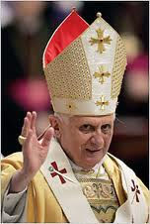
man Who opposeth and exalteth himself above all that is called God, or that is worshipped; so that he as God sitteth in the temple of God, shewing himself that he is God.
Notes:
man Who opposeth and exalteth himself above all that is called God, or that is worshipped; so that he as God sitteth in the temple of God, shewing himself that he is God.
*****

Slide 46
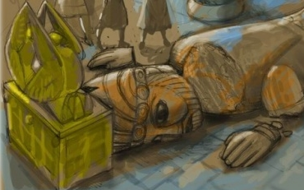
Dagon Characteristics
Notes:
significance, well - head is the seat of knowledge, controls what rest of body does.
It reasons, considers, and so to elevate it above God is to blaspheme him.
they knew of God ! – told this in cpt6 :6 re: Egyptians (Read)
So in retrospect if they would have called on the knowledge that they had of the God of Israel they would have saved them selves a lot of trouble.
and was it trouble!
this idol with a mans head and features was in direct opposition to Gods declaration that God alone rules in the kingdoms of men.
He had shown this in the past and the phils had ignored it..
*****

Slide 47

Dagon Characteristics
The
HAND
of the
LORD
Notes:
the Hand of God
the hand represents the Doing, Dagon could do nothing of himself - he idol
The hand of God defeats the hand of Dagon the hand of the Lord is real
The hand denotes the work, work shows results – just as Baal could not lick up the water when challenged
so this idol of stone could do nothing of itself,
Not even pick itself up off the floor!
also its relevant to note it was effectively broken in pieces – the image o man broken - a pattern we see repeated later (Nebs Image)
*****

Slide 48
Dagon Characteristics
The
HAND
of the
LORD
Notes:
note, the phils did not destroy the ark
their view was that the more gods the better that somehow this may make them more powerful – never changed gods just added to them – safety in numbers…
this has been the view of many civilizations thought the history of mankind.
Paul address this problem in Athens.
‘to the unknown God’
Acts 17:23For as I passed by, and beheld your devotions, I found an altar with this inscription, To The Unknown God. Whom therefore ye ignorantly worship, him declare I unto you.
and so God is declaring himself! I am the only true God.
Whether the opened the ark is debateable – it may well be that that they opened it to see its contents
Some commentaries say contents looted (cpt 6 vs:3) not my subject..
*****

Slide 49
The Fall of
Dagon
The
HAND
of the
Philistines
Notes:
As a sign - this demonstrated to the phils, their god could do nothing, either communicate with them or deliver them
rendered useless..
Reminder to us that we can do noting of ourselves…..
*****

Slide 50
Dagon Characteristics
The
HAND
of the
Philistines
Notes:
Threshold
this was the retaining rope if you like…..
Separating the sacred and common areas.
Obscure ref in Zech 1:9 God threatens to punish those who imitate this act (i.e. symbolically departing the safe parameters God has set us, and going over to the unclean thing.
Suggests that we don’t go over to the idol,
*****

Slide 51
Dagon Characteristics
God smote his enemies in the hinder parts, and put them to a perpetual reproach, Psalm 78:66
Notes:
READ Vs:6
Now Hand of the LORD smote with emorods ( piles)
interesting…
most encyclopaedias associate with piles, but I not convinced.
Piles rarely fatal ,more likely Boils associated with Bubonic plague
Clue in cpt6 :4 brought about by the mice
*****

Slide 52

Mouse
Infestation
Notes:
just so get idea of how bad things can get…..PLAY VIDEO
Lesson here.
remember how mentioned heavy drinkers with organised outlets etc
To make beer need grain, grain attracts mice, Mice spread disease.
God uses nature….
the mouse unclean lev 11:29
Tiny flea carried by mice/rats that infects Lymph nodes
Without treatment, the bubonic plague kills about two thirds of infected humans within 4 days
no wonder they we concerned…
*****

Slide 53
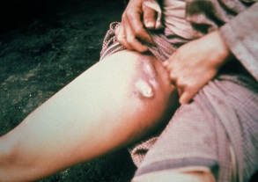
Bubonic Plague
Notes:
God didn’t miraculously cause the mice to exist at that time – he just used nature created correct conditions,
Cpt 5 :6 only mentions the Emorods not mice, seems just caused the correct environment ( weather etc) for the Insects to flourish…
so it was…. there life style ultimately decided their fate
Eat too much we put on weight…
Smoke poss. get cancer…..
Obvious exhortation!
Product of environments we choose to dwell in…
*****

Slide 54
Bubonic Plague
Notes:
READ Vs 7
how that faced with obvious truth of Gods existence they still choose Dagon!
the Gadarenes, who, when they had lost their swine, desired Christ to depart out of their coasts.
interesting, They still thought that The LORD was against their God!!!
He was against them, for unbelief,
they still thought the box was causing the problems…..
*****

Slide 55
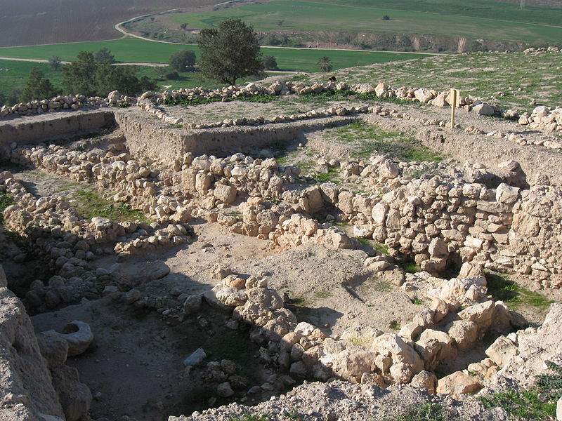
Sent To Gath
Notes:
READ VS:8
Under guidance of the ‘lords’
‘lords’ (princes) (but idea of hinge of the people ie opening a way one way or another)
that’s what hinge do!
What was their advice?
send it to Gath…
what happened in Gath? Nothing yet……..
READ VS:9
But is it poss. this is where the Giants might have resided…small and great!
For this where Goliath came from…
Seems they were willing recipient's of the ark!!!
Pride / arrogance
*****

Slide 56
Ekronites
Notes:
Read vs:10
Notice they don’t seek Lords this time just sent it to Ekron the most northerly city away
This too was city that should been under Judah’s rule.
they had taken it by the Hand of the LORD in Judges1:18 but at some point later lost it
Again through lack of faith….
no consultation this time
The Ark of the Covenant is now, among the Philistines, a “hot potato,” burning every city where it stays.
Vs:10 The Ekronites were not happy see the ark (“They have brought the ark of the God of Israel to us, to kill us and our people!”), but they still wouldn’t submit to the LORD God of Israel.

Slide 57
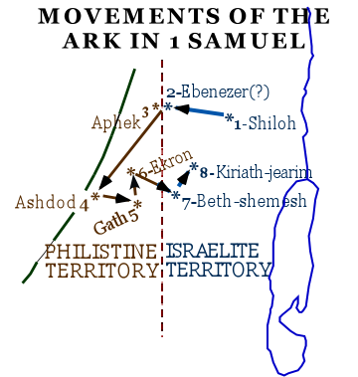
Ekronites
Notes:
Not the reaction that was hoped for they ought to have been parading it through the cities as a trophy, in stead parading as an instrument of death!
Ark amongst phils for 7 months 6:1 (Completion)
Took this time to realise God not Dagon was all powerful – yet refused to bow down to him as requested by the obvious sign of Dagon falling prostrate before him.
so suffered death – but did spare some v:12 presumably to recount the affair.(lest they Forget)
we seen how in cpt4 Israelites tried to manipulate God and cpt 5 Phils try manipulate God.
Both failed - God will not be mocked!
Lesson is that we must obey God and follow him and not expect God to follow us in our adventures in life.
The Israelites, if they had learned this lesson, then perhaps not wanted a king to be like the nations around them….
but rather remained separate unto their God - who rules in the Kingdoms of Men!
*****

Slide 58
1 Peter 5:6
Humble yourselves therefore under the mighty hand of God,
that he may exalt you
in due time:
Notes:
1 Peter 5:6 - Humble yourselves therefore under the mighty hand of God, that he may exalt you in due time:

Slide 59
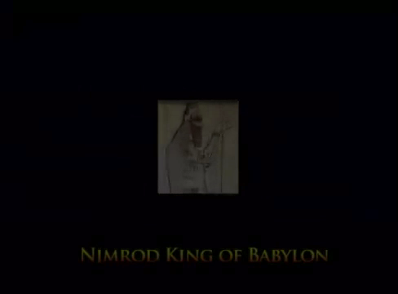
Notes:
*****

Slide 60

Notes:
Nevertheless spiritual sickness amongst the religious leaders of the day, the Pharisees, earns Jesus’ condemnation. He powerfully denounces their hypocrisy (Matthew 23), and drives out those using the temple courts for fraudulent commerce (Luke 19:45-46).

Slide 61
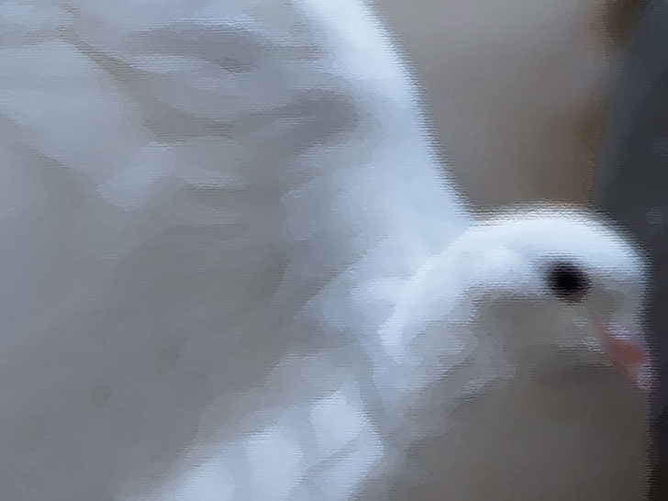
Notes:
The New Covenant
The new covenant (testament) between God and His people is established in Jesus Christ sacrificing his perfectly obedient life on the cross so that the power of sin (death) can be destroyed. The Gospel of John explains this, stating:
For God so loved the world that he gave his only Son, that whoever believes in him should not perish but have eternal life. (John 3:16, RSV)
Figure 7: ‘The Last Supper,’ 1498, da Vinci
Jesus institutes the sharing of bread and wine amongst his disciples to be repeated as a reminder of his sacrifice (1 Corinthians 11:23-26). He commands that his disciples should love God and love each other, as this is the manner in which their discipleship is demonstrated:
“A new commandment I give to you, that you love one another; even as I have loved you, that you also love one another. By this all men will know that you are my disciples, if you have love for one another.”
(John 13:34-35, RSV)
Jesus died on the cross so that God’s will – not his own – would be perfected. After three days, God raised Jesus back to life, showing He will not permit the sinless to suffer destruction (Acts 2:27 quoting Psalm 16:10), and that Jesus is the source of resurrection and life (John 11:21-25). Jesus revealed himself to his disciples and ascended into heaven to sit at the right hand of God, awaiting the appointed time of his return to the Earth as King (Acts 1:11).

Slide 62
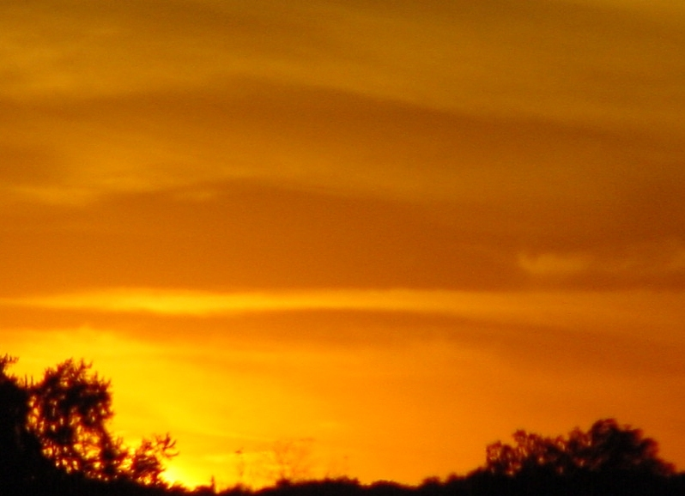
Notes:
New Testament Letters: Preaching and Correcting
The Early Church is pioneered by faithful apostles and other key converts such as the apostle Paul (Acts 9). The New Testament letters are from these men (mainly Paul) to the new believers in different cities throughout the Mediterranean region. They record the preaching of the Good News about Jesus Christ, the victory that he won on the cross and, via Jesus’ teachings, how to conduct one’s life so that at Jesus’ return one might be rewarded with a place in his kingdom rather than death. One example of this teaching is in Paul’s letter to the disciple Timothy:
Until I come, devote yourself to the public reading of Scripture, to preaching and to teaching. Do not neglect your gift… Be diligent in these matters; give yourself wholly to them, so that everyone may see your progress. Watch your life and doctrine closely. Persevere in them, because if you do, you will save both yourself and your hearers. (1 Timothy 4:13-16)
Paul explains to the believers that the promises made to Abraham are available to all because Abraham was chosen because of his faithfulness, and not his nationality. Thus those who are faithful qualify for God’s promises along with Abraham (Galatians 3:7-8). Unity between all nations and social classes is found in identification with Jesus Christ (Galatians 3:28-29). Paul gives practical advice to the churches on how the disciple should conduct himself: blamelessly and with purity, doing everything without complaining or arguing (Philippians 2:14-15); eliminating from his mind the selfish desires of the flesh (Romans 6, Colossians 4:5-9) and focusing instead on things good and profitable, always rejoicing in God’s blessings (Philippians 4:4-8). The faithful are instructed to come together as a loving family community (the Church), working together (Hebrews 10:25) with God (1 Corinthians 3:9) in an orderly fashion (1 Corinthians 14:33-40).
Peter adds the description of the church as a spiritual house built of living stones offering spiritual sacrifice to God through Jesus (1 Peter 2:5), and James stresses that faith is dead unless it is realized in works (James 2:14-26); recommending simple, yet fundamental practices:
Religion that God our Father accepts as pure and faultless is this: to look after orphans and widows in their distress and to keep oneself from being polluted by the world. (James 1:27)
Paul complements James’ instruction revealing that faithful works, though essential, do not themselves bring salvation. Salvation is only received as a gift of God’s grace, which He chooses to give to the faithful (Ephesians 2:8, Hebrews 11:6). John expands on the command to love, exhorting that if a man love God he must also love his brother (1 John 4:20-21).

Slide 63
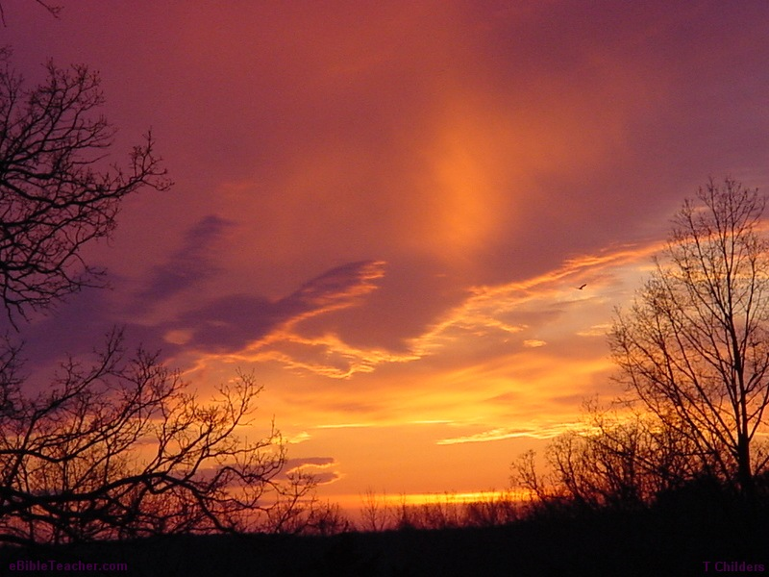
Notes:
New Testament Prophecy: Revelation
The final book of the Bible is the Revelation of Jesus Christ to John. Through a series of graphic visions (some expanding earlier visions to Ezekiel, Daniel and Zechariah) the future plan of God is revealed. All nations ultimately rise in war against Jesus Christ (Armageddon) and are defeated as Jesus sets up God’s Kingdom over all the Earth (Revelation 19). Christ’s reign culminates in a final Judgment Day when sin, wicked men, and death itself are permanently destroyed (Revelation 20), and God’s eternal peace reigns on Earth (Revelation 21).
Figure 9: River of life
And I heard a loud voice from the throne saying, “Now the dwelling of God is with men, and he will live with them. They will be his people, and God himself will be with them and be their God. He will wipe every tear from their eyes. There will be no more death or mourning or crying or pain, for the old order of things has passed away.” He who was seated on the throne said, “I am making everything new!” Then he said, “Write this down, for these words are trustworthy and true.”(Revelation 21:3-5)
Then the angel showed me the river of the water of life, as clear as crystal, flowing from the throne of God and of the Lamb…On each side of the river stood the tree of life…No longer will there be any curse. The throne of God and of the Lamb will be in the City, and his servants will serve him. They will see his face… (Revelation 22:1-4)

Slide 64

Notes:
Read vs 13
Button 1: In accordance with what seen so far…..
Button 2: Opposite to Pharisee.
Humble, in need of help.
Acknowledged his own sin.
Button 3: Which in that culture was the outward sign of an inward pain in one’s soul usually only seen at funerals
What about his prayer?
~@:>Some Bible accounts, like the Flood, seem beyond what I can reasonably believe.
I have trouble believing 66 books written across many centuries and cultures can be the “Word of God”.
Surely modern science has demonstrated that the Biblical account of creation is not literally true?
Where can I find concrete evidence that any of this Bible is true?
What is meant by the phrase: “The Kingdom of God”?
But doesn’t the Bible teach that Jesus is God as well as being born of Mary?

Slide 65
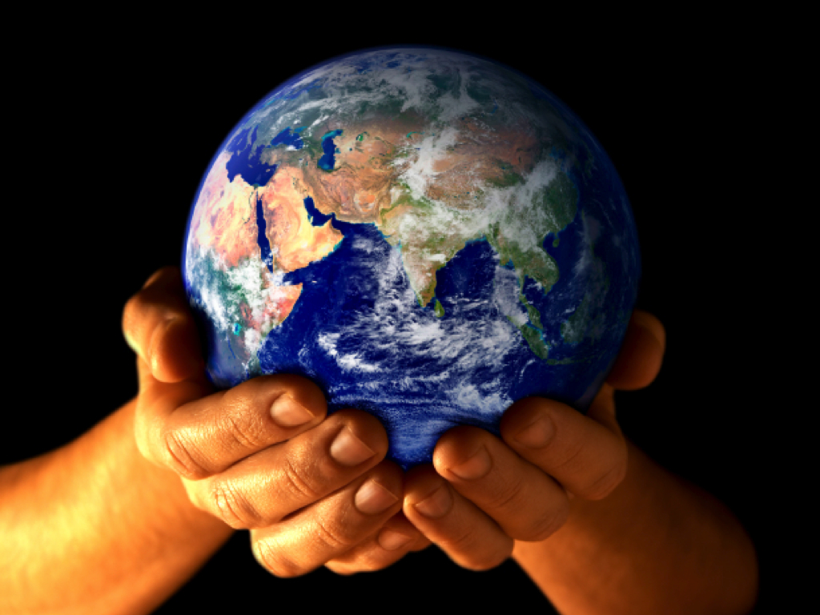

Slide 66
1 Kings 18:23-24 KJV
23 Let them therefore give us two bullocks; and let them choose one bullock for themselves, and cut it in pieces, and lay it on wood, and put no fire under: and I will dress the other bullock, and lay it on wood, and put no fire under:
24 And call ye on the name of your gods, and I will call on the name of the Lord: and the God that answereth by fire, let him be God. And all the people answered and said, It is well spoken.
Notes:
This now interesting, for God uses the characteristics of their so called God to show how futile there God really is
Remember incident with Elijah & prophets of Baal (1 kings 18:)
READ:
Baal being a God of rain, thunder, fertility and agriculture
The consumption of the bullock would not have been insurmountable for there God as show by the acceptance of the challenge…
causes Dagon to fall vs:3
so What are characteristics?
*****

