Slide 1
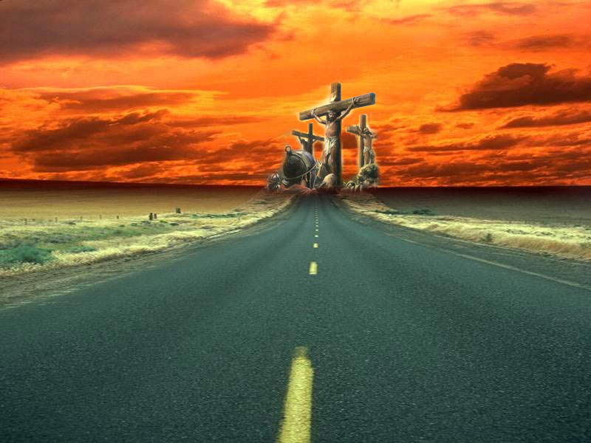
I have declared thy Name
Study No.1 – Yahweh Yireh
Okanagan, May 18, 2013

Slide 2
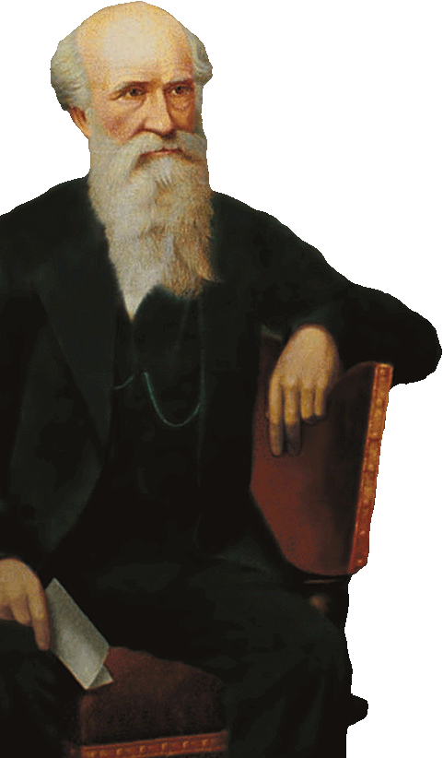
“Men were not ushered into being for the purpose of being saved or lost! God manifestation not human salvation was the great purpose of the Eternal Spirit. The salvation of a multitude is incidental to the manifestation, but was not the end proposed. The Eternal Spirit intended to enthrone Himself on the earth, and in so doing, to develop a Divine family from among men, every one of whom shall be Spirit, because born of the Spirit, and that this family shall be large enough to fill the earth, when perfected, to the entire exclusion of flesh and blood (﻿1 Cor. 15:28﻿)﻿”.
[Dr. Thomas, Herald of the Kingdom for 1858, pp. 84–85]

Slide 3
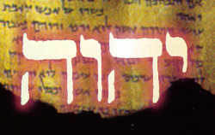
What is God Manifestation?
Manifestation:
To clearly reveal, to make manifest – Collins English dictionary
Greek phanerosis [5321], meaning ‘to render apparent’ – Strong’s concordance
  “But by manifestation of the truth commending ourselves to every man's conscience in the sight of God”, 2 Cor.4:2
  “And without controversy great is the mystery of godliness: God was manifest (phaneroo - #5319) in the flesh”, 1 Tim 3:16

Slide 4
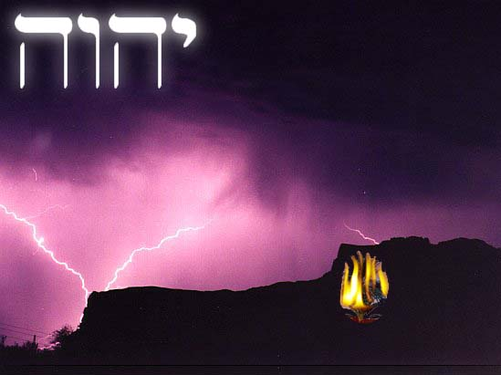
The Revelation
Exodus 2:24-25
“God heard their cry and remembered His covenant with Abraham, Isaac and Jacob”
Exodus 3:7-8
“And the LORD said, I have surely seen the affliction of my people which are in Egypt…And I am come down to deliver them out of the hand of the Egyptians, and to bring them up out of that land unto a good land ”.
Exodus 3:13-15
“…they shall say to me, What is his name? what shall I say unto them?
And God said moreover unto Moses, Yahweh Elohim of your fathers, the Elohim of Abraham, the Elohim of Isaac, and the Elohim of Jacob, hath sent me unto you”

Slide 5
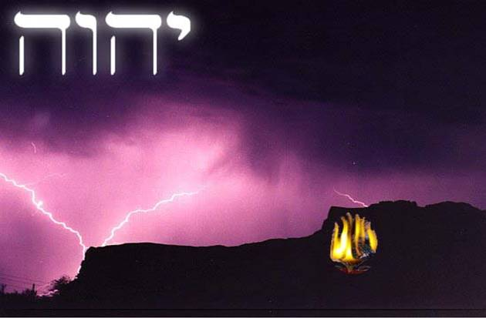
The Revelation
Exodus 3:13-15
“…they shall say to me, What is his name? what shall I say unto them?
And God said moreover unto Moses, Yahweh Elohim of your fathers, the Elohim of Abraham, the Elohim of Isaac, and the Elohim of Jacob, hath sent me unto you”
“He who shall be mighty ones of your fathers”
Impossible for man to achieve (Romans 3:23)
God raised up a man made strong for Himself (Psa.80:17) who became
  Our righteousness
  Our sanctification
  Our healer
  Our peacemaker

Slide 6
Prophecies of Jesus
Fulfilled in Jesus
Jesus was raised up to declare God’s Name – Psalm 22:22
Jesus to be exalted because he identified with God’s Name – Psalm 91:14
Jesus came in the Father’s Name – John 5:43; Matthew 21:9
Jesus manifested God’s Name in his life and death – John 17:6
Jesus, because of his obedience to death, inherited a more excellent Name – Hebrews 1:3,4; Philippians 2:9
God’s Name was visibly manifested in Jesus’ life
“They beheld his glory, the glory of...the Father”

Slide 7
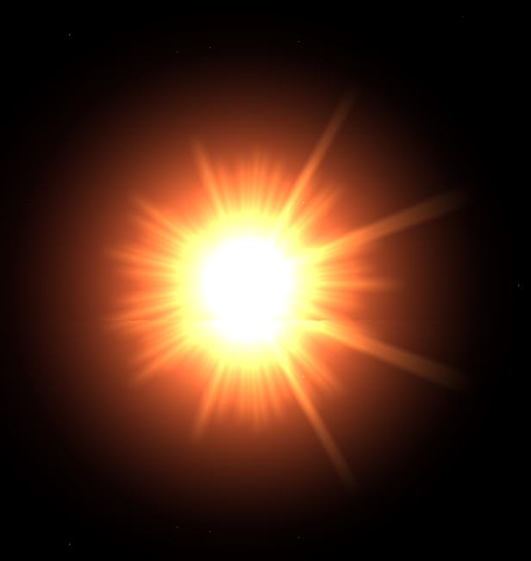
The Good Shepherd
Beheld his glory
The light of the world
God Manifestation
in Gospels
I am the Son of God
My doctrine is not mine but His that sent me
Jesus said, “I will raise it up again
Jesus said
“I say unto you”
Jesus
Christ
Given him a name above every name
Image of the invisible God
The Word made Flesh
God was in Christ
The first and the last
Emmanuel
God with us
Declared God’s name
I and the Father are one
Came to “finish the work of God”

Slide 8
Name-Titles
Yahweh Yireh (provide) – Gen.22:14 | Yahweh Shalom (Peace) – Judg.6:24
Yahweh Ropheka (healer) – Exod.15:26 | Yahweh Sabaoth (Hosts) – 1 Sam.1:3
Yahweh Nissi (banner) – Exod.17:15 | Yahweh Tsidkenu (Righteousness) – Jer.23:6
Yahweh MeKaddishkim (Sanctifier) – Lev.20:8 | Yahweh Roi (Shepherd) – Psa.23:1
Yahweh Elyon (Most High) – Psa.7:17 | Yahweh Shammah (is there) – Ezek.48:35
Yahweh Elohim (Mighty ones) – Exod.3:15 | Adonai Yahweh – Genesis 15:2

Slide 9
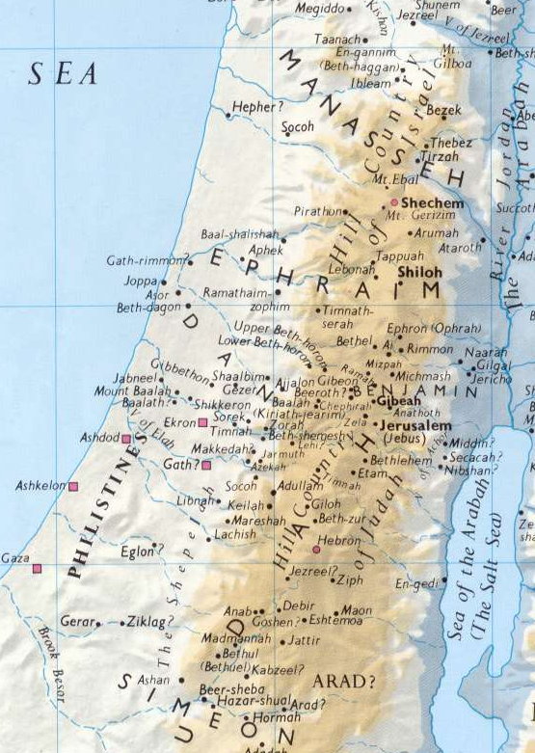
Abraham’s Travels
Haran: (12:4) Parched, dried up
Shechem: (12:6) Place of burdens, shoulder
Bethel & Ai: (12:8) House of God & Ruin
Hebron: (13:18) Friendship, alliance
Gerar: (20:1) Pilgramage, lodging place
Beersheba: (21:33) well of an oath
Moriah: ( 22:2) seen of Yah

Slide 10
Yahweh Yireh
A Prophecy:
Hagar and Ishmael: natural Israel Gal.4:22-31.
Not just about “casting out” – restoration – Gen.21:19 (Rom.11:25,26)
Abraham and Abimelech: Gentiles by nature (verse 23). Makes a covenant with Gentiles, verse 27.
An echo of Genesis 12:1-3:
  I will make of thee a great nation (v.2)
  In thee shall all nations be blessed.
Both events occur at Beer Sheba – “the well of the oath” (v.15; v.32)
“After these things…”
Verse 2 – take thine only son…Was this true?
  Ishmael was 14 years old
  Other children, Gen.25:1-6
Ref. to chapter 21. All about two sons
  Hagar and Ishmael – verses 1-21 (v.11)
  Abraham and Abimelech – verses 22-34 (v.23)

Slide 11
Yahweh Yireh
The land of Moriah
Heb. ‘raah⁷²⁰⁰ Yah’³⁰⁶⁸
The name of the place
Yahweh ³⁰⁵⁰ Yireh ⁷²⁰⁰
God’s focus had been watching since “the foundation of the world” (Rev.13:8)
God invites Abraham to look down the corridors of time and see what He sees
Abraham was about to enter into
THE FATHER’S EXPERIENCE

Slide 12
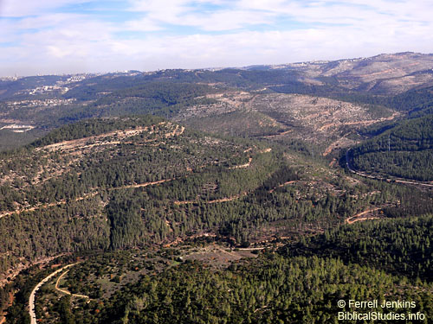
Yahweh Yireh
“And Abraham called the name of the place Yahweh Yireh: as it is said unto this day, In the mount of Yahweh it shall be seen” (Genesis 22:14)
CONTEXT
One of the mountains (v.2)
Reference to SON
Emphasis upon TOGETHER
Central theme = SACRIFICE (V.2, 6-8, 12-13)

Slide 13
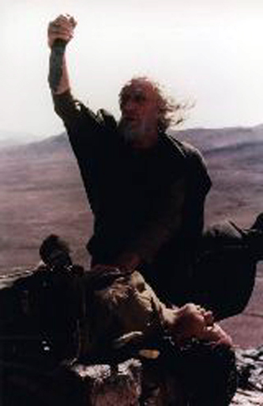
Yahweh Yireh
Thine only Son
Occurs 12x in OT (3x in Gen.22 – vv.2, 12, 16)
Only = Hb ‘yachiyd’ (3173); from root (‘yachad’ 3161) “to unite” (Psa.86:11); “join” (Isa.14:20)
Abraham to take part of himself and sacrifice it
Unity emphasized: vv.6, 8, 19 [together = ‘yachad’ (3162)]

Slide 14
Yahweh Yireh
Typical role (John 3:16)
Verse 6, the wood, “laid it upon Isaac, his son”
  Wood: Heb. ‘ets’, (6086) – a tree
  Gallows: Esther 5:14; (John 19:17)
Verse 8, Abraham’s response to Isaac: “My son, God will provide Himself a lamb for a burnt offering”.
  Revised Version: “God will see himself a lamb for a burnt offering, my son”.
  Note the prophetic use – Genesis 49:9; 2 Samuel 7:14 (Matthew 3:17 RV marg.)

Slide 15
Yahweh Yireh
Typical role (John 3:16)
Verse 8, Abraham’s response to Isaac: “My son, God will provide Himself a lamb for a burnt offering”.
Provide = ‘raah’, to see (as in Moriah or Yireh).
  ‘raah’ Four 4x in Genesis 22:4, 8, 13, 14
God to provide a lamb (v.8) –John 1:29
A Burnt offering (v.8) – Leviticus 5:8-10, normally a sin offering first, then a burnt offering
Note last occurrence of “only” in Zech.12:10
God was at the very centre of the entire experience.

Slide 16
Yahweh Yireh
Abraham’s Faith
“And Abraham rose early in the morning” (v.3):
No hesitation – characteristic of Abraham; eager to please his Heavenly Father
Typical of Yahweh
Psalm 121:3,4 – doesn’t sleep to fulfill His purpose.
“Laid the wood in order” (v.9)
Heb. ‘to set in rows’ – eager to be correct in his approach
Anticipated a resurrection
We will come again – verse 5
God will see Himself a lamb – verse 8

Slide 17
Yahweh Yireh
New Testament Commentary:
Hebrews 11:17 – “By faith Abraham…offered up Isaac”
  RV marg. “he hath offered”
  Verse 19 “Accounting that God..” Gk word ‘logizomai’ (3049) ‘to take an inventory, prepare a balance sheet.
James 2:21-23 – “…by works was faith made perfect”
  Genesis 15:6 was fulfilled
  Made “perfect” [Greek = ‘telioo’ (5048) – fully developed. Translated “finished” (John 5:6; 17:4)]. Note John 19:30
Romans 4:23 – “It was not written for his sake alone”
  Our commitment must reflect the faith of Abraham
  We must exhibit the same unity of mind with the Father.

Slide 18
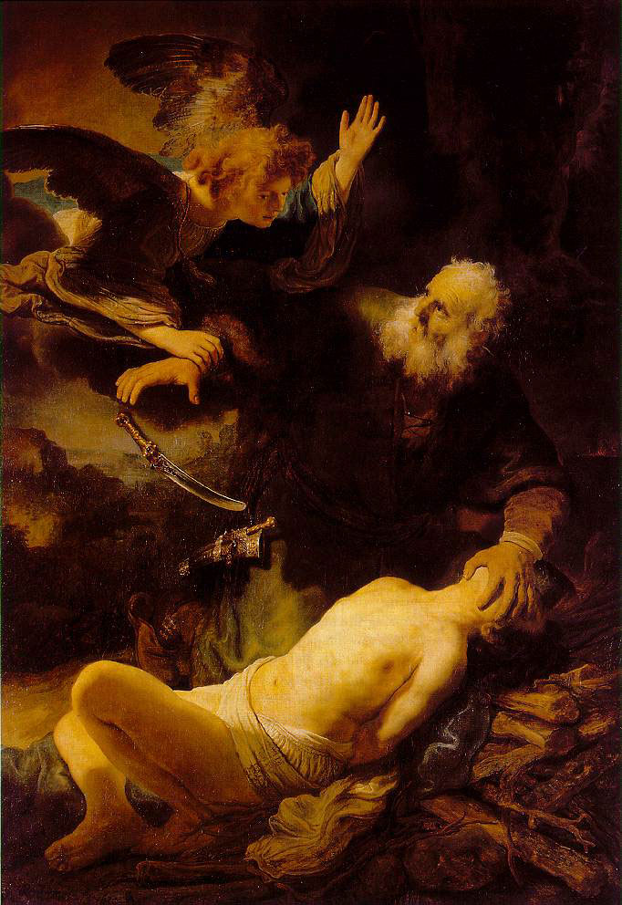
Yahweh Yireh
Divine intervention (Gen.22:10-12):
Jesus comment, John 8:56 – Abraham rejoiced to see my day”
  Gen.22:13: “Abraham…looked” (‘raah’)
Verse 12, “not withheld thy son” (also v.16)
  LXX “thou hast not spared thy beloved son”
An echo in Romans 8:32.
  God spared not His only son, but delivered him up “for us all” (Jew and Gentile).

Slide 19
Yahweh Yireh
The land of Moriah, the name of the place Yahweh Yireh
Heb. ‘raah⁷²⁰⁰ Yah’³⁰⁶⁸ or Yahweh ³⁰⁵⁰ Yireh ⁷²⁰⁰
Hebrew ‘raah’ (7200) – to see, provide
Where would these events be seen? Verse 2 – “one of the mountains”; verse 14 – “In the mount of Yahweh”
2 Chronicles 3:1 – Mount Moriah? (Solomon’s temple built)
  Psalm 132:13-14 – Zion, The place of God’s rest (see Psa.78:68)
  Genesis 14:16 – Melchizedek’s mountain; Exodus 15:13,17 – “the mountain of thy inheritance”; “The Place” (Deut.12:5,11,14)
Revelation 14:1 – “Behold the Lamb standing on mount Zion”
  With him 144,000, the redeemed (v.3) firstfruits unto God (v.4) [An echo of Genesis 22:17-18]

Slide 20
Yahweh Yireh
LESSONS LEARNED
“Where there is no vision, the people perish” (Proverbs 29:18)
We beheld his glory…full of grace and truth” (John 1:14)
“Behold what manner of love the Father hath bestowed upon us, that we should be called sons of God” (1 John 3:1)
“Let us run with patience the race that is set before us, looking unto Jesus the author and finisher of our faith” (Hebrews 12:1-2)

