Slide 1
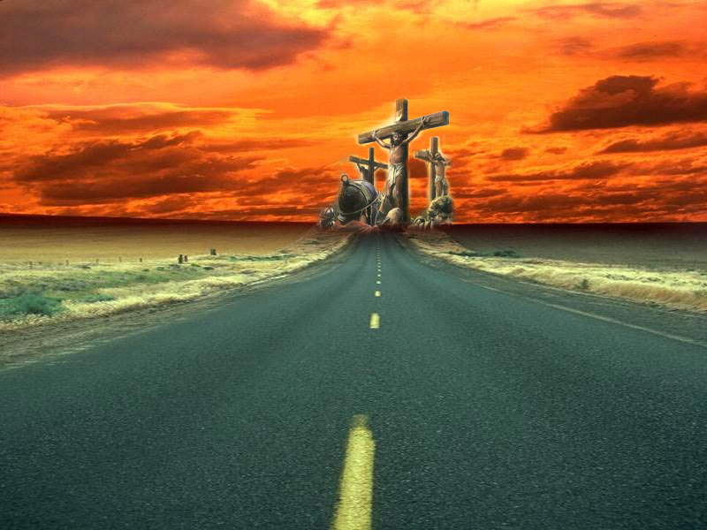
I have declared thy Name
Study No.2
Yahweh Tsidkenu
Okanagan, May 18, 2013

Slide 2
Jeremiah 23:5-6
Bible Echo: Melchizedek
Righteous – Heb. tsedeq
King – Heb. melech
Context – chapter 22
Addressed the king of Judah – “sitteth upon the throne of David” (vv.1-2).
Exhorted to “execute judgment and righteousness” (v.3).
The king had “forsaken the covenant of Yahweh their God” (v.9).
The king was guilty of building a “house in unrighteousness” (v.13).
Behold, the days come, saith the LORD, that I will raise unto David a righteous Branch, and a King shall reign and prosper, and shall execute judgment and justice in the earth. In his days Judah shall be saved, and Israel shall dwell safely: and this is his name whereby he shall be called, THE LORD OUR RIGHTEOUSNESS.

Slide 3
Jeremiah 23:5-6
Jeremiah 22 about three kings:
Shallum (Jehoahaz), verse 10-12
Jehoiakim verse 13-19 (v.18)
Coniah (Jehoiachin), verse 20-30 (v.24)
He did produce children (1Chron.3:17; Matt.1:12)
Jeremiah 22:30
Thus saith the LORD, Write ye this man childless, a man that shall not prosper in his days: for no man of his seed shall prosper, sitting upon the throne of David, and ruling any more in Judah.
Jeremiah 23:5
I will raise unto David a righteous Branch, and a King shall reign and prosper, and shall execute judgment and justice in the earth.

Slide 4
Jehoiachin
Son of Jehoiakim (Jer.22:24); 18 years old when he began to reign (2Kings 24:8)
Reigned for only 3 months and 20 days (2Chronicles 36:9)
He did evil in God’s sight, following the ways of his father (2Kings 24:9)
Influenced by his mother (v.8); her name: Nehushta = brass (2Kings 18:4 – brass serpent called Nahushtan). All about the flesh.
Surrendered to Nebuchadnezzar (2Kings 24:12) and imprisoned in Babylon (2Kings 24:15) for 37 years.

Slide 5
2 Kings 25:27-30
And it came to pass in the seven and thirtieth year of the captivity of Jehoiachin king of Judah, in the twelfth month, on the seven and twentieth day of the month, that Evilmerodach king of Babylon in the year that he began to reign did lift up the head of Jehoiachin king of Judah out of prison; And he spake kindly to him, and set his throne above the throne of the kings that were with him in Babylon; And changed his prison garments: and he did eat bread continually before him all the days of his life. And his allowance was a continual allowance given him of the king, a daily rate for every day, all the days of his life.
Repeated Jeremiah 52:31-34
Importance of record
Released him from Prison (2Kings 25:27)
Exalted his throne above other Gentile kings (2Kings 25:28)
Changed his clothes and ate at the king’s table (v.29)
And he died (Jeremiah 52:34)
None of this changed the decree of Yahweh in Jeremiah 22:30.

Slide 6
2 Chronicles 36:22-23
Now in the first year of Cyrus king of Persia, that the word of the LORD spoken by the mouth of Jeremiah might be accomplished, the LORD stirred up the spirit of Cyrus king of Persia, that he made a proclamation throughout all his kingdom, and put it also in writing, saying, Thus saith Cyrus king of Persia, All the kingdoms of the earth hath the LORD God of heaven given me; and he hath charged me to build him an house in Jerusalem, which is in Judah. Who is there among you of all his people? The LORD his God be with him, and let him go up.
Repeated Ezra 1:1-4
CYRUS:
The righteous man from the east (Isa.41:2)
God’s shepherd (Isa.44:28)
Charged to build God’s house (2Chron.36:23)
Committed work to Zerubbabel (Ezra 1:8 – Sheshbazzar, Persian name)
Zerubabel
Zerubabal = shoot (seed) out of Babylon
To build God’s house (Zech.4:9-10)
God’s servant (Haggai 2:23) and signet (cp. Jer.22:24).

Slide 7
Zedekiah
Nebuchadnezzar replaced Jehoiachin with Mattaniah (gift of Yahweh) – 2Kings 24:17.
Nebuchadnezzar changed his name to Zedekiah – “righteousness of Yahweh”.
Zedekiah did not live up to his name – Ezekiel 21:25 “profane wicked prince”; he refused to humble himself before God (2 Chron.36:12).
The work of Righteousness was not to be achieved by the flesh.
IT IS GOD’S WORK – Jeremiah 23:5 – this one was going to “PROSPER”.

Slide 8
Yahweh Tsidkenu
Jesus issued a warning to his disciples – Don’t be like the Pharisees, Matthew 5:20. Concerned with their “own righteousness (Rom.10:3); they “justified themselves before men” (Luke 16:15).
None righteous: Romans 3:10; Isaiah 64:6. God intends to create a new order in which RIGHTEOUSNESS resides – 2 Peter 3:13 .
  Speaking of Israel; righteousness is of Yahweh – Isaiah 54:13-14, 17.
  Privilege extends to all people; righteousness originates from Yahweh – Isaiah 45:22, 24
Righteousness is imputed – Genesis 15:6 (Rom.4:22; Gal.3:6)

Slide 9
What is Righteousness?
Righteous(ness): Heb ‘tsadaq’ (6663) A primitive root; to be (causatively make) right (in a moral or forensic [legal] sense). Also translated ‘Justify’.
Strong’s: “Doing or Being what is Just”.
Vine: (Gk. ‘dikaiosune’) “The character of being right or just”
Originally spelt “Rightwiseness”
Because Yahweh is God, He sets a high standard: Psa.145:17; Psa.119:137; Deut.32:4
God loves righteousness & hates iniquity: Psa.45:7; Psa.11:4-7

Slide 10
Isaiah 32
The work of Righteousness
Performed by an appointed king – verse 1
Introduction of a time of blessing – verses 2-8
Prior to these blessings
A time of desolation and trouble – verses 9-14
The outpouring of God’s spirit – verse 17
The work of righteousness = Peace – verses 17-20
Purpose for exercising Righteousness,
not simply to destroy sin,
But to reconcile the sinner.

Slide 11
The Failure of Judah’s kings
Jeremiah 22:3: The “king” failed to “execute judgment and righteousness”.
How were these terms to be interpreted?
  Delivering those who are oppressed.
  Caring for those who are destitute.
This is what God expected of His people – Jer.7:5-7; Zech.7:9-10.
This is God’s standard of right – Deut.10:17-19.

Slide 12
Psalms 103:6-8
⁽⁶⁾ The LORD executeth righteousness and judgment for all that are oppressed. ⁽⁷⁾ He made known his ways unto Moses, his acts unto the children of Israel. ⁽⁸⁾ The LORD is merciful and gracious, slow to anger, and plenteous in mercy.
God’s Righteousness is exercised towards the oppressed
Reference to God’s WAYS and ACTS
Reflects upon God’s Name – Exodus 34:6-7
God revealed the full expression of His character – His righteousness

Slide 13
The Branch
BRANCH – tsemach (H6780): From H6779 (tsamach); a sprout, literally or figuratively: - branch, bud, that which (where) grew (upon), spring (-ing).
Isaiah 42:9 – The passing away of the “former things”. Reference to Old Covenant created at Sinai
Isaiah 43:18,19 – “the former things” (echo of v.21 in 1 Peter 2:9). See also Isaiah 44:3,4.
Other references link the branching with righteousness – Isa.45:8; 58:8; 61:11.

Slide 14
Isaiah 45:22-25
Yahweh addresses “all ye ends of the earth”
“look unto me” (v.22)
“Unto me every knee shall bow” – A clear reference to Jesus Christ – Phil.2:9-11.
The prophet: “word gone from my mouth in righteousness” – (echo of John 1:14).
God’s work accomplished by one who says “In Yahweh have I righteousness” (v.24)
Look unto me, and be ye saved, all the ends of the earth: for I am God, and there is none else. I have sworn by myself, the word is gone out of my mouth in righteousness, and shall not return, That unto me every knee shall bow, every tongue shall swear. Surely, shall one say, in the LORD have I righteousness and strength: even to him shall men come; and all that are incensed against him shall be ashamed. In the LORD shall all the seed of Israel be justified, and shall glory.

Slide 15
The work of Righteousness
Isaiah 11:1-5
Jesus describes as Son of God and Son of man – verses 1-2
This produces righteous judgment towards the oppressed – verse 4-5
Isaiah 61:1-3
Bind up the broken hearted
Proclaim liberty to the captives, those bound
Oil poured on those that mourn
The result? “called trees of righteousness”

Slide 16
Isaiah 53
He was oppressed and afflicted (v.7)
He was taken from prison (v.8)
Who shall declare his generation (v.8)
He was cut off from the living (v.8)
He shall see his seed (v.10)
God’s pleasure shall prosper in his hand (v.10)
By His knowledge shall my righteous servant justify many (v.11).
How did the Lord Jesus obtain this knowledge?

Slide 17
By sharing Adam’s nature Jesus became knowledgeable of the experiences of his fellow man
“He was in all points tempted like as we are” (Heb.4:15)
“he himself also is compassed with infirmity” (Heb.5:2)
he suffered “being tempted” (Heb.2:18)
he “suffered in the flesh” (1 Peter 4:1)
2 Corinthians 5:21
“He hath made him to be sin for us, who knew no sin; that he might be made the righteousness of God for us”
He was made like unto his brethren (Hebrews 2:17)
Yahweh has laid upon him the iniquity of us all (Isaiah 53:6)
2 Corinthians 5:21 | 1 Peter 2:24
For he hath made him to be sin for us, who knew no sin | Who his own self bare our sins in his own body on the tree
that we might be made the righteousness of God in him | that we, being dead to sins, should live unto righteousness: by whose stripes ye were healed

Slide 18
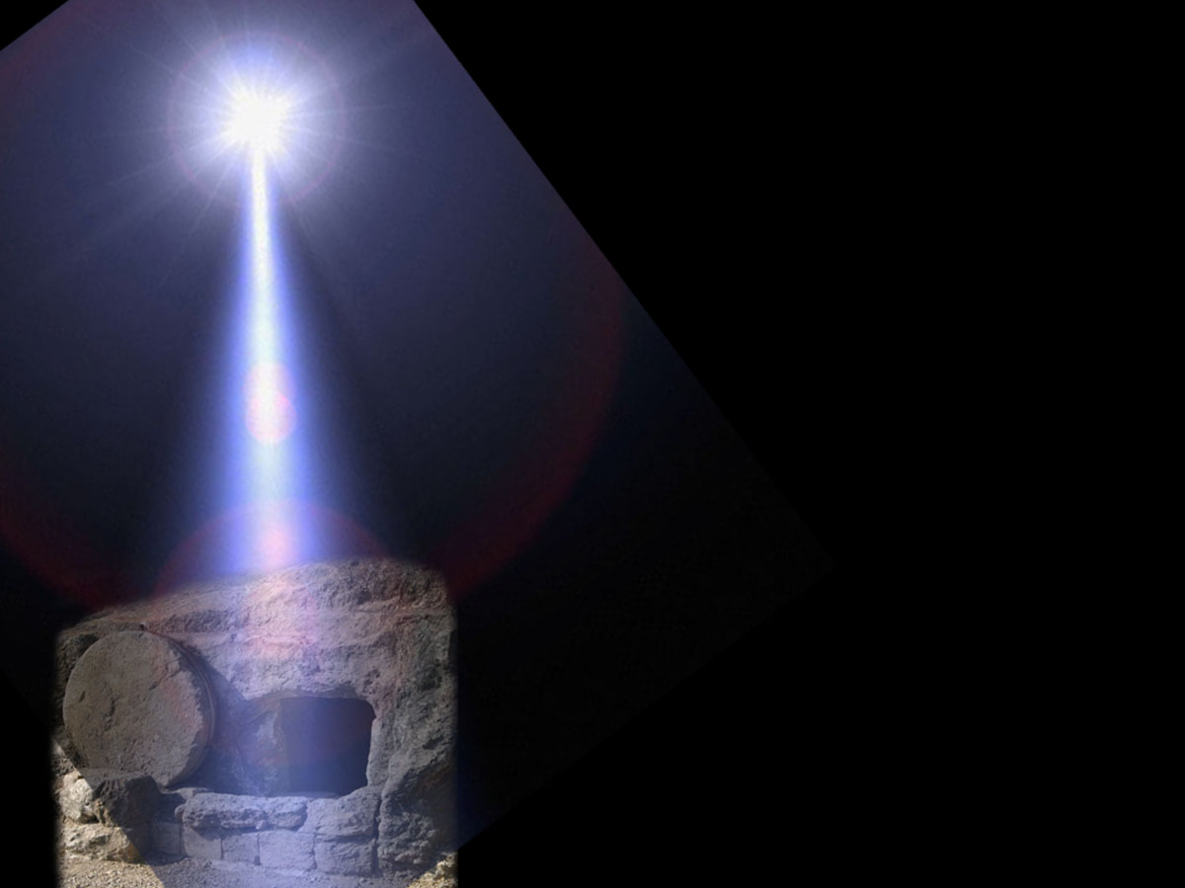
Psalm 85
“…Thou hast forgiven the iniquity of thy people, thou hast covered all their sin…”
“Mercy and truth are met together; righteousness and peace have kissed each other. Truth shall spring (tsamach) out of the earth; and righteousness shall look down from heaven”
RIGHTEOUSNESS
TRUTH

