Slide 1
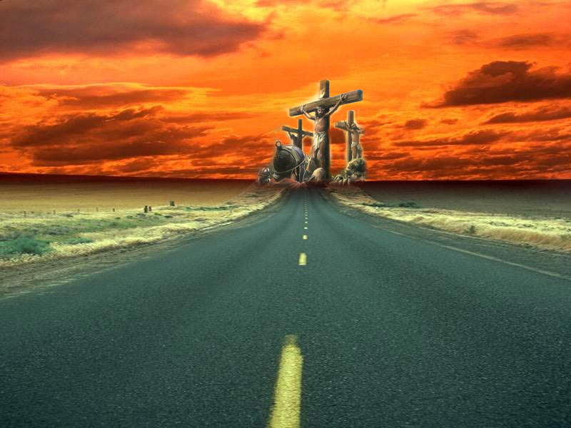
I have declared thy Name
Study No. 3
Yahweh Nissi
Okanagan, May 18, 2013
Notes:
Our title – Yahweh Nissi is found in Exodus 17:15
It is the name given to an altar built by Moses
This in itself suggests that the subject in some way is connected with sacrifice.
NEXT SLIDE

Slide 2
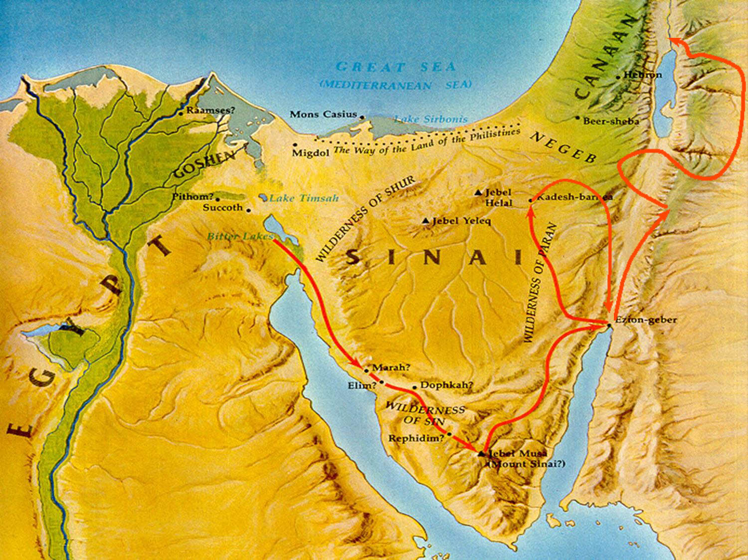
The Journey’s of Israel…
Israel’s journey took40 years
They stopped at 42 stations (Numbers 33)
Israel tempted God ten times (Numbers 14:22) [between Egypt and Kadesh]
Exodus 16:1-2 – they murmured after only one month (15 day, 2 month)
Chapter 16 lesson of the bread of life
Chapter 17 lesson of the water of life
Examples for US – 1Cor.10:2-6

Slide 3
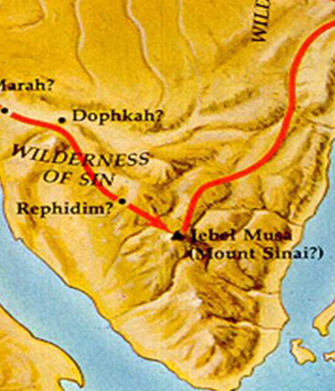
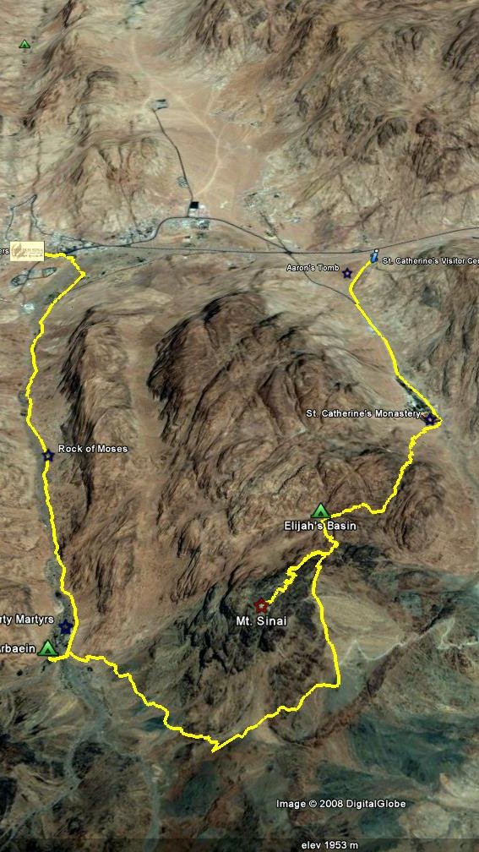
They came to Rephidim…
Elim?
Mount Horeb
Horeb
6 miles
approx
Notes:
Israel left Elim and travelled south-east; stopping at (Numbers 33:10-14):
Wilderness of Sin; Dophkah; Alush; Rephidim
Again encounter no water – 3 million people plus livestock and no water.
Exodus 17:1-5
Moses travel 6 miles (HPM notes) to Horeb – ENTER
Horeb and Sinai at opposite ends of Sinai range (see slide)
Verse 6: Moses stands on rock and strikes it – water gushes out (Psa.105:41; 78:16) like a river.

Slide 4
Rephidim…
Consider God’s warning – Exodus 17:7
Commentary: (1Cor.10:9) Hebrews 3:7-8, 15-19, quoting from Psalm 95:8, “if ye will hear his voice”
  Provocation = Meribah: Exodus 17:7; (Numbers 20: 13, 24)
  Temptation = Massah: Exodus 17:7; Deut.33:8
“Rephidim” – means “rest” or “resting places”
God’s purpose was to bring Israel into a rest – Deut.25:19
We are labouring to enter that rest – Heb.4:11
Notes:
Consider God’s warning – Exodus 17:7
Commentary: Hebrews 3:7-8, 15-19, quoting from Psalm 95:8, “if ye will hear his voice”
Provocation = Meribah: Exodus 17:7; Numbers 20: 13, 24
Temptation = Massah: Exodus 17:7; Deut.33:8
Hebrews 3:11 – “They shall not enter into my rest”
ENTER
“Rephidim” – means “rest” or “resting places” – Deut.25:19!!!
We are labouring to enter that rest – Heb.4:11.
God about to educate them
NEXT SLIDE

Slide 5
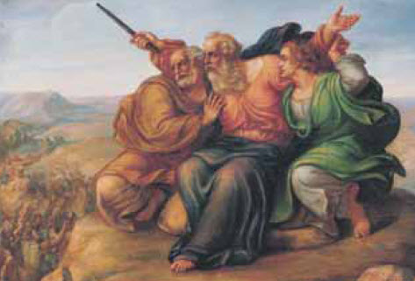
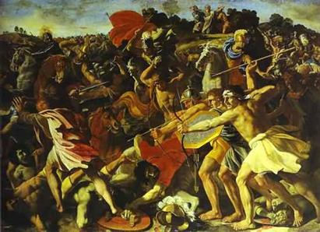
Then came Amalek…
Moses on mountain, Joshua in valley
Moses holds hands aloft but tires, Aaron and Hur support him with a stone.
God’s decree upon Amalek
  Put out remembrance of Amalek forever – v.14
  Builds an altar and names it “Yahweh Nissi” – v.15
Provides reason – “Because Yahweh hath sworn that Yahweh will have war with Amalek from generation to generation”, v.16
A PROPHECY
Moses = “to draw out”; Aaron = “Enlightened, illumined” (Yg); Hur = “free” (Yg), “white linen” (Stg)
“A people drawn out of bondage and enlightened, with the result that they are free or made righteous”
By what means? Joshua = “Yahweh Saves”
How? accomplished by lifting up an ensign.
Notes:
Exodus 17:8 Picture the circumstances
Moses on the mountain and Joshua in the valley
Moses’ hands held high by Aaron and Hur
A Prophecy in names:
ENTER
First meaning of names: Moses = “to draw out”; Aaron = “Enlightened, illumined” (Yg); Hur = “free” (Yg), “white linen” (Stg) – A prophecy of Israel’s circumstances, “a people drawn out of bondage and enlightened with the result that they are free or made righteous” By what means? Joshua = “Yahweh Saves” – accomplished by lifting up an ensign.
ENTER
God’s decree upon Amalek
Put out remembrance of Amalek forever – v.14
Builds an altar and names it “Yahweh Nissi” – v.15
Provides reason – “Because Yahweh hath sworn that Yahweh will have war with Amalek from generation to generation”, v.16
NEXT SLIDE

Slide 6
A challenge to authority…
Amalek = “Warlike” (Young’s or “dwellers in the valley”) – a characteristic inherited from his grandfather Esau [Gen.36:12].
Amalek represents flesh in organized rebellion against God
  Amalek FIRST (Heb. Reshith [rosh] = head) nation to oppose Israel – Num. 24:20. Divine Decree – PERISH FOREVER [cp.Exod.17:14].
  Smote weak and feeble from behind (Deut. 25:18).
  Had no fear for Yahweh (Deut. 25:18). Divine decree – BLOT OUT REMEMBRANCE. Note v.19 “thou shalt not forget”.
  Reason for judgment (Exodus 17:16). Literal Heb. R.V. margin. “A hand is lifted up upon the throne of Yah”
  Sin is depicted as a ruler or a king: Romans 6:12; John 12:31; Ephesians 2:2
The language of Romans
“We are all under sin” 3:9
“sin hath reigned” 5:21
“should not serve sin” 6:6
“I am sold under sin” 7:14
“sin that dwelleth in me” 7:20
Notes:
Amalek = “Warlike” (Youngs or “dwellers in the valley”). Warlike supports Amalek’s hostile nature – a characteristic inherited from his grandfather Esau [Gen.36:12].
Amalek represents flesh in organized rebellion against God.
War with Amalek:
(i) Amalek FIRST (Heb. Reshith [rosh] = head) nation to oppose Israel – Numb. 24:20. Divine Decree – PERISH FOREVER [cp.Exod.17:14].
(ii) Smote weak and feeble from behind (Deut. 25:18).
(iii) Had no fear for Yahweh (Deut. 25:18). Divine decree – BLOT OUT REMEMBRANCE. Note v.19 “thou shalt not forget”.
(iv) Reason for judgment (Exodus 17:16). Literal Heb. R.V. margin. “A hand is lifted up upon the throne of Yah”. Which both the AV and RV margin recognize as the Hand of Amalek. [supported by Roth; Ygs Lit; Strongs; Speakers]
ENTER
The box illustrates the dominion that sin has over people.

Slide 7
Yahweh Nissi
Nissi [#5251 ‘nec’] signifies “a banner”, or “an ensign” – a “standard bearer” (Isa.10:18); “sign” (Num.26:10) – something which draws attention. The idea of providing direction – “sail” (Isa.33:23; Ezek.27:7)
Ensign – Isa.11:10, 12 – a banner for rallying Jew and Gentile. The “branch” of David (v.1)
Jesus will be the Ensign, drawing attention to all nations – Genesis 49:10; John 12:32
Notes:
The word ”nissi” [#5251 ‘nec’] signifies “a banner”, or “an ensign” – having reference to a “standard bearer” – note Isa.10:18.
Translated “sign” [Num.26:10] referring to Korah, Dathan and Abiram – they were a “sign” – something which draws attention.
It also carries the idea of “providing direction” – transl. “sail” [Isa.33:23; Ezek.27:7].
More significant – translated “Ensign” – Isa.11:1, has ref. to Jesus Christ – the “branch” of David – in particularly His ruler-ship in the kingdom age [v.4].
Yet note verse 10, this root or branch to be “an ensign” – a banner for rallying Jew and Gentile [verse 12].
Jesus will be the Ensign, drawing attention to all nations.

Slide 8
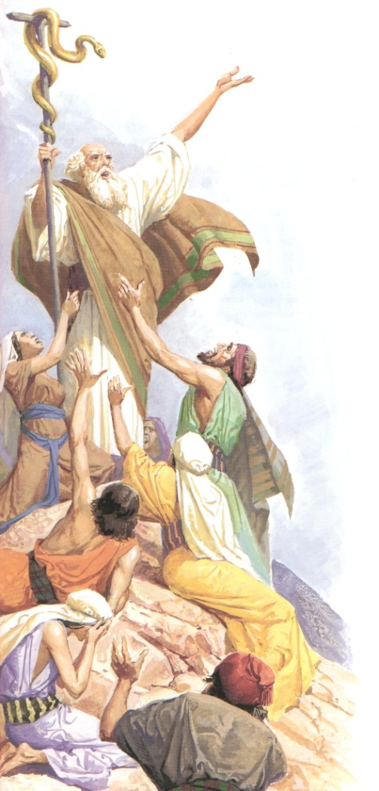
Numbers 21:1–9: An Illustration
The whole nation bit by fiery serpents, v.6
The law could only forgive (Lev.4:13-20); it couldn’t save.
Required to reproduce a fiery serpent of brass, v.8-9
Had to elevate it on a pole, v.8
Those that looked upon the serpent were saved, v.9
Notes:
Review the situation in Numbers 21
NEXT SLIDE

Slide 9
Numbers 21:1–9: An Illustration
Why not impale a real serpent?
  Would not truly represent Christ
What was significant about a brass fiery serpent?
  It was venom less; Jesus did not commit any sin
Why the choice of brass?
  It suitably represented the flesh (Isa.48:4; Jer.6:28; Ezek.22:18)
Why raise it on a pole? v.8
  Because it represented Jesus, John 3:13
What was required of the people?
  It required faith, vv.7, 9
Pole: Hebrew ‘nec’ (v.8); Jesus was “lifted up” – John 8:28; 12:32
Notes:
What can we make of the details in this event?
READ SLIDE
NEXT SLIDE

Slide 10
Romans 8:3: An Illustration
Jesus Christ
For what the law could not do, in that it was weak through the flesh
God sending his own Son in the likeness of sinful flesh,
and for sin, condemned sin in the flesh
The Law
The law was impotent to save, it could only forgive
God introduced an element outside of the law
Sin was elevated for all to see
Jesus Christ was publicly portrayed as crucified (Gal.3:1 ESV)
Notes:
Romans 8:3 parallels the circumstances of Israel in Numbers 21
NEXT SLIDE

Slide 11
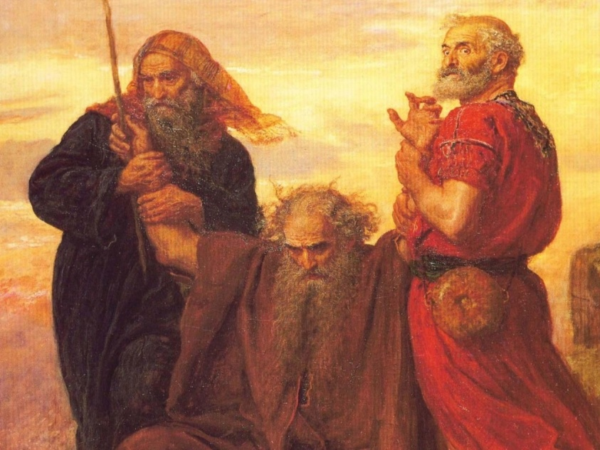
The message of Psalm 60…
Israel cast off in God’s displeasure – verse 1-3
A banner is raised for those that fear God – verse 4-5
God’s enemies to be eventually overthrown – verse 6-8
Who will achieve this victory? God. – verse 9-12
The banner is raised as a rallying point (v.4)
It is displayed because of truth (v.4)
It ensures the deliverance of “the beloved” (v.5)
This is God’s work (v.10)
Notes:
“Give us help from trouble for vain is the help of man. Through God we shall do valiantly: for he it is that shall tread down our enemies.”
Psalm 60:11,12
All this is possible because of verse 4 – “Thou hast given a banner to them that fear thee, that it may be displayed because of the truth”

Slide 12
The battle with Amalek…
  God’s directive to Saul (1Samuel 15:3)
    Saul disobeyed (vv.8-9)
    By rejecting God’s word he challenged God’s authority (v.23)
    Was rejected as God’s king (v.23)
  The challenge renewed (Esther 3:1-2)
    Haman was a descendent of Agag
    Mordecai was a descendent of Saul
    Sin in political manifestation destroyed (Esther 7:10)
  The final challenge (Ezekiel 36 – Gog)
    Israel’s king “shall be higher than Agag” (Numbers 24:7)
YAHWEH NISSI
The Ensign on the mountains
Isaiah 11:10 – “His rest shall be glorious”
  Isaiah18:3 – the restoration of Israel (cp. 49:22)
  Isaiah 62:10 – The ensign and the work of salvation
Notes:
The battle with Amalek
God’s war with Amalek began at the Exodus and will be completed at Christ’s return
Israel’s first king failed to accomplish God’s will
The Challenge was renewed with Mordecai (Saul’s descendent)
The final battle will be with Gog (Agag)
At this point God will once again lift up His ensign on the mountains of Israel as a rallying point for the dispersed of Israel.
READ SLIDE

Slide 13
Lessons learned…
All become restless and weary “in the way”, like Israel (Ex.17:7)
At our weakest moment, when we are resting from our journey, Amalek challenges the sovereignty of God in our lives.
All want to be Moses, on the hill top witnessing for the Truth, but the burden of sin is heavy and we crumbled.
We need the supportive hands of brethren and sisters (Heb. 12:12)
Also need to recognize we are built upon a sure foundation (1Pet.2:4,5)
Most of all never loose sight of the Ensign of God (Heb.12:1-3)
Notes:
Summary:
All become restless and weary “in the way”, like Israel [Ex.17:7]
At our weakest moment, when we are resting from our journey, Amalek challenges the sovereignty of God in our lives.
All want to be Moses, on the hill top witnessing for the Truth, but the burden of sin is heavy and we crumbled.
We need the supportive hands of brethren and sisters [Heb. 12:12]
Also need to recognize we are built upon a sure foundation [1Pet.2:4,5].
Most of all never loose sight of the Ensign of God [Heb.12:1-3]

