Slide 1
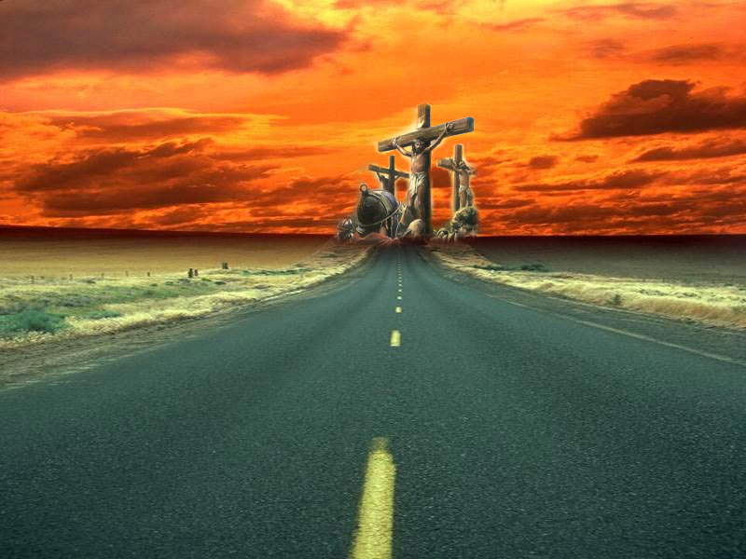
I have declared thy Name
Study No. 4
Yahweh Mekaddishkem
Okanagan, May 18, 2013

Slide 2
Sanctify
Old Testament | New Testament
Qadash (6942 - root) verb: 174 times, primarily “sanctify, sanctified | Hagios (40 - root) adj: 231 times, primarily “holy” (168), “saints” (60)
Qadosh (6918) from #6942, adj: 117 times, primarily “holy” | Hagiazo (37) from #40, verb: 29 times, primarily “sanctified”
Qodesh (6944) from #6942, noun masc: 458 times, primarily “holy”, “sanctuary” | Hagiasmos (38) from #37, noun masc: 10 times, “holiness” & “sanctification”
 | Hagion (39) from #40, “sanctuary” & “holiest”
 | Hagiates (41) from #40, noun femine: occurs once “holiness”

Slide 3
Holiness
Holiness: Its importance
Our approach –Leviticus 10:3
The standard – Leviticus 11:45
Holiness to cover all aspects of life
1Peter 1:14-15
Holiness: Its Need
Numbers 5:1-4
A leper – one whose flesh is unclean
Issue of blood – one whose nature is defiled at the source
Contact with death – Contamination by death

Slide 4
Be Ye Holy…
The Lord Jesus Christ
Sanctified by the Father – John 10:36
  By birth – Luke 1:35 (RV)
Sanctified himself – John 17:19
  By sacrifice – Heb.9:13,14; 13:12
The Believer
Sanctification is God’s will – 1 Thess.4:3; Eph.1:4
Prerequisites for seeing God – Heb.12:14
Achieved through Christ Jesus – Heb.10:10
HOLINESS DOES NOT END IN BAPTISM, BUT BEGINS IN NEWNESS OF LIFE

Slide 5
For this is the will of God, even your sanctification, that ye should abstain from fornication: (1 Thessalonians 4:3)
SANCTIFICATION
Qadash (6942 - root), קדשׁ verb
Qadosh (6918), קדושׁ, from #6942, adjective
Qodesh (6944), קדשׁ, from #6942, noun masculine
Set apart for God
HARLOT
Q^{e}dêshâh (6948), קדשׁה, noun fem. from #6945 (whore – Deut.23:17)
Qâdêsh (6945), קדשׁ, from #6942 (sodomite – Deut.23:17)
Set apart for immoral purposes

Slide 6
Yahweh Mekaddishkem
I Yahweh which sanctify you
Occurs 9 times in OT
Exod.31:13
Lev.20:8
Lev. 21:8,15,23
Lev.22:9,16,32
Ezek.20:12.
יהוה מקדשׁם

Slide 7
Yahweh Mekaddishkem
HOLINESS OF THE PRIESTHOOD – Leviticus 21
Lev.21:8, Affected service of priest (vv.1-8)
Lev.21:15, Affected service of High Priest (vv.9-15)
Lev.21:23, by physical conditions (vv.16-24)
HOLINESS OF THE SANCTUARY – Leviticus 22:1-16
Lev.22:9, Affected by defilement (vv.1-8).
Lev.22:16, Affected the eating of holy things (vv.10-16)
HOLINESS OF THE OFFERINGS – Leviticus 22:17-33
Lev.22:32, Affected what was offered (vv.17-33)

Slide 8
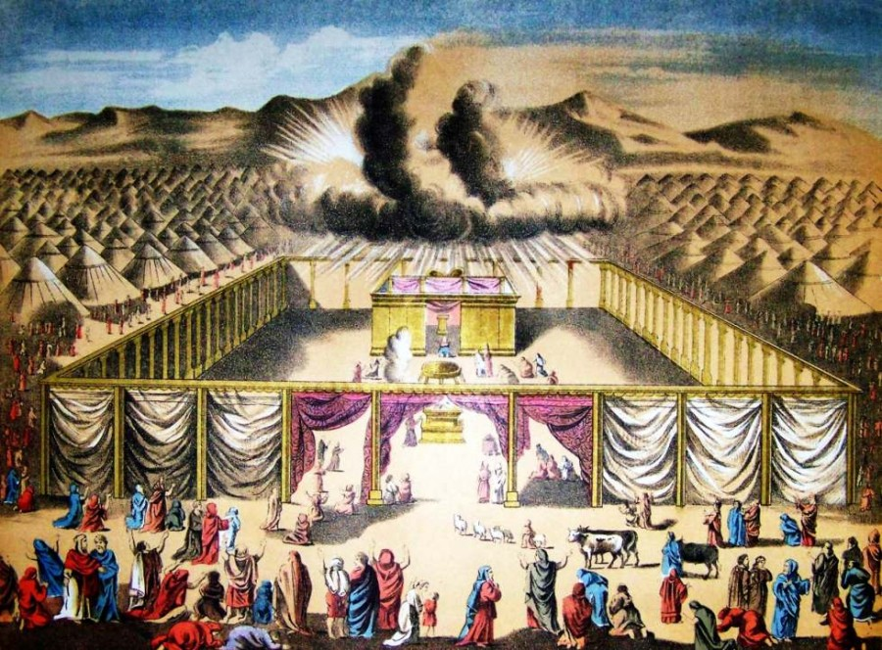
Exodus 31:13
“Be ye Holy, for I am Holy”
THE CONTEXT
Building the Tabernacle – vv.1-11
  The Tabernacle provided the environment for developing holiness.
HOLINESS IN THE CAMP God – Deut.23:14; Lev.10:3,10 Israel – Exod.19:6 Tabernacle – Exod.40:9-11 | High Priest – Exod.28:36 Nation – Lev.11:44-47 (19:2; 20:26)

Slide 9
Exodus 31:13
“Be ye Holy, for I am Holy”
THE CONTEXT
The law of the Sabbath – vv.12-18
“Speak thou also unto the children of Israel, saying, Verily my sabbaths ye shall keep: for it is a sign between me and you throughout your generations; that ye may know that I am the LORD that doth sanctify you”
The Sabbath established the means of obtaining holiness

Slide 10
The Law of the Sabbath Exod. 20:8-11; Exod. 31:17
God’s Sabbath provided a reminder of creation (Gen.2:1-3)
God's Sabbath was His rest (Psa. 95:11).
God invited man to enter into that rest (Deut 12:9) - the kingdom (lsa.11:10).
Man sought the easy route. He attempted to circumvent his responsibility (Gen. 3:6), was condemned to a life of labour and toil (Gen. 3:19).
The Sabbath law provided opportunity to reflect upon the purpose of man’s labour.
Weekly man could contemplate God's work.
Reminded that his toil wasn't permanent God's rest still available.

Slide 11
Leviticus 20:7-8
THE CONTEXT
Offering children to Molech, verses 1-5
The effect of such action? Verse 3
  “defiled God’s sanctuary”
  “profaned His Name”
Turning to familiar spirits and wizards, verse 6
What is the significance?

Slide 12
Leviticus 20:7-8
Children to Molech
All souls belong to God: Ezek.18:4; Num.3:13; 8:17; Isa.54:5
God’s purpose accomplished in the child bearing: 1Tim.2:15; producing a redeemer, Genesis 3:15
Purpose of marriage, to produce “a godly seed” (Mal.2:15).
Children are the product of a union – they are “the holy seed” (Ezra 9:2). Israel, God’s firstborn, was that holy seed (Exod.19:6).

Slide 13
Leviticus 20:7-8
Wizards and Divination
Molech and divination linked, Deut.18:9-12
Both impacted on the family values, both sacrificed the child’s welfare
They had a defiling affect (Lev.19:31)
Guilty of listening to sources other than God.
The garden of Eden all over (Gen.3:6)
There can be only one source – God’s word (Isa.8:19-20; 1Pet.2:2; John 17:17; Eph.5:26)

Slide 14
Jesus Christ
Holiness in the Tabernacle: John 14:2; Heb.8:1-3; Eph.2:20-22;
Faithfulness to the Sabbath: Heb.4:10; John 4:34; 9:4; 14:10
Concern for the children of Yahweh: Heb.2:13 (10); John 17:2,6,9,19; Isaiah 53:10-11
Listening to other sources: Deut.18:17-18 (10); John 7:17; 8:26; 12:49

Slide 15
Powerful Lessons
We are God’s children – called to holiness and living sacrifices: 1Peter 1:13-17; Romans 12:1
We are God’s Temple – we belong to God: 1Corinthians 6:19
We have our own Sabbath rest to strive after: Hebrews 4:11
God’s word is the sanctifying process today: John 17:17; Eph.5:26

Slide 16
Haggai 2:10-14
Holiness
If one bear holy flesh in the skirt of his garment, and with his skirt do touch bread, or pottage, or wine, or oil, or any meat, shall it be holy?
And the priests answered and said, No
Leviticus 6:24-30
Defilement
If one that is unclean by a dead body touch any of these, shall it be unclean?
And the priests answered and said, It shall be unclean
Numbers 19:11,22

Slide 17
Holiness
Constituted “holy” through contact with our sacrifice – Jesus Christ – Col.1:22; Heb.3:1.
Become part of an “holy nation” – 1Peter 2:9.
The danger of becoming unholy – Jer.11:15; Jude 8,
Defilement
God’s temple consists of many materials – 1Cor.3:9-16
Care to be taken not to defile – vv.16-17; ch.5:6-7
Can be easily deceived – verse 18
Necessary to purge the problem – 2Tim.2:20-21
“…even so now yield your members servants to righteousness unto holiness” (Romans 6:19)

