Slide 1
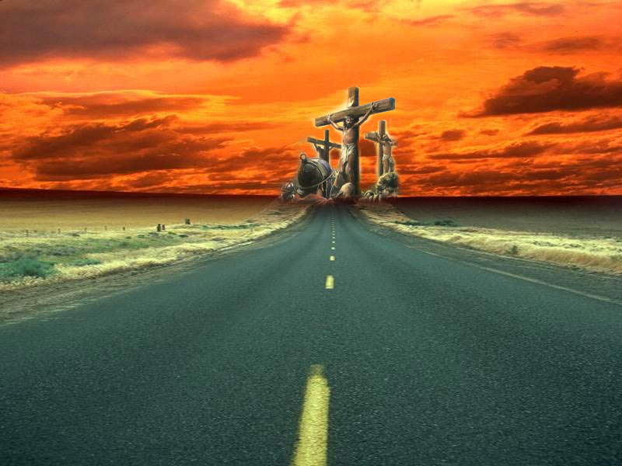
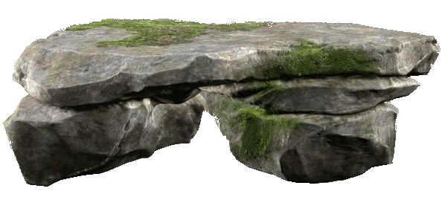
I have declared thy Name
Study No. 5
Yahweh Shalom
Okanagan, May 18, 2013

Slide 2
The work of Peace
All of Paul’s epistles begin with a reference to peace (except Hebrews) Rom.1:7; 1Cor.1:3; 2Cor.1:2; Gal.1:3; Eph.1:2; Phil.1:2; Col.1:2; 1Thess.1:1; 2Thess.1:2; 1Tim.1:2; 2Tim.1:2; Titus 1:4; Philem.1:3.
Yahweh is described as a “God of Peace”: Rom.15:33; 16:20; Phil.4:9; 1Thess.5:23; 2Thess.3:16 (Lord); Heb.13:20; (2Cor.13:11) – i.e. God works to achieve peace.
Possible to claim Peace, yet it is absent: Jer.6:14; 8:11; Ezek.13:10. Only achieved by spiritual mindedness, Rom.8:6.

Slide 3
The work of Peace
“seek peace”: 1Pet.3:11; Psa.34:14
“live in peace”: 2Cor.3:11
“Have peace with one another”: Mark 9:50; 1Thess.5:13
“Follow peace with all men”: Heb.13:14; 2Tim.2:22
“let the peace of God rule in your hearts”: Col.3:15
Isaiah 32:17: Peace follows Righteousness, one is the consequence of the other.
James 3:18: ESV – “A harvest of righteousness is sown in peace of them that make peace”
In order to reap righteousness peace must be at the heart of its pursuit

Slide 4
PEACE
Hebrew = shalom (H7965) Peace, complete, restore – especially in covenant relationship
Greek = eirēnē (G1515) Peace, set at one again, harmony, exemption from rage.
Peace
No longer estranged
full restoration.

Slide 5
Yahweh Shalom
Judges 6:24 – God’s promise of WHAT He intends to achieve – “He who shall be Peace”.
Isaiah 9:6 – God informs us WHO will achieve this – “A child is born...the Prince of Peace”
Isaiah 53:5 – God reveals HOW He will achieve peace – “the chastisement of our peace was upon him”.

Slide 6
The Book of Judges
Book of Judges – one of Israel’s darkest periods in OT history
There is a recurring cycle of SIN, SUFFERING, SUPPLICATION, SALVATION – a cycle occurring six times – the number of flesh.
Judges 6:1 – “children of Israel did evil in the sight of Yahweh”
A period when “everyman did that which was right in his own eyes” (Judges 17:6)
A few faithful individuals, loyal to Yahweh: Othniel; Ehud; Deborah/Barak; Gideon; Jephthah; Samson.

Slide 7
Judges 6
Verse 11: Gideon – “the hewer down”
Verse 12 – “thou mighty man of valour”.
Hebrew “Gibbor” (1368) – powerful, “by implication “warrior, translated “champion” (1Sam.17:51).
Reference to near kinsman, Ruth 2:1: Boaz, a mighty man.
Reference to Jesus, Isaiah 9:7 – The might God (El Gibbor).

Slide 8
Yahweh Shalom
God’s purpose of securing PEACE to be achieved in two stages
FIRST, through the individual who will achieve the victory
  Gideon is a representative man – “Judgment must begin at the house of God” (1Peter4:17)
SECOND, the final victory over the enemy of God – the Midianites

Slide 9
An echo of God’s deliverance from Egypt
Event | Moses | Gideon
Sent to Israel | Exod.3:10 | Judg.6:14
Questions his ability | Exod.3:11 | Judg.6:15
I will be (ehyeh) | Exod.3:12 | Judg.6:16
Receives three signs | Exod.3:1-9 | Judg.6:17,37-39

Slide 10
The Face of God
God hides His face from those who forsake him
  Duet.31:17-18; Gen.3:14; Job 13:24; Psa.30:7; Isa.54:8; 64:7
God’s face open to those who cry to Him
  Psa.22:23-24; 102:2; 143:7; Jer.16:17
“They cried unto the LORD” – Judges 6:6
Gideon’s work is typical

Slide 11
Judges 6
The people sat in darkness (Matt.4:14-16)
God sent John, a forerunner, to prepare the way (Matt.3:1-3)
God visited His people and sent a deliverer (Luke 1:68-74)
Jesus’ sacrifice confirmed God’s covenant (Heb.13:20)
Called to walk in newness of life (Rom.6:4)
Israel forsake God, v.1
Israel become captive to sin, vv.2-6
A forerunner goes to Israel, vv.8-10
A deliver is “sent”, vv.11-17
God’s covenant confirmed by sacrifice, vv.19-27
Judgment begins with the Household, vv.28-32

Slide 12
The Face of God
God hides His face from those who forsake him
  Duet.31:17-18; Gen.3:14; Job 13:24; Psa.30:7; Isa.54:8; 64:7
God’s face open to those who cry to Him
  Psa.22:23-24; 102:2; 143:7; Jer.16:17
“They cried unto the LORD” – Judges 6:6
“Yahweh looked upon him” – Judges 6:14
  Literally “Yahweh turneth unto him” (Youngs lit; RSV; Roth).
The angel had his back to Gideon and by turning He indicated a return to DIVINE FAVOUR

Slide 13
Numbers 6
Judges 6:12
Judges 6:14
Judges 6:17
Judges 6:23
Yahweh bless thee and keep thee (verse 24)
Yahweh make His face to shine upon thee (verse 25)
Yahweh be gracious unto thee (verse 25)
Yahweh lift up His countenance upon thee and give thee peace (verse 26)

Slide 14
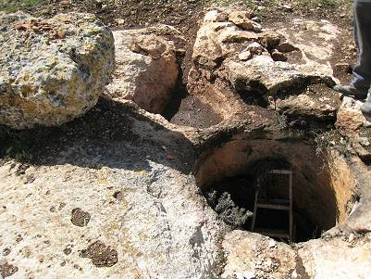
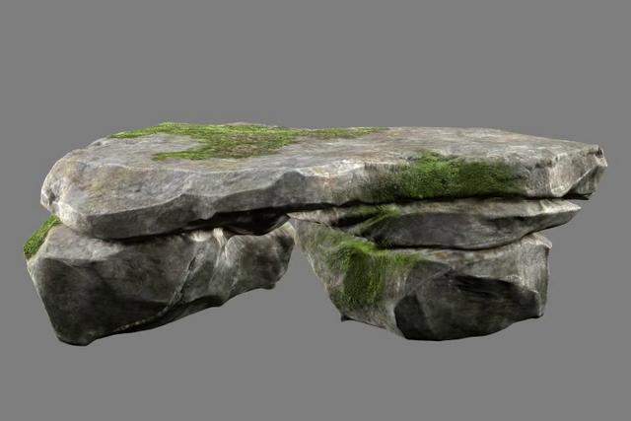
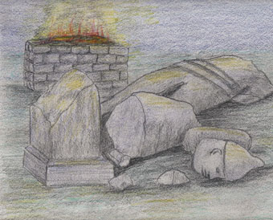
Three Altars
Altar No.1 – verse 20,21: Where he sacrificed the burnt offering and meal offering.
Altar No.2 – verse 23,24: An altar without sacrifice, called “Yahweh Shalom”
Altar No.3 – verse 25,26: built upon ruins of altar of Baal.

Slide 15
Altar No. 1
Gideon provides a PRESENT Judges 6:17,18. A large quantity in difficult times (verse 19)
Whatever purpose was intended the kid is accepted as a burnt offering (verse 20-21)
Two different rocks described!!
1st Rock (v.20) = selah (5553) denotes a lofty isolated rock. Can signify a rock split off. This is same word used in Numbers 20:8 – speak to the rock.
2nd Rock (v.21) = tsur (6697) denotes cliff or boulder. This is same word used in Exod.17:6 – smite the rock.
That “rock was Christ” (1Cor.10:4) – Christ in his Sacrificial role and Mediator’s role.
The kid is not the principle offering
“Present”: Heb. (4503) ‘minchah’ – reference to “meal offering” – CONSECRATION based upon “sincerity and truth” (1Cor.5:8).
The kid for a burnt offering indicates HOW our consecration is made, through TOTAL DEDICATION

Slide 16
Altar No. 3
Signifies the SECOND stage in overthrowing the enemy of God – verse 25-26. Cast down the altar of Baal which dominated Israel.
Midian had re-established a grip over Israel (6:1)
The sin of Balaam had returned (Num.22:4,7; 31:1-8)
There is a “way of peace”: Luke 1:79; Rom.3:17. But not everyone walks in it – Isa.48:22; 57:21; Rom.3:16-17. Such walk in crooked paths”, Isa.59:8.
Israel presently in this position – Jer.16:5; Isa.54:8; Ezek.38:29

Slide 17
Altar No. 2
The sacrificial altar is now followed by a memorial altar – Yahweh Shalom – “He who will be Peace”.
Sacrifice of Jesus brought PEACE – John 14:27; Eph.2:13-15 – the work of Jesus brought reconciliation between the Creator and His creation – 2Cor.4:6 (face of Jesus).
Paul comments in Phil.4:7 – the peace of God passes all understanding (see also Eph.3:19 the love of Christ passes knowledge).
Isaiah 53:4-5 “the chastisement of our peace”
God in the pursuit of peace with His creation was willing to sacrifice His son. Rom.4:25-5:1; Col.1:20

