Slide 1
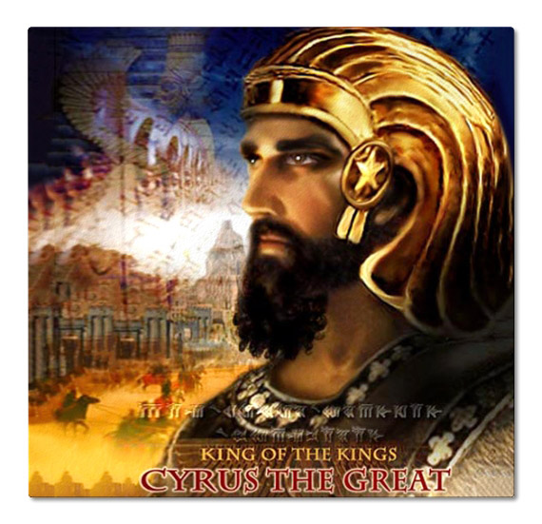
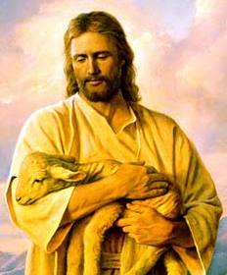
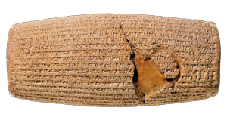
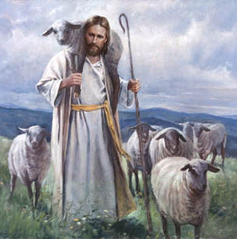
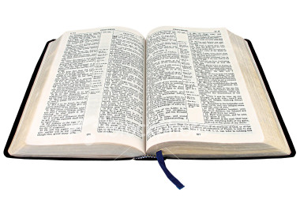
Cyrus and Jesus
God’s Shepherds

Slide 2
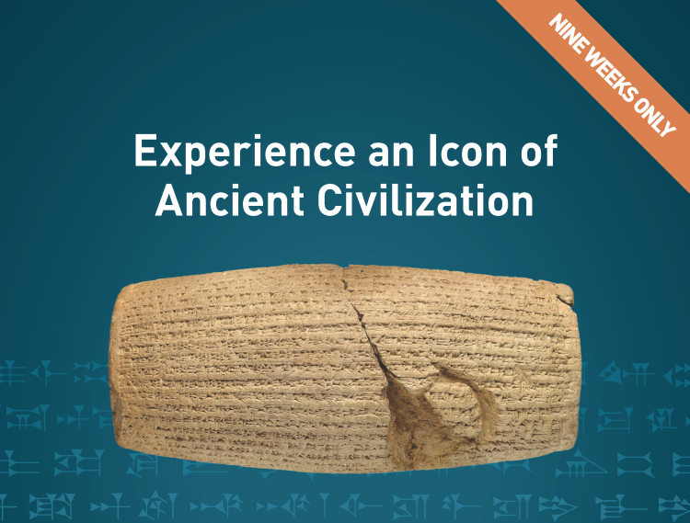
The Cyrus Cylinder and Ancient Persia
At the Getty Villa (Oct 2 to Dec 2)

Slide 3
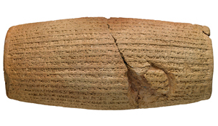
A Great Discovery over 140 years ago
The Cyrus Cylinder

Slide 4
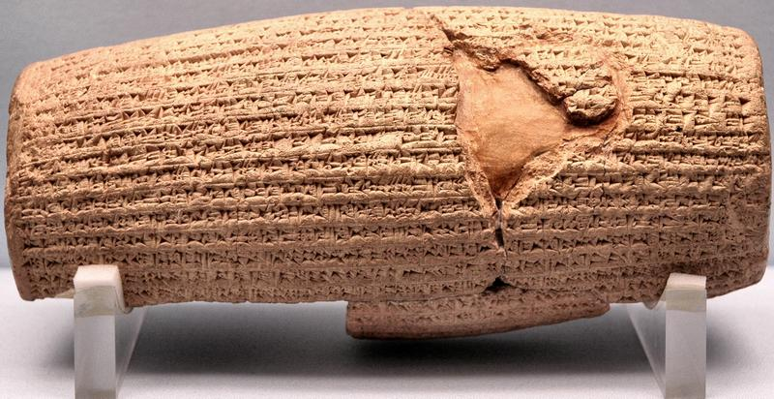
The Cylinder
Dates back to 6th century BC
Discovered in March 1879 in temple ruins of Babylon (now Iraq) by Hormuzd Rassam – an archaeologist
Written in cuneiform script in the name of Cyrus the Great – King of Persia
It was created to commemorate the Persian conquest of Babylon in 539BC when Cyrus incorporated Babylon into the Persian Empire
Cyrus had it made to remind everyone of his conquest

Slide 5
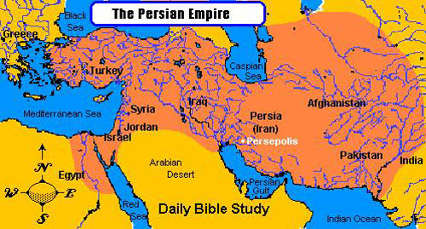
Babylon

Slide 6
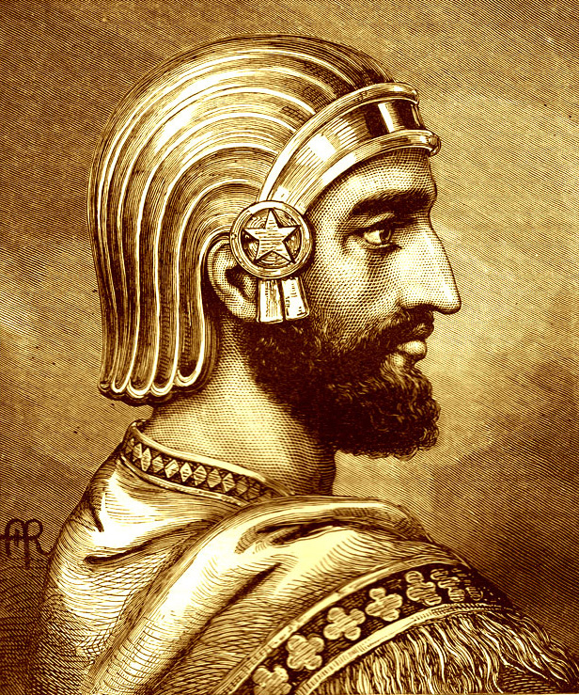
The Text of the Cylinder
Praises Cyrus, establishes his genealogy and presents him as a king in the line of kings
Nabonidus, the Babylonian king Cyrus conquered, is denounced as an impious oppressor of the Babylonian people
The cylinder presents Cyrus as the new ruler that the Babylonian god, Marduk chose to restore peace and order to Babylon

Slide 7
The Text of the Cylinder
It says that the Babylonian people welcomed Cyrus as the new ruler of Babylon and that he entered the city in peace
Cyrus is praised for improving the lives of the Babylonian people, allowing displaced peoples to return to their lands, and for restoring temples in the empire

Slide 8
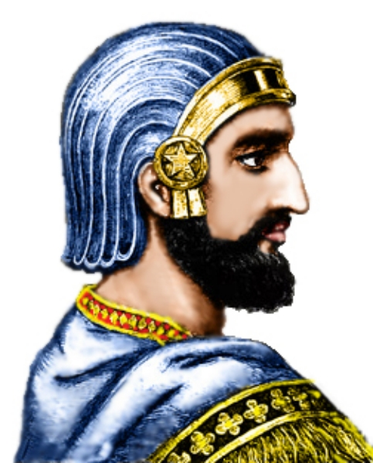
Cyrus’ reason for the cylinder
A propaganda tool for the Persians to give legitimacy to their conquest of Babylon
Depicts the Babylonian King Nabonidus as an impious failure and destroyer of the Babylonian people
Attempted to present Cyrus’ takeover as the will of the Babylonian god Marduk (Bel)
Also attempted to cement the reign of Cyrus and his son, Cambyses

Slide 9
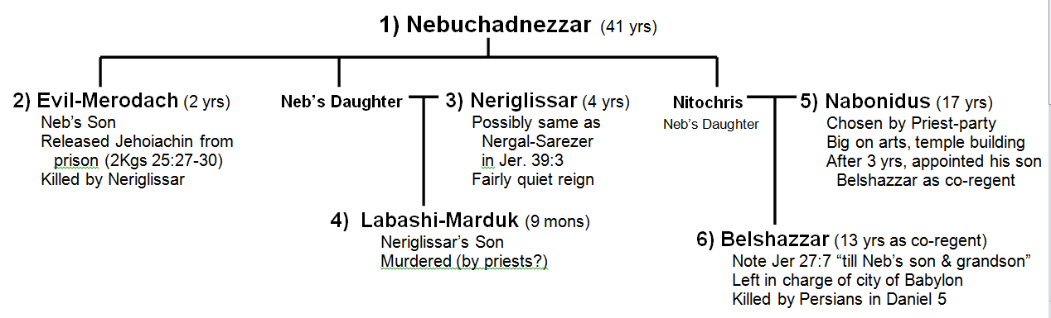
Kings of Babylon
1) Nebuchadnezzar (41 years)
Nabonidus set up his Son, Belshazzar, as a co-ruler and left him in charge of the city of Babylon

Slide 10
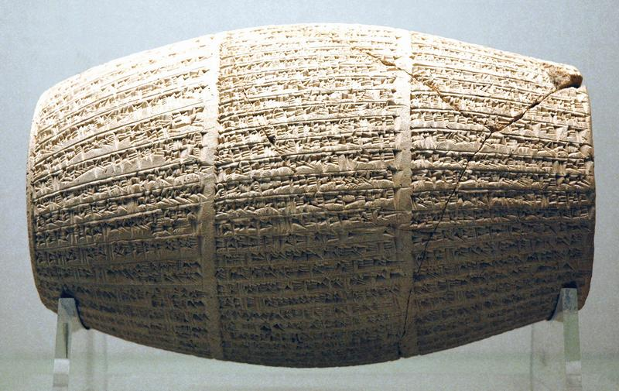
The Nabonidus Cylinder
G

Slide 11
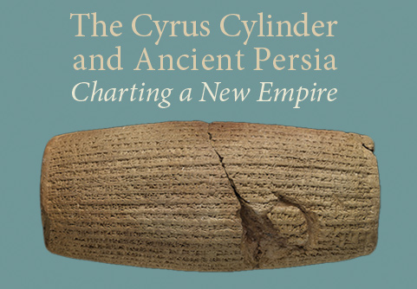
Significance of the Cyrus Cylinder
Iran uses it to demonstrate the time when the Persians ruled the world
Many politicians use it today as the oldest declaration of “human rights” because Cyrus let many captive peoples return to their native lands
Supports the authority of the Bible, because the Bible predicted that Cyrus would overthrow Babylon and set the Jews free
  The prophet Isaiah named Cyrus by name about 150 years before Cyrus was born!
  Isaiah prophesied around 730BC and Cyrus was born about 580BC
It is evidence of the reliability of the Bible!

Slide 12
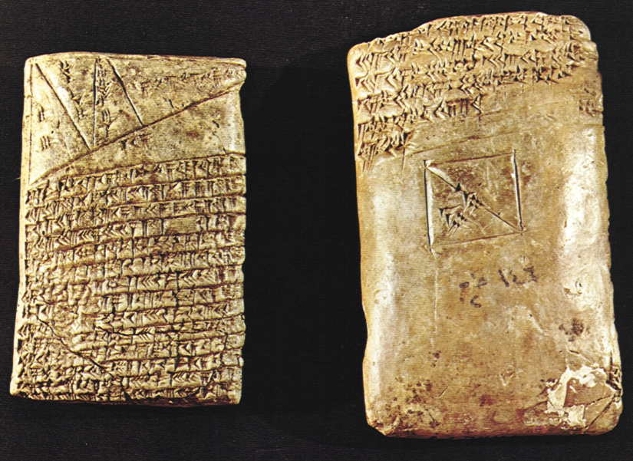
British Museum has two other tablets with the same information
In January 2010, the British Museum announced that two cuneiform tablets in its collection had been found to be inscribed with the same text as that on the Cyrus Cylinder, which, according to the Museum, "show that the text of the Cylinder was probably a proclamation that was widely distributed across the Persian Empire."
Further support on the reliability of the Bible

Slide 13
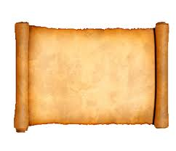
Isaiah 44:24, 28
God named Cyrus before he was born!
24 Thus says the Lord, your Redeemer, and He who formed you from the womb:
"I am the Lord, who makes all things, who stretches out the heavens all alone, who spreads abroad the earth by Myself;
28 Who says of Cyrus, 'He is My shepherd, and he shall perform all My pleasure,
Saying to Jerusalem, "You shall be built,"
And to the temple, "Your foundation shall be laid."'
Cyrus was born about 150 years later

Slide 14
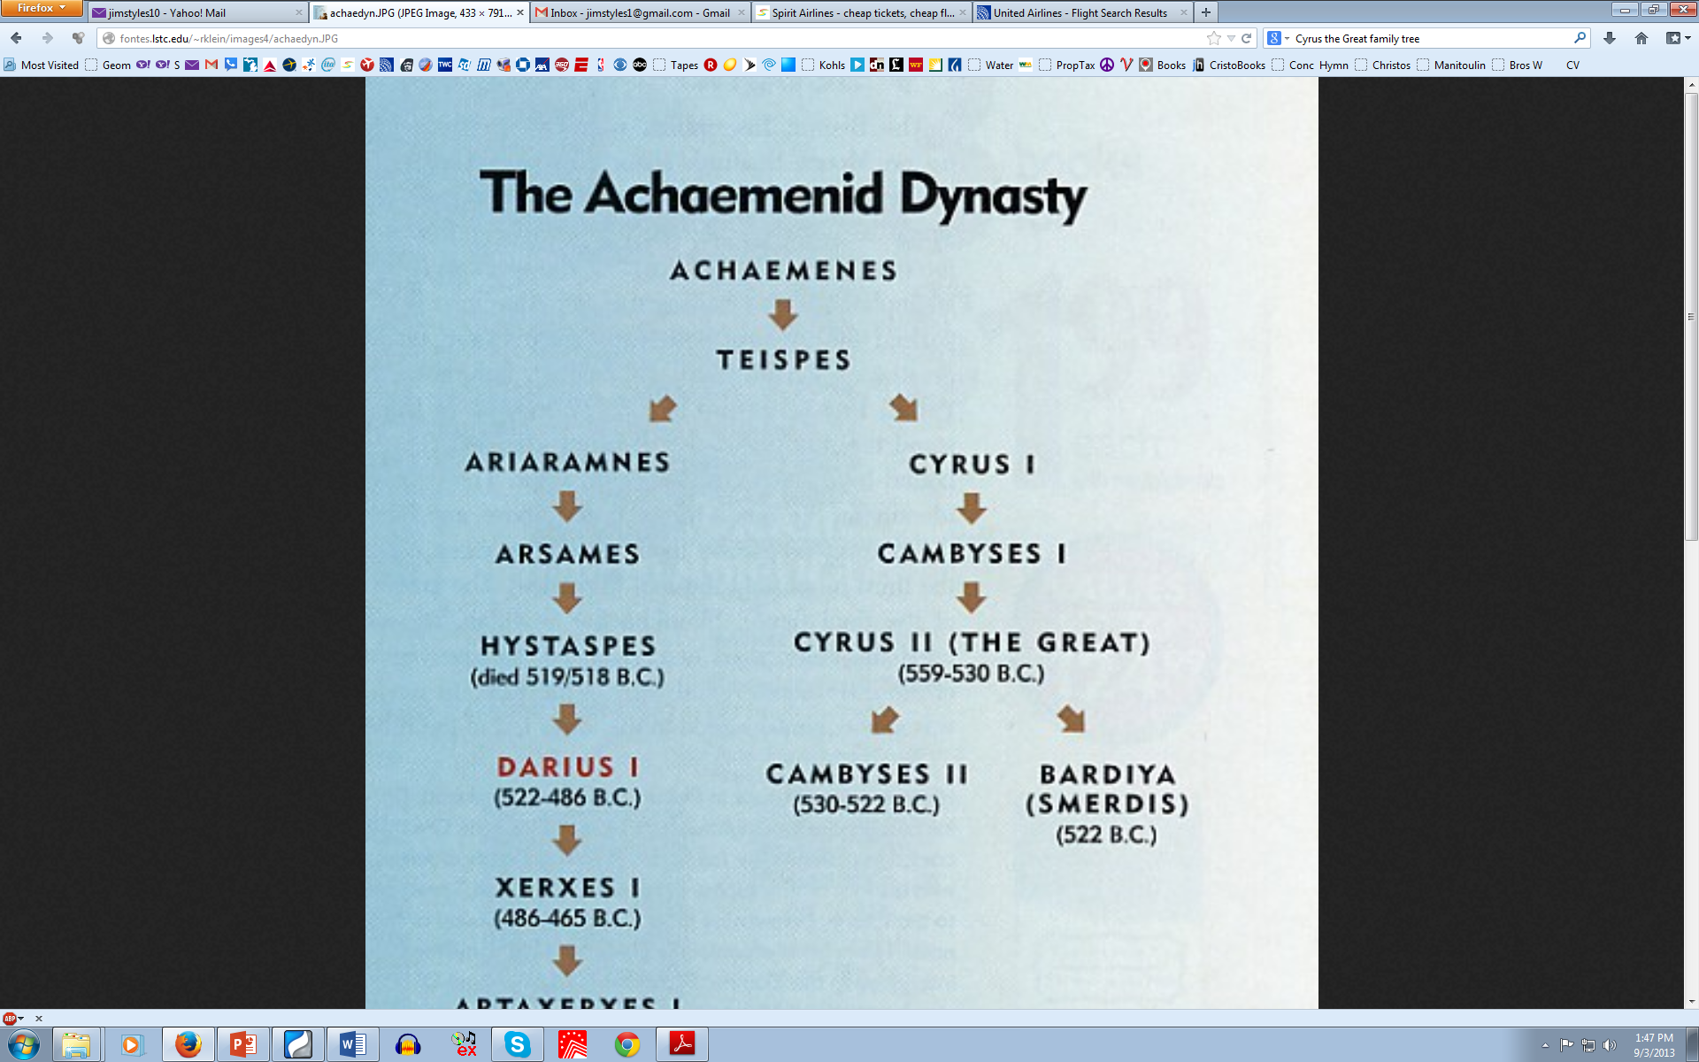
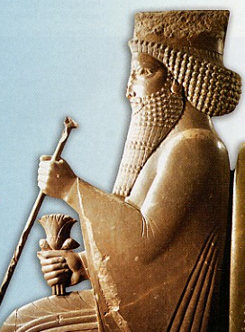

Slide 15
Isaiah 45:1-6
God used Cyrus to overthrow Babylon
1 "Thus says the Lord to His anointed, to Cyrus, whose right hand I have held — To subdue nations before him and loose the armor of kings, to open before him the double doors, so that the gates will not be shut:
2 'I will go before you and make the crooked places straight; I will break in pieces the gates of bronze and cut the bars of iron.
3 I will give you the treasures of darkness and hidden riches of secret places, that you may know that I, the Lord, who call you by your name, am the God of Israel.
The God of Israel set His people free

Slide 16
Isaiah 45:1-6
God used Cyrus even though he did not know God
4 For Jacob My servant's sake, and Israel My elect, I have even called you by your name; I have named you, though you have not known Me.
5 I am the Lord, and there is no other; there is no God besides Me. I will gird you, though you have not known Me,
6 That they may know from the rising of the sun to its setting that there is none besides Me. I am the Lord, and there is no other;
God wanted the world to know He set His people free

Slide 17
The Cyrus Cylinder demonstrates
Remember!
the Bible can be trusted

Slide 18
Ezra 1:1-4
Cyrus’ Decree
1 Now in the first year of Cyrus king of Persia, that the word of the Lord by the mouth of Jeremiah might be fulfilled, the Lord stirred up the spirit of Cyrus king of Persia, so that he made a proclamation throughout all his kingdom, and also put it in writing, saying,
2 Thus says Cyrus king of Persia:
All the kingdoms of the earth the Lord God of heaven has given me. And He has commanded me to build Him a house at Jerusalem which is in Judah.
continued

Slide 19
Ezra 1:1-4
Cyrus’ Decree
3 Who is among you of all His people? May his God be with him, and let him go up to Jerusalem which is in Judah, and build the house of the Lord God of Israel (He is God), which is in Jerusalem. 4 And whoever is left in any place where he dwells, let the men of his place help him with silver and gold, with goods and livestock, besides the freewill offerings for the house of God which is in Jerusalem.

Slide 20
Ezra 6:1-5
16 years later Darius found Cyrus’ Decree
1 Then King Darius issued a decree, and a search was made in the archives, where the treasures were stored in Babylon. 2 And at Achmetha, in the palace that is in the province of Media, a scroll was found, and in it a record was written thus:
3 In the first year of King Cyrus, King Cyrus issued a decree concerning the house of God at Jerusalem: "Let the house be rebuilt, the place where they offered sacrifices; and let the foundations of it be firmly laid, its height sixty cubits and its width sixty cubits,
continued

Slide 21
Ezra 6:1-5
Darius Found Cyrus’ Decree
4 with three rows of heavy stones and one row of new timber. Let the expenses be paid from the king's treasury. 5 Also let the gold and silver articles of the house of God, which Nebuchadnezzar took from the temple which is in Jerusalem and brought to Babylon, be restored and taken back to the temple which is in Jerusalem, each to its place; and deposit them in the house of God"
God had Cyrus restore His temple & His people!

Slide 22
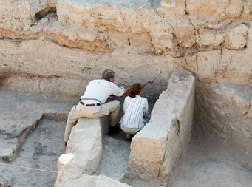
Archaeology Supports the Bible Record

Slide 23

You can Trust
S

Slide 24
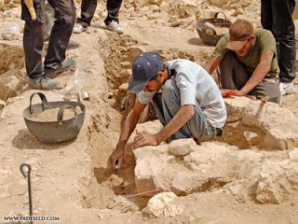
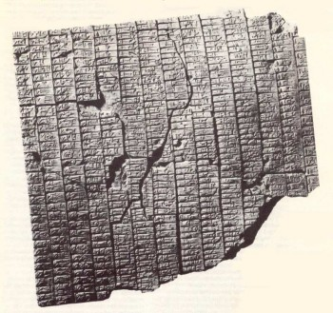
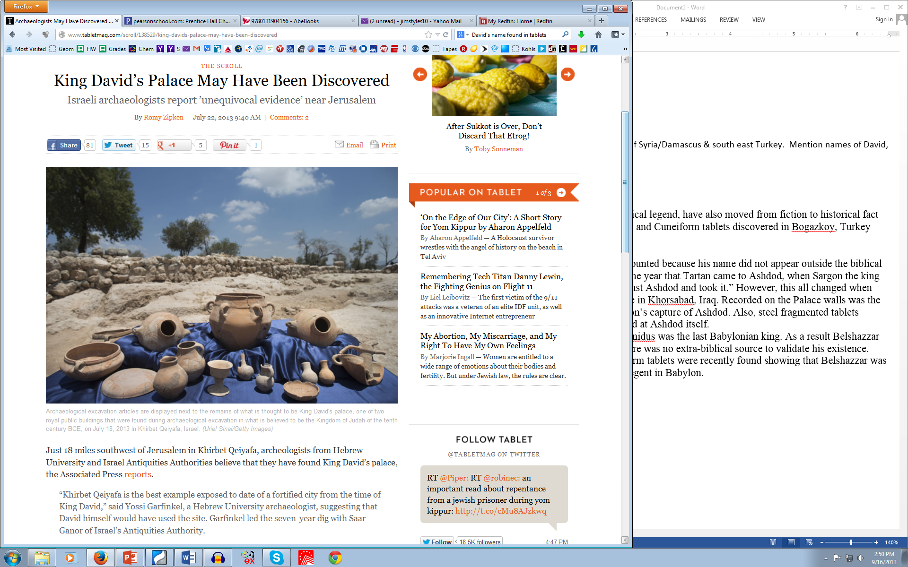
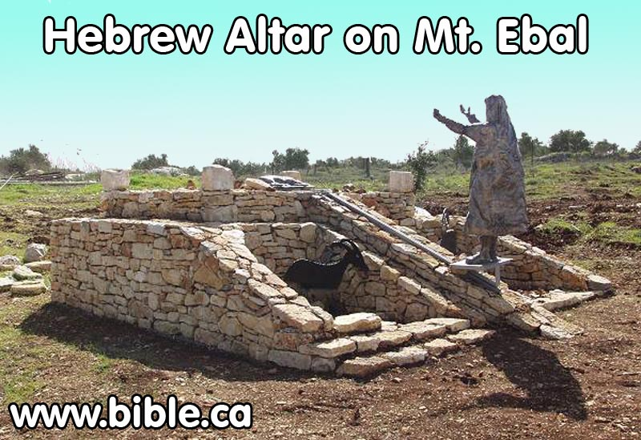
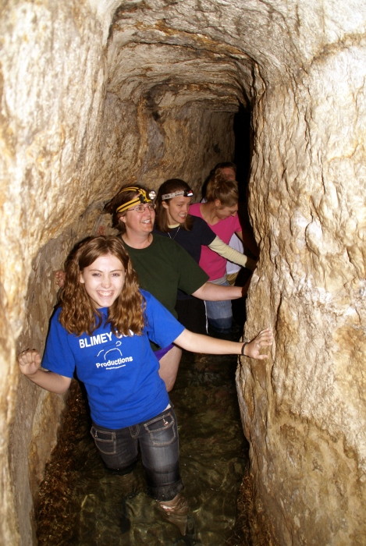
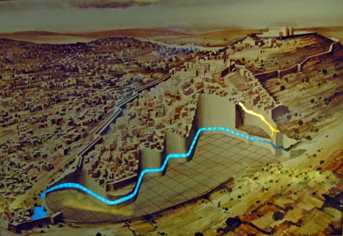
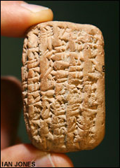
Some Archaeology discoveries that support the Bible
G

Slide 25
Ezekiel 26:3-14
God Predicts Tyre’s Destruction (587BC)
3 "Therefore thus says the Lord God: 'Behold, I am against you, O Tyre, and will cause many nations to come up against you, as the sea causes its waves to come up. 4 And they shall destroy the walls of Tyre and break down her towers; I will also scrape her dust from her, and make her like the top of a rock. 5 It shall be a place for spreading nets in the midst of the sea, for I have spoken,' says the Lord God; 'it shall become plunder for the nations. 6 Also her daughter villages which are in the fields shall be slain by the sword. Then they shall know that I am the Lord.'
God will scrape her dust from her!

Slide 26
Ezekiel 26:3-14
God’s destruction of Tyre
7 "For thus says the Lord God: 'Behold, I will bring against Tyre from the north Nebuchadnezzar king of Babylon, king of kings, with horses, with chariots, and with horsemen, and an army with many people. 8 He will slay with the sword your daughter villages in the fields; he will heap up a siege mound against you, build a wall against you, and raise a defense against you. 9 He will direct his battering rams against your walls, and with his axes he will break down your towers. 10 Because of the abundance of his horses, their dust will cover you; your walls will shake at the noise of the horsemen, the wagons, and the chariots, when he enters your gates, as men enter a city that has been breached.
God used Nebuchadnezzar of Babylon 2 years later – a 13 year siege

Slide 27
Ezekiel 26:3-14
God’s destruction of Tyre
11 With the hooves of his horses he will trample all your streets; he will slay your people by the sword, and your strong pillars will fall to the ground. 12 They will plunder your riches and pillage your merchandise; they will break down your walls and destroy your pleasant houses; they will lay your stones, your timber, and your soil in the midst of the water. 13 I will put an end to the sound of your songs, and the sound of your harps shall be heard no more. 14 I will make you like the top of a rock; you shall be a place for spreading nets, and you shall never be rebuilt, for I the Lord have spoken,' says the Lord God.
Tyre to become like the top of a rock

Slide 28
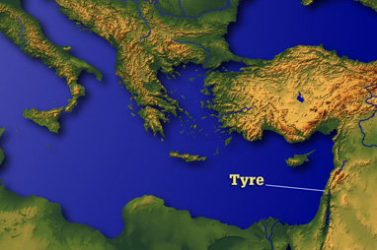
Where is Tyre?

Slide 29
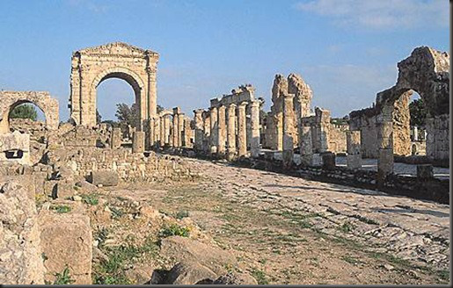
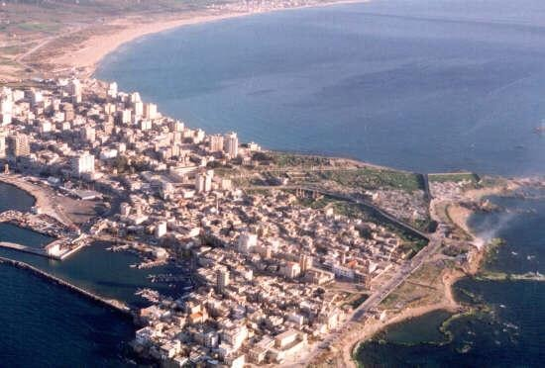
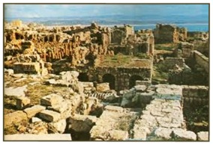
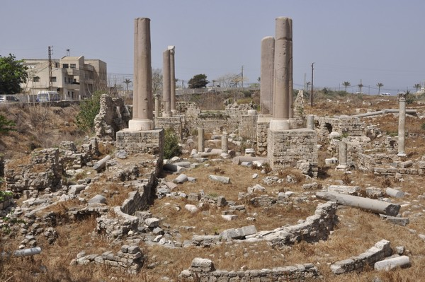
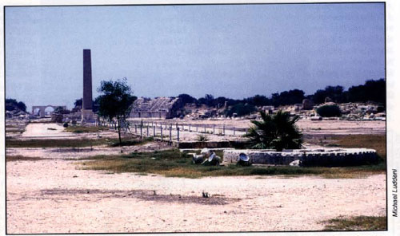
Old Tyre was scraped bare!

Slide 30
Ezekiel 29:17-20
Nebuchadnezzar didn’t get any reward from Tyre!
17 And it came to pass in the twenty-seventh year, in the first month, on the first day of the month, that the word of the Lord came to me, saying, 18 "Son of man, Nebuchadnezzar king of Babylon caused his army to labor strenuously against Tyre; every head was made bald, and every shoulder rubbed raw; yet neither he nor his army received wages from Tyre, for the labor which they expended on it. 19 Therefore thus says the Lord God: 'Surely I will give the land of Egypt to Nebuchadnezzar king of Babylon; he shall take away her wealth, carry off her spoil, and remove her pillage; and that will be the wages for his army. 20 I have given him the land of Egypt for his labor, because they worked for Me,' says the Lord God.
The people of Tyre must have escaped to the sea

Slide 31
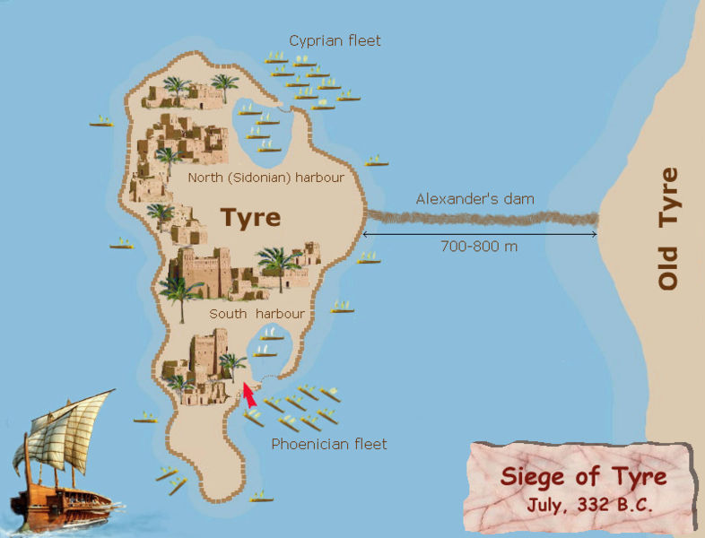
250 years later Alexander the Great of Greece destroyed Tyre again!

Slide 32
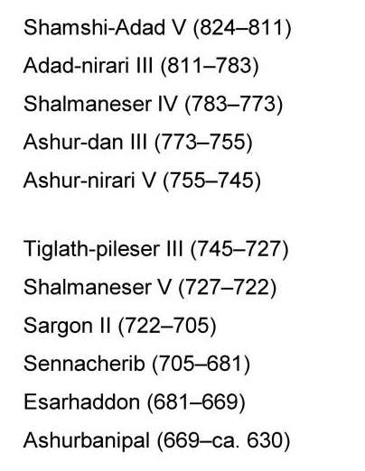
Kings of Assyria
For many years there was no evidence of Sargon King of Assyria, except in the Bible.

Slide 33
Isaiah 20:1
The Bible mentions Sargon
In the year that Tartan came to Ashdod, when Sargon the king of Assyria sent him, and he fought against Ashdod and took it,
There was no evidence of an Assyrian King named Sargon outside the Bible, until archaeologists found Sargon’s palace in Khorsabad, Iraq in the 1840’s. Recorded on the Palace walls was the event mentioned in Isaiah 20—Sargon’s capture of Ashdod. Also, steel fragmented tablets memorializing the victory were found at Ashdod itself.
When Sargon died, his son, Sennacherib, moved the capital to Ninevah

Slide 34
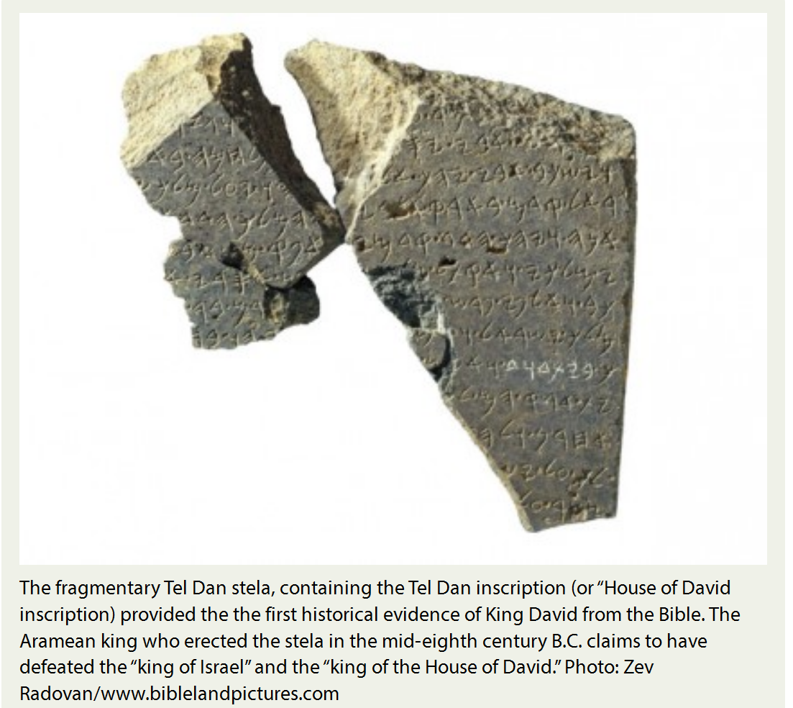
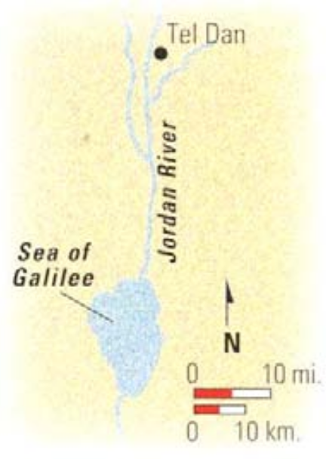
Discovered in 1993 at Tel Dan in Northern Israel
Evidence for King David from a Syrian stone

Slide 35
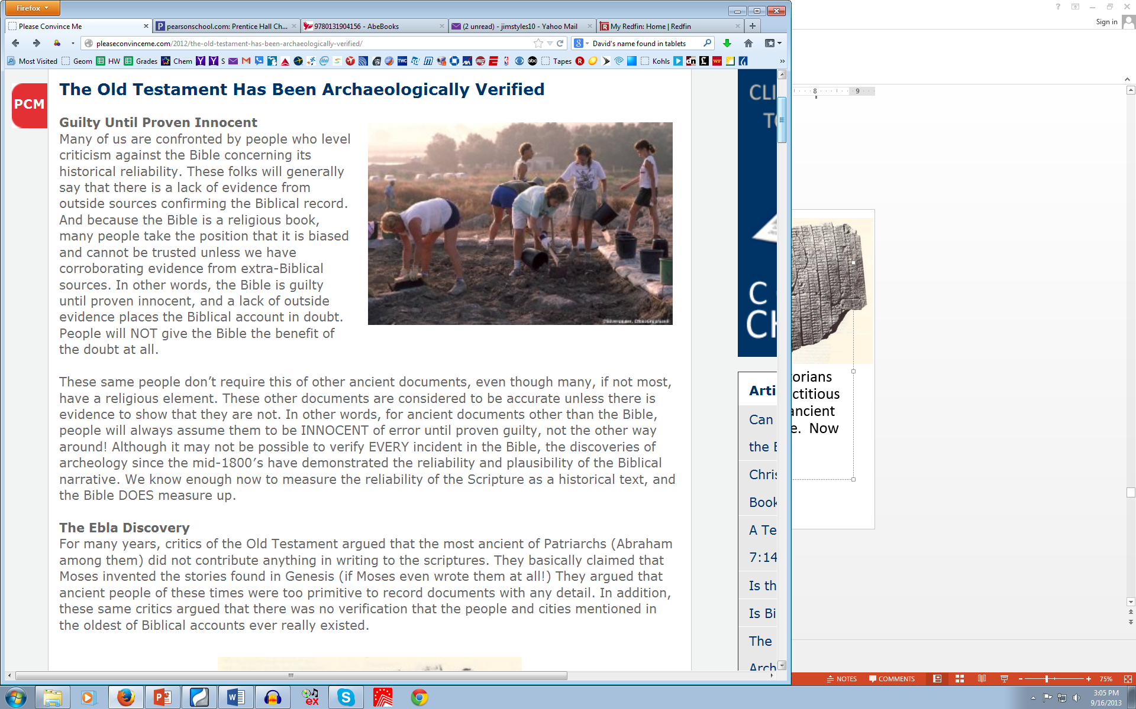

Slide 36
The Ebla Tablets
About 2500 tablets found in 1975 in northern Syria. These tablets are over 1000 years older than the oldest Torahs. They mention names of Abraham and Ishmael, and describe the land they lived in as the land of “Canaan”. Up until this discovery, historians claimed that Abraham and Ishmael were fictitious stories, and that the name “Canaan” was not an ancient name for the land of Palestine as used in the Bible. Now they have to admit that there is outside evidence supporting the records in the Bible account.
Once again the Bible records have been verified!

Slide 37
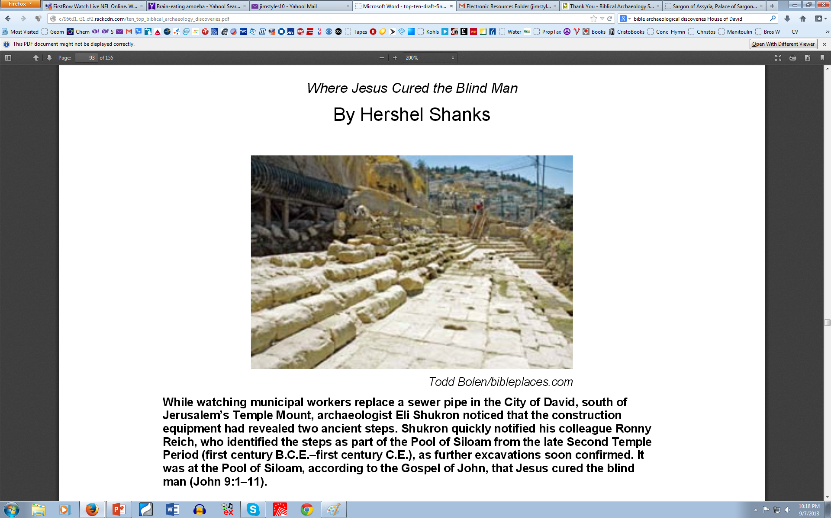
The Pool of Siloam found in 2004
Place where Jesus healed a blind man

Slide 39
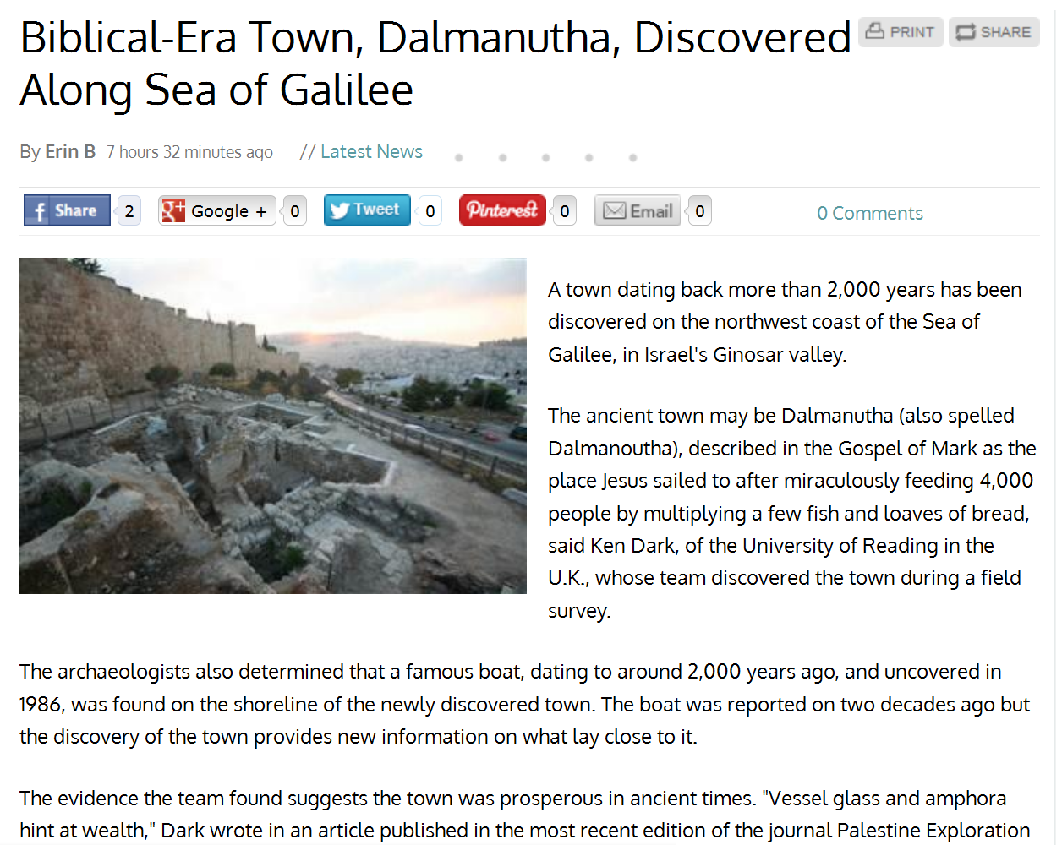
Sept 17, 2013

Slide 40
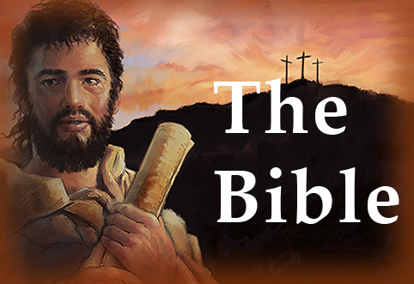
You can trust it!

Slide 41
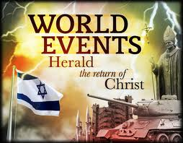

Slide 42
Matthew 24:29-31
Jesus will gather His sheep
29 "Immediately after the tribulation of those days the sun will be darkened, and the moon will not give its light; the stars will fall from heaven, and the powers of the heavens will be shaken. 30 Then the sign of the Son of Man will appear in heaven, and then all the tribes of the earth will mourn, and they will see the Son of Man coming on the clouds of heaven with power and great glory. 31 And He will send His angels with a great sound of a trumpet, and they will gather together His elect from the four winds, from one end of heaven to the other.
Just as Cyrus sent the Jews back to Israel

Slide 43
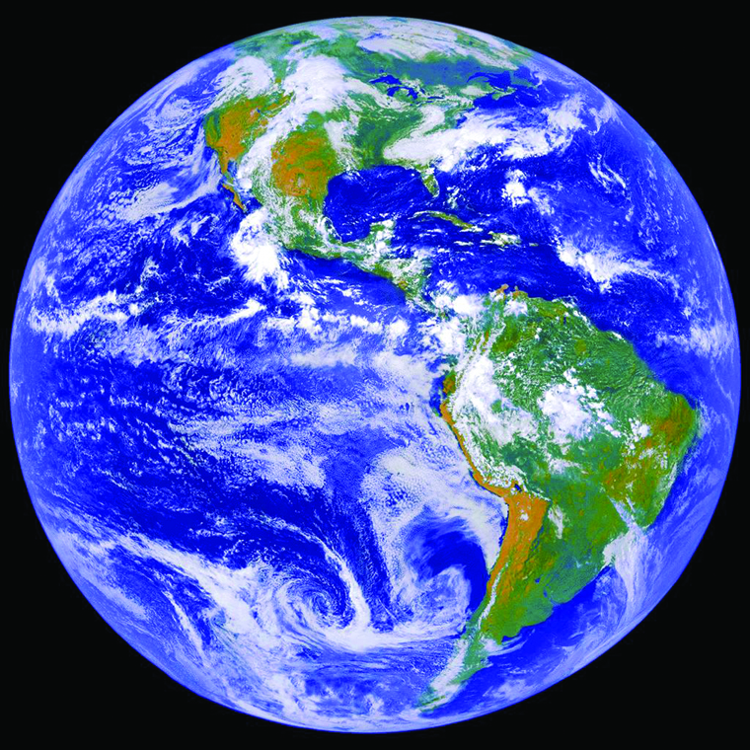
Christ’s Return
The Bible’s Answer to a World in Crisis
Jesus will fix this world!

Slide 44
1 Peter 5:1-4
Jesus will return & reward His followers
The elders who are among you I exhort, I who am a fellow elder and a witness of the sufferings of Christ, and also a partaker of the glory that will be revealed: 2 Shepherd the flock of God which is among you, serving as overseers, not by compulsion but willingly, not for dishonest gain but eagerly; 3 nor as being lords over those entrusted to you, but being examples to the flock; 4 and when the Chief Shepherd appears, you will receive the crown of glory that does not fade away.
Don’t miss out!

Slide 45
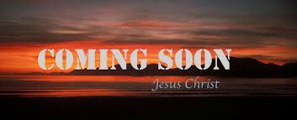
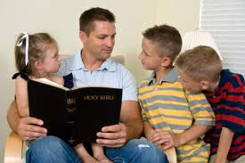
Read your Bible everyday, so you will be ready!

Slide 46

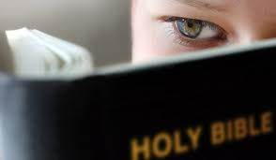
Now is the opportunity of your lifetime!
S
Find out what Jesus will do for you and this earth
It’s time to read the Bible and be prepared!
Get out your Bible and read!

Slide 47
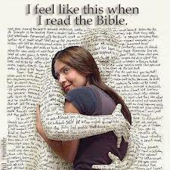
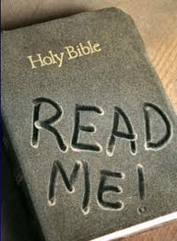
Reading the Bible is fun!
G

Slide 48

Sunday mornings at 9:30am
Wednesday nights at 7:30pm

Slide 50
2
S
G

Slide 51
2
S
G

Slide 52
2
W
17
!

Slide 53
2
S
G

Slide 54
2
W
17
!

Slide 55

Lessons from Today
Even

Slide 56
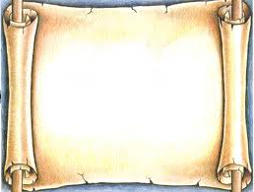
2
S
G

Slide 57
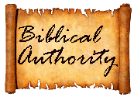
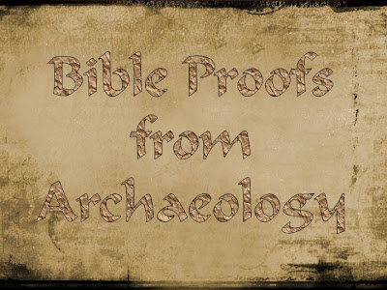
2
S
G

Slide 58
Other Archaelogy finds that Support the Bible
S
Ezekiel prophesied 592-586BC
Siege lasted 13 years (586-573BC)
Alexander the Great built land bridge in 332 BC (250 years after Nebuchadnezzar).
G

Slide 60


2
S
G

Slide 61


Slide 62
2
W
13 Then Daniel was brought in before the king. The king spoke, and said to Daniel, "Are you that Daniel who is one of the captives from Judah, whom my father the king brought from Judah? 14 I have heard of you, that the Spirit of God is in you, and that light and understanding and excellent wisdom are found in you. 15 Now the wise men, the astrologers, have been brought in before me, that they should read this writing and make known to me its interpretation, but they could not give the interpretation of the thing. 16 And I have heard of you, that you can give interpretations and explain enigmas. Now if you can read the writing and make known to me its interpretation, you shall be clothed with purple and have a chain of gold around your neck, and shall be the third ruler in the kingdom."
!

Slide 63
Daniel 5
W
17 Then Daniel answered, and said before the king, "Let your gifts be for yourself, and give your rewards to another; yet I will read the writing to the king, and make known to him the interpretation. 18 O king, the Most High God gave Nebuchadnezzar your father a kingdom and majesty, glory and honor. 19 And because of the majesty that He gave him, all peoples, nations, and languages trembled and feared before him. Whomever he wished, he executed; whomever he wished, he kept alive; whomever he wished, he set up; and whomever he wished, he put down. 20 But when his heart was lifted up, and his spirit was hardened in pride, he was deposed from his kingly throne, and they took his glory from him. 21 Then he was driven from the sons of men, his heart was made like the beasts, and his dwelling was with the wild donkeys. They fed him with grass like oxen, and his body was wet with the dew of heaven, till he knew that the Most High God rules in the kingdom of men, and appoints over it whomever He chooses.
!

Slide 64
2
17
G

Slide 65
2
17
G

