Slide 1
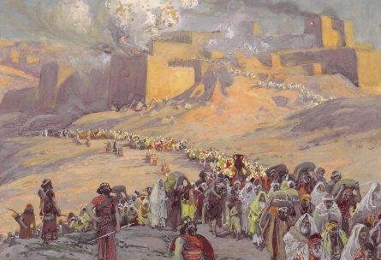

After the Captivity….
The Return of the Exiles

Slide 2
Why study this period?
Ties together Ezra, Nehemiah, Esther, Haggai, Zechariah, & Malachi. Some Jeremiah & Daniel
Helps us understand the background to the Jews’ religion and culture when Jesus was born
Lots of interesting history and political intrigue
Deals with typical problems we face individually and as a community
Great lessons for us about living as members of God’s family – young people too!
It’s your ticket to Youth Conference 2013

Slide 3
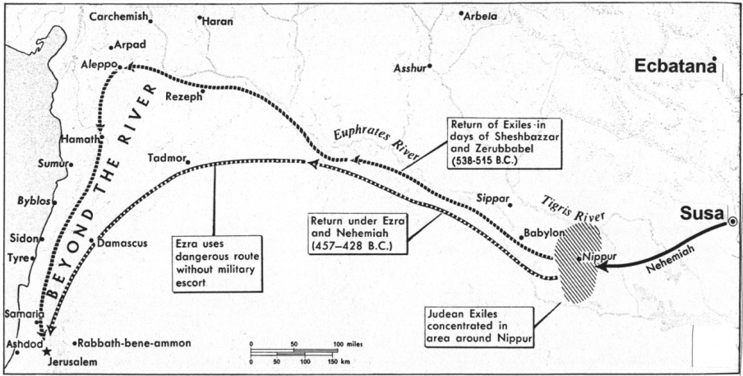
The Exiles Return
1000 miles (1600 km)
800 miles (1300 km)
Just to get to Jerusalem was a major trip!

Slide 4
How it fits together:
Jeshua & Zerubbabel return (Ezra 1-2)
Begin rebuilding the temple (Ezra 3-4)
Zechariah & Haggai motivate the people to finish the temple (Ezra 5-6)
Ezra returns with more exiles (Ezra 7-10)
God uses Haman to convince more Jews to return home (Esther)
Nehemiah builds the walls of Jerusalem
Malachi warns of religious legalism

Slide 5
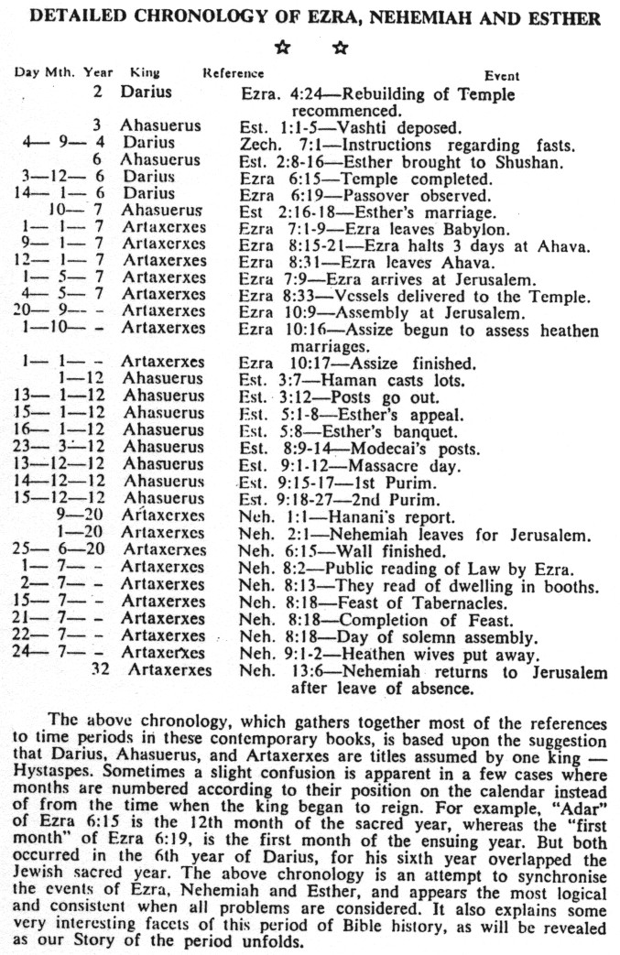
From Story of the Bible

Slide 6
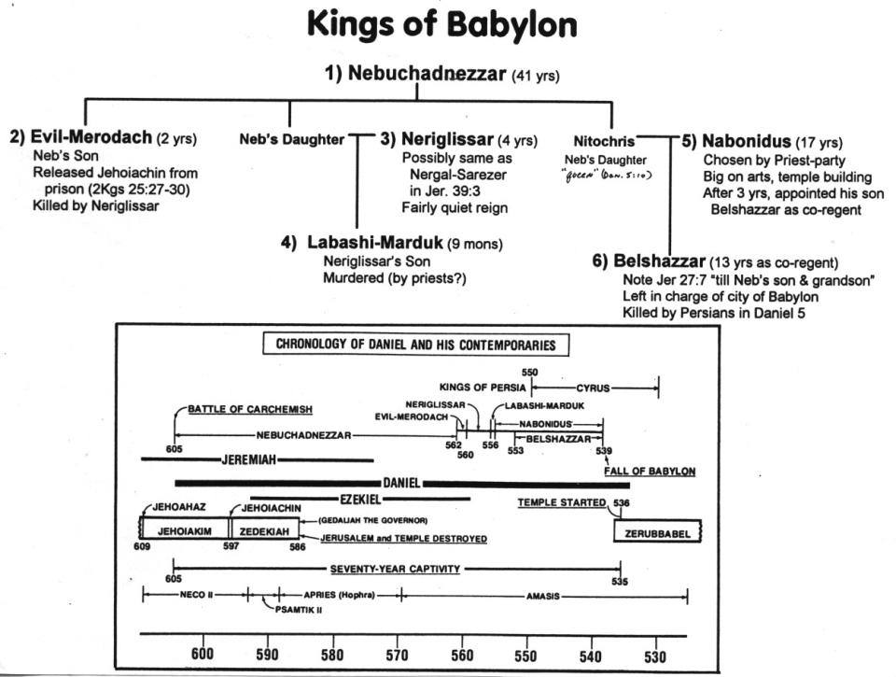

Slide 7
Persian Kings
Gomates

Slide 8
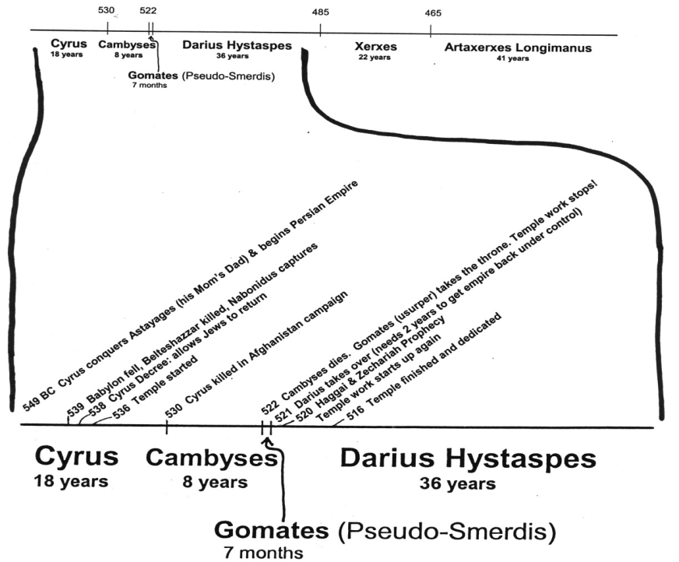
Persian Kings from Cyrus to Longimanus
-- 515 Ezra returns
-- 502 Nehemiah returns

Slide 9
People’s Reaction to Laying the Foundation (Ezra 3:12 )
Younger: Shouted & praised (excited!)
Older: Wept (disappointed) ☹
Hag 2:3-4 Is it not in your sight as nothing?
Zech 4:8-10 Who has despised the day of small things?
Learn to appreciate what God allows us to do & be thankful!

Slide 10
Samaritans Cause Trouble
Ezra 4:1-3
1 Now when the adversaries of Judah and Benjamin heard that the descendants of the captivity were building the temple of the LORD God of Israel,
2 they came to Zerubbabel and the heads of the fathers' houses, and said to them, "Let us build with you, for we seek your God as you do; and we have sacrificed to Him since the days of Esarhaddon king of Assyria, who brought us here."
3 But Zerubbabel and Jeshua and the rest of the heads of the fathers' houses of Israel said to them, "You may do nothing with us to build a house for our God; but we alone will build to the LORD God of Israel, as King Cyrus the king of Persia has commanded us."

Slide 11
Test #1: Return to Idols?
Idol worship was a primary cause of the 70-year captivity
Were the people willing to separate from the nations, stand fast for Yahweh their God, and guard the Truth that was entrusted to them?
Yes!

Slide 12
Test #2: Endurance
Were the people ready to endure tribulation from without?
Were the people ready to endure trouble for many years and continue steadfast in their devotion to building God’s house in faith?
☹ No! ☹

Slide 13
One Key: the Kings of Ezra 4:4-7
4 Then the people of the land tried to discourage the people of Judah. They troubled them in building,
5 and hired counselors against them to frustrate their purpose all the days of Cyrus king of Persia, even until the reign of Darius king of Persia.
6 In the reign of Ahasuerus, in the beginning of his reign, they wrote an accusation against the inhabitants of Judah and Jerusalem.
7 In the days of Artaxerxes also, Bishlam, Mithredath, Tabel, and the rest of their companions wrote to Artaxerxes king of Persia; and the letter was written in Aramaic script, and translated into the Aramaic language.

Slide 14
The Key!
The temple work is stopped in the reign of Artaxerxes of verse 7 (see v.23-23)
The temple is finished in the 6th year of the reign of Darius (6:15)
Temple finished
6

Slide 15
The Kings of Ezra 4
Effect on Temple | Name in Ezra 4 | Actual Name | Length of Reign
Issued decree to build temple | Cyrus | Cyrus the Great | 9 years after decree
Did not hinder the work | Ahaseurus | Cambyses II | 8 years
Stopped work on temple | Artaxerxes | Gomates (Pseudo-Smerdis) | 7 months
Encouraged work to finish | Darius | Darius Hystaspes (Darius the Great) | 36 years

Slide 16

Timeline of the Persian Kings during the temple building
-- 515 Ezra returns
-- 502 Nehemiah returns
[ 10 years ]

Slide 17
Why did God stop the work?
15 years of work had worn out and discouraged the people
Older people didn’t like the new temple
Adversaries hired counselors against them
Workers wanted to spend time on their own houses, farms and businesses
People were afraid of adversaries (8:4-5)
Be careful! Sometimes God gives us what we want so we will learn to quit dreaming about it!

Slide 18
If the work on the Temple began again in the 2nd year of Darius, how long did the work stop?
Just about 2 years!

Slide 19
Building the Temple
Cyrus 6 years
Cambyses 8 years
Gomates 7 months
Darius 6 years
Time to finish = 20 years

Slide 20
Jeremiah’s Prophecies about the 70 years
Jer 25:11-14 (during early years of Jehoiakim’s reign) after 70 years God will punish Babylon
Jer 29:10-14 (during early years of Zedekiah) after 70 years God will bring the Jews back and give them a future with peace and hope

Slide 21
What were the people doing?
(see Haggai 1)
Claimed the time was not right (v.2)
[said the 70 years were not over yet]

Slide 22
When did the 70 years start?
70 years
70 years

Slide 23
What were the people doing?
(see Haggai 1)
Claimed the time was not right (v.2)
[said the 70 years were not over yet]
Paneled their own homes (v.4)
Tried to improve their own economic situation (v.6)

Slide 24
God raises up Darius to be King!
A few months after the temple work was forced to stop, God opened a door by bringing Darius to the throne
Some of the Jews realized this was their opportunity and began working on the temple again, but they needed more help

Slide 25
“The Prophets of God Helping them” (Ezra 5:1-2 )
Coordinated efforts of Haggai & Zechariah
Haggai: Exhorts and reprimands the people for their poor choices and lack of faith.
Zechariah: Encourages the people that the angels are working behind the scenes and they will help finish the temple!

Slide 26
Zechariah’s
7 Night Visions
(Zech. 1-6)

Slide 27
Haggai & Zechariah together
2nd Year of Darius
Hag 1:1-11 6th month, 1st day
consider how your have fared!
Hag 1:12-15 6th month, 24th day
Began working on the temple again
Hag 2:1-9 7th month, 21st day
End of Tabernacles – “I am with you”

Slide 28
Haggai & Zechariah together
2nd Year of Darius
Zech 1:1-6 8th month
Return to God or face captivity again!
Hag 2:10-23 9th month, 24th day
Nation unclean, but God will bless them!
Zech 1:7-6:15 11th month, 24th day
Night visions: God will finish the temple!

Slide 29
Haggai & Zechariah together
4th Year of Darius
Zech 7:1-8:23 9th month, 4th day
Obedience to God is more important than rituals
The Lord will return to Zion and dwell in Jerusalem. A remnant of Jews and many nations will seek Him in Jerusalem

Slide 30
Temple is finished
Then Ezra returns
Then Nehemiah builds the wall
-- 515 Ezra returns
-- 502 Nehemiah returns
[ 10 years ]
6
7
20

Slide 31
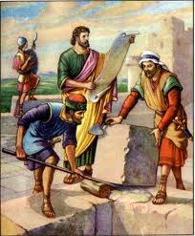
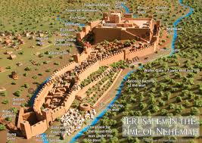
Nehemiah builds the wall
Great lessons about what faith will motivate us to do
Power of working together in ecclesial and family life
No compromise with unGodly
Nehemiah’s motivation gets the wall finished in 52 days!

Slide 32


Enjoy your studies this week & for next year!

Slide 33

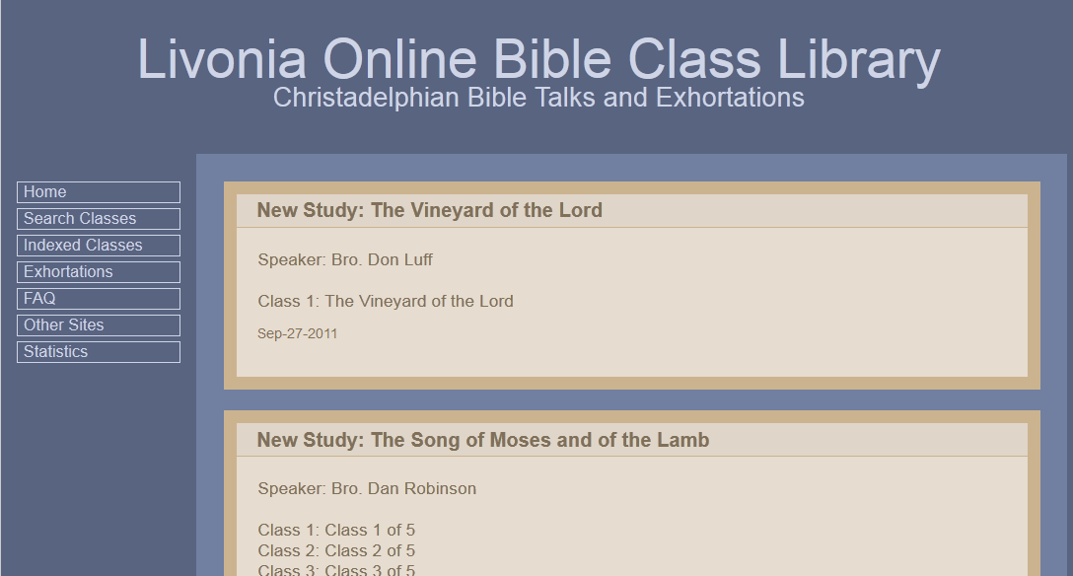
This class & Powerpoint
www.livoniatapes.com

