Slide 1
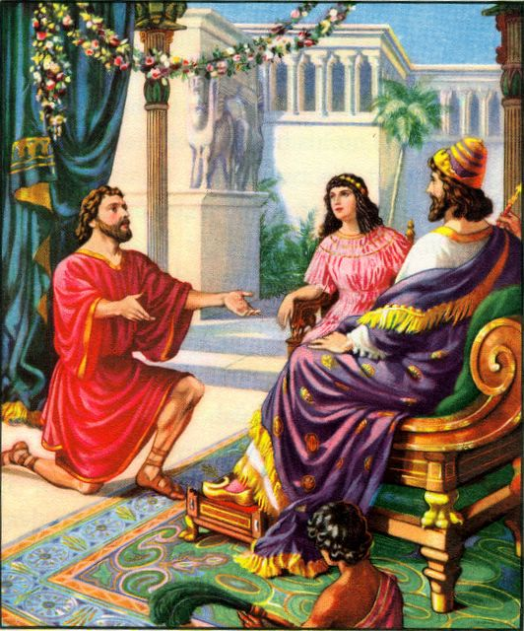
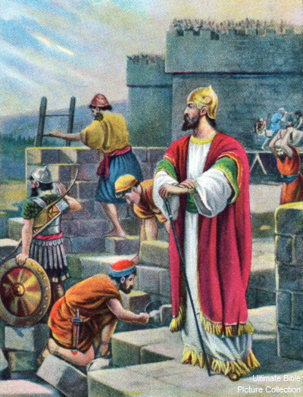
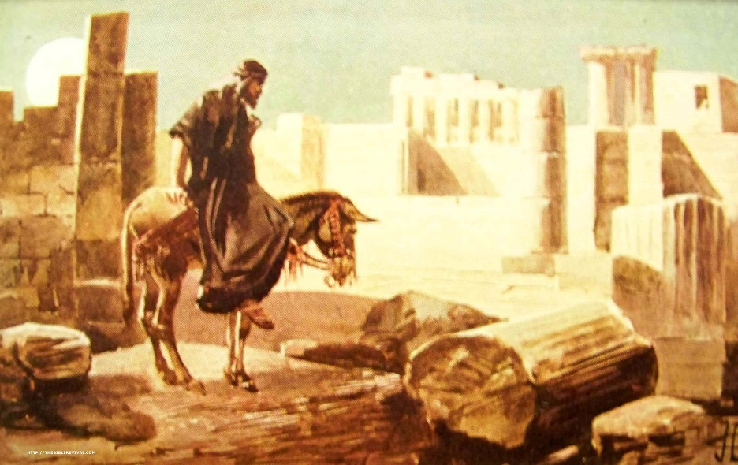
Nehemiah the Motivator
Notes:
In those days I was the king's cup-bearer (11b).
1. Wiersbe also notes, "A cupbearer was much more than our modern 'butler' (see Gen. 40). It was a position of great responsibility and privilege. At each meal, he tested the king's wine to make sure it wasn't poisoned. A man who stood that close to the king in public had to be handsome, cultured, knowledgeable in court procedures, and able to converse with the king and advise him if asked (see 41:1–13). Because he had access to the king, the cupbearer was a man of great influence, which he could use for good or for evil."
2. "That Nehemiah, a Jew, held such an important position in the palace speaks well of his character and ability (Dan. 1:1–4). For nearly a century, the Jewish remnant had been back in their own land, and Nehemiah could have joined them; but he chose to remain in the palace. It turned out that God had a work for him to do there that he could not have accomplished elsewhere. God put Nehemiah in Susa just as He had put Esther there a generation before, and just as He had put Joseph in Egypt and Daniel in Babylon. When God wants to accomplish a work, He always prepares His workers and puts them in the right places at the right time."
Ibid.

Slide 2
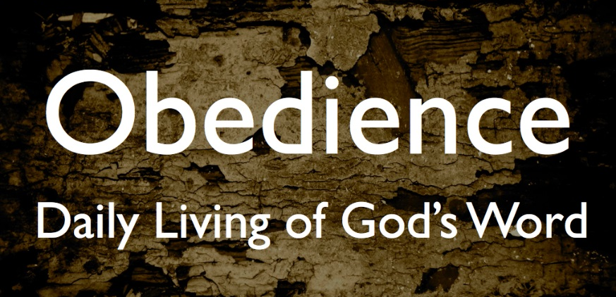
Esther’s Obedience
To the king (as opposed to Vashti’s disobedience)
  Decree that all wives honor their husbands (1:21-22)
To Hegai (2:15): she only took what Hegai suggested
To Mordecai (2:20): Esther still obeyed the command of Mordecai as when she was brought up by him
This was one of the issues that caused the captivity in the first place – disobedience to God’s commands!

Slide 3
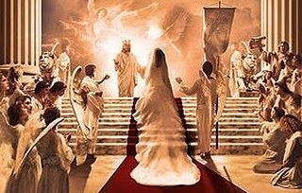
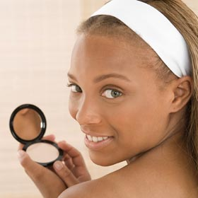
Preparation to meet the King
2:3 Let the maidens get beauty treatments
2:9 Hegai gave Esther beauty treatments and special food
2:12 Esther had to complete 12 months of beauty treatments
  6 months with oil of myrrh
  6 months with perfumes and cosmetics
2:17 The King loved Esther and she received grace and favor
God tries to remind us we need to prepare to meet our God (Amos 4:12)

Slide 4
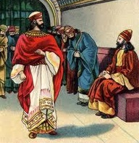
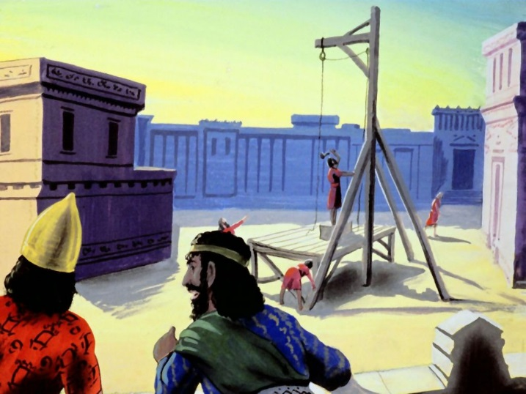
God’s war with Amalek (Sin)
Haman is an Agagite (3:1):
  Agag was king of the Amalekites (1 Sam 15:8)
  God promised to wipe out the remembrance of Amalek (Ex 17:14)
  God swore He would continually war with Amalek (Ex 17:16)
  Saul spared Agag, but Samuel hacked him in pieces (1 Sam 15:9, 33)
Haman wanted to kill all Jews – the people of Mordecai (3:6)
Haman is hung (7:10)
Haman’s 10 sons are killed & then hung on gallows (9:10, 14)
Esther receives all Haman’s house (8:1)
God has promised He will defeat Sin

Slide 5
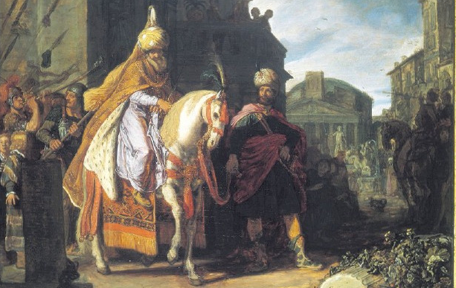
Mordecai’s Elevation: predicted Jesus’ elevation to God’s right hand
Mordecai gets King’s signet ring and is appointed over Haman’s house (8:1-2)
Mordecai writes decree to save the Jews from annihilation (8:9-14)
Gentiles became fearful of Mordecai, for he was prominent in the palace & his reputation spread (9:4)
Mordecai writes decree for annual celebration of Purim (9:20-22)
Summary of the elevation of Mordecai the Jew (10:1-3)
God promised all along to provide a savior of His people. We need to trust Him.

Slide 6
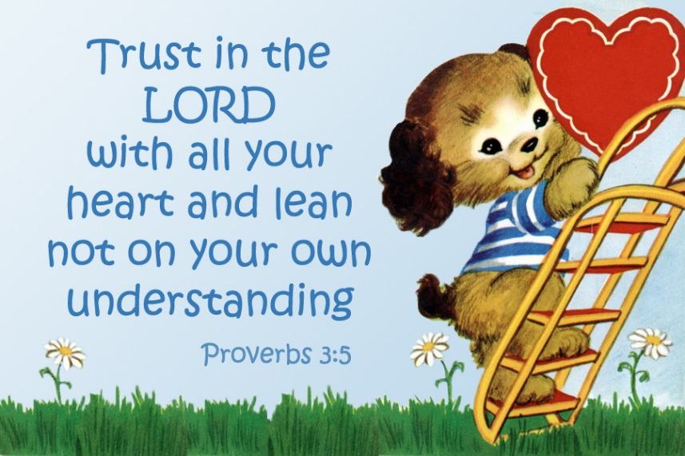
Trust God: Put your faith into action
Esther’s faith and trust that somehow becoming queen was part of God’s plan
Her willingness to go into the King….”if I perish, I perish” (4:16)
Esther’s banquets: illustrates how faith in action works
  She developed a reasonable plan,
  But trusted God to make it work
Trust in the Lord with all your heart, and lean not on your own understanding; In all your ways acknowledge Him, and He shall direct your paths (Prov 3:5-6)

Slide 7

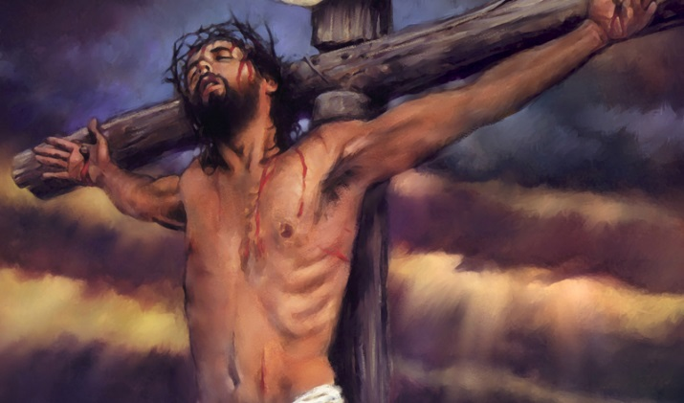
Our Faith in God and resulting actions can be an effective witness
Jews were full of happiness and joy and gladness and honor (8:17)
Many Gentiles became Jews when they realized the blessed status of Jews
Jesus’ faith in God’s way became the greatest witness ever!

Slide 8
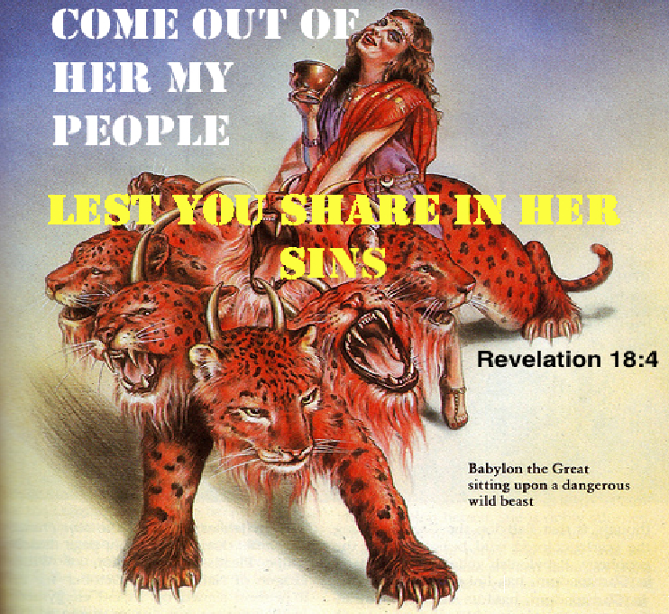
God’s warning to get out of Babylon!
(God’s gentle push!)
He raised up Haman to make them face the reality of destruction in a foreign land (Esther 3)
He promised to bless their economy and food (Hag 2:19)
He promised to protect their cities (Zech 2:1-5)
He promised to dwell in their midst (Zech 2:11)
"Come out from among them and be separate, says the Lord. Do not touch what is unclean, and I will receive you." 'I will be a Father to you, and you shall be My sons and daughters, says the Lord Almighty." (2 Cor 6:17-18)

Slide 9
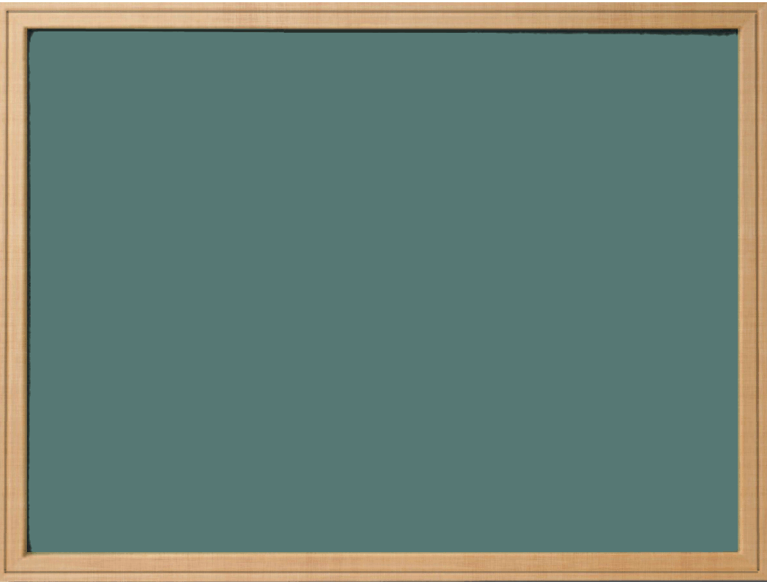
Lessons from Esther
Be aware of God’s providence: He’s working in your life and is in control
Prepare now to meet your King
Faith & Obedience are essential for us to join God’s family – practice them everyday
Our faithful way of life can be an effective witness for God
God is at war with Amalek – join the war!
Get out of Babylon mentally before it’s too late

Slide 10
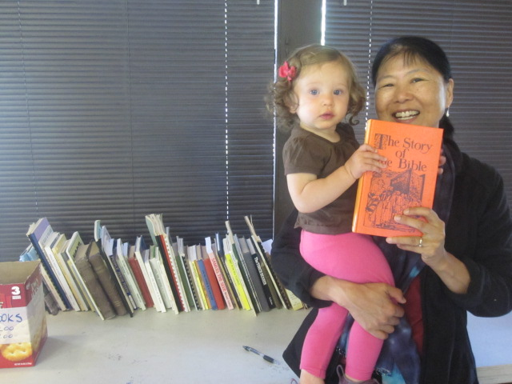
Don’t forget the used book sale!

Slide 11
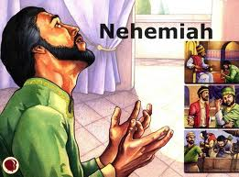
Great Lessons in Nehemiah
Motivated others to do more than they thought possible
  Set a standard for the community & stuck to it
Leadership & commitment of Nehemiah
  Great example for ourselves to follow
  He had a huge impact on the spiritual lives of others
Dealt with ecclesial problems and motivated people to rise about their problems
Let’s follow his example of Motivator & Leader

Slide 12
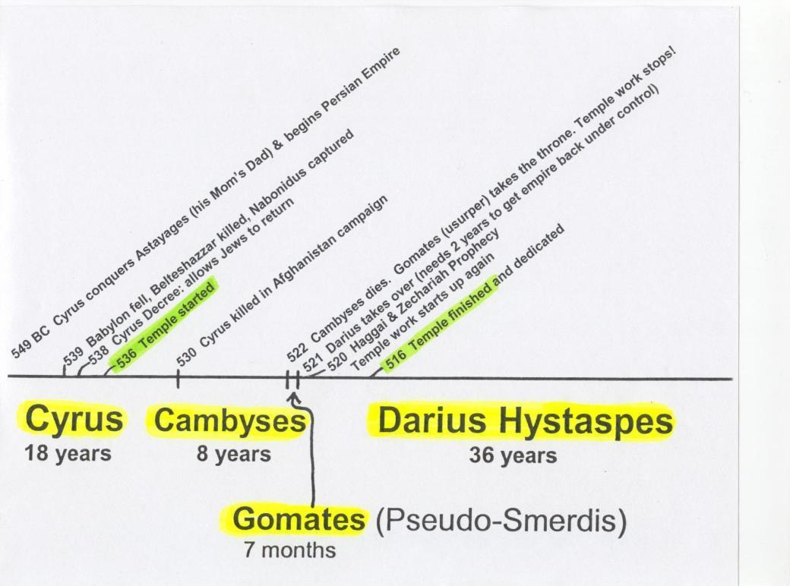
Timeline of the Persian Kings during the temple building
-- 515 Ezra returns
-- 502 Nehemiah returns
[ 10 years ]
6
20

Slide 13
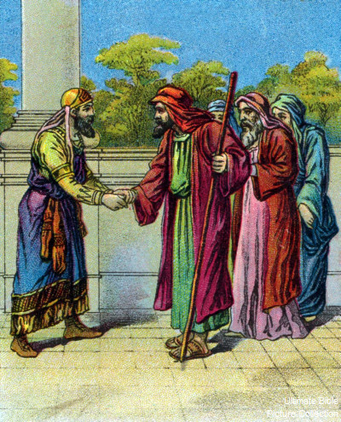
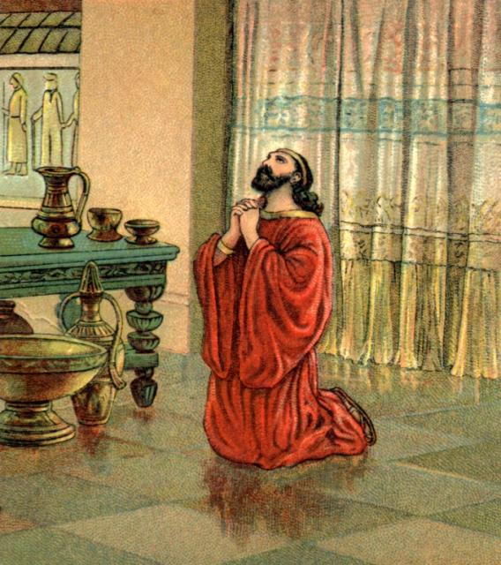
Nehemiah’s distress over the captives
Book begins with Nehemiah in Shushan in 20th year of Artaxerxes
He is the trusted cupbearer of the king
Nehemiah asked Hanani about surviving captives
  Hanani seems to be Nehemiah’s brother (7:2)
  They are in great distress (14 years since temple)
  Walls & gates of Jerusalem are still destroyed!
Nehemiah’s response (v.4):
  Wept, mourned, fasted and prayed
  A lot like Ezra (Ez 9:3,4; 10:1)
We need to respond to problems like Nehemiah: Serious commitment & prayer

Slide 14

Nehemiah 1:5-11
Nehemiah’s prayer
5 And I said: "I pray, Lord God of heaven, O great and awesome God, You who keep Your covenant and mercy with those who love You and observe Your commandments, 6 please let Your ear be attentive and Your eyes open, that You may hear the prayer of Your servant which I pray before You now, day and night, for the children of Israel Your servants, and confess the sins of the children of Israel which we have sinned against You. Both my father's house and I have sinned. 7 We have acted very corruptly against You, and have not kept the commandments, the statutes, nor the ordinances which You commanded Your servant Moses.
Note how he sees himself as part of the problem!

Slide 15
Nehemiah 1:5-11
Nehemiah’s prayer
8 Remember, I pray, the word that You commanded Your servant Moses, saying, 'If you are unfaithful, I will scatter you among the nations; 9 but if you return to Me, and keep My commandments and do them, though some of you were cast out to the farthest part of the heavens, yet I will gather them from there, and bring them to the place which I have chosen as a dwelling for My name.' 10 Now these are Your servants and Your people, whom You have redeemed by Your great power, and by Your strong hand. 11 O Lord, I pray, please let Your ear be attentive to the prayer of Your servant, and to the prayer of Your servants who desire to fear Your name; and let Your servant prosper this day, I pray, and grant him mercy in the sight of this man."
He knew he needed God’s mercy for his plan to work!

Slide 16
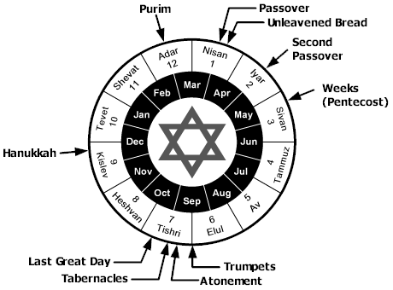
20th year of Artaxerxes (2:1)
Altho Nisan is in the next year of the Jewish calendar, it was still the 20th of Artaxerxes
Nehemiah asks the King (Neh 2)
Hanani brought news to Nehemiah (Neh 1)
Wall finished in only 52 days!

Slide 17
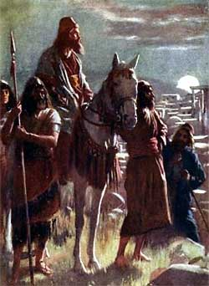
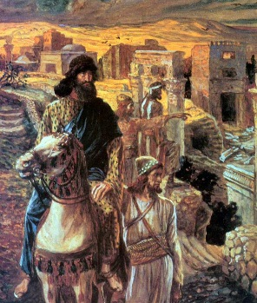
Nehemiah’s Faith (2:2-9)
He can’t hide his sadness from the king
  Nehemiah is dreadfully afraid of how the king might react to his sadness! Proceeds in faith.
He tells the king about the sad conditions of the Jews & Jerusalem
The king responds “what do you need?”
  Nehemiah prays – must have been quick!
  Asks for permission to go rebuild Jerusalem
  Queen sitting beside him = Esther!
  Tells the king about how long he will be gone
Additional requests: Had this thought out!
  Letters to governors allowing him to pass through
  Letter to Asaph for timber for: temple, wall, house
King sent army captains & horsemen with Nehemiah
Nehemiah planned ahead & had the faith to carry it out

Slide 18
Nehemiah 2:10
The opposition begins!
10 When Sanballat the Horonite and Tobiah the Ammonite official heard of it, they were deeply disturbed that a man had come to seek the well-being of the children of Israel.
Most projects come with a price! There is usually some opposition. We move forward in faith, trusting in God’s help

Slide 19
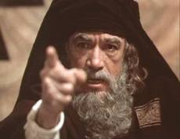
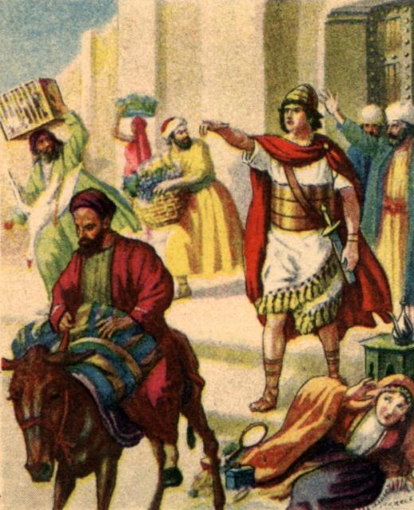
The outside opposition (2:19)
Sanballat: a Horonite (not Moabite), so probably from Beth-Horon in Ephraim making him a Samaritan.
  He was related by marriage to the son of Eliashib, the high priest at the time of the annulment of the mixed marriages forbidden by the Law (Neh 13:28).
Tobiah: an Ammonite official (slave of the Persian king) (Neh 4:1-3)
Geshem: an Arabian (Neh 6:1)
Nehemiah refused to let them stop the work!

Slide 20

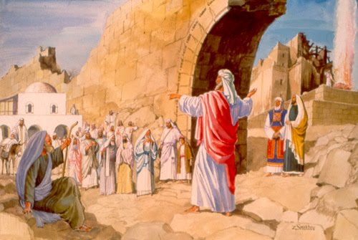
Nehemiah’s strategy to motivate his people
1st surveyed the situation to develop a plan (2:12-16)
  Went out at night & didn’t tell anyone
Explained to the people what he saw as the problem & laid out his plan to rebuild (17)
Revealed how God had been working in it all
  God had influenced the king to support the plan
People responded: “Let us arise and build” (18)
Nehemiah didn’t force them to work or tell them they had to do it. His success was in motivating the people to want to arise and build!

Slide 21
Nehemiah 2:19-20
Opposition makes it’s 1st move
19 But when Sanballat the Horonite, Tobiah the Ammonite official, and Geshem the Arab heard of it, they laughed at us and despised us, and said, "What is this thing that you are doing? Will you rebel against the king?"
20 So I answered them, and said to them, "The God of heaven Himself will prosper us; therefore we His servants will arise and build, but you have no heritage or right or memorial in Jerusalem."
Nehemiah doesn’t give an inch! He makes it clear God will support the project and these people have no right

Slide 22
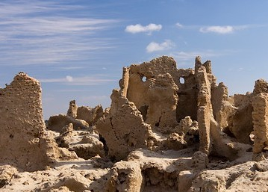
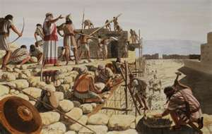
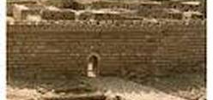
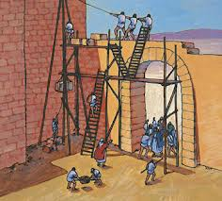
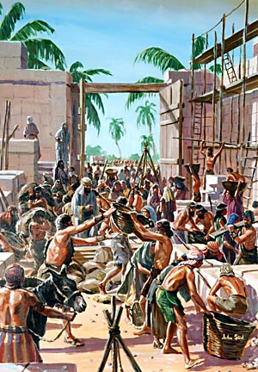
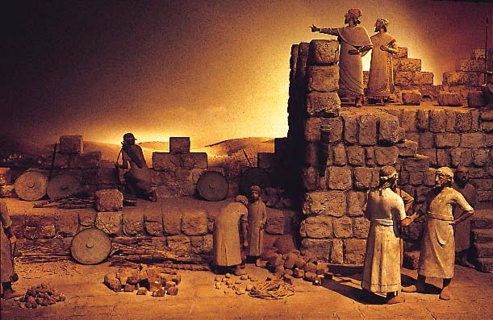
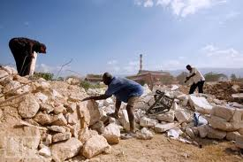
Building was hard work!
How long would you have lasted?

Slide 23
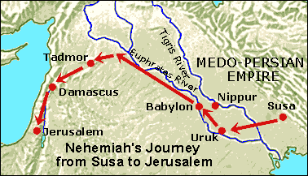
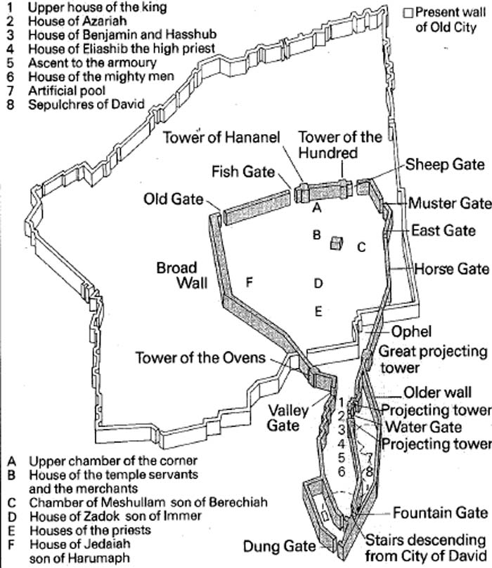
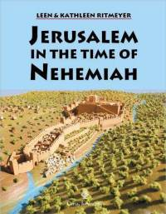
Jerusalem in the days of Nehemiah
S

Slide 24
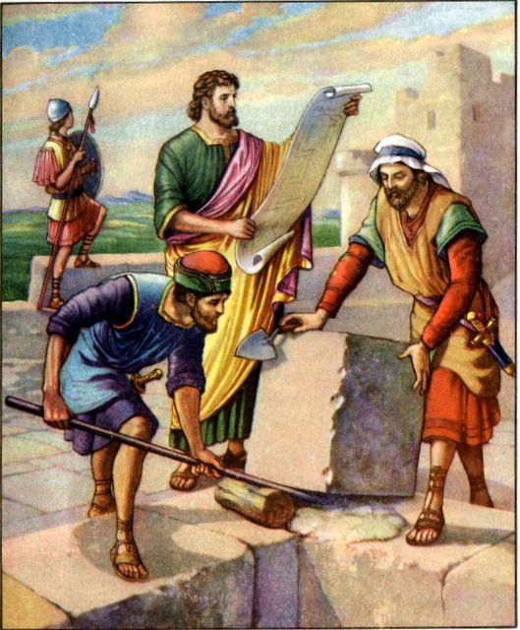
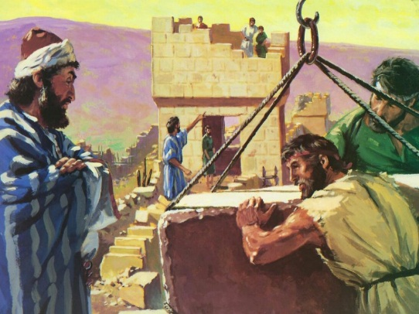
Great workers on the wall!
Most of the workers in 3:1-3 had to “build” the gates and wall sections – there was nothing left to repair on the northern wall.
Tekoites: did their section (v.5) & also another tough section (v.27)
Faithful Gibeonites (Josh 9:27) still working in Israel (v.7)
Shallum & his daughters (v.12)
Hanun & Zanoahites repaired a gate and 1000 cubits of the wall (v.13)
Malchijah, a son of Rechab –of faithful Rechabites (Jer 35)
Nethinim (Gentile servants who returned in Ezra 2:58) involved in repairing (v.26)
Many of these workers realized that they were really building Godly characters so they could become a dwelling place of God in the Spirit (Eph 2:22)

Slide 25
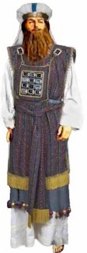
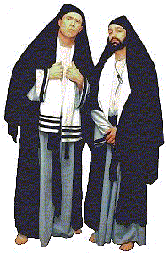
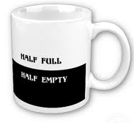
☹ Disappointing workers ☹
Eliashib the high priest built a gate with some help, but he didn’t finish around his own house like other priests (v.20-23) & later became allied with Tobiah (13:4)
Nobles of Tekoah didn’t work hard (v.5): probably not used to physical labor & may have thought it was beneath them.
One of our great challenges is to not get discouraged if some today are not engaged in God’s work. Focus on and be thankful for the many workers God has given us!

Slide 26
Look at what Nehemiah’s motivation accomplished with God’s help
Many of the Jewish people took up the responsibility to work on the wall
Many people had a greater awareness of God involved in their lives
People worked together to accomplish a united goal – great ecclesial unity!
Ecclesial projects can unite ecclesias and bring about spiritual growth

Slide 27
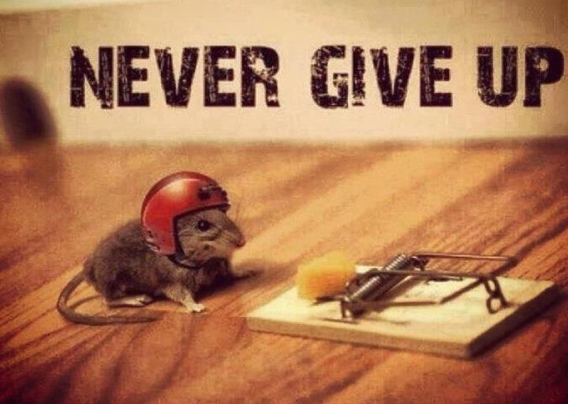
Let’s go home this week committed to become motivators like Nehemiah

Slide 28

Let’s leave camp, committed to go home and motivate each other, like Nehemiah did, to live for God
And let us consider how we may spur one another on toward love and good deeds. (Heb 10:24)

Slide 30
2
S
G

Slide 31
2
S
G

Slide 32
2
S
G

Slide 33
2
W
17
!

Slide 34
2
W
17
!

Slide 35
2
W
17
!

Slide 36
2
W
17
!

Slide 37
2
W
17
!

Slide 38
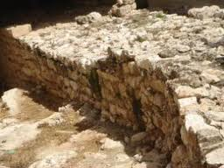
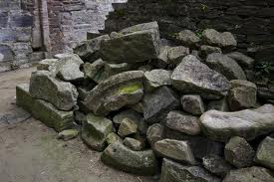

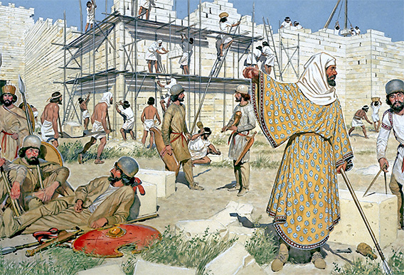
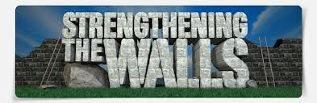
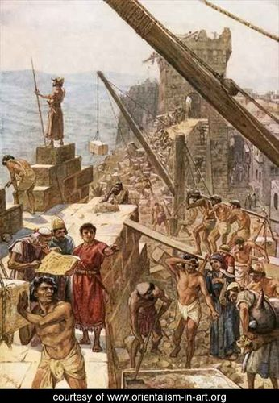
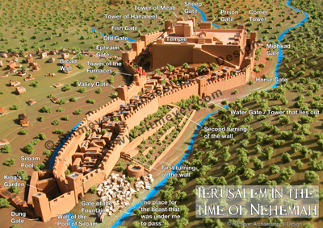
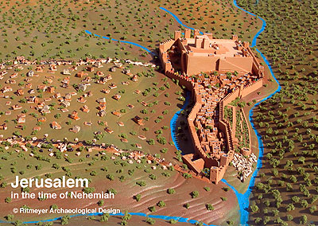
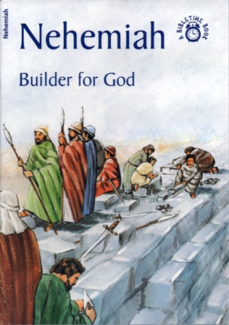
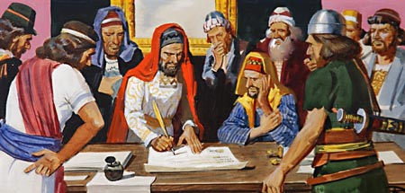
2
G

