Slide 1
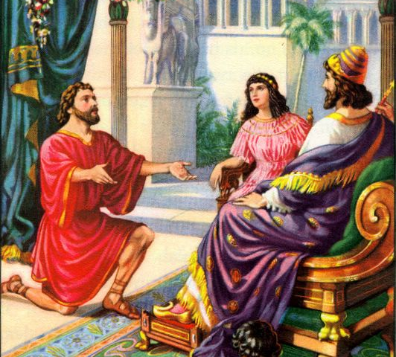
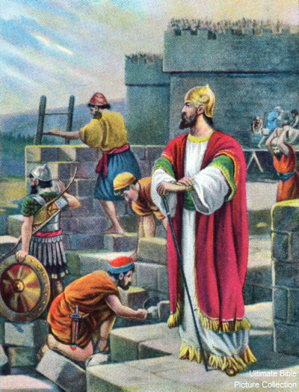
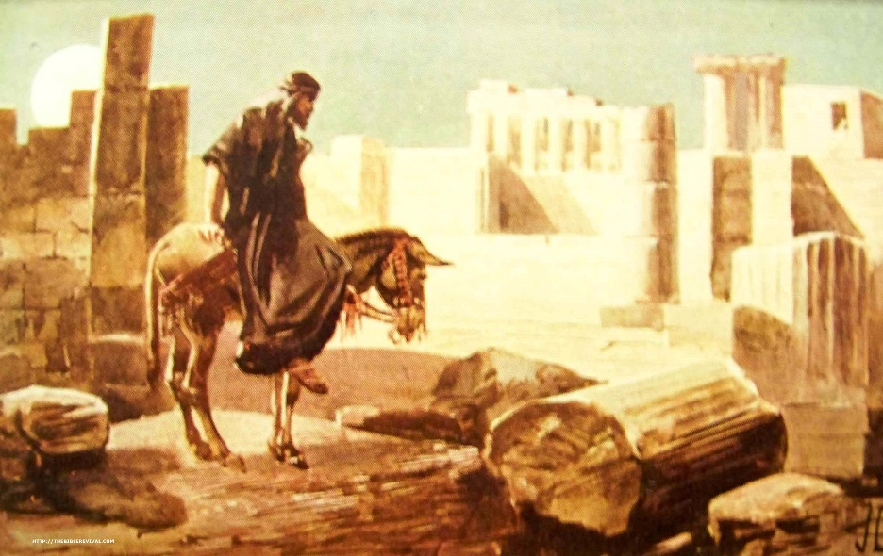
Nehemiah the Leader
Notes:
In those days I was the king's cup-bearer (11b).
1. Wiersbe also notes, "A cupbearer was much more than our modern 'butler' (see Gen. 40). It was a position of great responsibility and privilege. At each meal, he tested the king's wine to make sure it wasn't poisoned. A man who stood that close to the king in public had to be handsome, cultured, knowledgeable in court procedures, and able to converse with the king and advise him if asked (see 41:1–13). Because he had access to the king, the cupbearer was a man of great influence, which he could use for good or for evil."
2. "That Nehemiah, a Jew, held such an important position in the palace speaks well of his character and ability (Dan. 1:1–4). For nearly a century, the Jewish remnant had been back in their own land, and Nehemiah could have joined them; but he chose to remain in the palace. It turned out that God had a work for him to do there that he could not have accomplished elsewhere. God put Nehemiah in Susa just as He had put Esther there a generation before, and just as He had put Joseph in Egypt and Daniel in Babylon. When God wants to accomplish a work, He always prepares His workers and puts them in the right places at the right time."
Ibid.

Slide 2

Nehemiah 4:1-6
Opposition pushes!
1 But it so happened, when Sanballat heard that we were rebuilding the wall, that he was furious and very indignant, and mocked the Jews. 2 And he spoke before his brethren and the army of Samaria, and said, "What are these feeble Jews doing? Will they fortify themselves? Will they offer sacrifices? Will they complete it in a day? Will they revive the stones from the heaps of rubbish — stones that are burned?"
3 Now Tobiah the Ammonite was beside him, and he said, "Whatever they build, if even a fox goes up on it, he will break down their stone wall."
4 Hear, O our God, for we are despised; turn their reproach on their own heads, and give them as plunder to a land of captivity! 5 Do not cover their iniquity, and do not let their sin be blotted out from before You; for they have provoked You to anger before the builders.
6 So we built the wall, and the entire wall was joined together up to half its height (40-100ft), for the people had a mind to work.
Prayer & commitment saved the day!

Slide 3
Nehemiah 4:7-12
The opposition enlarges
7 Now it happened, when Sanballat, Tobiah, the Arabs, the Ammonites, and the Ashdodites heard that the walls of Jerusalem were being restored and the gaps were beginning to be closed, that they became very angry, 8 and all of them conspired together to come and attack Jerusalem and create confusion. 9 Nevertheless we made our prayer to our God, and because of them we set a watch against them day and night.
10 Then Judah said, "The strength of the laborers is failing, and there is so much rubbish that we are not able to build the wall."
11 And our adversaries said, "They will neither know nor see anything, till we come into their midst and kill them and cause the work to cease."
12 So it was, when the Jews who dwelt near them came, that they told us ten times, "From whatever place you turn, they will be upon us."
Nehemiah turned to prayer & action, trusting God would bless their work

Slide 4
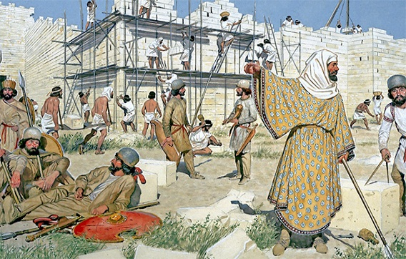
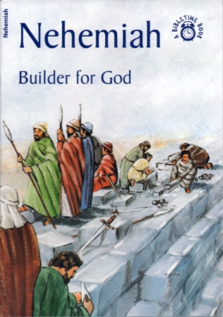
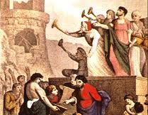
Nehemiah’s Defense Plan (4:13-23)
Set up defenses: swords, spears, bows (13)
Reminded leaders & people of the greatness of their God
Motivated them to fight for their brethren, sons, daughters, wives & houses
When the plan worked, Nehemiah gave the credit to God “who brought their (adversary’s) counsel to nothing” (15)
From then on, half the people worked & half defended & the leaders supported them (16)
Nehemiah set up a trumpet warning system (vs 19-20)
He convinced the workers to stay in the city over night to help defend (22)
Great blend of prayer & action – they did their part

Slide 5
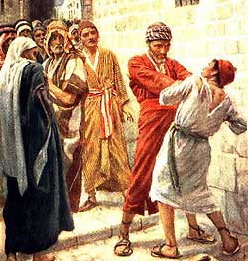
Internal Troubles (Neh 5)
Complaints against the Jewish brethren (1-5):
  The workers needed to get food to feed their families
  The workers had to borrow money to feed their families
  Workers had to sell their children as slaves to pay the King’s tax on their lands
Nehemiah discovers the leaders are charging their brethren a lot of interest (0.01 %) [vs 6-8]
  Many Jews had worked hard to buy their enslaved brethren back from foreigners – now they were being made slaves again!
Nehemiah’s solution: do right before God (9-11):
  Give back vineyards, olives trees & house right away
  Give back the interest you charged
  He requires the priests & leaders to take an oath (13)
Whole group said “amen” & did it!

Slide 6
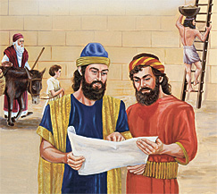
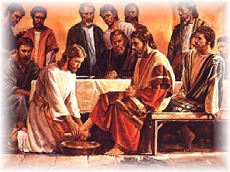
Nehemiah’s Personal Commitment (vs 14-18)
For 12 years as governor, he didn’t eat food from the people as previous governors had done
He worked on the wall & didn’t buy fields
He fed 150 Jewish people & officers, as well as foreign visitors
He didn’t want to further burden his Jewish brethren who were giving their all
If I, your Lord and Teacher, have washed your feet, you also should wash each other's feet (John 13:14)

Slide 7
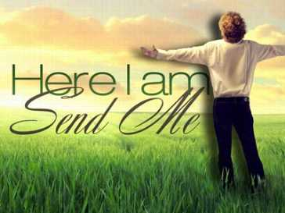
We must first be committed ourselves, to become an effective Leader for our Families & Ecclesias
Nehemiah’s Spirit

Slide 8
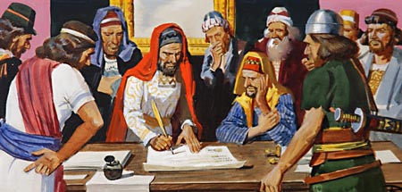
Adversaries try to harm Nehemiah (Neh 6)
Wall visibly getting done: no breaks in it (6:1)
Sanballat, Tobiah, Geshem & others step up their efforts to stop the wall by trying to harm Nehemiah (6:2-4)
  Ask to meet with him 4 times
  Nehemiah responds “I am doing a great work, can’t stop”
Adversaries write an open letter (6:5-7)
  Claim Nehemiah plans to rebel & make himself king
  Nehemiah prays for God’s help (6:9)
Jewish traitors & false prophets try to get Nehemiah to disappear – hide in the temple (6:10-14)
True Leadership: Don’t run, stand up to adversaries, trust in God’s help

Slide 9

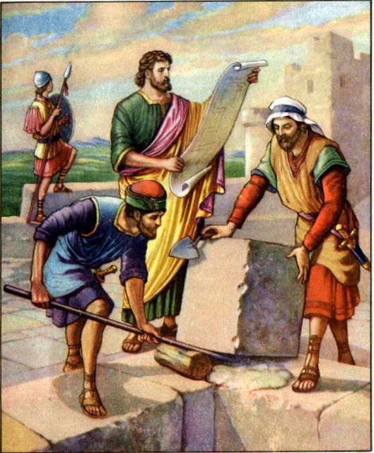
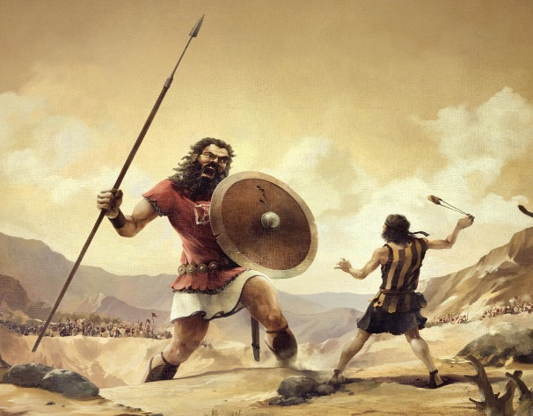
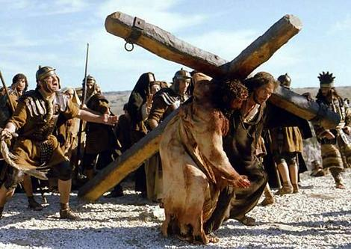
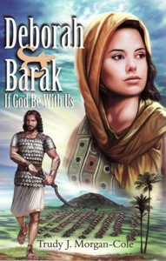
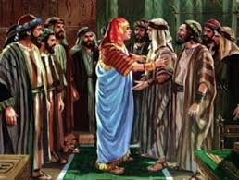
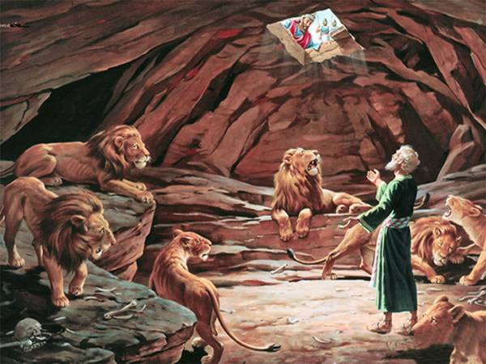

Slide 10
Nehemiah 6:15-16
Effective Witness
15 So the wall was finished on the 25th day of Elul, in 52 days. 16 And it happened, when all our enemies heard of it, and all the nations around us saw these things, that they were very disheartened in their own eyes; for they perceived that this work was done by our God.
People are watching the impact of our God in our lives & they are affected by it

Slide 11
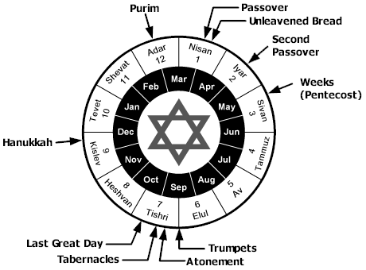
20th year of Artaxerxes
Altho Nisan is in the next year of the Jewish calendar, it was still the 20th of Artaxerxes
Nehemiah asks the King (Neh 2)
Hanani brought news to Nehemiah (Neh 1)
Wall finished in only 52 days!

Slide 12
Nehemiah 6:17-19
There have always been internal troubles!
17 Also in those days the nobles of Judah sent many letters to Tobiah, and the letters of Tobiah came to them. 18 For many in Judah were pledged to him, because he was the son-in-law of Shechaniah the son of Arah, and his son Jehohanan had married the daughter of Meshullam the son of Berechiah. 19 Also they reported his good deeds before me, and reported my words to him. Tobiah sent letters to frighten me.
Leadership requires that we trust God to help us stand against those who do not follow Truth

Slide 13
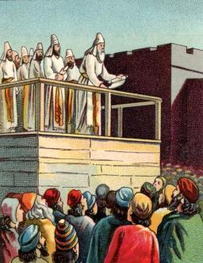
Spiritual Revival: Ezra Reads the Law (Neh 8)
People gathered as one man in the open square on the 1st day of the 7th month (8:1)
  6 months passed since Nehemiah asked King for permission to visit Jerusalem (month Nisan [Abib])
Ezra read the law from morning till midday to everyone who could understand [men & women] (8:3)
Ezra blessed the Lord & the people worshipped (8:6)
Levites & others read the law, “making it clear and giving the meaning (NIV) ” so everyone could understand (8:7-8)

Slide 14
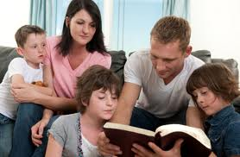
Effective Family Bible Readings
Pick a time when most are free, full and not distracted
Make it fun! Be creative & have snacks!
Pick a version everyone can understand
Explain what you read (better to read a little with understanding than three sections you don’t understand!)
Ask questions….stimulate thinking about lessons that apply to our lives
Oh, how I love Your law! It is my meditation all the day. (Psalm 119:97)

Slide 15
Nehemiah 8:9-12
Rejoicing in our God
9 And Nehemiah, who was the governor, Ezra the priest and scribe, and the Levites who taught the people said to all the people, "This day is holy to the Lord your God; do not mourn nor weep." For all the people wept, when they heard the words of the Law.
10 Then he said to them, "Go your way, eat the fat, drink the sweet, and send portions to those for whom nothing is prepared; for this day is holy to our Lord. Do not sorrow, for the joy of the Lord is your strength."
11 So the Levites quieted all the people, saying, "Be still, for the day is holy; do not be grieved." 12 And all the people went their way to eat and drink, to send portions and rejoice greatly, because they understood the words that were declared to them.
We should rejoice & be glad when we consider our loving God and what He has done for us!

Slide 16
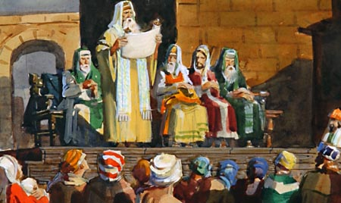
Impact of Reading God’s word
People read the word and find out about the feast of booths in the 7th month (8:13-15)
They decide to keep the feast (8:16-18)
  Reminded them of God’s great salvation from bondage in Egypt
  Supposed to be a time of great joy
24th day of month: assembled with fasting, sackcloth, dust on heads (9:1)
  Israelites separated from foreigners
  Confessed their sins & sins of ancestors
  Stood & read from God’s word for ¼ of the day
  Worshipped & confessed their sins for ¼ of the day
Praised God for His loving kindness, patience, mercy & faithfulness – then made a covenant to follow Him

Slide 17
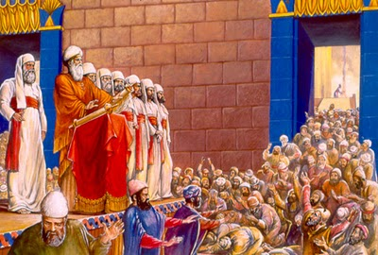
The Covenant they sealed with an oath & a curse (Neh 10:28-39)
Walk in God’s law and obey His commands
No marriages with unbelievers of the land
No buying on the Sabbath
Forego the 7th year’s produce & debts
Also made ordinances for themselves:
  Pay annual 1/3 shekel tax for operating temple
  Cast lots to determine who brings wood
  Made ordinances to bring firstfruits & tithes
Committed to keep the temple operating
Cast lots to bring 10% of people to Jerusalem (11)

Slide 18
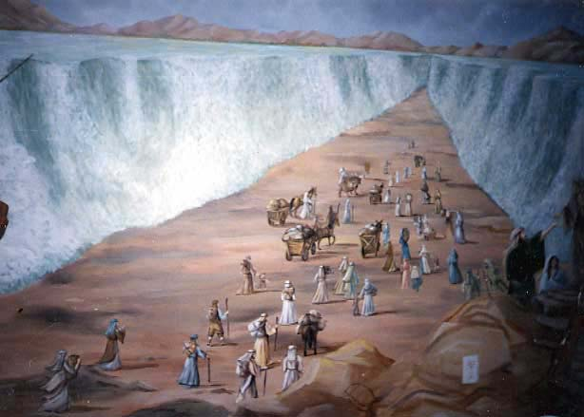
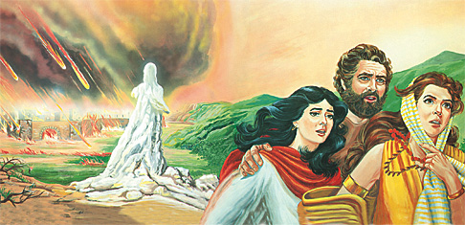
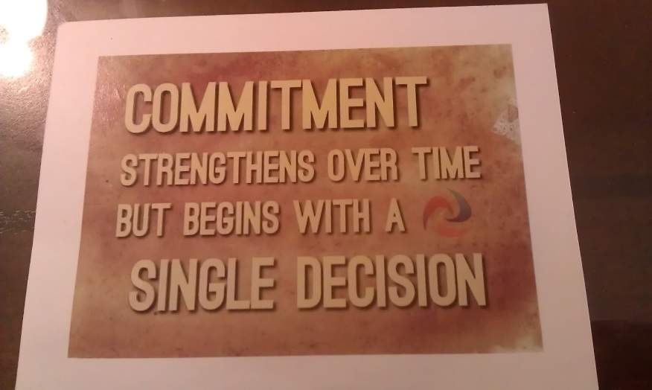
Making a commitment to God
S
It’s time for us to commit! Let’s go home & get involved in God’s family!

Slide 19
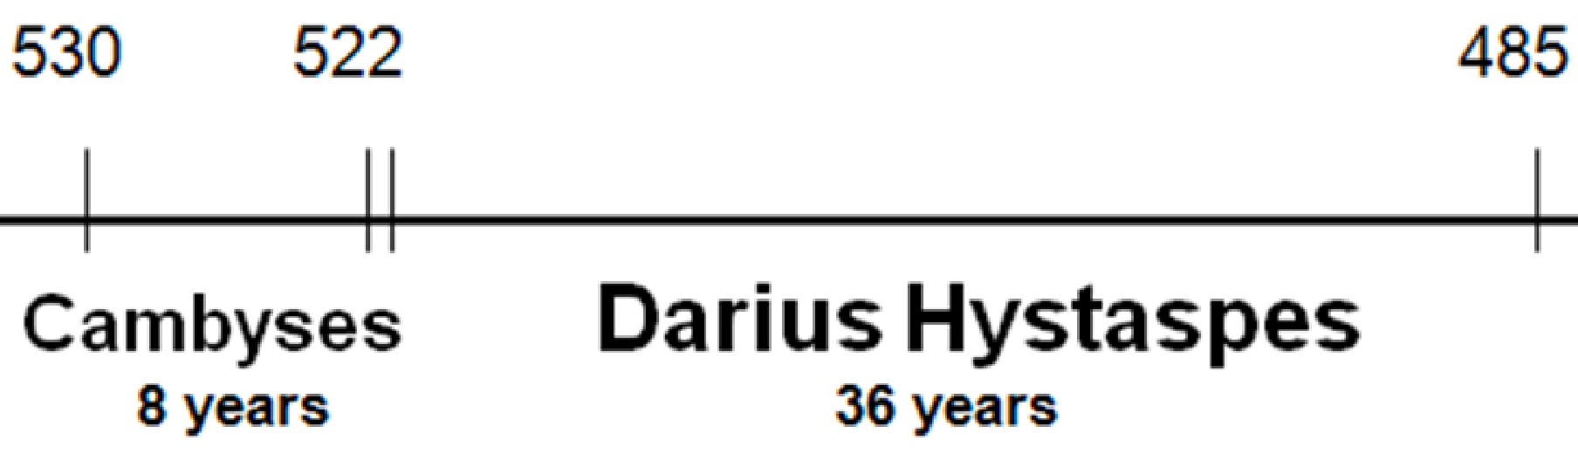
Nehemiah returns to the King in the 32nd year, and then later comes back to Jerusalem
Nehemiah returned to king, then came back
Nehemiah builds wall
Temple finished
Ezra returns
6 7
20
32
Malachi’s Prophesy
In a short time, many of the people broke the covenant they had sealed

Slide 20
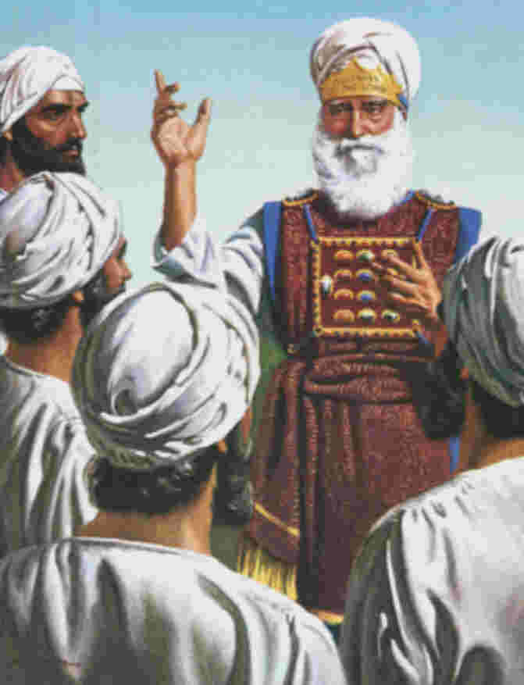
The Evils of Eliashib the High Priest
Eliashib (High Priest)
Joiada (12:22)
Sanballat
Manasseh (13:28)
Nicaso
(Sanballat’s Daughter)
According to Josephus
According to HPM
Eliashib allied himself with Sanballat

Slide 21
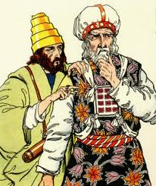
Tobiah weasels his way into power
Arah
Berechiah
(a priest 3:28,30)
Shecaniah
Meshullam Foremost in building (3:4, 30)
Daughter
Tobiah
Daughter
Jehohanan

Slide 22
The Evils of Eliashib the High Priest
Gave temple chamber to Tobiah (13:4,5)
Faithful priests flee because they have no support & return to the fields (13:10-14)
Temple worship is forsaken (13:11)
Sabbath profaned by Gentile traders and Jewish buyers (13:15-22)
Marriage to unbelievers: Children spoke only the language of Ashdod, Ammon & Moab (13:23-27)
Eliashib failed as a leader & motivator, because he was in it for himself!

Slide 23

Let’s leave camp and try to be a leader like Nehemiah, or at least support our leaders who try to help us doing God’s work
Shepherd the flock of God which is among you, serving as overseers, not by compulsion but willingly, not for dishonest gain but eagerly; 3 nor as being lords over those entrusted to you, but being examples to the flock; 1 Peter 5:2-3

Slide 24
2
S
G

Slide 25
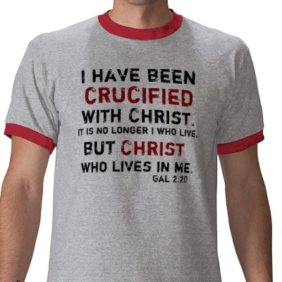

Slide 26
2
W
17
!

Slide 27
2
W
17
!

Slide 28
2
W
17
!

Slide 30
2
W
17
!

Slide 31
Nehemiah’s Leadership
1. He established a reasonable & attainable goal.
2. He had a sense of mission.
3. He was willing to get involved.
4. He rearranged his priorities to accomplish his goal.
5. He patiently waited for God's timing.
6. He showed respect to his superior.
7. He prayed at crucial times.
8. He made his request with tact and graciousness.
9. He was prepared & thought of his needs in advance.
10. He went through proper channels.
G

Slide 32
Nehemiah’s Leadership
11. He took time (3 days) to rest, pray & plan.
12. He investigated the situation firsthand.
13. He informed others only after he saw the problem's size.
14. He identified himself as one with the people.
15. He set before them a reasonable & attainable goal.
16. He assured them God was in the project.
17. He displayed self-confidence in facing obstacles.
18. He displayed God's confidence in facing obstacles.
19. He did not argue with opponents.
20. He was not discouraged by opposition.
21. He courageously used the authority of his position.
G

Slide 33
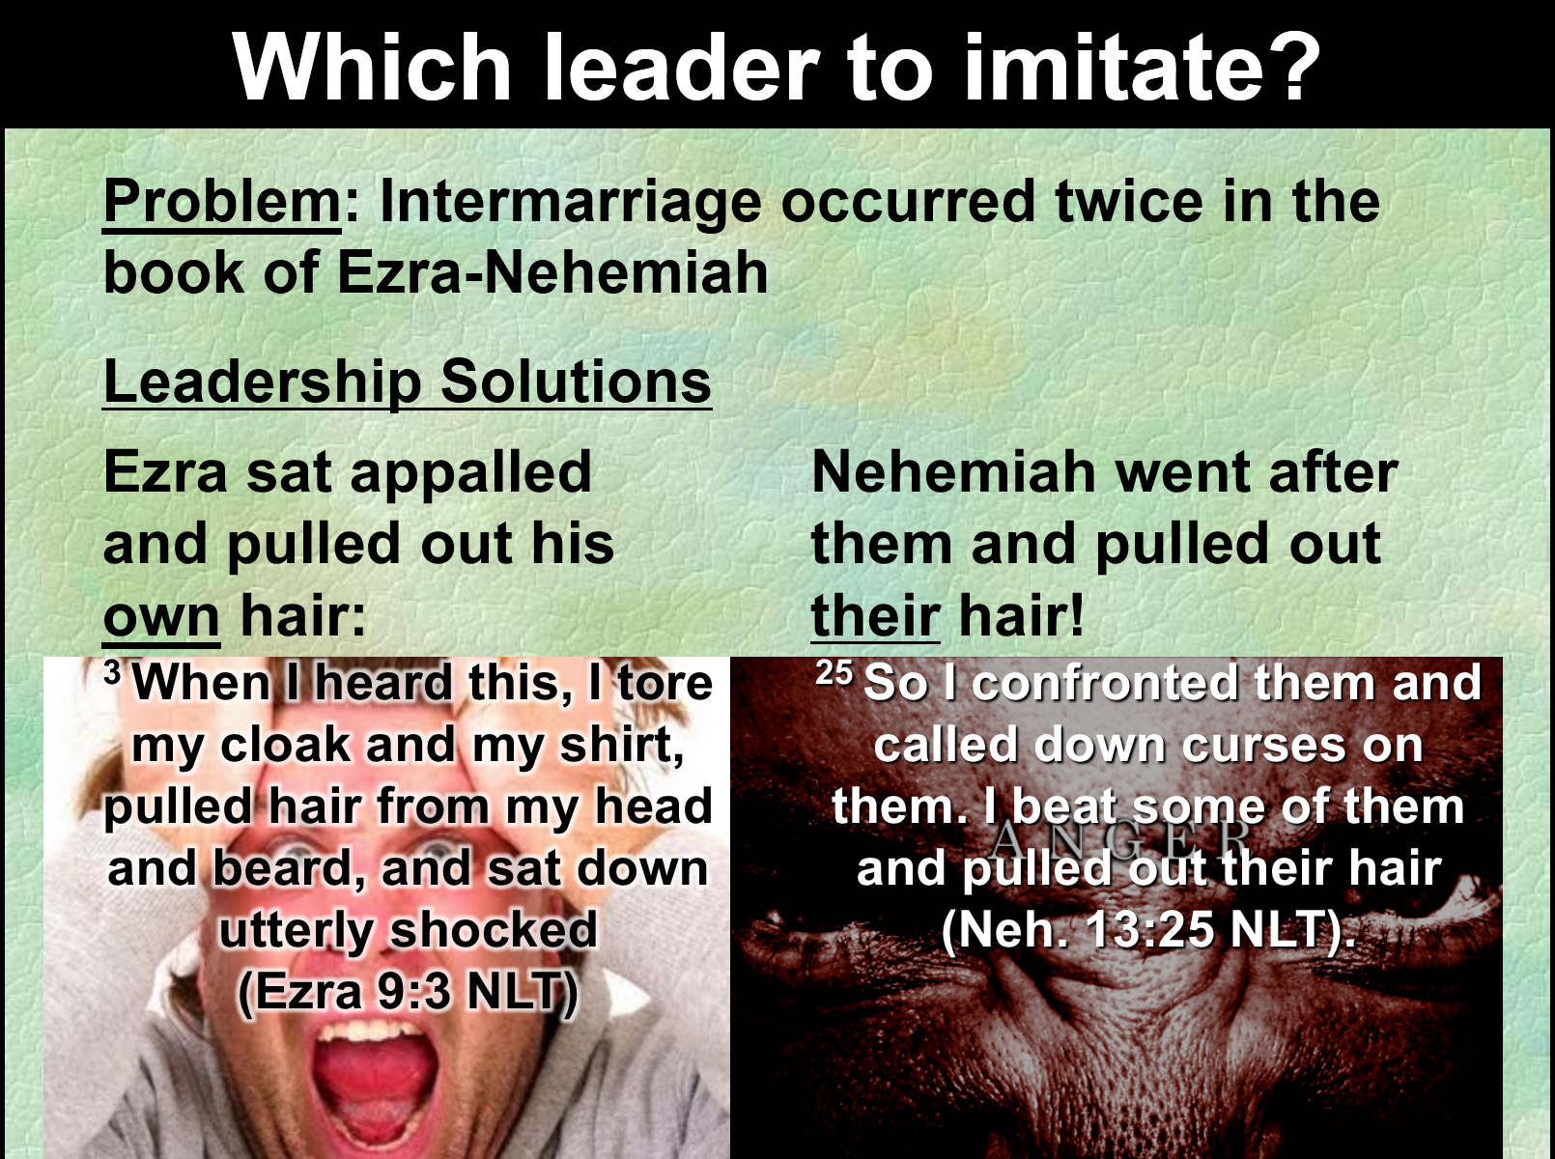

Slide 36
2
S
G

Slide 38
2
S
G

Slide 39
2
S
G

Slide 40
2
17
G

Slide 41
2
17
G

Slide 42
2
W
17
!

Slide 43
2
W
17
!

Slide 44
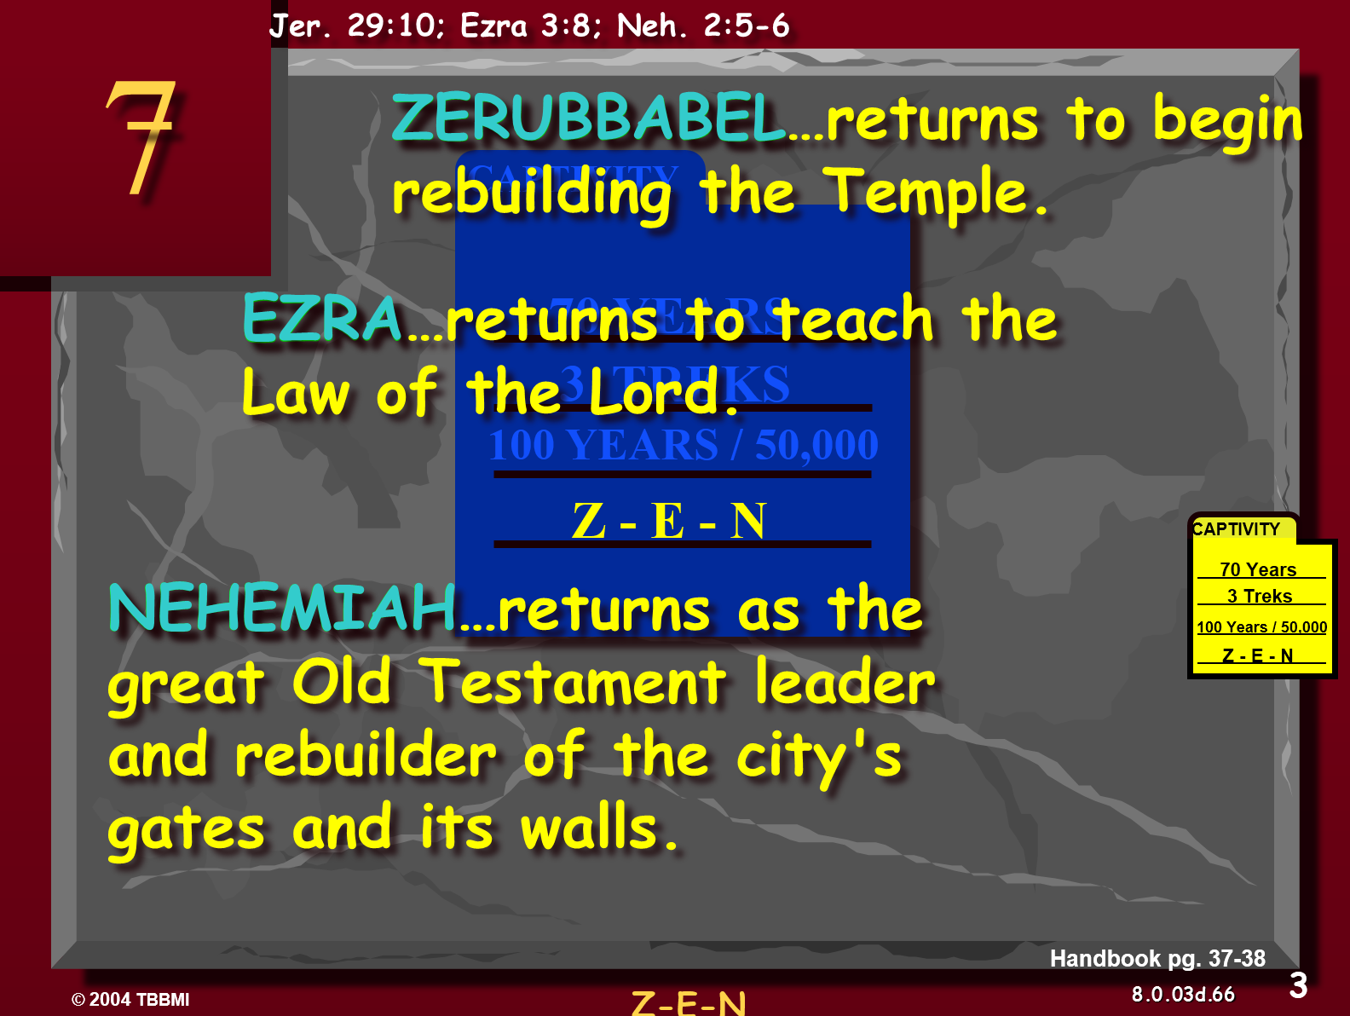

Slide 45
2
W
17
!

Slide 46
2
W
17
!

Slide 47
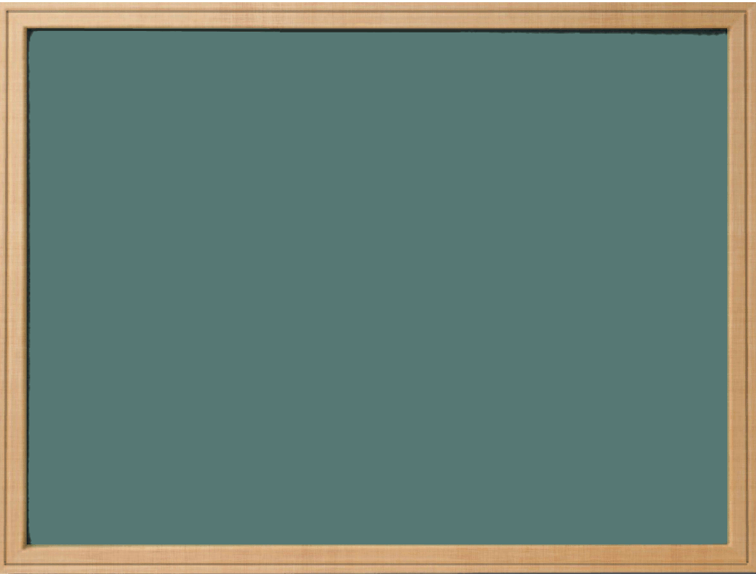
Lessons from Today
Even

Slide 48
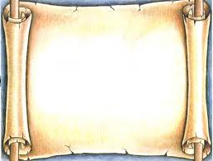
2
S
G

Slide 49
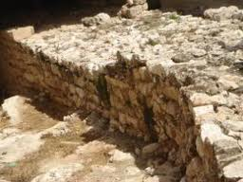
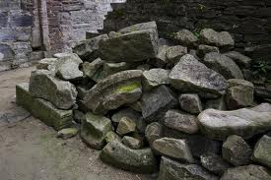
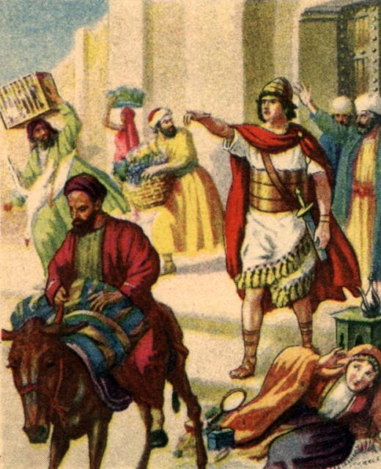
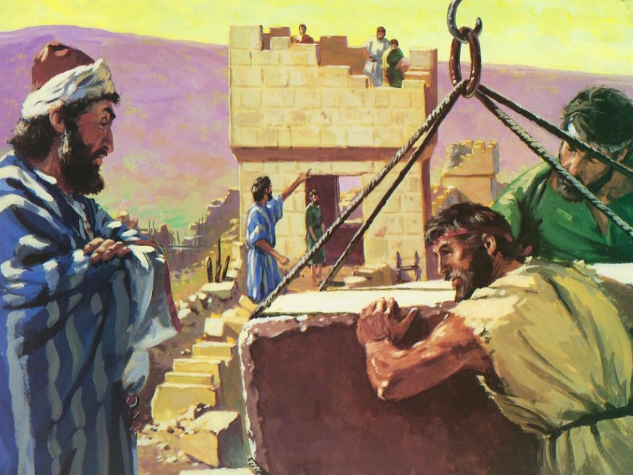

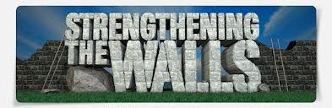
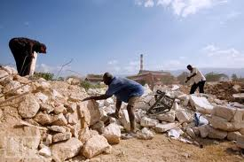
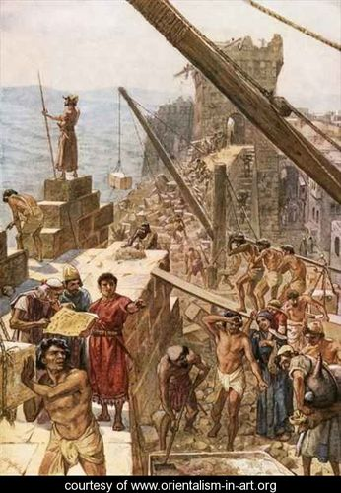
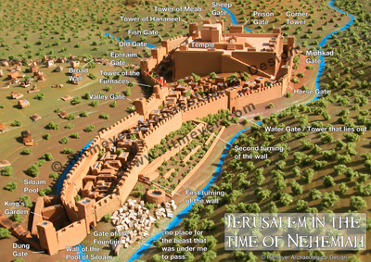
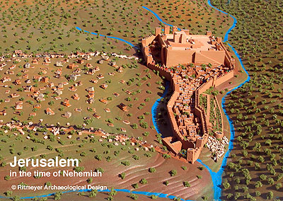
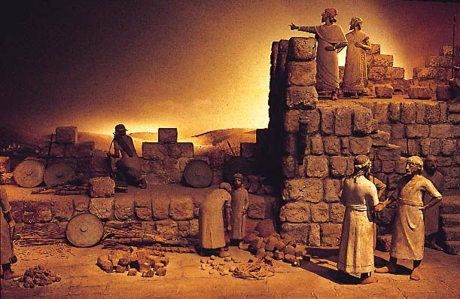
2
G

