Slide 1
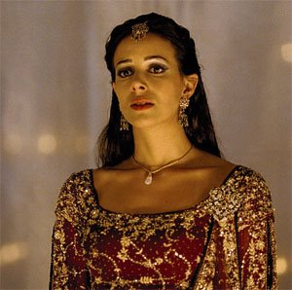
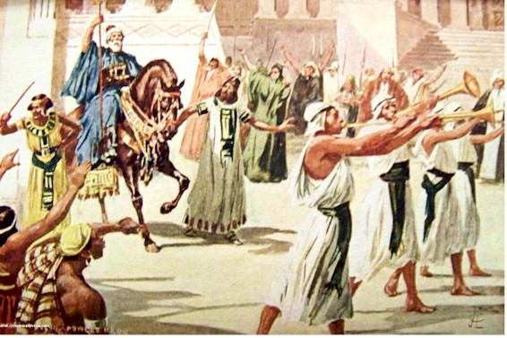
Esther:
Childlike trust in God
Mordecai
God’s faithful leader

Slide 2
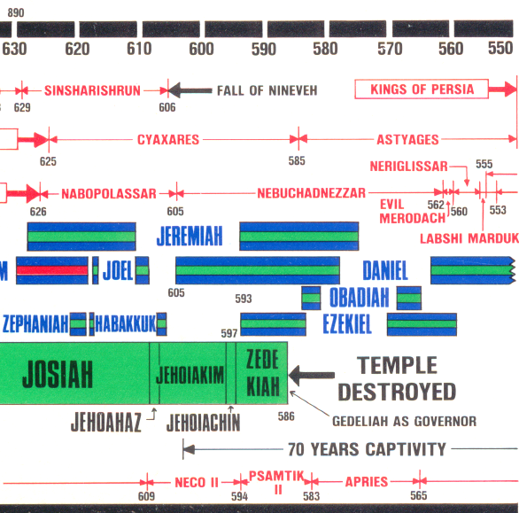
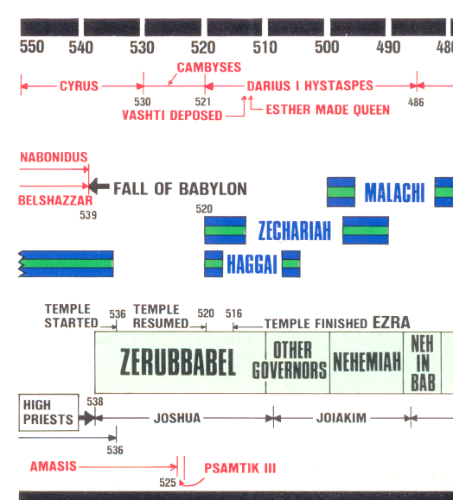
Where are we on the timeline?

Slide 3

Esther 1:1-4
Who is the king?
Now it came to pass in the days of Ahasuerus (this was the Ahasuerus who reigned over one hundred and twenty-seven provinces, from India to Ethiopia), 2 in those days when King Ahasuerus sat on the throne of his kingdom, which was in Shushan the citadel, 3 that in the third year of his reign he made a feast for all his officials and servants — the powers of Persia and Media, the nobles, and the princes of the provinces being before him — 4 when he showed the riches of his glorious kingdom and the splendor of his excellent majesty for many days, one hundred and eighty days in all.
The only Persian king to reign over 127 provinces was Darius Hystaspes

Slide 4
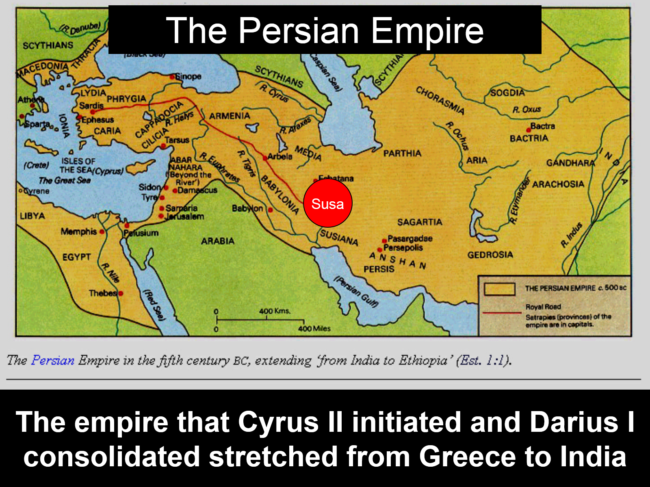

Slide 5
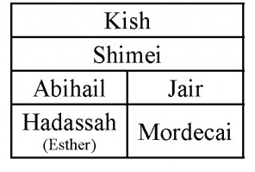
Esther 2:5-7
Esther & Mordecai were related
5 In Shushan the citadel there was a certain Jew whose name was Mordecai the son of Jair, the son of Shimei, the son of Kish, a Benjamite. 6 Kish had been carried away from Jerusalem with the captives who had been captured with Jeconiah king of Judah, whom Nebuchadnezzar the king of Babylon had carried away. 7 And Mordecai had brought up Hadassah, that is, Esther, his uncle's daughter, for she had neither father nor mother.
So Mordecai was Esther’s cousin, not his uncle!

Slide 6

Timeline of the Persian Kings during the temple building
3
Book of Esther begins

Slide 7
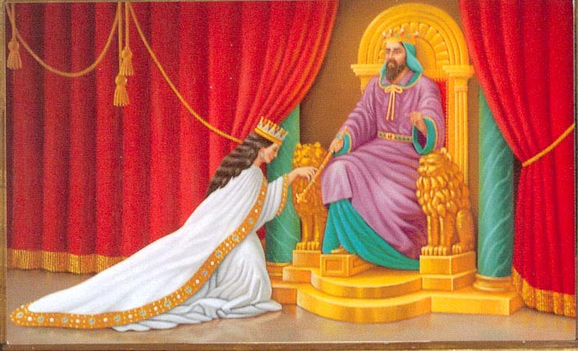
Purpose of the Story of Esther
Show how God is in control, even when things seem out of control, and He will be faithful to His promises
Demonstrate God’s providence – He is involved in our lives even when there is no open manifestation of angels or miracles
Motivate the Jewish captives in Babylon to return to the land of Israel
Illustrate how God continues to war against Amalek (Sin) and redeem His children
This story is recorded with specific messages to the captives & exiles – like the story of Melchizedek

Slide 8

Themes with lessons for us
God’s providence: He is in control & working
Preparation: to meet our King
Obedience: to our Heavenly Father & Lord
Faith in God: demonstrated in action
Witnessing: our actions can draw others to God
God’s war with Amalek (Sin): He’s still fighting
Get out of Babylon: before it’s too late!
This story was recorded to teach us these lessons

Slide 9

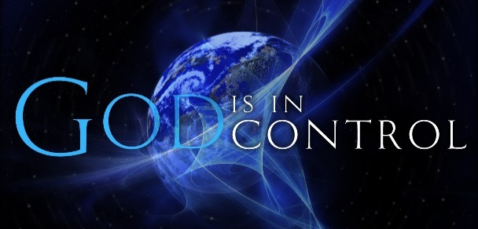
God’s Providence (but no mention of God)
2:21-23 Mordacai just happened to hear Bigthana & Teresh’ plan to hurt the king
Then it just happened to be recorded in the chronicles of the kings
4:13-14 Mordecai understood deliverance would arise to save the Jews
You may have come to the kingdom at this time so you can influence the king!
6:1-3 King couldn’t sleep & just happened to read about Mordecai’s revelation of Bigthana & Teresh’s plan to harm the king
6:10-11 Haman has to lead Mordecai around showing people that the king honors him
7:10 Haman gets hung on the very gallows he had built to hang Mordecai on
Providence is still operating today & we see it by Faith

Slide 10
Philemon 10-16 (RSV)
Looking for God’s providence
10 I appeal to you for my child, Onesimus, whose father I have become in my imprisonment. 11 (Formerly he was useless to you, but now he is indeed useful to you and to me.) 12 I am sending him back to you, sending my very heart. 13 I would have been glad to keep him with me, in order that he might serve me on your behalf during my imprisonment for the gospel; 14 but I preferred to do nothing without your consent in order that your goodness might not be by compulsion but of your own free will.
15 Perhaps this is why he was parted from you for a while, that you might have him back for ever, 16 no longer as a slave but more than a slave, as a beloved brother, especially to me but how much more to you, both in the flesh and in the Lord.
Look for God’s involvement in your life! He talks to us in many different ways

Slide 11
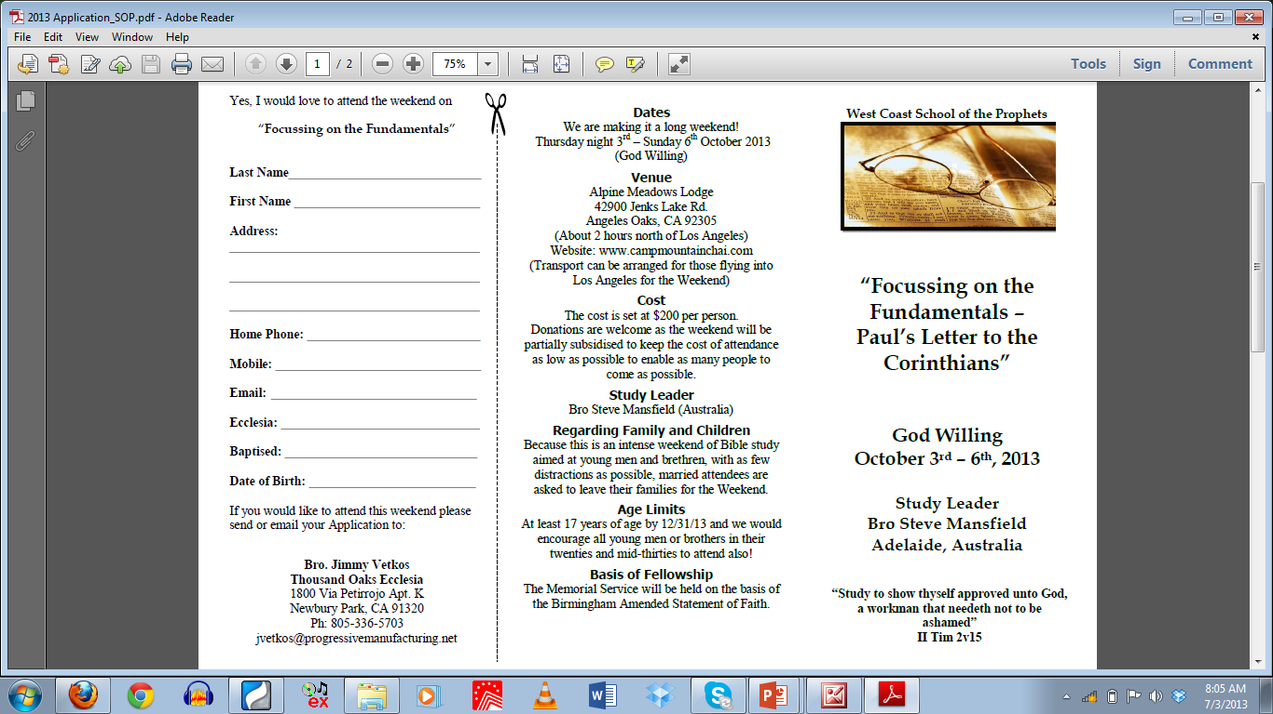

Slide 12
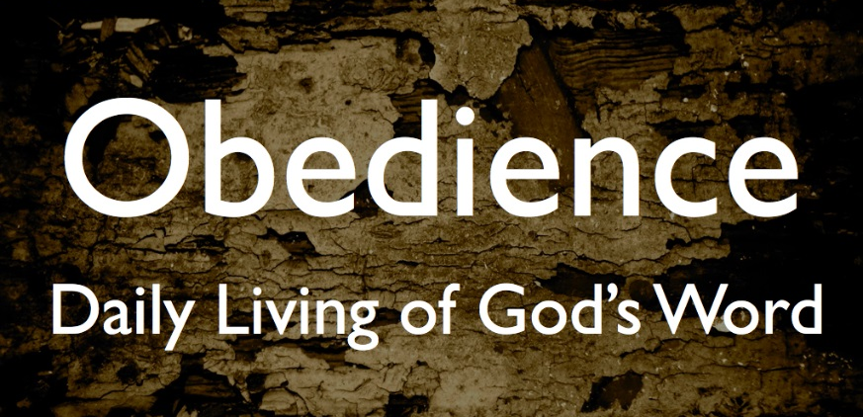
Esther’s Obedience
To the king (as opposed to Vashti’s disobedience)
  Decree that all wives honor their husbands (1:21-22)
To Hegai (2:15): she only took what Hegai suggested
To Mordecai (2:20): Esther still obeyed the command of Mordecai as when she was brought up by him
This was one of the issues that caused the captivity in the first place – disobedience to God’s commands!

Slide 13
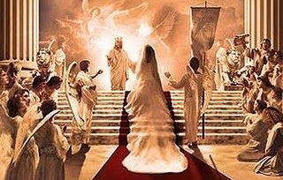

Preparation to meet the King
2:3 Let the maidens get beauty treatments
2:9 Hegai gave Esther beauty treatments and special food
2:12 Esther had to complete 12 months of beauty treatments
  6 months with oil of myrrh
  6 months with perfumes and cosmetics
2:17 The King loved Esther and she received grace and favor
God tries to remind us we need to prepare to meet our God (Amos 4:12)

Slide 14
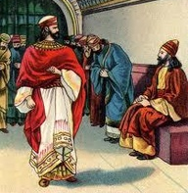
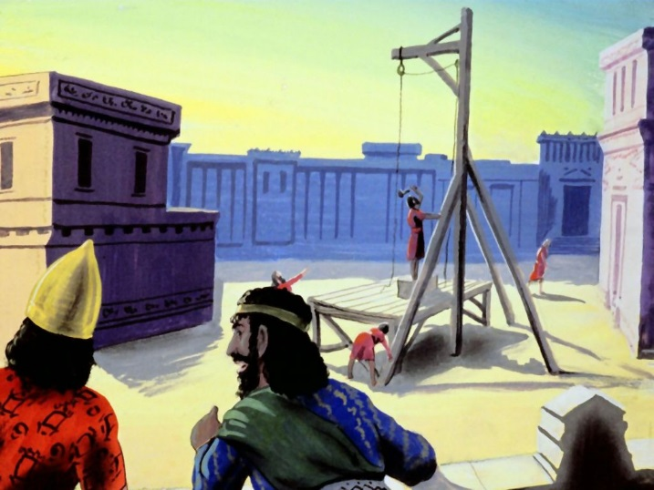
God’s war with Amalek (Sin)
Haman is an Agagite (3:1):
  Agag was king of the Amalekites (1 Sam 15:8)
  God promised to wipe out the remembrance of Amalek (Ex 17:14)
  God swore He would continually war with Amalek (Ex 17:16)
  Saul spared Agag, but Samuel hacked him in pieces (1 Sam 15:9, 33)
Haman wanted to kill all Jews – the people of Mordecai (3:6)
Haman is hung (7:10)
Haman’s 10 sons are killed & then hung on gallows (9:10, 14)
Esther receives all Haman’s house (8:1)
God has promised He will defeat Sin

Slide 15
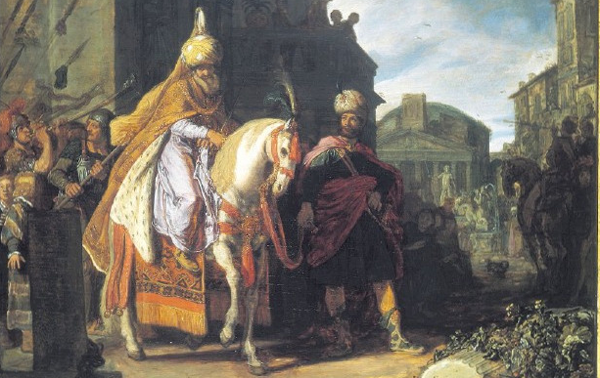
Mordecai’s Elevation: predicted Jesus’ elevation to God’s right hand
Mordecai gets King’s signet ring and is appointed over Haman’s house (8:1-2)
Mordecai writes decree to save the Jews from annihilation (8:9-14)
Gentiles became fearful of Mordecai, for he was prominent in the palace & his reputation spread (9:4)
Mordecai writes decree for annual celebration of Purim (9:20-22)
Summary of the elevation of Mordecai the Jew (10:1-3)
God promised all along to provide a savior of His people. We need to trust Him.

Slide 16
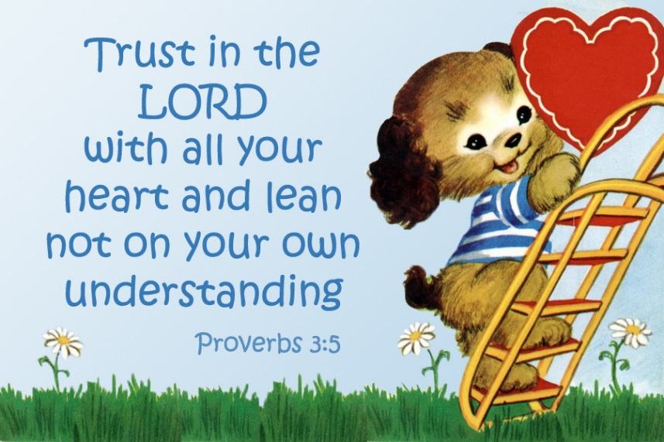
Trust God: Put your faith into action
Esther’s faith and trust that somehow becoming queen was part of God’s plan
Her willingness to go into the King….”if I perish, I perish” (4:16)
Esther’s banquets: illustrates how faith in action works
  She developed a reasonable plan,
  But trusted God to make it work
Trust in the Lord with all your heart, and lean not on your own understanding; In all your ways acknowledge Him, and He shall direct your paths (Prov 3:5-6)

Slide 17

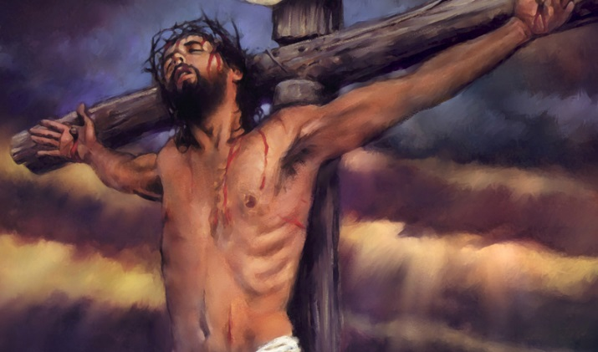
Our Faith in God and resulting actions can be an effective witness
Jews were full of happiness and joy and gladness and honor (8:17)
Many Gentiles became Jews when they realized the blessed status of Jews
Jesus’ faith in God’s way became the greatest witness ever!

Slide 18
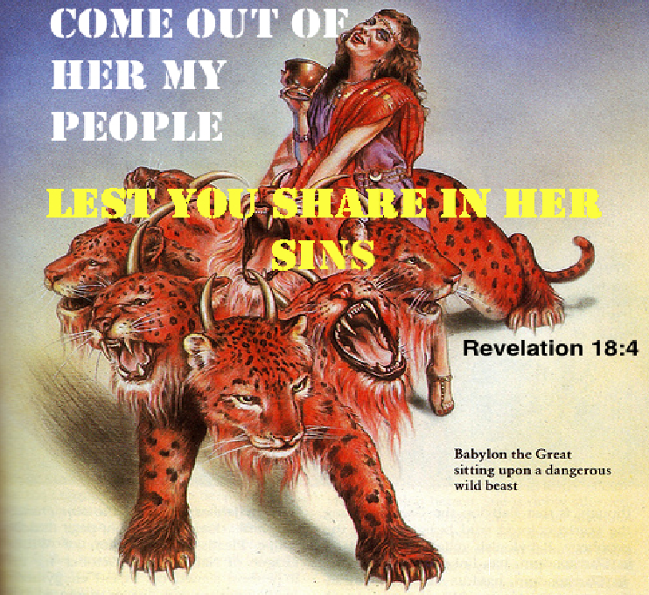
God’s warning to get out of Babylon!
(God’s gentle push!)
He raised up Haman to make them face the reality of destruction in a foreign land (Esther 3)
He promised to bless their economy and food (Hag 2:19)
He promised to protect their cities (Zech 2:1-5)
He promised to dwell in their midst (Zech 2:11)
"Come out from among them and be separate, says the Lord. Do not touch what is unclean, and I will receive you." 'I will be a Father to you, and you shall be My sons and daughters, says the Lord Almighty." (2 Cor 6:17-18)

Slide 19

Lessons from Esther
Be aware of God’s providence: He’s working in your life and is in control
Prepare now to meet your King
Faith & Obedience are essential for us to join God’s family – practice them everyday
Our faithful way of life can be an effective witness for God
God is at war with Amalek – join the war!
Get out of Babylon mentally before it’s too late

Slide 20
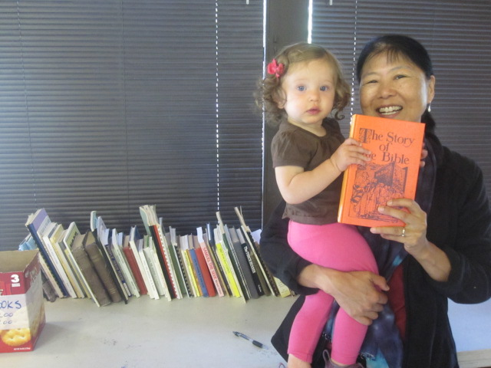
Don’t forget the used book sale!

Slide 21
2
S
G

Slide 22
2
S
G

Slide 23
2
W
17
!

Slide 24
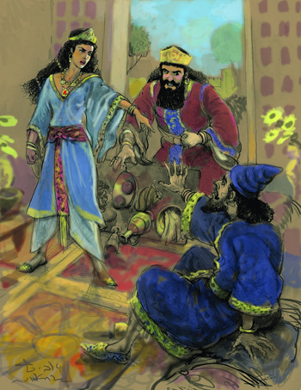
2
S
G

Slide 25
2
W
17
!

Slide 26
2
17
G

