Slide 1



Ezra: Working together in God’s service
Class 1: God set us Free to work in His Service!

Slide 2

An Exciting Study for Today!
Study Ezra!
Experience brothers & sisters working together through troubles in ecclesial life
Practical lessons in family life & ecclesial life
Parallels to Christ’s soon return to restore & build the everlasting household of God
Confidence & peace that grows as we watch the unseen angels working behind the scenes to carry out God’s plan
Everyone will find practical lessons in this study!

Slide 3
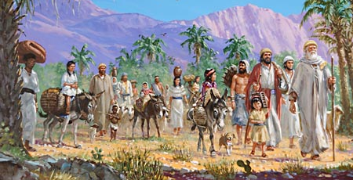
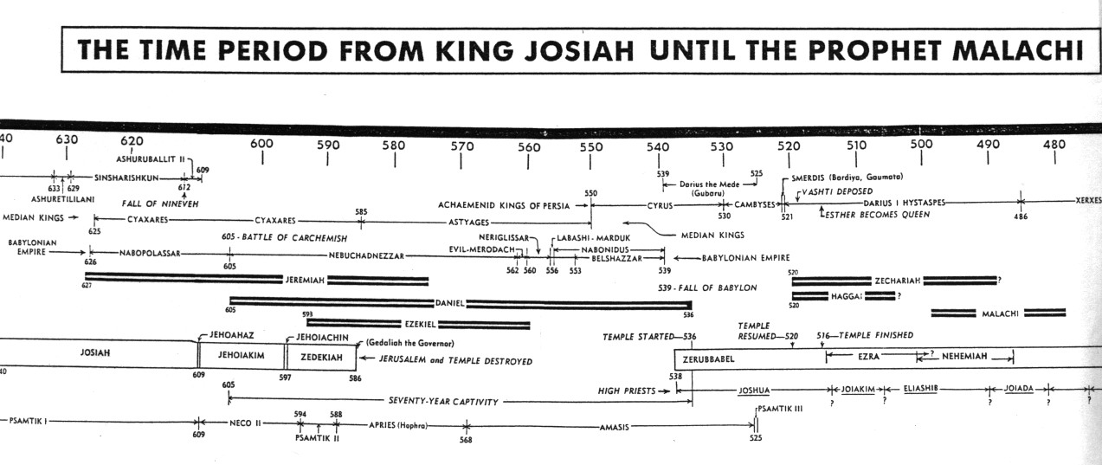
Sequence of Events
1) Some return with Jeshua & Zerubbabel (Ezra 1-2)
2) Rebuilding the temple (Ezra 3-4)
3) Zechariah & Haggai motivate the finishing of the temple (Ezra 5-6)
4) Ezra Returns with more exiles (Ezra 7-10)
5) God uses Haman to convince the Jews to return home (Esther)
6) Nehemiah builds the walls of Jerusalem
7) Malachi, then time between the Testaments

Slide 4
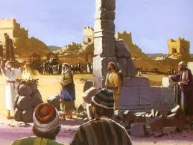
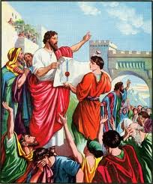
2 Sections in the Book of Ezra
Chapters 1-6 Don’t involve Ezra himself
Continue 2 Chronicles 36:23
initial return from captivity
rebuilding of the temple
Don’t involve Ezra himself
Chapters 7-10 involve Ezra himself
Ezra returns to work in the temple
Solving the mixed marriages problem
Ezra probably returned as soon as the temple was finished

Slide 5
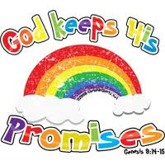
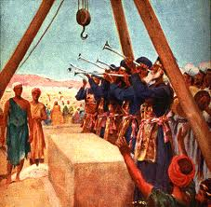

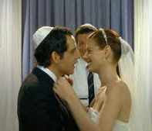
Purpose of the Book of Ezra
1) God is faithful – He will restore Israel as He promised
2) God will build His house (both physical & spiritual)
4) Warnings about mixed marriages
3) Illustrates the cost of Unity

Slide 6
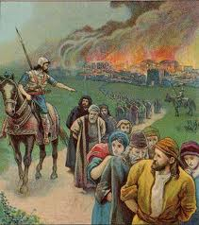

Reasons for the 70-year Captivity
1) Idol worship was so integrated in the people (Ezekiel 14:1-5) (God’s plan worked! Idolatry was abolished)
2) God wanted to save a remnant (He had promised Abraham)
3) United Judah & Israel again (the power of adversity!) Sad it takes this to bring unity ☹
4) So the land could enjoy its Sabbaths (Lev 26:43; 2 Chron 36:21)
1 Now some of the elders of Israel came to me and sat before me.
2 And the word of the LORD came to me, saying,
3 "Son of man, these men have set up their idols in their hearts, and put before them that which causes them to stumble into iniquity. Should I let Myself be inquired of at all by them?
4 "Therefore speak to them, and say to them, 'Thus says the Lord GOD: "Everyone of the house of Israel who sets up his idols in his heart, and puts before him what causes him to stumble into iniquity, and then comes to the prophet, I the LORD will answer him who comes, according to the multitude of his idols,
5 "that I may seize the house of Israel by their heart, because they are all estranged from Me by their idols.“’
Captivity accomplished God’s plan

Slide 7

Jeremiah 16:14-18
Babylonian captivity will be devastating!
14 "Therefore behold, the days are coming," says the Lord, "that it shall no more be said, 'The Lord lives who brought up the children of Israel from the land of Egypt,' 15 but, 'The Lord lives who brought up the children of Israel from the land of the north and from all the lands where He had driven them.' For I will bring them back into their land which I gave to their fathers.
16 "Behold, I will send for many fishermen," says the Lord, "and they shall fish them; and afterward I will send for many hunters, and they shall hunt them from every mountain and every hill, and out of the holes of the rocks. 17 For My eyes are on all their ways; they are not hidden from My face, nor is their iniquity hidden from My eyes. 18 And first I will repay double for their iniquity and their sin, because they have defiled My land; they have filled My inheritance with the carcasses of their detestable and abominable idols."
This captivity would be remembered!

Slide 8
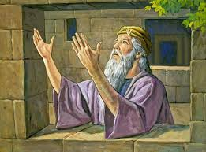
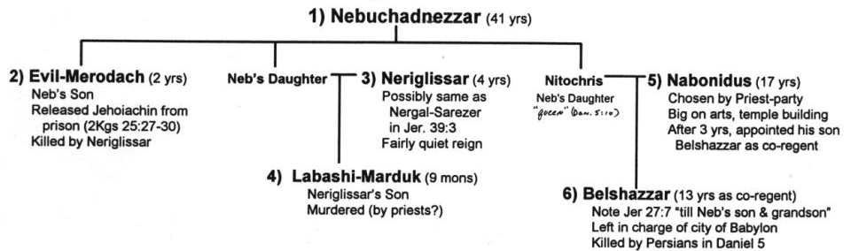
Political Situation: Looked Hopeless for Jews to Return
Nabonidus king of Babylon – very religious – built temples for gods of other nations
Belshazzar (Nabonidus’ son) left in charge (Dan 5)
Nabonidus brought foreign gods to Babylon to protect it.
This really upset the Babylonian priests and people!

Slide 9
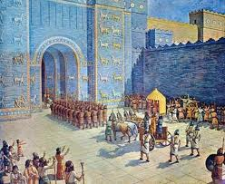
Political Situation: Looked Hopeless for Jews to Return
Cyrus entered Babylon without a battle & liberated city
Different Strategies: Babylonians exiled people. Persians left people and incorporated existing governments & people.
Similar situation to our day: No angelic visits, No spirit gifts – Yet God still working in the nations for His people!

Slide 10

The Lesson for Us!
You must be ready!
Events of the last days can change and happen fast!
We need to watch always, and be ready at all times “for the son of man is coming at an hour you do not expect” (Mat 24:44)
The angels are working tirelessly today to prepare for the Day of the Lord – they will get it done on time!
But you, brethren, are not in darkness, so that this Day should overtake you as a thief. You are all sons of light and sons of the day. We are not of the night nor of darkness. Therefore let us not sleep, as others do, but let us watch and be sober. (1 Thes 5:4-6)

Slide 11
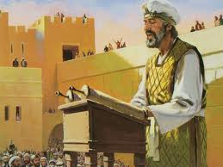
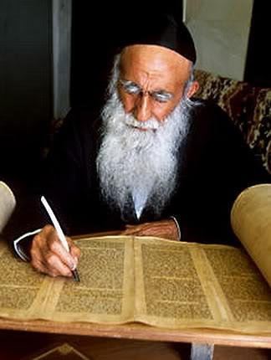
Author of the Book of Ezra
Ezra: note his use of “I”, “me” (8:15, etc.)
Earlier information was probably compiled later by Ezra
Clear sections of Hebrew & Aramaic:
Hebrew: 1:1 – 4:7
Aramaic: 4:8 – 6:18
Hebrew: 6:19 – 7:11
Aramaic: 7:12-26
Hebrew: 7:27 – end
Probably switches because book was compiled by Ezra

Slide 12
Time Line for Ezra
S
Ezra returns here
G
Book of Ezra starts here

Slide 13

Jason Says……Don’t forget the…..

Slide 14
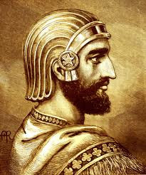
The First Year of Cyrus (1:1)
The 1st year Persia took over Babylon and Cyrus ruled over Babylon
Cyrus actually became a Persian ruler about 10 years earlier
G

Slide 15
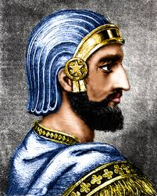
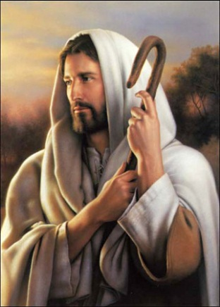
Cyrus as a type of Christ
God’s shepherd (Isa 44:28)
God’s anointed (Isa 45:1)
Illustrated God’s ultimate salvation of Israel through God’s Son
This is a study in itself…. Our goal is to focus on lessons from family & ecclesial issues of Ezra’s time
Many of the prophecies about the return of the Jews from captivity apply at this time & to Christ’s time too

Slide 16
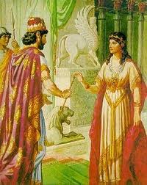
God used Unbelieving Rulers during the Captivity to Illustrate His Redemptive Plan
Cyrus (represented Christ)
King Ahaseurus (represented God)
  Mordecai (represented Christ)
  Esther (represented God’s faithful remnant)
The kingdom of Israel didn’t exist during this period

Slide 17
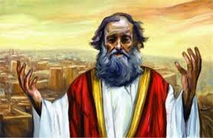
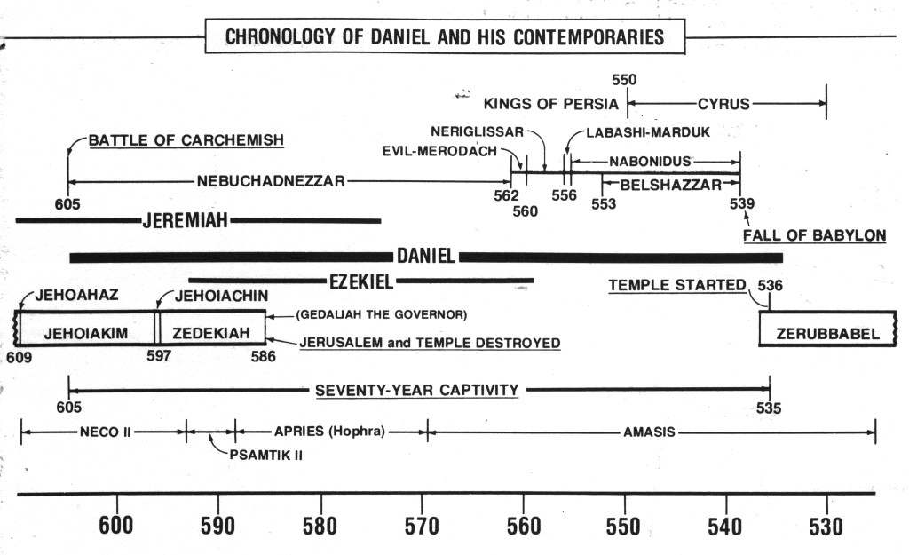
Jeremiah’s Prophecies about the 70 Years
Jer 25:11-14 after 70 yrs God will punish Babylon
Jer 29:10-14 after 70 years God will bring Jews back and give them a future with peace and hope
G

Slide 18
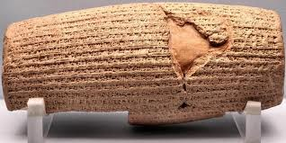
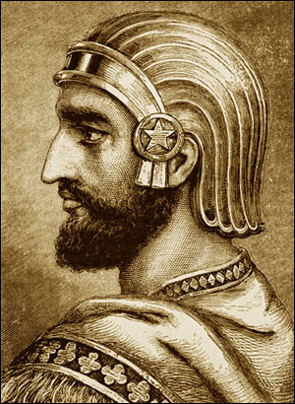
Cyrus’ Decree was recorded
Put it in writing: worth noting because this was really important later in 6:1-3
It was all of God:
  Freedom of the Jews from captivity
  Opportunity to build God’s house in Jerusalem
It’s good to reflect daily on our freedom in Christ & the opportunities we have to work in God’s family

Slide 19
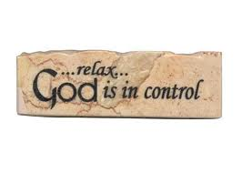
God Stirred up the Spirit
God was in complete control
Had Cyrus’ decree put in writing
Ex 35:21 LORD stirred up spirits and hearts of everyone to bring supplies for His tabernacle
Jer 51:11 LORD has raised up the spirit of the kings of the Medes against Babylon
Ezra 1:1 LORD stirred up the spirit of Cyrus to make a decree
Ezra 1:5 God stirred up the spirits of heads of Judah and Benjamin, priests and Levites, to rebuild His house
Hag 1:14 LORD stirred up the spirit of Zerubbabel, Joshua and all the remnant to go and work on His house
Thank God daily for initiating our salvation

Slide 20

Cyrus learned a key Lesson: The God of Heaven has given me all kingdoms (v.2)
Same lesson God tried to teach Nebuchadnezzar through Daniel
God wanted all foreign nations to realize that He had allowed other nations to take Jews captive – not that their gods had triumphed over Yahweh!
Build Him a house: Note that the house is 1st priority! The Jews’ freedom is a result of God wanted His house built!
This must be a priority in our lives & ecclesias too – build a house unto our God

Slide 21

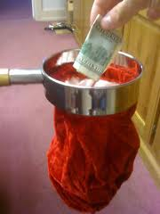
2 Types of Service:
Return to Israel & build
  1Cor 12: lots of variety in body of Christ
  v.18 God has set members as He pleased
  v.24-26 God composed body that there be no schism
Stay put: send money & supplies
  Rom 12: he who gives….liberally!
We need everyone involved in whatever capacity you can serve! So many jobs to do! Fun & exciting ecclesias tap into all the talents of its members! Learn to appreciate the help! It’s not just about Bible Study

Slide 22
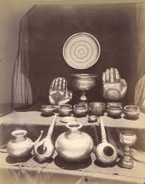
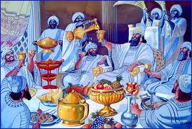
Vessels of God’s House (v.7)
1) Some taken by Nebuchadnezzar during Jehoiakim’s reign (2 Chron 36:7) others taken at end of Zedekiah’s (2 Kgs 25:14)
2) God promised he would bring them back (Jer 27:21-22)
3) Misused by Belshazzar (Dan 5:2-4)
4) Returned by Cyrus (Ezra 1:7)
God used the vessels of His house to represent the people in His house
Sheshbazzar (v.8) = Zerubbabel more on this in Ezra 5

Slide 23
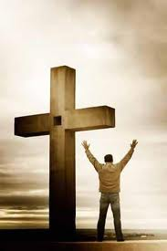

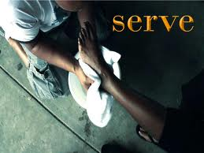
Set free to serve in God’s service
Gal 5:1, 13-16 Christ has set us free
  Don’t use freedom for the flesh
  Through love serve one another
Rejoice in our freedom
  Use it to build God’s house by working in our ecclesias
  Conduct ourselves like God’s children
Freedom brings the responsibility to serve the one who set us free!

Slide 24
Ezra: Working together in God’s service
Ezra 2: We must learn to work together now!

Slide 25
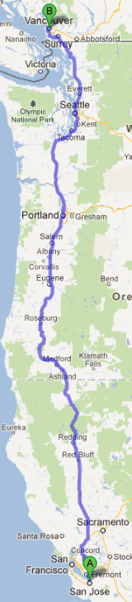
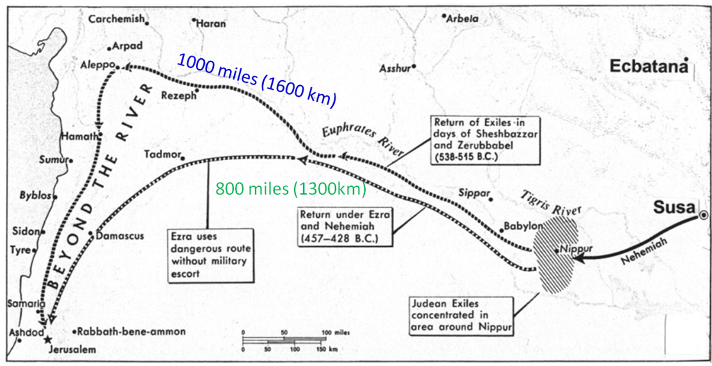
Return of the Exiles
Jeshua & Zerubabbel took the long, safe route (1000 miles) Ezra took the short, risky route

Slide 26
Some from All 12 Tribes Returned
Ezra 6:16-17 Sin offering at dedication of temple was 12 male goats, according to the number of the tribes of Israel
Ezra 8:35 Exiles returning with Ezra offered “12 bulls for all Israel” and 12 male goats for sin offering.
Mat 10:6; 15:24 Jesus and disciples sent to “lost sheep of house of Israel”
Appears that some from 10 tribes moved south early on and survived the captivity (Josh 19:9; 1 Kg 12:17; 1 Chr 9:3; 2 Chr 11:3, 13-16; 15:9)
British Israelites misunderstand this

Slide 27
Summary of those who Returned
People
Priests
Levites
Singers
Gatekeepers
Temple Servants & Solomon’s servants
Total
24,194
4,289
74
128
139
392
29,216
Notice the low number of Levites!
Much of Ezra 2 is also recorded in Neh 7 after the wall is finished

Slide 28
Comparison of the Levites
74__
29,216
Ezra 2
Num 2
Num 26
= 0.25% 1 of 400
= 3.5% 1 of 28
= 3.7% 1 of 27
22,000_
625,550
23,000_
624,730
Seems Levites not interested in returning

Slide 29
The Role of the Levites
Support group for ecclesia (things like Sunday school teachers, CYC leaders, seminar helpers, etc. – not high profile jobs!
Responsible to teach the truth
  Better educated
  Used to higher standard of living (probably supplied some of the money in Ezra 1)
  More easily integrated into Babylonian life
Warning: Believers today tend to shoot up the corporate ladder – Be careful – work & life-style can limit our service to God
We need lots of volunteers for the support jobs in ecclesial life today!

Slide 30
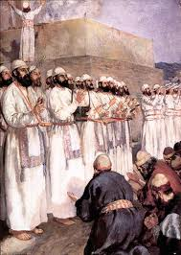
Those excluded from the Priesthood as defiled (v.62)
Shows the Jews were attempting to follow God’s recorded Law
Illustrates the need to respect dividing lines
  Ecclesial jobs & positions
  Fellowship lines
God doesn’t need the best person for a job. He can work through many people if they are willing to let him.

Slide 31
Freewill Offerings to God
To build the tabernacle (Ex 25:2; 35:21-29)
Gives it willingly with his heart (Ex 25:2)
All the men & women whose hearts were willing (35:29)
To build Solomon’s temple (1 Chron 29:5,6,9,14,17)
People rejoiced because with a loyal heart they offered willingly (v.9)
To rebuild the temple (Ezra 1:4; 1:6; 2:68-69)
According to their ability (Ezra 2:69)
To help the poor in Jerusalem (2 Cor 8 & 9)
Beyond their ability, they were freely willing (8:3)
According to what one has, and not what he doesn’t have (8:12)
As a matter of generosity and not as a grudging obligation (9:5)
God loves a cheerful giver (9:7)
Freewill giving should be in response to our faith, in appreciation for God’s gift of grace to us!
“Thanks be to God for His indescribable gift!” (2 Cor 9:15)

Slide 32
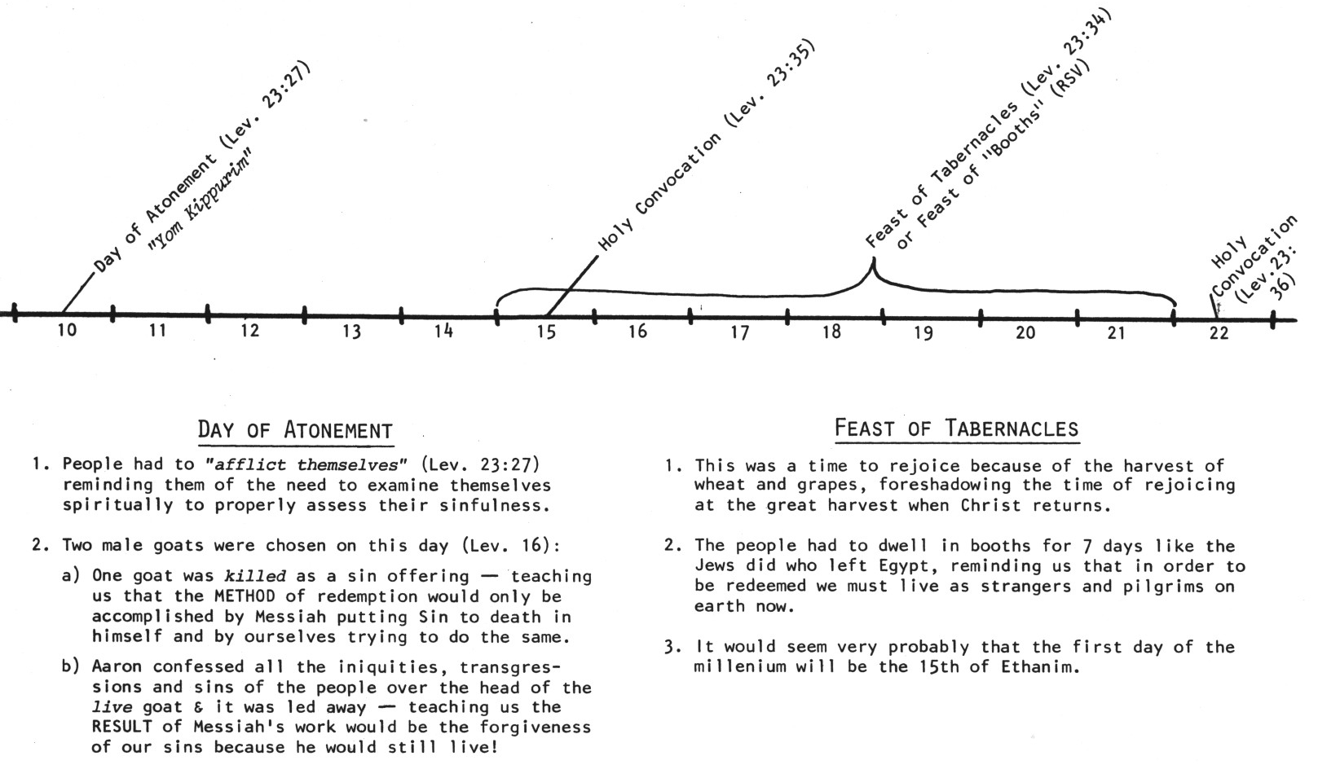
Now the 7th month (Ethanim) [3:1]
Kept Feast of Tabernacles
No mention of Day of Atonement – not ready for this yet

Slide 33

Zerubbabel = “shoot of Babylon” (Yg)
Organized the return from Babylon
Would have been king now
Really the son of Pedaiah (1 Chr 3:19), but counts as Shealtiel’s son (maybe a Levirate marriage?)
Zerubbabel represents “the king” and Joshua represents “the priest”

Slide 34
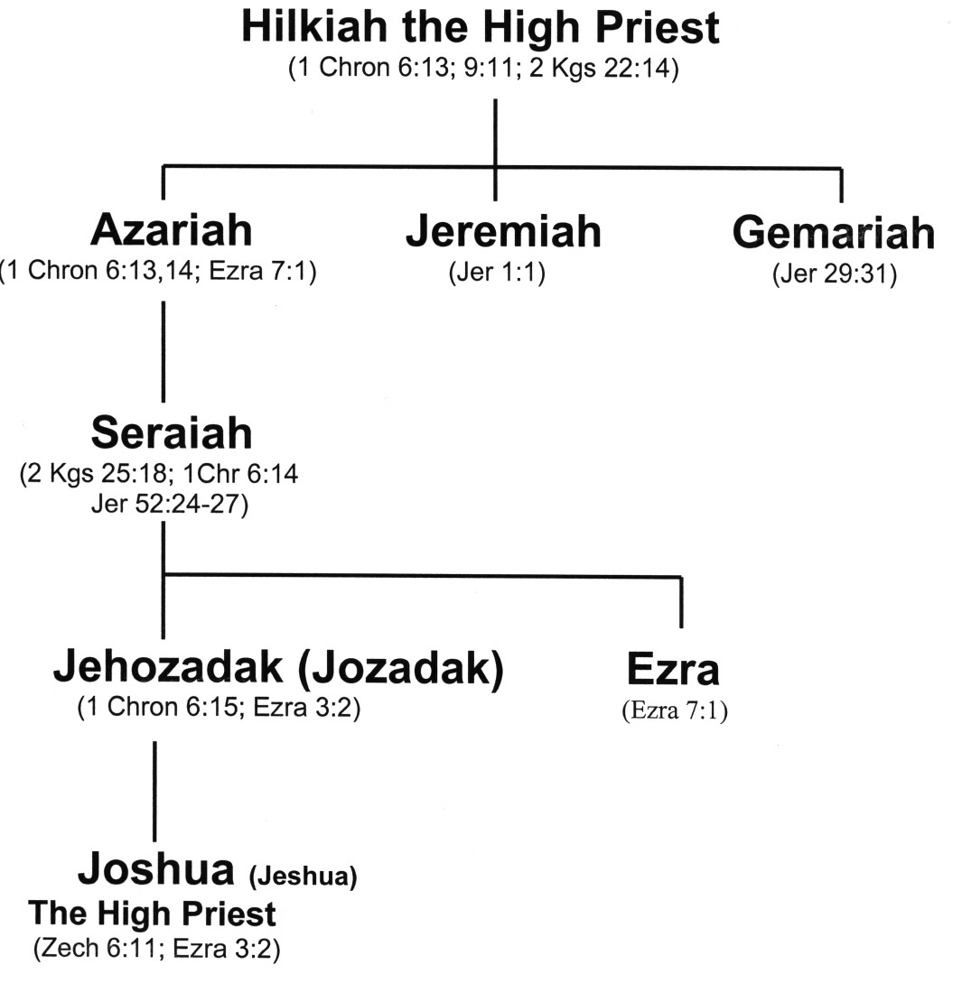
Family Line of Jeshua ( )
“God is Salvation”
Carried away captive
Ezra was his Uncle

Slide 35
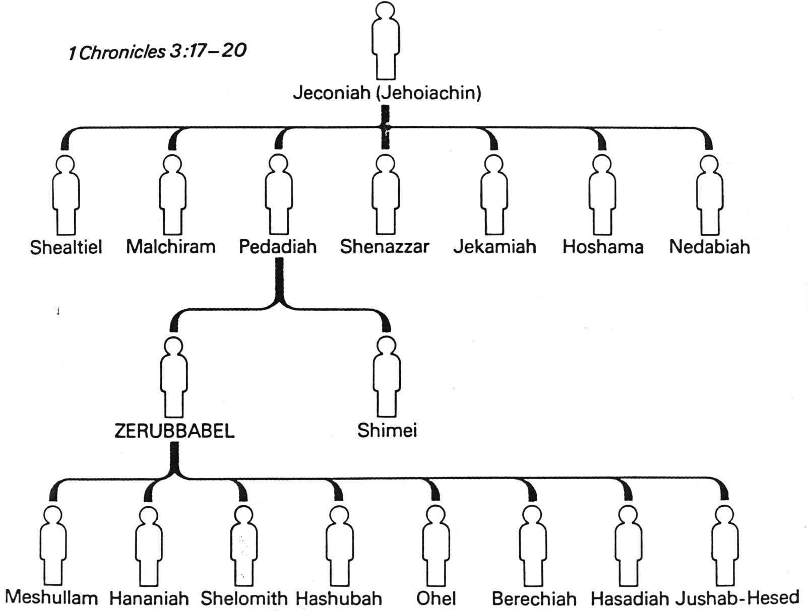
Zerubbabel’s Family Tree
1Chr 3:17-20
1Chr 3:17-20
Zerubbabel is called the “son of Shealtiel” so there was probably a Levirate marriage involved

Slide 36
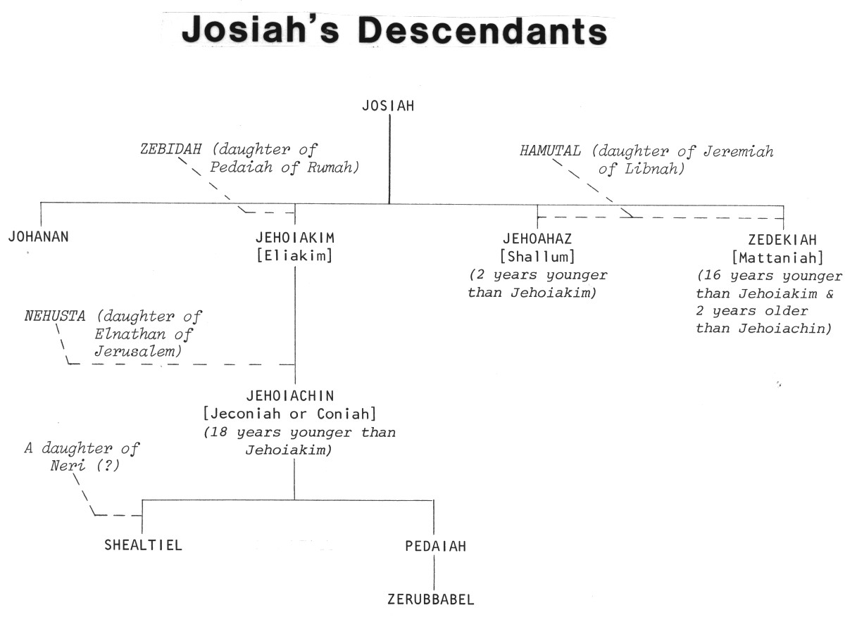
King Josiah’s Descendants
Josiah
2
1
4
3
Good King Josiah had no children who were like him!

Slide 37
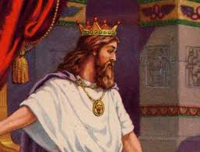
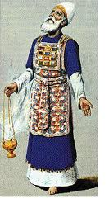
Judgment & Mercy
Zerubabbel – King – Judgment
Joshua – Priest – Mercy
The Law of Moses separated these two offices until Messiah would come who could perfectly balance judgment and mercy
This is the challenge of every parent & Ecclesial leader: properly balance judgment & mercy! Two parents & many ecclesial leaders help us to find a balance.

Slide 38
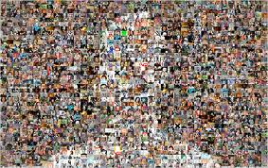
“As one Man” (3:1)
Judah & Israel were finally united!
Cost to bring about unity was huge: 70 years of captivity
Learn to value ecclesial unity and work for it constantly
  Many years of working for unity can be overturned in a moment
  Ecclesial leaders need to provide activities that will encourage unity of the members
Behold, how good and how pleasant it is for brethren to dwell together in unity! (Ps 133:1)

Slide 39
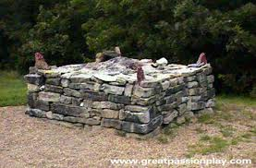
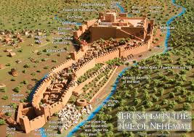
The Order of the Building
Altar – dedication to become living sacrifices
2) Temple – commitment to daily service & worship
3) Walls – (during Nehemiah) develop defenses against the evils of this world
God wanted it this way to encourage faith in His ability to provide

Slide 40
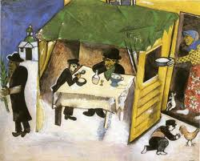
Feast of Tabernacles (v.4)
Required in Ex 23:14-17
Didn’t need a temple
Represented the final gathering of saints throughout the ages into God’s kingdom
Reminder of redemption from Egypt (sin)
  When Jews were slaves and had nothing
  God in His mercy redeemed them
Would have been encouraging & exhortational to experience the Feast at this time

Slide 41
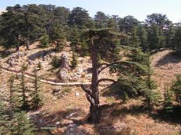
Use of foreign supplies (v.7)
As Solomon in 1Kgs 5:6-11
Only allowed foreigners to supply materials – not actually build temple
Joshua & Zerubbabel drew a line: no foreigners on site!
There are times to be selective about who we are willing to use in God’s service too!

Slide 42
Years to Build the Temple
Cyrus
Cambyses
Pseudo-Smerdis
Darius
Years to finish =
6 years
8 years
7 months
6 years (6:15)
20 years
That’s a long time to maintain interest in an ecclesial project!

Slide 43
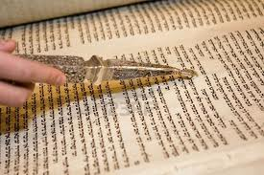
Following David’s Directions
V. 8 Levites: originally began at 25 years old (Num 8:24)
David changed to 20 years old (1 Chron 23:24) when there was no need to carry the tabernacle
V.10-11 Reenactment of 2 Chron 5 – Solomon brought ark into the new temple
David’s directions: 1 Chr 6:31; 16:4,5,7; 25:1-31
V.11 Quoted from:
1 Chron 16:34 – David brought ark into Jerusalem
2 Chron 5:13 – Solomon brought ark into Temple
Lots of responsibilities for 20-year olds. Older members must be willing to let young people be involved.

Slide 44
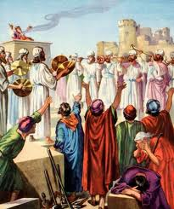
People’s Reaction to the Laying of the Foundation
Younger: Shouted and praised (excited!)
Older: Wept (disappointed)
This problem hung on for 20 years! Still around for Haggai & Zechariah
Hag 2:3-4 Is it not in your sight as nothing?
Zech 4:8-10 Who has despised the day of small things?
God wants our best effort, not best ever result!

Slide 45

Class 2: Don’t give up when things go wrong!

Slide 46
2
S
G

Slide 47
Daniel & His Contemporaries
G

Slide 48
2
S
G

Slide 49

Lessons from Today
Remember

Slide 50
2
W
17
!

Slide 51

2
S
G

