Slide 1



Ezra: Working together in God’s service
Class 2: Don’t give up when things go wrong!

Slide 2
Freewill Offerings to God
To build the tabernacle (Ex 25:2; 35:21-29)
Gives it willingly with his heart (Ex 25:2)
All the men & women whose hearts were willing (35:29)
To build Solomon’s temple (1 Chron 29:5,6,9,14,17)
People rejoiced because with a loyal heart they offered willingly (v.9)
To rebuild the temple (Ezra 1:4; 1:6; 2:68-69)
According to their ability (Ezra 2:69)
To help the poor in Jerusalem (2 Cor 8 & 9)
Beyond their ability, they were freely willing (8:3)
According to what one has, and not what he doesn’t have (8:12)
As a matter of generosity and not as a grudging obligation (9:5)
God loves a cheerful giver (9:7)
Freewill giving should be in response to our faith, in appreciation for God’s gift of grace to us!
“Thanks be to God for His indescribable gift!” (2 Cor 9:15)

Slide 3
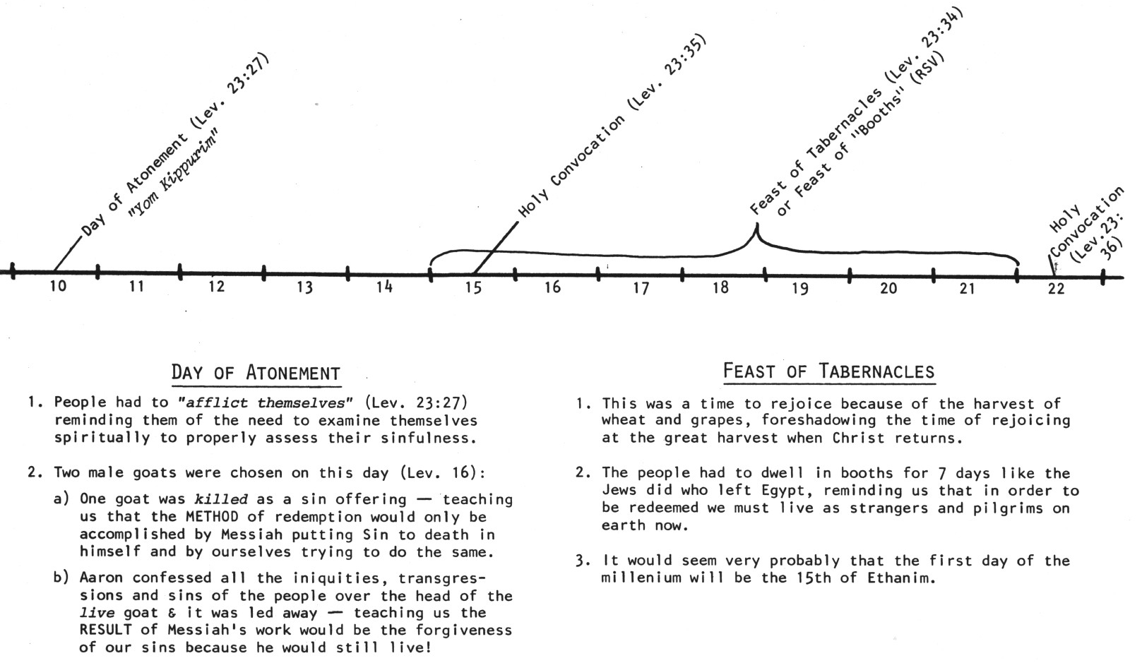
Now the 7th month (Ethanim) [3:1]
Kept Feast of Tabernacles
No mention of Day of Atonement – not ready for this yet

Slide 4
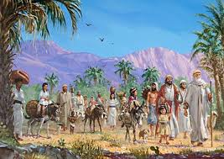
Zerubbabel = “shoot of Babylon” (Yg)
Organized the return from Babylon
Would have been king now
Really the son of Pedaiah (1 Chr 3:19), but counts as Shealtiel’s son (maybe a Levirate marriage?)
Zerubbabel represents “the king” and Joshua represents “the priest”

Slide 5
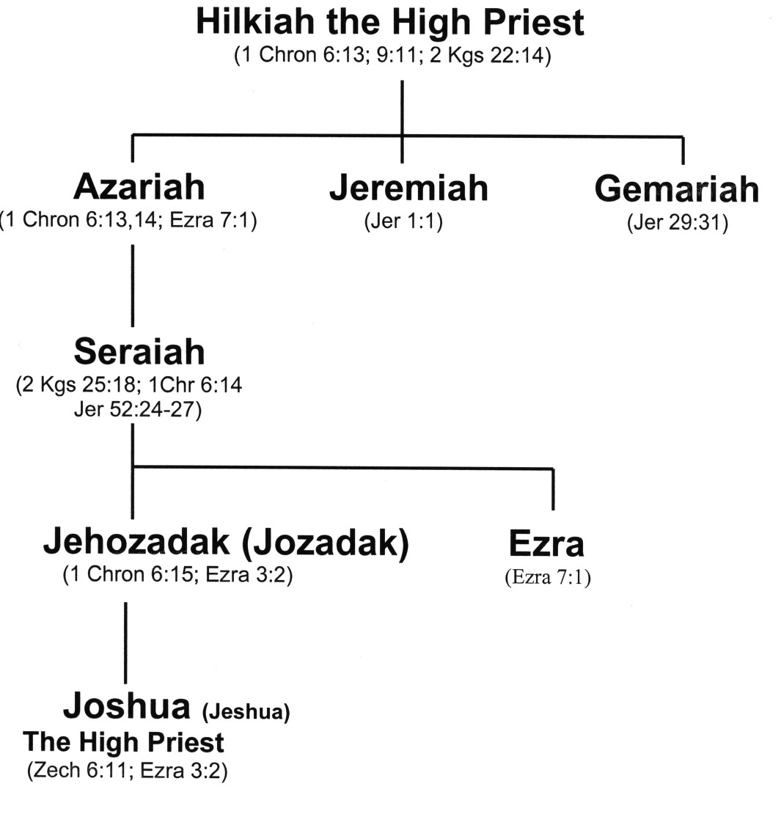
Family Line of Jeshua ( )
“God is Salvation”
Carried away captive
Ezra was his Uncle

Slide 6
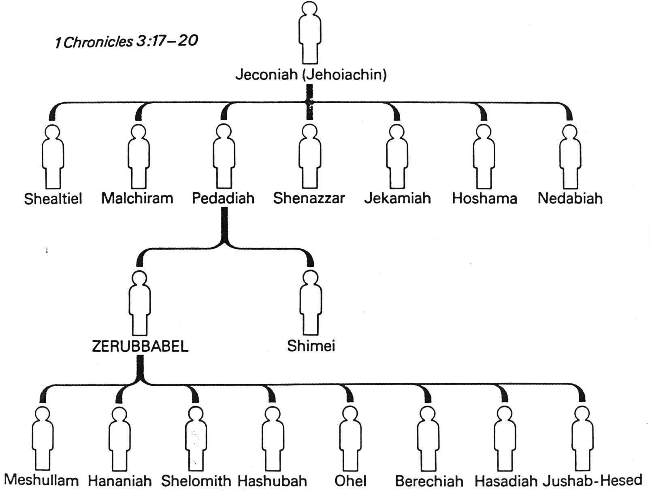
Zerubbabel’s Family Tree
1Chr 3:17-20
1Chr 3:17-20
Zerubbabel is called the “son of Shealtiel” so there was probably a Levirate marriage involved

Slide 7
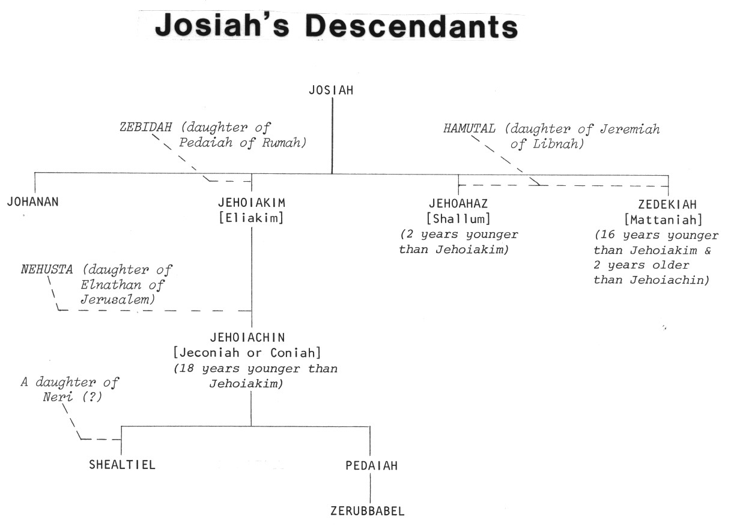
King Josiah’s Descendants
Josiah
2
1
4
3
Good King Josiah had no children who were like him!

Slide 8
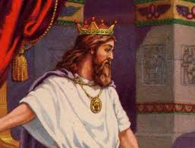
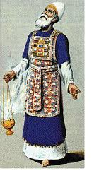
Judgment & Mercy
Zerubabbel – King – Judgment
Joshua – Priest – Mercy
The Law of Moses separated these two offices until Messiah would come who could perfectly balance judgment and mercy
This is the challenge of every parent & Ecclesial leader: properly balance judgment & mercy! Two parents & many ecclesial leaders help us to find a balance.

Slide 9
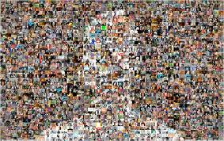
“As one Man” (3:1)
Judah & Israel were finally united!
Cost to bring about unity was huge: 70 years of captivity
Learn to value ecclesial unity and work for it constantly
  Many years of working for unity can be overturned in a moment
  Ecclesial leaders need to provide activities that will encourage unity of the members
Behold, how good and how pleasant it is for brethren to dwell together in unity! (Ps 133:1)

Slide 10
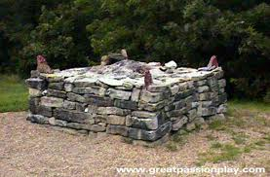
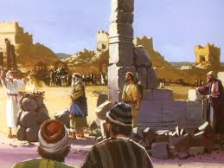
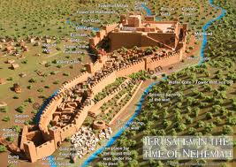
The Order of the Building
Altar – dedication to become living sacrifices
2) Temple – commitment to daily service & worship
3) Walls – (during Nehemiah) develop defenses against the evils of this world
God wanted it this way to encourage faith in His ability to provide

Slide 11
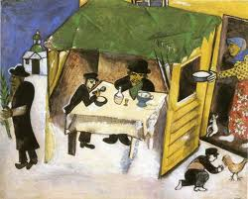
Feast of Tabernacles (v.4)
Required in Ex 23:14-17
Didn’t need a temple
Represented the final gathering of saints throughout the ages into God’s kingdom
Reminder of redemption from Egypt (sin)
  When Jews were slaves and had nothing
  God in His mercy redeemed them
Would have been encouraging & exhortational to experience the Feast at this time

Slide 12
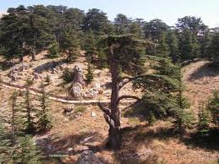
Use of foreign supplies (v.7)
As Solomon in 1Kgs 5:6-11
Only allowed foreigners to supply materials – not actually build temple
Joshua & Zerubbabel drew a line: no foreigners on site!
There are times to be selective about who we are willing to use in God’s service too!

Slide 13
Years to Build the Temple
Cyrus
Cambyses
Pseudo-Smerdis
Darius
Years to finish =
6 years
8 years
7 months
6 years (6:15)
20 years
That’s a long time to maintain interest in an ecclesial project!

Slide 14
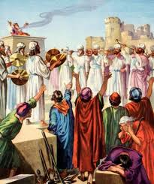
People’s Reaction to the Laying of the Foundation
Younger: Shouted and praised (excited!)
Older: Wept (disappointed)
This problem hung on for 20 years! Still around for Haggai & Zechariah
Hag 2:3-4 Is it not in your sight as nothing?
Zech 4:8-10 Who has despised the day of small things?
God wants our best effort, not best ever result!

Slide 15
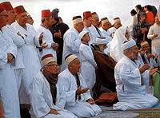
The Adversaries Challenge!
Adversaries (v.1): Samaritans – Introduced as adversaries from the start!
Let us build with you: the Jews could sure use the help!
Days of Esarhadddon (son of Sennacherib) about 130 years ago!
We worship God: but idols too! (2Kgs 17:24-33, 39-41)
Assyrians moved Jews out of North & brought in Gentiles
  Gentiles brought their idols & mixed in with Jews in the North part of Israel
  Samaritans feared Yahweh & all their other gods too
No compromise for Zerubbabel & Joshua

Slide 16

Background to the Samaritans: 2 Kings 17:28-41
28 Then one of the priests whom they had carried away from Samaria came and dwelt in Bethel, and taught them how they should fear the LORD.
29 However every nation continued to make gods of its own, and put them in the shrines on the high places which the Samaritans had made, every nation in the cities where they dwelt.
30 The men of Babylon made Succoth Benoth, the men of Cuth made Nergal, the men of Hamath made Ashima,
31 and the Avites made Nibhaz and Tartak; and the Sepharvites burned their children in fire to Adrammelech and Anammelech, the gods of Sepharvaim.
32 So they feared the LORD, and from every class they appointed for themselves priests of the high places, who sacrificed for them in the shrines of the high places.
They were adversaries from the start!

Slide 17
Background to the Samaritans: 2 Kings 17:28-41
33 They feared the LORD, yet served their own gods-- according to the rituals of the nations from among whom they were carried away.
34 To this day they continue practicing the former rituals; they do not fear the LORD, nor do they follow their statutes or their ordinances, or the law and commandment which the LORD had commanded the children of Jacob, whom He named Israel,
40 However they did not obey, but they followed their former rituals.
41 So these nations feared the LORD, yet served their carved images; also their children and their children's children have continued doing as their fathers did, even to this day.
They were adversaries from the start!

Slide 18
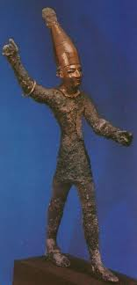
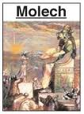

Test #1: Return to Idols?
Idol worship was a primary cause of the 70-year captivity
Were the people willing to separate from the nations, stand fast for Yahweh their God, and guard the Truth that was entrusted to them?
Yes!

Slide 19

Compromising Alliances with the World are Destructive
Lot: Political (Gen 19:1)
Sat in the gate at Sodom
Judah: Business/economic (Gen 38)
Friends with Hirah the Adullamite
Jehoshaphat: Marriage (2 Chr 18:1) Married his son (Jehoram) to Ahab’s daughter (Athaliah)
Political/Military (2 Chr 18:3) war with Ahab against Syria
Economic (2 Chr 20:35-36) built ships with Ahaziah at Ezion Geber
Dangerous behavior
And Jehu the son of Hanani the seer went out to meet him, and said to King Jehoshaphat, "Should you help the wicked and love those who hate the LORD? Therefore the wrath of the LORD is upon you. (2 Chr 19:2)
We cannot compromise in building our CYC’s, Sunday Schools, and witnessing!

Slide 20
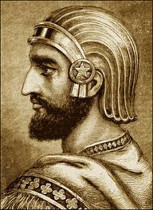
Joshua & Zerubbabel’s Defense
As Cyrus commanded (v.3):
  Cyrus told “those that go up to Jerusalem” to rebuild the temple
  So those already in the land not involved
People of the land discouraged the Jews (v.4)
  Decision not to compromise led to immediate trouble
  Some of the Jews became discouraged
Many of our decisions not to compromise with this world will cost us too. This is where faith & trust in God carry us forward!

Slide 21
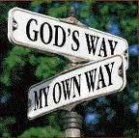

Test #2: Pressure & Endurance
Were the people ready to endure tribulation from without?
Were the people ready to endure trouble for many years and continue steadfast in their devotion to building God’s house during times of distress & disappointment when their faith was challenged?
No!

Slide 22
Ezra 4:4-7
4 Then the people of the land tried to discourage the people of Judah. They troubled them in building,
5 and hired counselors against them to frustrate their purpose all the days of Cyrus king of Persia, even until the reign of Darius king of Persia.
6 In the reign of Ahasuerus, in the beginning of his reign, they wrote an accusation against the inhabitants of Judah and Jerusalem.
7 In the days of Artaxerxes also, Bishlam, Mithredath, Tabel, and the rest of their companions wrote to Artaxerxes king of Persia; and the letter was written in Aramaic script, and translated into the Aramaic language.
Who are these Kings?

Slide 23
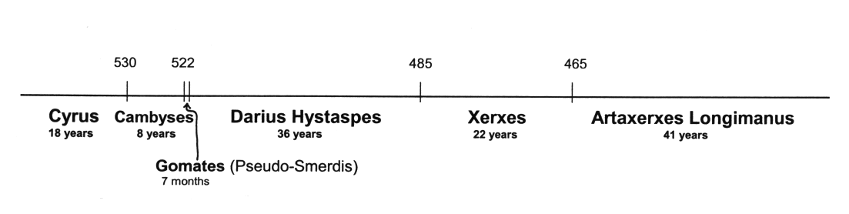
Persian Kings: Cyrus to Longimanus
Some take Ahasuerus (v.6) to be Xerxes & Artaxerxes to be Longimanus (58 years after Darius Hystaspes) and apply it to the building of the walls in Nehemiah’s time
but v.24 shows this is about the temple, not walls.
If Ezra returned in the days of Longimanus, he would be ancient! (over 130 years old)
So Ahasuerus is Cambyses & Artaxerxes is Gomates

Slide 24
Ezra 4:23-24 Shows that entire chapter is about the Temple
23 Now when the copy of King Artaxerxes' letter was read before Rehum, Shimshai the scribe, and their companions, they went up in haste to Jerusalem against the Jews, and by force of arms made them cease.
24 Thus the work of the house of God which is at Jerusalem ceased, and it was discontinued until the second year of the reign of Darius king of Persia.
Nothing in Ezra 4 is about Nehemiah’s walls

Slide 25
Ezra 4:4-7, 23-24
5 and hired counselors against them to frustrate their purpose all the days of Cyrus king of Persia, even until the reign of Darius king of Persia.
6 In the reign of Ahasuerus, in the beginning of his reign, they wrote an accusation against the inhabitants of Judah and Jerusalem.
7 In the days of Artaxerxes also, Bishlam, Mithredath, Tabel, and the rest of their companions wrote to Artaxerxes king of Persia; and the letter was written in Aramaic script, and translated into the Aramaic language.
23 Now when the copy of King Artaxerxes' letter was read before Rehum, Shimshai the scribe, and their companions, they went up in haste to Jerusalem against the Jews, and by force of arms made them cease.
24 Thus the work of the house of God which is at Jerusalem ceased, and it was discontinued until the second year of the reign of Darius king of Persia.
God gave them what many wanted

Slide 26
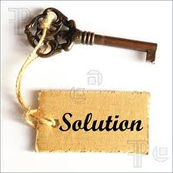
The Key!
The temple work is stopped in the reign of Artaxerxes of verse 7 (see v.23-24)
The temple is finished in the 6th year of the reign of Darius (6:15)
Temple work stopped
Temple finished
6
So all the kings in Ezra 4 influenced the building of the temple

Slide 27
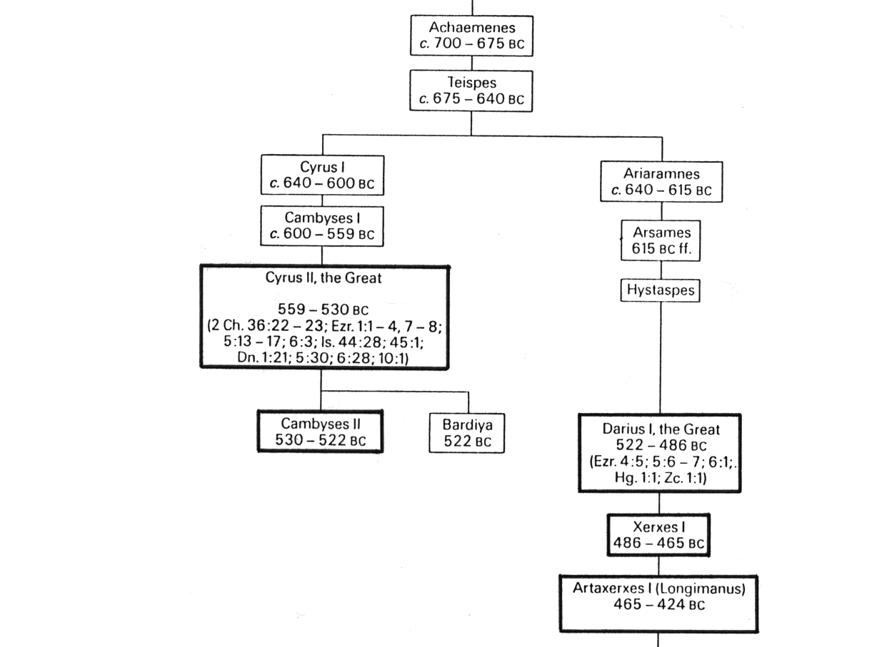
Persian Kings
The Angels ended their work with the line of Cyrus
They began working with Darius Hystaspes
Gomates

Slide 28
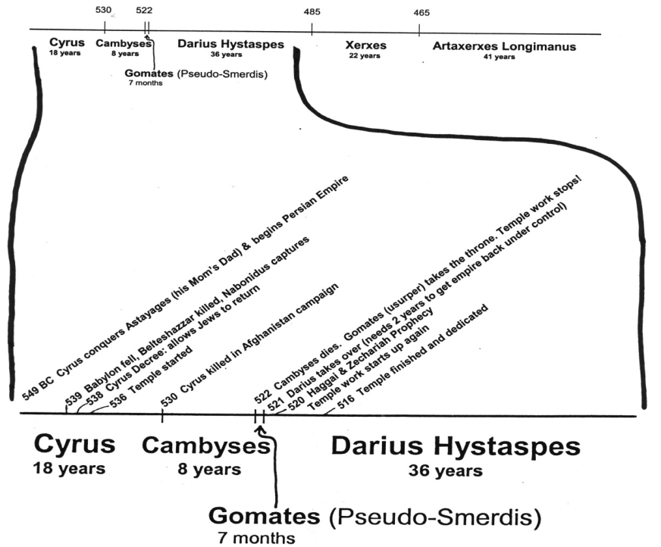
Persian Kings from Cyrus to Longimanus
Ezra only deals with Cyrus to Darius
-- 515 Ezra returns
-- 502 Nehemiah returns

Slide 29
The Kings of Ezra 4
Effect on Temple | Name in Ezra 4 | Actual Name | Length of Reign
Issued decree to build temple | Cyrus | Cyrus the Great | 9 years after decree
Did not hinder the work | Ahaseurus | Cambyses II | 8 years
Stopped work on temple | Artaxerxes | Gomates (Pseudo-Smerdis) | 7 months
Encouraged work to finish | Darius | Darius Hystaspes (Darius the Great) | 36 years

Slide 30

Timeline of the Persian Kings during the temple building
-- 515 Ezra returns
-- 502 Nehemiah returns
[ 10 years ]
6
7
20

Slide 31
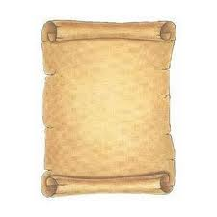
The Samaritans’ Letter
Lies..lies.. More lies
Artaxerxes (v.7) = Gomates
V.10 check a modern version
Rebellious & evil city (v.12): trying to make Jerusalem look bad for the Persians
  v.15 “harmful to kings” & “incited sedition”
Rebuilding the walls: a lie! Misleading.
Search (v.15): about Jerusalem (not Cyrus’ decree)
  These people are not interested in Truth!
Mighty kings: David, Solomon
  Menahem (2Kgs 15:16)
  Josiah (2 Chron 34:6,7; 35:18)
Remember: God is in Control!

Slide 32


Lies of the Samaritans
1) Jews are rebuilding the city and finishing the walls (v.12)
[no mention of temple]
2) Jews will not pay taxes, tribute (v. 13)
3) Jerusalem is rebellious, harmful to kings, incited sedition - that’s the reason it was destroyed (v.15)
4) if city is finished, Persia will lose its dominion this side of Euphrates (v.16)
God used this to stop the work

Slide 33
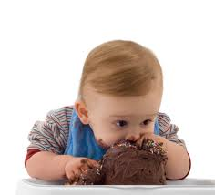
God gives them what they wanted
Have your cake & eat it too!
By force and power (v.23):
  When we complain about life God sometimes gives us what we really want
  Makes us re-think our situation
  Don’t complain about your family, ecclesia or job!
The work stopped:
  Only for about 2 years
  True believers were probably frustrated
  It was a time to test their Faith: do we really believe God is in control and using these events to save His people?
This is when faith gets you through!

Slide 34
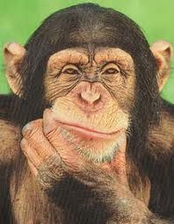
Why did God stop the work?
15 years of work had worn out and discouraged the people
Older people didn’t like the new temple
Adversaries hired counselors against them
Workers wanted to spend time on their own houses, farms and businesses
People were afraid of adversaries (8:4-5)
Now was the time for faithful believers to step forward and stir up the community to finish God’s house

Slide 35
Ezra: Working together in God’s service
Ezra 5: God will Provide the Motivation to Finish!

Slide 36
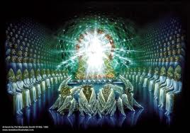
God stopped the work
15 years of work had worn out & discouraged the people – they gradually stopped working
Older people didn’t like the new temple
Adversaries hired counselors against them
Workers wanted to spend time on their own houses, farms and businesses
People were afraid of adversaries (8:4-5)
Be careful! When we think we have it rough, it can get worse!

Slide 37
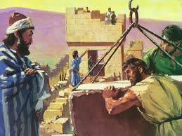
God gets the work going again!
Used Haggai & Zechariah
Similar to today: no angel visits, no spirit gifts
People needed faith to see what God & His angels were doing for them behind the scenes
Only took 4 more years to finish
It’s amazing what can be accomplished in families & ecclesias when we have the faith to get involved in God’s work!

Slide 38
Temple is finished
Then Ezra returns
Then Nehemiah builds the wall
-- 515 Ezra returns
-- 502 Nehemiah returns
[ 10 years ]
2
6
7
20

Slide 39
“The Prophets of God Helping them” (Ezra 5:1-2 )
Coordinated efforts of Haggai & Zechariah
Haggai: Exhorts and reprimands the people for their poor choices and lack of faith.
Zechariah: Encourages the people that the angels are working behind the scenes and they will help finish the temple!
In our next class we will look at how these two prophets stirred up the people

Slide 40

God raises up Darius to be King!
A few months after the temple work was forced to stop, God opened a door by bringing Darius to the throne
Some of the Jews realized this was their opportunity and began working on the temple again, but they needed more help
The angels were busy at work in the Persian Empire so that the work on the Temple could finish

Slide 41
People challenged again (vs 3-4)
Tatnai = Tattenai (Governor of province)
It’s been about 16 years since Cyrus’ decree
Work stopped for about 2 years
These people are not as nasty as Samaritans - they ask questions but don’t push their view.
Elders individually challenged – need to stand up personally for our beliefs
God will continually challenge us too – He’s hoping we will grow and triumph!

Slide 42
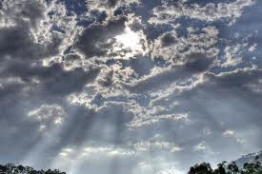
The Eye of God upon them (but not visible to human eyes!)
2 Chron 16:9 Hanani to Asa: “the eyes of the Lord run to and fro throughout the whole earth, to show Himself strong on behalf of those whose heart is loyal to Him”
Zech 3:9 See, the stone I have set in front of Joshua! There are seven eyes on that one stone (NIV)
Zech 4:10 “For who has despised the day of small things? For these seven rejoice to see the plumb line in the hand of Zerubbabel. They are the eyes of the LORD, which scan to and fro throughout the whole earth.” (angels will make sure the temple is finished!)
1 Pet 3:12 “for the eyes of the Lord are on the righteous, and His ears are open to their prayers”
Angels are hidden, but always there to help! We need to be aware of their presence & thank them.

Slide 43

The People Respond in Faith
Continued working this time – endurance through persecution & pressure
Unbelievers noticed the commitment of God’s people (v.8)
Faithfully witnessed to God (v.10) & gave God the credit (v.11)
Accepted the blame: “our fathers angered God” (v.12)
Acknowledged God brought the captivity
Referred to the political authority to build – Cyrus’ decree (v.13)
Faith in God can motivate us to move mountains & conquer giants

Slide 44
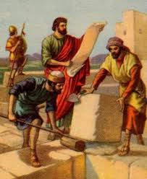
Evidence that Sheshbazzar of v.16 is Zerubbabel
Sheshbazzar
Ezra 5:14
Ezra 5:16
Zerubbabel
Hag 1:1
Zech 4:9
Governor:
Laid Temple Foundation
According to Neh 7:5 Zerubbabel led the first return of the exiles!

Slide 45
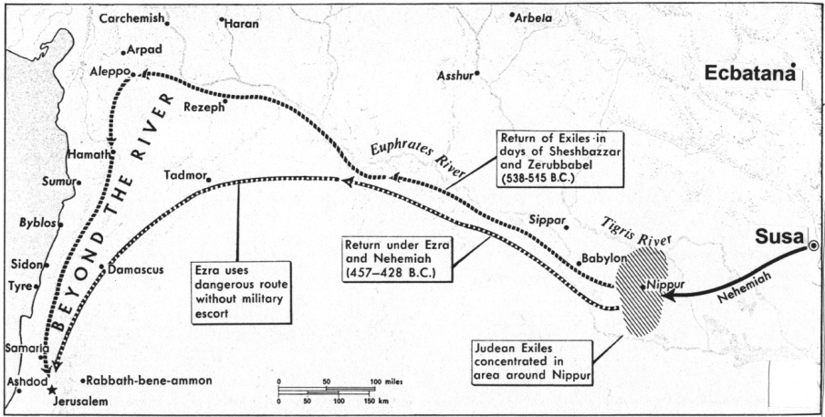
Achmetha (6:2) = Ecbatana (capital city of Cyrus)
1000 miles (1600 km)
800 miles (1300 km)
Ecbatana was the summer residence of Persian kings, Susa was used in winter

Slide 46
Comparison of the Decrees in Ezra 1 & Ezra 6
Ezra 1 (Hebrew)
Yes
No
Yes
No
Ezra 6 (Aramaic)
No
Yes
No
Yes
Yahweh Name
Size Limits
Free Will Offerings
Pay from Treasury
Some differences may have developed when being translated

Slide 47
Look at what the Angels accomplished behind the scenes!
v.6 Keep yourselves far from there
v.7 Let the work of this house of God alone
v.8 Let the cost be paid from the King’s expense from taxes (so the adversaries of Ezra 4 ended up paying to finish the temple!)
v.9 And whatever else they need --- let it be given them day by day without fail!
Now to him who by the power at work within us is able to do far more abundantly than all that we ask or think (Eph 3:20 RSV)

Slide 48
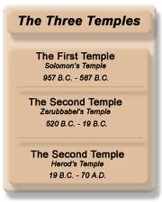
Temple is Finished!
Pray for King & Son - Persians asked everyone in empire to pray to their god for the empire (v.10)
Cyrus & Darius & Artaxerxes – we will look at this tomorrow!
Adar = 12th month. Ready for 1st month of new year for Passover & Feast of Unleavened Bread
Temple took about 20 yrs to build – Cyrus (6) + Cambyses (8) + Darius (6)
Celebrated with joy! (v.16) – remember Zech 4 “whoever despises the day of small things will rejoice”
Never despise or discourage God’s work today, no matter how small it is!

Slide 49
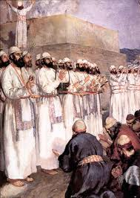
Temple service organized
Offerings (v.17): small compared to Solomon’s (1 Kings 8:63)
Sin offering: Solomon didn’t have these [maybe exiles were confessing their sins that had caused the exile]
12 Tribes: implies some from all 12 tribes did return
Priests & Levites organized (v.18): as per 1 Chr 23:6-24; 24:1-19
Ate together with all (v.21) – included Gentiles! Worship Yahweh, the God of Israel
King of Assyria (v.22): An Assyrian king began the exile, now the temple is finished during another
God wants us to rejoice in our service to Him – it’s time to celebrate what He has done for us!

Slide 50
Philippians 1:6 (RSV)
And I am sure that he who began a good work in you will bring it to completion at the day of Jesus Christ.
Whatever our current trials & problems, never lose Paul’s confidence in God’s ability to finish His work!

Slide 51

Class 3: Preparation for Service is Essential

Slide 52
2
S
G

Slide 53
2
S
G

Slide 54

Lessons from Today
Remember

Slide 55
2
W
17
!

Slide 56
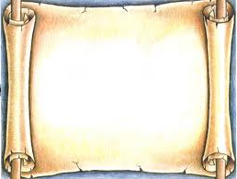
2
S
G

Slide 57
2
S
G

