Slide 1



Ezra: Working together in God’s service
Class 3: Preparation for Service is Essential

Slide 2
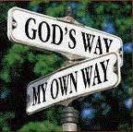
People challenged again (vs 3-4)
Tatnai = Tattenai (Governor of province)
It’s been about 16 years since Cyrus’ decree
Work stopped for about 2 years
These people are not as nasty as Samaritans - they ask questions but don’t push their view.
Elders individually challenged – need to stand up personally for our beliefs
God will continually challenge us too – He’s hoping we will grow and triumph!

Slide 3

The People Respond in Faith
Continued working this time – endurance through persecution & pressure
Unbelievers noticed the commitment of God’s people (v.8)
Faithfully witnessed to God (v.10) & gave God the credit (v.11)
Accepted the blame: “our fathers angered God” (v.12)
Acknowledged God brought the captivity
Referred to the political authority to build – Cyrus’ decree (v.13)
Faith in God can motivate us to move mountains & conquer giants

Slide 4
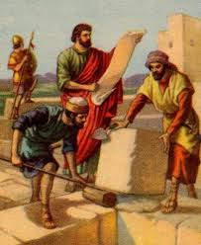
Evidence that Sheshbazzar of v.16 is Zerubbabel
Sheshbazzar
Ezra 5:14
Ezra 5:16
Zerubbabel
Hag 1:1
Zech 4:9
Governor:
Laid Temple Foundation
According to Neh 7:5 Zerubbabel led the first return of the exiles!

Slide 5
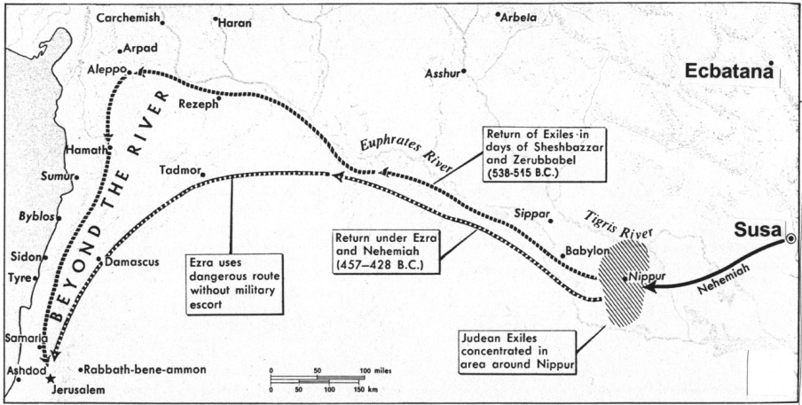
Achmetha (6:2) = Ecbatana (capital city of Cyrus)
1000 miles (1600 km)
800 miles (1300 km)
Ecbatana was the summer residence of Persian kings, Susa was used in winter

Slide 6
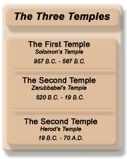
Temple is Finished!
Pray for King & Son - Persians asked everyone in empire to pray to their god for the empire (v.10)
Cyrus & Darius & Artaxerxes – spans the 20 years of building. “Darius, even Artaxerxes”
Adar = 12th month. Ready for 1st month of new year for Passover & Feast of Unleavened Bread
Temple took about 20 yrs to build – Cyrus (6) + Cambyses (8) + Darius (6)
Celebrated with joy! (v.16) – remember “whoever despises the day of small things will rejoice” Zech 4
Never despise or discourage God’s work today, no matter how small it is!

Slide 7
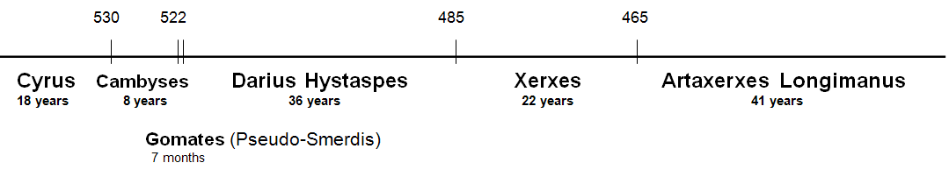
Who is Artaxerxes of Ezra 7?
Neh 5:14; 13:6 indicates that Artaxerxes reigned at least 32 years. Darius Hystaspes & Artaxerxes Longimanus are the only Persians kings to reign that long.
That narrows it down to only 2

Slide 8
Who is Artaxerxes of Ezra 7?
Artaxerxes is just a title, not a specific individual. Now his 7th year (v.7)
Most say Longimanus (58 years after Hystaspes)
  But…..Longimanus did not build the temple
  Longimanus was not mentioned before this in Ezra
Probably Darius Hystaspes
  Darius & Artaxerxes are titles like: President, Prime Minister, King, etc.
  Ezra compiled information from returned exiles in Israel and added his own experience. Different sources probably used different titles for the King.
Ezra returned as soon as the temple was finished!

Slide 9
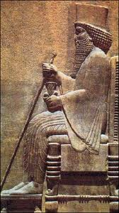
Evidence that Artaxerxes is Darius Hystaspes
Temple finished in his reign. Ezra 6:14 says “Cyrus and Darius and [even] Artaxerxes”
Artaxerxes sends Ezra back in 7th year to work in Temple, offer sacrifices & teach Jews how to worship Yahweh. Why wait 58 years to do this?
Ezra’s age: he was born before captivity began. In 7th year of Hystaspes he would be at least 94 years old. In 7th of Longimanus he would be over 152 & even older in Nehemiah!
Compare Neh 10:2-10 with Ezra 2. Out of 30 priests & Levites who returned with Zerubbabel, 20 of them signed the covenant with Nehemiah. In Longimanus’ reign they would all be alive 92 years after Zerubbabel’s return – not very likely!
Artaxerxes is just a title

Slide 10

Ezra 6:14 is a key to understanding the kings
Ezra 6:14 (RSV)
They finished their building by command of the God of Israel and by decree of Cyrus and Darius and Artaxerxes king of Persia
Ezra 6:14 (H.P.M.)
They finished their building by command of the God of Israel and by decree of Cyrus and Darius even Artaxerxes king of Persia. [there was only 1 decree, supported by only one later king]
Darius and Artaxerxes are different titles for the same king

Slide 11

Ezra 7:8-10
Ezra’s preparation to serve
And Ezra came to Jerusalem in the fifth month, which was in the seventh year of the king. 9 On the first day of the first month he began his journey from Babylon, and on the first day of the fifth month he came to Jerusalem, according to the good hand of his God upon him. 10 For Ezra had prepared his heart to seek the Law of the Lord, and to do it, and to teach statutes and ordinances in Israel.
Ezra came ready to work!

Slide 12

Ezra’s Preparation (7:10)
His heart was immersed in the Law of the Lord
1) Seek [study (RSV, NASB, NKJVmg)]: “to tread or frequent” (Strongs) – He poured over the Scriptures
2) Do it – he lived his message, it was not just an academic study! [like Paul showing Gentiles Jesus Christ crucified]
3) Teach – he felt the responsibility and privilege to share with others – that’s the goal
This helps us today to be effective workers in God’s ecclesia

Slide 13
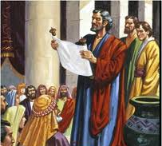
Artaxerxes’ Decree in Ezra 7
Esther was probably now queen!
Allowed any Jews to return (13)
Inquire about Jews following God’s laws in Judah (14)
Convey silver & gold offered by King & counselors & Jews to buy animals, grains & wine for offerings (15-18)
Convey vessels to temple for service (19)
Buy anything else needed out of King’s treasury (20)
Told treasurers in province to supply silver, wheat, wine, oil & salt (21-23)
Treasurers not to tax temple workers (24)
Gave Ezra authority to appoint officials & judges, and to impose punishments (25-26) – Became useful in implementing the demands of the curse of Zech 5
God gave them far more than they could “ask or think”

Slide 14

Artaxerxes helps Ezra out!
7 counselors (v.14) = 7 princes of Esther 1:14
Silver & gold – amounts in 8:25-27
Lest His wrath be against the king:
  Ezra used this as a motive in 8:22
  Pray for the King and his sons (back in 6:10)
Note use of “me” and “I” – implies Ezra was the author of the book.
Ezra prepared to seek God’s law, then God did more than Ezra could have imagined

Slide 15
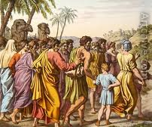
The Exiles that Returned with Ezra (Ezra 8)
Phinehas & Ithamar (v.2) = families
  Nadab & Abihu were killed (Lev 10)
  Eleazar was in the line of Phinehas
Made it to River Ahava (v.15) – took 9 days & stayed 3 (see 7:9 & 8:31)
No Levites! Similar problem in 2:40-42
  Rough life in Israel. Couldn’t own land.
  Depended on people for support
  Some (38) did come when pressured a bit!
Some folks need a push to get involved. Start out gently!

Slide 16
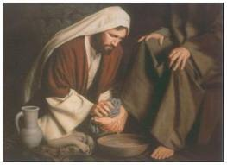
Ezra starts with humility (8:21)
Ezra proclaims fast to humble themselves
  Ezra starts with humility – good lesson for us!
  Contrast Nehemiah who brought whole army (2:9)
  Nehemiah was faithful too…. Not only one way!
  Ezra backed word with actions showing great faith! (note ambushes in v.31)
Fasted & prayed (v.23): Actions that allowed God to act for them
  Isa 58: purpose of fast – neglect self & serve others
Ezra completely trusted God’s involvement in his life. He was willing to accept God’s direction & decisions

Slide 17
The Exiles Return
1000 miles (1600 km)
800 miles (1300km)
Ezra took the dangerous route, and trusted in God to protect them!

Slide 18

Flexibility: a key characteristic in families and ecclesias
Many times in life there is more than one acceptable way to get a job done.
  Ezra verses Nehemiah
  Ezra verses Josiah
It’s our responsibility to look at the options, pray about it, and ask God to bless the choice we think will work best for our family or ecclesia.
When ecclesias make choices that differ from ours, be flexible and realize that God can work in either decision if we proceed in faith, asking God to make it work
Even God is flexible! He listens to our prayers & modifies His plans.

Slide 19
Ezra: Working together in God’s service
We must provide an inheritance for our children (9-10)

Slide 20

Considered how some Ecclesial Problems were solved:
1) Joshua 22: The 2nd altar the 2.5 tribes built
2) Lev 10: Moses angry at Eleazar & Ithamar
3) Acts 15 Problem of fellowshipping Gentiles
4) Joshua 9 Gibeonites deceive Joshua & leaders
5) Judges 20-21 Levite & concubine. Benjamin nearly wiped out completely! People emotionally reacted, rather than patiently discussing a solution
6) Num 27 & 36 Daughters of Zelophehad’s inheritance
God has given us examples in the Bible so we can use them as patterns to solve our problems

Slide 21
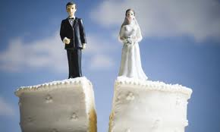
Now we’ll look at 2 tough issues:
Marriage to unbelievers
Divorce
Our Goal Today:
Understand how the people of Ezra’s day solved their problem
This should help us in making decisions with our problems today
Remember: God may be more interested in how we solve our problems than the end result!

Slide 22
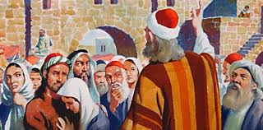
1) Acknowledge the Problem and openly discuss it
Officials approach Ezra (9:1)
  Indicates Ezra has become a spiritual leader
  Ezra has wisdom and authority
People – Priests – Levites: problem throughout Israel!
  May have resulted from Gentiles who were attracted back in Ezra 7
  Some Jews then took Gentile wives who were not believers
Communication is a key to all family & ecclesial problems

Slide 23
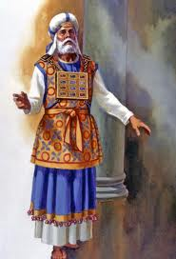
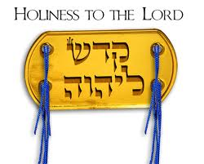
Holiness: Not separated themselves
Ex 22:31 “Be you holy for I am holy”
Lev 11-22 Clean/unclean, defilement – God tried to impress the people
You shall be holy, for I the Lord your God am holy (Lev 19:2)

Slide 24
Lev 20:24-26
24 'But I have said to you, "You shall inherit their land, and I will give it to you to possess, a land flowing with milk and honey." I am the LORD your God, who has separated [badal] you from the peoples.
25 'You shall therefore distinguish[badal] between clean animals and unclean, between unclean birds and clean, and you shall not make yourselves abominable by beast or by bird, or by any kind of living thing that creeps on the ground, which I have separated [badal] from you as unclean.
26 'And you shall be holy to Me, for I the LORD am holy, and have separated [badal] you from the peoples, that you should be Mine.

Slide 25
Deuteronomy 7:1-6
1 "When the LORD your God brings you into the land which you go to possess, and has cast out many nations before you, the Hittites and the Girgashites and the Amorites and the Canaanites and the Perizzites and the Hivites and the Jebusites, seven nations greater and mightier than you,
2 "and when the LORD your God delivers them over to you, you shall conquer them and utterly destroy them. You shall make no covenant with them nor show mercy to them.
3 "Nor shall you make marriages with them. You shall not give your daughter to their son, nor take their daughter for your son.
4 "For they will turn your sons away from following Me, to serve other gods; so the anger of the LORD will be aroused against you and destroy you suddenly.
5 "But thus you shall deal with them: you shall destroy their altars, and break down their sacred pillars, and cut down their wooden images, and burn their carved images with fire.
6 "For you are a holy people to the LORD your God; the LORD your God has chosen you to be a people for Himself, a special treasure above all the peoples on the face of the earth.
This was the principle

Slide 26

Applying the principles
Ammonites, Moabites, Egyptians
  not specifically mentioned in Deut 7
  Principle was extended to apply
  Legalists would have claimed it did not apply!
Lesson: learn principles & apply them in faith
  Adam to Eve: “neither shall you touch it”
  If wrong to murder, then wrong to hate in heart
  If wrong to commit adultery, then wrong to look & lust
Look for ways to apply God’s principles – don’t condense them to letter of the Law. God wants us to marry believers!

Slide 27
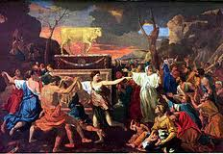
Extent of the Problem
They have taken wives for themselves & their sons
  Elders have tremendous responsibility to live by God’s standard
  Children do as parents, so parents must live by God’s standard
Holy race has mixed itself: divided loyalties & interests
  Talk to folks who have unbelieving spouses & discover the tough decisions they face
  Have someone share the issue with our CYCs
Note: mixed marriages & idolatry that followed were what caused the exile (v.14)
  Fear of punishment is not a powerful motivation in the long run
  Must learn to love the Lord our God with all our heart, soul, strength & mind (Mat 22:37; Deut 6:5)
Ecclesial elders & Parents must lead!

Slide 28
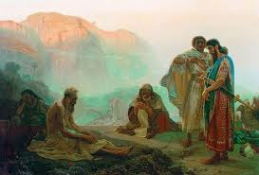
Dealing with the Issue
Rent garments, mantle, pull out hair (v.3)
  Some think Ezra over-reacted, but he was terrified about the future of God’s ecclesia
  This issue had led to the captivity in the first place, and the death of Ezra’s Dad (Seraiah)
All who trembled at God’s word (v.4)
  They were concerned about the future
  Note how the faithful were attracted to Ezra
Evening sacrifice (v.5): time of continual burnt offering – time for dedication!
Fell on my knees: before the temple (10:1)
Prayer: note that the language is normal Hebrew
  Like Paul in the NT
This is true Leadership

Slide 30
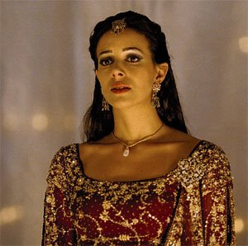
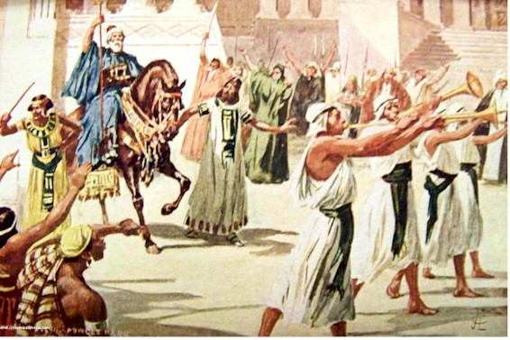
Esther:
Childlike trust in God
Mordecai
God’s faithful leader

Slide 31
Ezra’s Approach to Mistakes:
1) Publicly acknowledge the issue is wrong and mistakes have been made (9:3)
2) Think about what we have done and the consequences of our mistakes (9:4)
3) Pray: admit mistakes and ask for God’s mercy and help (9:5-15)
4) Consider possible plans to move forward to correct the mistake (10:1-4)
5) Implement the plan, trusting in God to bless the efforts (10:5-44)
Similar strategy used by Joshua for solving the Gibeonite mistake in Joshua 9

Slide 32
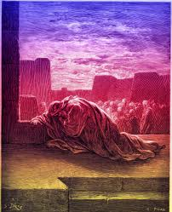
Ezra’s Prayer (9:6-15)
Begins with humility (v.6)
Confession of sin (v.7)
God’s kindness & mercy (v.8)
Purpose of Freedom: build temple (9)
Acknowledged Peoples’ failure (v.10)
God warned of the danger (v.11)
God commanded separateness (v.12)
Not punished as sins deserve [mercy] (v.13)
If break commands, there will be no remnant (v.14)
God is just, no one is righteous (v.15)
Great leaders identify with the peoples’ sin & plead for God’s help to recover

Slide 33
Finding a Solution (Ezra 10)
Ezra’s sincerity, commitment & example cause others to join (v.1)
Before the house of God: Note Solomon’s prayer in 1Kgs 8:30,35 “when they pray toward this place”
People wept bitterly: Not a sign of weakness, but a part of confession & true repentance
Shecaniah (v.2): his Dad (Jehiel) has a foreign wife (v.26), but he’s still willing to deal with the problem
There is hope: he knew about God’s great mercy when there is true repentance
Ezra’s leadership caused Shecaniah to rise to the occasion

Slide 34

Solution: Divorce the foreign wives who were not committed to Yahweh
Put away (v.3): same Hebrew word as in Deut 24:2
  Some Christadelphians claim these men only “lived with” these foreign women, but did not marry them or divorce them
  However, these foreign women were taken as wives in Ezra 9:2 (compare Deut 7:3; Gen 34:9) & as acknowledged by Ezra in 9:12 – that’s why the solution was so difficult to implement
Wives & their children = wives & children who still lived as foreigners (worshipped idols)
  In Neh 13:24, where this occurs again, the children did not know the Hebrew language
  Maybe this became a test of the commitment of the foreign wives to Yahweh
Note: this was not a simple solution of demanding every foreign wife be divorced.
  Some foreigners had joined Israel & participated in the Passover back in Ezra 6:21
  This was a selective process & took 3 months to implement
Good solutions take time and involve examining each case

Slide 35
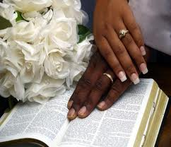
Paul’s marriage counsel in 1 Corinthians 7
v.12-14 If an unbeliever is willing to stay, then give it a try. Who knows, maybe the unbeliever will be won over to God.
v.15 If an unbeliever departs (not interested), let them go. God has called us to peace! (note: this only works if the believer is walking with God!
There wouldn’t be peace if an unbelieving spouse taught our children another language and how to worship another god!

Slide 36
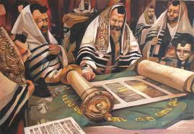
Principles Involved in the Law used by Ezra:
1) Separate ourselves to God – “be you holy”: don’t marry unbelievers: (Deut 7:1-5)
2) Marriage should be for life (Gen 2:24, Mat 19:8) Divorce was permitted (Deut 24:2), but not the Divine ideal! “for the hardness of your hearts” (Mat 19:8)
3) God wants us to raise Godly children, so he “hates divorce” (Mal 2:15) – but these families were not Godly & not raising Godly children!
The challenge of living the Truth is to weigh up all the principles, and then prayerfully choose a pathway that attempts to faithfully follow God’s way!

Slide 37
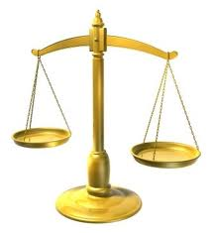
Marriage Relationship is not always the primary Issue
1) Master/slave relationship rated higher than a marriage relationship (Ex 21:1-11)
2) Marriage to ungodly unbelievers who brought evil practices into the family (Ezra 10:11, 19, 44; Neh 13:23-27)
3) Converts to Christ whose spouses desired to leave the marriage. Converts were “not under bondage” because “God has called us to peace” (1 Cor 7:12-16)
When Biblical principles conflict, we have to wisely rank them according to God’s ways

Slide 38

Conflicting Principles in the Bible:
We have to make a choice!
Sabbath OR Circumcision on 8th day
Sabbath OR Priests’ daily temple work
Showbread rules OR David’s men need food
Marriage for life OR Separateness to God
Gibeonites should die OR faithfulness to covenant
These are the issues that help us learn to live like God

Slide 39

Weighing the Issues in Ezra
Divorce was secondary
Unbeliever marriage was primary
Rigid rules don’t always produce wise solutions

Slide 40

Conflicting principles in Christ
We have to make a choice!
Use freedom to eat meat offered to idols
OR
Try not to cause others to sin
Exercise liberties we have in Christ
OR
Through love serve one another
Carry out judgments against one another
Extend God’s mercy to others
OR
The choices we make reveal our understanding of God’s character

Slide 41
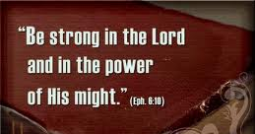
Solution is implemented
“Be courageous (strong) & do it” (10:4) from 1Chr 28:10 David to Solomon
Ezra made them swear on oath (v.5)
  Asa (2 Chr 15:12-14)
  Hezekiah (2 Chr 29:10)
  Josiah (2 Chr 34:31-32)
  Nehemiah (Neh 5:12 restore land, no interest)
  10:29 (put away foreign wives)
Chamber (v.6): in side of temple (1Kgs 6:5)
  Eliashib = high priest in Neh 3:1
  No bread or water: Ezra willing to make personal sacrifices for the sake of the community
Within 3 days (v.8): no one lived more than 3 away
  Note: Ezra’s authority & willingness to disfellowship
9th month, 20th day: 4.5 months after Ezra’s arrival in Jerusalem (7:9)
  Open square = temple court
  Heavy rain: possible drought before this? (see Hag 1:10)
Go forward, trusting God

Slide 42
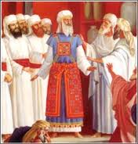
The Result: 113 divorced families
Took 90 days (v.16): didn’t rush thru in 1 week
  Note: no women married foreign men
Total in the list: 113 men
  4 of High priest’s family
  13 of other priests
  10 Levites
  86 common Israelites
Indicates problem was spread through community, but not very many affected
  Low percentage of men – only 0.3%
  Much lower than our community today
  27 priests & Levites: Leaders were the worst offenders!
Maybe Ezra’s reaction was based on the failure of the Leaders

Slide 43

Ezra’s success based on:
1) Admitted the problem existed
2) Identified with the people: “our iniquities”
3) Prayed to God for help
4) Let people develop a solution
It was not Ezra’s mandate
5) Got most people to agree with plan
6) Took the time to examine each case.
Did not mandate blanket rule!
This problem & solution is in the Bible to help us today

Slide 44
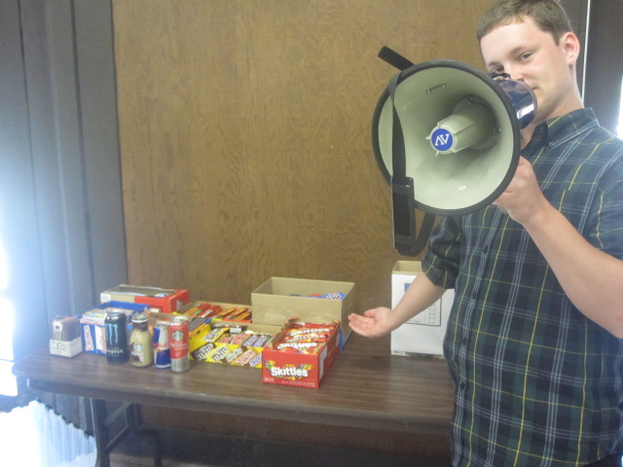
Snack Sale is still available till tomorrow

Slide 45
2
S
G

Slide 46
2
S
G

Slide 47

When we return home…
Remember:
You set the standards for your families & ecclesias. So pray for God’s wisdom! Study & then do it!
Look to the future! Make tough decisions today for sake of your families, your children and grandchildren, so you can leave them a Godly inheritance!
Pray for God’s help & blessing: Unless the Lord builds the house we labor in vain (Psa 127:1)
“I have no greater joy than to hear that my children are walking in the truth” (3 Jn 4 NIV)

Slide 48
1
5
G

Slide 49

Temple is finished
Then Ezra returns
Then Nehemiah builds the wall
-- 515 Ezra returns
-- 502 Nehemiah returns
[ 10 years ]
2
6
7
20

Slide 50
Temple is finished
Then Ezra returns
Then Nehemiah builds the wall
-- 515 Ezra returns
-- 502 Nehemiah returns
[ 10 years ]
2
6
7
20

Slide 51
The Exiles Return
1000 miles (1600 km)
800 miles (1300 km)
Just to get to Jerusalem was a major trip!

Slide 52
2
S
G

Slide 53
2
W
17
!

Slide 54

Lessons from Haggai
Even

Slide 55
2
W
17
!

Slide 56
Lessons from Haggai
Even

Slide 57
