Slide 1
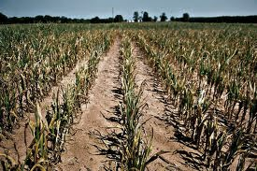
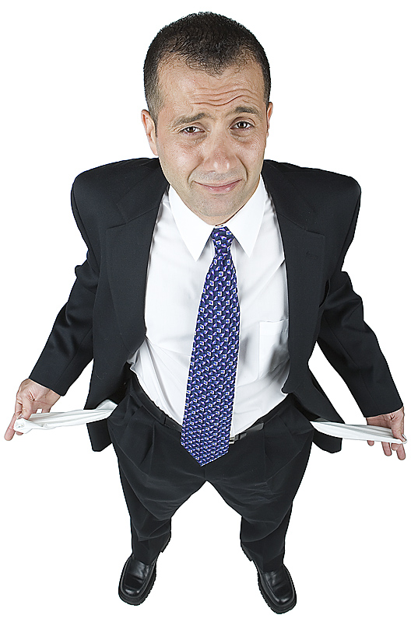
Haggai
Consider how you have fared!

Slide 2
The Kings of Ezra 4
Effect on Temple | Name in Ezra 4 | Actual Name | Length of Reign
Issued decree to build temple | Cyrus | Cyrus the Great | 9 years after decree
Did not hinder the work | Ahaseurus | Cambyses II | 8 years
Stopped work on temple | Artaxerxes | Gomates (Pseudo-Smerdis) | 7 months
Encouraged work to finish | Darius | Darius Hystaspes (Darius the Great) | 36 years

Slide 3

Timeline of the Persian Kings during the temple building
-- 515 Ezra returns
-- 502 Nehemiah returns
[ 10 years ]
6
7
20

Slide 4
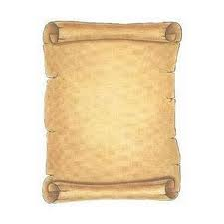
The Samaritans’ Letter
Lies..lies.. More lies
Artaxerxes (v.7) = Gomates
V.10 check a modern version
Rebellious & evil city (v.12): trying to make Jerusalem look bad for the Persians
  v.15 “harmful to kings” & “incited sedition”
Rebuilding the walls: a lie! Misleading.
Search (v.15): about Jerusalem (not Cyrus’ decree)
  These people are not interested in Truth!
Mighty kings: David, Solomon
  Menahem (2Kgs 15:16)
  Josiah (2 Chron 34:6,7; 35:18)
Remember: God is in Control!

Slide 5
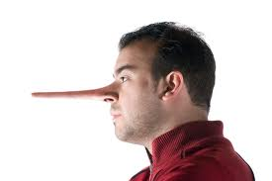

Lies of the Samaritans
1) Jews are rebuilding the city and finishing the walls (v.12)
[no mention of temple]
2) Jews will not pay taxes, tribute (v. 13)
3) Jerusalem is rebellious, harmful to kings, incited sedition - that’s the reason it was destroyed (v.15)
4) if city is finished, Persia will lose its dominion this side of Euphrates (v.16)
God used this to stop the work

Slide 6
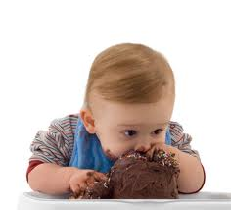
God gives them what they wanted
Have your cake & eat it too!
By force and power (v.23):
  When we complain about life God sometimes gives us what we really want
  Makes us re-think our situation
  Don’t complain about your family, ecclesia or job!
The work stopped:
  Only for about 2 years
  True believers were probably frustrated
  It was a time to test their Faith: do we really believe God is in control and using these events to save His people?
This is when faith gets you through!

Slide 7
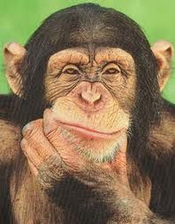
Why did God stop the work?
15 years of work had worn out and discouraged the people
Older people didn’t like the new temple
Adversaries hired counselors against them
Workers wanted to spend time on their own houses, farms and businesses
People were afraid of adversaries (8:4-5)
Now was the time for faithful believers to step forward and stir up the community to finish God’s house

Slide 8



Ezra: Working together in God’s service
Ezra 5: God will Provide the Motivation to Finish!

Slide 9
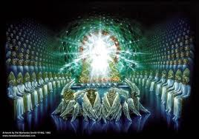
God stopped the work
15 years of work had worn out & discouraged the people – they gradually stopped working
Older people didn’t like the new temple
Adversaries hired counselors against them
Workers wanted to spend time on their own houses, farms and businesses
People were afraid of adversaries (8:4-5)
Be careful! When we think we have it rough, it can get worse!

Slide 10
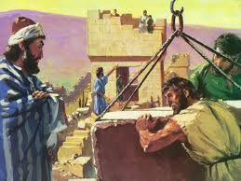
God gets the work going again!
Used Haggai & Zechariah
Similar to today: no angel visits, no spirit gifts
People needed faith to see what God & His angels were doing for them behind the scenes
Only took 4 more years to finish
It’s amazing what can be accomplished in families & ecclesias when we have the faith to get involved in God’s work!

Slide 11
Temple is finished
Then Ezra returns
Then Nehemiah builds the wall
-- 515 Ezra returns
-- 502 Nehemiah returns
[ 10 years ]
2
6
7
20

Slide 12
Haggai
Consider how you have fared!

Slide 13
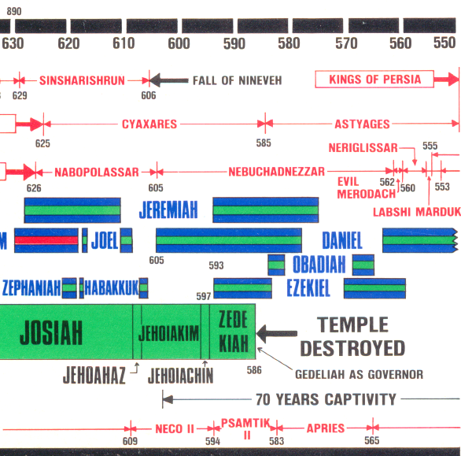
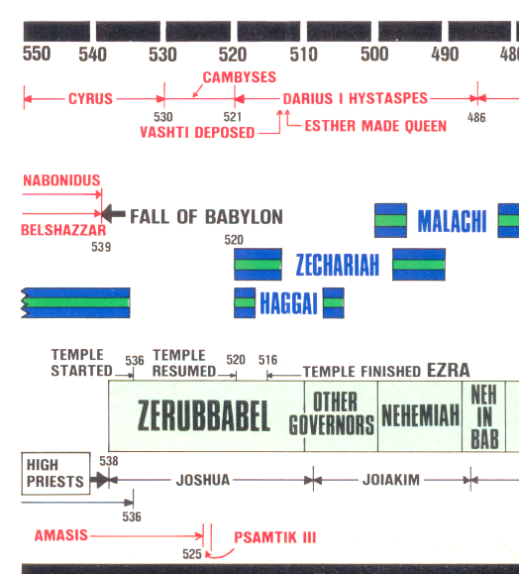
When did Haggai prophesy?

Slide 14

Timeline of the Persian Kings during the temple building

Slide 15
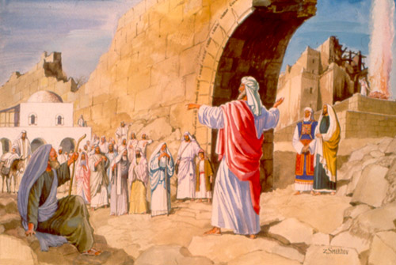
“The Prophets of God Helping them” (Ezra 5:1-2 )
Coordinated efforts of Haggai & Zechariah
Haggai: Exhorts and reprimands the people for their poor choices and lack of faith.
Zechariah: Encourages the people that the angels are working behind the scenes and they will help finish the temple!

Slide 16
Haggai & Zechariah together
2nd Year of Darius
Hag 1:1-11 6th month, 1st day
consider how your have fared!
Hag 1:12-15 6th month, 24th day
Began working on the temple again
Hag 2:1-9 7th month, 21st day
End of Tabernacles – “I am with you”

Slide 17
Haggai & Zechariah together
2nd Year of Darius
Zech 1:1-6 8th month
Return to God or face captivity again!
Hag 2:10-23 9th month, 24th day
Nation unclean, but God will bless them!
Zech 1:7-6:15 11th month, 24th day
Night visions: God will finish the temple!

Slide 18
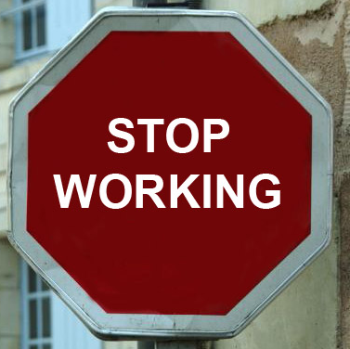
Why did God stop the work?
15 years of work had worn out and discouraged the people
Older people didn’t like the new temple
Adversaries hired counselors against them
Workers wanted to spend time on their own houses, farms and businesses
People were afraid of adversaries (8:4-5)
Be careful! Sometimes God gives us what we want so we will learn to quit dreaming for it!

Slide 19
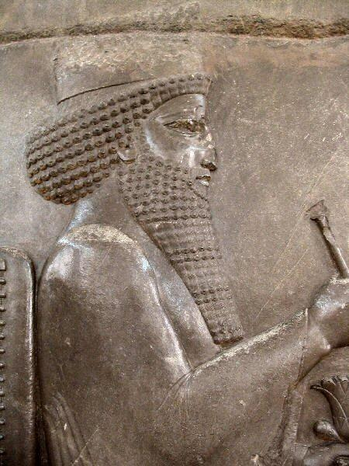
God raises up Darius to be King!
A few months after the temple work was forced to stop, God opened a door by bringing Darius to the throne
Some of the Jews realized this was their opportunity and began working on the temple again, but they needed more help
The angels were busy at work in the Persian Empire so that the work on the Temple could finish

Slide 20

Haggai 1:1-2
The setting…
1 In the second year of King Darius, in the sixth month, on the first day of the month, the word of the Lord came by Haggai the prophet to Zerubbabel the son of Shealtiel, governor of Judah, and to Joshua the son of Jehozadak, the high priest, saying, 2 "Thus speaks the Lord of hosts, saying: 'This people says, "The time has not come, the time that the Lord's house should be built."'"
Many people were looking for an excuse not to get involved in the work!

Slide 21
People’s Reaction to Laying the Foundation (Ezra 3:12 )
Younger: Shouted & praised (excited!)
Older: Wept (disappointed) ☹
Hag 2:3-4 Is it not in your sight as nothing?
Zech 4:8-10 Who has despised the day of small things?

Slide 22
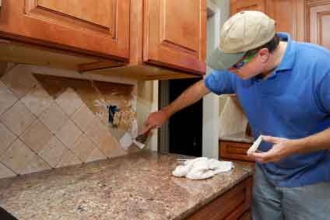
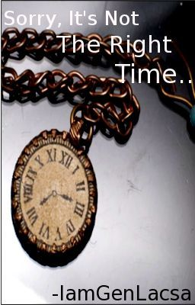
What had the People been doing over the last 15 years? (see Haggai 1:1-6)
1) Claimed the time was not right (v. 2) because it was not yet the end of the 70 years

Slide 23
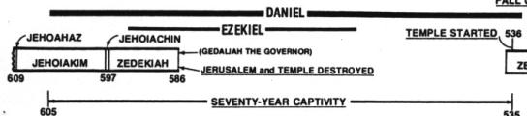
Jeremiah’s Prophecies about the 70 years
Jer 25:11-14 (during early years of Jehoiakim’s reign) after 70 years God will punish Babylon
Jer 29:10-14 (during early years of Zedekiah) after 70 years God will bring the Jews back and give them a future with peace and hope

Slide 24
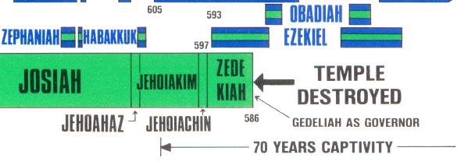
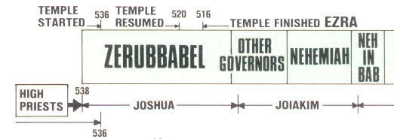
When did the 70 years start?
70 years
70 years
In the 4th year of Jehoiakim when the good figs (like Daniel) were taken captive, or at the end of Zedekiah when the temple was destroyed?
People justified what they really wanted to do!

Slide 25
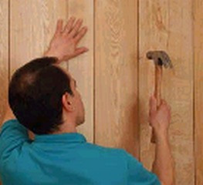

What had the People been doing over the last 15 years? (see Haggai 1:1-6)
1) Claimed the time was not right (v. 2)
- not yet the end of the 70 years
2) Paneled their own homes (v. 4)
3) Tried to improve their economic situation (v. 6)
When we aren’t involved in God’s work, we tend to serve ourselves

Slide 26
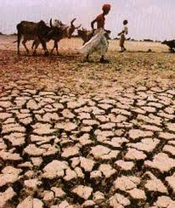
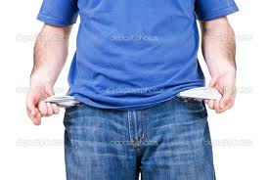
God tried to talk to the people by influencing the conditions in the land (Hag 1:5)
1) Small harvests: blight, mildew & hail (2:17)
2) Droughts
3) Cold
4) Inflation
God talked to them through economic & environmental events
We need to examine our own lives and consider how we have fared

Slide 27

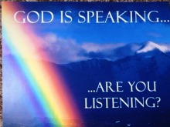



Slide 28

Put God First in your life!
School
Work
Friends
Hobbies
Free time
When you put God first, He takes care of all your needs
And my God will supply every need of yours according to his riches in glory in Christ Jesus. (Phil 4:19-20 RSV)

Slide 29

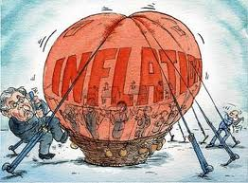
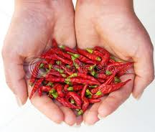
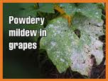
Haggai’s Message: Consider how you have fared!
God had influenced their lives
1:6 Small harvest, not enough to eat or drink, cold temperatures, high inflation
1:11; 2:17 drought, blight, mildew on crops
1:9 God blew it away!
1:8 Solution: Get involved in building temple!
1:13 God’s assurance: “I am with you”.
He stirred up the spirit of the people
1:14 Response: they came and worked
2:1-9 Don’t worry that this temple is not as good as the former. It’s latter glory will be greater
2:10-14 Nation is unclean. Much easier to learn wickedness than righteousness
2:15-23 God will bless Israel from now on because they involved again in God’s work of building
Get priorities right: Spiritual issues first!

Slide 30
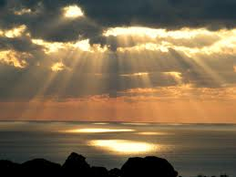
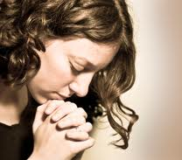
God talks to us through the experiences of life
We need to meditate and consider the events of our lives – they are not by chance!
God attempts to influence us through life events – if we are listening
He uses economics, jobs, health, family troubles, accidents, friends
We need to meditate
& consider how we have fared!
God’s talking…are we listening?

Slide 31
Haggai 1:14-15
God helped out
So the Lord stirred up the spirit of Zerubbabel the son of Shealtiel, governor of Judah, and the spirit of Joshua the son of Jehozadak, the high priest, and the spirit of all the remnant of the people; and they came and worked on the house of the Lord of hosts, their God, 15 on the twenty-fourth day of the sixth month, in the second year of King Darius.
God is thrilled when we respond to His work and He joyfully helps us out

Slide 32
Haggai 2:1-5
This temple was not like Solomon’s
In the seventh month, on the twenty-first of the month, the word of the Lord came by Haggai the prophet, saying: 2 "Speak now to Zerubbabel the son of Shealtiel, governor of Judah, and to Joshua the son of Jehozadak, the high priest, and to the remnant of the people, saying: 3 'Who is left among you who saw this temple in its former glory? And how do you see it now? In comparison with it, is this not in your eyes as nothing? 4 Yet now be strong, Zerubbabel,' says the Lord; 'and be strong, Joshua, son of Jehozadak, the high priest; and be strong, all you people of the land,' says the Lord, 'and work; for I am with you,' says the Lord of hosts. 5 'According to the word that I covenanted with you when you came out of Egypt, so My Spirit remains among you; do not fear!'
God wants us to do the best we can with what we have!

Slide 33
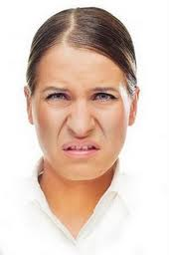
Who has despised the day of small things?
Most ecclesias today are small
Many have simple buildings, rent, or use homes
Witnessing projects may appear simple and small
Services: we try to use everyone
Warning: Don’t despise what God has given us and He is using to build His house! Get involved and appreciate what He has provided!

Slide 34

Lessons from Haggai
Get involved in God’s work today
Stay involved even in tough times
When we get discouraged, remember:
  the angels are on our side and enthusiastically work for our spiritual success!
  God loves us and is zealous for us to grow and develop in His family

Slide 35
Haggai 2:6-9
God will provide a more glorious temple
6 "For thus says the Lord of hosts: 'Once more (it is a little while) I will shake heaven and earth, the sea and dry land; 7 and I will shake all nations, and they shall come to the Desire of All Nations, and I will fill this temple with glory,' says the Lord of hosts. 8 'The silver is Mine, and the gold is Mine,' says the Lord of hosts. 9 'The glory of this latter temple [the latter glory of this temple – NASB] shall be greater than the former,' says the Lord of hosts. 'And in this place I will give peace,' says the Lord of hosts."
God intends to build another temple on this site which will surpass all previous temples!

Slide 36
Haggai 2:10-14
Transferring clean & unclean
10 On the twenty-fourth day of the ninth month, in the second year of Darius, the word of the Lord came by Haggai the prophet, saying, 11 "Thus says the Lord of hosts: 'Now, ask the priests concerning the law, saying, 12 "If one carries holy meat in the fold of his garment, and with the edge he touches bread or stew, wine or oil, or any food, will it become holy?"'"
Then the priests answered and said, "No." (Lev 6)
13 And Haggai said, "If one who is unclean because of a dead body touches any of these, will it be unclean?"
So the priests answered and said, "It shall be unclean."
14 Then Haggai answered and said, "'So is this people, and so is this nation before Me,' says the Lord, 'and so is every work of their hands; and what they offer there is unclean.
Much easier to transfer uncleanness

Slide 37


1 Tim 4:7-10 (RSV)
Train yourself in godliness; for while bodily training is of some value, godliness is of value in every way, as it holds promise for the present life and also for the life to come. The saying is sure and worthy of full acceptance.
But you have to work at it every day and pray for God’s help!

Slide 38

It’s your choice!

Slide 39
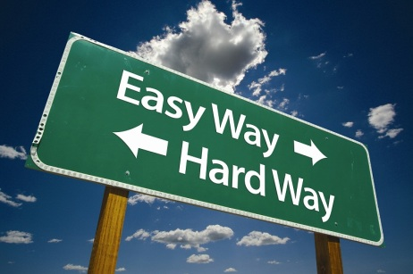

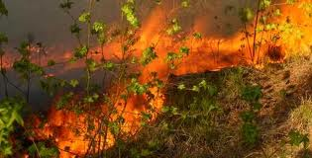
W
The way of Sin is the easy way & it is very contagious!
Sin spreads like wild fires!

Slide 40
Haggai 2:15-19
God wants to bless them!
15 'And now, carefully consider from this day forward: from before stone was laid upon stone in the temple of the Lord — 16 since those days, when one came to a heap of twenty ephahs, there were but ten; when one came to the wine vat to draw out fifty baths from the press, there were but twenty. 17 I struck you with blight and mildew and hail in all the labors of your hands; yet you did not turn to Me,' says the Lord. 18 'Consider now from this day forward, from the twenty-fourth day of the ninth month, from the day that the foundation of the Lord's temple was laid — consider it: 19 Is the seed still in the barn? As yet the vine, the fig tree, the pomegranate, and the olive tree have not yielded fruit. But from this day I will bless you.'"
He’s waiting for our commitment!

Slide 41

God loves you and wants to bless you!

Slide 42

Go home and get involved!

Slide 43
W
1) C
W

Slide 44
2
W
17
!

Slide 45
W
1) C
W

Slide 46
2
W
17
!

Slide 47
W
1) C
W

Slide 48
2
17
G

Slide 49
2
17
G

Slide 50
Lessons from Haggai
Even

