Slide 1

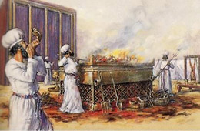
Malachi: God’s love for His people
Warning not to trust in rituals

Slide 2
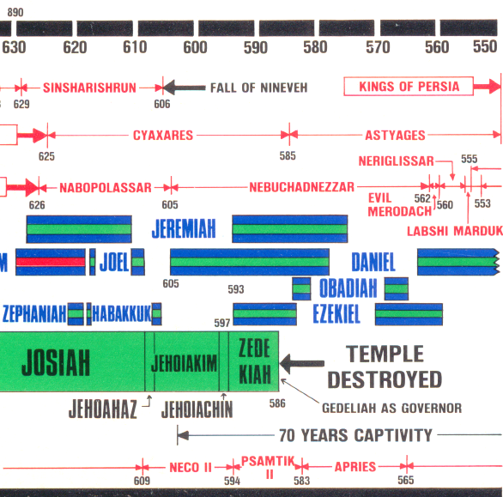
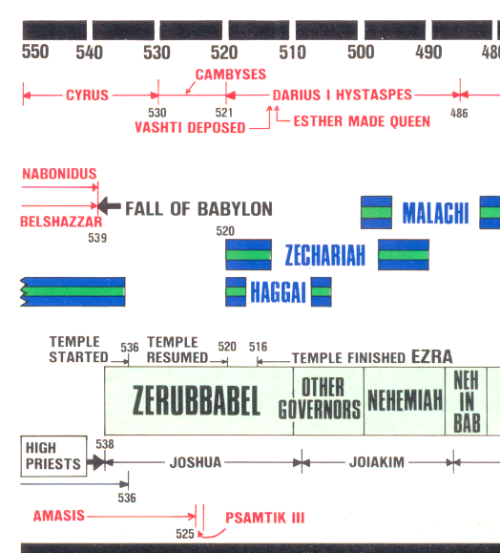
Where are we on the timeline?

Slide 3
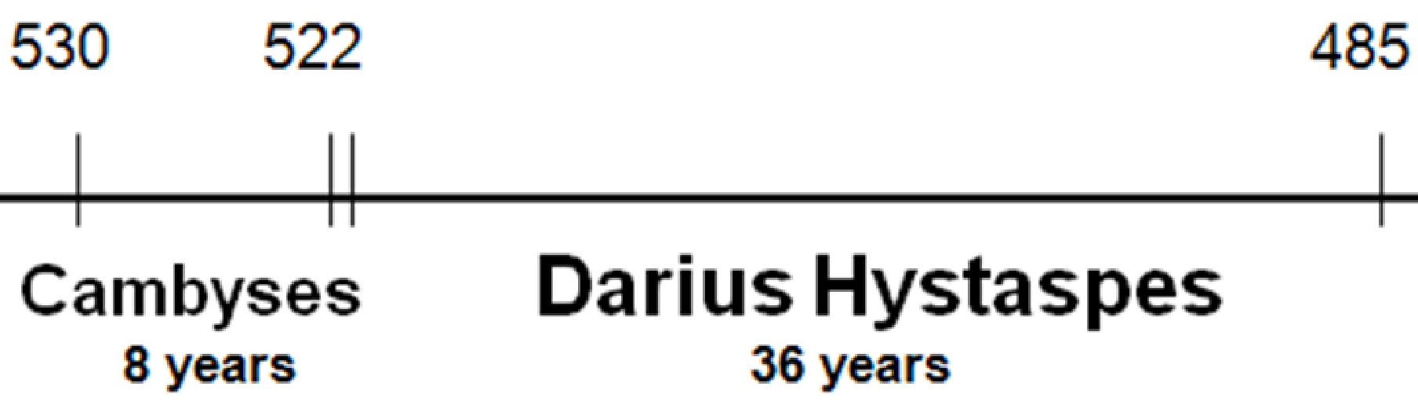
Time for Malachi’s prophecy
Probably occurred right before Nehemiah returned to Jerusalem
Nehemiah returned to king, then later came back
Nehemiah builds wall
Temple finished
Ezra returns
6 7
20
32
Malachi’s Prophesy

Slide 4

Malachi 1:1-6
God has consistently loved Israel
The burden of the word of the Lord to Israel by Malachi. 2 "I have loved you," says the Lord.“ Yet you say, 'In what way have You loved us?‘ Was not Esau Jacob's brother?“ Says the Lord.
"Yet Jacob I have loved; 3 But Esau I have hated, And laid waste his mountains and his heritage for the jackals of the wilderness."
4 Even though Edom has said, "We have been impoverished, but we will return and build the desolate places,“ Thus says the Lord of hosts:
"They may build, but I will throw down;
They shall be called the Territory of Wickedness, and the people against whom the Lord will have indignation forever. 5 Your eyes shall see, and you shall say,
'The Lord is magnified beyond the border of Israel.'
Israel had a special place in God’s plan, but they began to trust in their status

Slide 5
Romans 9:1-5
Jews were given special privileges
9 I tell the truth in Christ, I am not lying, my conscience also bearing me witness in the Holy Spirit, 2 that I have great sorrow and continual grief in my heart. 3 For I could wish that I myself were accursed from Christ for my brethren, my countrymen according to the flesh, 4 who are Israelites, to whom pertain the adoption, the glory, the covenants, the giving of the law, the service of God, and the promises; 5 of whom are the fathers and from whom, according to the flesh, Christ came, who is over all, the eternally blessed God. Amen.
But with privileges comes responsibility!

Slide 6
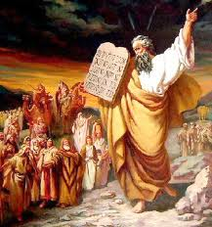
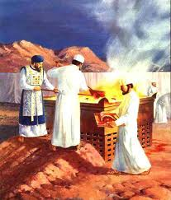
Privileges of Israel (Rom 9)
Israelites: members of Jacob’s family, “power with God”, plead to God with tears to save them
Adoption: taken into God’s family
Glory of the covenants: Ex 20 (the 10 commandments) & Deut 29 (the new covenant)
Giving of the Law: National Law for serving God
Service of God: God chose Levites to serve in His house
Promises: God’s promises to Abraham
Fathers: Abraham, Isaac, Jacob
The Jewish community was truly blessed by God

Slide 7
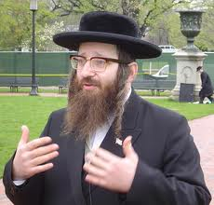
Jewish thinking
God will bless children of Abraham
Children of Abraham are viewed in a special way by God
We are children of Abraham
God is obligated to bless us – we have a special claim to God’s blessing
Paul’s answer: For they are not all Israel who are of Israel (v.6)

Slide 8
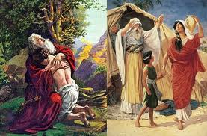
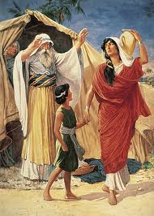
Not all of Abraham’s offspring are children of Abraham by Faith
Romans 9:6-8
6 But it is not that the word of God has taken no effect [God’s plan has not failed!]. For they are not all Israel who are of Israel,
7 nor are they all children because they are the seed of Abraham; but, "In Isaac your seed shall be called."
8 That is, those who are the children of the flesh, these are not the children of God; but the children of the promise are counted as the seed.
So far: Not all of Abraham’s children are God’s children

Slide 9
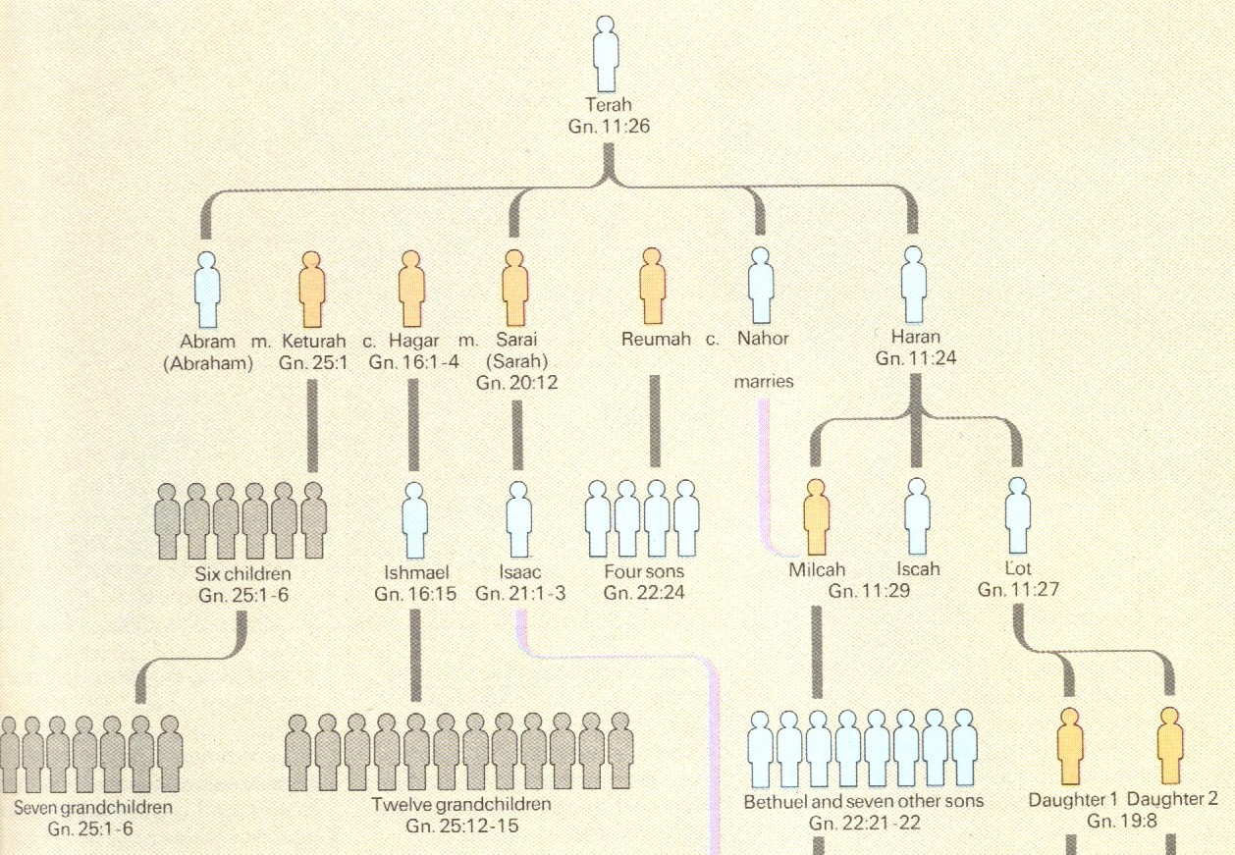
Abraham’s Wives and Children

Slide 10
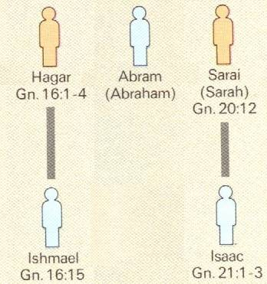
God’s Election
One man, two women, (Hagar was a bondwoman)
In Isaac your seed shall be called (Gen 21:12; Rom 9:7)
God doesn’t call Ishmael Abraham’s son (Gen 21:11-14)
So it’s not about circumcision!
Which one was circumcised?
BOTH!

Slide 11
Romans 9:9
9 For this is the word of promise: "At this time I will come and Sarah shall have a son.”
It’s all of God! It’s His election! Isaac was not selected just because he was Abraham’s son!

Slide 12
Romans 9:10-13
10 And not only this, but when Rebecca also had conceived by one man, even by our father Isaac
11 (for the children not yet being born, nor having done any good or evil, that the purpose of God according to election might stand, not of works but of Him who calls),
12 it was said to her, "The older shall serve the younger."
13 As it is written, "Jacob I have loved, but Esau I have hated.”
God made His choice before the kids had done anything good or evil!

Slide 13
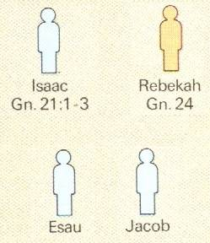
God’s Election
Jacob I have loved,
One man, one wife
but Esau I have hated (Mal 1:2; Rom 9:11)
Two boys born at the same time!
God made his selection before they had done anything!
His selection involved 2 nations! Not just 2 boys! (Malachi 1:2-3)

Slide 14
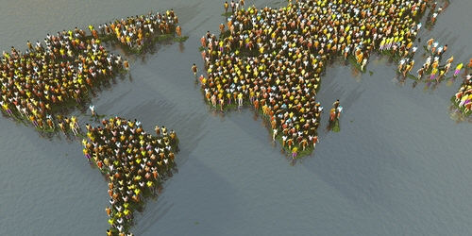
God’s Election: He’s the potter
7 Billion people on earth today
What if God decides to only work with the people in South America? Is that fair?

Slide 15
Malachi 1:6-9 (NIV)
6 "A son honors his father, and a servant his master. If I am a father, where is the honor due me? If I am a master, where is the respect due me?" says the Lord Almighty. "It is you, O priests, who show contempt for my name.
"But you ask, 'How have we shown contempt for your name?'
7 "You place defiled food on my altar.
"But you ask, 'How have we defiled you?'
"By saying that the Lord's table is contemptible. 8 When you bring blind animals for sacrifice, is that not wrong? When you sacrifice crippled or diseased animals, is that not wrong? Try offering them to your governor! Would he be pleased with you? Would he accept you?" says the Lord Almighty.
9 "Now implore God to be gracious to us. With such offerings from your hands, will he accept you?“ says the Lord Almighty.

Slide 16
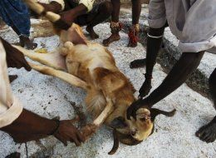
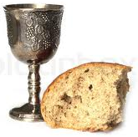
Tired of the Rituals?
The Jews of Nehemiah’s time were just going through the motions, without any moral meaning to their lives
Without any meaning, people tend to go through the motions without even following God’s directions!
  Repetitive rituals without meaning become boring and useless
  Without God’s directions, the moral meanings are lost
Don’t ever get trapped into ritual religion!

Slide 17
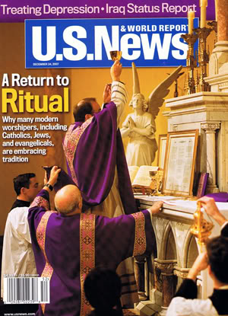
Some people like rituals because it gives them a good feeling of stability & safety

Slide 18
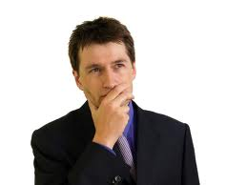


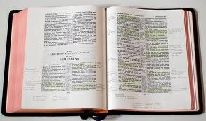
We have the true understanding of the Bible
We have our marked, wide-margin Bibles
We have been baptized into Christ
We are God’s special people
We do our daily Bible readings
We have the bread & wine
Yet for all this, we could hear “depart from me, I never knew you”

Slide 19
Malachi 1:10-14 (NIV)
Robbing God
10 "Oh, that one of you would shut the temple doors, so that you would not light useless fires on my altar! I am not pleased with you," says the Lord Almighty, "and I will accept no offering from your hands. 11 My name will be great among the nations, from the rising to the setting of the sun. In every place incense and pure offerings will be brought to my name, because my name will be great among the nations," says the Lord Almighty.
12 "But you profane it by saying of the Lord's table, 'It is defiled,' and of its food, 'It is contemptible.' 13 And you say, 'What a burden!' and you sniff at it contemptuously," says the Lord Almighty.
"When you bring injured, crippled or diseased animals and offer them as sacrifices, should I accept them from your hands?" says the Lord. 14 "Cursed is the cheat who has an acceptable male in his flock and vows to give it, but then sacrifices a blemished animal to the Lord. For I am a great king," says the Lord Almighty, "and my name is to be feared among the nations.
Be careful lest you rob God of your time, money, or service - He knows!

Slide 20
Malachi 2:1-9 (NIV)
Warning for the Priests
"And now this admonition is for you, O priests. 2 If you do not listen, and if you do not set your heart to honor my name," says the Lord Almighty, "I will send a curse upon you, and I will curse your blessings. Yes, I have already cursed them, because you have not set your heart to honor me.
3 "Because of you I will rebuke your descendants; I will spread on your faces the offal from your festival sacrifices, and you will be carried off with it. 4 And you will know that I have sent you this admonition so that my covenant with Levi may continue," says the Lord Almighty. 5 "My covenant was with him, a covenant of life and peace, and I gave them to him; this called for reverence and he revered me and stood in awe of my name. 6 True instruction was in his mouth and nothing false was found on his lips. He walked with me in peace and uprightness, and turned many from sin.
7 "For the lips of a priest ought to preserve knowledge, and from his mouth men should seek instruction — because he is the messenger of the Lord Almighty. 8 But you have turned from the way and by your teaching have caused many to stumble; you have violated the covenant with Levi," says the Lord Almighty. 9 "So I have caused you to be despised and humiliated before all the people, because you have not followed my ways but have shown partiality in matters of the law."
Ex 32:28 Levites killed 3,000 Israelites! Num 25:12 God’s covenant with Phinehas & Levites

Slide 21
Malachi 2:10-12 (NIRV)
Failure to be faithful to covenants
10 People of Judah, all of us have one Father. One God created us. So why do we break the covenant the Lord made with our people long ago? We don’t even keep our promises to one another.
11 You have broken your promises. A hateful thing has been done in Israel and Jerusalem. The Lord loves his temple. But you have polluted it. You men have married women who worship other gods.
12 May the Lord punish you who do that. It doesn’t matter who you are. May the Lord who rules over all cut you off from the tents of Jacob’s people. May he remove you even if you bring offerings to him.
God expects faithfulness. Marriage to people who do not worship Him is failure!

Slide 22
Malachi 2:13-16 (NKJV)
Failure to be faithful in marriage
13 And this is the second thing you do: You cover the altar of the Lord with tears, with weeping and crying; so He does not regard the offering anymore, nor receive it with goodwill from your hands.
14 Yet you say, "For what reason?“ Because the Lord has been witness between you and the wife of your youth, with whom you have dealt treacherously; Yet she is your companion and your wife by covenant.
15 But did He not make them one (Eve for Adam), having a remnant of the Spirit? And why one? He seeks godly offspring. Therefore take heed to your spirit, and let none deal treacherously with the wife of his youth.
16 "For the Lord God of Israel says that He hates divorce, for it covers one's garment with violence,“ says the Lord of hosts. "Therefore take heed to your spirit, that you do not deal treacherously."
God designed marriage to train our children to become children of God

Slide 23
Malachi 2:17
The heart is deceitful
17 You have tired the Lord with your words.
You ask, "How have we tired him?"
You did it by saying, "The Lord thinks anyone who does evil is good, and he is pleased with them." Or you asked, "Where is the God who is fair?"
These people envied the prosperity of the wicked & used it as an excuse to justify their own wicked lives

Slide 24
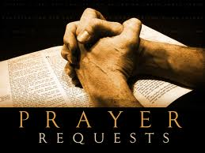
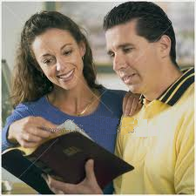


Good Marriages are the result of Daily Prayer and effort!
Pray for God’s help and blessing
Recognize it takes daily effort
Read the Bible together
Work on projects together
Don’t try to change your partner! Change yourself Let God change your partner
Marriage is a work in progress!

Slide 25
Proverbs 19:14
Thank God for success!
Houses and riches are an inheritance from fathers, but a prudent wife is from the LORD.
Thank God daily for success in marriage. One plants, another waters, but it is God who gives the growth!

Slide 26
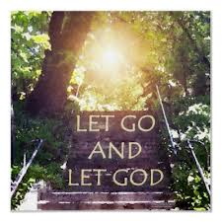
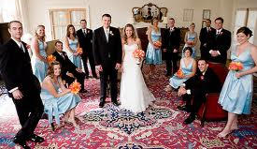
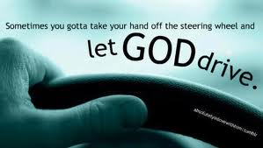
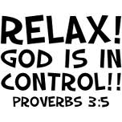
Goals & emphasis today may be in the wrong place
Lot’s of looking and choosing by us
Later leads to 2nd guessing: “I made a mistake” “I married the wrong person”
Too much emphasis put on expensive, elaborate weddings
  The wedding doesn’t make the marriage
  24:67 Isaac simply “brought Rebekah into his mother Sarah’s tent”
Godly partners let God make it work!

Slide 27
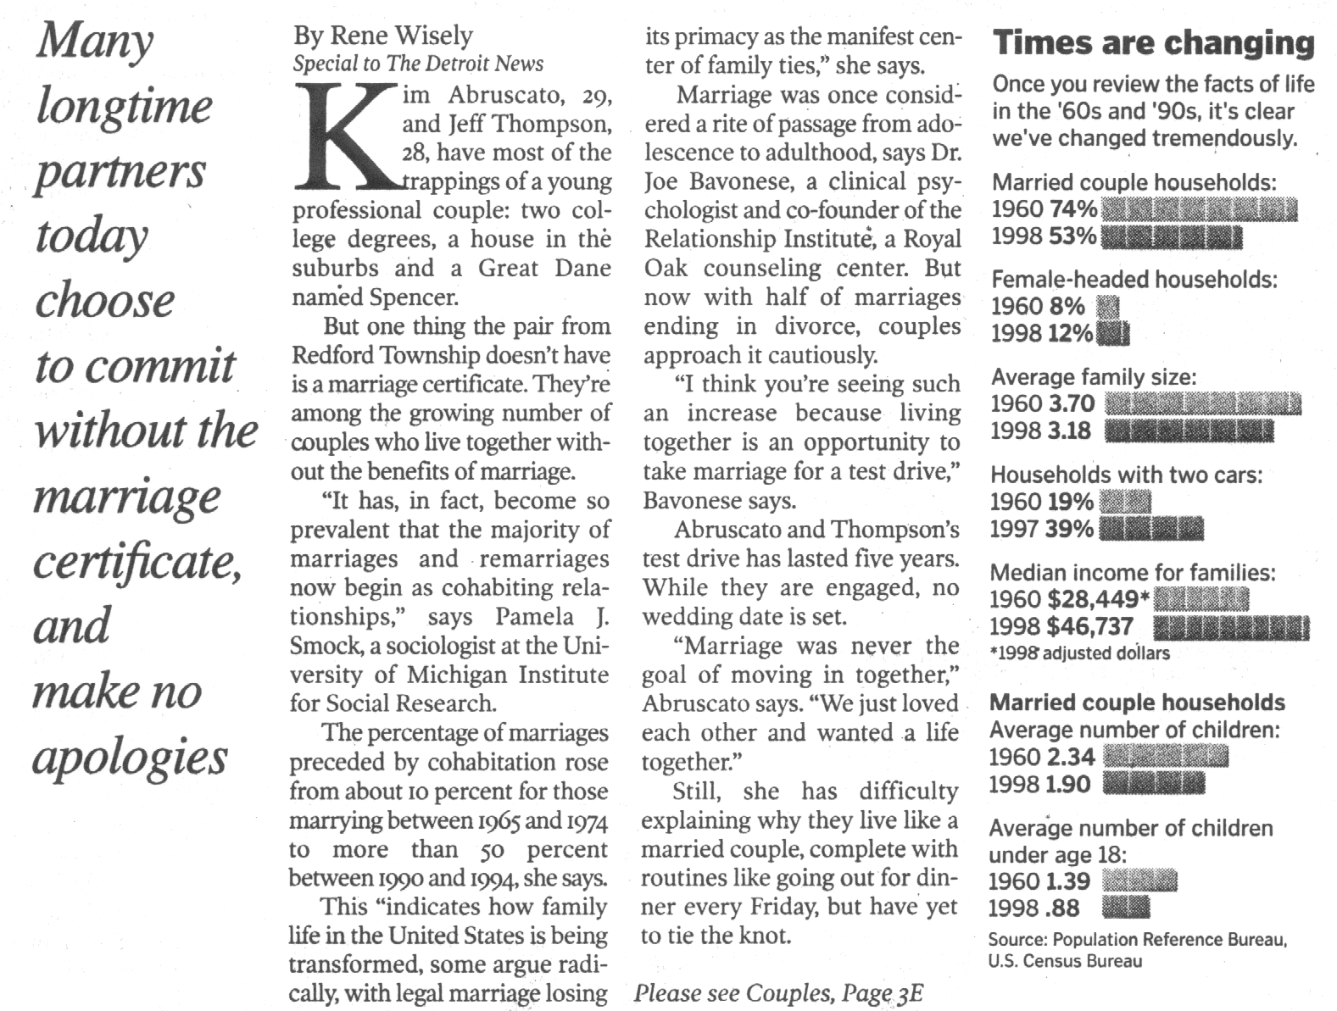
Why Couples Don’t Tie the Knot
Detroit News: April 12, 2000

Slide 28
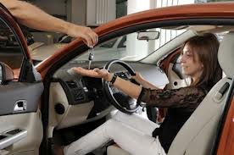
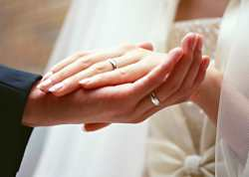

Marriage is not like buying a car!
Trust in the Lord with all your heart, and lean not on your own understanding
In all your ways acknowledge him, and He will direct your paths (Prov 3:5-6)
God’s way requires Faith that He will keep it running!

Slide 29
Malachi 3:1-5 (NIV)
God’s messenger will purify
"See, I will send my messenger, who will prepare the way before me. Then suddenly the Lord you are seeking will come to his temple; the messenger of the covenant, whom you desire, will come," says the Lord Almighty.
2 But who can endure the day of his coming? Who can stand when he appears? For he will be like a refiner's fire or a launderer's soap. 3 He will sit as a refiner and purifier of silver; he will purify the Levites and refine them like gold and silver. Then the Lord will have men who will bring offerings in righteousness, 4 and the offerings of Judah and Jerusalem will be acceptable to the Lord, as in days gone by, as in former years.
5 "So I will come near to you for judgment. I will be quick to testify against sorcerers, adulterers and perjurers, against those who defraud laborers of their wages, who oppress the widows and the fatherless, and deprive aliens of justice, but do not fear me," says the Lord Almighty.
Don’t be deceived! God will not justify the wicked.

Slide 30
Malachi 3:6-12 (NIV)
God is faithful to His promises
6 "I the Lord do not change [God is faithful to his covenant]. So you, O descendants of Jacob, are not destroyed. 7 Ever since the time of your forefathers you have turned away from my decrees and have not kept them. Return to me, and I will return to you," says the Lord Almighty.
"But you ask, 'How are we to return?'
8 "Will a man rob God? Yet you rob me.
"But you ask, 'How do we rob you?'
"In tithes and offerings. 9 You are under a curse — the whole nation of you — because you are robbing me. 10 Bring the whole tithe into the storehouse, that there may be food in my house. Test me in this," says the Lord Almighty, "and see if I will not throw open the floodgates of heaven and pour out so much blessing that you will not have room enough for it. 11 I will prevent pests from devouring your crops, and the vines in your fields will not cast their fruit," says the Lord Almighty. 12 "Then all the nations will call you blessed, for yours will be a delightful land," says the Lord Almighty.
God can control our economic situation & bless us when we faithfully follow Him

Slide 31
Malachi 3:13-18 (NIV)
They didn’t think God distinguishes between good & evil people
13 "You have said harsh things against me," says the Lord.
"Yet you ask, 'What have we said against you?'
14 "You have said, 'It is futile to serve God. What did we gain by carrying out his requirements and going about like mourners before the Lord Almighty? 15 But now we call the arrogant blessed. Certainly the evildoers prosper, and even those who challenge God escape.'"
16 Then those who feared the Lord talked with each other, and the Lord listened and heard. A scroll of remembrance was written in his presence concerning those who feared the Lord and honored his name.
17 "They will be mine," says the Lord Almighty, "in the day when I make up my treasured possession. I will spare them, just as in compassion a man spares his son who serves him. 18 And you will again see the distinction between the righteous and the wicked, between those who serve God and those who do not.
Sometimes in this life we can’t tell the difference, but we will at the judgment seat!

Slide 32
Malachi 4:1-6 (NIV)
God’s righteous judgment is coming
4 "Surely the day is coming; it will burn like a furnace. All the arrogant and every evildoer will be stubble, and that day that is coming will set them on fire," says the Lord Almighty. "Not a root or a branch will be left to them. 2 But for you who revere my name, the sun of righteousness will rise with healing in its wings. And you will go out and leap like calves released from the stall. 3 Then you will trample down the wicked; they will be ashes under the soles of your feet on the day when I do these things," says the Lord Almighty.
4 "Remember the law of my servant Moses, the decrees and laws I gave him at Horeb for all Israel.
5 "See, I will send you the prophet Elijah before that great and dreadful day of the Lord comes. 6 He will turn the hearts of the fathers to their children, and the hearts of the children to their fathers; or else I will come and strike the land with a curse."
Time to change our hearts before the day of the Lord comes!

Slide 33
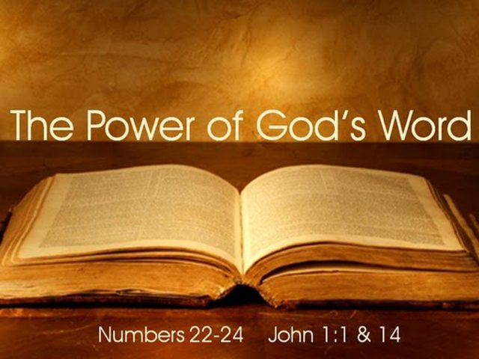
Our hearts can be changed by…

Slide 34

Let’s leave camp and try to be a leader like Nehemiah, or at least support our leaders who try to help us doing God’s work
Shepherd the flock of God which is among you, serving as overseers, not by compulsion but willingly, not for dishonest gain but eagerly; 3 nor as being lords over those entrusted to you, but being examples to the flock; 1 Peter 5:2-3

Slide 35
2
S
G

Slide 36
2
S
G

Slide 37
2
S
G

Slide 38
2
S
G

Slide 39
2
W
17
!

Slide 40
2
S
G

Slide 41
2
W
17
!

Slide 42
2
S
G

Slide 43
2
W
17
!

Slide 44
2
S
G

Slide 45
2
W
17
!

Slide 46
2
S
G

Slide 47
2
W
17
!

Slide 48
2
S
G

Slide 49
2
W
17
!

Slide 50
2
S
G

Slide 51
2
W
17
!

Slide 52
2
S
G

Slide 53
2
S
G

Slide 54
2
S
G

Slide 55
2
S
G

Slide 60
2
S
G

Slide 61
2
S
G

Slide 62
2
17
G

Slide 63
2
17
G

Slide 64
2
W
17
!

Slide 65
2
W
17
!

Slide 66

Lessons from Today
Even

Slide 67
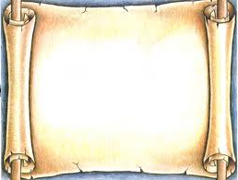
2
S
G

