Slide 1
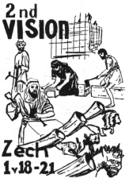
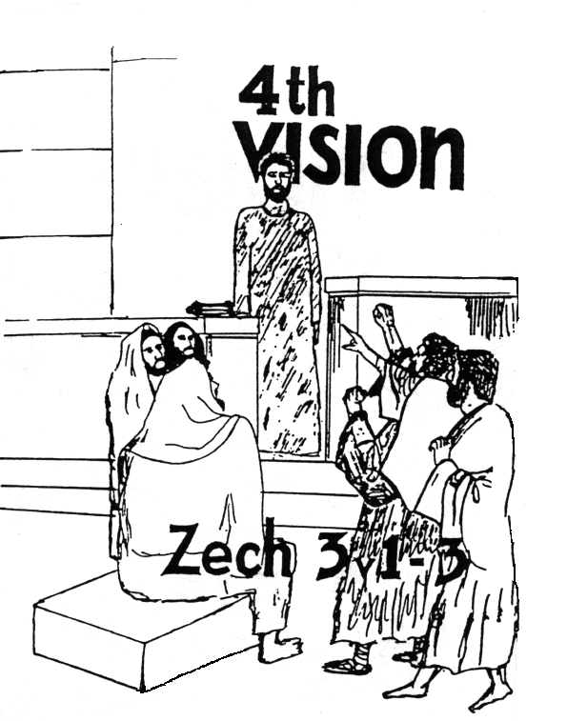
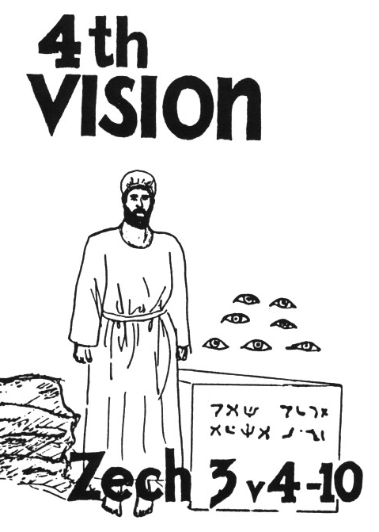

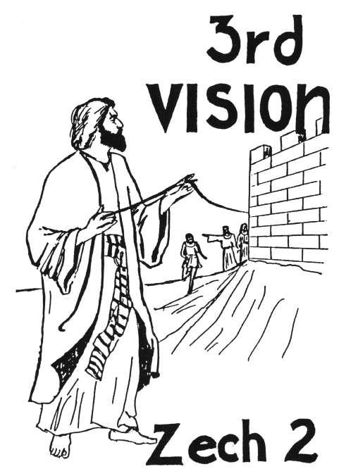



Zechariah’s
Night Visions
(Zech. 1-6)
Class 1:
Background and Zech 1

Slide 2

Haggai 2:6-9
God will provide a more glorious temple
6 "For thus says the Lord of hosts: 'Once more (it is a little while) I will shake heaven and earth, the sea and dry land; 7 and I will shake all nations, and they shall come to the Desire of All Nations, and I will fill this temple with glory,' says the Lord of hosts. 8 'The silver is Mine, and the gold is Mine,' says the Lord of hosts. 9 'The glory of this latter temple [the latter glory of this temple – NASB] shall be greater than the former,' says the Lord of hosts. 'And in this place I will give peace,' says the Lord of hosts."
God intends to build another temple on this site which will surpass all previous temples!

Slide 3
Haggai 2:10-14
Transferring clean & unclean
10 On the twenty-fourth day of the ninth month, in the second year of Darius, the word of the Lord came by Haggai the prophet, saying, 11 "Thus says the Lord of hosts: 'Now, ask the priests concerning the law, saying, 12 "If one carries holy meat in the fold of his garment, and with the edge he touches bread or stew, wine or oil, or any food, will it become holy?"'"
Then the priests answered and said, "No." (Lev 6)
13 And Haggai said, "If one who is unclean because of a dead body touches any of these, will it be unclean?"
So the priests answered and said, "It shall be unclean."
14 Then Haggai answered and said, "'So is this people, and so is this nation before Me,' says the Lord, 'and so is every work of their hands; and what they offer there is unclean.
Much easier to transfer uncleanness

Slide 4
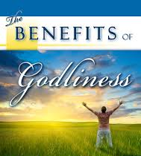
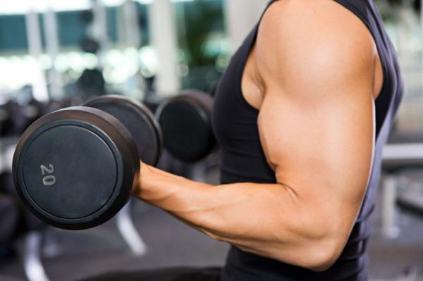
1 Tim 4:7-10 (RSV)
Train yourself in godliness; for while bodily training is of some value, godliness is of value in every way, as it holds promise for the present life and also for the life to come. The saying is sure and worthy of full acceptance.
But you have to work at it every day and pray for God’s help!

Slide 5

It’s your choice!

Slide 6
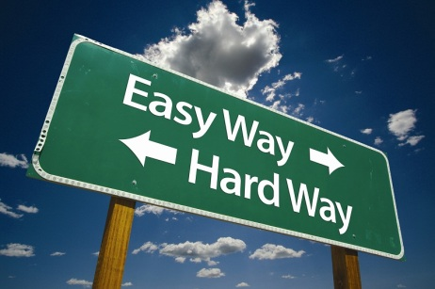

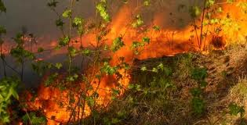
W
The way of Sin is the easy way & it is very contagious!
Sin spreads like wild fires!

Slide 7
Haggai 2:15-19
God wants to bless them!
15 'And now, carefully consider from this day forward: from before stone was laid upon stone in the temple of the Lord — 16 since those days, when one came to a heap of twenty ephahs, there were but ten; when one came to the wine vat to draw out fifty baths from the press, there were but twenty. 17 I struck you with blight and mildew and hail in all the labors of your hands; yet you did not turn to Me,' says the Lord. 18 'Consider now from this day forward, from the twenty-fourth day of the ninth month, from the day that the foundation of the Lord's temple was laid — consider it: 19 Is the seed still in the barn? As yet the vine, the fig tree, the pomegranate, and the olive tree have not yielded fruit. But from this day I will bless you.'"
He’s waiting for our commitment!

Slide 8

God loves you and wants to bless you!

Slide 9
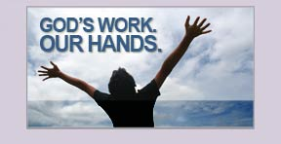
Go home and get involved!

Slide 10
Zechariah
Name means “Yah has remembered”
Son of Berechiah: “Blessing of Yah”
Grandson of Iddo: probably the same Iddo who returned with Zerubabbel (Neh 12:16)

Slide 11
Zechariah’s prophecy has two applications
1) Original application to the return of Jeshua & Zerubbabel and the building of God’s physical house (temple).
2) Future application to Christ’s coming & return, and the building of his spiritual house
Understanding the original application helps us to properly apply the future

Slide 12
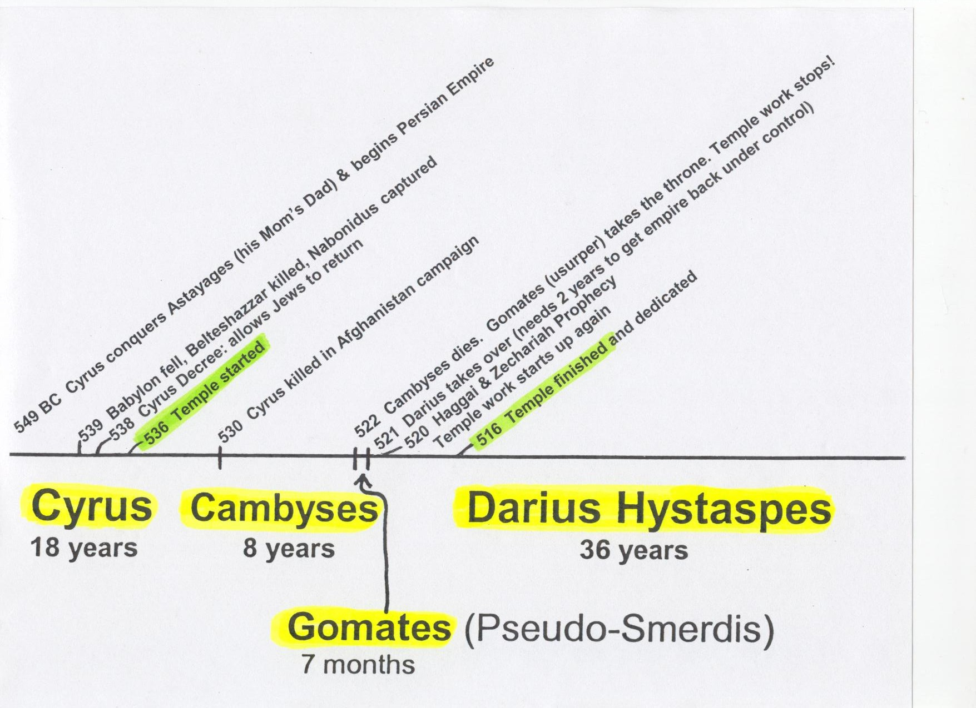
Timeline of the Persian Kings during the temple building

Slide 13
Outline of Zechariah 1
1-6 Return to the Lord, or face captivity again!
7-11 Vision: 4 horsemen
12-17 God will extend mercy to Jerusalem & build His house again
18-21 Vision: 4 horns & 4 craftsmen

Slide 14
1st Step: “Return to Me”
Same message before in Jer 3:1,7; 4:1; 24:7; Isa 44:22
Quoted later in Mal 3:7-10
Our God is faithful and will not fail us

Slide 15
Turn from your evil ways (1:4)
Taken from 2 Kings 17:13 when God explained why He had to remove Israel from the land.
God’s warning is that if the people do not respond, He will have to send them away captive again!

Slide 16
The people’s response (1:6):
God was right!
People admit they made mistakes
Acknowledge God dealt with them according to their deeds

Slide 17
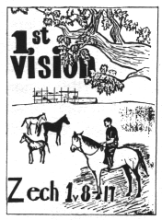
The 1st Vision
What Zechariah saw:
A man riding on a red horse
standing among myrtle trees
Red, sorrel & white horses behind
What had they done?
Patrol the earth
Bought rest

Slide 18
Vision of the Horses among the Myrtle Trees
Colored horses used to represent God’s power to enforce war, famine, pestilence and peace throughout the world (Zech 6:1-8; Rev 6:1-8; 19:11-16) – Zechariah gives us a basis to understand Revelation, but it doesn’t mean the exact same thing!
Myrtle trees (evergreens) used to represent endurance, stability and peace (Lev 23:40-43 & Neh 8:15; Isa 55:13; 41:19; 61:3) – May also be connected to Esther (myrtle) because these angels were designing events to replace Vashti with Esther as queen for Darius Hystaspes!

Slide 19
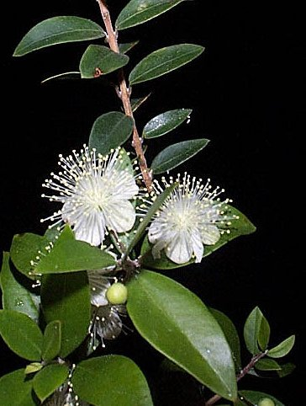
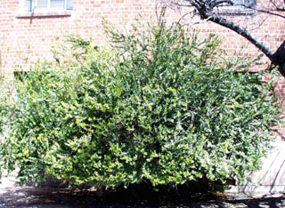
Myrtle shrub or small tree
(Myrtus communis)
5 to 15 feet tall, 4 to 20 feet spread
Key Characteristics:
  evergreen
  drought tolerant

Slide 20
Who are the horsemen?
1:10 These are the ones whom the LORD has sent to walk to and fro throughout the earth
4:10 These seven…they are the eyes of the Lord which scan to and fro throughout the whole earth
They are the Angels! God’s eyes that run to and fro throughout the whole earth (2 Chron 16:9)

Slide 21
What had the Angels done?
Installed Darius Hystaspes as king
Put down the rebellions throughout the Persian empire caused by Gomates’ 9 month take over and Darius’ overthrow of Gomates
Brought the earth back to “resting quietly” (Zech 1:11)
Suppressed the adversaries of Ezra 4 so the work on the temple could begin again

Slide 22
Look at what the Angels were doing behind the scene! (Ezra 5)
v.6 Keep yourselves far from there
v.7 Let the work of this house of God alone
v.8 Let the cost be paid from the King’s expense from taxes (so the adversaries of Ezra 4 ended up paying to finish the temple!)
v.9 And whatever else they need…let it be given them day by day without fail!

Slide 23
How long will God not have Mercy?
God still has great zeal for Jerusalem (14)
God is angry at the nations (15)
God will show mercy to Jerusalem (16)
God’s house will be built (16)
God will again choose Jerusalem (17)

Slide 24
The Lesson for us!
Get involved in God’s work today
Stay involved even in tough times
When we get discouraged, remember:
  the angels are on our side and enthusiastically work for our spiritual success!
  God loves us and is zealous for us to grow and develop in His family

Slide 25
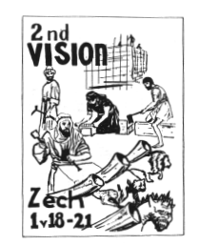
The 2nd Vision
What Zechariah saw:
4 horns
4 craftsmen or carpenters
What happened?
The horns scattered and
humiliated Israel
The carpenters will terrify
and cast out the horns

Slide 26
4 Horns of Zech 1:18-10
Horns = Kings (Dan 7:24; 8:21)
4 Kings responsible for scattering Israel:
Shalmaneser – 2 Kgs 18:9-12
Sennacherib – 2 Kgs 18:13-16
Pharaoh Necho – 2 Kgs 23:31-34
Nebuchadnezzar – 2 Kgs 24:10–25:11
Or the 4 horns may refer to the adversaries all around Israel that had bothered them until now

Slide 27
4 Carpenters (KJV)
“craftsmen” (NKJ, NIV, NASB)
1 Sam 13:19 Now there was no blacksmith to be found throughout all the land of Israel, for the Philistines said, “Lest the Hebrews make swords or spears.”
Ezra 3:7 They also gave money to the masons and the carpenters…
God will empower His temple builders to overcome their adversaries so they can finish the temple

Slide 28
Use of “Lord of hosts”
Isaiah – about 60 times
Jeremiah – about 80 times
Zechariah – about 50 times
in only 14 chapters!
The people were scared and needed assurance that Yahweh of armies would be there to save and protect His people!

Slide 29
Nations learned to fear Jews
Deut 2:25 `This day I will begin to put the dread and fear of you upon the nations under the whole heaven, who shall hear the report of you, and shall tremble and be in anguish because of you.'
Deut 11:25 "No man shall be able to stand against you; the LORD your God will put the dread of you and the fear of you upon all the land where you tread, just as He has said to you.
Josh 2:9-11 Rahab: "I know that the LORD has given you the land, that the terror of you has fallen on us, and that all the inhabitants of the land are fainthearted because of you.
Esther 6:13 When Haman told his wife Zeresh and all his friends everything that had happened to him, his wise men and his wife Zeresh said to him, "If Mordecai, before whom you have begun to fall, is of Jewish descent, you will not prevail against him but will surely fall before him."

Slide 30
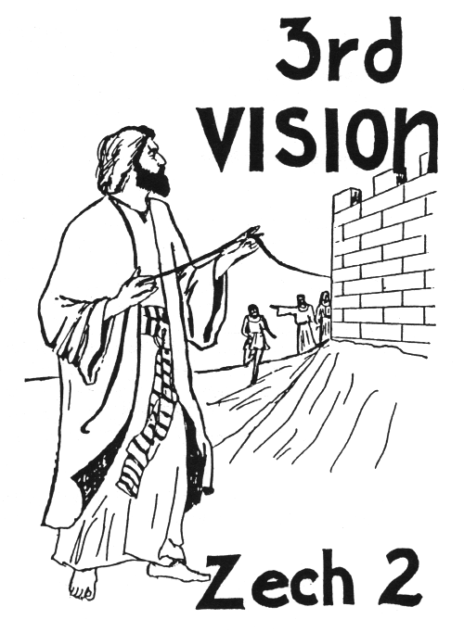
The 3rd Vision
What Zechariah saw:
A man with a measuring line
Man intends to measure Jerusalem
Another angel comes out
This angel says to tell the young
man Jerusalem will not need walls
Jerusalem will be overflowing with
people and livestock
God will her wall of fire and glory

Slide 31
Vision of the Measuring Line
Consider the situation:
1) Only about 40,000 Jews back in the land
2) Adversaries discouraged, troubled and hired counselors against them
3) Persian King demanded the work stop
Most people would have been thinking about security and protection – walls!

Slide 32
Why doesn’t Jerusalem need walls?
Because God will bless the city with many people and animals
Because God will be a wall of fire to protect the city
This vision required the people have faith that God would accomplish his promise!

Slide 33
Get out of Babylon!
Return to Israel!
“Flee” (v.6) and “escape” (v.7). Get out of the places you were held captive!
God will shake His hand against the nations
Many nations will be joined to the Lord
God will dwell in your midst in Jerusalem

Slide 34
Convincing the Jews to Return
Only about 42,000 returned with Jeshua and Zerubbabel (Ezra 2), and only 74 of those were Levites!
Ezra brought more people back (Ezra 8), but he had trouble convincing any Levites to return (8:15)

Slide 35
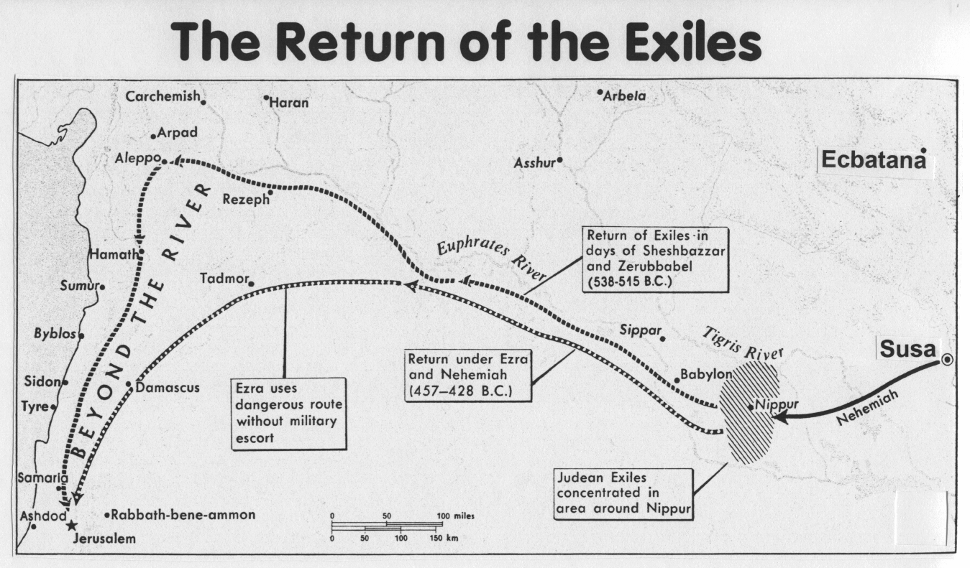

Slide 36
Why didn’t the Jews want to return?
Easier to stay in Persia!
Long journey (400-600 miles) to Israel
The land was a mess (run down for 70 years and lots of rubble)
God had sent drought, famine and economic trouble on the land (Hag 1)
The Levites didn’t trust the people to support them with tithes
Required Faith to make the move!

Slide 37
God’s Motivation to Return
He promised to bless their economy and food (Hag 2:19)
He promised to protect their cities (Zech 2:1-5)
He promised to dwell in their midst (Zech 2:11)
He raised up Haman to make them face the reality of destruction in a foreign land (Esther 3) God’s gentle push!

Slide 38
Many Nations (Gentiles!)
Ezra 6:21-22
21 Then the children of Israel who had returned from the captivity ate together with all who had separated themselves from the filth of the nations of the land in order to seek the LORD God of Israel.
22 And they kept the Feast of Unleavened Bread seven days with joy; for the LORD made them joyful, and turned the heart of the king of Assyria toward them, to strengthen their hands in the work of the house of God, the God of Israel.

Slide 39
Many Nations (Gentiles!)
Zech 8:20-23 (4th of Darius)
20 "Thus says the LORD of hosts: 'Peoples shall yet come, inhabitants of many cities;
21 The inhabitants of one city shall go to another, saying, "Let us continue to go and pray before the LORD, and seek the LORD of hosts. I myself will go also."
22 Yes, many peoples and strong nations shall come to seek the LORD of hosts in Jerusalem, and to pray before the LORD.'
23 "Thus says the LORD of hosts: 'In those days ten men from every language of the nations shall grasp the sleeve of a Jewish man, saying, "Let us go with you, for we have heard that God is with you."'"

Slide 40

Lessons from Zechariah
God loves us and wants to bless us when we make good choices for Him
God can use craftsmen (ecclesial workers) to accomplish his work – we just need to be involved!
God will protect His ecclesias, if we are working on His house
Flee out of Babylon while we can, before the great and terrible Day of the Lord
The angels are watching over our ecclesial work and will make sure God’s spiritual house (his family) is assembled in the kingdom

