Slide 1
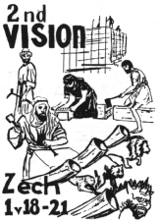
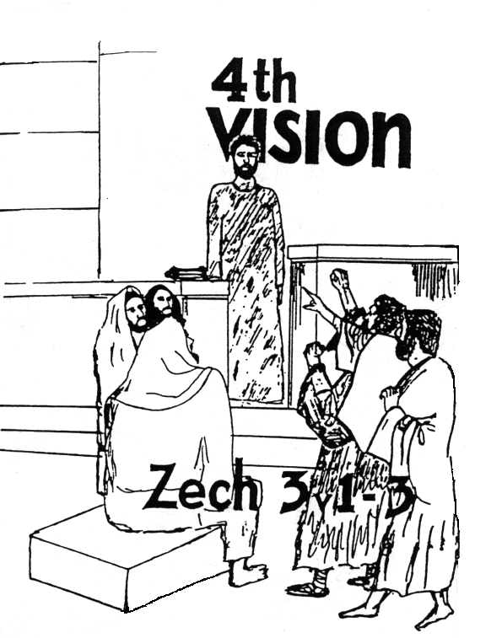
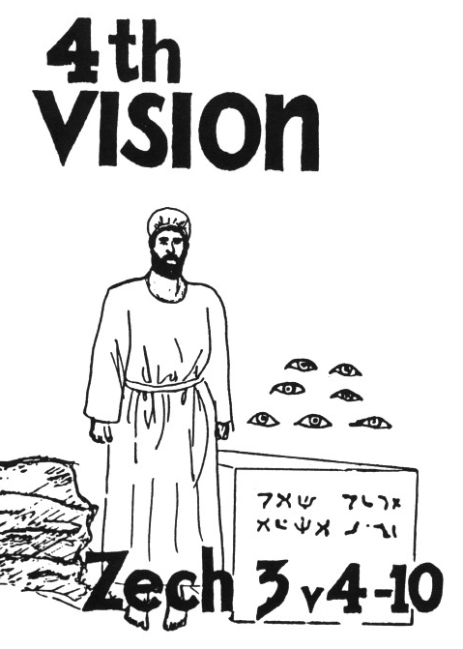
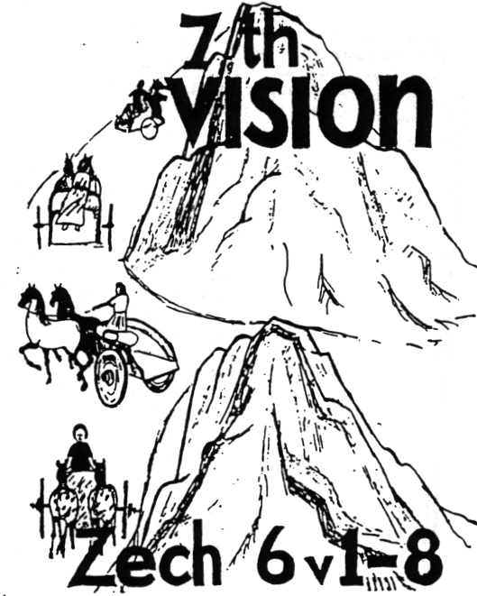
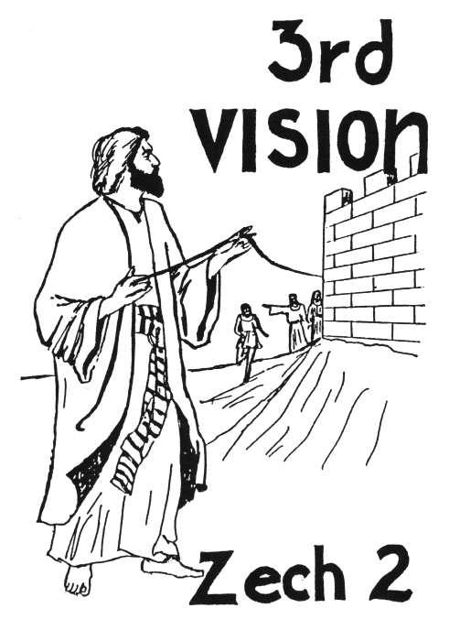
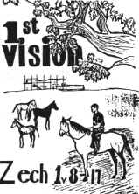
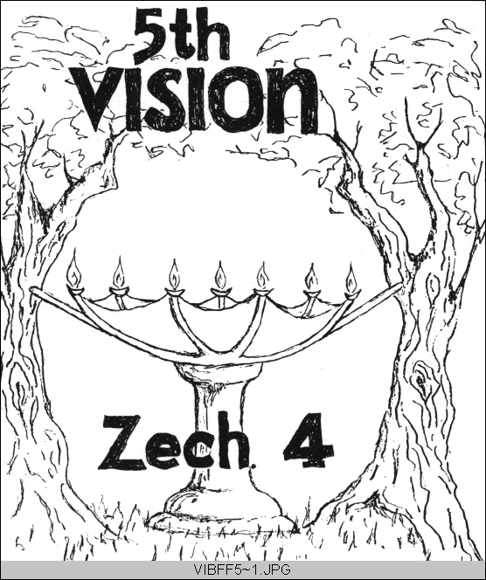
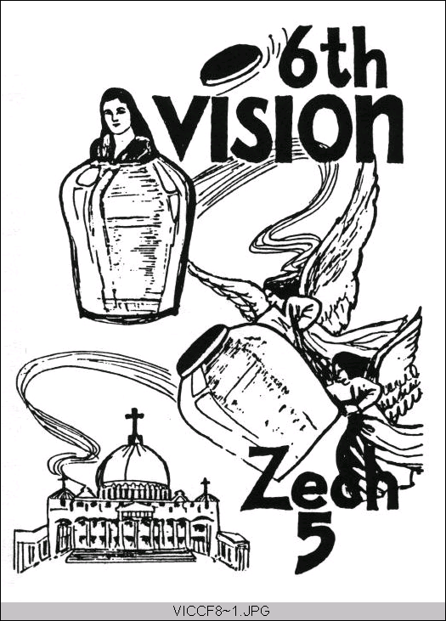
Zechariah’s
Night Visions
(Zech. 1-6)
Class 1:
Background and Zech 1

Slide 5
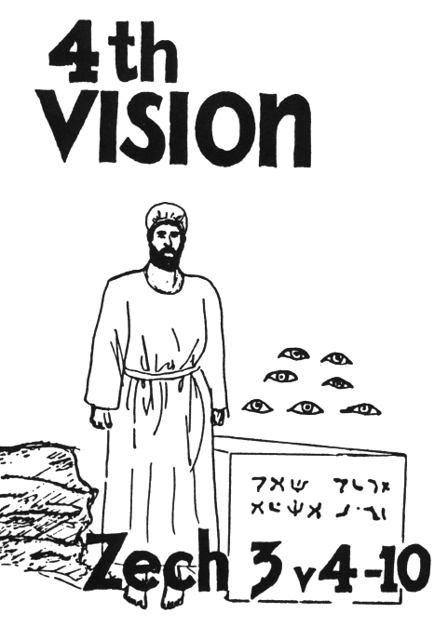
The 4th Vision:
What Zechariah saw:
Joshua & Satan standing before the
Angel of the Lord
Angel tells Satan “the Lord rebuke you”
Angel tells other angels to change
Joshua’s dirty clothes & put a clean
turban on him
Joshua and his companions are a
wondrous sign
God will bring forth His servant, the
Branch, the stone
7 eyes are looking at the stone
God will remove the iniquity of the land

Slide 6
Who is Satan in Zechariah 3?
Satan represents the Samaritans who were moved into Israel by Esarhaddon, and the local authorities who opposed the temple
Ezra 4:1-5 They discouraged the Jews and troubled their building, and hired counselors against them to frustrate their purpose
Ezra 5:3-4 They collected the names of the leading Jews and wrote a letter to Darius

Slide 7
Vision of the High Priest
Zechariah 3
Appears like a court scene
The Angel of the Lord is the judge
Joshua and Satan stand before him
Other angels stand before him too (v.4)

Slide 8
Who is the Angel of Zechariah 3?
Jude 1:9
Yet Michael the archangel, in contending with the devil, when he disputed about the body of Moses, dared not bring against him a reviling accusation, but said, "The Lord rebuke you!"
This may mean that the Angel of the Lord
throughout Zechariah is Michael
Note the reference to the brand plucked from the fire in Jude 1:23: ”but others save with fear, pulling them out of the fire, hating even the garment defiled by the flesh.”

Slide 9
Joshua’s Sad State
Joshua was the High Priest of Israel (Hag 1:12; Ezra 5:2)
He had no temple to work in
He was filthy from working on the temple
He did not have the holy garments that were for glory and beauty (Ex 28:2)
The adversaries were committed to make him fail

Slide 10
God’s Encouragement to Joshua
God has chosen Jerusalem & plucked it from the fire (v.2) [Note Jude 23]
The Angel of the Lord is on your side (v.2)
The Lord will rebuke the adversaries (v.2)
Joshua’s iniquity will be removed (v.4)
Joshua will be clothed in rich robes (v.4) and a clean turban (v.5)

Slide 11
Angel’s charge to Joshua (6-7)
Walk in My ways
Keep My command
Then you will also judge My house
They you will have charge of My courts
Then you will have “right of access” (RSV) among those who stand by (the angels)

Slide 12
Lesson for Us:
John 14:2 In God’s house are many dwelling places (NASB). Jesus has gone ahead to prepare a place for us.
Those who attain to the resurrection are equal to the angels (Luke 20)
God will reward those who work in His service, trying to build His house

Slide 13
My Servant, the Branch
Used in Jer 23:5 and 33:15 of someone who would be raised up in the line of David (a King)
Hag 2:23 – God says he will take “Zerubbabel My servant” make him as a signet ring, because He has chosen him.
Here applies to Zerubabbel, the governor, in the line of the King, whose hands will finish the temple! (4:9)

Slide 14
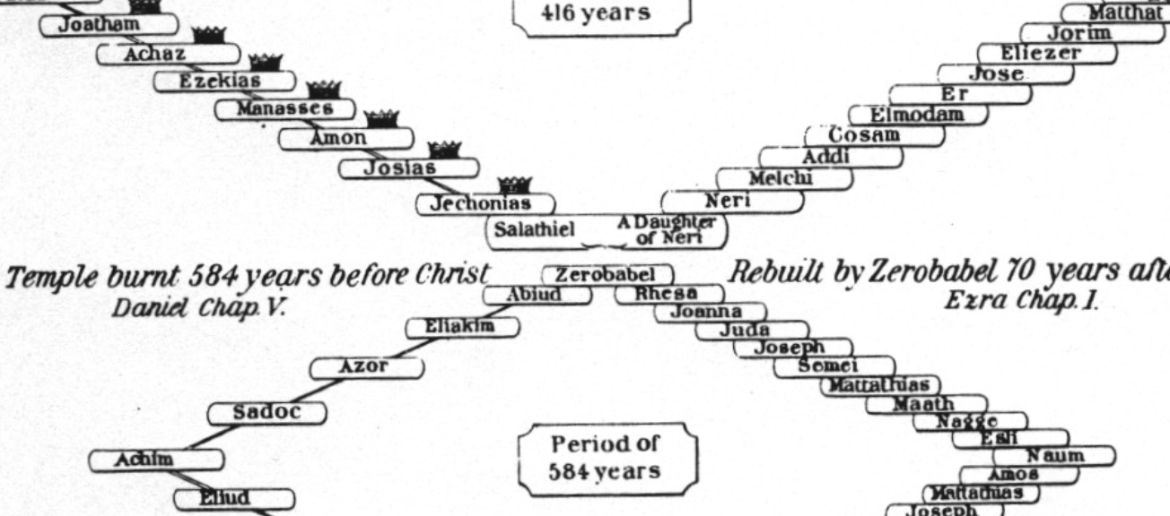
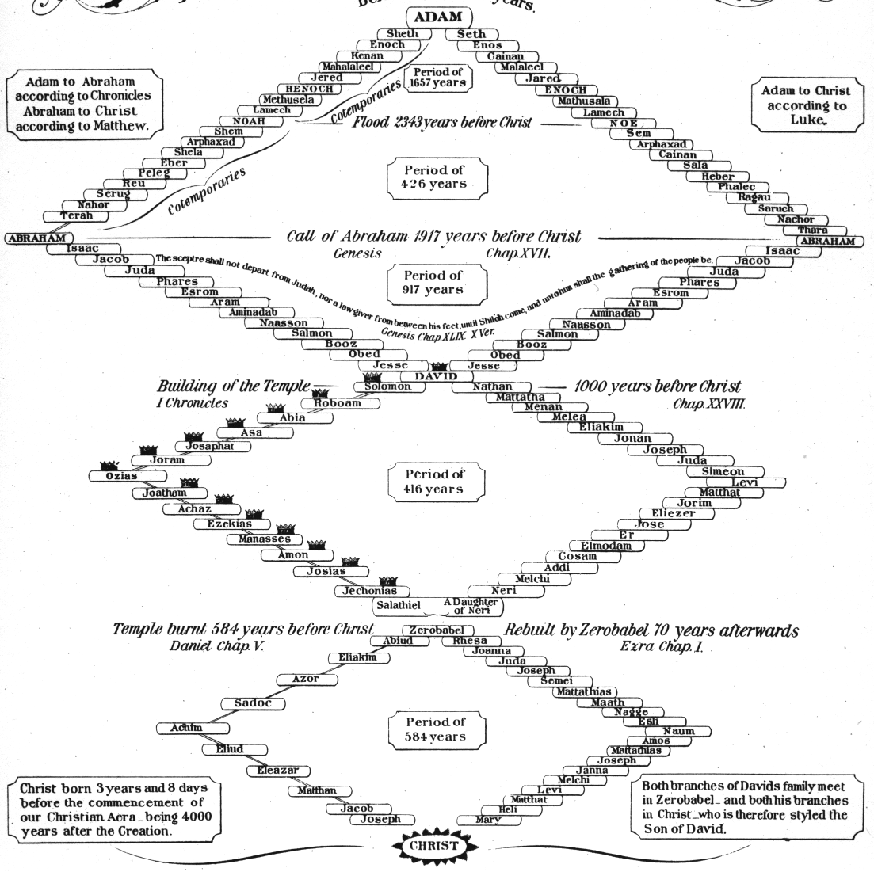

Slide 15
My Servant, the Branch
Used again in 6:11-13 and clearly applies to Joshua
The “Branch” prophecies ultimately predict a Messiah to come who will unite the offices of priest and king, as he will sit on his throne as priest and king (6:13)
Neither Joshua nor Zerubabbel could individually depict what Messiah would do, but together they predicted what God would do through His Son

Slide 16

Zechariah 6:12-13
Office of king & priest will be joined
"Behold, the Man whose name is the BRANCH! From His place He shall branch out, And He shall build the temple of the Lord;
13 Yes, He shall build the temple of the Lord. He shall bear the glory, and shall sit and rule on His throne; So He shall be a priest on His throne, and the counsel of peace shall be between them both."'
Jesus will rule as king/priest (Psa 110)

Slide 17
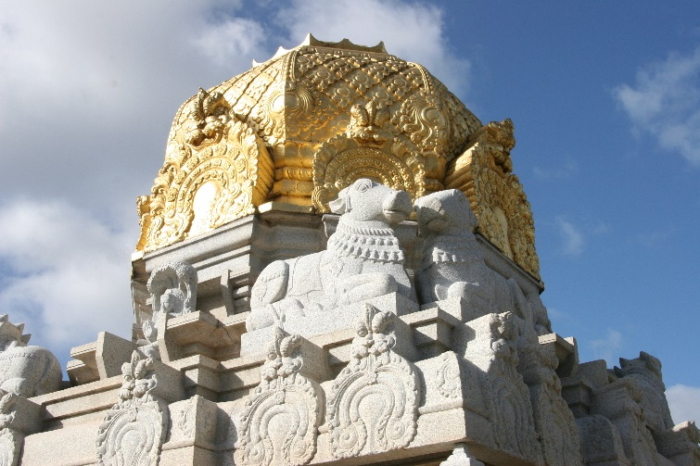
The Stone (3:9)
Not the cornerstone of the temple foundation because it was laid 16 years earlier in Ezra 3:8-13
This stone is the capstone (Zech 4:7), the final stone of the temple
Inscription was probably “Grace” as this was shouted in 4:7

Slide 18
Upon the stone are 7 eyes
“upon the stone” means the eyes are fixed, looking upon the stone. They are not in the stone, because the inscription is engraved in the stone
“7 eyes” are the angels (4:10) who will make sure the last stone is placed into the temple

Slide 19
His Vine & His Fig Tree
Taken from Micah 4:4 indicating peace and prosperity
“invite his neighbor” implies a time of wonderful peace between people who get along and work together
If this is what the kingdom will be like, we should try to make it happen today!

Slide 20
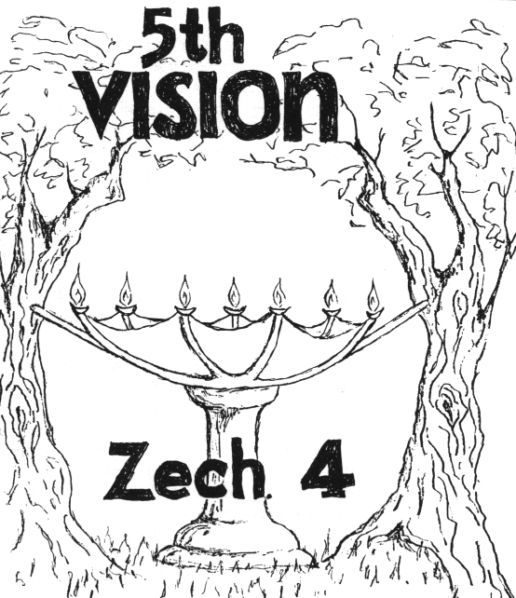
On to the 5th Vision
What Zechariah saw:
Lampstand with a bowl
on top
7 lamps and 7 pipes
2 olive trees dripping oil
through 2 pipes into the
bowl

