Slide 1
Zechariah’s
Night Visions
(Zech. 1-6)
Class 4: Visions 6 & 7

Slide 2

Pseudo Smerdis (the imposter king!) with his “wanna be” queen

Slide 3

Zechariah 5:1-4
6th Vision
Then I turned and raised my eyes, and saw there a flying scroll. 2 And he said to me, "What do you see? "So I answered, "I see a flying scroll. Its length is twenty cubits and its width ten cubits."
3 Then he said to me, "This is the curse that goes out over the face of the whole earth: 'Every thief shall be expelled,' according to this side of the scroll; and, 'Every perjurer shall be expelled,' according to that side of it."
4 "I will send out the curse," says the Lord of hosts; "It shall enter the house of the thief and the house of the one who swears falsely by My name. It shall remain in the midst of his house and consume it, with its timber and stones."

Slide 4
Zechariah 5:5-11
W
5 Then the angel who talked with me came out and said to me, "Lift your eyes now, and see what this is that goes forth." 6 So I asked, "What is it?" And he said, "It is a basket that is going forth.“ He also said, "This is their [thief & perjurer of v.3] resemblance throughout the earth: 7 Here is a lead disc lifted up, and this is a woman sitting inside the basket"; 8 then he said, "This is Wickedness!" And he thrust her down into the basket, and threw the lead cover over its mouth. 9 Then I raised my eyes and looked, and there were two women, coming with the wind in their wings; for they had wings like the wings of a stork, and they lifted up the basket between earth and heaven.
10 So I said to the angel who talked with me, "Where are they carrying the basket?" 11 And he said to me, "To build a house for it in the land of Shinar; when it is ready, the basket will be set there on its base."
!

Slide 5

The 6th Vision
What Zechariah Saw:
A flying scroll (20 X 10 cu)
It cursed thieves and
perjurers
An ephah basket with a
woman inside
A lead disc on the basket
2 women with wings flew
the basket to the land of
Shinar, where there is a
house for it

Slide 6
The Flying Scroll
Same measurements as the Holy Place of the tabernacle
Written on both sides like the 10 commandments (Ex 32:15)
Flying – widespread implementation of this curse throughout the land
Sent out by God (v.4)

Slide 7
Purpose of the Curse
Expel the thieves and perjurers
Consume their homes (suffer same fate as houses infected with leprosy – Lev 14:45; Matt 10:6)
Purge the land so God’s house will not be surrounded by wickedness

Slide 8
“cut off” (KJV) or “expelled” (NKJV) (5:3)
Strongs #5352 naqah (naw-kaw’); a primitive root; to be (or make) clean
Theological Wordbook of the O.T.
By Harris, Archer & Waltke
In the case of the Piel nqh it is always (with the exception of 1 Kgs 2:9) the LORD who is the subject. Thus he is the one addressed in petitions for acquittal (e.g. “acquit me of hidden faults” Ps 19:12 [H 13]), or the One who does not leave the sinner unpunished (Ex 20:7; 37:7; Jer 30:11; 46:28; Job 9:28).
Likewise, in the case of the adjective when it means “innocent” it is God who assumes responsibility for the guiltless. Thus he holds himself responsible for innocent blood (Deut 19:10, 13; 2 Kgs 24:4; Jer 2:34f; 19:3f; 22:3ff; passim). Job, however, in a trough of pessimism, observes that God destroys the innocent with the guilty (Job 9:23).
Not only may the sinner himself be cleansed, freed of guilt, acquitted or held innocent, but a place may be purged of the evil found in it. The “cutting off” of liars and perjurers from the land spoken of in the vision of the flying roll (Zech 5:3) would amount to a purging of the land from evil.

Slide 9
God’s House being built brings responsibility to live for God
God wants to live and dwell among His people (Ex 25:8; 1 Kg 6:13)
God cannot dwell among unrighteousness
Num 35:34
34 'Therefore do not defile the land which you inhabit, in the midst of which I dwell; for I the LORD dwell among the children of Israel.'"

Slide 10
Lesson for us
Adoption into God’s family brings responsibility to serve God and follow His commands
Membership in God’s ecclesias brings responsibility to work in God’s house and serve one another

Slide 11
2 Cor 6:16-18
Membership in God’s family brings responsibilities
16 What agreement has the temple of God with idols? For you are the temple of the living God. As God has said: "I will dwell in them and walk among them. I will be their God, and they shall be My people."
17 Therefore "Come out from among them and be separate, says the Lord. Do not touch what is unclean, and I will receive you."
18 "I will be a Father to you, and you shall be My sons and daughters, says the Lord Almighty."
God expects us to live as His children

Slide 12
The woman in the ephah
What’s an ephah?
International Standard Bible Encyclopedia
A dry measure of about one bushel capacity. It corresponds to the bath in liquid measure and was the standard for measuring grain and similar articles since it is classed with. balances and weights (Lev 19:36; Amos 8:5) in the injunctions regarding just dealing in trade.
In (Zech 5:6-10) it is used for the utensil itself.

Slide 13
The Woman in the Ephah
Who’s the Woman?
She represents a religious group (Rev 12, 17) which in this case is based on economics. Note “their resemblance” (v.6) is the thief and perjurer (v.3).
Refers to people who either fled back to Babylon or stayed in Babylon for greater economic prosperity.

Slide 14
This is Wickedness (Lawlessness)
Woman tries to escape and spread her influence throughout the land of Israel
The angel thrusts her back and puts a lead cover over the basket
2 women: apostate Judah & Israel (Jer 3:6-10; Ezek 23:4-5) fly the basket to Shinar (Babylonia in its fullest extent). See Gen 11:2. They set up an apostate religion in Babylon!

Slide 15
Zechariah 6:1-8
7th Vision
Then I turned and raised my eyes and looked, and behold, four chariots were coming from between two mountains, and the mountains were mountains of bronze. 2 With the first chariot were red horses, with the second chariot black horses, 3 with the third chariot white horses, and with the fourth chariot dappled horses — strong steeds. 4 Then I answered and said to the angel who talked with me, "What are these, my lord?"
5 And the angel answered and said to me, "These are four spirits of heaven, who go out from their station before the Lord of all the earth. 6 The one with the black horses is going to the north country, the white are going after them, and the dappled are going toward the south country." 7 Then the strong steeds went out, eager to go, that they might walk to and fro throughout the earth. And He said, "Go, walk to and fro throughout the earth." So they walked to and fro throughout the earth. 8 And He called to me, and spoke to me, saying, "See, those who go toward the north country have given rest to My Spirit in the north country."

Slide 16

What Zechariah saw:
4 chariots coming between 2 mountains
Red, black, white and speckled horses
They are the 4 spirits of heaven (angels on patrol)
Black & white go north, speckled go south, red stick around (like man on red horse under myrtle tree in 1:8)
Chariots bring rest to the north

Slide 17
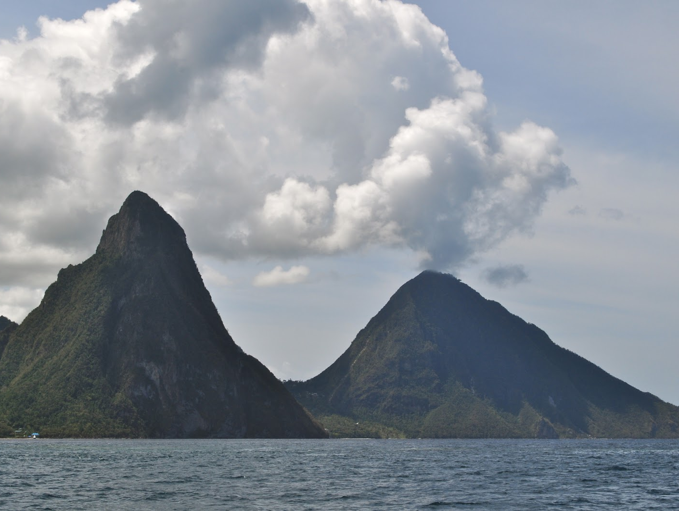
The 2 Mountains: seemingly impassible barriers
Persian army
Samaritans

Slide 18
The Chariots
Symbols of power in war. In this case God’s angels enforcing His will on earth (Psa 68:17).
Red = violence & bloodshed
Black = mourning & woe
White = victory & peace
Speckled = mix of mourning and victory
Darius’ wars against Babylon, Scythians, Macedonia and India

Slide 19
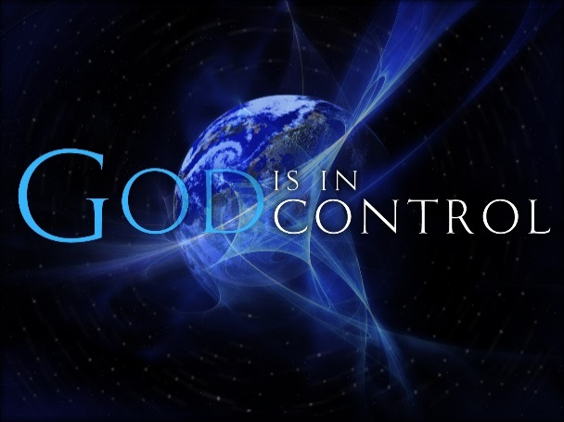
Chariots were a comforting reminder that….

Slide 20
End of the Night Visions
6:9 Is the normal opening of prophecy: “Then the word of the Lord came unto me, saying”
Night visions end on the encouraging note that God will continue to provide peace for the returned captives building God’s house.
6:9-15 is connected to the night visions, but not necessarily part of them.

Slide 21
The Coronation of Joshua
Heldai, Tobijah, and Jedaiah return from Babylon and bring a gift of silver & gold.
Zechariah is told to make a crown and set it on Joshua
Joshua is crowned as “the man whose name is the Branch”

Slide 22
Joshua’s Role
He shall “branch out” (same word in Jer 33:15 'I will cause to grow up to David a Branch of righteousness; he shall execute judgment and righteousness in the earth.
He shall build the temple of the Lord
He shall bear the glory (honor)
He shall sit and rule on his throne
He shall be a priest on his throne
Counsel of peace will be between both offices (priest and king)

Slide 23
Why Joshua is King/Priest
Israel had no king at this time.
Role of the High Priest was going to become extremely powerful and valuable.
Great way to predict that the true Messiah would perfectly blend the offices of king and priest.

Slide 24
Helem, Tobijah, Jedaiah & Hen
Captives who returned at this time to finish the temple
Obeyed the call of 2:7 “up, Zion! Escape, you who dwell with the daughter of Babylon”
They were important examples of God’s promise to bring back more captives to finish the work on His house

Slide 25
“Then you will know that the Lord of hosts has sent Me to you”
Moses to Pharaoh (Ex 3:13,14,15; 7:16)
Angel’s words to Zechariah (2:9,11; 4:9; 6:15)
Probably Zechariah’s words to his people
God’s support for His messengers and prophets. He is faithful and will do it!

Slide 26
Final exhortation & warning
This will come to pass IF you diligently obey the voice of the Lord your God
The discouraged, disappointed, fearful returned captives did obey God’s voice and they got to work and finished His house.

Slide 27

Lessons for Us
Be aware of and appreciate the work of the Angels in our lives
Trust God’s work in your life – “And I am sure that he who began a good work in you will bring it to completion at the day of Jesus Christ.” (Philip 1:6 RSV)
Get to work in your family and ecclesia to build a house unto the Lord
May our heavenly Father bless you to see and participate in the day when the man whose name is the Branch will reign as King and Priest, to bring mercy and truth to the earth

Slide 28
2
W
f
!

