Slide 1

Mark – The action gospel
Greek word – “euthios” – occurs 38 times
Translated as ‘immediately,’ ‘straightway’, ‘forthwith’, ‘anon’
No genealogy, birth details – but a focus of the miracles –the impact of Christ
Starts with six miracles
Twelve of the 16 chapters begin with ‘And’
Theme is the power of The Son of God
(1:1,1:11,3:11, 5:7, 10:48, 15:39)

Slide 2
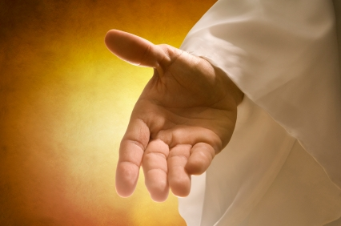
Mark – The action gospel
SIX SUCCESSIVE MIRACLES
Man with unclean spirit
Peter`s mother in law – fever
Crowds of sick and disabled
A leper
Man crippled with palsy
Man with a withered hand

Slide 3
The Sabbath-healing ministry of
Jesus Christ, the lord of
The sabbath
7 Confrontations
1. Demoniac in the Synagogue (Capernaum)
Mark 1:21-28; Luke 4:31-37
2. Peter`s Mother-in-law (Capernaum)
Mark 1:29-31; Matt. 8:14-15; Luke 4:38-39
3. Man with the Withered Hand (Capernaum)
Mark 3:1-6; Matt. 12:9-14; Luke 6:6-11
Cont.

Slide 4
The Sabbath-healing ministry
of Jesus Christ
7 Confrontations (continued)
4. Man Paralysed Thirty Eight Years’
(Jerusalem) John 5:1-18; 7:23-24
5. Woman with Eighteen Years Infirmity
(Judea, near Jerusalem?) Luke 13:10-17
6. Man with Dropsy (Jerusalem?) Luke 14:1-5
7. Man Born Blind (Jerusalem) John 9:1-41

Slide 5
The power of the miracles
‘Ye men of Israel, hear these words; Jesus of Nazareth, a man approved of God among you by miracles and wonders and signs, which God did by him in the midst of you, as ye yourselves also know’
Acts 2v22
‘And many other signs truly did Jesus in the presence of his disciples, which are not written in this book: But these are written, that ye might believe that Jesus is the Christ, the Son of God; and that believing ye might have life through his name.
John 20v30-31

Slide 6
The house of mark – Mark 2:1
It was a certain day…Luke 5v17.
A very important and much travelled group of Jewish teachers was here –the meeting must have been pre arranged.
Diaglott for Mark 2v1…”a house”
The greek word for “gathered together” in v2
is ‘Synagogous’
Cont.

Slide 7
The house of mark – Mark 2:1
The Synagogue was commonly known as the house of assembly, the house of prayer or the house of God
The friends knew exactly where Jesus was…
so they could correctly find the spot directly above him.

Slide 8
The critical spirit – Mark 2
V7 Accusations of blasphemy
V16 Guilt by association
V18 Inconsistency
V24 Watching for keeping of regulations
The legal mind is paralysed – and becomes critical

Slide 9
The fallacy of a law-keeping mind
How the Sabbath became corrupted by tradition
Mishnah - 39 categories of work forbidden on the Sabbath – especially any creative activity.
Halacuot - Rules for avoiding ‘work’ (thousands of definitions – still being added too, to cope with modern technology)
Examples:
A tailor was advised to put down his needle well before sunset lest he inadvertently carry it on the Sabbath. (Shabbat 1.3)
Cont.

Slide 10
How the Sabbath became corrupted by tradition
Nor should one search for fleas by lamplight on the Sabbath, lest he forget and adjust the wick. But using candle light is permissible (Shabbat 1.3)
The rabbis carefully distinguished between wearing and carrying. They had to decide if a women’s hair clip, for instance, was worn or carried. If carried, then it would be a burden and forbidden on the Sabbath . A women could go into the courtyard of her house wearing a wig, but not into public streets.
Cont.

Slide 11
How the Sabbath became corrupted by tradition
Erubim – Limits for travel on Sabbath, differed for city and country.
Mutzkeh - Things which became off limits, in case of accidental use. Concept of hedges or fences to avoid unintentional defilement
(example - touching a hammer became forbidden on the Sabbath)
Cont.

Slide 12
How the Sabbath became corrupted by tradition
Exceptions to the Sabbath Law
You could attend the sick
You could rescue an animal in a pit
You could water an animal
The Problem
The less one did, the more holy you became … so you became totally unable to do good.

Slide 13
The man with palsy
Had not come to the Lord - ashamed
Young man - paralysed
Loco motor – Ataxia - a form of syphilis
So Lord focuses on the need for forgiveness

Slide 14
The four friends
Had carried him to the synagogue
Had tried repeatedly to gain entrance through the crowd
Carried him up the stairs
One must have run off to find ropes
They broke up the roof and lifted the paving stones
They lowered him down….not an easy task
Cont.

Slide 15
The four friends
They would have been roundly resented and abused by those below who were being covered in dust and rubble.
They interrupted an important gathering
They were totally determined
And when Jesus saw their faith….
A friend loveth at all times and a brother is born for adversity… Prov 17:17

Slide 16
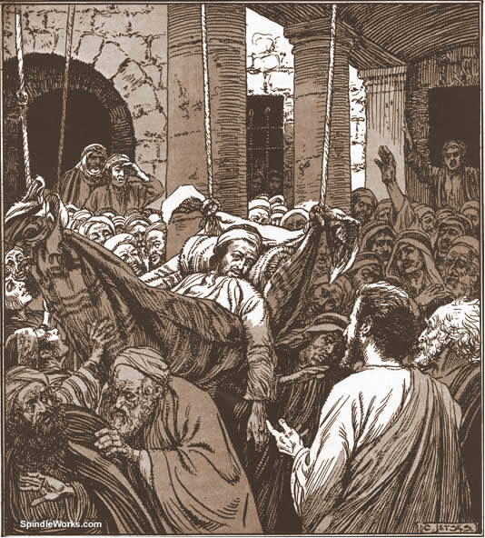
The man let down by his 4 friends

Slide 17
The lord’s challenge
The Son of Man has power on earth
If I can heal this man, then you will know
I also have the power to forgive sins.
If I can command God`s power to heal,
then I have the delegation to forgive sins.

Slide 18
The son of man
First time used by Jesus in Mark 2:10
This title is almost only used by Jesus about himself
It is by far the most common name he gives himself
The title occurs 85 times in the gospel records
Was used by Stephen … Acts 7:56
Is always very specifically THE Son of Man, not son of man as for Ezekiel
1 of 3

Slide 19
The son of man
Adam was the first Son of Man, created to rule the earth and have dominion.. but failed
Psalm 8 ..note the difference between “man” and the “son of man”…God is now providing a second Adam who will subdue the carnal mind and be crowned with glory.
Psalm 80:17..’the man of Gods right hand, the son of man thou madest strong for thyself.”… God intended to make one man the new head of the race
2 of 3

Slide 20
The son of man
Hebrews 2:9-14..see the application made to Jesus specifically ... ’taste death for every man’
John 5:26-27.. Jesus will be the judge of the world (able to forgive or not) because he is
the Son of Man
Dan 7:13, Rev1:13, Rev14:14 …
the glorified saint body is described in symbol
as “like The Son of Man”
3 of 3

Slide 21
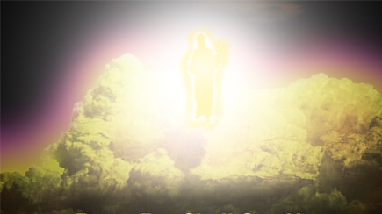
The son of man
I saw in the night visions, and, behold, one like the Son of man came with the clouds of heaven, and came to the Ancient of days, and they brought him near before him.
Dan 7:13

Slide 22
The son of man
And in the midst of the seven candlesticks one like unto the Son of man, clothed with a garment down to the foot, and girt about the paps with a golden girdle. Rev 1:13
And I looked, and behold a white cloud, and upon the cloud one sat like unto the Son of man, having on his head a golden crown, and in his hand a sharp sickle. Rev 14:14

Slide 23
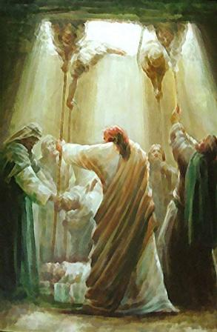
The impact of the son of man
And they were all amazed, and they glorified God, and were filled with fear, saying, We have seen strange things to day.
Luke 5v26

Slide 24
Lessons from mark 2
Friends are important
The Lord loves a determined faith
Beware the mind paralysed by
self confidence-that becomes
critical of others
Believe the Son of Man has
power to forgive sins

Slide 25
Healing all our diseases..Hymn 407
No word from thee can fruitless fall
Thy touch still has its ancient power
Hear in this solemn evening hour
And in thy mercy heal us all

