Slide 1
STUDY 3
THE LORD OF LIFE- HEALING ALL OUR DISEASES

Slide 2
The Power of the Miracles
“Ye men of Israel, hear these words; Jesus of Nazareth, a man approved of God among you by miracles and wonders and signs, which God did by him in the midst of you, as ye yourselves also know’:
Acts 2v22

Slide 3
MIRACLES SIGNS AND WONDERS
Miracles- dunamis- “works of power”
Wonders-..... “awe inspiring events” (the impact on people)
Signs- semeion- “a sign, significant event”- carefully designed to teach specific lessons.

Slide 4
THE POWER OF THE MIRACLES
And many other signs truly did Jesus in the presence of his disciples, which are not written in this book: But these are written, that ye might believe that Jesus is the Christ, the Son of God; and that believing ye might have life through his name’.
John 20v30-31

Slide 5
OLD TESTAMENT SHADOWS
(Rom 15:8) Now I say that Jesus Christ was a minister of the circumcision for the truth of God, to confirm the promises made unto the fathers:
(Isa 61:1) The Spirit of the Lord GOD is upon me; because the LORD hath anointed me to preach good tidings unto the meek; he hath sent me to bind up the brokenhearted, to proclaim liberty to the captives, and the opening of the prison to them that are bound;

Slide 6
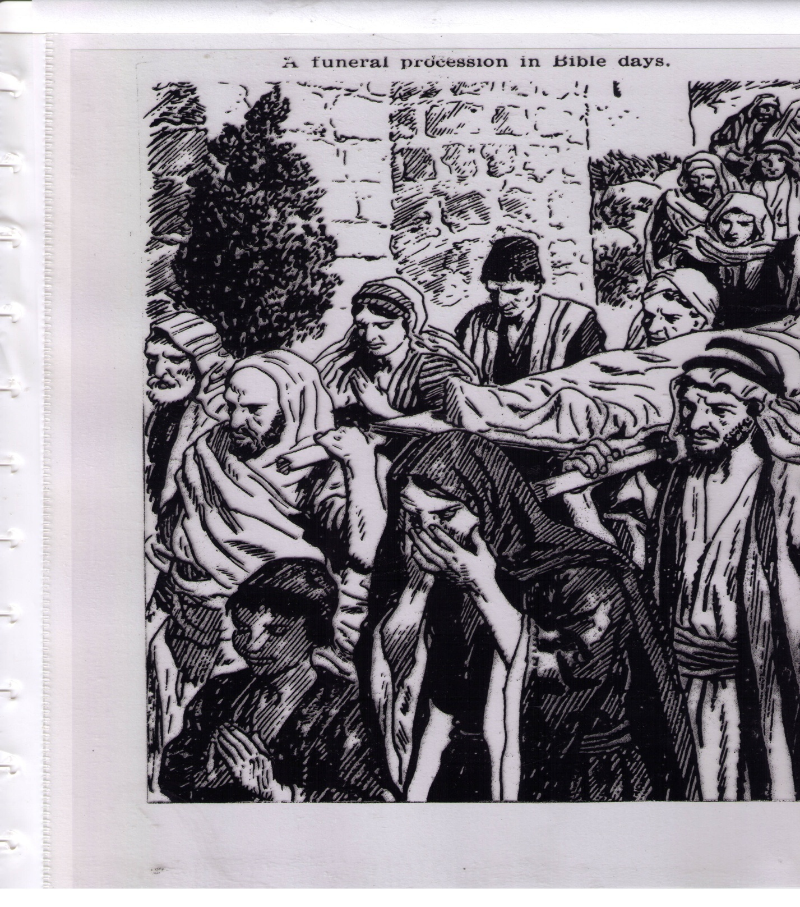
THE PROCESSION OF DEATH

Slide 7
“ONLY” CHILDREN IN MIRACLES
Abraham and Isaac.. Gen 22v2
Son of the widow of Zarephath 1 Kings 18
The Shunemite woman’s son 2Kings 4
The widow of Nain’ son Luke 7v12
The daughter of Jairus Luke 8v42
The epileptic child Luke 9v38

Slide 8
Compassion
Greek word .. “a suffering with”
Indicative of a PRACTICAL identification.
But whoso hath this world’s good and seeth his brother have need , and shutteth up his bowels of compassion from him, how dwelleth the love of God in him?
My little children , let us not love in word , neither in tongue, but in deed and in truth.
1 John 3v17-18

Slide 9
COMPASSION
-7 records of Christ’s identification with the needs of humanity.
THE LEPER- living death , desperate and rejected.
MULTITUDES of SICK- mortal, blind, lame and deaf
LEGION- madly rushing around wounding self
THE EPILEPTIC- suffering falling sickness
BLIND BARTIMAEUS-out of the way, blind at birth
WIDOW OF NAIN-Faced with cruel mortality
PEOPLE AS SHEEP WITH NO SHEPHERD-all we like sheep , have gone astray
Plus the Good Samaritan...
  GO THOU AND DO LIKEWISE

Slide 10
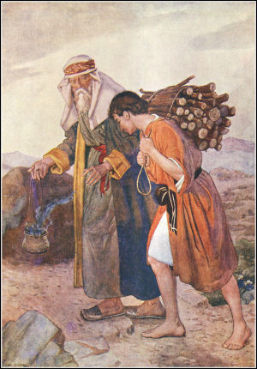
Take now thy son , thine only son Isaac, whom thou lovest ....
Thy seed shall possess the gate of his enemies..

Slide 11
THE WORDS OF ZACHARIAS
Blessed be the Lord God of Israel; for he hath visited and redeemed his people,And hath raised up an horn of salvation for us in the house of his servant David;
That we should be saved from our enemies, and from the hand of all that hate us;
To perform the mercy promised to our fathers, and to remember his holy covenant;
The oath which he sware to our father Abraham,
That he would grant unto us, that we being delivered out of the hand of our enemies might serve him without fear,
v79 To give light to those in the shadow of death.
Luke 1 v68-74

Slide 12
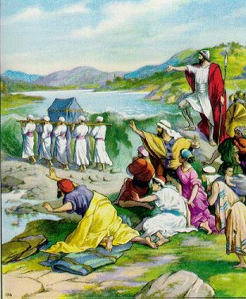
THE WATERS WENT BACK..beyond Adam

Slide 13
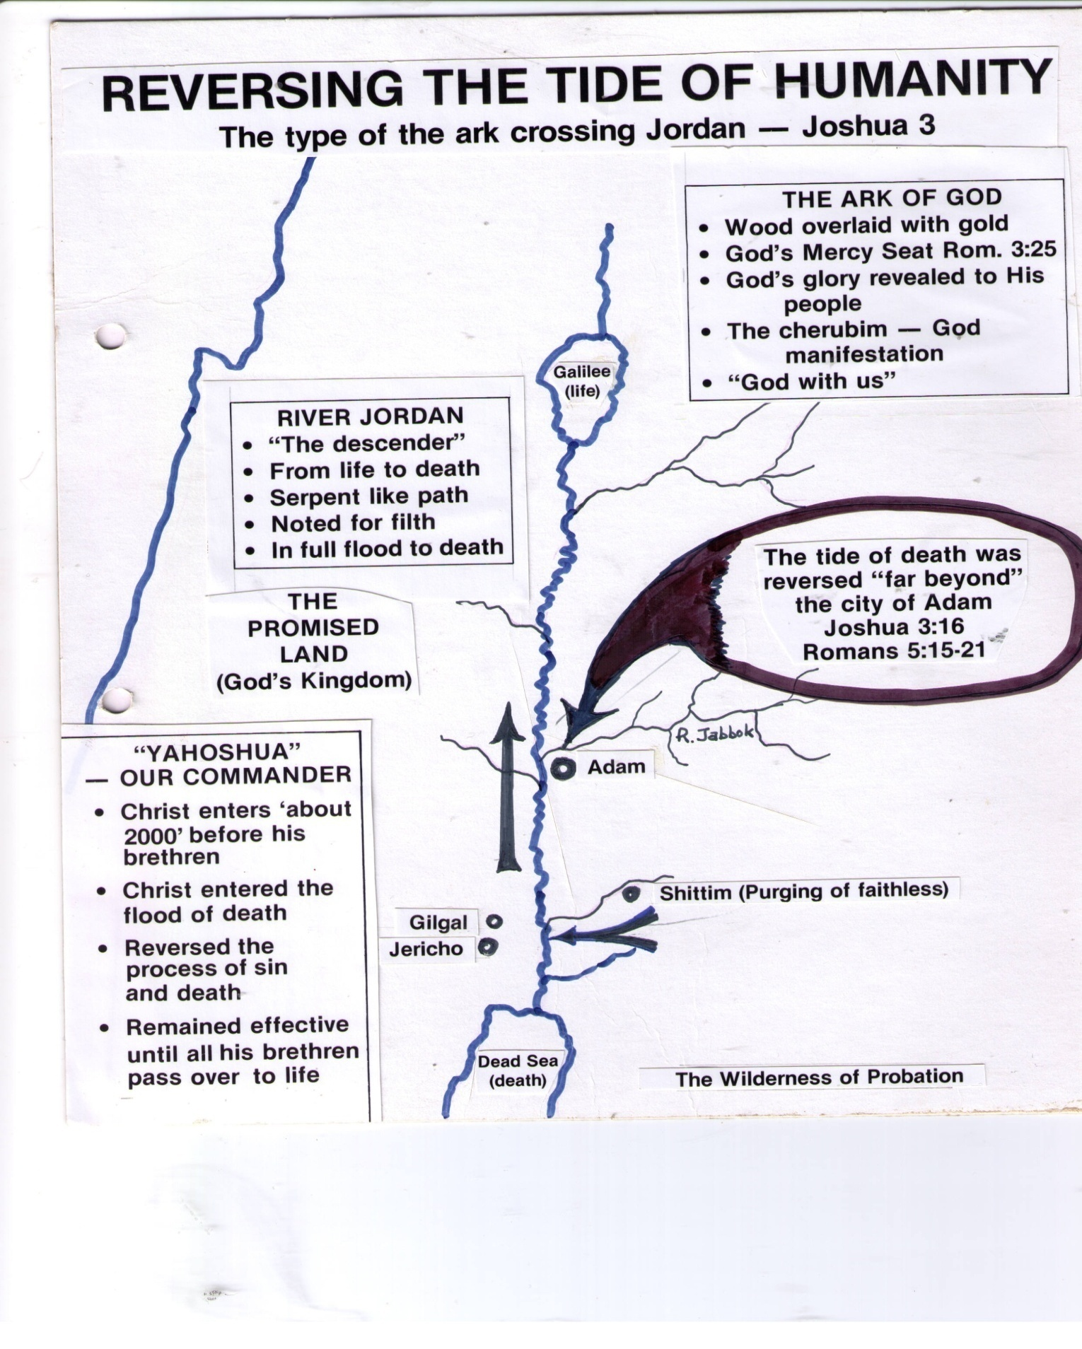

Slide 14
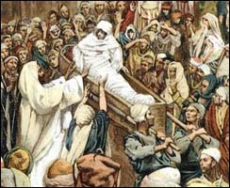
THE WIDOW OF NAIN

Slide 15
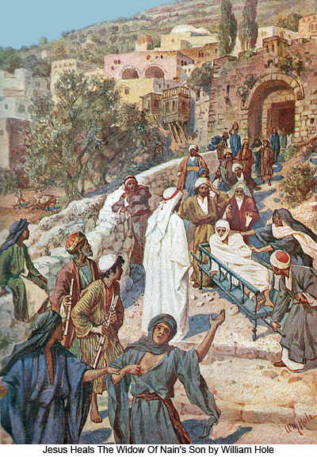
YOUNG MAN- I SAY UNTO THEE- ARISE

Slide 16
THE LAST ENEMY DESTROYED
For as in Adam all die, even so in Christ shall all be made alive.
But every man in his own order: Christ the firstfruits; afterward they that are Christ's at his coming.
Then cometh the end, when he shall have delivered up the kingdom to God, even the Father; when he shall have put down all rule and all authority and power.
For he must reign, till he hath put all enemies under his feet.
The last enemy that shall be destroyed is death. (1Cor 15:22-26)

Slide 17
ROMANS 5 -Weymouth Translation
But Christ.
God’s free gift immeasurably outweighs the transgression. For if through the transgression of one individual the mass of mankind have died, infinitely greater is the generosity of God’s grace in Jesus Christ .
Death made use of the one individual to seize the sovereignty , all the more shall those who receive God’s overflowing grace and gift of righteousness reign as kings in Life though one individual, Jesus

Slide 18
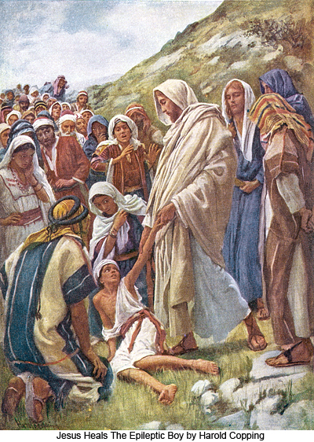
The Epileptic child

Slide 19
The Power of the Miracles
‘The Falling Sickness’ (Mark 9v20)
We are all prone to ‘falling sickness’
It brings a loss of spiritual consciousness
We do ourselves harm, and fall into the fires of sin
Convulsions and bruising follow our fall
It is a ‘foul’ spirit (v25), lewd and unclean
It is a dumb spirit, as God’s word cannot penetrate
We are all born with ‘falling sickness’ (v21)
It strikes us suddenly and unexpectedly
It will be fatal it not healed

Slide 20
How we cure ‘Falling Sickness’
‘Bring him unto me’ (Luke 9v41)
Confess our unbelief, pray for help (Mark 9v24)
Apply ourselves to prayer and self denial (Mark 9v29)
See God’s power to heal ,by hearing His Son (Luke 9v44)

Slide 21
Healing all our diseases..Hymn 407
No word from thee can fruitless fall
Thy touch still has its ancient power
Hear in this solemn evening hour
And in thy mercy heal us all

Slide 22
LET THESE SAYINGS SINK DOWN INTO YOUR EARS.........

