Slide 1
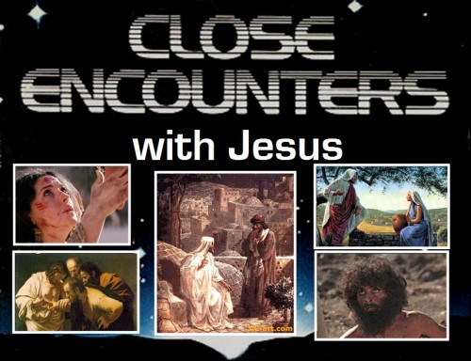

Slide 2

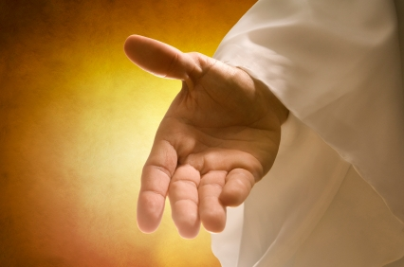
Encounters With Christ

Slide 3
Encounters With Christ
Now when they saw the boldness of Peter and John, and perceived that they were unlearned and ignorant men, they marvelled; and they took knowledge of them, that they had been with Jesus.
Act 4:13

Slide 4
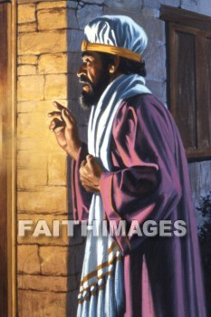

Nicodemus
He Came by Night

Slide 5
Flesh versus spirit – John 3
Terms used are:
Man 2:25 (twice)
3:1, 2, 3, 4, 5, 13, 19
Flesh v6
Darkness/Evil deeds v19
-------------------------------------------------------------------------
Born from above v3
Born of water and spirit v5
Spirit v6
Born again v7
Born of the spirit v8
The Light/deeds of God v19
FLESH
SPIRIT

Slide 6
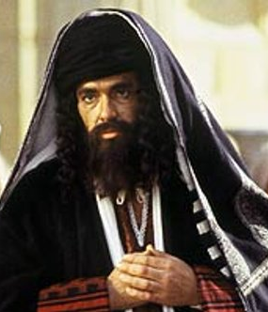
Nicodemus
He Came by Night unto Jesus
A ruler of the Jews, a Pharisee
‘THE’ Teacher of Israel, the top man
Name means “victorious over the people”
Probably was 60-70 years old
May have seen Christ as a boy 20 years before
Wealthy – later donated large quantities of
myrrh and aloes to bury Jesus
Insulted by his peers for merely seeking a fair
hearing for Jesus 7v52
Finally comes to the light 19:39

Slide 7

Nicodemus
There was a man of the Pharisees, named Nicodemus, a ruler of the Jews: The same came to Jesus by night … John 3:1-2
Nicodemus saith unto them, (he that came to Jesus by night, being one of them,)
John 7:50
And there came also Nicodemus, which at the first came to Jesus by night … John 19:39

Slide 8
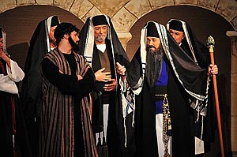
The Jewish mindset
Jews were the one chosen people of God
Genealogy mattered
(“we be not born of fornication”) – John 8:41
We have Abraham as our father (Matt 3:9 Luke 3:8)
Pride in natural descent
Proud they were of the circumcision – Acts 11:2
(not sinners of the Gentiles)
We are free, never in bondage –
the children of the kingdom

Slide 9
One birth – of water and spirit
A Greek form of words – called ‘henydiadys’ - meaning – “one by means of two”
Dual expressions of one item
Philosophy & vain deceit - Col 2:8
Judgement & righteousness - Jer 22:3
The Holy One and the Just - Acts 3:14
That world, and the resurrection from the dead
- Luke 20:35
… shall baptize you with the Holy Spirit, and
with fire - Matt 3:11

Slide 10
Baptism
An outward sign of an inward change
And such were some of you: but ye are washed, but ye are sanctified, but ye are justified in the name of the Lord Jesus, and
by the Spirit of our God. 1Cor 6:11
The like figure whereunto even baptism doth also now save us (not the putting away of the filth of the flesh, but the answer of a good conscience toward God,) 1Pet 3:21

Slide 11
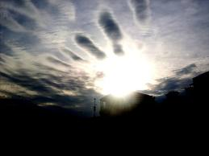
The spirit
The Spirit breathes where he pleases
and thou hearest his voice,
but knowest not whence he comes
or whither he leads – in like manner is every one being begotten of the Spirit.
Bro John Thomas

Slide 12
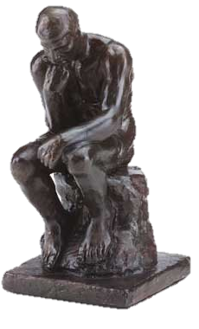
The spiritual mind
Now an animal man does not receive the things of the Spirit of God: for they are foolishness to him and he is not able to understand, because they are spiritually examined.
But the spiritual man examines,
indeed, all things, yet he is examined
(AV discerned) by no one.
1Cor 2:14-15 Diaglott

Slide 13
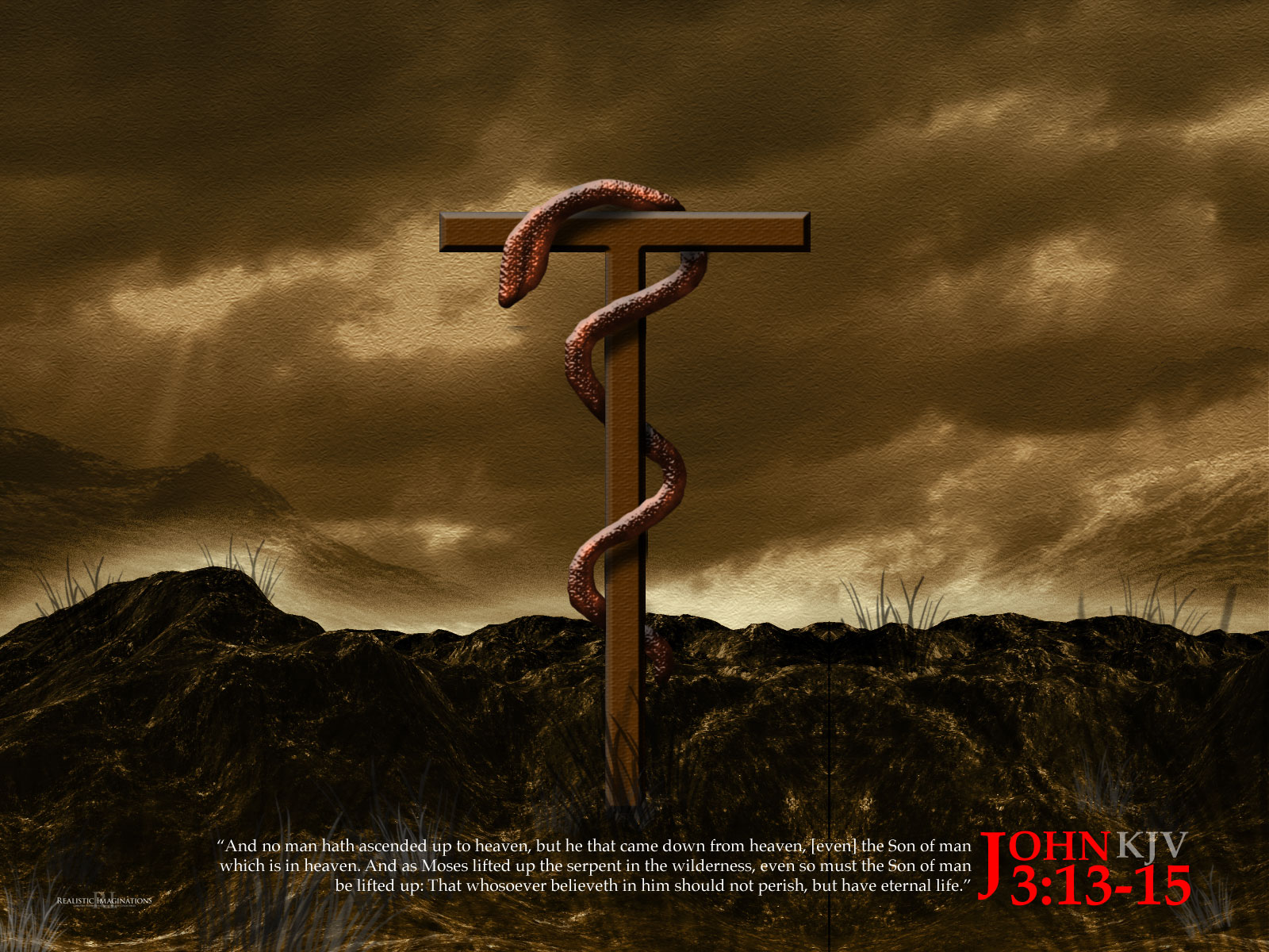
The serpent on the pole
…even so must the Son of man be lifted up

Slide 14
How to avoid perishing
Born from above ……………v3
Born of water and spirit …v5
Spirit ……………………………..v6
Born again ……………………..v7
That whosoever believeth in him should not perish, but have eternal life. For God so loved the world, that he gave his only begotten Son, that whosoever believeth in him should not perish, but have everlasting life. John 3:15-16

Slide 15
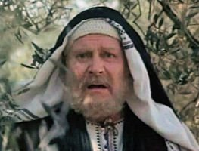
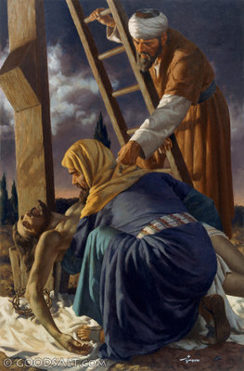
Nicodemus
Out of the darkness into the light

Slide 16

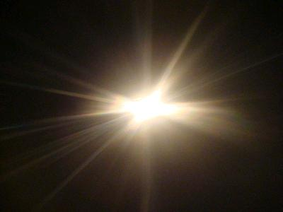
Quoted from Isaiah 9:1-2
The great light to shine in Galilee
That it might be fulfilled which was spoken by Esaias the prophet, saying, The land of Zabulon, and the land of Nephthalim, by the way of the sea, beyond Jordan, Galilee of the Gentiles; The people which sat in darkness saw great light; and to them which sat in the region and shadow of death light is sprung up.
Matt 4:14-16

Slide 17
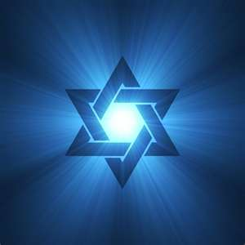
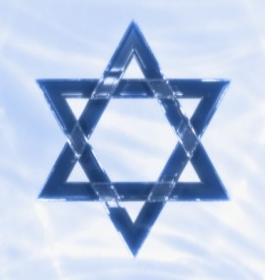
The ensign lifted up
And in that day there shall be
a root of Jesse, which shall stand
for an ensign of the people;
to it shall the Gentiles seek:
and his rest shall be glorious.
Isa 11:10

Slide 18
Comparison of john 3 & 4
NICODEMUS | womAn of Samaria
Man | Woman
By Night | Midday
A Ruler | A Nobody
Of the Jews | A Samaritan
Pharisee | A Sinner
Nicodemus told God loves the world | Woman told Salvation is of the Jews

Slide 19

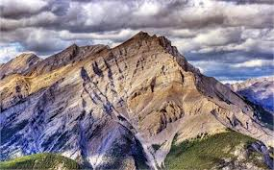

Nicodemus - & the Woman of Samaria
Principle … all flesh is grass before God
-------------------------------------------------------------
Every valley shall be exalted, and every mountain and hill shall be made low: and the crooked shall be made straight, and the rough places plain: Isa 40:4

Slide 20
Born of water and spirit
Begettal | 1 Peter 1:3 & 23 … by the Spirit Word – John 6:63
Quickening | Eph 2:1 & 5 By baptism into Christ
Birth | Walking in the Spirit as new creatures Rom 6:17 & 18, Gal 5:25
Outcome | Sons of God now & Sons of God for ever 1 John 3:1 & 2, Rom 8:19

Slide 21
Lessons from nicodemus
Ye must be born from above
– create a new mind
Ye cannot properly serve Jesus
without walking in the light
The mind of the Spirit is often
misunderstood and not appreciated
We must be born again – and then constantly renewed by the Spirit-Word

Slide 23
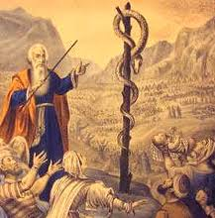
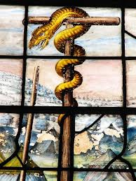
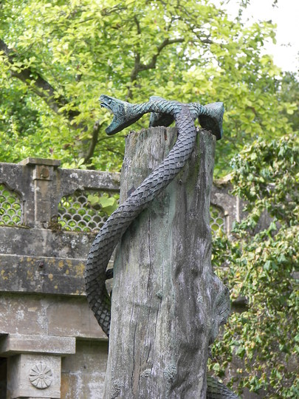
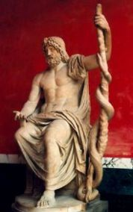

Slide 24
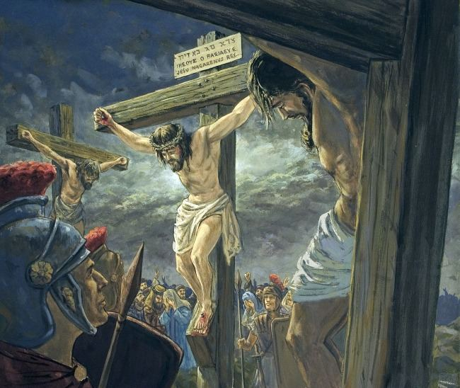

Slide 25
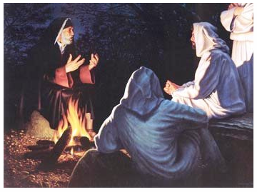

Slide 26
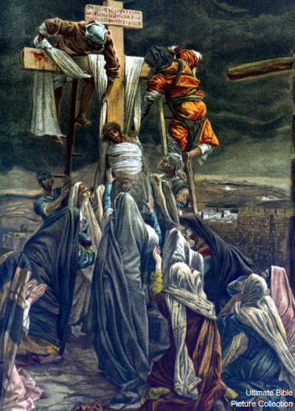

Slide 27
The Jewish concept of the Law
‘The Law’ – was interpreted in 3 senses
The Ten commandments – the ultimate essence
The Pentateuch – the 5 books of Moses
The Scribal or Oral Law – definitions on how keep Law
To the Scribes and Pharisees the Scribal or Oral Law was the most important and the most binding of all.
‘This have ye made the commandment of God of non effect through your tradition…’
For in vain do they worship me, teaching for the doctrines the commandments of men…’
Matt 15v6-9

Slide 28
The Jewish concept of the Law
Thus the 10 Commandments became a whole library
Their stated view:
‘It is more culpable to teach contrary to the precepts of the scribes, than contrary to the Law itself’

Slide 29
The Jewish concept of the Law
‘The Law’ – was interpreted in 3 senses
The Ten commandments – the ultimate essence
The Pentateuch – the 5 books of Moses
The Scribal or Oral Law – definitions on how keep Law
To the Scribes and Pharisees the Scribal or Oral Law was the most important and the most binding of all.
‘This have ye made the commandment of God of non effect through your tradition…’
For in vain do they worship me, teaching for the doctrines the commandments of men…’
Matt 15v6-9

