Slide 1
THOSE JESUS LOVED
            Mary, Martha and Lazarus

Slide 2
Loved by Jesus
John the son of Zebedee
The rich young ruler
The disciples
Paul (Gal 2v20)
Martha , Mary and Lazarus.
His disciples that would later believe

Slide 3
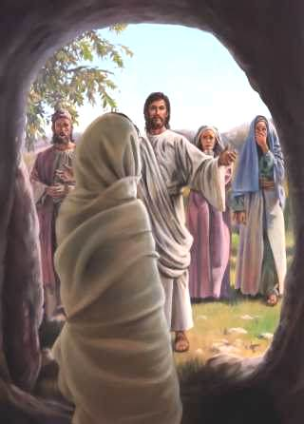
LAZARUS- COME FORTH!

Slide 4
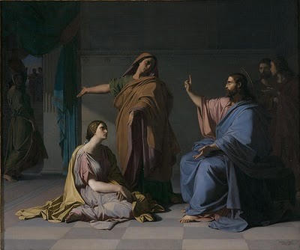
Bid her come and help me.

Slide 5
HOSPITALITY
Given to hospitality. Rom 12v13
Given to hospitality . 1Tim 3v2
A lover of hospitality. Titus 1v8
Use hospitality one to another without grudging. 1 Pet 4v9

Slide 6
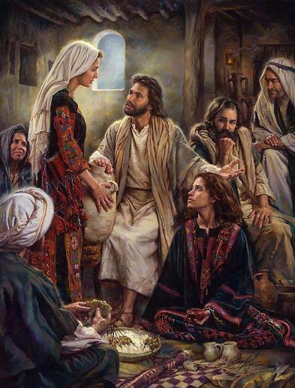
She hath chosen the better part.

Slide 7
MARTHA- loved by Jesus
Hospitable ,generous and hard working
Practical and factual
Strong in faith
Amazing conviction about Christ
Strong belief in the Lord, despite sadness
Continues to do what Martha does best.

Slide 8
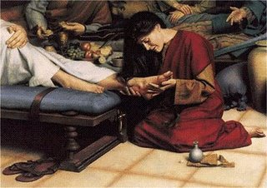
She hath done what she could

Slide 9
Distrust all men in whom the impulse to punish is powerful

Slide 10
MARY’S ATTRIBUTES
Careful listener
Devoted to sit at Lord’s feet and hear his words-comprehended his impending death
Intuitive recognition of Lord’s sadness
Never defended herself from criticism
Took her limited opportunity
When there is a need..do something and do it now.

Slide 11
When there is grief sadness or tragedy , and you don’t know what to do to show you care - think of anything you can do and do that.
Whatever you do, it will far outweigh doing nothing.

Slide 12
JESUS -THE MASTER TEACHER
Whenever Jesus’ wrath appears it always concerns a wrong done to others or a public evil that needs redress, but it never concerns a private injury.
The truth of Christ’s teaching seems to be that in our our own person and fortune we should be ready to pardon all ; it is our cheek we are to turn : it is our coat we are to give away...
BUT when another’s face has been buffeted , perhaps a little of the lion will become us the best . That we are to suffer others to be injured or unjustly criticised is not conceivable nor is it the spirit of Christ.
William Barclay-The Mind of Jesus.

Slide 14
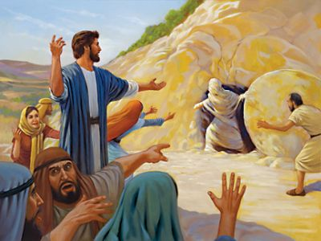

Slide 15
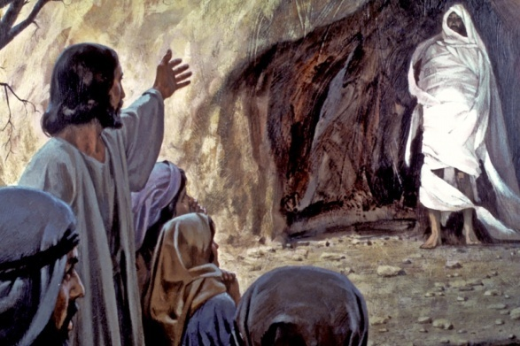

Slide 16
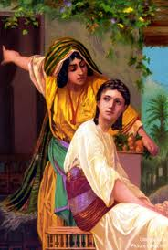

Slide 17
