Slide 1
The Warrior Family
of Manasseh

Slide 2
Manasseh
Machir + Maachah Gen 50:23; 1Chr 7:15
Gilead Num 26:29; 36:1; Josh 17:1; 1 Chr 7:17?
Num 26:29-32
Jeezer (Abiezer) Helek Asriel Shechem Shemida Hepher
Josh 17:2

Slide 3
Tribe | Num. 1 | Num. 26 | Fluctuation
Reuben Simeon Gad Judah Issachar Zebulun Ephraim Manasseh Benjamin Dan Asher Naphtali | 46,500 7 59,300 3 45,650 8 74,600 1 54,400 5 57,400 4 40,500 10 32,200 12 35,400 11 62,700 2 41,500 9 53,400 6 | 43,730 9 22,200 12 40,500 10 76,500 1 64,300 3 60,500 4 32,500 11 52,700 6 45,600 7 64,400 2 53,400 5 45,500 8 | -2,770 -37,100 -5,150 +1,900 +9,900 +3,100 -8,000 +20,500 +10,200 +1,700 +11,900 -8,000

Slide 4
Dan, Asher, Naphtali
157,600
Ephraim
Manasseh
Benjamin
Judah
Issachar
Zebulun
108,100
186,400
151,450
Rueben, Simeon, Gad

Slide 5
Manasseh
Machir + Maachah Gen 50:23; 1Chr 7:15
Gilead Num 26:29; 36:1; Josh 17:1; 1 Chr 7:17?
Num 26:29-32
Jeezer (Abiezer) Helek Asriel Shechem Shemida Hepher
Josh 17:2

Slide 6
Manasseh
Machir + Maachah Gen 50:23; 1Chr 7:15
Gilead Num 26:29; 36:1; Josh 17:1; 1 Chr 7:17?
Num 26:29-32
Jeezer (Abiezer) Helek Asriel Shechem Shemida Hepher
Josh 17:2
Zelophehad
Josh 17:3
Num 27:1
Mahlah Noah Hoglah Milcah Tirzah

Slide 7
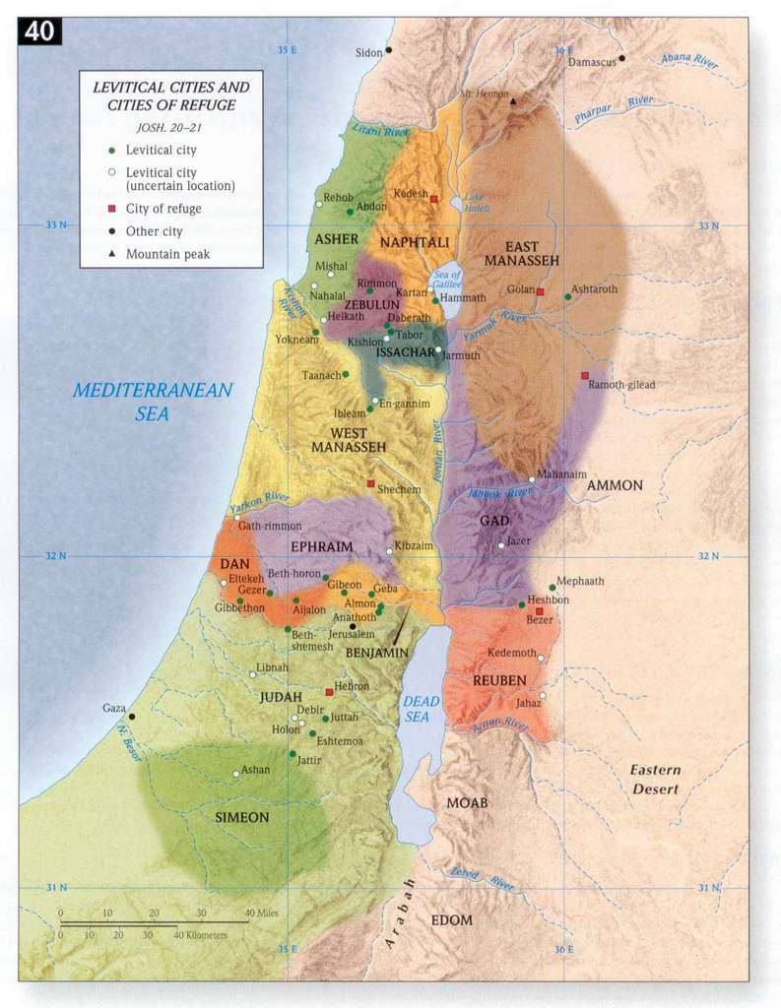

Slide 8
Manasseh
Machir + Maachah Gen 50:23; 1Chr 7:15
Gilead Num 26:29; 36:1; Josh 17:1; 1 Chr 7:17?
Num 26:29-32
Jeezer (Abiezer) Helek Asriel Shechem Shemida Hepher
Josh 17:2
Zelophehad
Josh 17:3
Num 27:1
Mahlah Noah Hoglah Milcah Tirzah

Slide 9
Judah
Manasseh
Pharez 1Chr 2:4-5
Machir + Maachah Gen 50:23; 1Chr 7:15
Hezron
Gilead Num 26:29; 36:1; Josh 17:1; 1 Chr 7:17?
Num 26:29-32
Jeezer (Abiezer) Helek Asriel Shechem Shemida Hepher
Josh 17:2
Zelophehad
Josh 17:3
Num 27:1
Mahlah Noah Hoglah Milcah Tirzah

Slide 10
Judah
Manasseh
Pharez 1Chr 2:4-5
Machir + Maachah Gen 50:23; 1Chr 7:15
Hezron + Abiah 1Chr 2:21,24
Gilead Num 26:29; 36:1; Josh 17:1; 1 Chr 7:17?
Num 26:29-32
Segub 1Chr 2:21
Jeezer (Abiezer) Helek Asriel Shechem Shemida Hepher
Josh 17:2
Jair 1Chr 2:21-23; 1Kin 4:13; Deu 3:14; Num 32:41
Zelophehad
Josh 17:3
Num 27:1
Mahlah Noah Hoglah Milcah Tirzah

