Slide 1
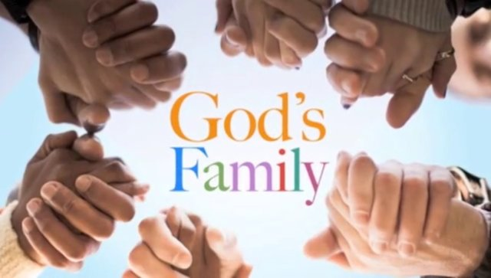
Training
to Join
Forever

Slide 2

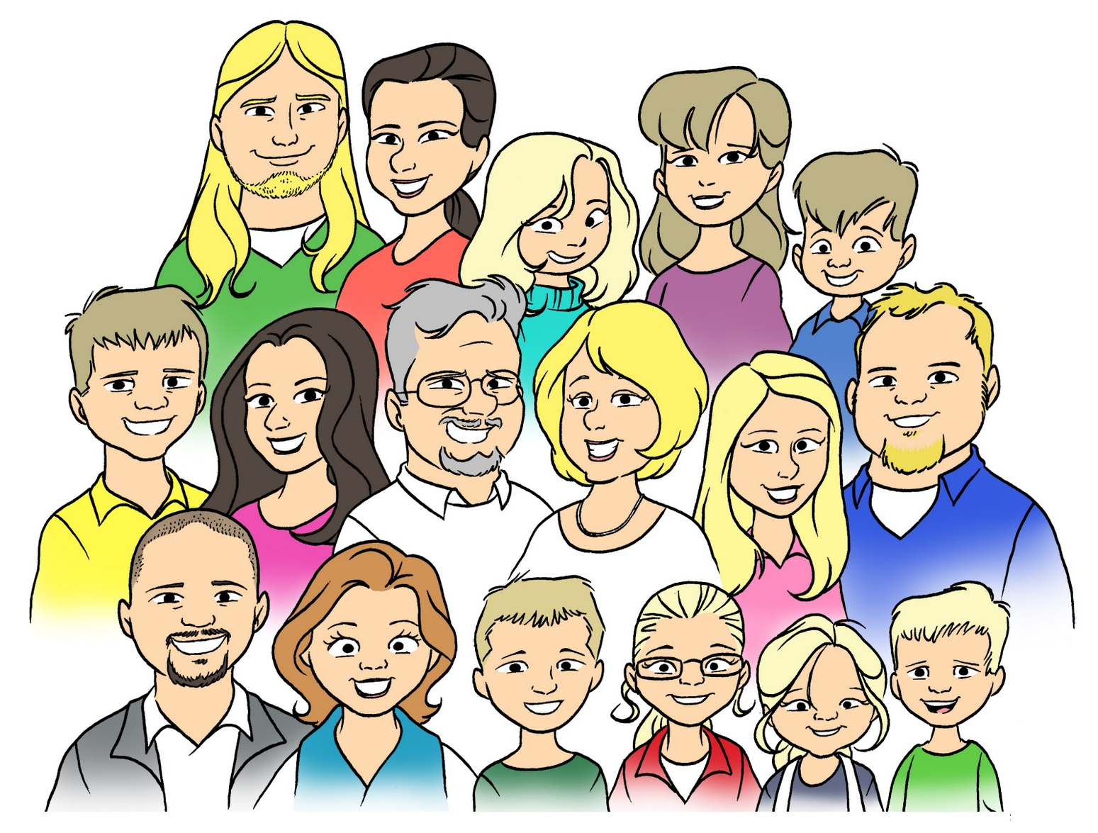
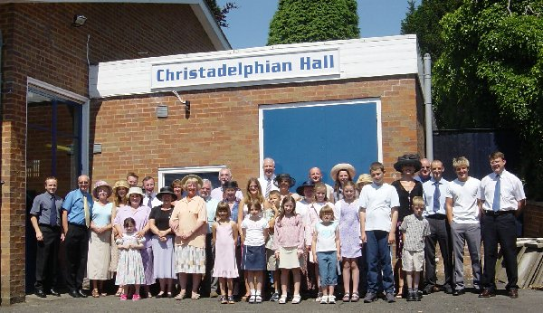
God Designed the Family Unit
He knows what He’s doing! Trust Him!

Slide 3
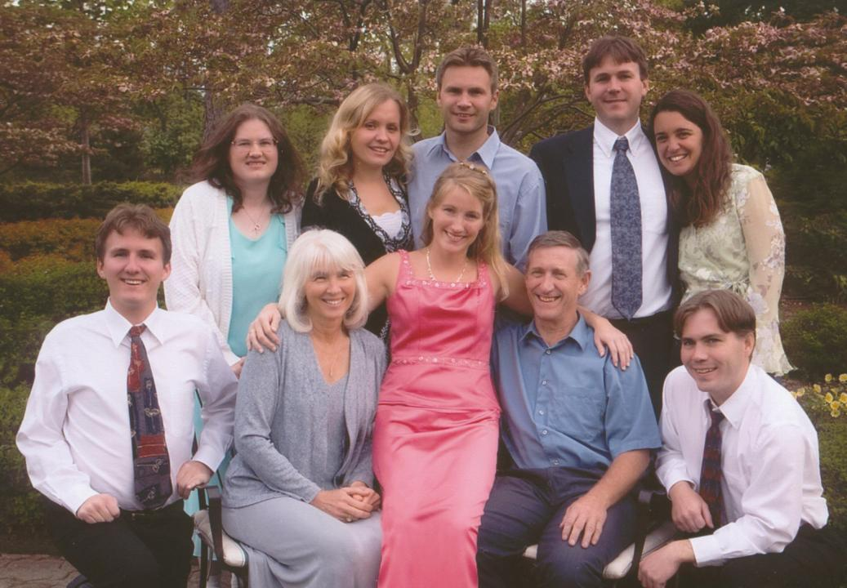
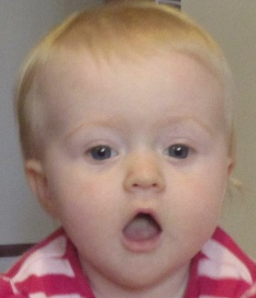
Families

Slide 4
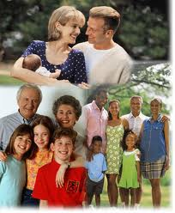
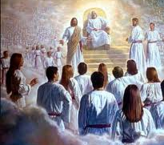
God chose to Use Families
He could have chosen another way - communes, polygamy, divorce….
Gen 6 God chose Noah’s family
Gen 13 God chose Abraham’s family
Gen 19 God saved Lot’s family
Amos 3:2 “you only have I known of all the families”
God allows us to experience His divine family and character through our families

Slide 5

Genesis 2:18-23 (NASB)
God designed the first family
18 Then the Lord God said, "It is not good for the man to be alone; I will make him a helper suitable for him." 19 Out of the ground the Lord God formed every beast of the field and every bird of the sky, and brought them to the man to see what he would call them; and whatever the man called a living creature, that was its name. 20 The man gave names to all the cattle, and to the birds of the sky, and to every beast of the field, but for Adam there was not found a helper suitable for him. 21 So the Lord God caused a deep sleep to fall upon the man, and he slept; then He took one of his ribs and closed up the flesh at that place. 22 The Lord God fashioned into a woman the rib which He had taken from the man, and brought her to the man.
Be fruitful & multiply, and fill the earth (1:28)

Slide 6
Genesis 18:17-19
God wants to work in Families
And the Lord said, "Shall I hide from Abraham what I am doing, 18 since Abraham shall surely become a great and mighty nation, and all the nations of the earth shall be blessed in him? 19 For I have known him, in order that he may command his children and his household after him, that they keep the way of the Lord, to do righteousness and justice, that the Lord may bring to Abraham what He has spoken to him."
Families provide a basis for God to choose children who have been raised to love God

Slide 7
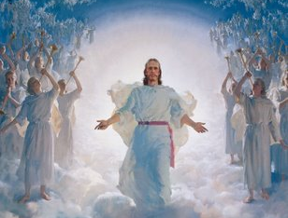
God is Expanding His Family
Ephesians 3:14-21
14 For this reason I bow my knees to the Father of our Lord Jesus Christ, 15 from whom the whole family in heaven and earth is named, 16 that He would grant you, according to the riches of His glory, to be strengthened with might through His Spirit in the inner man, 17 that Christ may dwell in your hearts through faith; that you, being rooted and grounded in love, 18 may be able to comprehend with all the saints what is the width and length and depth and height-- 19 to know the love of Christ which passes knowledge; that you may be filled with all the fullness of God.
God’s family has been around for a long time & He intends to add to it!

Slide 8
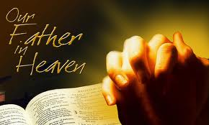
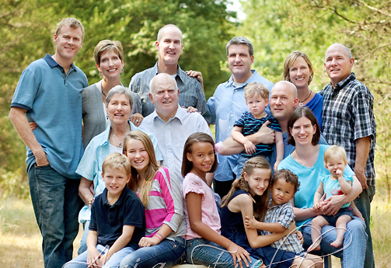
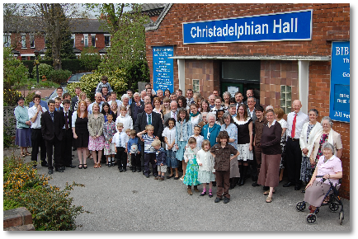
What better way to come to know & understand God than to live in families ourselves?
God allows us to experience His divine family and character through our families & ecclesias

Slide 9

Raising children helps us understand what God’s Family goes through to raise us!
2 Cor 12:14-15
14 Now for the third time I am ready to come to you. And I will not be burdensome to you; for I do not seek yours, but you. For the children ought not to lay up for the parents, but the parents for the children. 15 And I will very gladly spend and be spent for your souls; though the more abundantly I love you, the less I am loved.
God is training us to join the angels in their work!

Slide 10
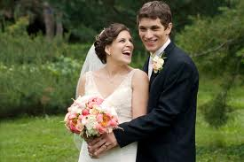
Marriage helps us practice Faithfulness and Mercy
Deuteronomy 7:9
"Therefore know that the Lord your God, He is God, the faithful God who keeps covenant and mercy for a thousand generations with those who love Him and keep His commandments;

Slide 11

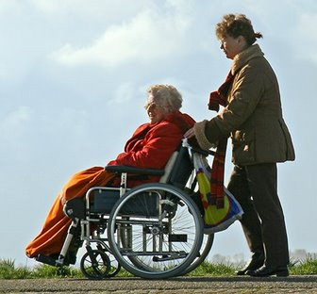
Caring for our parents helps us learn to be patient & compassionate
1 Timothy 5:3-8
3 Honor widows who are really widows. 4 But if any widow has children or grandchildren, let them first learn to show piety at home and to repay their parents; for this is good and acceptable before God. …. 8 But if anyone does not provide for his own, and especially for those of his household, he has denied the faith and is worse than an unbeliever.
God expects us to take care of our families!

Slide 12
1 Timothy 3:1-7
Taking care of our family trains us to take care of God’s family
3 This is a faithful saying: If a man desires the position of a bishop, he desires a good work. 2 A bishop then must be blameless, the husband of one wife, temperate, sober-minded, of good behavior, hospitable, able to teach; 3 not given to wine, not violent, not greedy for money, but gentle, not quarrelsome, not covetous; 4 one who rules his own house well, having his children in submission with all reverence 5 (for if a man does not know how to rule his own house, how will he take care of the church of God?); 6 not a novice, lest being puffed up with pride he fall into the same condemnation as the devil. 7 Moreover he must have a good testimony among those who are outside, lest he fall into reproach and the snare of the devil.
God designed the family unit to train us to learn how to live in His family forever!

Slide 13
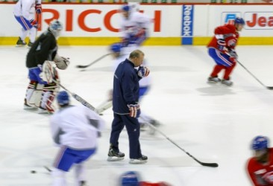
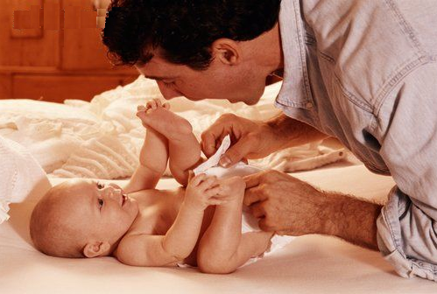
The concept is easy to understand
If you want to be a member of a team, you have to practice!
And do what the coach says!
If you want to be a member of God’s family, you have to practice
And do what our Heavenly Father says!
God’s game plan is pretty simple

Slide 14
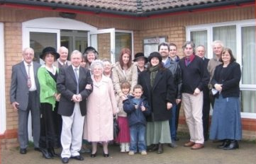
God chose to Use Ecclesias
1 Timothy 3:15 (NKJV)
15 but if I am delayed, I write so that you may know how you ought to conduct yourself in the house of God, which is the church of the living God, the pillar and ground of the truth.
1 Timothy 3:15 (NIV)
15 if I am delayed, you will know how people ought to conduct themselves in God's household, which is the church of the living God, the pillar and foundation of the truth.

Slide 15
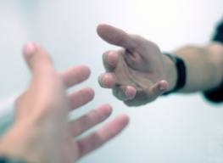
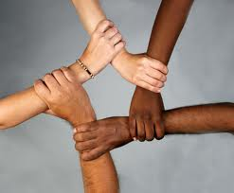
Why Does God Use Families & Ecclesias?
Helps us to keep on track when we go through trials or get discouraged.
Helps us to learn to extend beyond our own family and work with God’s whole family – even different cultures!
Helps to balance us when God brings together people from different backgrounds.
Helps us appreciate others in God’s family when He supplies members who have differing talents.
Provides us with an opportunity to serve others in love, like Christ has done for us
Brings Glory to God because the ability to make it work – function as one unit – is all of God!

Slide 16
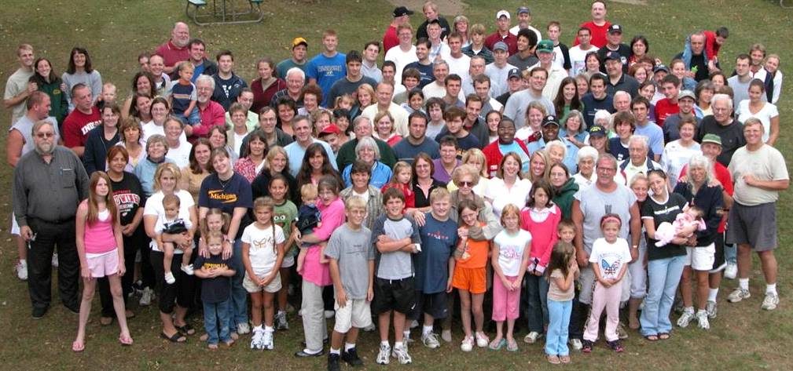
Thank God for our families & ecclesias!
Do your best to encourage & comfort one another

Slide 17

Don’t complain about others
No “put downs”
Keep it positive!
A few ground rules ☺

