Slide 1
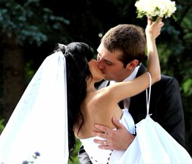
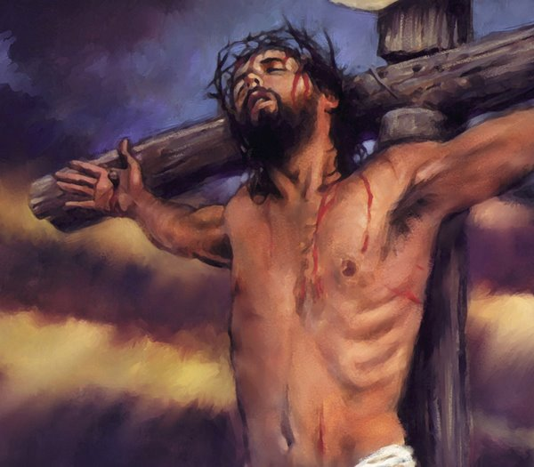
Learning to give your life for your Bride…
like Christ did for you!

Slide 2

Ephesians 5:25-32
Christ is our model: He desired to save us
25 Husbands, love your wives, just as Christ also loved the ecclesia and gave Himself for her, 26 that He might sanctify and cleanse her with the washing of water by the word, 27 that He might present her to Himself a glorious ecclesia, not having spot or wrinkle or any such thing, but that she should be holy and without blemish. 28 So husbands ought to love their own wives as their own bodies; he who loves his wife loves himself. 29 For no one ever hated his own flesh, but nourishes and cherishes it, just as the Lord does the church. 30 For we are members of His body, of His flesh and of His bones. 31 "For this reason a man shall leave his father and mother and be joined to his wife, and the two shall become one flesh." 32 This is a great mystery, but I speak concerning Christ and the ecclesia.
Husbands bear the primary responsibility

Slide 3
Romans 5:6-8 (NIV)
Christ died for us when we weren’t worth saving
6 You see, at just the right time, when we were still powerless, Christ died for the ungodly. 7 Very rarely will anyone die for a righteous man, though for a good man someone might possibly dare to die. 8 But God demonstrates his own love for us in this: While we were still sinners, Christ died for us.
We don’t deserve it & never can – that’s the model for us!

Slide 4

God can make it happen if we trust Him!

Slide 5
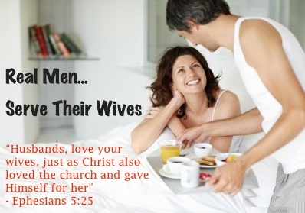

Every husband’s goal should be…
to help save his wife
So aim at the target!
Don’t get out of focus

Slide 6
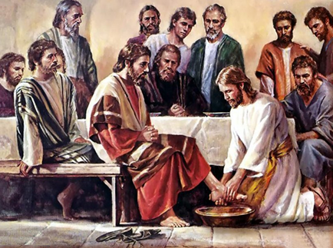
Really bring Christ’s life into your marriage
Give yourself for your bride in every way – serve her!
Don’t expect her to earn or deserve your love
When mistakes are made and things go bad…use those opportunities to pour out more grace
Recognize God is involved in your lives – He is using your marriage to save both of you
When husbands reflect Christ in a marriage, most wives gladly respond in love

Slide 7
Colossians 3:1-20 (RSV)
Set your minds on things above
1 If then you have been raised with Christ, seek the things that are above, where Christ is, seated at the right hand of God. 2 Set your minds on things that are above, not on things that are on earth. 3 For you have died, and your life is hid with Christ in God. 4 When Christ who is our life appears, then you also will appear with him in glory.
Continued…

Slide 8
Colossians 3:1-20 (RSV)
We must become new creatures
5 Put to death therefore what is earthly in you: fornication, impurity, passion, evil desire, and covetousness, which is idolatry. 6 On account of these the wrath of God is coming. 7 In these you once walked, when you lived in them. 8 But now put them all away: anger, wrath, malice, slander, and foul talk from your mouth. 9 Do not lie to one another, seeing that you have put off the old nature with its practices 10 and have put on the new nature, which is being renewed in knowledge after the image of its creator. 11 Here there cannot be Greek and Jew, circumcised and uncircumcised, barbarian, Scyth'ian, slave, free man, but Christ is all, and in all.
Continued…

Slide 9
Colossians 3:1-20 (RSV)
Let the word of Christ dwell in you
12 Put on then, as God's chosen ones, holy and beloved, compassion, kindness, lowliness, meekness, and patience, 13 forbearing one another and, if one has a complaint against another, forgiving each other; as the Lord has forgiven you, so you also must forgive. 14 And above all these put on love, which binds everything together in perfect harmony. 15 And let the peace of Christ rule in your hearts, to which indeed you were called in the one body. And be thankful. 16 Let the word of Christ dwell in you richly, teach and admonish one another in all wisdom, and sing psalms and hymns and spiritual songs with thankfulness in your hearts to God. 17 And whatever you do, in word or deed, do everything in the name of the Lord Jesus, giving thanks to God the Father through him.
18 Wives, be subject to your husbands, as is fitting in the Lord. 19 Husbands, love your wives, and do not be harsh with them.
Christ expects us to love our wives like he loves us

Slide 10

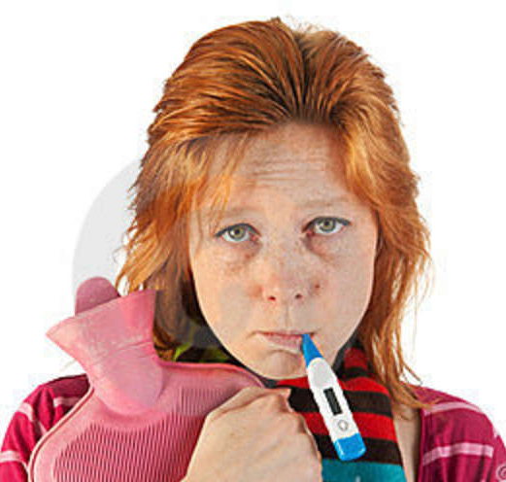



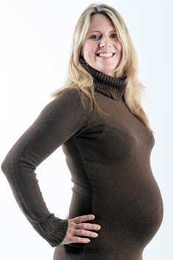

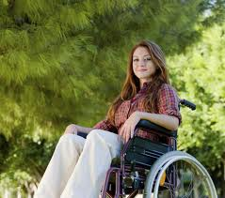
This principle extends to all circumstances
G

Slide 11

Common problems in marriages
Lack of communication
Inability to adapt to changing situations
  Family, financial, work, health
Lack of commitment
Sex problems
Unrealistic expectations
Lack of time together
These are areas to monitor & seek help if they become problems for you

Slide 12
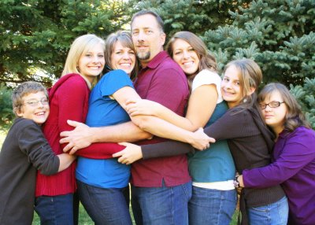
As many counselors say:
The best thing a Dad can do for his children….
Is to love their Mom

Slide 13
Malachi 2:13-16 (NIrV)
God wants us to practice faithfulness
13 Here’s something else you do. You flood the Lord’s altar with your tears. You sob and cry because he doesn’t pay attention to your offerings anymore. He doesn’t accept them from your hands with pleasure.
14 You ask, “Why?” It’s because the Lord is holding you accountable. He watches how you treat the wife you married when you were young. You have broken your promise to her. You did it even though she’s your partner. You promised to stay married to her. And the Lord was a witness to it.
15 Hasn’t he made the two of you one? Both of you belong to him in body and spirit. And why has he made you one? Because he was looking for godly children. So guard yourself in your spirit. Don’t break your promise to the wife you married when you were young.
16 “I hate divorce,” says the Lord God of Israel. “I hate it when people do anything that harms others,” says the Lord who rules over all.
Our example of faithfulness will effect our children!

Slide 14

Time to find out what You are thinking!
How can God expect this?
Can we discuss this now?
Here’s what I find
I can’t do it
Is it over?
I’m lost!
I’m so tired!
How can I do it?
When’s lunch?
Sports?

